Slide 1
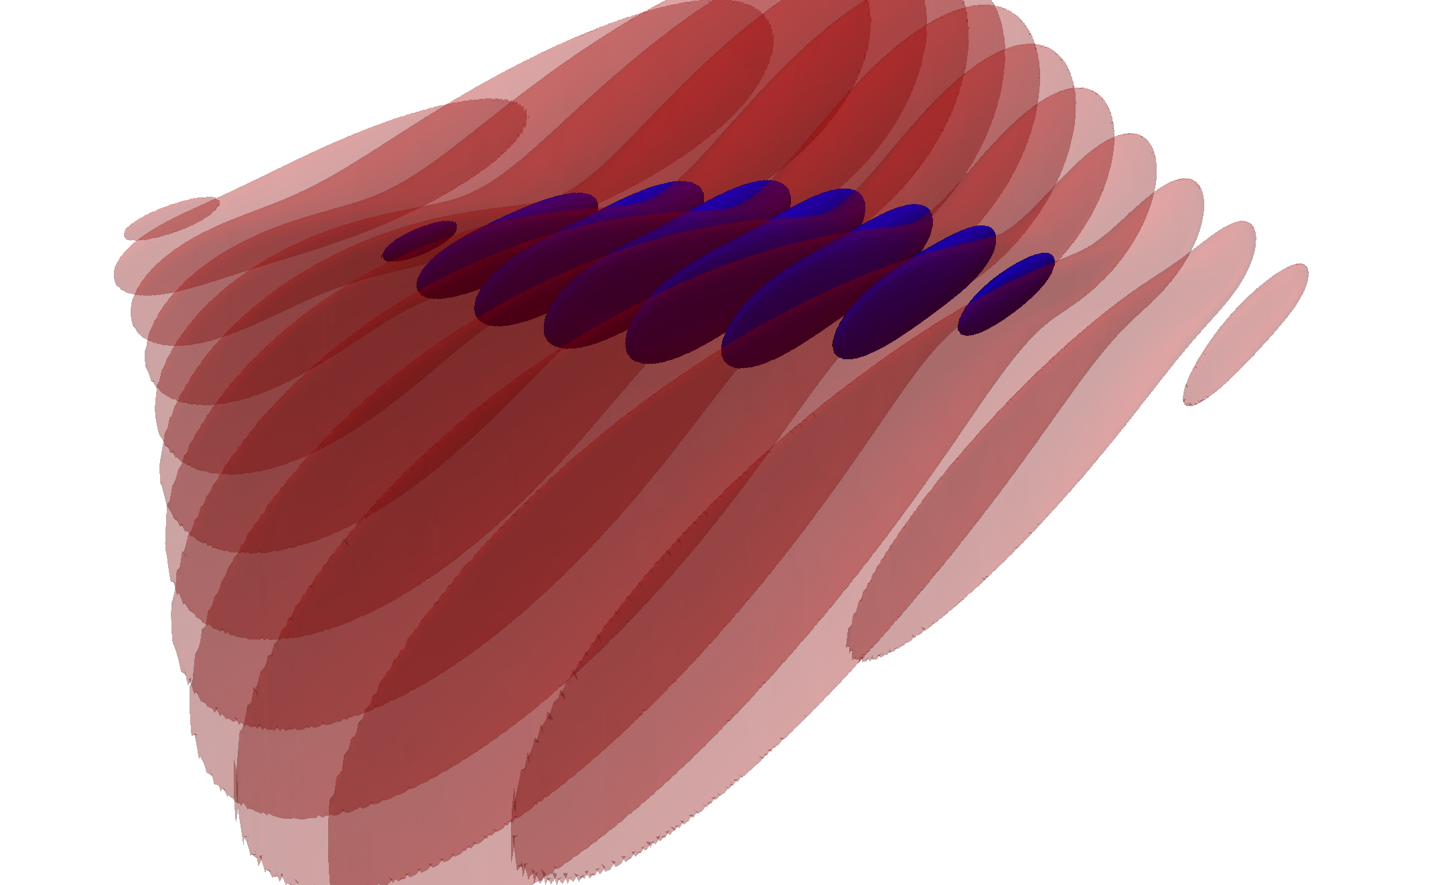
W
SPEED TALK Scaling EUV and X-ray Thomson Sources to Optical Free-Electron Laser Operation with Traveling-Wave Thomson-Scattering
Klaus Steiniger^{1,2}, Daniel Albach¹, Michael Bussmann¹, Markus Loeser^{1,2}, Richard Pausch^{1,2}, Fabian Röser¹, Ulrich Schramm^{1,2}, Mathias Siebold¹, Alexander Debus¹
¹ Helmholtz-Zentrum Dresden – Rossendorf , ² Technische Universität Dresden

Slide 2
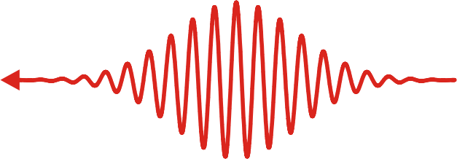
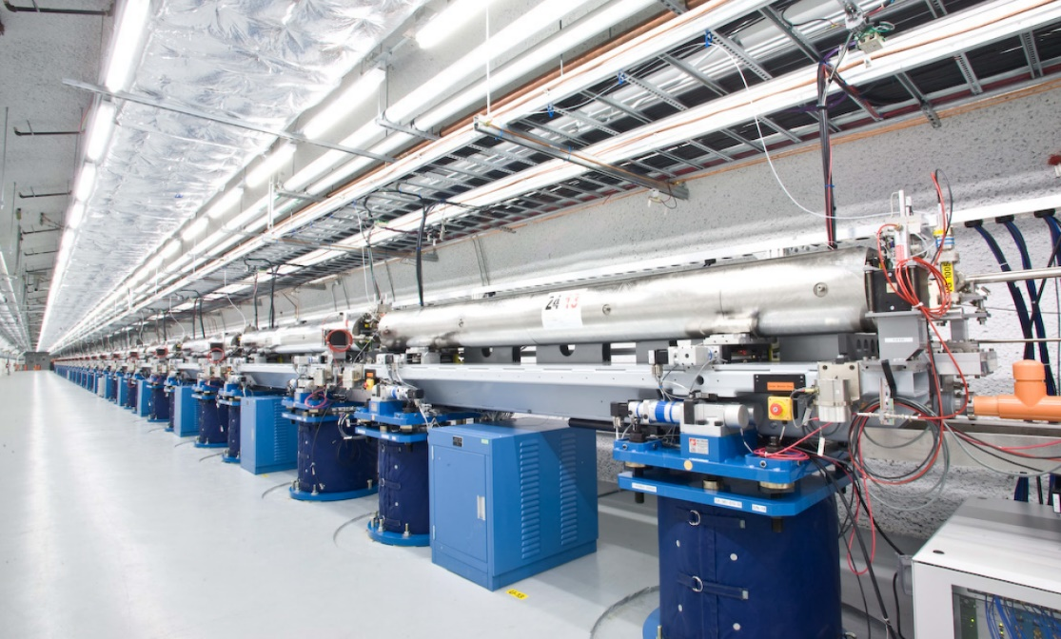
Optical free-electron laser (OFELs) – shorter FEL wavelengths while using less electron energy on table-top?
Laser
Electrons
Even if GeV-scale LWFA accelerators are table-top,
X-ray FEL undulators usually are not !
Optical lasers provide µm-scale undulator lengths at high fields.
However, yields of existing Thomson sources indicate challenges in realization.
10⁷ - 10⁸
photons
shot
~100m
The 0.1nm FEL at SLAC (http://lcls.slac.stanford.edu)

Slide 3
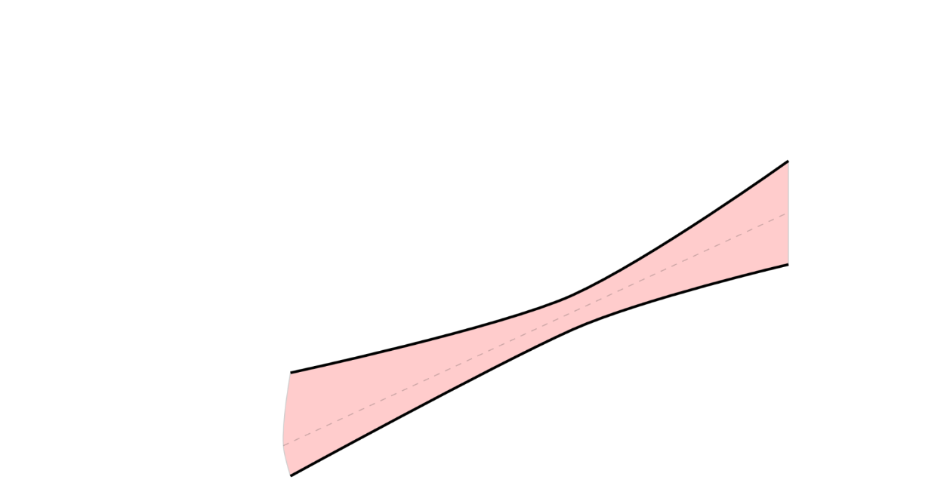
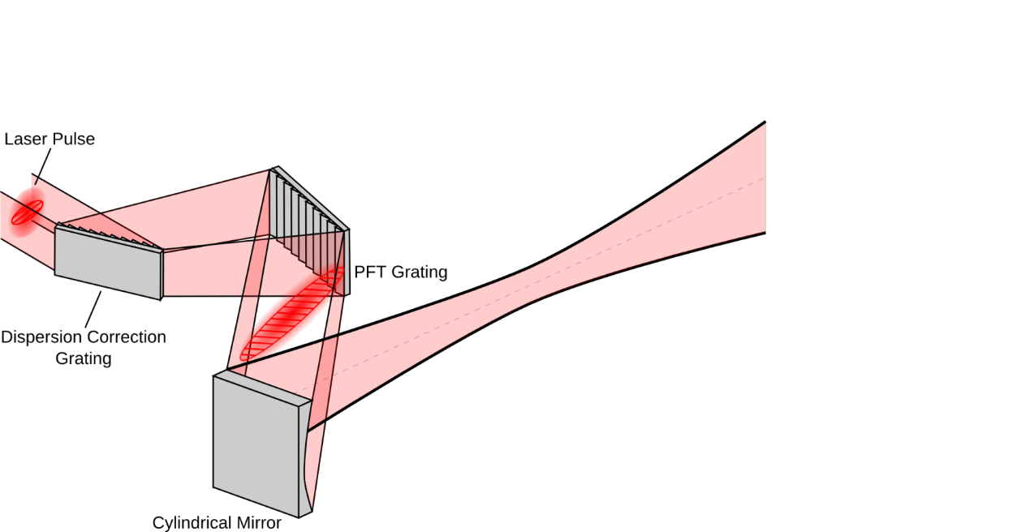
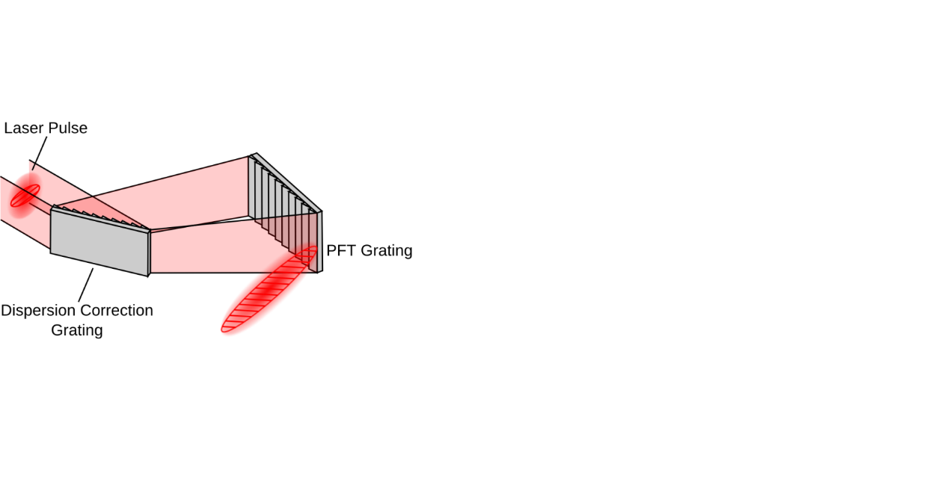
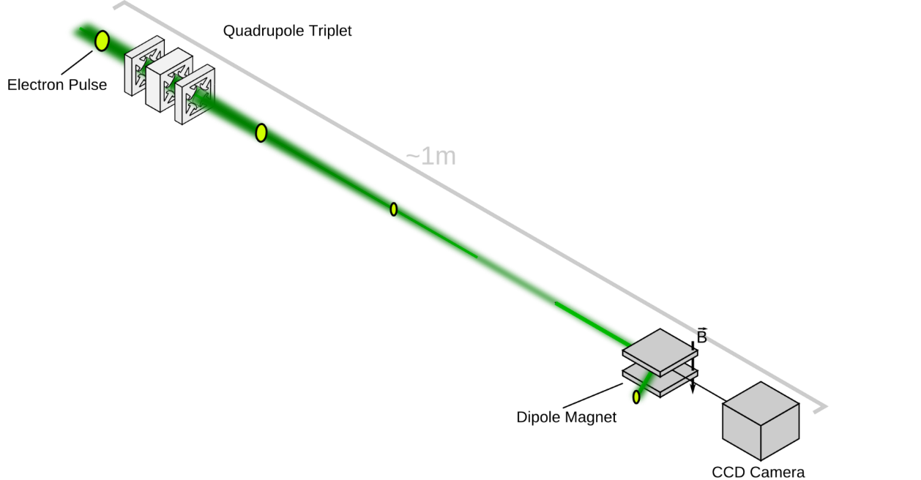
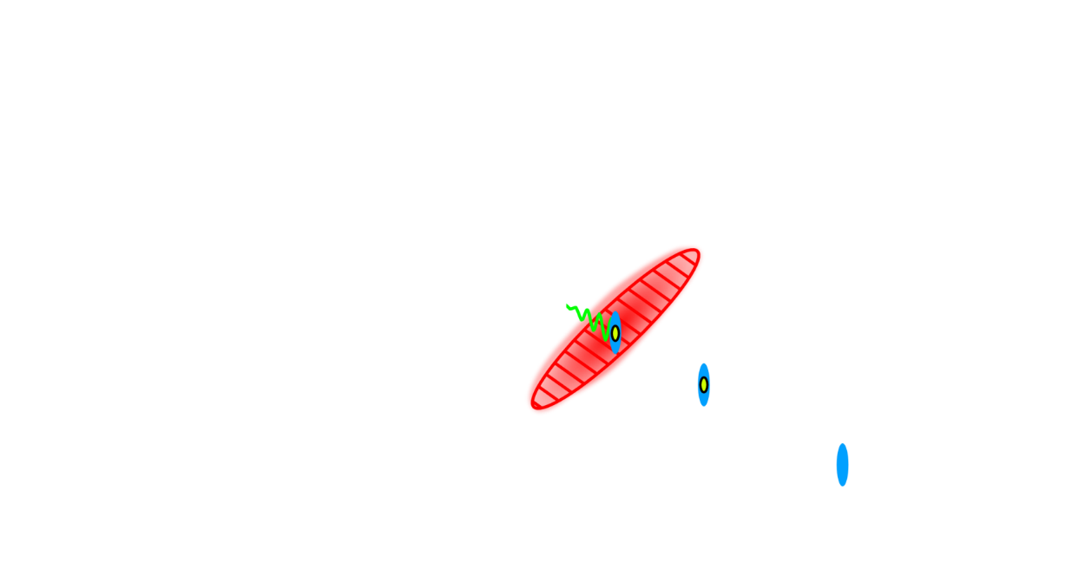
Scaling EUV and X-ray Thomson Sources to Optical Free-Electron Laser Operation with Traveling-Wave Thomson-Scattering (TWTS)
Visit the poster!
Optical free-electron lasers can be realized with existing accelerator and laser technology.
TWTS employs pulse-front tilted laser pulses in side-scattering geometry and is scalable from UV to X-ray wavelengths.
Optical setups require only a few components for which highly reflective optics are available.
Klaus Steiniger et al., Frontiers in Physics 6 (2019)
“Building an Optical Free-Electron Laser in the Traveling-Wave Thomson-Scattering Geometry”

Slide 4
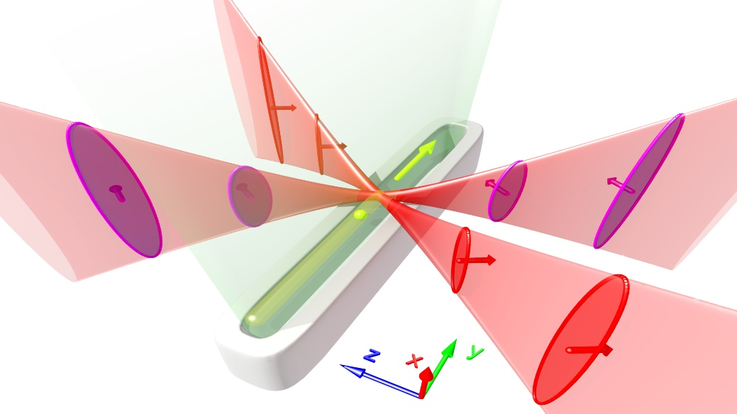
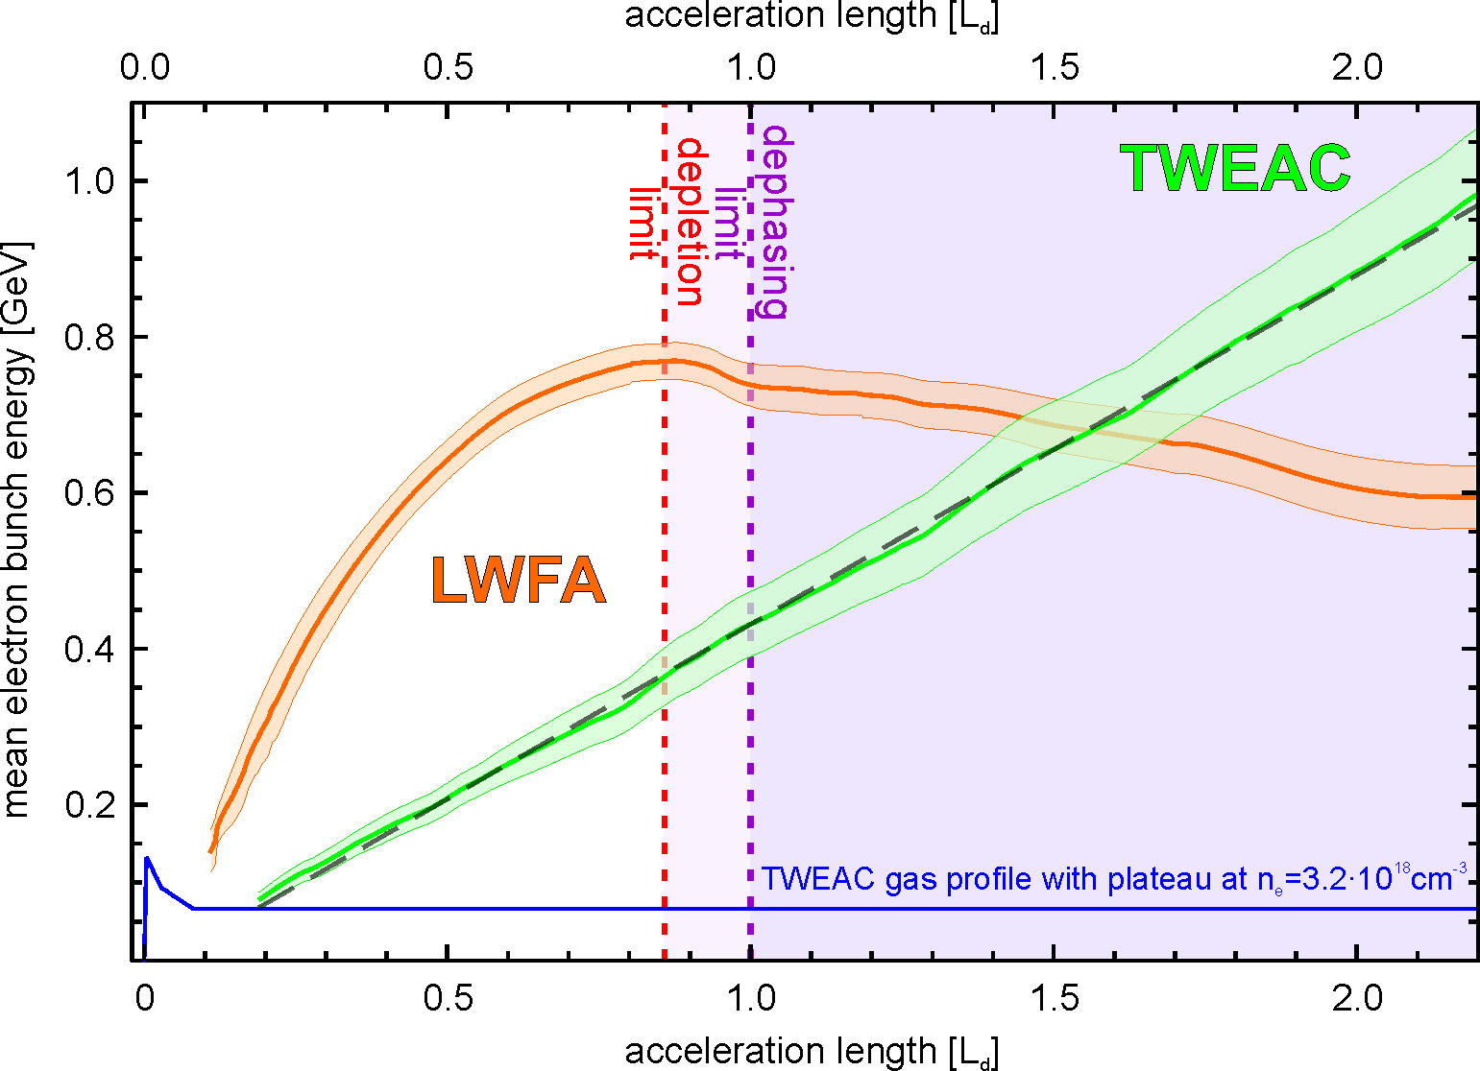
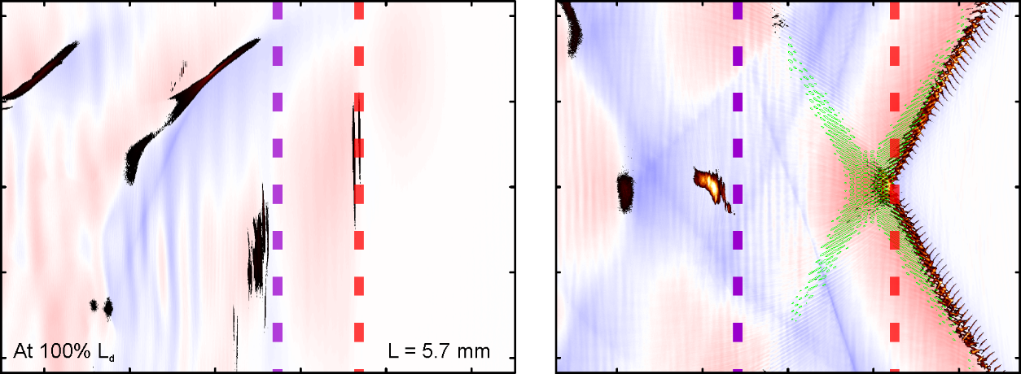
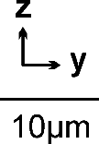
Traveling-wave Electron Acceleration (TWEAC) eliminates the dephasing and depletion limit
Two pulse-front tilted lasers enforce vacuum speed of light propagation of the laser overlap in plasma.
Oblique laser beam geometry continuously feeds a „fresh“ portion of the laser beams into an unperturbed plasma.
cylindrical focus along slit nozzle
LWFA
TWEAC
mean bunch energy [GeV]
picongpu.hzdr.de
After 100% dephasing length
acceleration length [L_{d}]

Slide 5
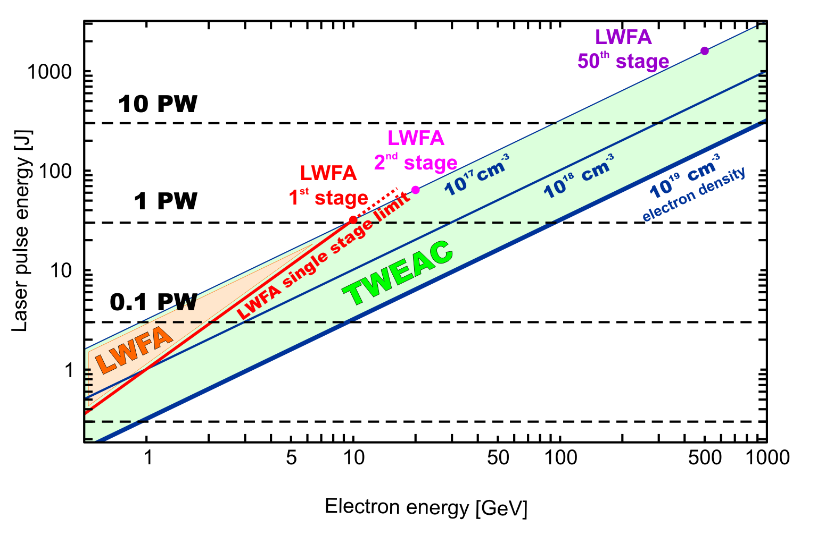
TWEAC - Energy-efficient Laser-plasma Acceleration beyond the Dephasing and Depletion limits
See you
at the posters!
Alexander Debus, Richard Pausch, Axel Hübl, Klaus Steiniger, René Widera, Ulrich Schramm, Thomas E. Cowan and Michael Bussmann
Can in principle be arbitrarily extended in a single stage up to the energy frontier.
Does not require laser guiding structures.
Quasi-static plasma conditions without (parasitic) self-injection.
No laser self-phase modulation or depletion along direction of electron acceleration.
ELI type lasers
could reach the
energy frontier
Low-power,
high-rep.-rate lasers

