Slide 1
Project status and All Hands objectives
Daniele Cesini
daniele.cesini<at>extreme-datacloud.eu

Slide 2
Welcome to Hamburg
Thanks to DESY for hosting the meeting, in particular to Patrick and his collaborators for the organization
Agenda:
https://indico.desy.de/indico/event/21131/timetable

Slide 3
The Plan for the Next Months
Functionalities and Scalability demonstrated
Architecture finalized
Kickoff@INFN
Reference Release -1
Dissemination event@IFCA
XDC started
All-Hands@DESY
Reference Release - 2
Nov ‘17
May‘18
Jul ‘18
Nov ‘18
Nov ‘19
Jan ‘18
Jun ‘18
Sep’18
Jan ‘20
DI4R
8-11 Oct
XDC end
Project Setup
Use case definition
Architecture definition
Dissemination
Development started
Interaction with RDA and SNIA
Pilot tb in place
Release procedures
End of Feb or beginning of Mar 2019
1st EC review

Slide 4
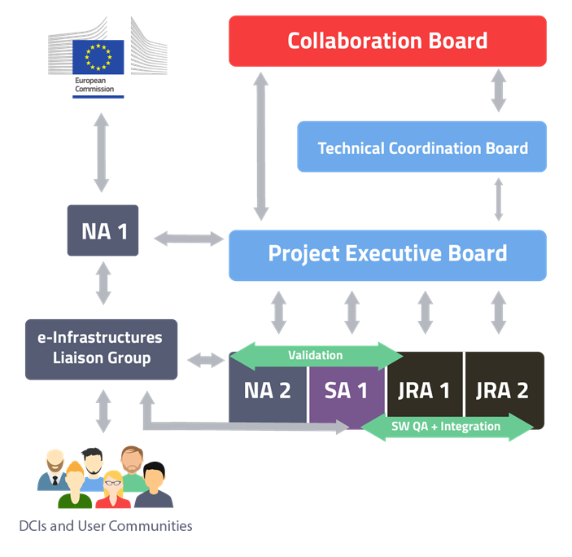
Management bodies
CB the ultimate decision-making body of the consortium
TCB in charge of steering the technical developments of the project
ELG is responsible for maintaining active relationships with the infrastructure and technology providers, discussing synergies, strategies, roadmaps and requirements workflow for the software released by the project.
PEB is responsible for the decisions affecting the project strategy, plans, delivery schedule, conflicts within the partners and risk management
It is also responsible for the quality of the project outcome.
EMT
https://confluence.extreme-datacloud.eu/display/XDCPROJ/EMT+-+Engineering+Management+Team
https://confluence.extreme-datacloud.eu/display/XDCPROJ/SPB+-+Service+Providers+Board
SPB
TCB, ELG – we need to track and/or formalize their activity

Slide 5
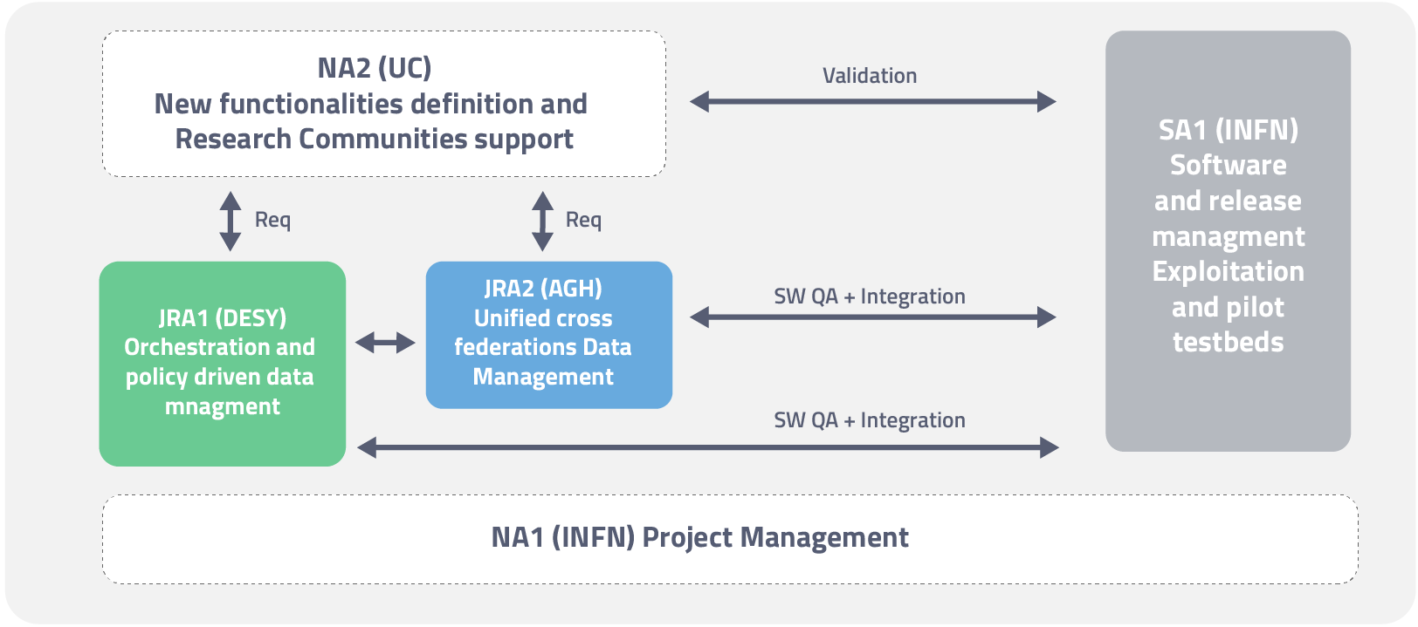
WP1 – Topics for the All Hands
Review QA metrics and KPIs
How are we behaving?
Consortium Agreement Signature
during the Collaboration Board
Liaisons with EOSC-Hub (in collaboration with WP3/WP2)
We should be ready for exploitation
What is missing? A service catalogue? A White paper?
Review expenses reporting
Start discussing the preparation of the First EC review (PM16/17)
Communication
How to improve website updates
Gadgets, Twitter etc..
Track WP1 activity in confluence?
Also WP4 and WP5
Collect publications list
INDIGO review outcome analysis
WP1 - Project Management (NA1)
T1.1: Consortium coordination and Project Management
T1.2: Financial Management
T1.3: Project Quality Assurance and Activities Oversight
TT1.4: Communication

Slide 6
Recommendation to indigo follow-up projects
Major effort has been put into adequate metrics and thresholds to measure the success of use [….]. Based on this exercise the metrics itself as well as the procedure to assess the metrics should be optimised in future projects.
What is missing so far is a clear plan for uptake of the results and spread of tools and services to other research communities not involved in INDIGO or one of the upcoming projects
Work in this area (collaboration with e-infras) must be expanded to gain wider acceptance, and the EOSC-Hub is a good platform to address this
The project should pulish in gold open access journals and conferences
A comprehensive networking solution should be considered for future projects leveraging INDIGO deliverables
More extensive scalability testing should be performed to have a convincing case when interacting with other EINFRA. INDIGO will need to demonstrate that platform and framework can scale
Continue and expand on training events to promote user and community adoption
QoS standard implemented in OneData

Slide 7
WP2 – Topics for the All Hands
Review use case status
Is there something important missing in their definition?
Issues in the interaction with the developers?
Requirements passing process
Dissemination
DEMOs
We need one or more DEMO
DI4R?
Preparation of a joint use case with DEEP
CDB
Status review and next step, should we withdraw?
Identify next dissemination events
WP2: New functionalities definition and Research Communities support (NA2)
T2.1 Use Case Analysis
T2.2 Solutions for the EOSC Data Management
T2.3 Integration and Testing
T2.4 Dissemination and Training

Slide 8
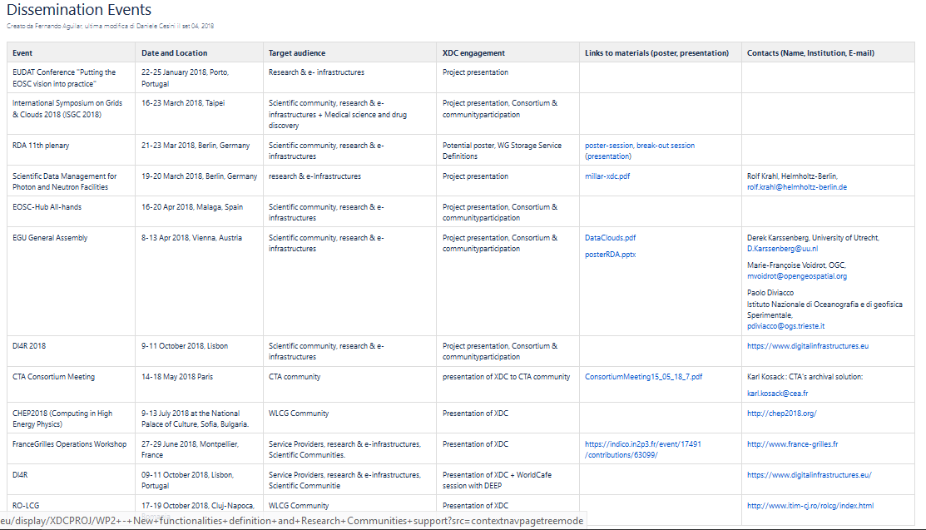
Dissemination events….
https://confluence.extreme-datacloud.eu/display/XDCPROJ/Dissemination+Events
We attended/organized several dissemination events and technical groups…
…created a lot of expectations
We should show demos/results in the forthcoming events

Slide 9
WP3 – Topics for the All Hands
Release structure definition
What will be in the release?
Review, update and refine the list of XDC Products
Identify the final release date
and name
Service catalogue definition for exploitation (WP1/WP2)
Software license(s) collection (with all other WPs)
Release testing plan
Including scalability tests
Documentation
Which is the status for all the products?
WP3: Software Lifecycle Management, Pilot Infrastructures & Exploitation (SA1)
T3.1: Software Lifecycle Management
T3.2: Pilot e-Infrastructures and support services
T3.3: Exploitation

Slide 10
WP4 – Topics for the All Hands
Architecture finalization
Auth, Message Bus/Notification, etc..
Multi-system distributed storage
Was the final architecture agreed?
The “Sync protocol”
Which is the status of the developments?
What is achievable for the first release?
DEMOs preparation
QoS + Orchestrator
Caching with xrootd
EOS-dCache integration?
XDC Participation in the WLCG-DOMA activities
QoS sub-group leadership
WP4: Orchestration and policy driven data management (JRA1)
T4.1 Intelligent data management and data lifecycle management
T4.2 Smart Caching
T4.3 Data pre-processing at ingestion/Orchestrating workflows based on data

Slide 11
WP5 – Topics for the All Hands
Architecture finalization
And integration with the WP4 architecture
DEMOs preparation
Can we identify a use case that is almost ready for a DEMO with ONEDATA?
CTA?
LIFEWATCH?
One-to-one meetings with the User communities
Need to track the work done and results in one of XDC document repo
Confluence?
WP5: Unified cross federations data management (JRA2)
T5.1 Cross-cloud Exascale data access and processing
T5.2 Metadata management and open data support for extreme collections
T5.3 Structural metadata database support
T5.4 Distributed encrypted storage for large scale sensitive data

Slide 12
Deliverables – so far…

Slide 13
Deliverables - future

Slide 14
Milestone – up to now

Slide 15
Milestone - Future

Slide 16
This All-Hands…
Let’s start from the users needs
We organized many “Users meet WP*” sessions
address remaining issues
clarify doubts
Let’s discuss in particular cross-WPs and cross-products issues
Less pre-defined agenda, more discussion to converge
We are few months away from the release

