Slide 2
Aris Angelogiannopoulos
FTS in XDC status update

Slide 3
Topics
FTS
FTS in XDC project
Authentication on FTS
OpenID Connect
Questions?
12/9/2018
3

Slide 4
FTS in XDC project
CERN IT is participating to XDC with FTS, EOS and Dynafed
Activities for FTS in 2018
OpenId Connect authentication for FTS
Tokens used for authorizing transfers on storages
Storage QoS exploitation
Through integration of the CDMI interface
12/9/2018
4

Slide 5
Authentication on FTS
Currently done through X509 certificates
User has to create one and correctly place it at the environment
Lengthy process
Ideally have an easier way to authenticate
OpenID Connect will be used
Modern standard widely used
Direction that the WLCG Authz is taking for the future
12/9/2018
5

Slide 6
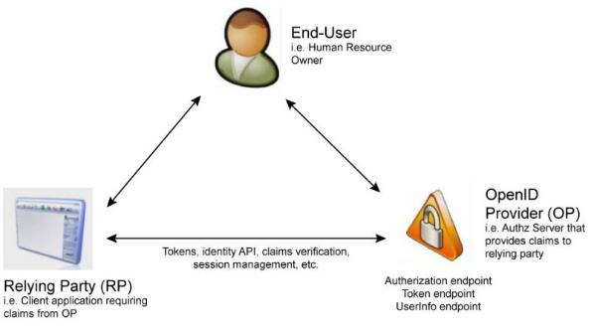
OpenID Connect (1/2)
12/9/2018
6

Slide 7
OpenID Connect (2/2)
OpenID Connect is a simple identity layer on top of the OAuth 2.0 protocol
Allows clients to verify the identity of an end-user based on the authentication performed by an Authorization server
Access/refresh tokens can be used by the users
Access to basic profile information is allowed
REST-like manner
IAM server will be used as OP
https://iam.extreme-datacloud.eu
12/9/2018
7

Slide 8
OpenID Connect integration on FTS
Two ways of accepting IAM tokens
Directly receive access-tokens through the CLI clients
Redirect users, through a web-interface to the IAM webpage in order to acquire a token (https://webfts.data.kit.edu/ WebFTS extension implemented at KIT)
FTS-REST component verifies tokens through the introspect endpoint of the IAM server and store them at the FTS DB.
12/9/2018
8

Slide 9
Current status
Python Flask App has been written to easily acquire an IAM access token
http://iam-access-token.cern.ch:5000/ (at the moment only accessible from within CERN)
Repo: https://gitlab.cern.ch/fts/openIdConnectPOC
FTS-REST module has been modified in order to accept an access token
Verification is done at the introspect endpoint of IAM
Valid tokens are saved to the FTS-DB in order for FTS to use them for transfers
Repo: https://gitlab.cern.ch/fts/fts-rest/tree/fts-oidc-integration/
FTS has been modified and can use IAM access tokens for transfers
Access tokens are retrieved from the DB and set to gfal2 commands as BEARER tokens in order to be used for commencing transfers on storage (currently only dCache supports this)
Repo: https://gitlab.cern.ch/fts/fts3/tree/fts-oidc-integration
12/9/2018
9

Slide 10
Next steps
Integration of Token Translation Services
Present a token – get an X509 certificate
Usage of Watts (https://watts.data.kit.edu/). An XDC IAM endpoint already configured
What is the priority? Do we need this?
Refresh tokens
These have to be acquired in case of the access token expiring
Does IAM offer all relevant endpoints?
How/What do we need to get the refresh token from IAM? Is only an access token enough?
12/9/2018
10

Slide 11
Questions?
12/9/2018
11

Slide 12
12/9/2018
Document reference
12

