Slide 1
LIFEWATCH USE CASE All Hands Meeting
Water Quality Forecast System
Daniel García & Fernando Aguilar
garciad@ifca.unican.es
aguilarf@ifca.unican.es
10/09/2018
eXtreme DataCloud
<número>

Slide 2
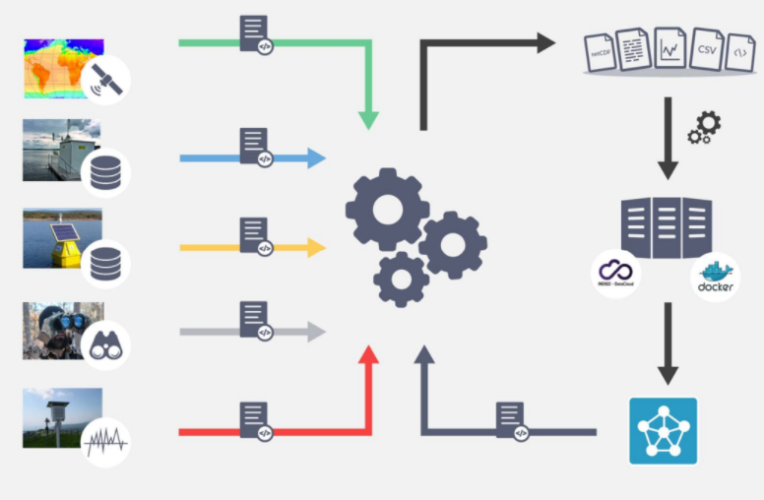
Use Case Goals
Objetives: Integrate different and heterogeneous data sources: satellite data, real-time monitoring system based on sensors, observations, and meteorological data to feed the hydrological and water quality models, thus automating modeling and prediction of water quality.
General Requirements:
Sufficient and accurate data to feed the hydrological and water quality models.
Good models to make the predictions.
Services Requirements:
OneData:
OneData Attachment
OneData Discovery
Orchestrator
10/09/2018
eXtreme DataCloud
<número>

Slide 3
Use Case Architecture
Data Ingestion
Data Analysis (TBD)
GUI
PaaS Orchestrator
JSON
PaaS Orchestrator
To be Integrated
Docker Ready
Web Service
To be Integrated
Docker Ready
SAT
Celery
Repo
Meteo
Onedata
10/09/2018
eXtreme DataCloud
<número>

Slide 4
Use Case Update
Satellite data:
Description: Remote sensing to monitor the water quality of the water reservoirs with two of the most important satellite: Landsat-8 and Sentinel-2.
Working in two different methods to apply atmospheric corrections to the images to improve the accuracy of the measurements.
Working with machine learning techniques to improve the spatial resolution.
Available parameters: Detection of water bodies, Temperature, Secchi Disk, Turbidity, Chlorophyll
Characteristics:
Format files: netCDF.
GB of data per day.
Configuring to works on a local way and with OneData attachment.
10/09/2018
eXtreme DataCloud
<número>

Slide 5
Use Case Update
Real-time monitoring system:
Description: Almost five years of physical, chemical and biological real-time measurements from different kind of sensors. Stored in a database and preprocessed to feed the hydrological and water quality models and for calibrate the satellite data.
Searching a public repository to upload the data.
Add the API repository in to the module
Characteristics:
Format files: CSV
GB of data
10/09/2018
eXtreme DataCloud
<número>

Slide 6
Use Case Update
Meteorological data:
Description: Also need meteorological data to feed the hydrodynamics and water quality models. Temperature, Humidity, Radiation, etc.
Have develop an API to get the data of meteorological stations by selecting the region and the date.
Now the API Works with AEMET(Spanish meteorological stations).
Characteristics:
Format files: CSV
Configuring to works on a local way and with OneData attachment.
10/09/2018
eXtreme DataCloud
<número>

Slide 7
Use Case Update
Attachment: We are working on it.
Configured to work with some of the data sources (satellite and meteorological data).
Small subset of EML.
Format of the metadata files: JSON
Metadata attributes to be consolidated.
Discovery:
To be discussed in AHM
10/09/2018
eXtreme DataCloud
<número>

Slide 8
Potential Stoppers
OneData: Scalability: Works well with hundreds of GB ?
Attachment:
Format of the metadata files: EML(XML), JSON
Metadata attributes.
Discovery:
Problems with incompatible versions.
Fast enough to find the data.
Orchestrator: Not configured yet
Integration (but it should be fine)
State of the Jobs Monitoring/Notifications.
How to know when a job has finished?
When the data will be available?
10/09/2018
eXtreme DataCloud
<número>

Slide 9
Potential Stoppers
Dockers images (potential problems):
Data ingestion, based on onedata docker.
Data analysis/ modeling
Others Problems:
Problems with the data.
Not enough data to feed a model.
Not enough accuracy data to get good results.
Hydrological and water quality models integration.
10/09/2018
eXtreme DataCloud
<número>

Slide 10
Workplan
Satellite data:
1- Atmospheric corrections.
2- Improve the spatial resolution
3- Available parameters
Real-time monitoring system:
1- Upload the data to one public repository
2- Add the API repository to others modules
Meteorological data:
1- Final version of module
Hydrological and water quality models:
1- Create/upload new image Docker.
2- Data preprocessing.
10/09/2018
eXtreme DataCloud
<número>

Slide 11
Workplan
OneData:
Attachment:
1- Chose Metadata attributes or fields into the metadata.
2- Configure with the rest of the modules
3- Final version of the module
Discovery:
1- Explore
Orchestrator:
1- Explore
2- Add orchestrator to the module
3- Probe Docker image with orchestrator
4- Workflows
API Structure:
1- Documentation
2- Interface
10/09/2018
eXtreme DataCloud
<número>

Slide 12
Workplan
Octubre | Noviembre | December | January | February | March | Later
1º Real-time monitoring system | 2º Satellite data | 3º Satellite data | 2º Real-time monitoring system | 3º Orchestrator | 1º OneData attachment | 1º Meteorological data
1º Satellite data | 1º Orchestrator | 2º Orchestrator | 2º Water quality models | 4º Orchestrator | 2º OneData attachment | 3º OneData attachment
 |  | 1º Water quality models | 1º OneData discovery |  |  | 1º API interface
 |  |  |  |  |  | 2º API interface
10/09/2018
eXtreme DataCloud
<número>

Slide 13
Potential Demo
We have configured onedata attachment with some of data modules, and we have developed a python notebook as a user interface
We haven`t configured onedata discovery yet
10/09/2018
eXtreme DataCloud
<número>

