Slide 1
WP1 meets WP2
Status and activities
Alessandro Costantini
INFN-CNAF

Slide 2
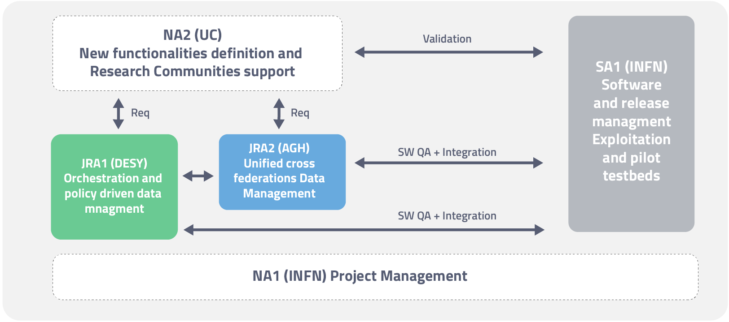
WP1 – Topics for the All Hands
Review QA metrics and KPIs
How are we behaving?
Consortium Agreement Signature
during the Collaboration Board
Liaisons with EOSC-Hub (in collaboration with WP3/WP2)
We should be ready for exploitation
What is missing? A service catalogue? A White paper?
Review expenses reporting
Start discussing the preparation of the First EC review (PM16/17)
Communication
How to improve website updates
Gadgets, Twitter etc..
Track WP1 activity in confluence?
Also WP4 and WP5
Collect publications list
INDIGO review outcome analysis
WP1 - Project Management (NA1)
T1.1: Consortium coordination and Project Management
T1.2: Financial Management
T1.3: Project Quality Assurance and Activities Oversight
TT1.4: Communication

Slide 3
WP1 and WP2 Activities
The Work Package is composed of four tasks:
Task T1.1: Consortium coordination and Project Management
Task T1.2: Financial Management
Task T1.3: Project Quality Assurance and Activities Oversight
Task T1.4: Communication
WP2
Task T2.1 Use Case Analysis
Task T2.2 Solutions for the EOSC Data Management
Task T2.3 Integration and Testing
Task T2.4 Dissemination and Training

Slide 4
Summary
Recommendation to indigo follow-up projects
Communication and Dissemination
Project metrics and status
Liaisons with other projects
EOSC-Hub
DEEP
CDB
Discussion on the first EC review

Slide 5
Recommendation to indigo follow-up projects
Major effort has been put into adequate metrics and thresholds to measure the success of use [….]. Based on this exercise the metrics itself as well as the procedure to assess the metrics should be optimised in future projects.
What is missing so far is a clear plan for uptake of the results and spread of tools and services to other research communities not involved in INDIGO or one of the upcoming projects
Work in this area (collaboration with e-infras) must be expanded to gain wider acceptance, and the EOSC-Hub is a good platform to address this
The project should publish in gold open access journals and conferences
A comprehensive networking solution should be considered for future projects leveraging INDIGO deliverables
More extensive scalability testing should be performed to have a convincing case when interacting with other EINFRA. INDIGO will need to demonstrate that platform and framework can scale
Continue and expand on training events to promote user and community adoption
QoS standard implemented in OneData

Slide 6
Communication and Dissemination
Dissemination Plan D2.2
https://confluence.extreme-datacloud.eu/display/XDCPROJ/Dissemination+Events
Dissemination Events
https://confluence.extreme-datacloud.eu/display/XDCPROJ/Dissemination+Events
Publications
https://confluence.extreme-datacloud.eu/display/XDCPROJ/Publications

Slide 7
Communication and Dissemination
Communication strategies
Gadget to be prepared for oncoming events
T-shirt, stickers, …
Social media
Dissemination activities
Half day session in major conferences and events
Demo needed
Dissemination actvities
Training
School/Course on the Santander model

Slide 8
Santander Course
Agenda with material available
Can be used for dissemination
First example of interaction with external projects
https://agenda.indigo-datacloud.eu/conferenceTimeTable.py?confId=214#20180619

Slide 9
Project metrics and status
D1.2 Project Quality Assurance and Progress Monitoring Plan
https://nextcloud.extreme-datacloud.eu/s/CBPHDAf44kaWXG2#pdfviewer
Area | KPI | Achieved | Notes
User Community adoption | Number of research communities internal and external to the project that adopted the developed services 5/7/10 Number of extreme scale future experiments evaluating the developed services 1/3/5 Number of use-cases implemented on the e-infrastructures that take advantage of the project developments 5/8/12 Number of applications using the developed services 5/8/12 | - - 5 -
User Community productivity and involvement | Number of publications related to researches and use cases that exploit the developed services 4/6/8 Tutorials/demos on developed services made available 1/3/5 | 1 - | 2 in submission
Project visibility and role in policy making | Number of contributions to roadmaps and strategic papers 3/5/7 Number of presentation at international conferences and workshop 15/20/30 Number of scientific paper published by the project members 6/8/12 Website and social network activity. Quarterly growth rate(%) 5/10/20 Software repositories activity. Quarterly average growth rate(%) 3/5/15 | - 9 1 Q2: 60% - | WP2 Q3: 30% WP3
Project Technical Productivity | Number of new functionalities addressing real requirements released 3/5/7 Number of major and minor releases 3/5/7 Number of high level requirements received 4/8/12 Number of high level requirements addressed and implemented 4/8/12 | 3 - - - | WP2 WP2/JRAs
E-Infrastructures adoption | Number of sites that deployed services developed by the project 4/6/8 Number of XDC services deployed in production in Europe and Worldwide 4/6/8 | - -

Slide 10
Liaisons with other projects
EOSC-hub
User involvement
Engage with external users from day 1
An interactive way to recieve direct suggestion
E.g., a INDIGO-XDC webinar for EOSC-hub CCs, TCs
Design considerations
Interoperability with other EOSC services
Service/soft provisioning model suits for EOSC context
XDC service catalogue
White paper used for dissemination

Slide 11
Liaisons with other projects
DEEP
Some people are working in both projects
Common WP3 activity
Common usecase (from Santander)
Provide storage managemetn components and services
https://docs.google.com/document/d/1eLZUdDwk2k7qPWUgbSjQkkXcDEesFw2Ch-yIPDipchQ/edit
Other E-INFRA21 project
Invited at EOSC-Hub week in Malaga
No more contacts

Slide 12
Liaisons with other projects
CDB
Ongoing activity under the TRUST-IT coordination
Joint XDC, DEEP, INDIGO projects
Project management and branding strategies
Maximize communication and dissemination
Phase 5
They need 2 people for each project to start a management,dissemination and communication course
Online course with final evaluation
Limited interest from projects
Leave the CDB project is not an option

Slide 13
Discussion on the first EC review
Deliverables and Milestones
https://docs.google.com/spreadsheets/d/1Yv4vGvvGFClitMkfLunu6hOc-xA_xY2MdjjnaUyM3Hg/edit#gid=0
Almost in time but…
Architecture still missing
Justification about the D3.1 submission
Due at M4, submitted at M
Add deadlines in the XDC calendar?
Concentrate on Demo from usecases
Devs and Users made aware of common tools and criterias and how to use them
Starting populate Confluence and JIRA
Track activities

