Slide 1
Big Data Analytics
deep learning in particle
& astroparticle physics
Joint, interdisciplinary activities & developments:
Basic structure?
Rapid development: HEP at new level of Big Data Analysis
Education: Anchoring machine learning in curriculum
Funding: Competence networks of various disciplines & funded structure
Martin Erdmann, RWTH Aachen University, 27-Sep-2018

Slide 2
1) Rapid development:
HEP at new level of Big Data Analysis
Deep Learning, Information Field Theory, Reconstruction Algorithms

Slide 3
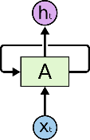
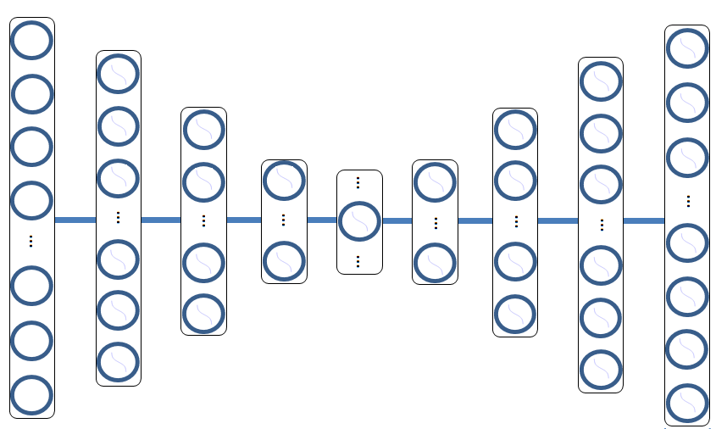
Analytics: Deep Learning
Architectures
Neural networks with ‘many‘ hidden layers
Fully connected
Convolutional
Adversarial
Recurrent
Autoencoder
adapt & combine according to physics requirements
net 2
net 1
x multi-dimensional input data
W, b to be trained
successively apply 2 operations:
Improved set of tools
Train millions of parameters by:
Data preprocessing
Normalization etc
y = W x + b
h = σ(y)
departure from linear system
Computing
Graphics Processing Unit (GPU)
Software Libraries

Slide 4
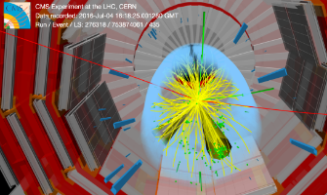
LHC: Coupling Top-Quark – Higgs Boson
CMS Collaboration, Phys. Rev. Lett. 120, 231801 – Published 4 June 2018
Deep Learning predicts physics process for each event (Aachen)
Observation of ttH production
proton
H→ bb
proton
H→ WW
H→ ZZ
H→ γγ
H→ ττ
excluded:
no coupling
Measured signal
close to Standard Model
of particle physics (μ=1)
Deep Learning arrived at particle physics publications

Slide 5
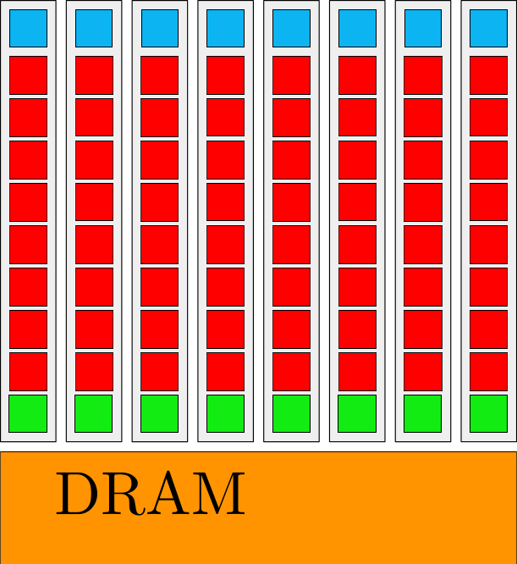
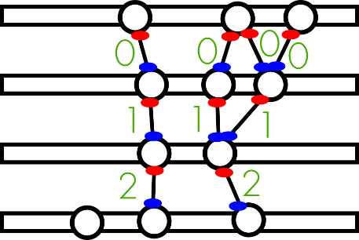
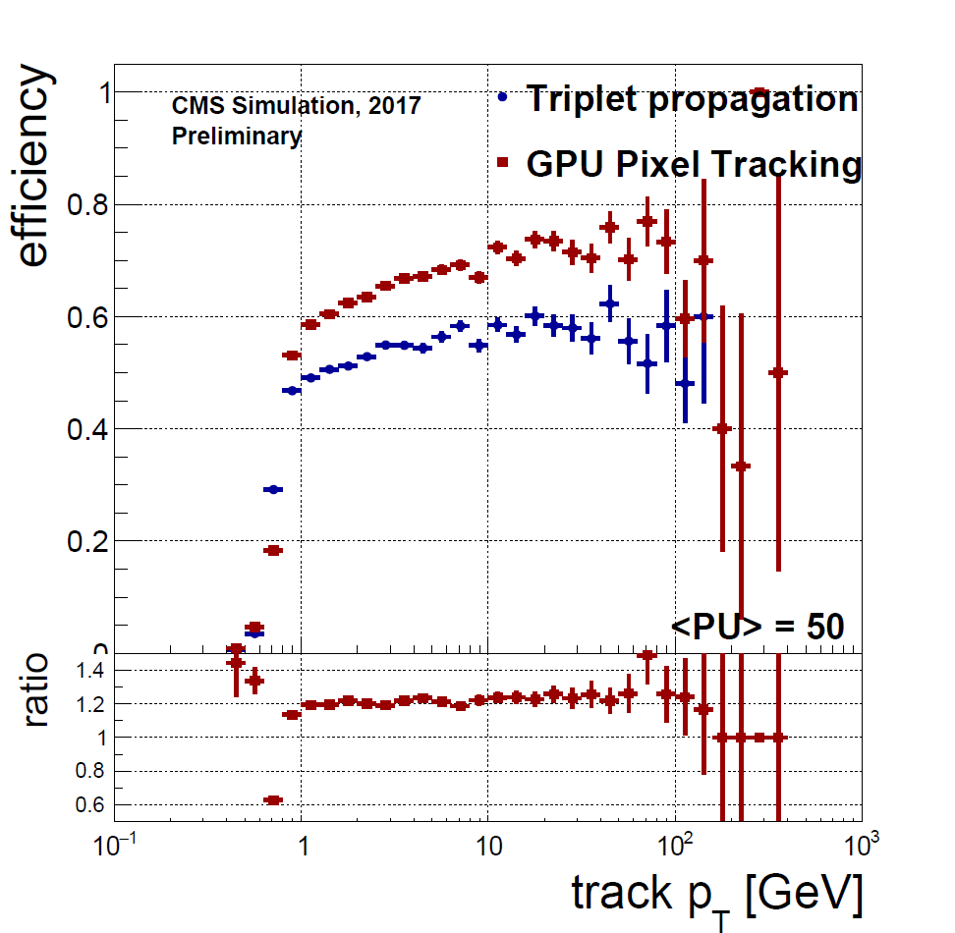
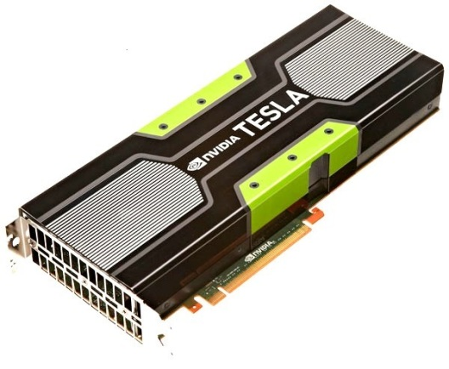
New data processing algorithms: track seeding
Pantaleo, Schmidt, Innocente, Hegner, Pfeiffer, Meyer, CMS-TS-2017-028 ; CERN-THESIS-2017-242
new seeding algorithm based on parallel-friendly algorithmic structure (cellular automaton), computing time grows linear with Pileup
GPU
 | time per event CPU (ms) | time per event GPU (ms)
Triplet propagation
cellular automaton
66.3
22
1.6
prerequisite to process the High Luminosity - LHC data

Slide 6
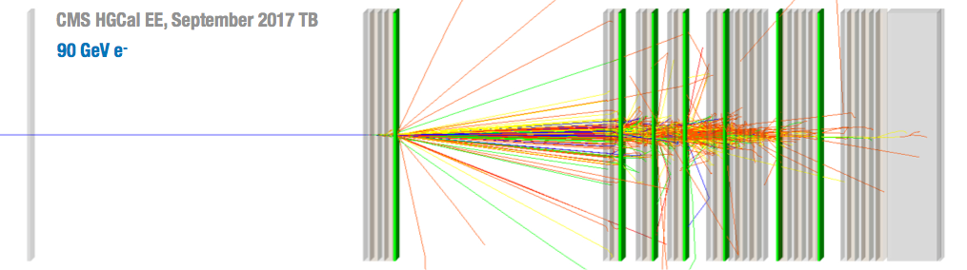
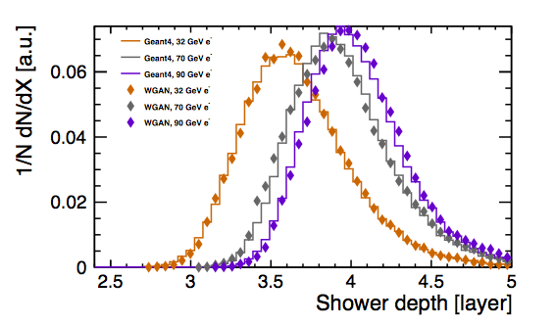
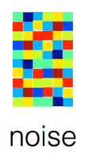
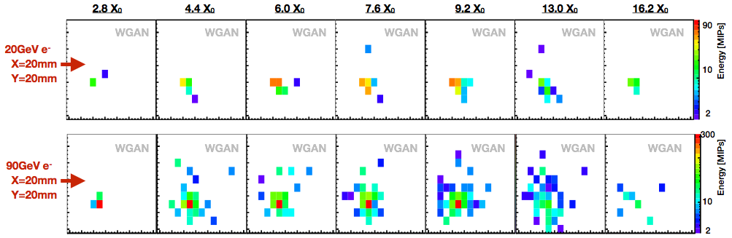
Ultra-fast simulations: WGAN
net 2
M.E., J. Glombitza, T. Quast
net 1
arxiv 1807.01954
Shower depth
Electron calorimeter in CERN test beam
Wasserstein-based Generative Adversarial Network
Correlations between layers
WGAN
Generation Method | Hardware | milliseconds/ shower
GEANT4 | CPU | 2000
WGAN | CPU | 52
 | GPU | 0.3
Goal: use measured data to re-train WGAN
Challenge: low-energy depositions

Slide 7
Deep neural networks in FPGAs
Javier Duarte et al., arXiv:1804.06913
Distinguish jets from quarks, gluons, `fat‘ jets
Remarkable
Fully connected neural network to identify jets with 4389 parameters
Implemented in FPGA using network compression & reduced precision
Latency of inference 75–150 ns with clock frequency 200 MHz → LHC Trigger

Slide 8
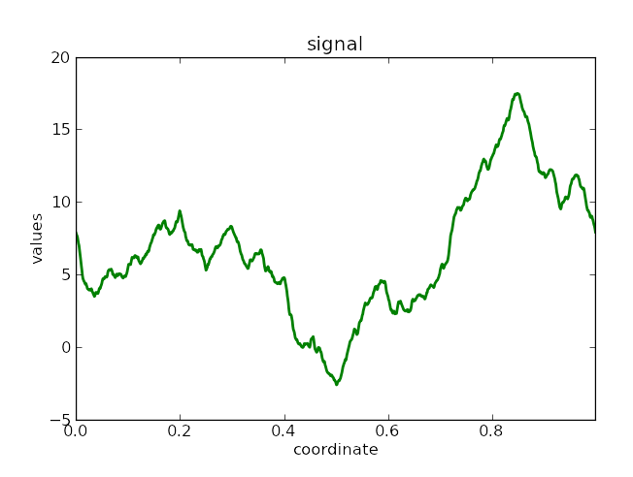
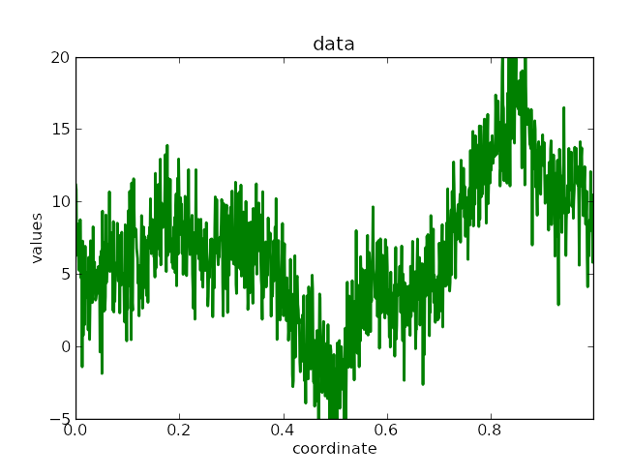
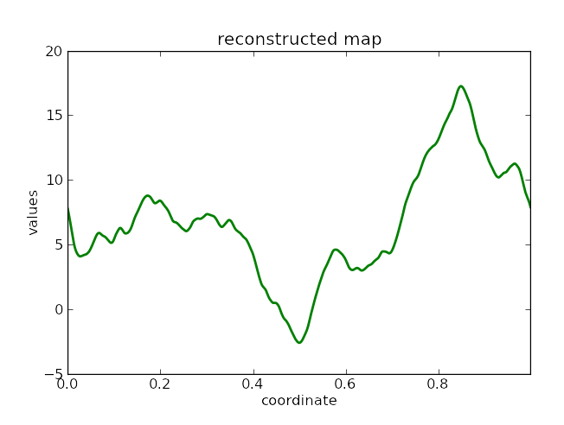
Information Field Theory
Torsten Enßlin, arXiv:1804.03350
http://www.mpa-garching.mpg.de/ift/
Bayesian method to fuse multiple information sources,
Separate contribution to Hubble‘s Andromeda galaxy
learning from a single data set
Simulated signal
original image
reconstructed
stars
Simulated data
reconstructed diffuse emission
Reconstructed signal

Slide 9
2) Education: Anchoring machine learning in curriculum
„Broschüre“

Slide 10

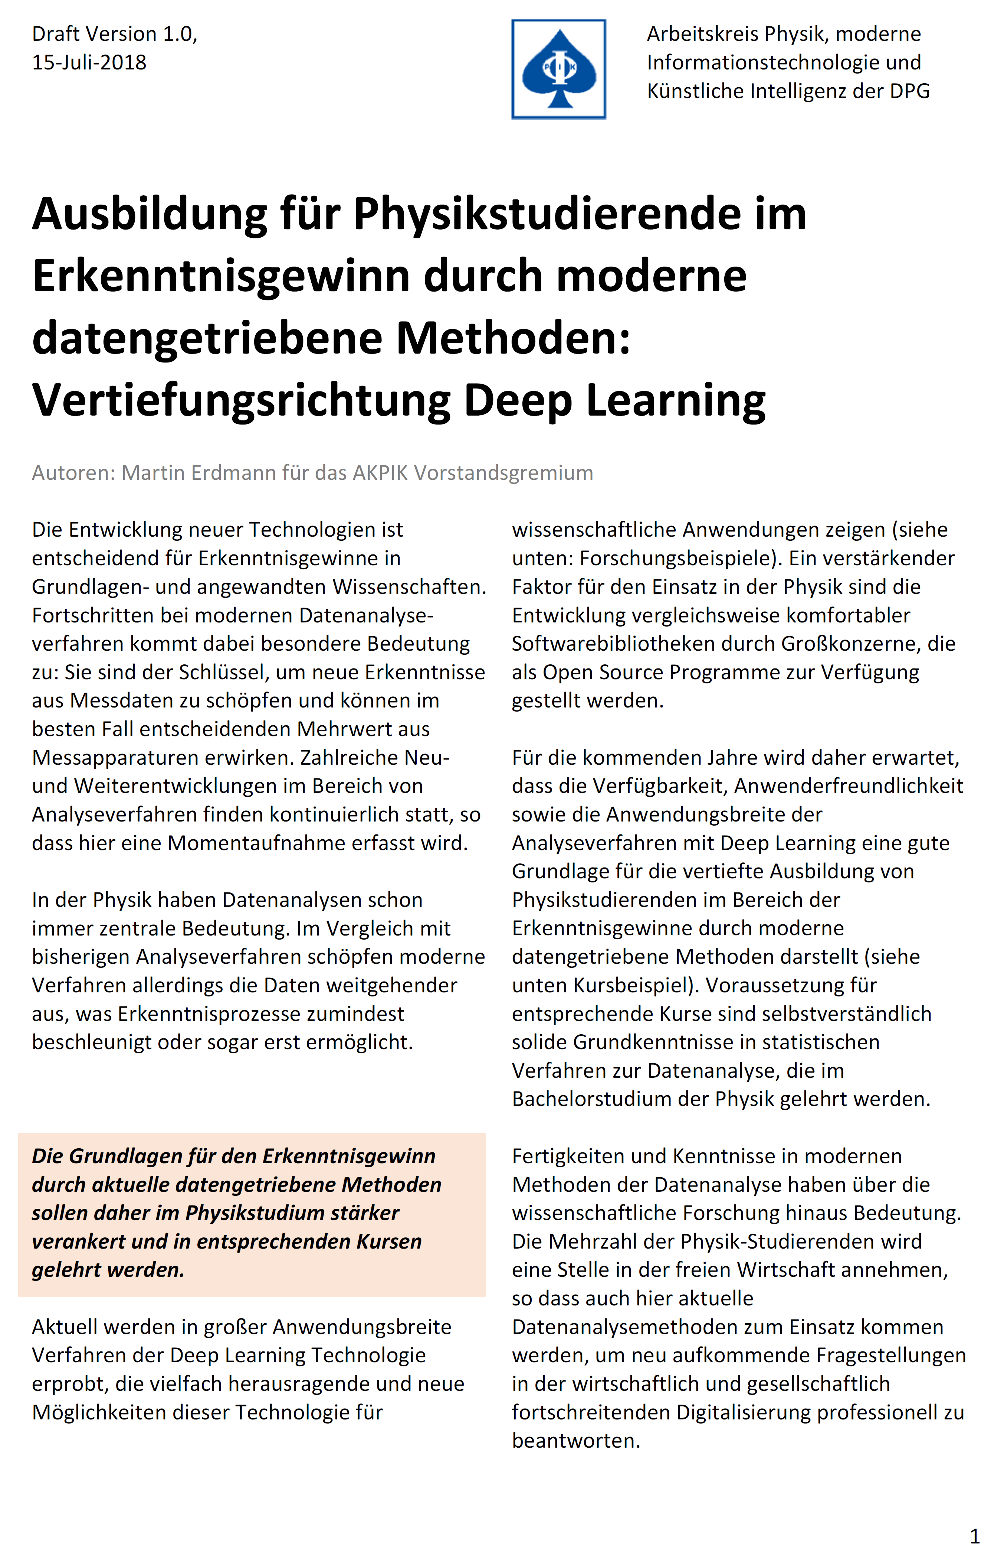
„Broschüre“
KAT + AKPIK: M.E., U. Katz, T. Enßlin, A. Hamm, K. Mannheim, V. Markl, K. Morik, …
„We want to achieve that physics students receive an educational offer in the application of machine learning in physics in the standard curriculum of their studies“ (Uli Katz)
Contents
Training Concept: Machine Learning for Physics Research
Examples applications of deep learning concepts in physics
Recommendations
Broadening of the course portfolio...
Installation and maintenance of graphics processors at university computer centres...
Establishment of a training platform for the exchange of course materials ...
→ Konferenz der Fachbereiche Physik

Slide 11
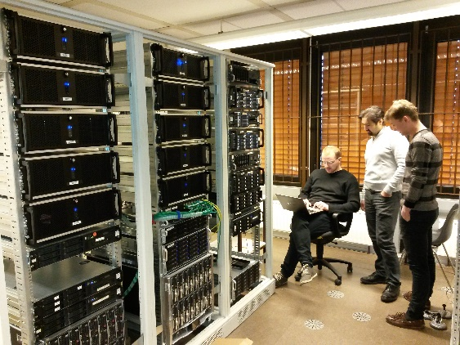
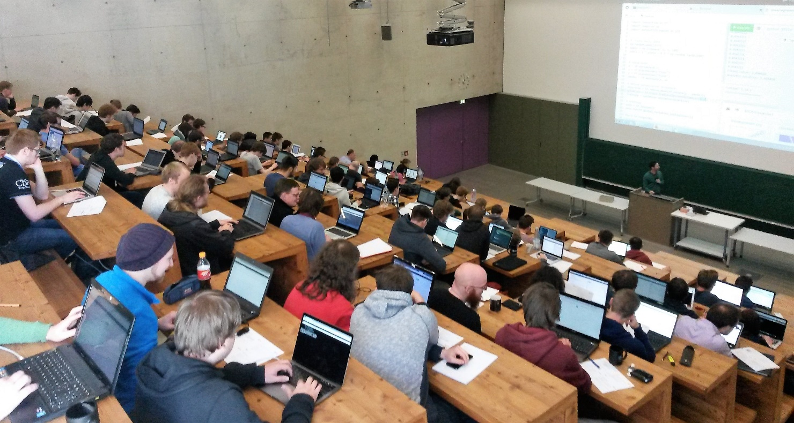
Education:
Deep Learning in Physics Research
Example: RWTH Aachen Summer term 2017 & 2018
VISPA
20 GPU
12 lectures and exercises
1. Fundamentals of deep learning
2. Regularization & generalization
3. Optimization & hyperparameter tuning
4. Convolutional neural networks
5. Classification of magnetic phases
6. Advanced computer vision methods
7. Application in astroparticle physics
8. Autoencoders & application in solid state physics
9. Generative adversarial networks
10. Restricted Boltzmann machines
11. Recurrent networks
12. Summary & a bit more on recurrent networks

Slide 12
3) Funding: Competence networks of various disciplines
"Digitalisierung in ErUM": BMBF-Workshop 4.-5-Oct-2018
KAT, KET, KfB, KFN, KFS, KHuK, RDS
Federated Infrastructures
Big Data Analytics
Research Data Management

Slide 13




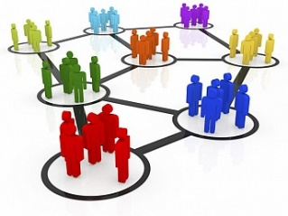
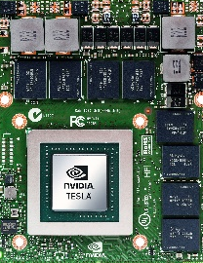

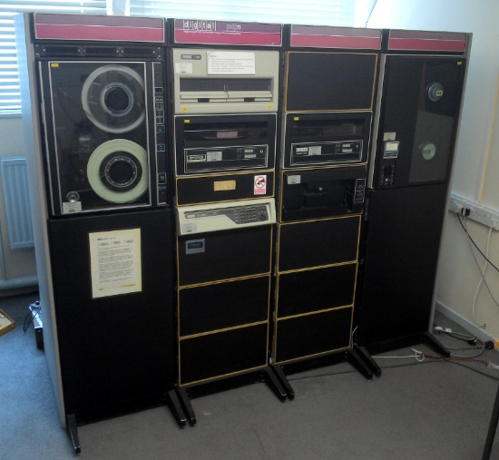

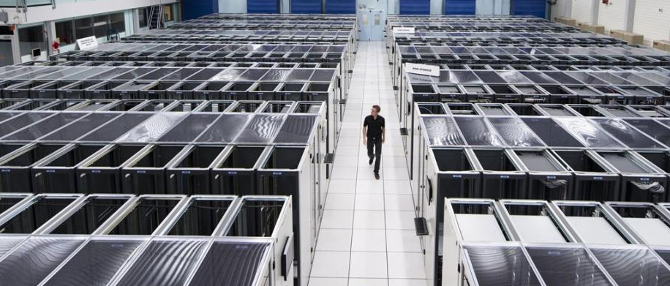

The Digital Basic Delivery for Scientists
1980th
2020th: interconnected
local
VISPA
Interactive & batch access via web browser to all scientific data, the required computing resources, exchange of information with colleagues
→ Should look & feel as if local
→ New own ideas through better technologies

Slide 14

Numerous great activities KET, KAT, …
Gefördertes Projekt: Förderung von ausgewählten Schwerpunkten der Erforschung von Universum und Materie auf dem Gebiet „Physik der kleinsten Teilchen“
Innovative Digitale Technologien für die Erforschung von Universum und Materie
Proposal: Entwicklung und Erprobung von Kurationskriterien und Qualitätsstandards von Forschungsdaten im Zuge des digitalen Wandels im deutschen Wissenschaftssystem.
FAIRe Forschungsdaten aus der Hochenergie Astroteilchenphysik: Teilchenschauer
Federated Infrastructures
Big Data Analytics
Research Data Management
New computing model following
The Worldwide LHC Computing Grid
VISPA internet platform:
development environment
for data analysis in web browser
Jupyterhub: Multi-user
web server for Jupyter
Notebooks (Belle II, SWAN@CERN)
Workshops: Big Data Science in Astroparticle Research in Aachen 2017/2018/2019, CERN machine learning 2017/2018, Dortmund 2019,..
Schools on Computing & Machine Learning: GridKa school 2017/2018, DESY school 2018, Dortmund 2018…
in 2017:
~750k CPU cores
~1 EB of storage
10-100 Gb links
>2 million jobs/day
→We need a home for all these activities to stay focused on the scientist & her/his questions !

Slide 15
asking for ErUM-Alliance
Funded structure to achieve all objectives
Main objective of developments
Scientist: Question
Advisory Council
Governing Body
Workshops,
Schools
User Interface (WEB)
Federated Infrastructures
Big Data Analytics
Research Data Management
Meta Data & Knowledge (Publications, data bases…)
Resources: Data, Methods, Computing, Visualization

Slide 16
asking for ErUM-Alliance
Funded structure to achieve all objectives
Main objective of developments
Advisory Council
Scientist: Question
Governing Body
Workshops,
Schools
User Interface (WEB)
Federated Infrastructures
Big Data Analytics
Research Data Management
Meta Data & Knowledge (Publications, data bases…)
Resources: Data, Methods, Computing, Visualization
Established institute groups
Tenure track groups
…
…
Newly establish strong physicists groups on Big Data Infrastructures & Management & Analytics

Slide 17
asking for ErUM-Alliance
Funded structure to achieve all objectives
Infrastructure Hardware
Main objective of developments
Advisory Council
Scientist: Question
Governing Body
Workshops,
Schools
User Interface (WEB)
Federated Infrastructures
Big Data Analytics
Research Data Management
Meta Data & Knowledge (Publications, data bases…)
Resources: Data, Methods, Computing, Visualization
Established institute groups
Tenure track groups
…
…
Newly establish strong physicists groups on Big Data Infrastructures & Management & Analytics

Slide 18
BMBF working group: Big Data Analytics
Big Data Analytics
BMBF specifications for working group topics Big Data Analytics:
The considerably higher resolution of detectors and experiments is accompanied by a rapid increase in the resulting measurement data...
Translation into concrete discussion topics
Trigger: "on-the-fly" data analysis & data selection
Simulation: new approaches e.g. generative models
Algorithms: optimal match with computer technology, scalable, parallel, "green
Signal/background (noise): machine learning (deep learning, information field theory)
Systematic effects: new approaches e.g. adversarial decrease
Precision: Combination of big data methods for more accurate results
Suitability: Big Data methods also for complex, unstructured data sets
Results, Meta-Results: New Conclusions from Data Using Big Data Methods
Artificial intelligence?

Slide 19
Consideration of other aspects
Big Data Analytics
Disciplines (particles, matter and universe) with the same challenge:
Access for all: new methods for efficient use of measurement data
Method development: develop new, specifically designed methods.
Aim of this working group: "common challenges & concrete approaches":
Enable solutions as well as cooperation between different areas.
Mathematics & Informatics: Opportunities for interdisciplinary cooperation & possible approaches.
Additions:
Young talent qualification
Interdisciplinarity
internationalisation
Cooperation with industry

Slide 20
Questions to KET: approximation of language comprehension & needs of community
Big Data Analytics
Questions and expectations for Big Data Analytics
Which questions should be solved?
What expectations are associated with Big Data Analytics?
How much experience is there already?
Evaluation of past experiences?
Which challenges need to be solved?
Data level for Big Data Analytics
Online "at the measuring sensor"?
Offline from files?
On single events (e.g. collision events, X-ray images, ...)?
On the totality of data sets (e.g. sky maps, ...)?
Which data structures and formats are used?
Who stores the data where?
Data volume for "Big Data" analyses
Typical data volumes per analysis
Analyses performed per year
Bytes (or number of variables) per record element
Analysis methods for Big Data Analytics
Adaptations with very large numbers of parameters (e.g. fits with >10,000 parameters)?
Methods with high demands on training data (deep networks)?
Methods with numerical inference methods (e.g. Bayes: information field theory)?
Existing and expected cooperations Big Data Analytics
Within your own community area (e.g. only particles)
Neighboring communities (particle astroparticles, synchrotron neutrons, ...)
International Partners
Mathematics, Computer Science
Economy
Need your input now

Slide 21
Messages
Lively exchange on current developments in "digitization" in particle physics:
  Machines exploit physics data more deeply
  New data processing algorithms: prerequisite to High Luminosity - LHC data
  Improved digital basic infrastructure: new own ideas through better technologies
  Education: training the next generation of scientists in new developments
Strong desire in KAT-KET-KHuK Community for joint & interdisciplinary developments:
  Needs structure for the "home" of the activities (similar to Allianz, FSP,...) for coordinated efforts

Slide 22
backup

Slide 23
DPG Arbeitskreis „Physik, moderne Informations-technologie und Künstliche Intelligenz“
BIG DATA
IT
KI & ROBOTIK
HOCHSCHULE
INDUSTRIE und GESELLSCHAFT
http://www.dpg-physik.de/dpg/gliederung/ak/akpik/organisation.html

Slide 24
Overarching take home messages
Lively exchange on current developments in "digitization" in particle physics:
  Improving the digital basic infrastructure: new own ideas through better technologies
  Heterogeneous computing resources indispensable -> Web -> Cloud Services -> Data Centers
  New data processing algorithms: prerequisite to process the High Luminosity - LHC data
  Paradigm shifts:
    Machines exploit physics data more deeply
    Software development as professional branch
    Data quality & meta data need agreed standards
    Analysis development in web browser → look & feel as local computer
    Analysis workflow management & analysis preservation
  Education: training the next generation of scientists in new developments
Strong desire in KAT-KET-KHuK Community for joint & interdisciplinary developments:
  Needs structure for the "home" of the activities (similar to Allianz, FSP,...) for coordinated efforts

Slide 25
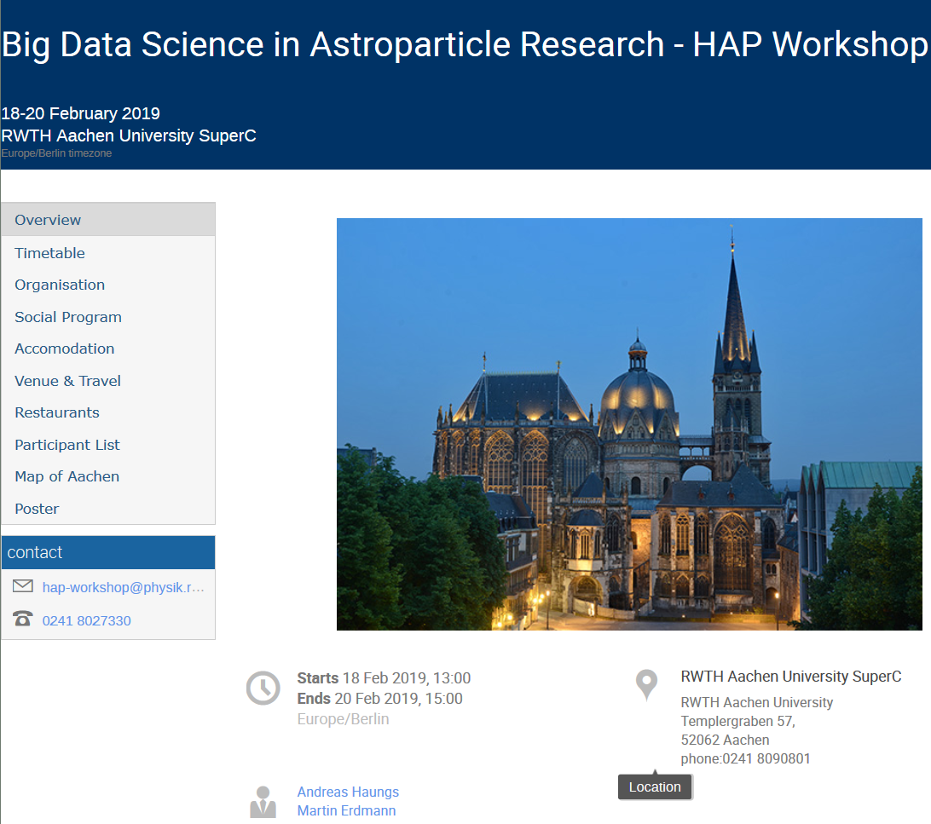
Big Data Science in Astroparticle Research (III.)
Aachen, 18.-20. Feb-2019
We invitation your contributions
Progress in deep learning applications
Data management and data centers
Software
Analysis preservation
Platforms for algorithms & network architectures
Education material
Keynote speakers
Hands-on tutorial deep networks

