Slide 1
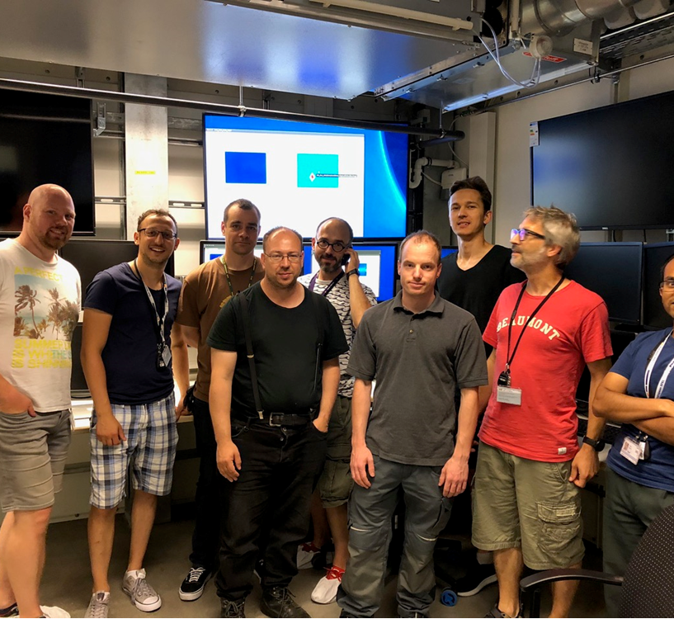
SCS
Progress
first beam in the SCS hutch at 12:40 and radiation safety test successfully completed at about 13:15pm. all went just super smooth.

Slide 2
SQS
Progress
Radiation safety test successfully done!! (60 bunces, 660 eV, 7.3 mJ !!!)
start of commissioning of the beam line up to KB.
Continuation of installation work (motor test) for LIC and AQS chamber.
Continuation of KB vacuum tests.

Slide 3
MID
Progress
Progress week 30 (July 23-27):
All day 1 components installed and under vacuum in OH
Phase-2 cabling finished in OH but…
Several cables/connectors were not available. Schulz must return and finish the
work later
Assembly of diagnostics end station
Karabo/firmware tests (tech commissioning) of two JJ slits (XTD6) almost complete
Local tests of imagers (XTD6) started
Other:
Waiting for PINK’s installation of improved MCP y-motion in EH (mid-end Aug)
CRL-2 (XTD6) to be opened soon to make diagnostics of possible damages…

Slide 4
HED
Progress
PAM assembled, vacuum test in progress
MEA came and aligned: 4BladeSlits, ATT, CRL.
Some discrepancies remain and need clarification
Amplitude laser installation ongoing,
oscilator and first amplifier stage aligned and running.
Routing for roughing vacuum line from pump outside hutch to IC1
identified, will be contracted next week. Last checks by VAC group ongoing.

Slide 5
SASE2 XTD6

Slide 6
Laser
SASE 3:
Lasermet interlock commissioning close to finished (end of week)
AC heat load test beg. next week
laser layout mask will be transferred next week
second week in August Amphos installation
FE has spent already weeks in customs now...
SASE 2:
facility status not clear
Amphos will be placed on table second or third week in August

Slide 7
Vacuum
MID optics hutch connected to tunnel vacuum
HED installation is ongoing
Instrument support for MID, SQS, SPB...

Slide 8
Optics

Slide 9
Photon Diagnostics
MCP XTD6 is commissioned, ready for beam.

Slide 10
Advanced Electronics
XTD6 PBLM-1,2 and MID tested and interlocks added
SQS and SCS with radiation tests today 26.07 so loops have to keep running without any update.
SQS working in loops 4 , 5 and 1. One crate missing in loop 5.
SQS interlocks to be integrated next days, also keep working in different loops.
SCS: Works mainly in Vacuum components this week, problems with turbopumps. Check of cables and motors in loop 1. Loop 2 working ongoing with Elmo controllers, some motors still not connected.
MPS crates for both experiments to be connected this week or early next week.
Other points
Working with CAS in order to be able to get parameters from Mc2 motors, feature that is needed to update SQS and SCS loops.

Slide 11
ITDM
finalizing DAQ/online cluster setup for SASE3 - should be ready on Monday
aim is to get first DAQ working in SQS/SCS next week
DAQ configurations and permissions discussed with instrument scientists
SASE2 networks are in operation

Slide 12
Detectors
2nd AGIPD MID
AGIPD is expected be ready for transportation to XFEL end of August
Illumination of FEM modules (to be used at MID) with lab X-rays @ CFEL ongoing
Current source data will be taken within the next two weeks
DSSC
Testing of the DSSC vessel
Few new RGA performed, the spectrum slowly improves all the times. Effect of the first bad RGA? Vessel+motion system close to XFEL oil-free specs
Leak detector to be transported to CFEL on Thursday. Then it will be connected to the vacuum system and the system pumped, to be ready for tests next week
Power supplies for lab MB proposal submitted, approval hopefully next week
New components to connect the second Huber chiller arrived
Three PPT feedthrough flanges tested and found leak tight, the last one is under long test
PLC system to be updated
Change request submitted to include the chiller control in the system, in contact with EETF and CAS for that, comments implemented, waiting for final approval
Power supply control in Karabo
Procedure cleared, first version of LV and HV tables with tags prepared
FastCCD
Calibration measurements ongoing with PulXar

Slide 13
CAS

Slide 14
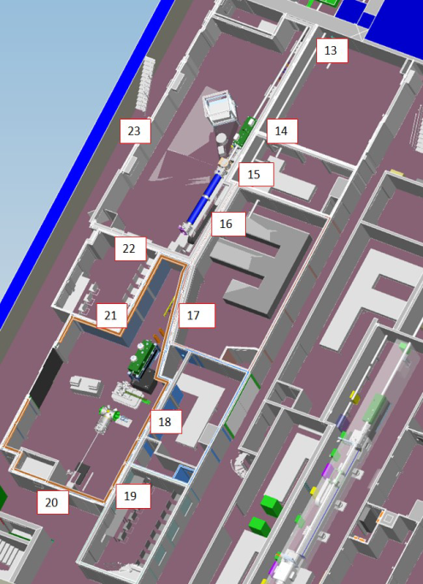
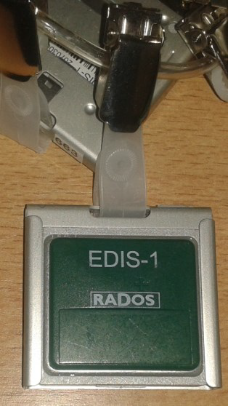
SRP
Commissioning of SASE 3 Radiation Hutches on 26 July:
Radiation tests conducted with 60 bunches delivering photons with 660 eV photon energy and 7.3 mJ
As expected. No detectable radiation inside the hutches
Area Monitoring dosimeters now hanging in SASE 3 – DO NO T REMOVE

