Slide 1
LUXE update
F. Burkart
E. Negodin, N. Golubeva, W. Decking

Slide 2

Option 1
β collimation
photoconverter
e+
Fast Kicker Magnet
e+
Final Focus
IP
XTD5
e-
dump
Dillution magnets
photons
e-
e+
Single bunch kicker helps machine protection.
Space efficient design – new location with crane.
Kicker and Septa design can be copy-pasted.

Slide 3
Option 2
photoconverter
e+
IP
e+
Fast Kicker Magnet
γ
e-
XTD5
dump
Dillution magnets
photons
e-
e+
Photoconverter: Foil

Slide 4
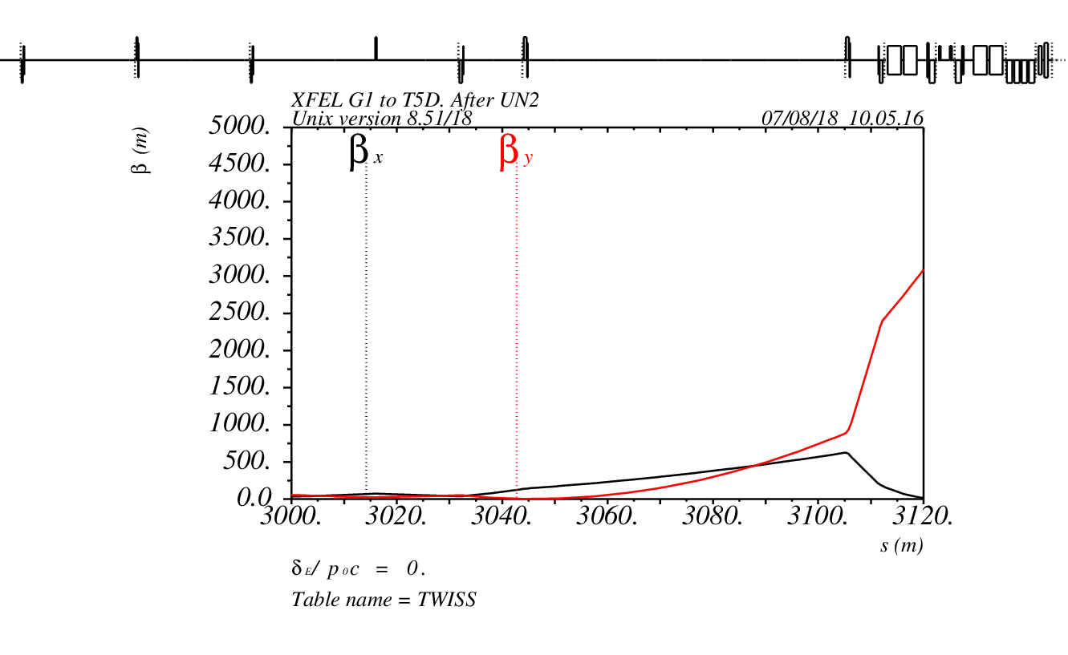
Optics
Bends
UN2

Slide 5
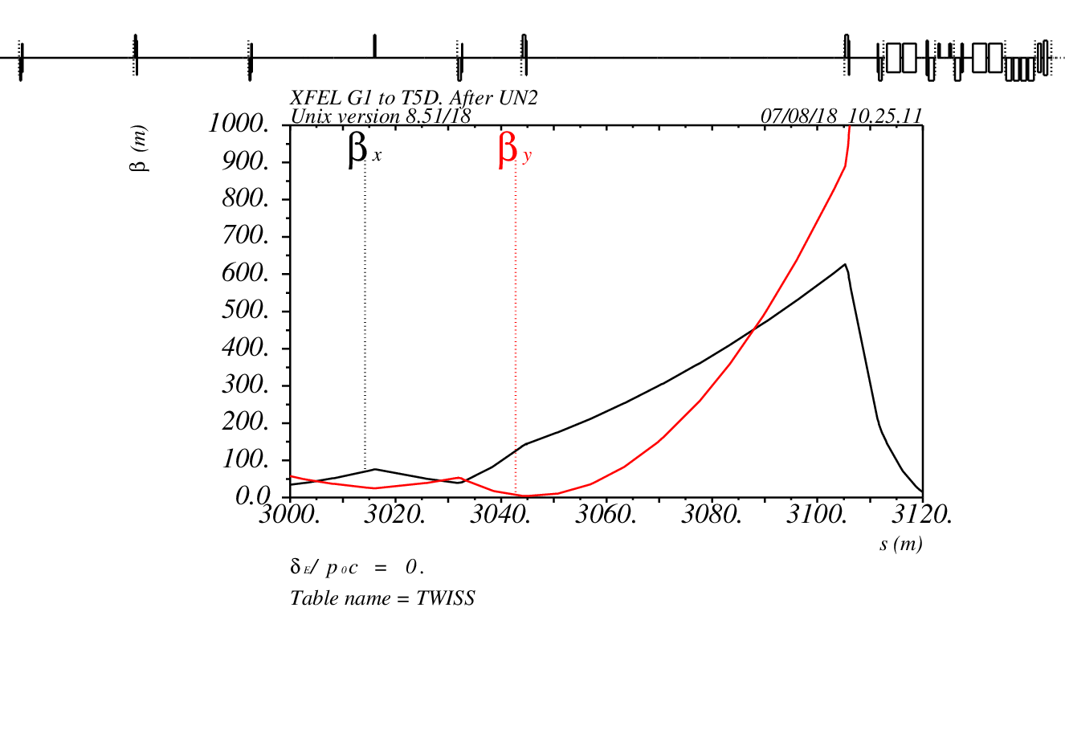
Optics

Slide 6
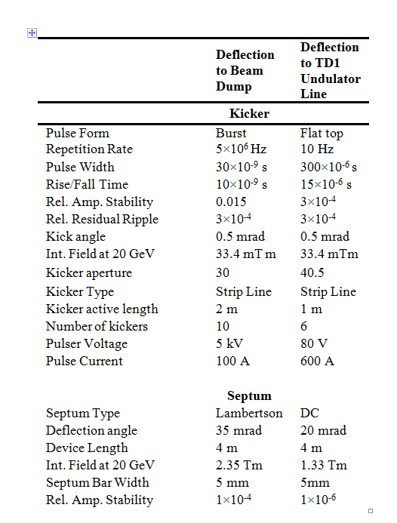
Kicker and Septa parameters

Slide 7
Next steps
Meeting with Kicker experts.
Design optics and layout.

