Slide 1
Tests on Chess 2 ASIC
Yubo Han_{IHEP} , Dionisio Doering, Pietro Caragiulo, Larry Ruckman, Camillo Tamma, Su Dong

Slide 2
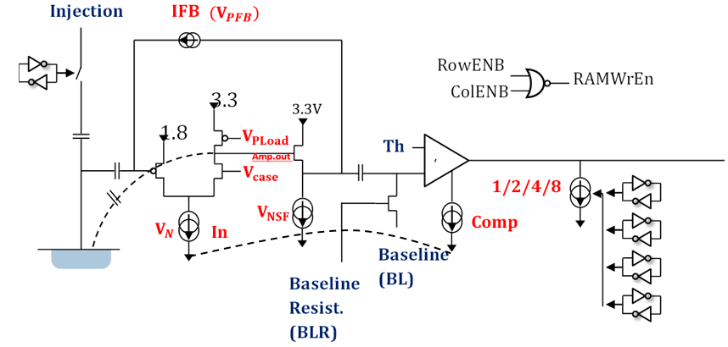
Pixel description

Slide 3
Outline
Tests on Readout speed of stream readout
Updates on stream readout data saving
  Saving method
  Results of a quick test
    Without blocking any “hot pixel”
    Without time alignment (using another IR Laser)
    Rooms to improve

Slide 4
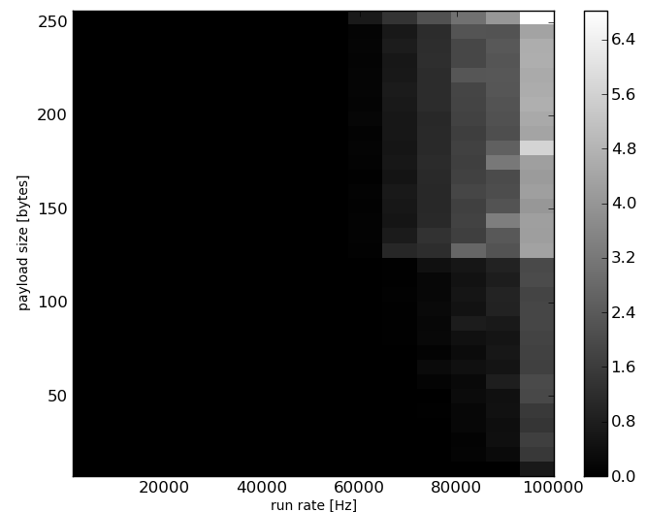
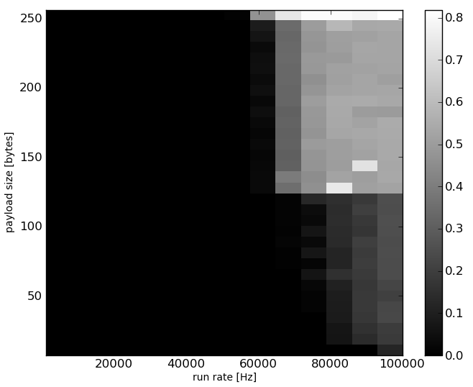
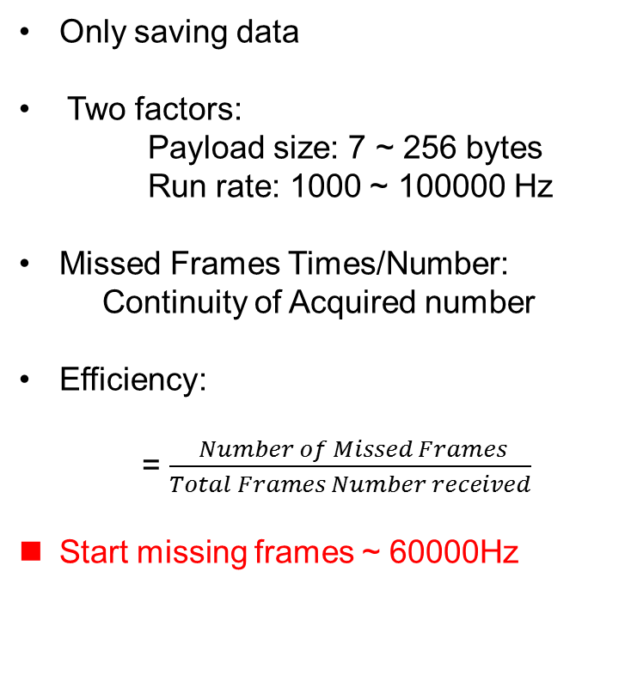
Speed of Stream readout
Only saving data
Two factors:
Payload size: 7 ~ 256 bytes
Run rate: 1000 ~ 100000 Hz
Missed Frames Times/Number:
Continuity of Acquired number
Efficiency:
= $\frac{ Number of Missed Frames}{Total Frames Number received}$
Start missing frames ~ 60000Hz
Efficiency
Fraction of discontinuous Acquired number

Slide 5
Updates on stream readout data saving
Main Challenges:
  Hard to tracking the configuration and parameter changed during tests
  Ideas and updates for saving the data:
    Using Python
  Raw date + “log.txt” file (initial configuration & parameters which changed)
  Read the two files together
  Saving the data into a .root file according to the “log.txt”

Slide 6
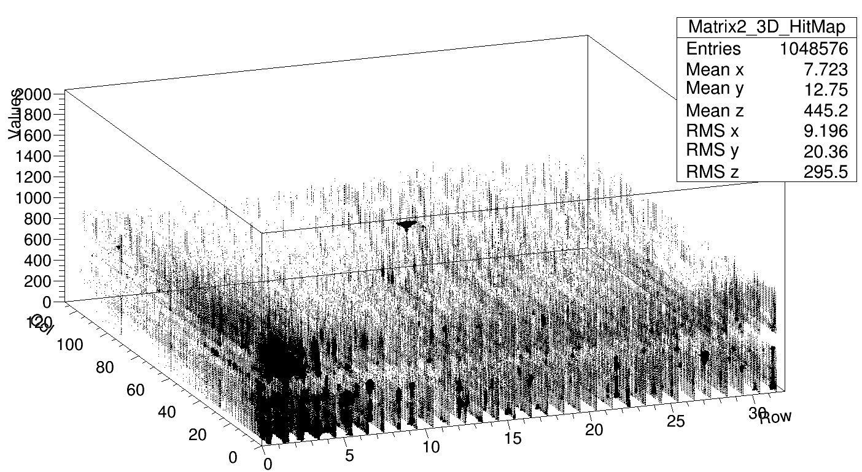
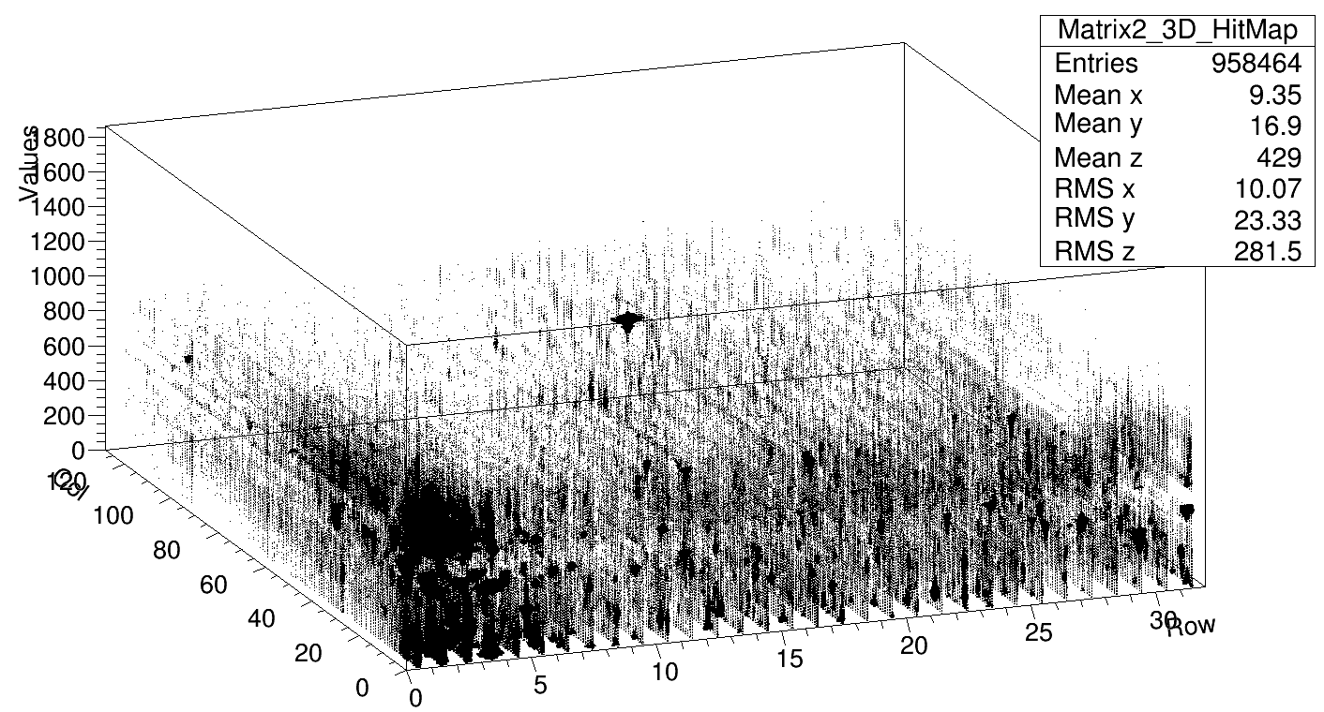
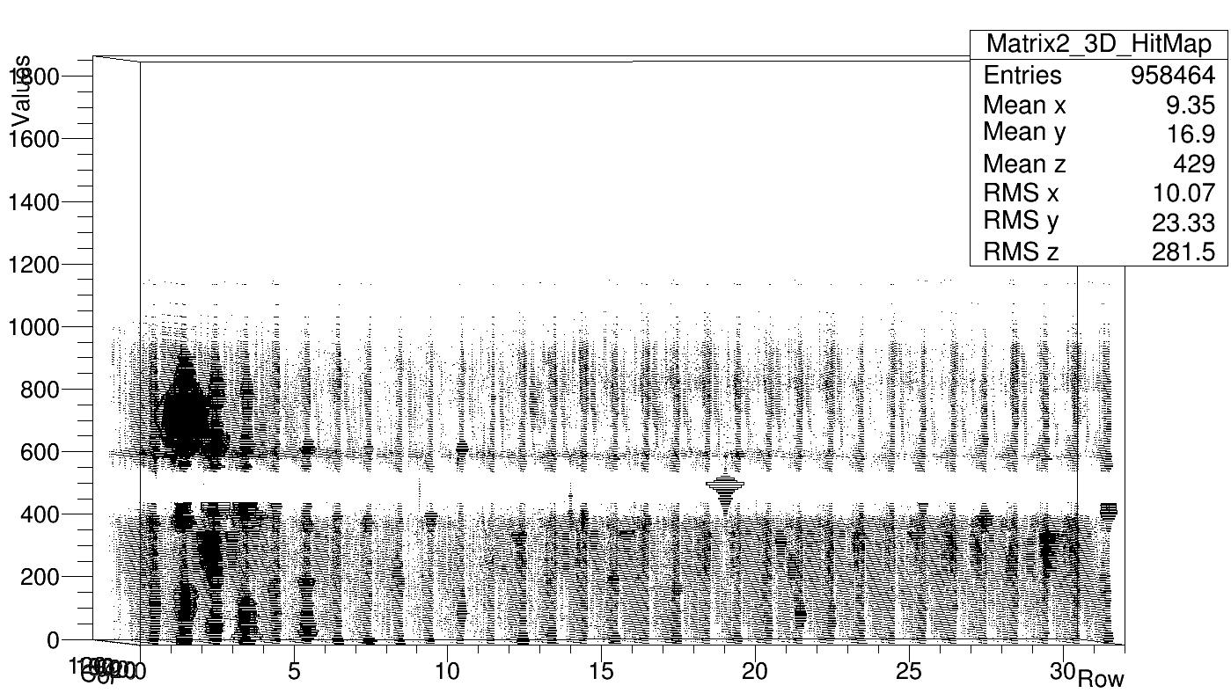
Results of a quick test
No Laser
Std resistance chip #02
Bias voltage: -7V
Default configuration
Test with IR Laser pointing at Matrix 2
BL=0.75V (774)
Threshold sweeping: 0~2V(7.8mV step, 256 steps)
External Trigger: 1000Hz
Time for testing: ~330s to finish
Data file: ~50MB
Too much noise at lower Threshold
Hard to see the signal
Test parameters to be optimized
with Laser

Slide 7
Summary and Next
Scripts almost ready for the stream readout
Next:
Debug IR Laser test
Pre-amplifier configuration optimization study
  Variations might be potentially profitable?
Instruction on website
Tests with Radioactive source

