Slide 1
Low T Bake – Cool Down Studies
Daniel Bafia
TTC WG3
7 February 2019

Slide 2
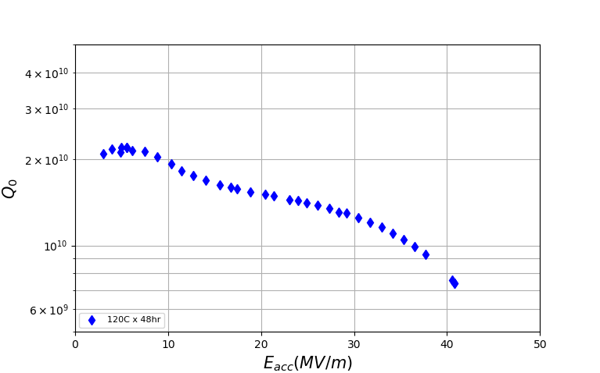
Push for Higher Accelerating Gradients: 75/120 Bake
f=1.3GHz
T=2K
Higher quench fields
Fewer cavities
Lower cost

Slide 3
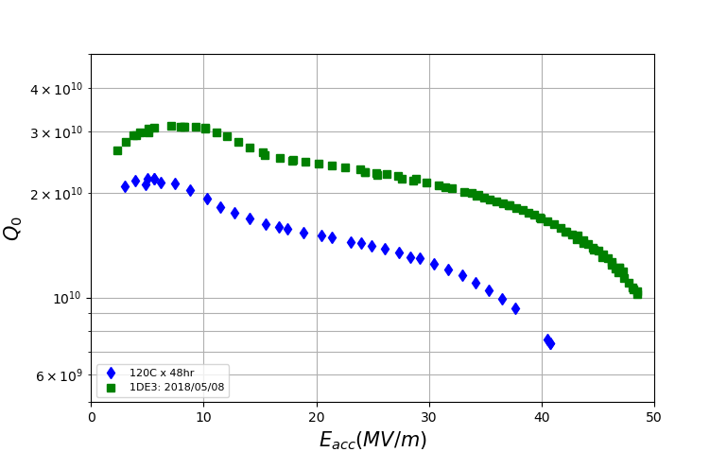
Push for Higher Accelerating Gradients: 75/120 Bake
Quench at 49MV/m!
f=1.3GHz
T=2K
Higher quench fields
Fewer cavities
Lower cost

Slide 4
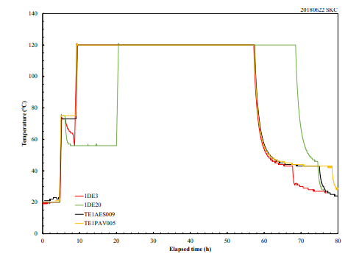
Push for Higher Accelerating Gradients: 75/120 Bake
Quench at 49MV/m!
f=1.3GHz
T=2K
Additional 2 hours at 75C
75/120 bake recipe:
75x4hrs/120Cx48hr in UHV

Slide 5
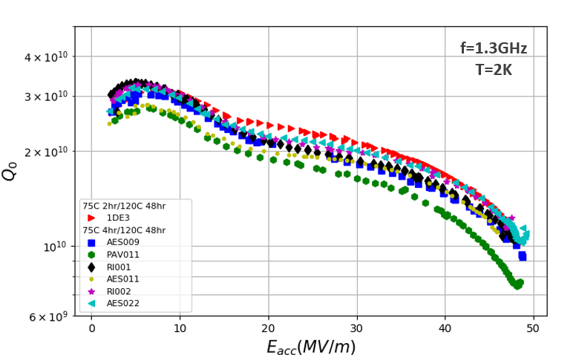
Exploring 75/120C Bake Cavity Performance
Gradients of 49MV/m have been achieved at Fermilab
Notes:
Sequence: 75/120 then EP then 120
-- Q matches at low

Slide 6
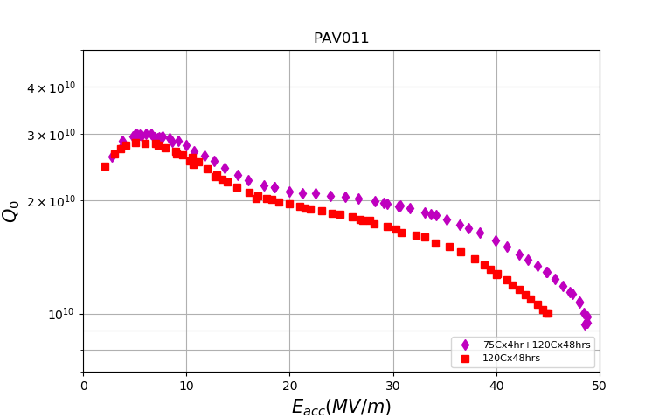
Exploring 75/120C Bake Cavity Performance
Gradients of 49MV/m have been achieved at Fermilab
75/120 bake recipe yields higher Q₀ and G (+4MV/m) than standard 120C bake
Curve shape changes – not due to trapped magnetic flux
Notes:
Sequence: 75/120 then EP then 120
-- Q matches at low

Slide 7
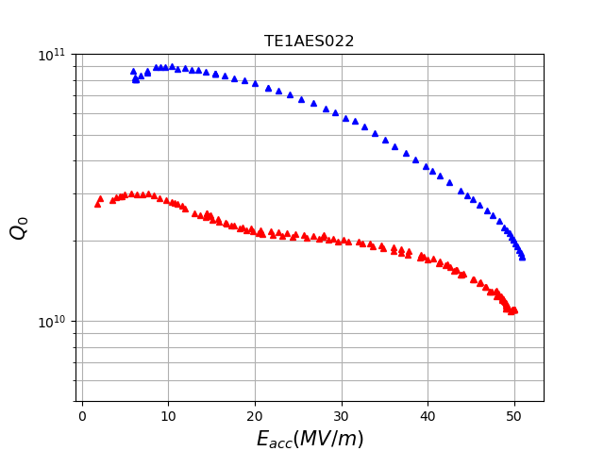
Further World Record Achieved: +50MV/m!
51MV/m=218mT
@ Low T!
50MV/m=213mT
@ 2K

Slide 8
Quench Field Histogram
More than a dozen different cavities tested; multiple tests for several cavities
Consistently achieve excellent cavity performance
Material : WC, TD, NX, Hareaus; cavities from AES, RI, DESY, KEK
FNAL, DESY: TD, NX, WC, H
KEK cavities (TD material): optical inspection indicates some potential surface flaws?
“Bunching up” of quench field observed: (45MV/m vs 48MV/m)

Slide 9
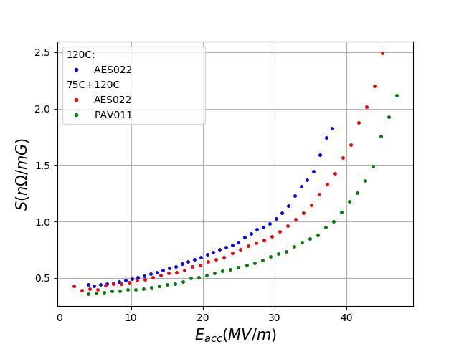
Sensitivity of 75/120C vs 120C Baked Cavities
Compared to 120C bake, sensitivity to trapped magnetic flux is decreased post 75/120
Could be due to differences in the pinning of vortices due to introduction of vacancies at 75C
2/7/2019

Slide 10
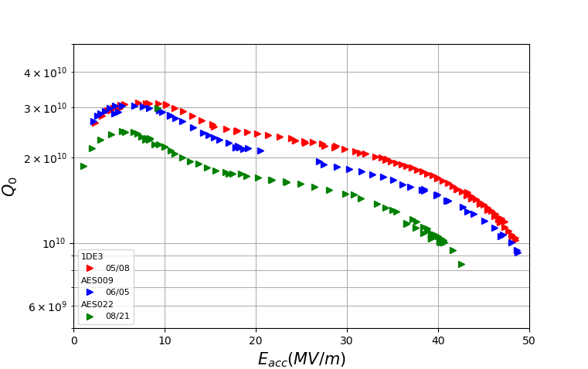
Bifurcation in Performance Post 75/120 Bake
f=1.3GHz
T=2K

Slide 11
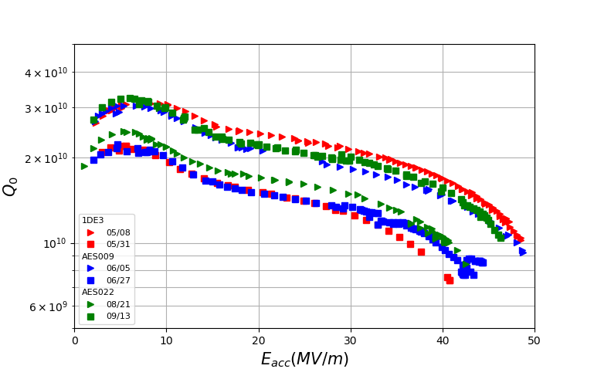
Bifurcation in Performance Post 75/120 Bake
Observed branching behavior in cavities retested without disassembly in between
f=1.3GHz
T=2K

Slide 12
Bifurcation in Performance Post 75/120 Bake
Observed branching behavior in cavities retested without disassembly in between
Possible Causes for Branching | Likely Candidate?
Dewar | NO – observed in 2 separate dewars
Top Plate | NO
Cables | NO
Calibration | NO - Qext 2 does not explain branching in Q and G
Flux trapping | NO – MOST were cooled in zero compensated field
f=1.3GHz
T=2K

Slide 13
Likelihood of Trapped Flux Causing Bifurcation
No transverse field compensation/fluxgates for these tests – but transverse fields measured to be <1mG in the past
Estimate of field necessary to cause bifurcation @ 40MV/m:
R_{upper} =270/1.56E10 = 17.3nΩ
B_{trapped} =10nΩ /1.7nΩ /mG = 5.88mG
R_{lower} =270nΩ/1E10 = 27nΩ

Slide 14
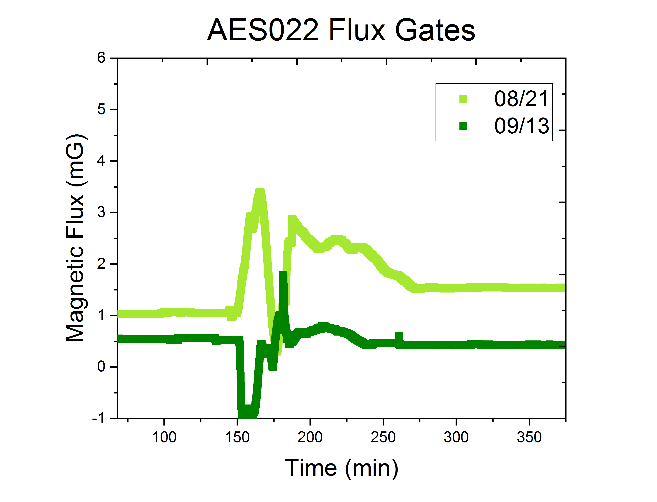
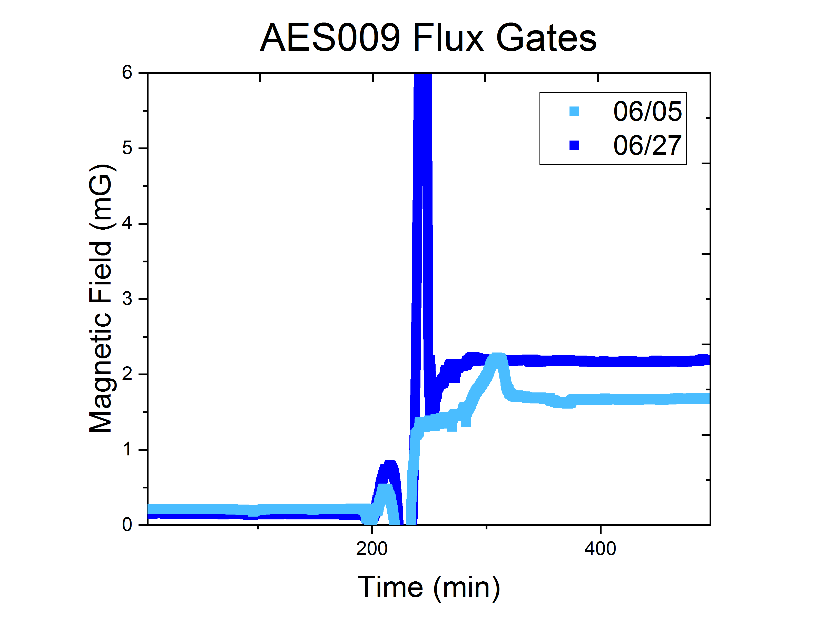
Likelihood of Trapped Flux Causing Bifurcation
No transverse field compensation/fluxgates for these tests – but transverse fields measured to be <1mG in the past
Estimate of field necessary to cause bifurcation @ 40MV/m:
R_{upper} =270/1.56E10 = 17.3nΩ
B_{trapped} =10nΩ /1.7nΩ /mG = 5.88mG
R_{lower} =270nΩ/1E10 = 27nΩ
T_{c}
T_{c}
≤1mG before T_{c}
≤0.2mG before T_{c}

Slide 15
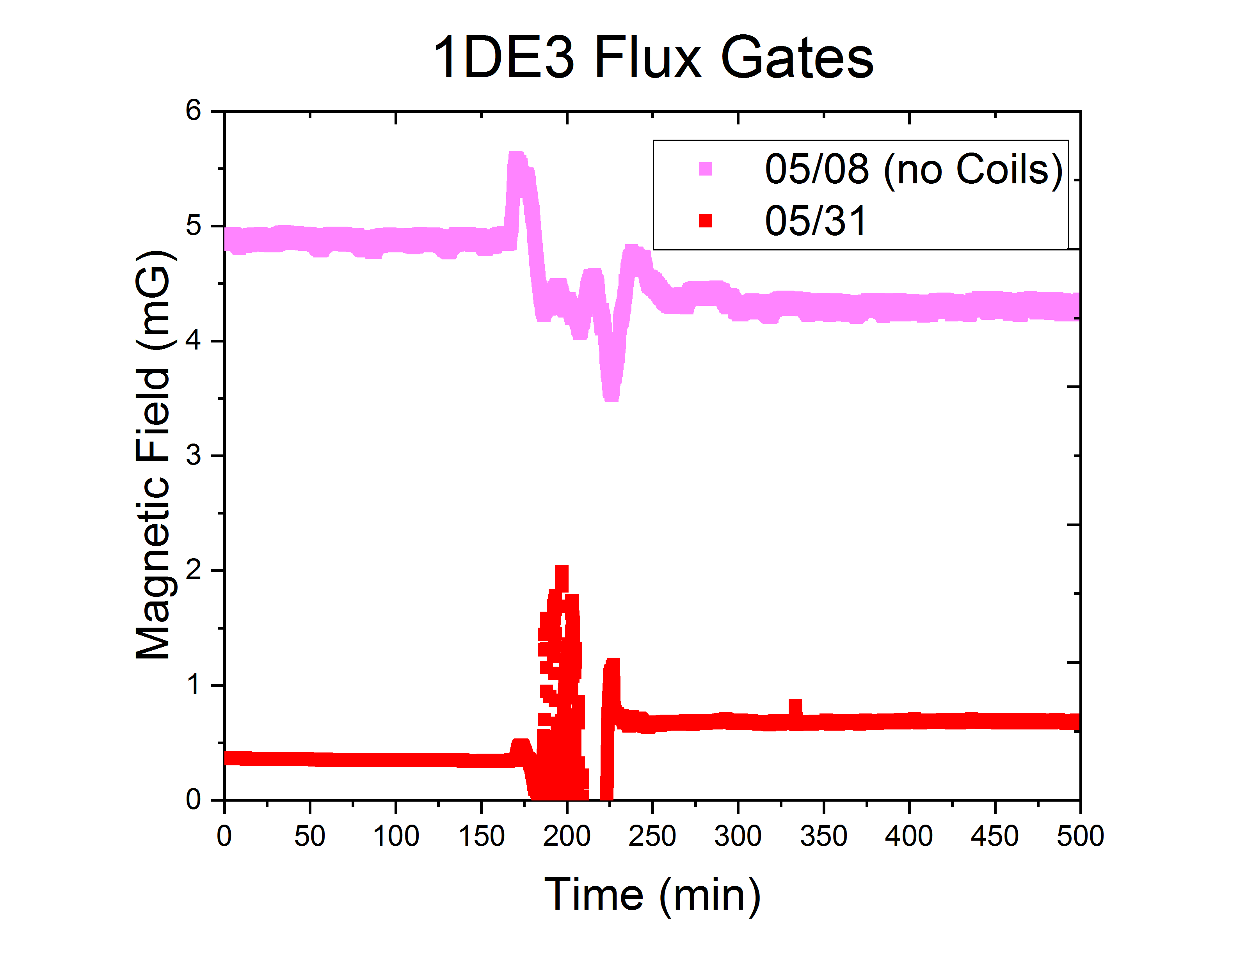
Likelihood of Trapped Flux Causing Bifurcation
No transverse field compensation/fluxgates for these tests – but transverse fields measured to be <1mG in the past
Estimate of field necessary to cause bifurcation @ 40MV/m:
R_{upper} =270/1.56E10 = 17.3nΩ
B_{trapped} =10nΩ /1.7nΩ /mG = 5.88mG
R_{lower} =270nΩ/1E10 = 27nΩ
T_{c}
T_{c}
T_{c}
≤1mG before T_{c}
≤0.2mG before T_{c}
05/08 – no coils – 49MV/m
5/31 – coils – 41MV/m!

Slide 16
Likelihood of Trapped Flux Causing Bifurcation
No transverse field compensation/fluxgates for these tests – but transverse fields measured to be <1mG in the past
Estimate of field necessary to cause bifurcation @ 40MV/m:
Trapped flux may not be responsible for bifurcation in performance
R_{upper} =270/1.56E10 = 17.3nΩ
B_{trapped} =10nΩ /1.7nΩ /mG = 5.88mG
R_{lower} =270nΩ/1E10 = 27nΩ
T_{c}
What about the effect of cavity cool down protocol?
T_{c}
T_{c}
≤1mG before T_{c}
≤0.2mG before T_{c}
05/08 – no coils – 49MV/m
5/31 – coils – 41MV/m!

Slide 17
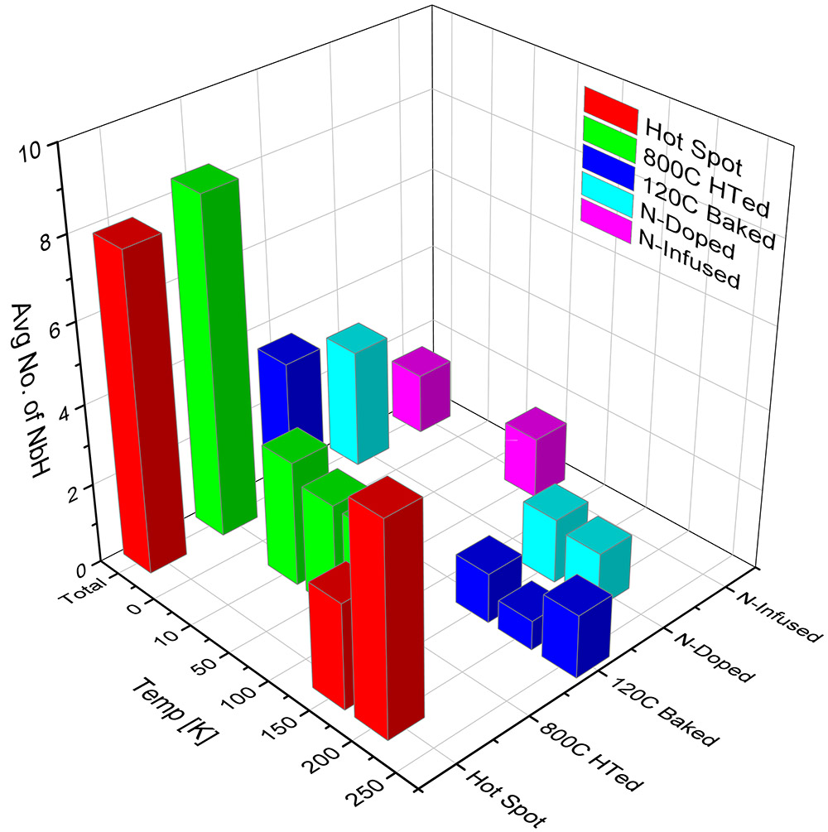
Motivation for Investigating Cavity Cool Down: Hydride Formation
Different recipes produce different amounts of hydrogen capture sites (vacancies, nitrogen, dislocations, etc)
Amount of captured hydrogen could vary the dangerous temperature region in which hydrides form
Dwelling in this “dangerous” temperature region could be detrimental to cavity performance – cool down rate could affect 75/120 bake cavity performance
Avg. No. of NbH Precipitates within 10 x 10 μm² unit area during cooling
Nb-H Phase Diagram
Plots courtesy of Zuhawn Sung
2/7/2019
Daniel Bafia | TTC at TRIUMF

Slide 18
Motivation for Investigating Cavity Cool Down: Hydride Formation
Different recipes produce different amounts of hydrogen capture sites (vacancies, nitrogen, dislocations, etc)
Amount of captured hydrogen could vary the dangerous temperature region in which hydrides form
Dwelling in this “dangerous” temperature region could be detrimental to cavity performance – cool down rate could affect 75/120 bake cavity performance
No obvious relationship between cavity cool down rate and performance
Avg. No. of NbH Precipitates within 10 x 10 μm² unit area during cooling
Nb-H Phase Diagram
Plots courtesy of Zuhawn Sung
2/7/2019
Daniel Bafia | TTC at TRIUMF

Slide 19
Motivation for Investigating Cavity Cool Down: Hydride Formation
Different recipes produce different amounts of hydrogen capture sites (vacancies, nitrogen, dislocations, etc)
Amount of captured hydrogen could vary the dangerous temperature region in which hydrides form
Dwelling in this “dangerous” temperature region could be detrimental to cavity performance – cool down rate could affect 75/120 bake cavity performance
No obvious relationship between cavity cool down rate and performance
Avg. No. of NbH Precipitates within 10 x 10 μm² unit area during cooling
Nb-H Phase Diagram
For a 120C baked cavity cutout, hydrides appear to decrease in size when the sample is heated to 320K
Heating to 340K appears to INCREASE hydride size.
Elevated initial dewar temperatures may also affect the performance of 75/120 bake cavities
Plots courtesy of Zuhawn Sung
2/7/2019
Daniel Bafia | TTC at TRIUMF

Slide 20
Effect of Elevated Initial Dewar Temperature on Cavity Performance

Slide 21
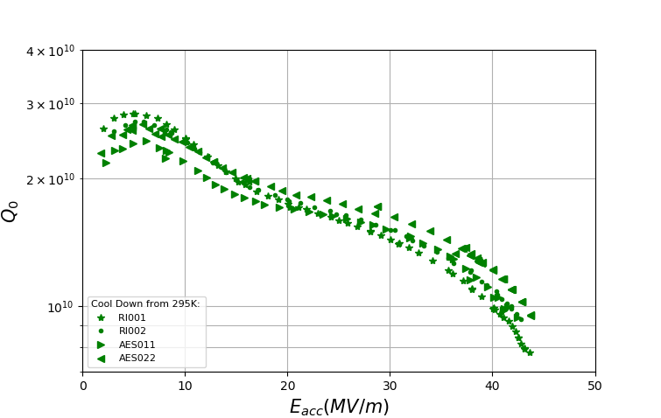
Comparison of 75/120 Bake Cavities Cooled From 295K vs 320K
QvsE of Cavities Post 75/120 Bake
f=1.3GHz
T=2K

Slide 22
Comparison of 75/120 Bake Cavities Cooled From 295K vs 320K
QvsE of Cavities Post 75/120 Bake
f=1.3GHz
T=2K
Cooling cavities from 320K shows consistently higher quench field and Q₀ at high fields for cavities post 75/120 bake when compared to cooling from 295K.

Slide 23
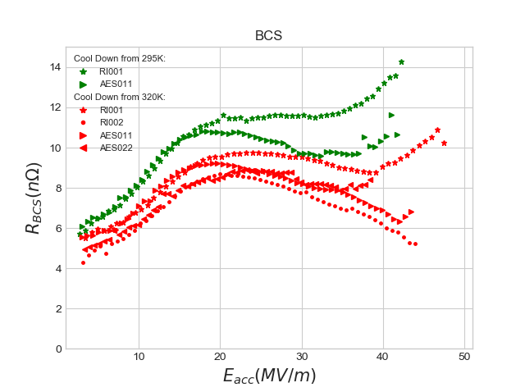
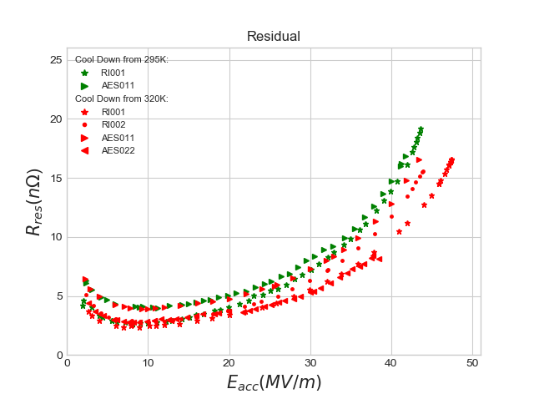
Decomposition of 75/120 Bake Cavities Cooled from 295K vs 320K
Branching in both BCS and residual components – not due to trapped flux
Cooling down from 320K gives a BCS similar to that of infusion

Slide 24
Comparison of 75/120 Bake Cavities Cooled From 295K vs 320K
QvsE of Cavities Post 75/120 Bake
f=1.3GHz
T=2K
AFM finds minimum Nb-H size @ 320K
Courtesy of Zuhawn Sung
Cooling cavities from 320K shows consistently higher quench field and Q₀ at high fields for cavities post 75/120 bake when compared to cooling from 295K.
In-situ 320K may be dissociating non-superconducting niobium hydrides

Slide 25
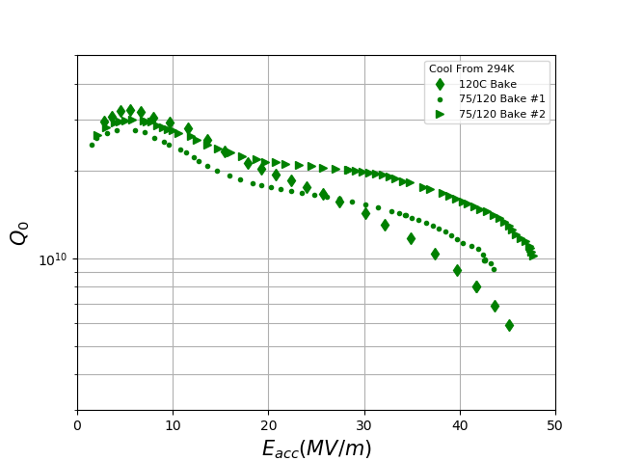
Comparison of Cavities Cooled From 295K vs 345K
QvsE of 120C and 75/120 Bake Cavities
f=1.3GHz
T=2K

Slide 26
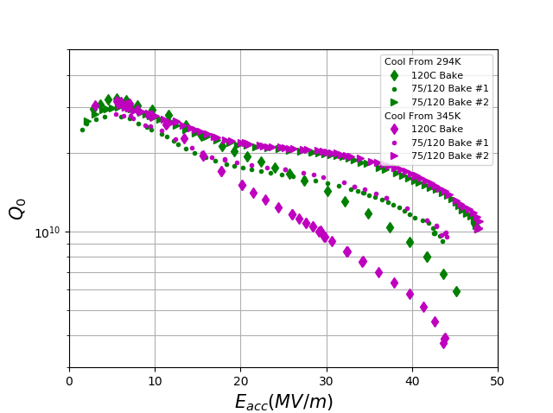
Comparison of Cavities Cooled From 295K vs 345K
QvsE of 120C and 75/120 Bake Cavities
120C baked cavity performs on lower branch post in-situ 345K!
f=1.3GHz
T=2K
In-situ 345K bake degrades 120C bake cavity performance, not 75/120 baked cavities!

Slide 27
Comparison of Cavities Cooled From 295K vs 345K
QvsE of 120C and 75/120 Bake Cavities
120C baked cavity performs on lower branch post in-situ 345K!
f=1.3GHz
T=2K
In-situ 345K bake degrades 120C bake cavity performance, not 75/120 baked cavities!
In-situ 345K bake could be increasing hydride size for 120C bake but not for 75/120 bake
75/120 bake may introduce more vacancies – more robust to hydride formation at higher temps

Slide 28
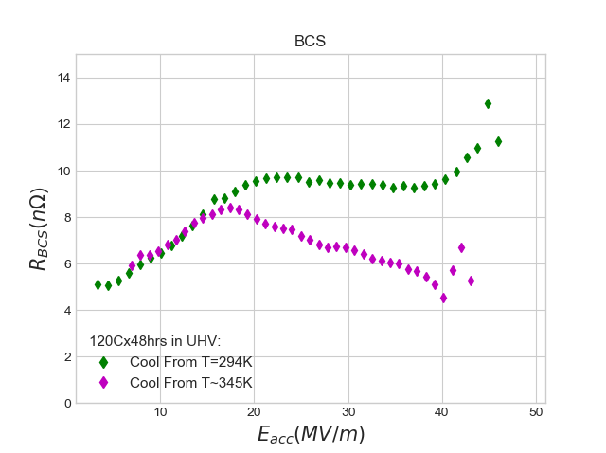
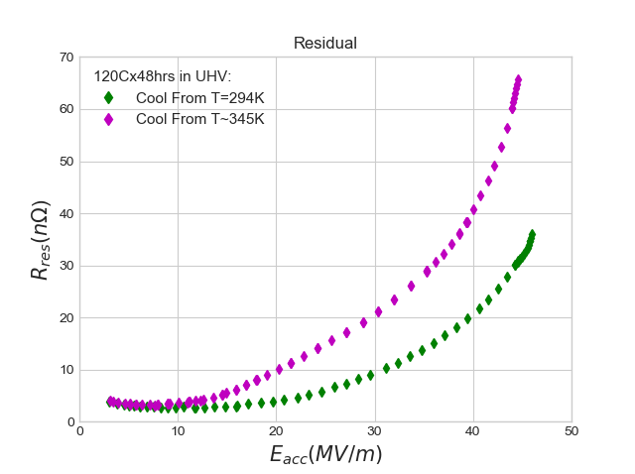
Decomposition of 120C Baked Cavity Cooled from 294K vs 345K
*
*
* Both curves have trapped flux
Branching observed in both residual and BCS resistances
Cooling from 345K causes BCS to resemble N-infused cavities

Slide 29
Conclusions
Bifurcation in performance of cavities post 75/120 bake recipe is still not fully understood; branching behavior exists in both BCS and residual resistances
Branching behavior is likely not due to trapped magnetic flux
The decrease in the sensitivity to trapped magnetic flux could be due to a change in the pinning of vortices due to introduction of vacancies at 75C
Cavity cool down rates through “dangerous” nano-hydride formation regions may be responsible for observed bifurcation but has not yet been observed
Cooling cavities down from an initial dewar temperature of 320K consistently gives upper branch performance for 75/120 bake cavities whereas cooling from 345K causes degradation of 120C bake only.

Slide 30
Backup Slides

Slide 31
Flux Gates

Slide 32
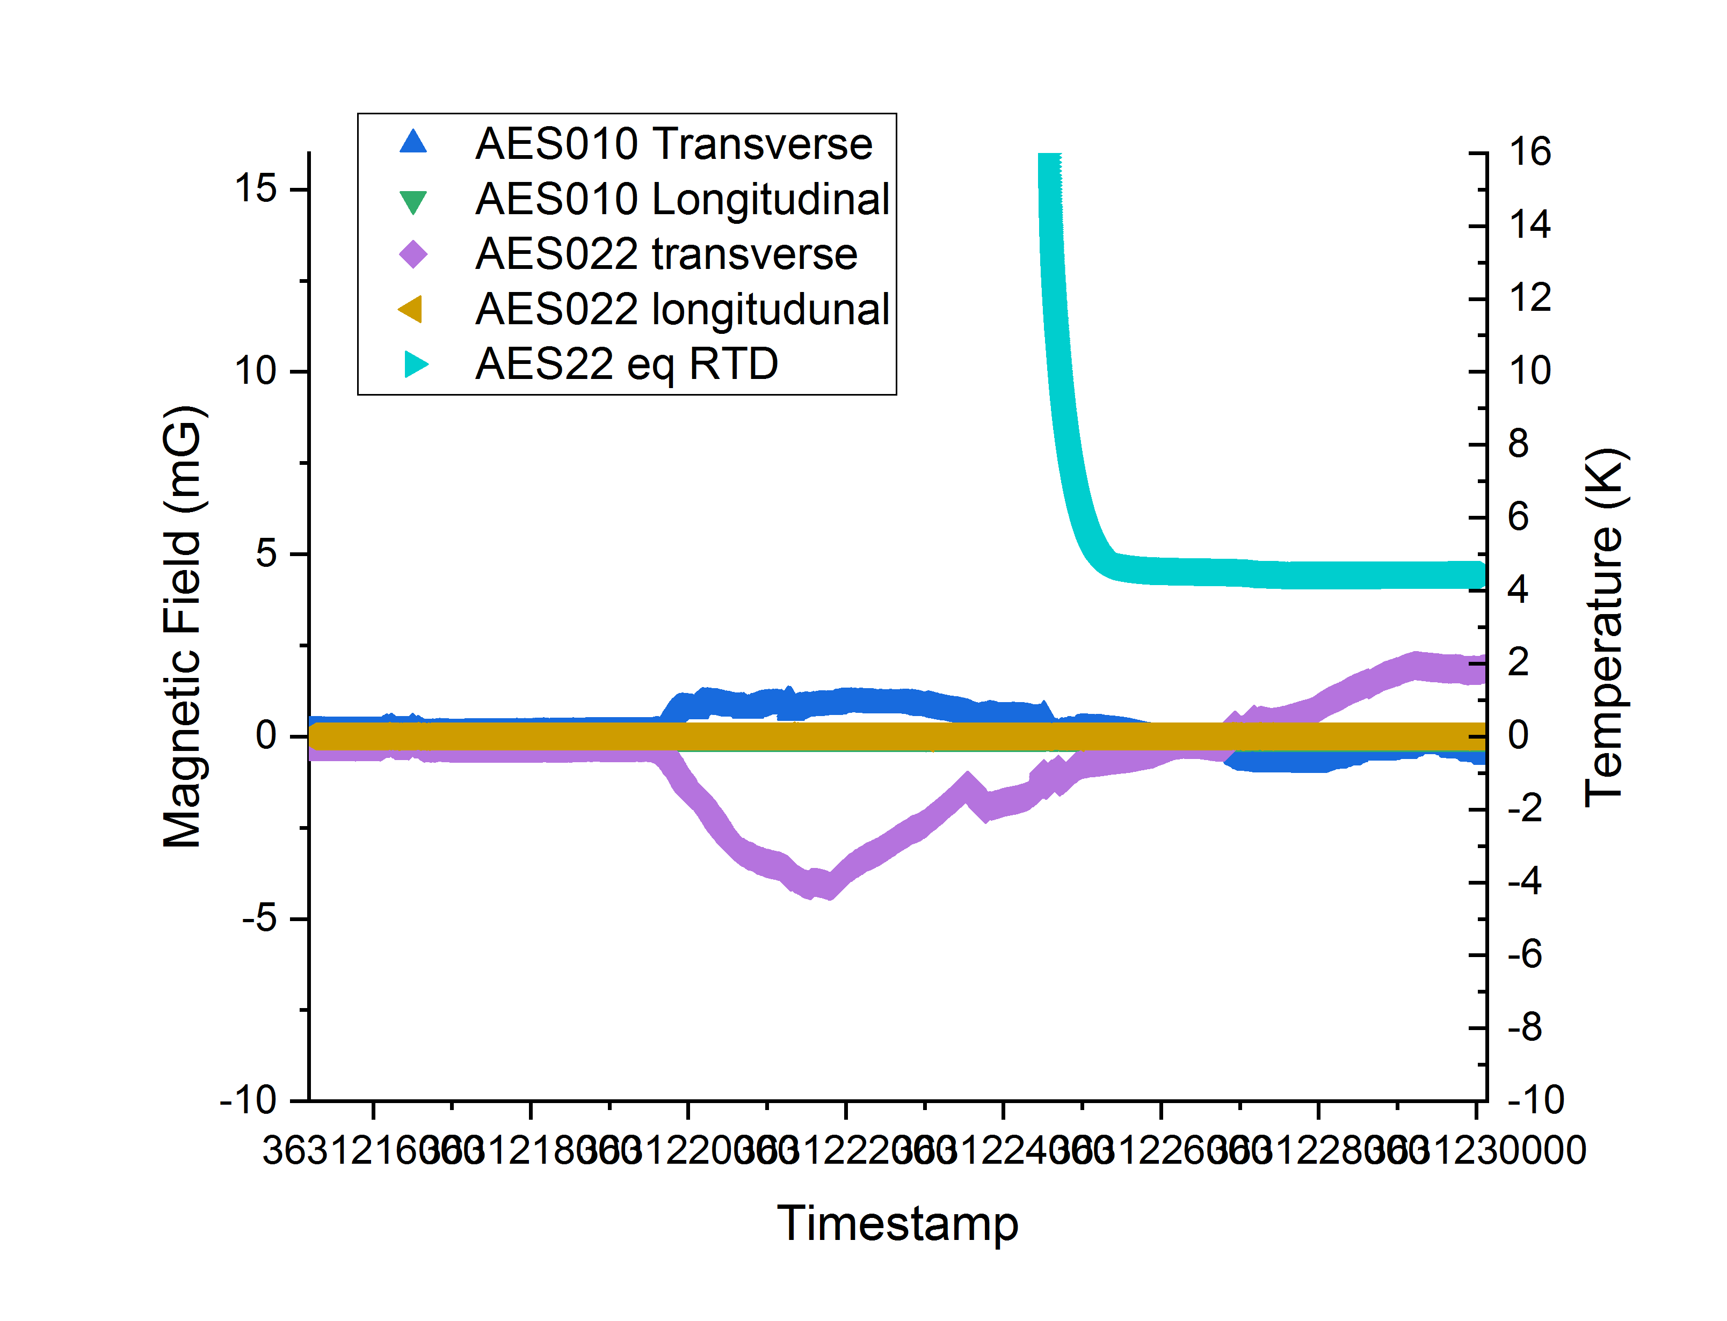
Flux Gates – AES010 + AES022
Cool From 294K
Cool From 345K
Upper performance for 120C
Lower performance branch for 120C

Slide 33
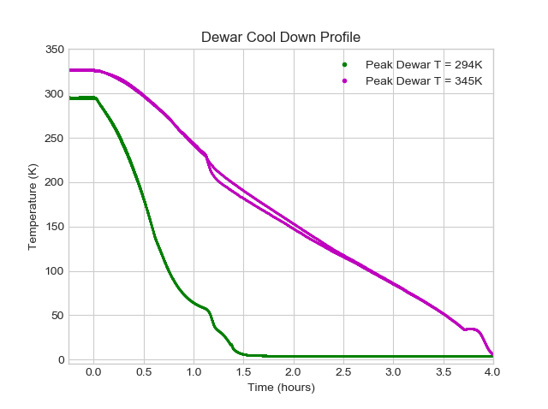
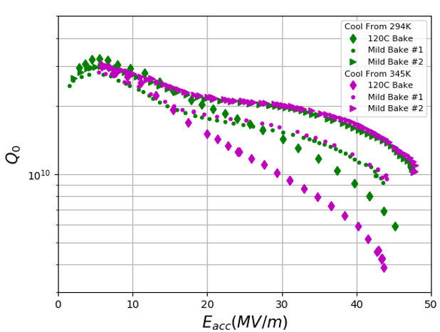
Comparison of Cavities Cooled Down from 294K vs 345K
QvsE
f=1.3GHz
T=2K

Slide 34
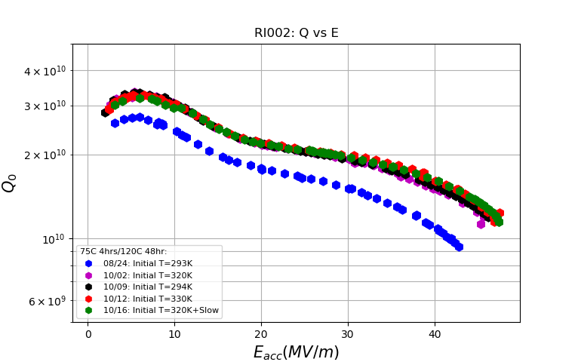
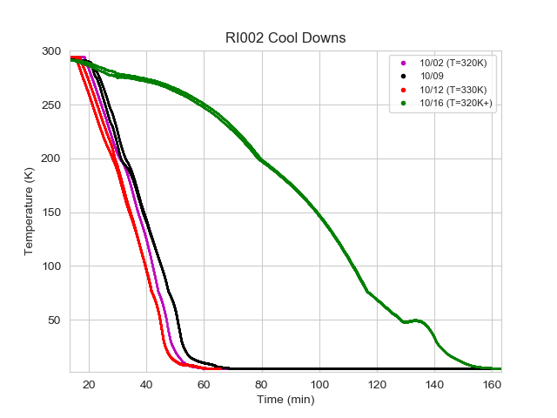
Effect of Cool Down on Performance: RI002
“Slow” Cool down
Upper branch obtained after cooling from 320K, could not recover lower branch

Slide 35
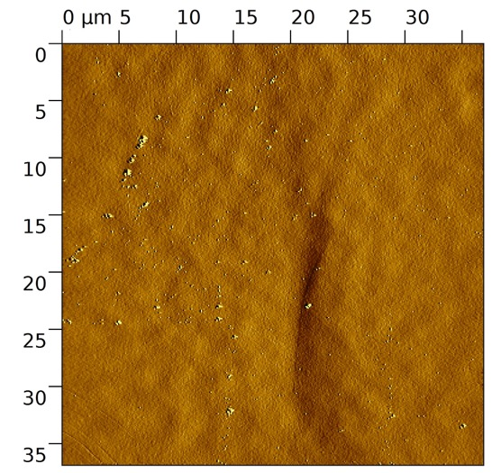
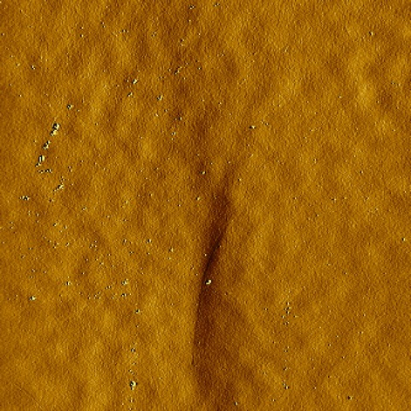
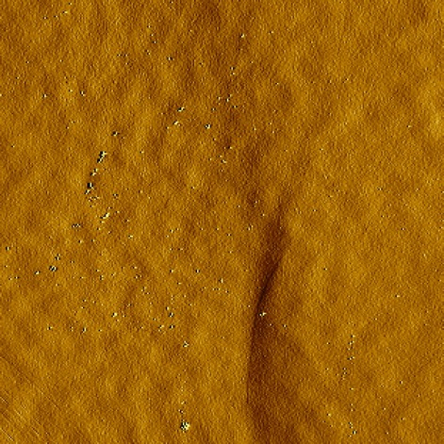
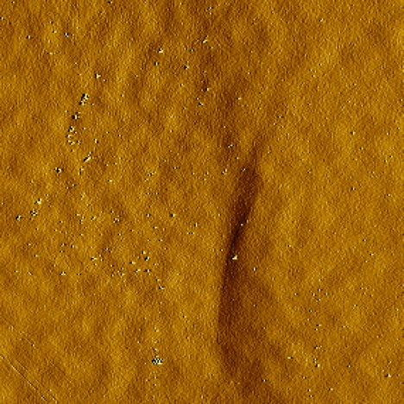
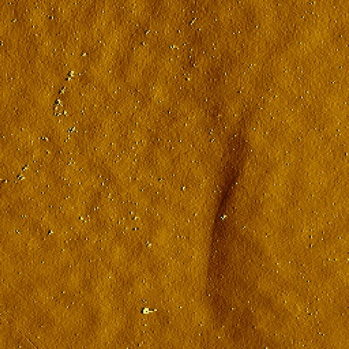
AFM Warm up Study by Zuhawn Sung
300K
320K
340K
360K
380K

Slide 36
Recovering Lower Performance Curve

Slide 37
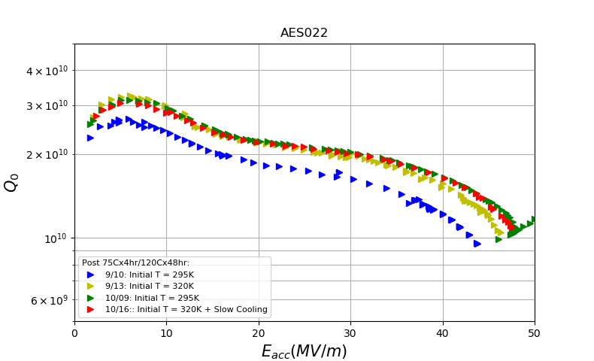
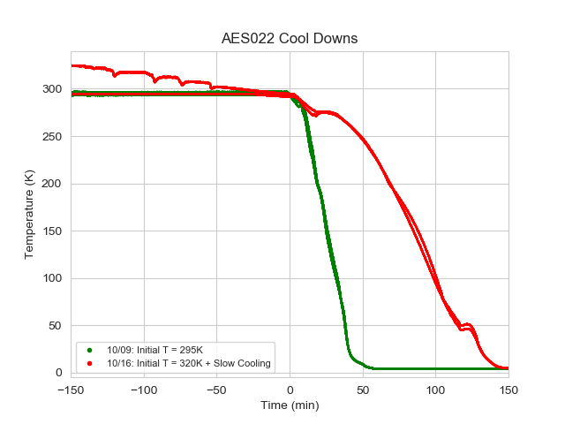
Recovering the Lower Performance Curve – AES022
“Slow” Cool down
Upper branch obtained by cooling from T=320K
Cooling from T₀=295K again does not recover lower branch
Slow cooling from T₀=320K also fails – cannot recover the lower curve

