Slide 1
LCLS-II Cryomodule Transportation Experience and Lessons Learned
Tom Peterson
LCLS-II Project, SLAC
6 Feb 2019
TTC Working Group 4

Slide 2
LCLS-II 1.3 CM Transport System
Feed Cap
Transportation Frame
1.3 GHz CM
End Cap
Beam

Slide 3
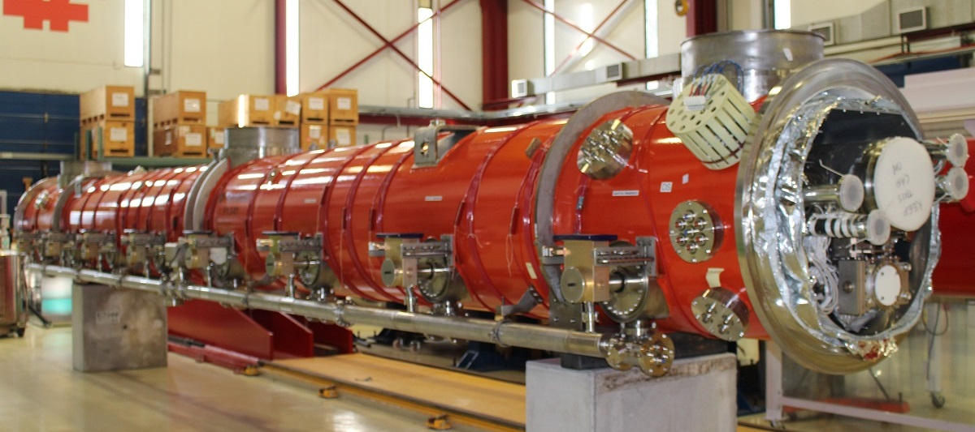
LCLS-II 1.3 GHz cryomodule – 8 superconducting niobium RF cavities, 12 meters long assembly

Slide 4
Transport System. DESY Feed Cap Sectional View
Shipping end cap supports 300 mm pipe with attachment to
vacuum vessel flange. Support is provided in all directions.

Slide 5
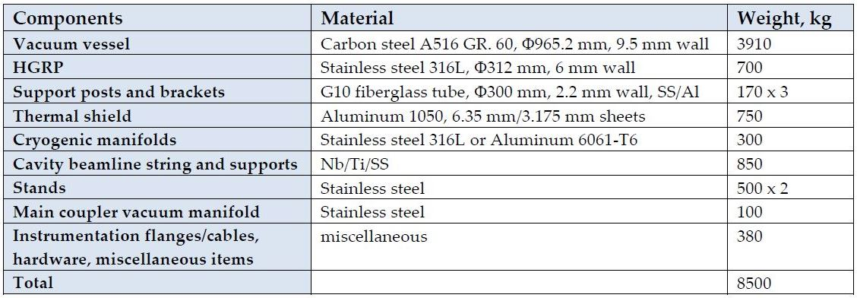
1.3 GHz Cryomodule Mass

Slide 6
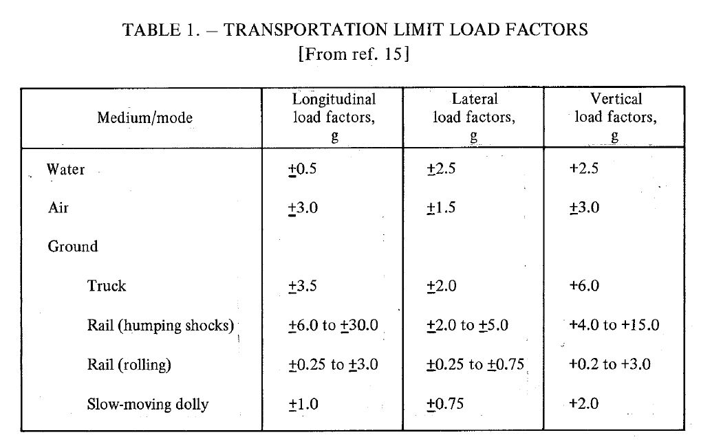
Transport Accelerations – Summary of NASA Study
“Structural Design Criteria Applicable to a Space Shuttle,”
NASA Space Vehicle Design Criteria (Structures), NASA SP-8057,1971.

Slide 7
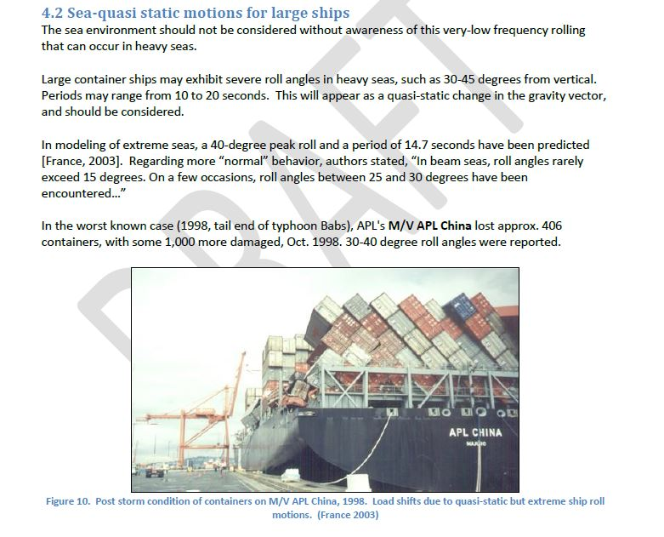
Sea transport – slow motion but large angles possible

Slide 8
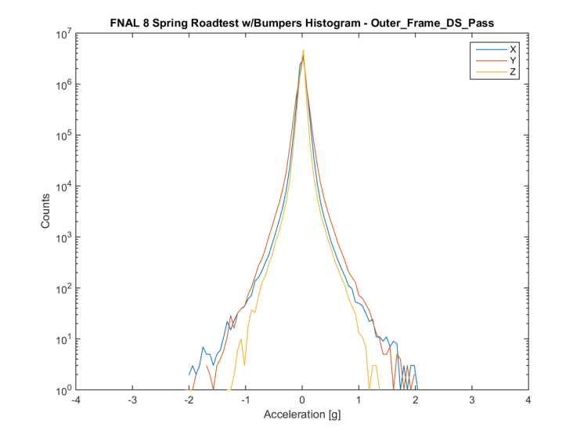
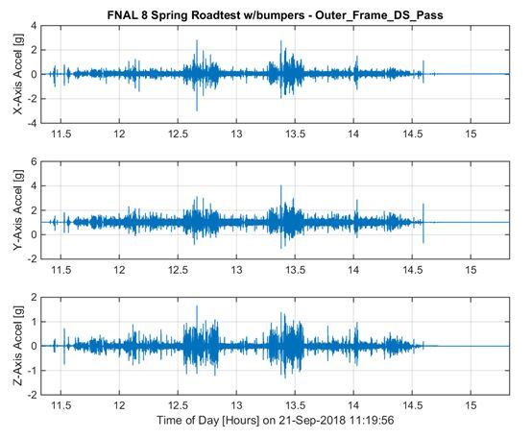
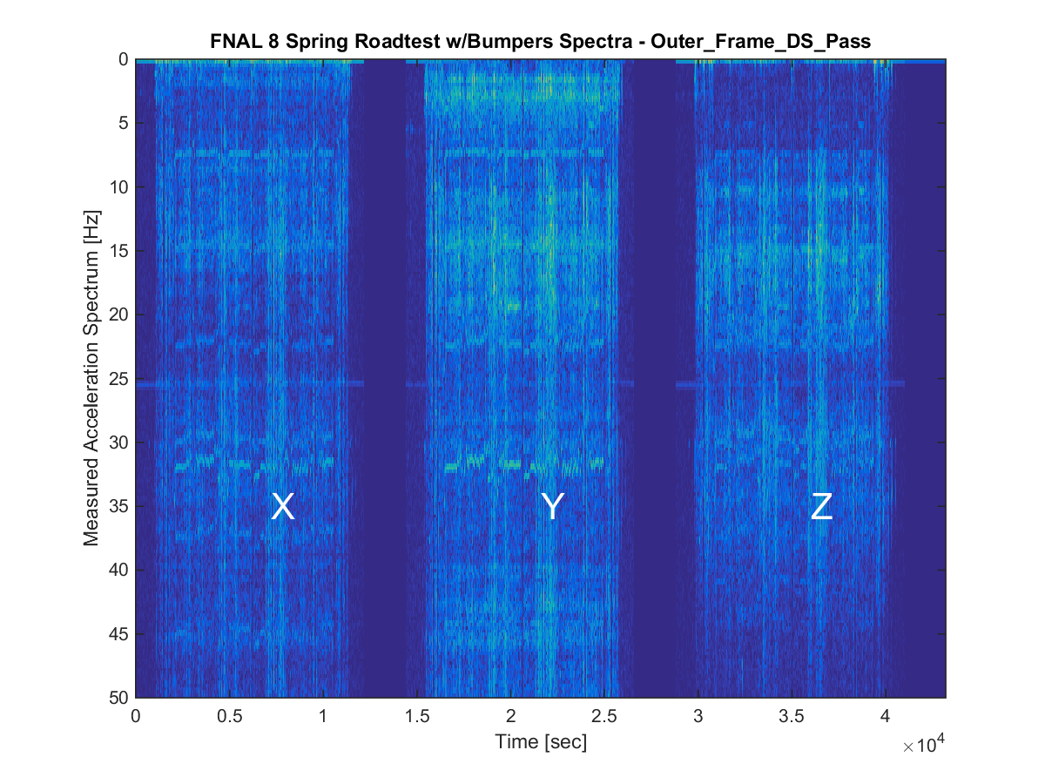
Acceleration vs Time – DS Outer Frame (Truck)

Slide 9
Our experience for truck transport with transport frame
X – horizontal side motion
Y – vertical
Z – horizontal travel direction
On the truck trailer bed with air-ride suspension
X < 2.5 g
Y < 2.5 g
Z < 1.5 g
At our cryomodule on the inner frame on springs
X < 1 g
Y < 1.5 g
Z < 1 g

Slide 10
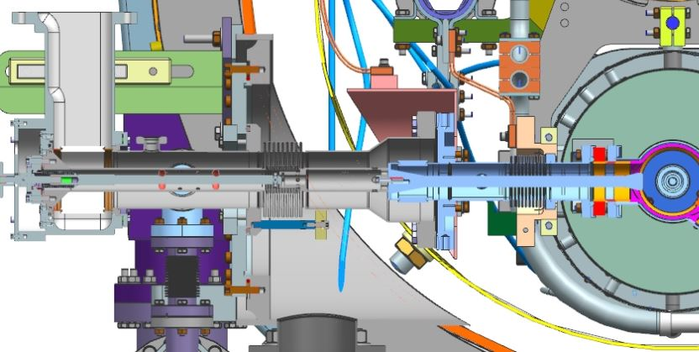
CAD model cross section at RF power coupler
Center part of coupler between bellows is free to oscillate front to back in this image, cryomodule axis direction. Relative motion of cavity string and coupler in X (cavity string swinging side-to-side in this image) is also taken mostly via the inner coupler bellows.

Slide 11
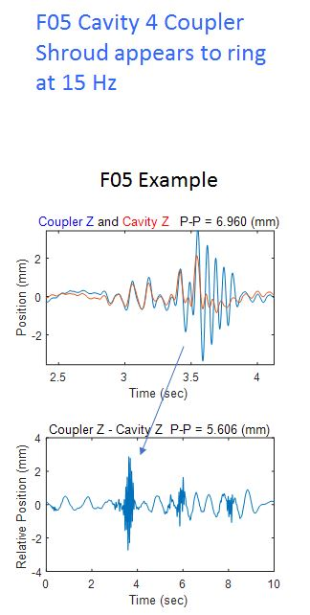
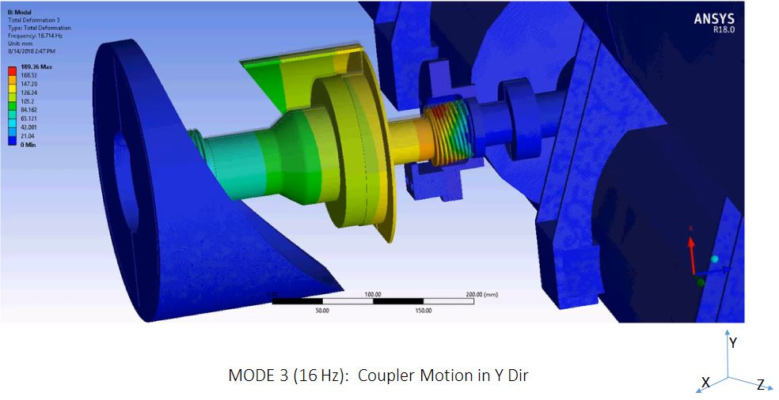
Coupler internal motion during shipping
Analysis predicts 16 Hz. During last road test,
we measured 15 Hz with amplitudes sufficient
to damage the bellows.

Slide 12
MODE 1 (12 Hz) :Rocking Mode in X-Dir
Y
X
Z

Slide 13
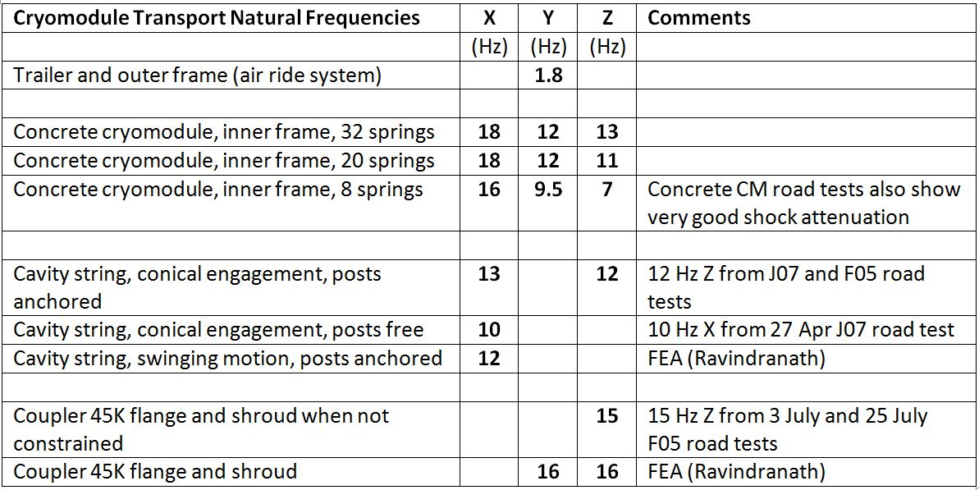
Many resonance frequencies in the 10 – 20 Hz range

Slide 14
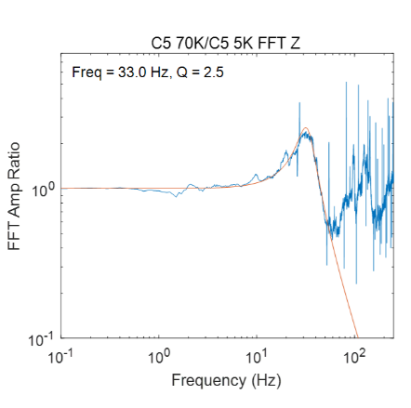
Key improvements in transportation system
Improved shipping frame spring configuration
Reconfigured CM isolation frame springs:
lowered frame Z motion resonance from 13 Hz to 7 Hz
Constrained bellows motion:
increased coupler Z motion resonance from 15 Hz to > 30 Hz

Slide 15
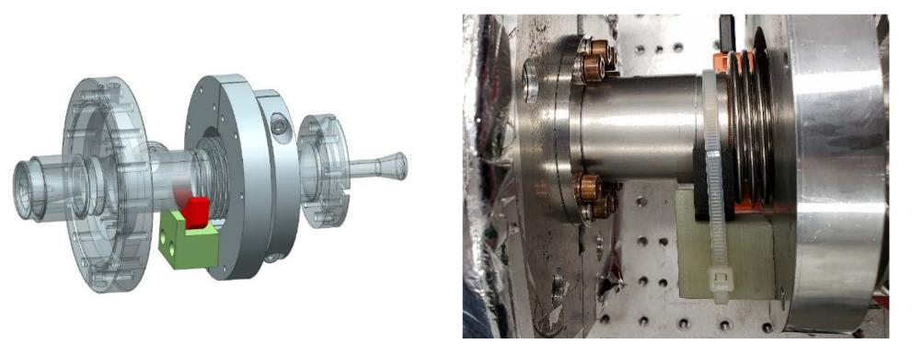
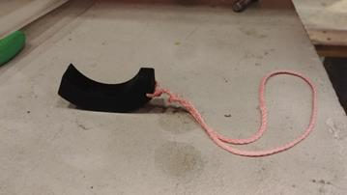
“M-mount” constraint of assembled coupler
Neoprene constraint sits on G-10
block, held with tie-wrap.
Limits Z (coupler lateral) motion
but permits axial movement.

Slide 16
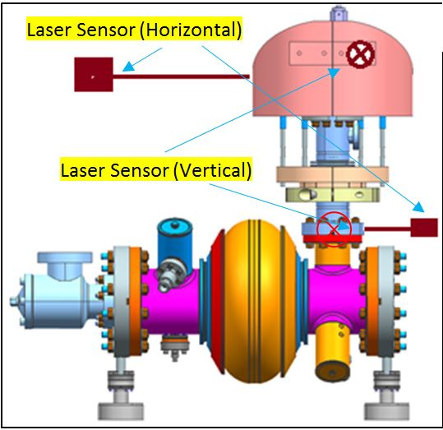
A cage of thin rods – another transport option (tested and proven OK but not presently in use)
Warm half of coupler removed, so disconnected from vacuum vessel.
Cold half constrained by a cage of thin rods.
This shipping method was verified with two short road tests, a 3000 mile
road test to JLab, and was our configuration for F07 delivery to SLAC.
Shake table test model

Slide 17
Lessons learned
Design for transportation
Seismic design is different – short duration.
Transportation may mean long periods of vibration with risk of fatigue failure.
Shipping after cold test may be different from shipping before cold test.
Thermal cycling can loosen fasteners in ways which room-temperature vibration does not, so the sequence of the two events (cold test and shipping) may make a difference.
Small differences in design and structure may provide dramatically different results.
Take time to reexamine key features even in a “copied” design.
Perform an in-depth review (not just PPT slides) of the design early during the project.
This review may take the form of a risk analysis or a Failure Mode and Effects analysis, a detailed look for failure modes.

Slide 18
Engage shipping professionals
Just a comment –
Our experience was that shipping professionals can provide very detailed, practical advice and experience regarding specific plans and modes of transport.

Slide 19
Acknowledgements
The partner labs and entire collaboration responded immediately and with continued intense, expert effort to bring us to our present understanding and set of solutions.
Thanks to people in the LCLS-II collaboration for slides, images, information and all the excellent work which I have only briefly summarized in this presentation.

Slide 20
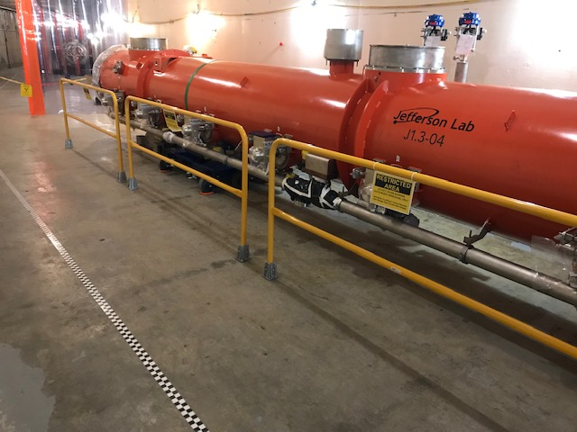
Sector 10 entrance
F07

Slide 21
Additional slides for reference

Slide 22
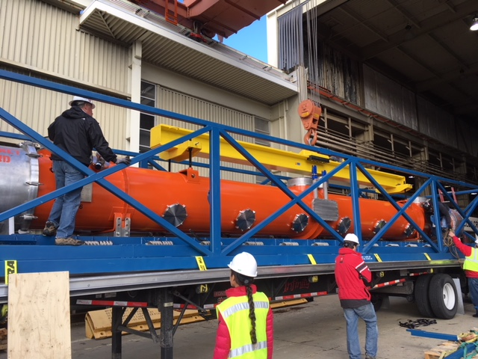
F1.3-06. First cryomodule shipped to SLAC. Arrival 19 Jan 2018

Slide 23
Some dimensions,
for reference

Slide 24
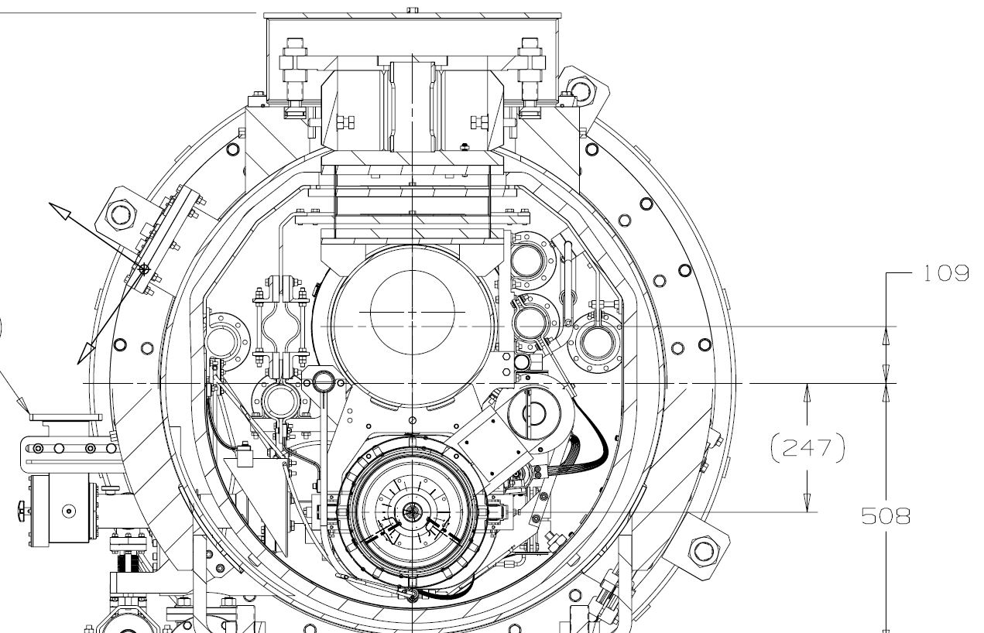
Cavity motion which could result from support motion
Cold mass is not
locked down at the
top. Rests here
on vertical
alignment
bolts.
Ratio of cavity motion
to support bolt lift is
about 1.6. Cavity
motion up at about a
17 degree (0.3 radian)
angle.
Motion in the direction shown would lift the G-10 support block into contact with the coupler.
~476 mm
~774 mm

Slide 25
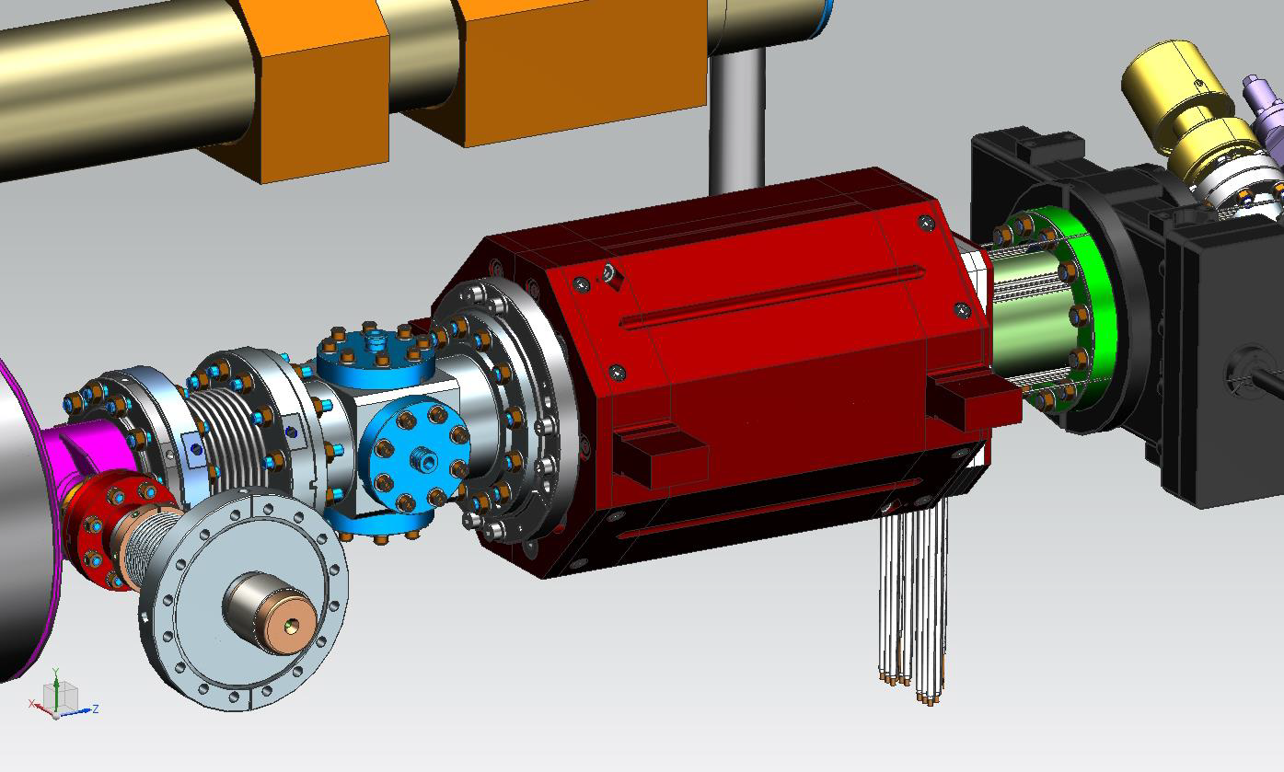
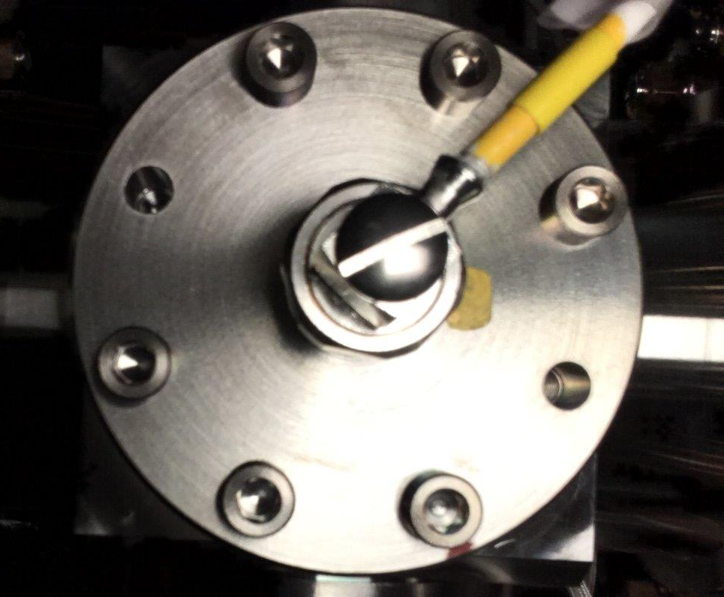
LCLS-II-4.5-ES-0403, Cold Button Beam Position Monitor

Slide 26
Project response to cryomodule fasteners issues
Various reviews provided recommendations which were used to establish conditions for production restart and actions to be taken at the partner labs
Repair of existing cryomodules including BPM seal bolt replacement
Resumption of production of new cryomodules
Study of vibration in transportation– possible adjustments for transportation frame
A spreadsheet was created listing all fasteners specifies methods for ensuring the quality of each joint. [ED0007530 -- 1.3 GHz Cryomodule Threaded Fasteners]
Conclusion at the end of this process: “The design is sound. We understand how to fix the beamline vacuum seal issue, tighten and replace loose fasteners, and ensure fastener integrity.”

Slide 27
The rough ride continued
F1.3-06 returned to Fermilab on April 8
On April 23 we learned that a leak check of the cavity string revealed leaks in addition to the likely BPM seal leaks.
Cracks were found in two bellows
Inner coupler bellows of cavities 4 and 5
Subsequent leak checking showed these to be the only leaks other than the BPM bottom flange where bolts had come loose.
We do not know whether bellows cracking occurred on the first trip (to SLAC) or on the return trip (to Fermilab).

Slide 28
Eu-XFEL road shock data were similar to ours
From Proceedings of LINAC2014, Geneva, Switzerland
XFEL Cryomodule Transport: From the Assembly Laboratory in CEA-Saclay (France) to the Test Hall in DESY-Hamburg (Germany), by S. Barbanotti, K. Jensch, W. Maschmann, O. Sawlanski, DESY, Hamburg, Germany
“From these results, the damping factor of the new frame looks satisfactory. Nevertheless, values higher than 1.5 g on the inner frame have to be accepted also with the new frame design.” (my emphasis)

Slide 29
F1.3-05 Shipping Test July 25, 2018, More Results

Slide 30
Summary for F1.3-05 road tests
F1.3-05 vacuum cavity loss during second road trip, July 25, 2018.
Total miles to failure ~ 200
Inner bellows for RF coupler at cavity 1 (inner bellows failed on F1.3-06 for couplers at cavities 4 and 5)
Shipping configuration was that agreed upon following the June 12 Transportation Review
Road shocks occasionally exceed the 1.5 g specification but are similar to those experienced by Eu-XFEL and within our expectations
This short road test was to measure displacements with better instrumentation
We were not ready to ship to SLAC
We thought this might be the final configuration for transportation to SLAC
But some additional data were needed
Vacuum loss was totally unexpected

Slide 31
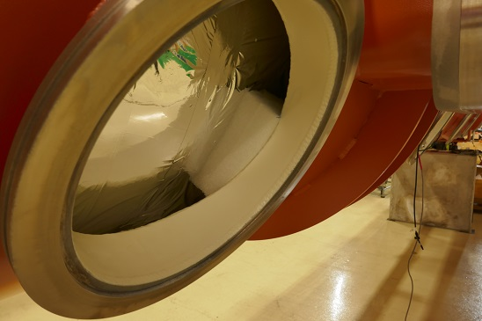
Foam blocks damp thermal shield swinging

Slide 32
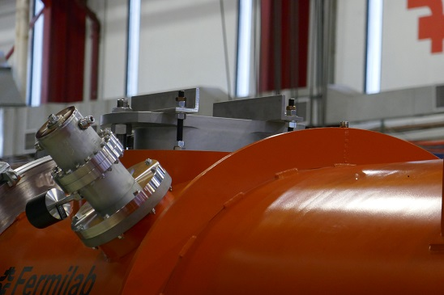
Upstream end post tie-down

Slide 33
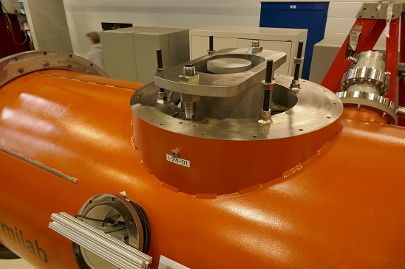
Upstream end post with tie-down removed

Slide 34
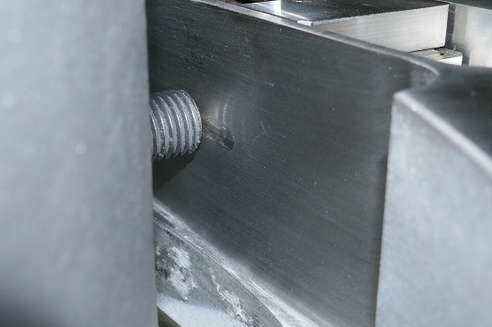
Upstream end post shows normal cool-down slide mark

Slide 35
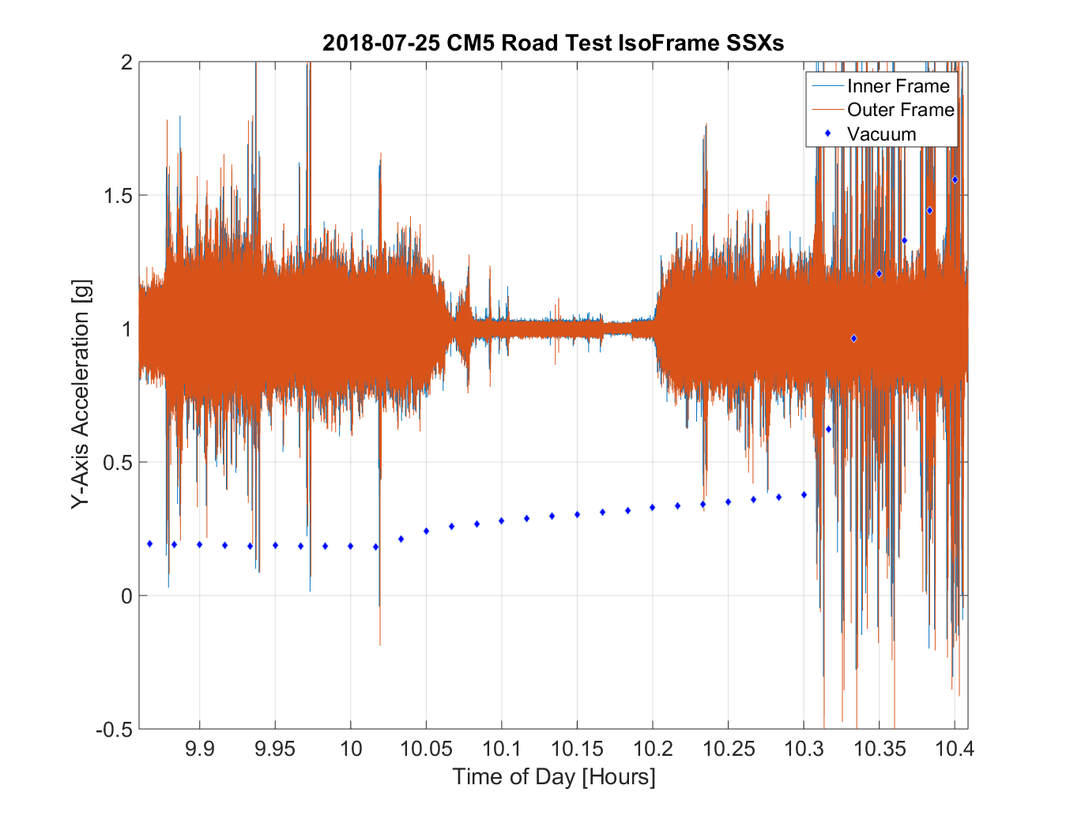
SSX-002
SSX-003
Slice 238.2
Slide Courtesy J Holzbauer

Slide 36
Technical Failure Analysis Logic Path

Slide 37
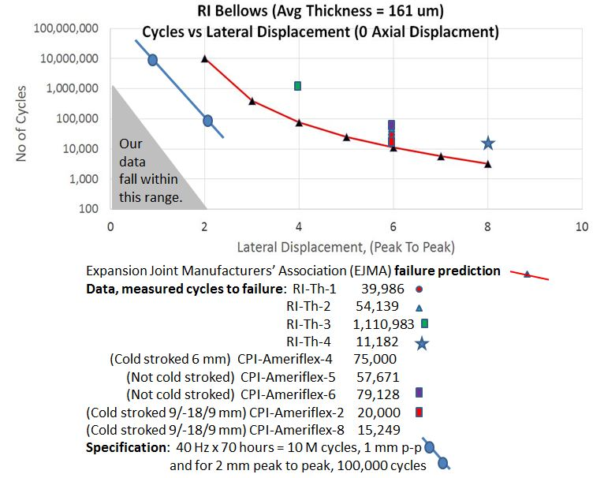
Bellows prediction, data, and specification
Note about the blue line specification:
Below 2 mm peak to peak lateral offset, bellows stress is below the fatigue limit for 316L stainless.
We selected a specification which sets the number of cycles at 2 mm peak to peak at no more than 100,000, two orders of magnitude below failure. We set the magnitude of high frequency cycles at 1 mm peak to peak, a factor of two below failure amplitude.

Slide 38
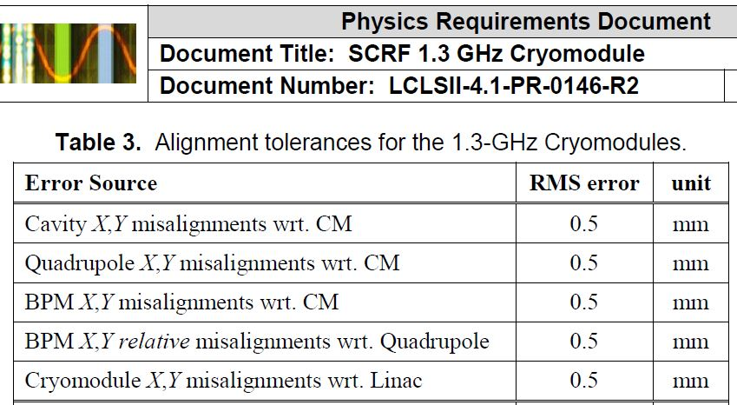
Alignment requirements
Cavity strings are aligned at the partner labs, and data referenced to vacuum vessel fiducials provide cavity positions with respect to the vacuum vessel. Tunnel alignment sets vacuum vessel position so as to place cavities, quad, and BPM on the beamline. Thus, offsets during shipping result in errors regarding our knowledge of cavity position and should be small, (e.g., tenths of a mm).

Slide 39
Present status at SLAC
Five cryomodules are at SLAC
In Sector 10 entrance and linac tunnel
Four are linac-ready; one is for practice and will be rebuilt
F1.3-07 (linac-ready cryomodule) arrived successfully at SLAC from Fermilab in November using the bolt cage solution for RF coupler support.
Couplers were reassembled by Fermilab personnel in December.
F1.3-05 (needs eventual rebuild) remains at SLAC for practice handling.
Traveled over 10,000 miles for various tests without losing cavity vacuum.
The last test and delivery from Jefferson Lab to SLAC utilized constraints (M-mounts and another design) of fully assembled couplers.
M-mount is our long-term solution.
J1.3-04 (linac-ready cryomodule) arrived at SLAC in December using M-mount constraints of fully assembled RF couplers.
F1.3-04 and J1.3-08 (linac-ready cryomodules) arrived at SLAC in January with our new transportation methods and procedures.
We have released SLAC Engineering Note LCLSII-4.5-EN-1370-R0, “F1.3-05 Study, Lines of Inquiry Conclusions and Responses”.
This summarizes the conclusions and project responses to the investigation of the cryomodule transportation issues.
We now have our cryomodule transportation solutions in place.

Slide 40
Next
One trailer and end caps returning from SLAC to Fermilab now.
The other trailer with end caps departs from SLAC to JLab on Monday.
Jlab personnel will be here next week for M-mount removal from F05 and J04 and associated training of SLAC personnel.
F-05 will be moved into CM15 slot (last of L2) where it will be mounted and aligned, followed by HPRF waveguide practice installations, cable dressing, and measurements for terminations.
F1.3-04 is being prepared for shipping from Fermilab with M-mounts.
Next cryomodules from Jefferson Lab and Fermilab will arrive at SLAC by late January. (Jan 22 and Jan 28)
We plan to bring another “practice” cryomodule (one which needs rebuilding) to SLAC, which combined with F05 will enable full practicing of interconnect assembly in the tunnel.
Fermilab and Jefferson Lab have a total of 7 cryomodules now which are ready to send for linac installation.
We expect to begin receiving one cryomodule every few weeks starting in February.

