Slide 1
T-mapping, B-measurements and Vertical Diagnostics at Cornell
Ryan Porter
Cornell University
Supported by:
U.S. DOE award DE-SC0008431.

Slide 2
Outline
Vertical test diagnostic
Setup
Analysis
Temperature mapping
Flux Trapping Measurements
Experimental setup
Comparison with other labs
Electromagnetic simulations

Slide 3
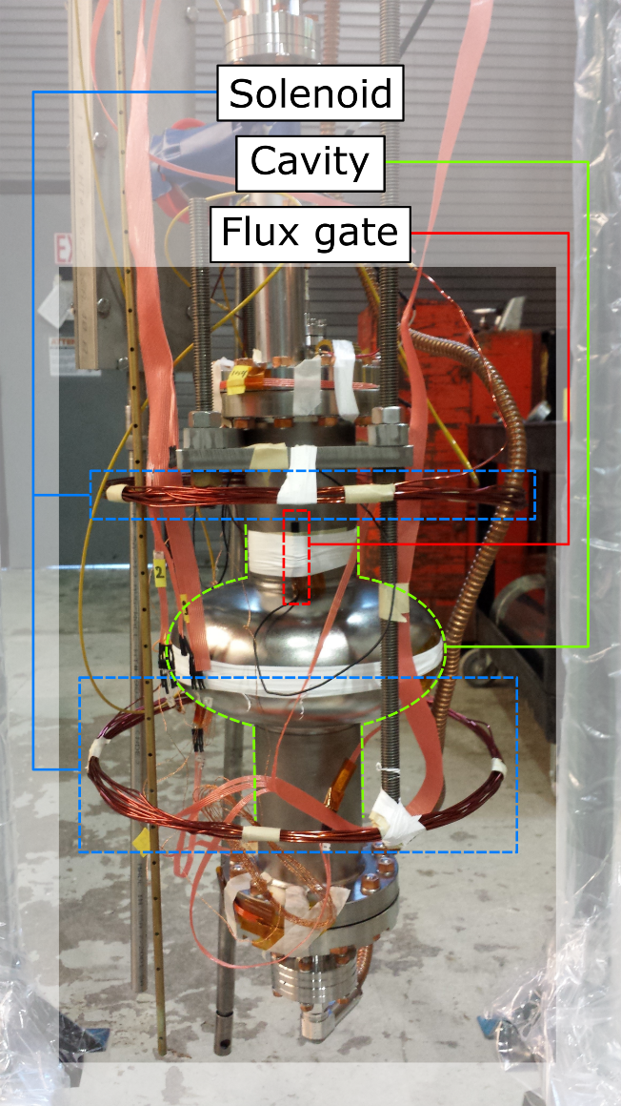
Experimental setup
Cernox Temperature Sensors
Flux Gates
Helmholtz Coil
3 Cernox sensor
Bartington Flux Gates (Mag-01H type F)
Historically:
Always one of top iris
Sometimes another on equator
Helmholtz coil

Slide 4
Phase Locked-Loop
Diagram take from: D. L. Hall, “New Insights into the Limitations on the Efficiency and Achievable Gradients in Nb3Sn SRF Cavities,” Ph.D. Dissertation, Cornell University, 2017
B
F

Slide 5
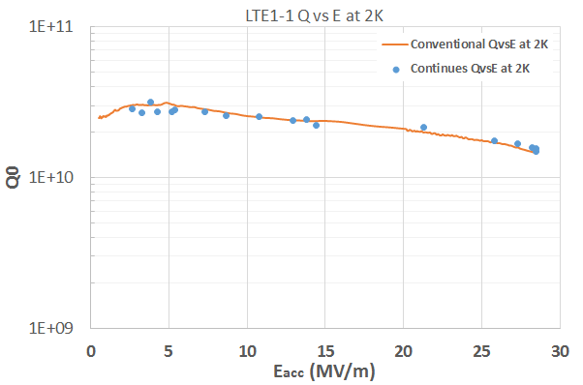
Measurement Techniques
Quality factor
Use decay curve method
Use decay constant near peak field to calculate Q
Analyze entire decay curve to find Q from peak E_{acc} to low field
Allows to measure Q vs E at many temperatures during cooldown
Confirm by measuring Q vs E using only peak field at some temperatures
$$Q_{0}=2πf_{0}τ_{L}(1+β)$$
f vs T
Measure frequency of cavity vs temperature
Remove effects from pressure
Acquire change in penetration depth by fitting

Slide 6
Coupling Calculation
Use average of two coupling calculation
Measure P_{f} and P_{r} with power on then P_{e} (emitted power from cavity) immediately after turning off power to the cavity.
Beta is calculated from P_{e} and P_{f}:
$β_{e}=\frac{1}{2\sqrt{\frac{P_{f}}{P_{e}}}−1}$
Beta is calculated from ratio of P_{f} and P_{r}
$β_{r}=\frac{1±\sqrt{\frac{P_{r}}{P_{f}}}}{1∓\sqrt{\frac{P_{r}}{P_{f}}}}$
Where + is chosen if P_{f} < P_{e} and – is chosen if P_{f} > P_{e}
Only accept measurement if the two couplings are close in value

Slide 7
Temperature Mapping at Cornell

Slide 8
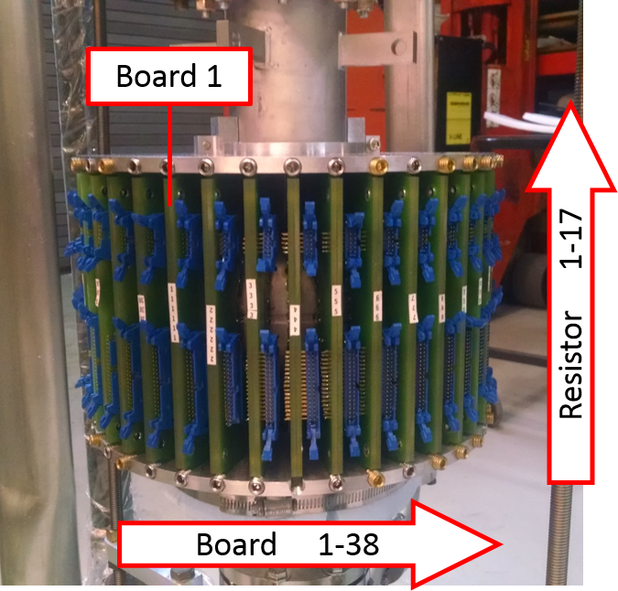
Temperature mapping
646 sensors on cavity + 4 LHe bath sensors
~1.7 cm between sensors on equator and flats of cavity
16 bit ADC at 24 kHz
Multiplexed
Typically average 1000 measurements for each resistor in T-map
Takes several seconds to read entire board
Can also measure a single sensor at 24 kHz
T-Map board

Slide 9
Temperature mapping
Allen-Bradley carbon resistors
Bad resistor = good thermometer
Resistors embedded in stycast to shield from LHe bath
Shielding on resistor removed to allow direct contact to cavity wall
Springed “pogo” sticks keep sensor in contact with cavity surface
Silicon grease applied to sensor as a thermal paste
Niobium surface
T-Map sensor
Thermal paste
Connector leads
Pogo stick
Carbon resistor
T-Map sensor head

Slide 10
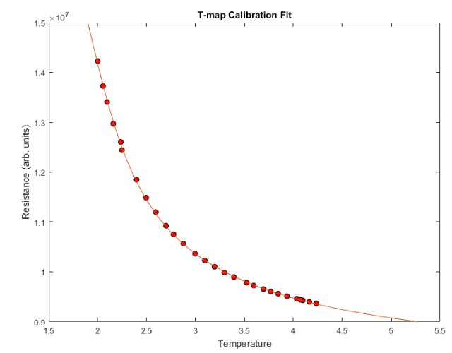
Calibrating T-Map
Measure resistance by applying constant current source and measuring voltage drop
Allen-Bradley resistors ~30 Ω/mK
Need calibrating
Calibrate while cooling below 4.2 K using Cernox sensors
Fit a 4th order polynomial to T⁻¹ vs ln(R)
Can get 1 mK resolution (after averaging)

Slide 11
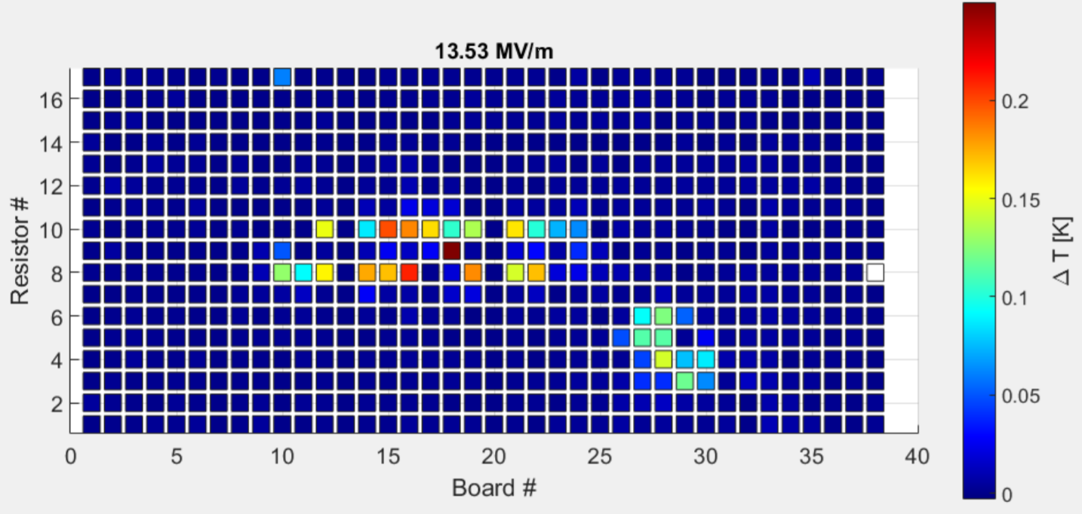
Example Temperature Map
Temperature map of a Nb cavity at Cornell
ΔT = T_{RF-on} - T_{RF-off}
Use bath resistors to account for LHe bath T drift

Slide 12
Flux Trapping Measurements at Cornell

Slide 13
Experimental setup
Cernox Temperature Sensors
Flux Gate on top iris
Helmholtz Coil
Cooldown in applied field, then turn off Helmholtz coil
B_{trapped} = B_{left} - B_{amb}

Slide 14
Three Methods
Shichun Huang(IMP,CAS), Rongli Geng(JLAB), “Can Present Techniques for Cavity Flux Expulsion Efficacy Measurements be Unified?”, TTC 2018 CERN, Nov 2018
Method adopted at JLAB[1]
$$B_{trap}=(1−ε_{Eq})×B_{a}$$
$$ε_{eq}=\frac{B_{SC,Eq}−B_{NC,Eq}}{B_{SC,Eq}^{(0)}−B_{NC,Eq}}=\frac{\frac{B_{SC,Eq}}{B_{NC,Eq}}−1}{\frac{B_{SC,Eq}^{(0)}}{B_{NC,Eq}}−1}$$
Method adopted at FNAL[2]
$$B_{trap}=B_{NC}\left(1−\frac{\frac{B_{SC,eq}}{B_{NC,eq}}−1}{R_{PD}−1}\right)$$
Method adopted at Cornell[3]
$$B_{trapped}=B_{left}−B_{amb}$$
Method J
Method F
Numerically Calculated Ratio
Modeling perfect dia-gmagnetism
R_{PD} = 1.7 for 1-cell TESLA end cell shape
Varies with cavity geometry
Method C
[1]. S. Huang, Takayuki Kubo, and R.L. Geng, Phys, Rev. ST Accel. Beams 19, 082001(2016).
[2]. M. Martinello et al., in Proceedings of SRF2015, Whistler, BC, Canada, MOPB015.
[3]. D. Gonnella, J. Kaufman, and M. Liepe, J. Appl. Phys119, 073904 (2016).
4

Slide 15
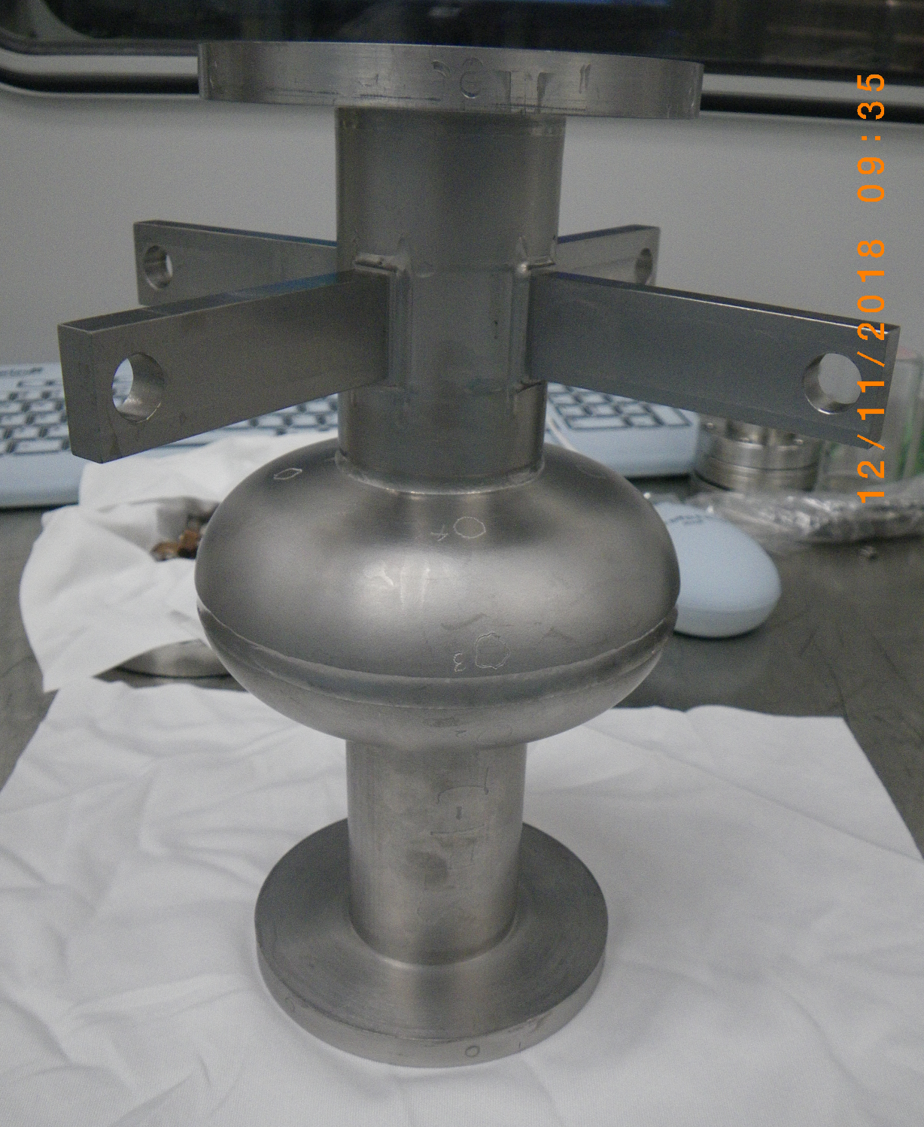
Flux Trapping Experiment on STE1-2
Was preparing to test STE1-2
2.6 GHz Nb₃Sn cavity
Will present results on Thursday!
Opportunity to compare flux trapping techniques!
Compare techniques all in one test with top iris, bottom iris, and equator flux gates
Cornell:
Cooldown, measure top iris
Jlab:
Cooldown, measure equator
Cooldown in “zero” (ambient field) then turn on Helmholtz coil to same current
Fermi Lab*:
Cooldown, measure equator
*Calculate/simulate new R_{PD} number for specific geometry
Note: cooldown rate 1 K/10 min

Slide 16
Flux Trapping Experiment on STE1-2
STE1-2 looks like it is near 100% trapping
For 106 mG applied field change in field through transition/transitions is 1 mG or less.
After cooldown with Helmholtz coil off flux top iris fluxgate read 46.3 mG
Much less than 106 mG!
Historic Cornell method under estimates trapped flux
“Real” | JLab | Fermi | Cornell
106 mG | 106 mG | 106 mG | 46.3 mG

Slide 17
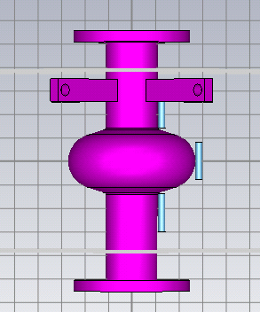
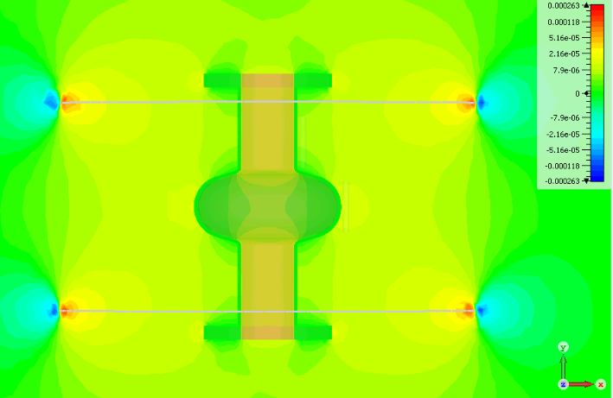
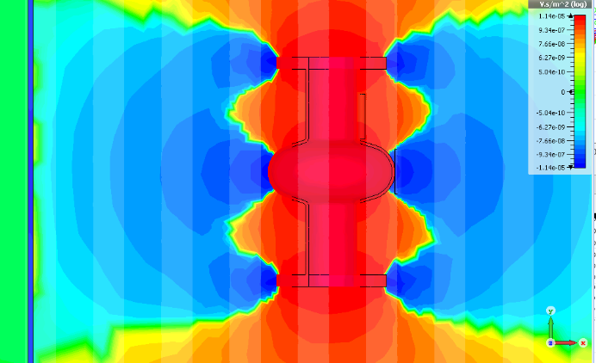
Simulations
Simulated STE1-2 flux trapping/expulsion
Model in CST Studio with very small µ_{r} (0.0000001) (near perfect diamagnet)
Complete Expulsion of 106 mG
106 mG trapped, no Helmholtz coil
Assumption Field trapped perfectly vertical
Average B-field over active region of flux gate
100% Expelling (cooled in 100 mG)
y-component B-field
100 mG trapped
y-component B-field

Slide 18
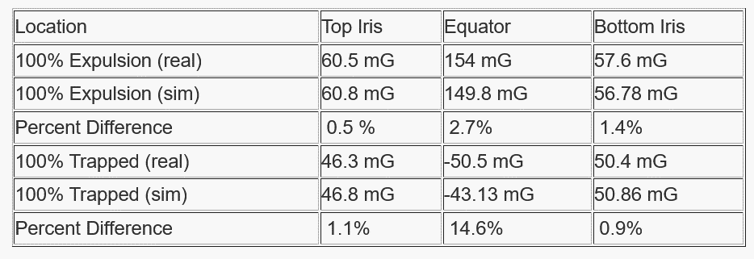
Simulation Results
Simulation results for 106 mG applied/trapped
Within 15% for all measurements!
‘Tabs’ are important in simulation (for 2.6 GHz)!

Slide 19
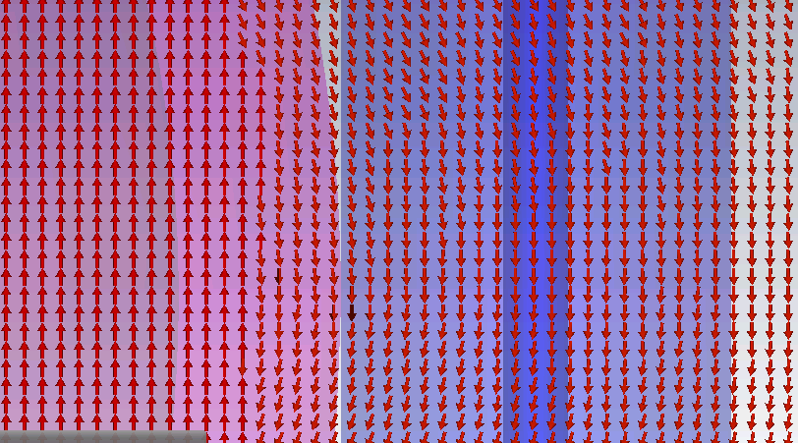
Equator is bad… Why!?
Simulation not entirely getting correct fields inside walls. Field switches from 100 mG at halfway point of wall (1.25 mm/2.5 mm)
High density mesh or smaller µ_{r} does not help
Problem with program for this application?
Magnetic field incorrect through half of wall

Slide 20
LTE – 1.3 GHz Tesla Style Cavities
Have conducted simulations of LTE (1.3 GHz) flux trapping
The cavity simulations find top iris fluxgate measures 58.0% of ‘actual’ trapped flux
Previous data could be corrected using simulation results
Need to confirm flux trapping simulations with experiments

Slide 21
Flux Trapping Sim Conclusions
Cornell’s historic iris measurements trapped flux have underestimated trapped magnetic fields
Cornell measurements have overestimated flux trapping sensitivity
Some improvement needed in flux trapping simulations
B-field changing in walls
For STE (2.6 GHz) cavity top iris measures only 43.7% of ‘actual’ trapped flux
For LTE (1.3 GHz) cavity simulations find top iris fluxgate measures 58.0% of ‘actual’ trapped flux
Need to do 1.3 GHz flux trapping experiments to confirm simulations

Slide 22
Further Questions
Flux trapping measurements assume trapped flux is oriented with the applied field. If trapped flux moves during partial expulsion, how much does this impact measurements? T-maps imply that the flux distribution is not uniform.
How does the orientation of trapped flux w.r.t. the RF surface impact losses? And sensitivity measurements?

Slide 23
Back up

Slide 24
Continuous Q vs E
For continuous Q vs E the entire decay curve is used
The conventional decay curve Q vs E point is found
This first point is used to determine Q_{e}
This allows a continuous Q₀ to be calculated as:
$Q_{0}\left(t\right)=2πf_{0}{\left(\frac{1}{\frac{d }{dt}lnP_{e}(t)}−\frac{2πf_{0}}{Q_{e}}\right)}^{−1}$
E_{acc} as a function of time is:
$E_{acc}\left(t\right)=\sqrt{\frac{P_{r}\left(t\right)Q_{e}}{2πf_{0}}}$

