Slide 1
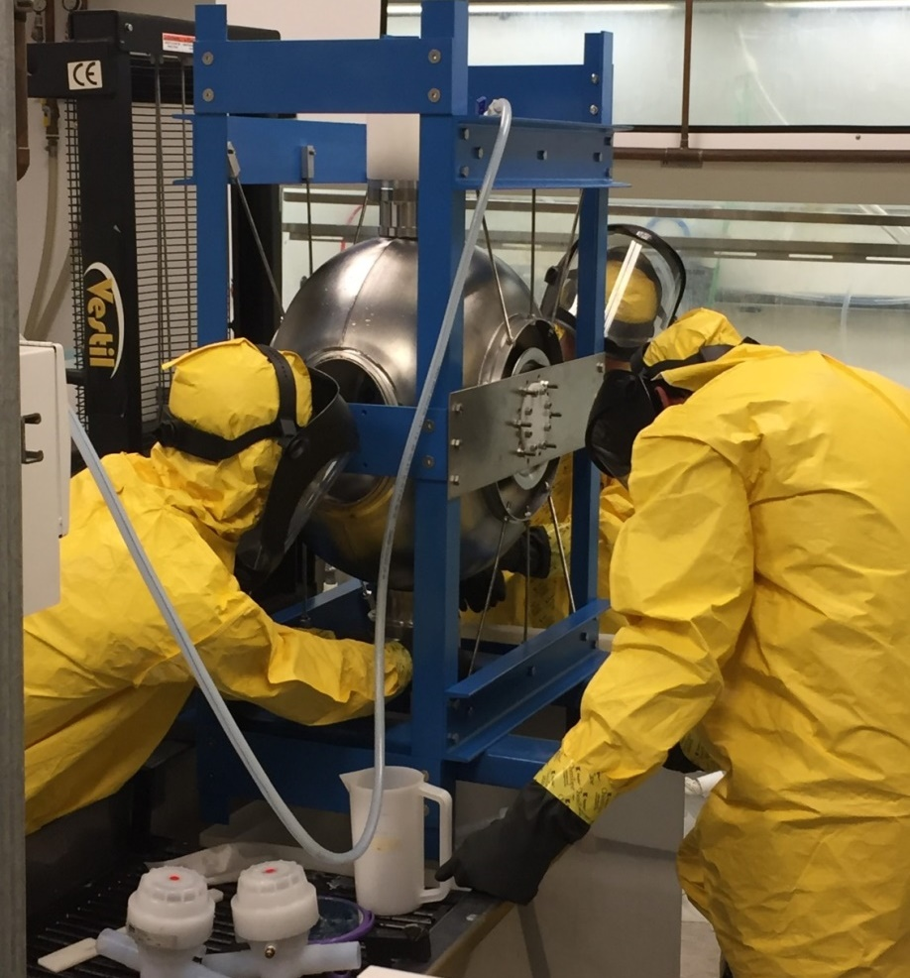
CB Report
Hans Weise, DESY
February 5th, 2019
Notes:
How to edit the title slide
Upper area: Title of your talk, max. 2 rows of the defined size (55 pt)
Lower area (subtitle): Conference/meeting/workshop, location, date, your name and affiliation, max. 4 rows of the defined size (32 pt)
Change the partner logos or add others in the last row.

Slide 2
The mission of the TESLA Technology Collaboration
The mission of the TESLA Technology Collaboration is
to advance SRF technology R&D and related accelerator studies across the broad diversity of scientific applications, and
to keep open and provide a bridge for communication and sharing of ideas, developments, and testing across associated projects.
To this end the Collaboration supports and encourages free and open exchange of scientific and technical knowledge, expertise, engineering designs, and equipment.
The TTC organizes regular collaboration meetings where new developments are reported, recent findings are discussed and technical issues are concluded. This time, TTC meeting is hosted by TRIUMF on 05-08 February 2019.

Slide 3
Agenda
We approved the minutes of the RIKEN CB meeting.
Short reports/discussion on TTC WGs and topical meetings
Report from Charlie Reece: TTC High Qo Working Group; new WG lead…
Our TTC meeting schedule included
Summary of Recent Progress in High Q and High Gradient Research
Report from the Second Topical Workshop on Microphonics, LLRF Workshop Series, Brooklyn, NY, October 25-26, 2018
Report from the 8th International Workshop on Thin Films and New Ideas for Pushing the Limits of RF Superconductivity, INFN/Legnaro, October 8-10, 2018
Report from the TTC/ARIES topical workshop on flux trapping and magnetic shielding, CERN, November 8-9, 2018
We agreed that a permanent link to the respective web sites should be created on the TTTC page. This creates visibility and allows easier access. The presentations at the TTC meeting can be used as summary.
We agreed to continue promoting topical workshops. Since we are not the organizers, we can only recommend careful scheduling.

Slide 4
Agenda
There is more to be added to the TTC web page…
WG info incl. charter
Links to the TTC members’ SRF pages
Renewal of the Technical Board membership.
See TB Report
This time there was no application for new TTC Membership
There will be no second TTC meeting in 2019. We all see us at the SRF Conference in Dresden http://srf2019.org/ .
But we discussed location and timing of next the TTC meeting to be organized around February 2020. CERN offered to host us, very likely in the week starting February 3rd; after the Chinese New Year….
After some discussion we agreed that the selection of future hosts should consider unrestricted access for all TTC members.
AOB

Slide 5
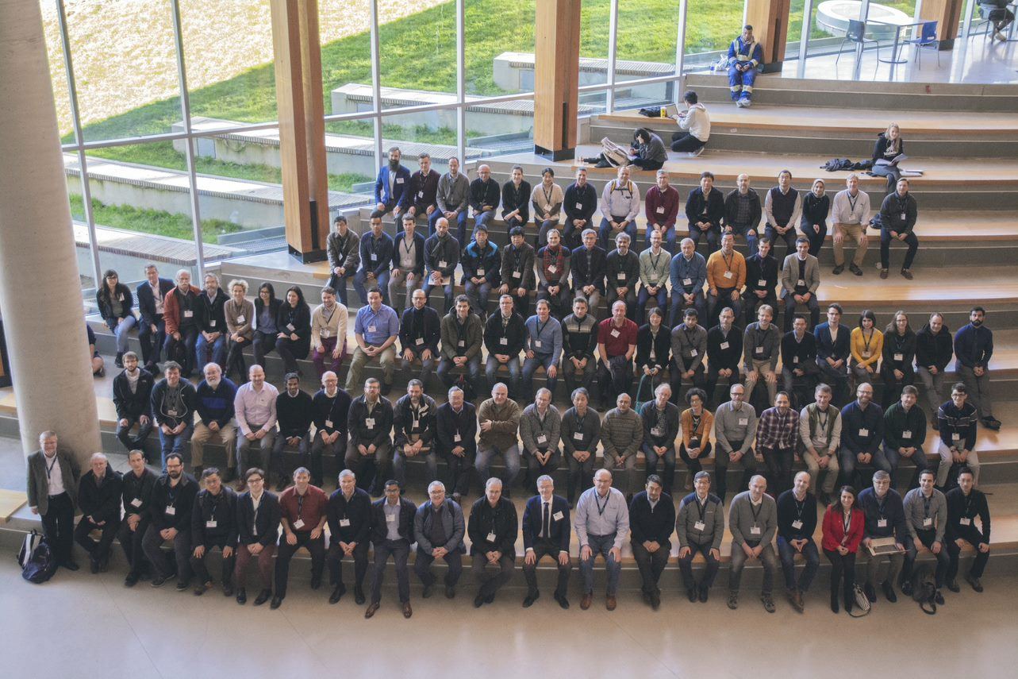
We had a great meeting!
A large variety of topics
Very detailed presentations with lots of new results and material to discuss
Perfect meeting organization!!!
The team chaired by Bob did an excellent job!
The PC, under Eiji / Wolf-Dietrich, with all it’s WG chairs, did a great job in assembling the sessions
Therefore: Let us continue…
advancing SRF technology R&D and related accelerator studies across the broad diversity of scientific applications, and
to keep open and provide a bridge for communication and sharing of ideas, developments, and testing across associated projects.

