Slide 1
Tests on Chess 2 ASIC
Yubo Han_{IHEP} , Dionisio Doering, Pietro Caragiulo, Larry Ruckman, Camillo Tamma, Su Dong

Slide 2
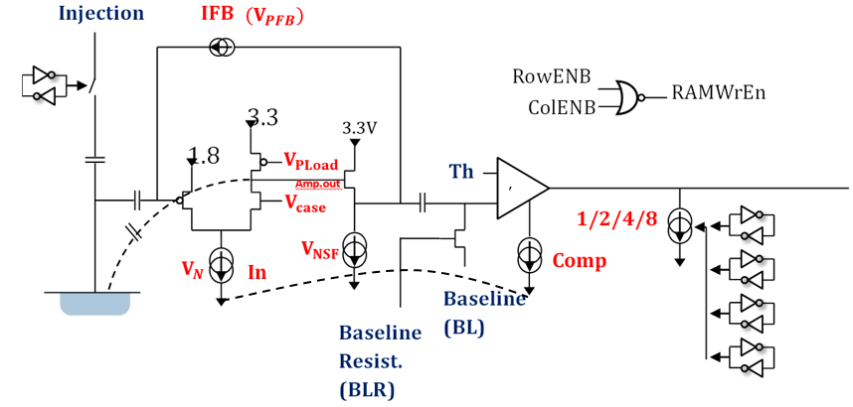
Pixel description

Slide 3
Outline
Last time: Difficult finding the signal with stream readout
Simulation
  Different current source
The laser performance (tested by Photodiode)
  Red, IR with red component, IR
Improved test and the results

Slide 4
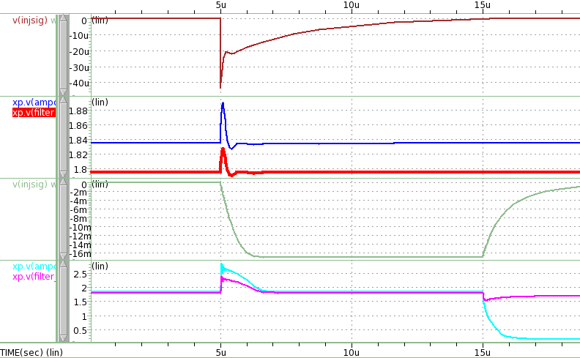
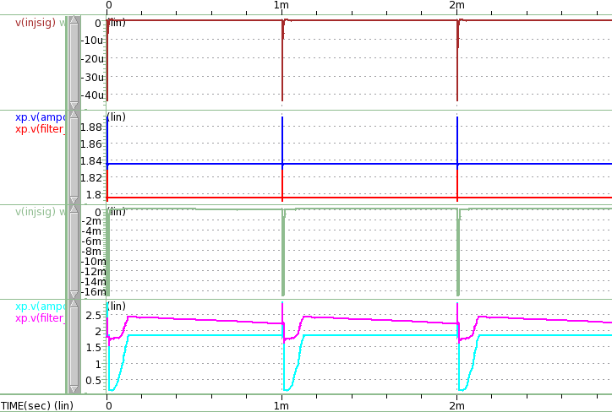
Simulation results
Current source to the Nwell:
Definition:
i18 nwell 0 PULSE 0 cur t1 t2 t3 t4 t5
Cur=112n [A]
Delay time[s]
Onset ramp[s]
Recovery ramp[s]
Pulse width[s]
Repetition period[s]
Width of the pulse
0 cur 5e-6 1e-9 1e-9 0 1000e-6
0 cur 5e-6 1e-9 1e-9 10e-6 1000e-6
Width of the signal will cause very long recovery time.

Slide 5
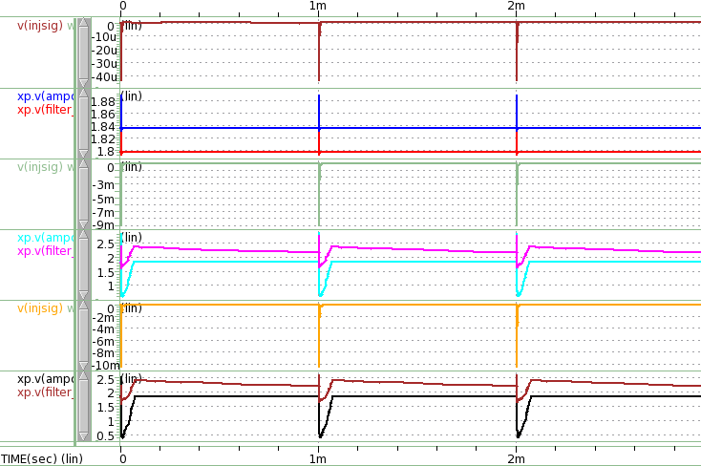
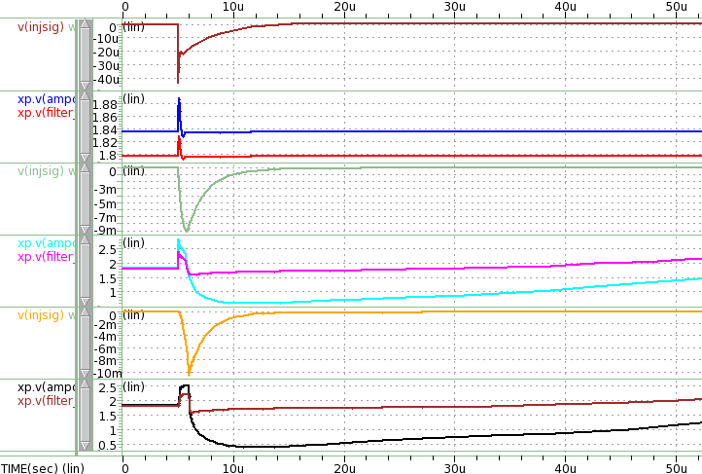
Simulation results
Current source to the Nwell:
Definition:
i18 nwell 0 PULSE 0 cur t1 t2 t3 t4 t5
Cur=112n [A]
Delay time[s]
Onset ramp[s]
Recovery ramp[s]
Pulse width[s]
Repetition period[s]
Ramp time
0 cur 5e-6 1e-9 1e-9 0 1000e-6
0 cur 5e-6 1e-9 1e-6 0 1000e-6
0 cur 5e-6 1e-6 1e-9 0 1000e-6
Slow raising/decreasing time will also cause lone recovery time
-> ideal signal: very fast pulse

Slide 6
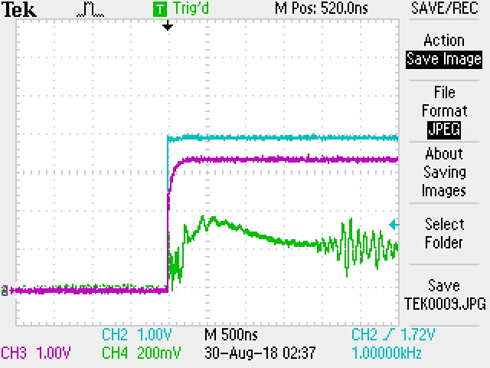
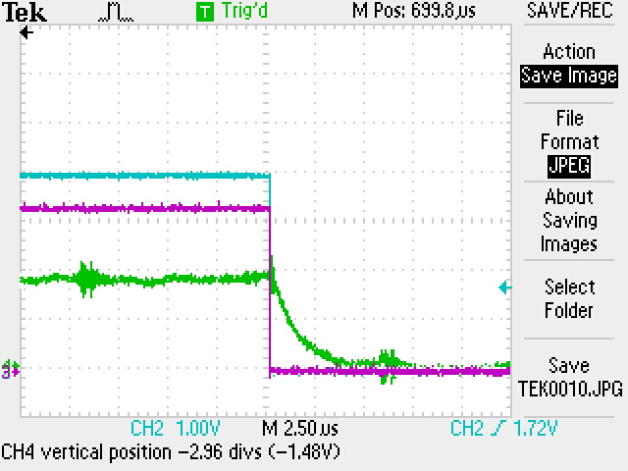
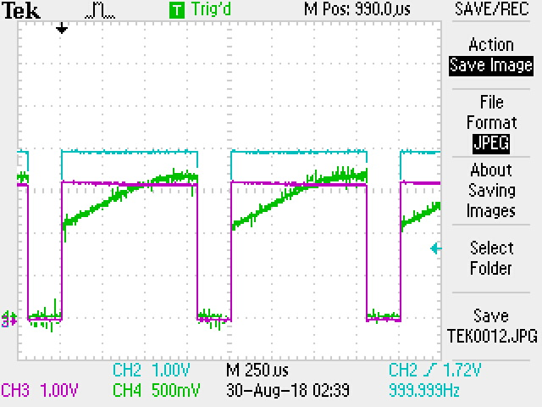
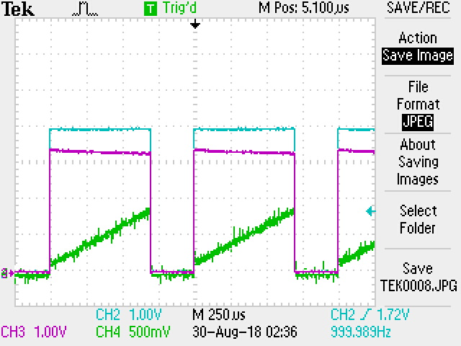
Laser time Characteristic
Photodiode with time resolution ~5ns
Red laser, IR with Red component, Pure IR
~500micros width needed to light up the laser(At 1000Hz)
Once lighted up, will start from the beginning (always very wide with increasing amplitude)
Not an ideal signal source
Width: 700 and 800 micro seconds
Rate: 1000Hz

Slide 7
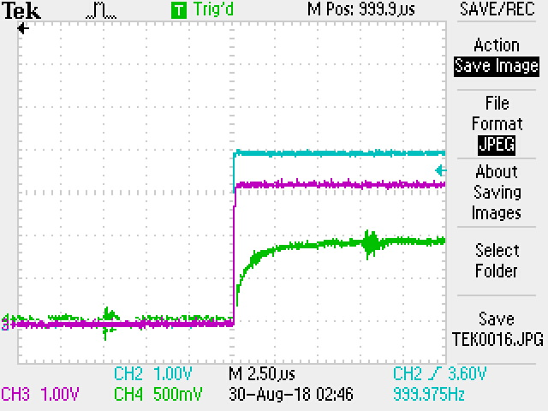
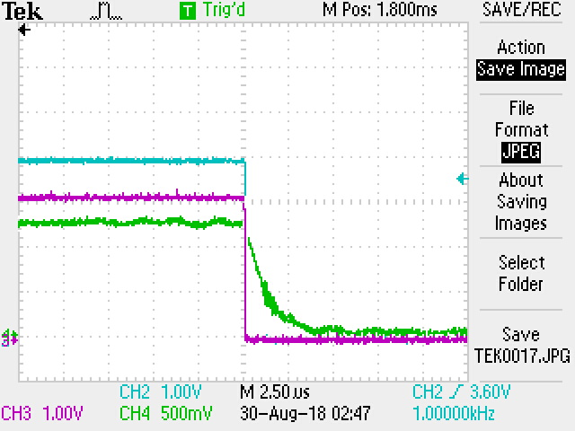
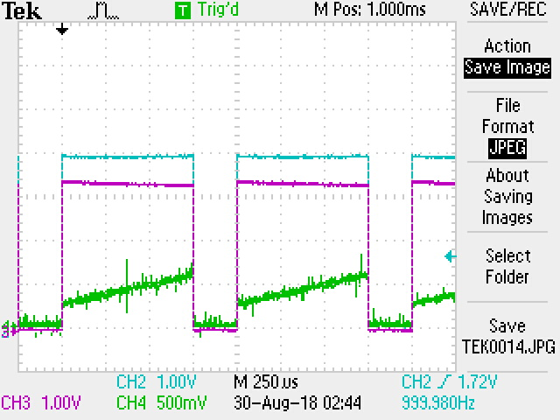
Laser time Characteristic
Photodiode with time resolution ~5ns
Red laser, IR with Res component, Pure IR
Even wider pulse needed to light up
Similar performance with IR(with red) laser
Not an ideal signal source
Width: 750 micro seconds
Rate: 1000Hz

Slide 8
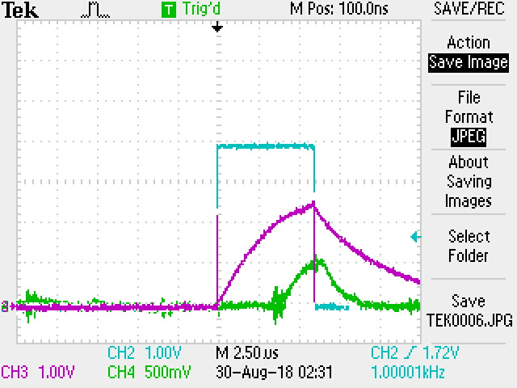
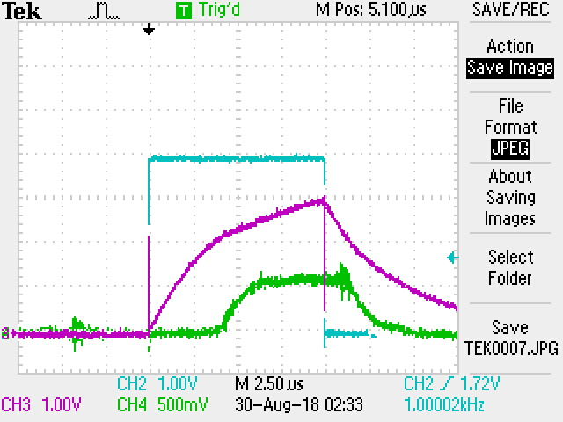
Laser time Characteristic
Photodiode with time resolution ~5ns
Red laser, IR with Res component, Pure IR
The Best situation
Trigger Pulse Width : 6 micro seconds
Rate : 1000Hz
~5 micro seconds delay found
~3 micro second raising time/disappearing time
Width : 10 micro seconds
Rate : 1000Hz
~same delay/raising/disappearing time found

Slide 9
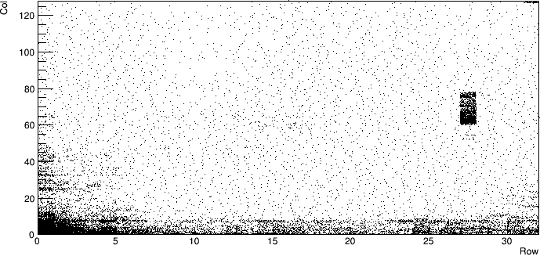
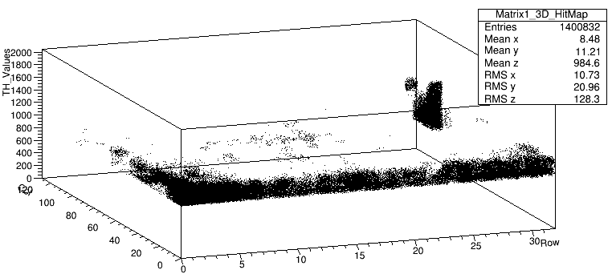
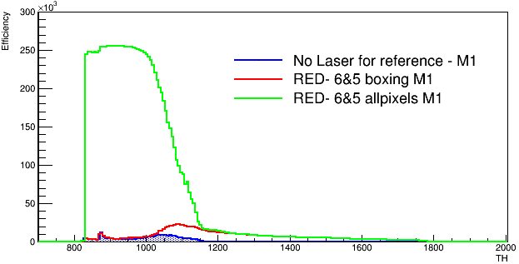
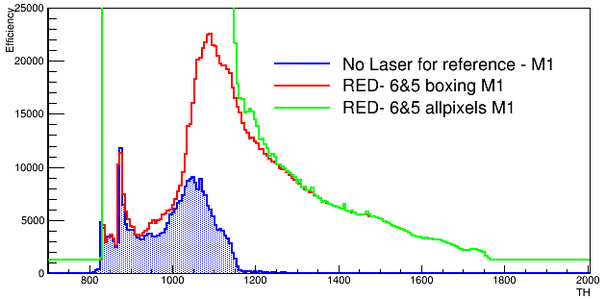
Tests with Red laser
Red laser
Width: 6 micro seconds
Delay: 5 micro seconds
Threshold sweeping(BL=0.75V)
1000Hz
Bias: -7V
1000 frames per step
Signal

Slide 10
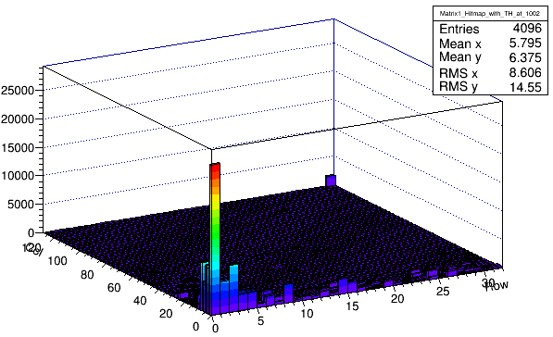
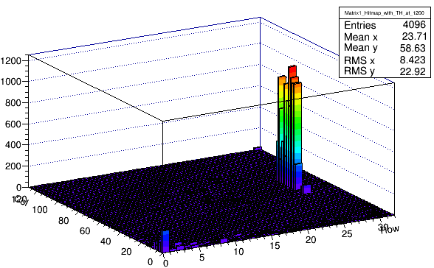
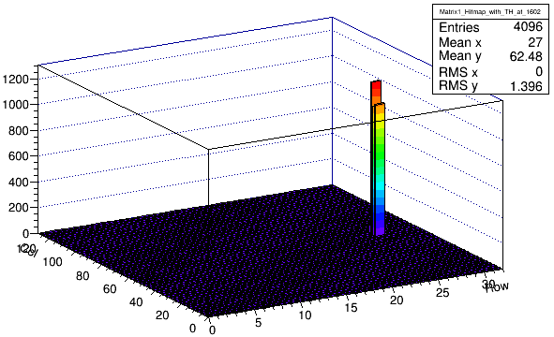
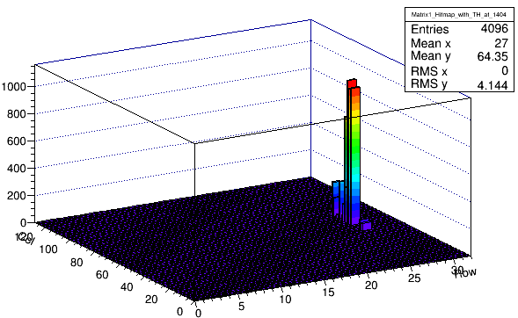
Tests with Red laser
Red laser
Width: 6 micro seconds
Delay: 5 micro seconds
Threshold sweeping(BL=0.75V)
1000Hz
Bias: -7V
1000 frames per step
Select 4 Threshold to see the hit map
  1000, 1200, 1400,1600 (1241\1V)
  With out block the pixels near to the edge
Big s/n ratio with threshold larger than 1V
Further data analysis needed.

Slide 11
Summary and Next
The signal source expected should be a very fast current source
IR laser may need a pulser with higher voltage
Red laser with 6 micro seconds trigger pulse is the best we could have for now
Large signal observed using the red laser
Very low noise at higher threshold almost 100% efficiency
Next:
Optimize the pre-amp using red laser
Find a proper pulse for IR laser
Test with Source

