Slide 1
Joint Operation & Readiness meeting
Report Operation / Photon Run Coordinator
Report Dispatch
Instruments
FXE
SPB/SFX
SCS
SQS
MID
HED
Beam transport
Task force XTD6 installation
Vacuum
X-ray optics
Photon diagnostics
Optical lasers
Detectors
Electronics
AE
EETF
CAS
ITDM
SRP
Technical services
AoB

Slide 2
PRC
SASE1
User program started on Thursday
SPB: Day shift with 120 pulses with 1MHz beam delivery of intensity ~900uJ.
FXE: night shift, 60 pulses with 0.5MHz beam delivery of intensity ~700uJ.
PBLM of SASE1 are tested.
SASE3
XTD10 was open on Tuesday
Gas ATT is added/upgraded with gauge for interlock in MPS.
Gas ATT interlock conditions commissioned and tested.
SCS_VALVE_OPEN triggers the machine MPS which prevented the beam permission to SASE1. Couldn’t solve this issue, Machine RC masked the MPS signal and continue SASE1 beam operation.
After testing interlock condition on Thursday, we couldn’t do Gas ATT interlock conditions with beam, since it will interference with SASE1 user operation, So it has been decided there will be no beam for SCS and SQS over weekend.

Slide 3
Report from Dispatch / Various
It has been reported in the PLC and Cabling meeting that the information flow in terms of Component Requirement Documents (CRDs) has slowed down, becoming now the bottleneck in the planning process of PLC modules.
Reminder:
In the current process, a lot of time & effort is required to compose and finalize the CRDs
We can only plan and allocate resources properly if theexpected delivery date of CRDs is respected
We can only keep up the number of modules and cables planned if the information in the CRDs is provided on time.
It takes more than ½ a year to provide cabling and components AFTER the CRDs have been finalized

Slide 4
HED
XTD6: HRDCM grouting plate installation, aligned tube needs removal, after Sept 12th.
precision AC zones regulation with heat load in progress (A.23 done, A.08 in progress, A.12 next)
OPT: Started optics hutch device alignment, Z axis adjustments.
OPT: PP laser posts for the optics hutch, installation
A.23 LAS BAY: breadboards moved into compressor vessel, pump down, RGA in progress.
EXP: drilling of IA2 rails and covers next week
EXP: Started alignment of laser mirror installation / DPS / C-slits testing

Slide 5
SA2-XTD6 Tech. Commissioning (T-C) status 31.8.2018 KW35
A reminder of our targets
Target-MID: XTD1-XTD6-MID all components ready for beam to Optics hutch by end-Sept
Target-HED: SDL bypass transport pipe mounted and vacuum line operating, T-C those HED components which are ready, beam to shutter by end-Sept
Reminder of time plan for MID & HED targets – most significant items only
– KW36:
Commission HED PLC loop (Eplan export – Benoit; f/w and implementation– Nerea)
Replace HED_XTD6_CRL bellows – VAC group
T-C MID_XTD6_BMPI-1 & 2 – AE, CAS, MID
– KW37:
T-C HED_XTD6_CRL; then HED_XTD6_PPU… (plus HED_XTD6_PBLM)
Remove HED_XTD6_HMONO bypass pipe – VAC; install/grout HMONO mounting – HED & align
– KW38 + 39:
Install HED dist. Mirror M3 – VAC and XRO
HED_XTD6_HMONO start h/w installation & complete – HED & FBM-Oxford
– KW40:
T-C HED_XTD6_HMONO
Close out tests (interlocks)
• XTD6 closes 5.10.2018 (pm)

Slide 6
SA2-XTD6 Tech. Commissioning (T-C) status 31.8.2018 KW35
MID XTD6 to-do list
MID_XTD6_CRL
Rebuilt by JJ-Xray: need 1) list of work done, 2) list of h/w improvements; 3) rebuilt plan for other CRLs
CHAM_AX, _AY: Karabo scenes shows position as mm, should be radians ? CRL owners should state what they want.
MID must specify chamber X, Y, AX and AY end-switch positions for bellow safety. AX & AY disabled until implemented.
PT100 sensors not connected – where is the Beckhoff module (crate) ?
MID_XTD6_ATT
Technically commissioned, but table X and Y disabled as bellow safety failed.
MID_XTD6_MONO
Check needed to ensure that the mono h/w is out of the beam
MID_XTD6_BMPI-1 & -2
Technical commissioning required
Owners must regularly test operability of ticked-off components

Slide 7
SA2-XTD6 Tech. Commissioning (T-C) status 31.8.2018 KW35
HED XTD6 to-do list
Install: HED_XTD6_HMONO component h/w
Technical commissioning priority list (top = 1st)
HED_XTD6_CRL (includes bellow compliance test)
HED_XTD6_PPU
HED_XTD6_HMONO (28.9.2018 onwards)
HED_XTD6_SDLBM-1 & 2 (when ready)
VAC, XRO & XPD XTD6 to-do list
Install M3 mirror – VAC & XRO
Install HED_XTD6_SDL bypass beam pipe - VAC
Mount M1, M2 and M3 TX motor cages - XRO
Alignment of SA2_XTD6_MCP – XPD
Clarify use of VAC cable for Si-MONOs and tell ETTF – Liuba
Final interlock tests
AE & CAS to-do list
HED loop commissioning
Work associated with component commissioning

Slide 8
Bellows XTD6 to-do list
– Disable axes with end-switches not compliant with max bellow lateral extension
Axis | At switch | Left | Right
AX | CCW | 2 | -5
AX | CW | -15 | 4
Y | CCW | 15 | 12
Y | CW | -12 | -16
Left
Right
15 + 12 = 27 is > 20mm
⇒ AX disabled
Conclusions
No show stoppers in sight, but some technical & group interface issues still present
Do not expect to dismantle a component to T-C it – it should be ready and design safe
Need to solve the where am I question correctly
‘Homing’ documentation (owners should find their use cases planned) & f/w (delivered)
Need to avoid regressing back to not commissioned state
Review & solve Mc2 – Beckhoff terminal interfaced stepper motor miss-configuration, lab test new f/w prior to deploy..
Need to avoid identical components becoming different
May have to disabling a component device, but should MDL s/w should still work, ..

Slide 9
Detectors – DET
1st AGIPD SPB
Operation – User proposal p2116:
Configuration with 176 memory cells, 120 X-ray pulses per train @ 1Mhz were collected
Collected data: 214 TB
Issues:
Hardware problem (ADC board for Q1M2 module) → Power cycling the system solved the problem.
Configuration of the detector was not always properly applied → the detector operators were made aware of this problem and temporary solution (before the problem will be fixed on the firmware level) was provided
Operation – User proposal p2120:
Configuration was updated to avoid storage of the data w/o X-rays → current configuration: 128 memory cells per train @ 1.1 Mhz
LPD at FXE
Operation
Collected data: 20 TB
Issues
Overcurrent in module Q2M4 observed, factor of 10 higher as nominal
Removed sensor tile from module, this fixed potential short though broken bond wires on the module
Confirmation with X-rays still pending

Slide 10
Detectors – DET
2nd AGIPD MID
AGIPD was transported from CFEL to the detector lab @ HERA South on 28.08.2018
Vacuum system was attached to the vessel and system was pumped
pressure after 48 hours of pumping 5.7 x 10⁻⁶ mbar
Cooling system was checked and connected to the detector → no leak is observed
Tests of AGIPD temp. sensors (in vacuum and ambient)
no problem on the detector side was observed, small issues on the cables or PLC side to be investigated and fixed this week as it is critical for the detector interlock system
DSSC
Testing of the DSSC vessel
Quadrant mounting tool checked, several flaws identified. Fixing of the design has started. This will probably impact on the detector delivery date, exact impact to be estimated once the redesign of the tool is finished.
Check of the internal geometry of the vessel and motion system vs CAD model ongoing. No problems identified up to now.
Revised document (with remaining tasks to be performed at CFEL) sent to CFEL personnel, now waiting for feedback. The document needs to be signed in order to bring the vessel to HERA South.

Slide 11
Detectors – DET
Side flange sent to an external company for surface repair. This should cure the remaining small leak.
UHV compatible collision switches ordered. Cable system for motion system under revision to check what is missing.
Ladder 2.1 removed from our test stand, to be used for the assembly of the 2nd quadrant at FEC. Ladder 2.10 now installed and ready for use.
Power supply control in Karabo
Tables produced by CAS, to be checked, person-power is being allocated for the testing
FastCCD
Detector setup for pre-installation tests in detector laboratory at XHQ, first noise data taken after transport to Schenefeld
Testing and bug fixing of new control software ongoing
Draft version of operation manual prepared

Slide 12
AE
SASE3 Tunnel: Configuration of new interlock definition for MPS to include GATT into it. PLC EPS and GATT restarted, also PLC MOV2 to correct HSLITs and planning PBLMs SCS and SQS for following week.
SASE2 Tunnel: Support on final CRL MID commissioning tests. Start to gather information about hardware available for HED in the tunnel.
SASE3 Instruments:
SCS: Since they didn't have bean we were taking time to fixing problems in different crates (connectors, fuses, ...).
SQS: Loop 6 almost ready, just one Technosoft has to be checked. Also coordinated motion in one loop has one faulty encoder and they can't use the coordinated motion interlock, to be checked when this encoder will be replaced.
SASE2 MID Instrument: Working with EETF to produce exports to start to generate loop 1 and 4. Connecting PLCs to network and crates.

Slide 13
VAC
SA1:
nothing to report
SA3:
intervention in SA2-XTD10 for additional signals for Safety interlock was performed successfully
SA2:
missing vacuum parts for HED branch are delivered and will be
installed next week (CRL and SDL replacement pipes)
Shutters in Experiment hutches will be wired next week (TÜV-Test by end of September)

Slide 14
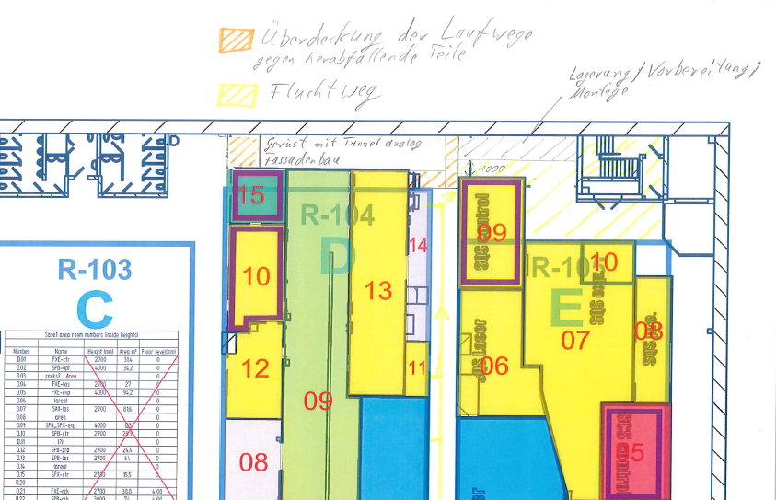
SRP
Corridor behind SASE1 will be fenced off starting
from the end of September until at least the
end of October Due to the steel and
drywall construction of D.23

