Slide 1
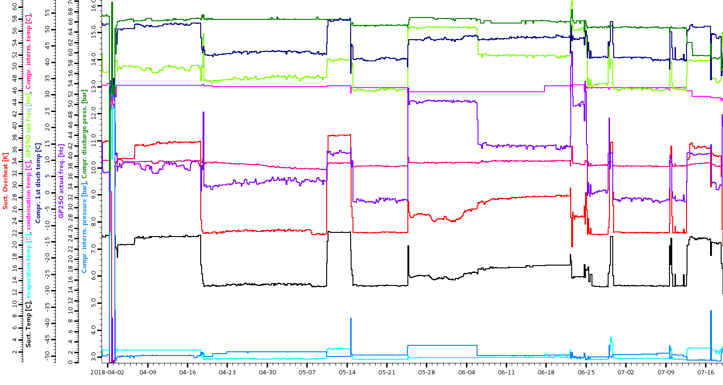
IBBelle Status
9.1.2018 switch on after shutdown
('Wed Jan 10 00:30:54 2018', 0) run at +15°C
('Tue Jan 16 07:28:13 2018', 0) heater alarm (EH103, pump he ater)
('Wed Jan 17 04:11:51 2018', 0) heater alarm
('Wed Jan 24 11:13:49 2018', 0) heater alarm
('Wed Jan 24 18:57:09 2018', 0) heater alarm
('Fri Jan 26 07:40:34 2018', 0) heater alarm
('Sun Jan 28 07:37:17 2018', 0) heater alarm
('Mon Jan 29 06:17:51 2018', 0) heater alarm
('Tue Jan 30 01:44:35 2018', 0) heater alarm
('Thu Feb 8 12:20:42 2018', 0) warm operation interlock, SH244 SH
('Thu Feb 8 12:52:41 2018', 0) noflow alarm, to be blocked
('Thu Feb 8 12:53:41 2018', 0)
('Thu Feb 8 12:54:32 2018', 0)
('Thu Feb 8 12:56:50 2018', 0)
('Wed Feb 14 17:49:00 2018', 0)
('Sat Mar 3 10:03:57 2018', 0)
('Mon Mar 5 13:21:27 2018', 0)
('Mon Mar 5 19:20:59 2018', 0)
('Thu Mar 8 11:20:40 2018', 0)
('Fri Mar 16 17:09:41 2018', 0)
('Fri Mar 16 17:17:15 2018', 0)
('Sun Mar 18 21:03:07 2018', 0)
('Mon Mar 19 08:33:30 2018', 0)
('Mon Mar 19 08:40:24 2018', 0)
('Tue Mar 20 14:44:29 2018', 0) Training of KEK crew
('Tue Mar 20 14:59:31 2018', 0) “
('Tue Mar 20 17:57:38 2018', 0) “
('Tue Mar 20 18:02:25 2018', 0) “
('Sat Mar 24 22:31:46 2018', 0) (false) humidity alarm, shutdown
('Sat Mar 24 22:41:38 2018', 0) chiller shutdown during startup (SH)
('Mon Apr 2 07:08:37 2018', 0) QCS quench, phase watch tripped
('Mon Apr 2 07:38:18 2018', 0) 2nd start needed (cooldown of CO2?)
('Mon May 14 16:07:38 2018', 0) QCS quench, phase watch tripped
('Mon May 14 16:37:09 2018', 0) startup problems (low supercooling of
('Mon May 14 16:41:51 2018', 0) pump
('Mon May 14 17:04:00 2018', 0) “
('Thu May 24 15:01:53 2018', 0) Off to connect/disconnect UPS
('Fri Jun 22 04:51:03 2018', 0) humidity alarm, broken sensor.
('Fri Jun 22 04:54:24 2018', 0) Stopped several times due to heater
('Fri Jun 22 04:57:19 2018', 0) overheating in accum.
('Fri Jun 22 05:05:21 2018', 0) Content only 5.5kg
('Fri Jun 22 05:08:16 2018', 0) “
('Fri Jun 22 05:10:44 2018', 0) „
('Fri Jun 22 05:13:12 2018', 0) „
('Fri Jun 22 05:35:45 2018', 0) „
('Fri Jun 22 05:40:05 2018', 0) „
('Fri Jun 22 05:43:26 2018', 0) „
('Sun Jun 24 16:20:39 2018', 0) humidity alarm, EH106 at 1500W warm
('Sun Jun 24 16:24:09 2018', 0) up till 14°C, then stop (heater)
('Thu Jun 28 23:54:48 2018', 0) humidity alarm, manually set warm
('Fri Jun 29 00:03:08 2018', 0) follow up (reason for stop unknown)
('Mon Jul 9 16:40:51 2018', 0) stop to check oil level
('Mon Jul 9 17:14:21 2018', 0) low superheat at restart (?)
('Mon Jul 16 21:22:54 2018', 0) QCS quench
('Mon Jul 16 21:35:23 2018', 0) work around low supercooling for pump
('Mon Jul 16 21:45:24 2018', 0) “
('Wed Jul 18 19:55:24 2018', 0) warm up before stop. Ok till 10°C
('Wed Jul 18 19:59:54 2018', 0) several tries to go to 19°C in steps
('Wed Jul 18 20:05:48 2018', 0) “
('Wed Jul 18 20:14:20 2018', 0) °
('Wed Jul 18 20:19:13 2018', 0) “
('Wed Jul 18 20:54:44 2018', 0) “
('Wed Jul 18 22:07:48 2018', 0) “
('Wed Jul 18 22:14:08 2018', 0) “
('Wed Jul 18 23:21:25 2018', 0) “
('Wed Jul 18 23:28:27 2018', 0) “
('Wed Jul 18 23:33:47 2018', 0) “
('Thu Jul 19 00:17:06 2018', 0) stop completely for shutdown
Betrieb (s): 15553300, days: 180
IBBelle worked continuously from March to July without problems
Shutdown July 18
Start: January 10: 15°C
Continuous cold running: March 20
Few stops due to (false) humidity alarms
Humidity alarm: IBBelle goes to warm operation (15°)
Works, but IBBelle stops, manual recovery needed
Total ON time from January to July: 180 days.

Slide 2
After Shutdown
August: detector disconnected, CO₂ loop closed in Junction Box for stand alone tests
Discovered heater failure: connection to ground => fuse blows (humidity)
Disabled heater (software) and started again (September 5)
Heater was still active and fuse blew again (while compressor was running)
September 6: chiller worked strangely
Start-up problems
No R404a supercooling
Strange parameters

Slide 3
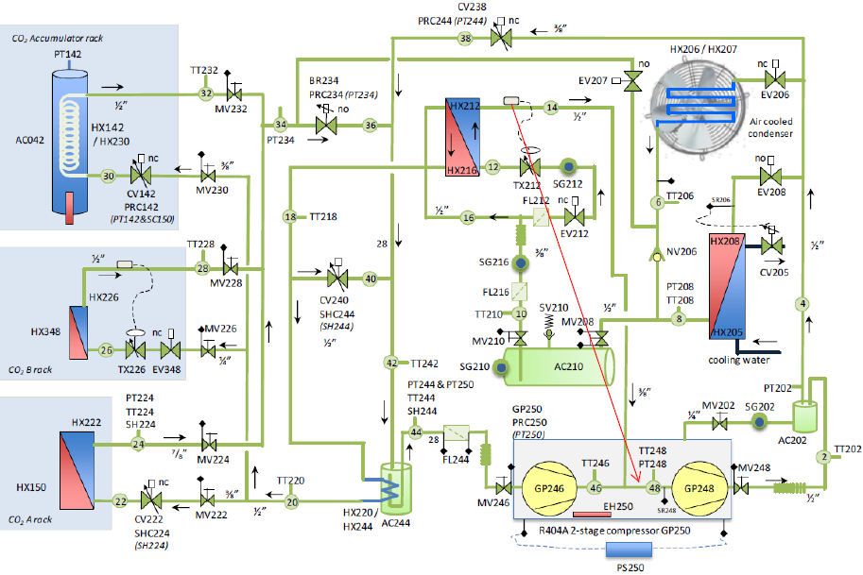
Chiller

Slide 4
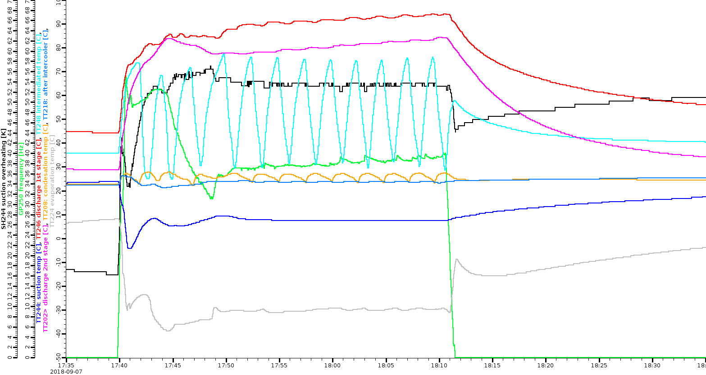
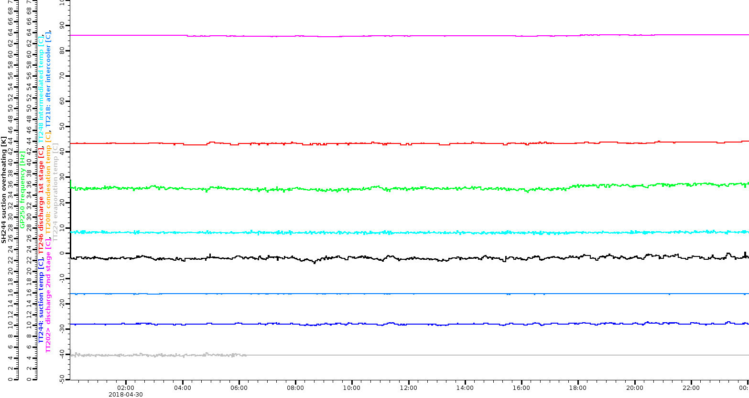
Observations
Temperatures
After September 5
No subcooling
High 1st stage discharge temperature
(TT246)
Oscillation of MD (TT248)
b) During Phase II
(normal operation)
R404a subcooling
22°C instead of -16°C
TT248 MP
10-70°C oscillations
Instead of 10°C
TT246 1st discharge
90°C instead of 45°C

Slide 5
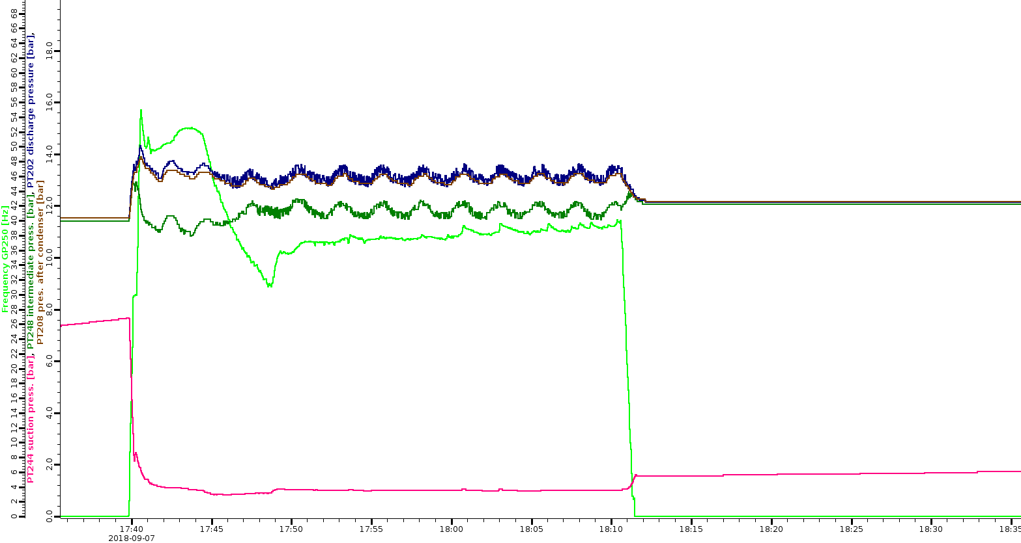
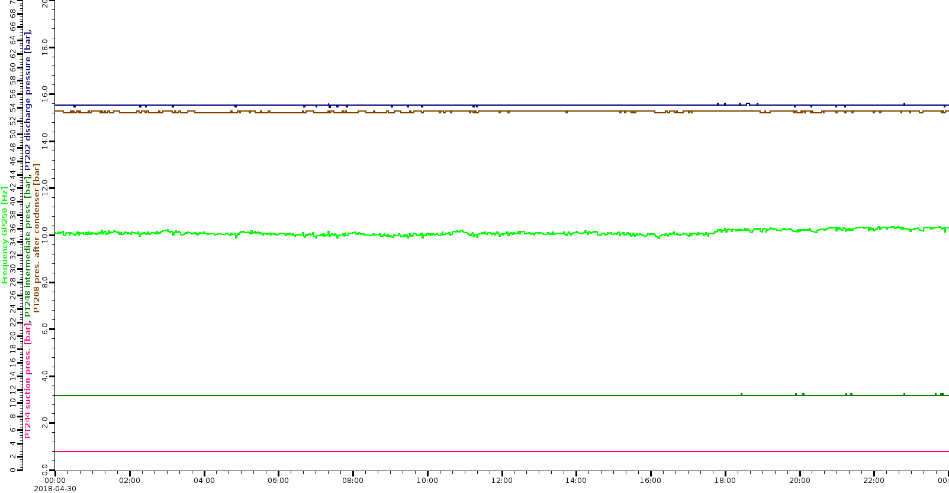
Observations
pressures
After September 5
- Midpressure (MP) went from 3 bar to 12 bar
(PT248)
b) During Phase II
PT248 MD: 12bar instead of 3bar:
no pressure difference, no subcooling

Slide 6
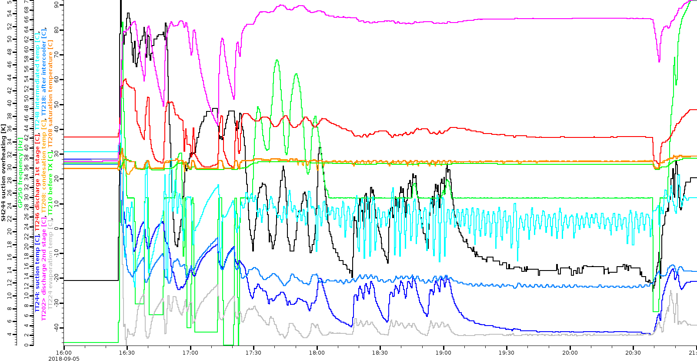
Observations
September 5 and before: intercooling and MP pressure still ok, but temperature at MP started oscillating: hunting of TX valve

Slide 7
Interpretation
Oscillations of TX valve (MP temperature)
Valve works properly only if there are no gas bubbles in the liquid
R404a must be supercoolded (1 K below evaporation temperature)
This is assured if condensation temperature in heat exchanger is above ambient temperature, so that R404a cannot heat up on the way to the valve
Before July: T_cond ~30°C, supercooling ~ 1K (ok)
From August on: cooling water pressure changed from 3bar to 9bar and condensation temperature fell to 26°C => no supercooling
Bubbles can damage valve (cavitation)
Damage of suction valve of 2nd compressor stage (MP rise to 12 bar)
Could be a consequence of TX hunting, liquid injection, liquid shock
Could also be du to shutdown: PLC was off, but compressor still powered. FI ramped down the compressor (~ 1 min) but valves may have been in a wrong position (no control by PLC). Pressure rise my have caused damage (have indications of pressure shock)
=> Unsafe shutdown strategy: needs to be changed

Slide 8
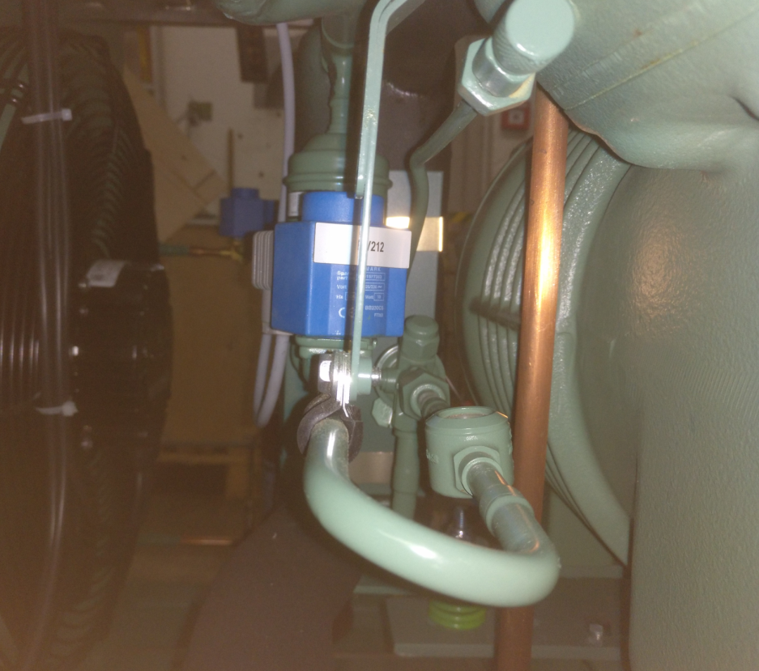
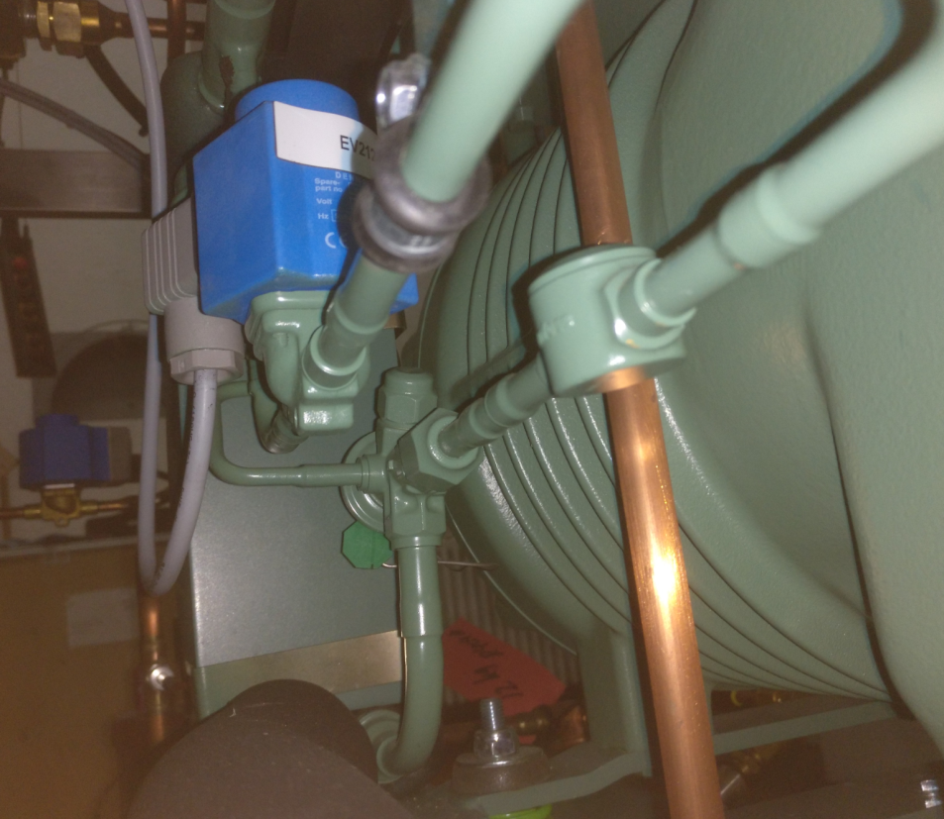
Repair versus Exchange
TX valve and head of 2nd compressor stage can only be accessed if compressor is removed
Empty R404a done by company (SAN-EIGIKEN), Oct. 10.
Un-cableling done by MPP technician. Oct. 12
Opening of tubes (4) and compressor removal (SAN-EIGIKEN), Oct. 15

Slide 9
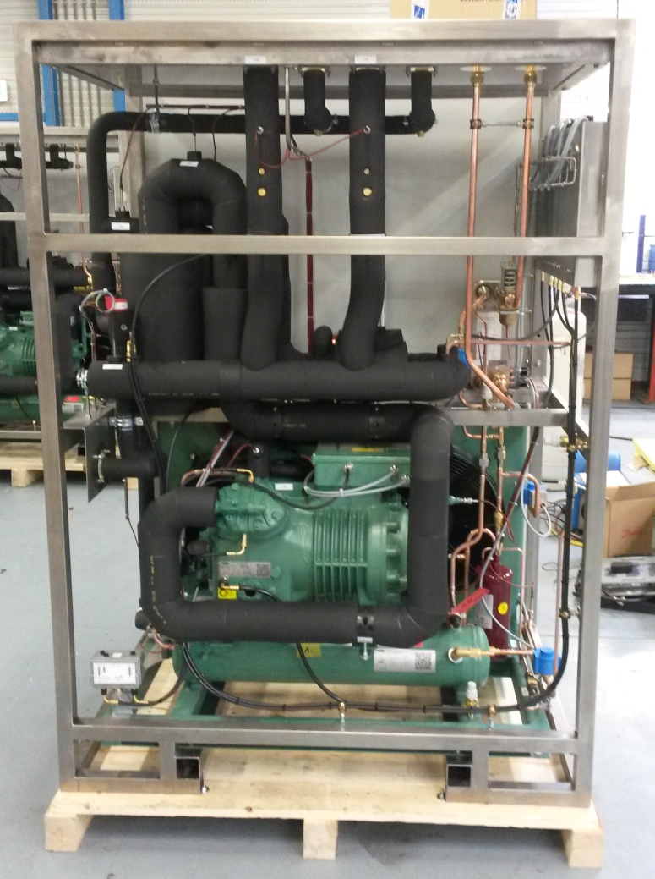
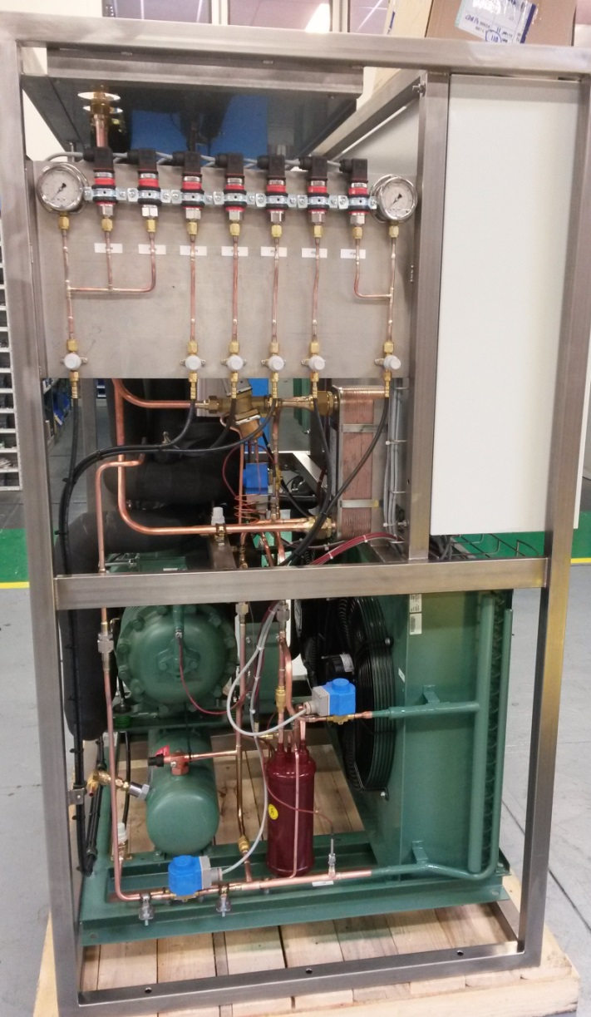
Compressor Removal

Slide 10
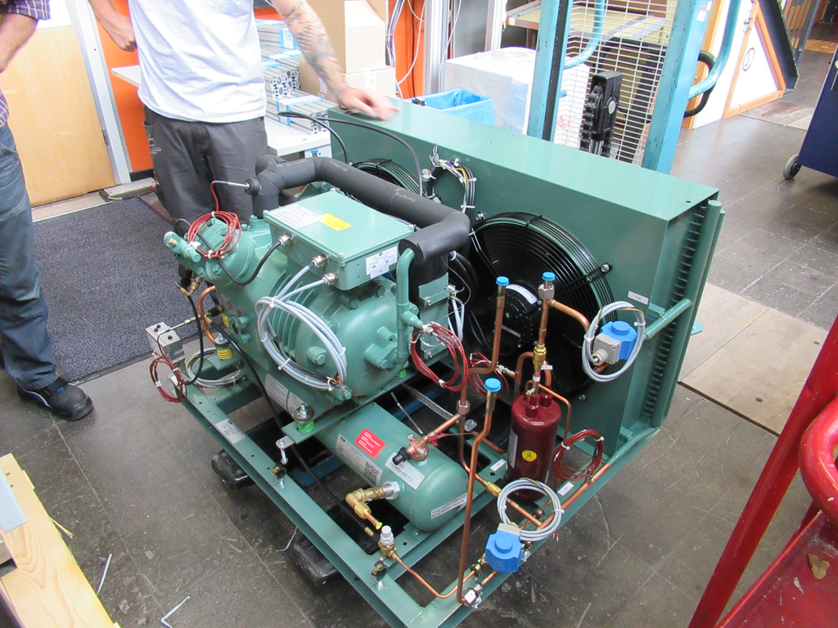
Trial Removal

Slide 11
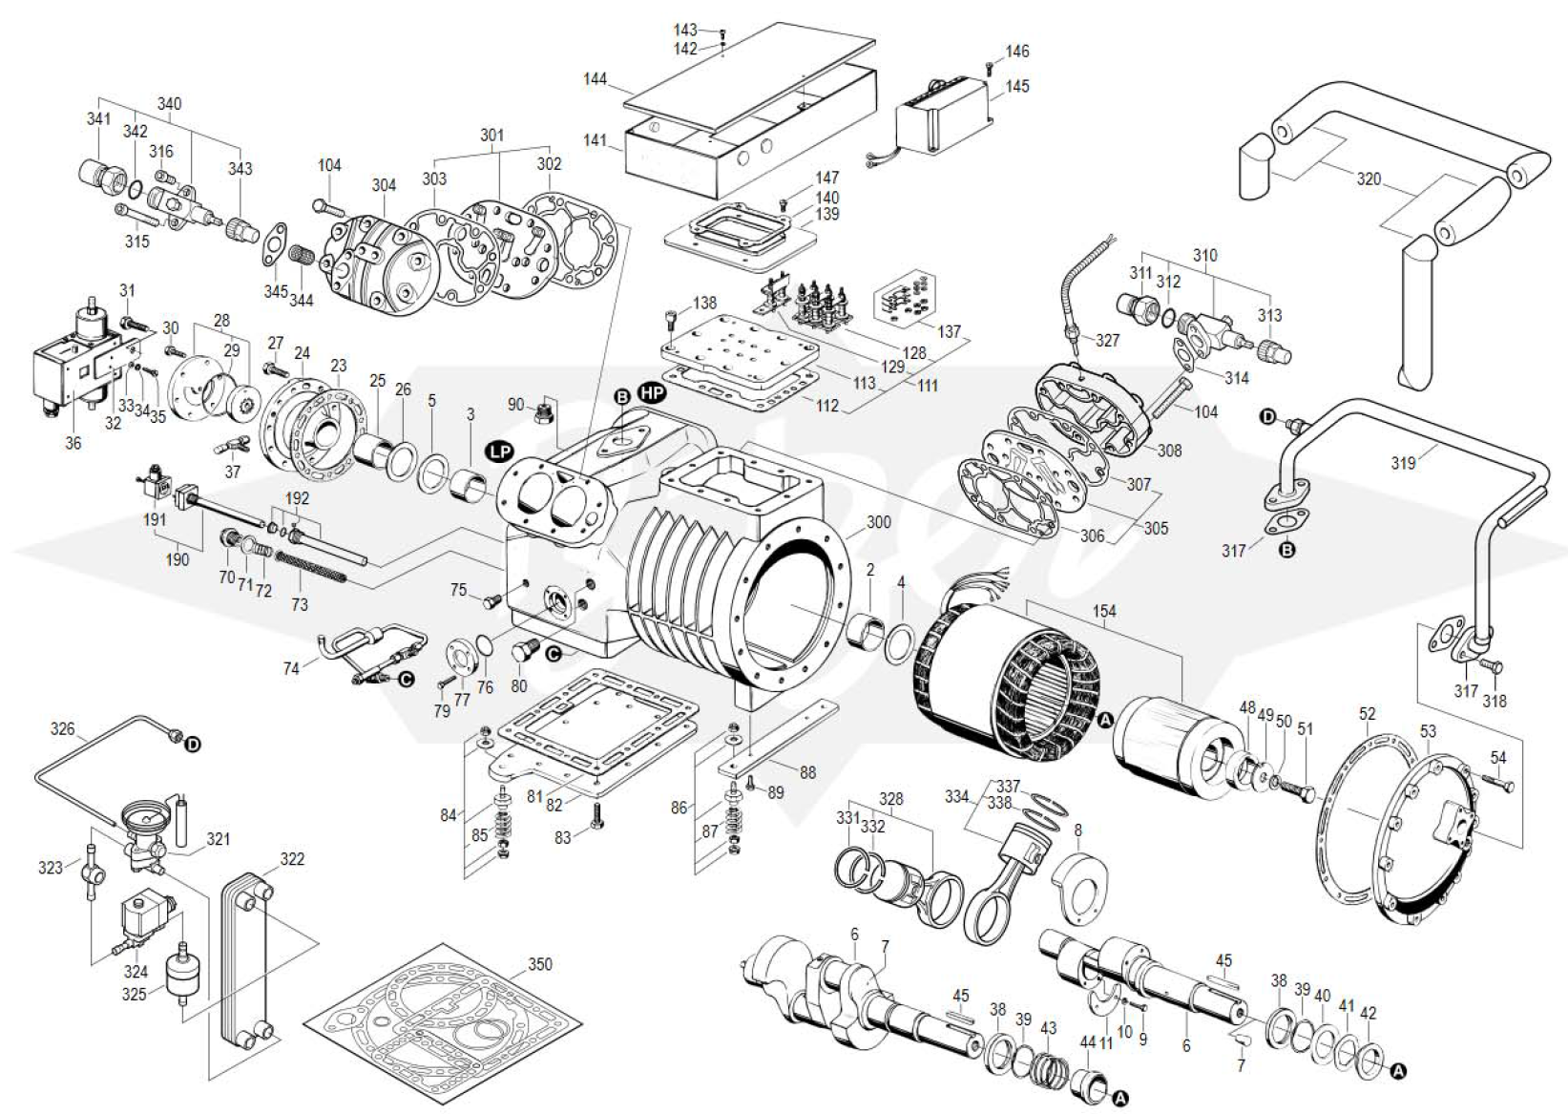
Spare Parts (ordered)

Slide 12
Options
Change TX valve and compressor valve plate (2nd stage)
Replace complete compressor unit
In any case: compressor has to be disconnected and removed, cabling and tube connection work is the same.
b) Takes less time (if well prepared), start with new, working compressor. No risk that further damage is present but not detected (which would man to repeat everything)
Replace unit and repair compressor after exchange (best by manufacurer)
Unlikely that spare compressor arrives in time (bafa).
Shipment this week, arrival next week.
Prepare everything October 15-19
Return in November for replacement and re-start.

Slide 13
To Do List
Replace/re-cable heater
Seal heater (humidity protection)
Replace analogue pressure gauge
Replace leaking safety valve
Replace compressor
Add general stop if any circuit breaker opens
Direct stop of compressor if overpressure is detected
Add sensor for ambient temperature
Alarm/interlock if T_amb > T_condensation
Monitor R404a supercooling before TX valve
Improve transition into warm operation (regulation)
Display IBBelle paramters in control room and add communication panel with Nikko control room (cryo group)

