Slide 1
•Florian Lütticke
Testbeam and Irradiation Plans
Universität Bonn, Physikalisches Institut, Nussallee 12

Slide 2
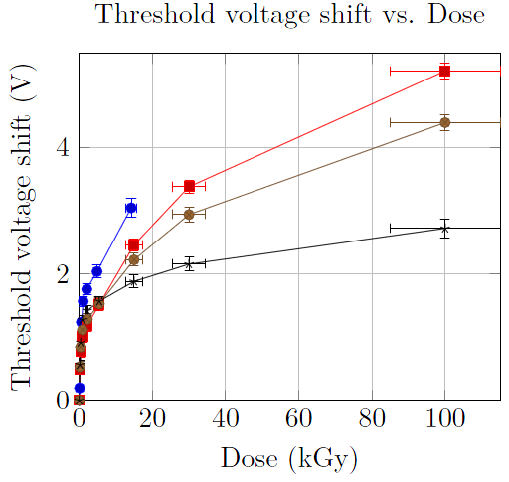
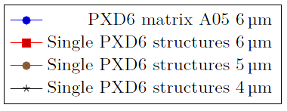
We need some Data
Previous Irradiations:
DCDBpp and DHPT1.0 on EMCM – Problematic because of weak link between both ASICs.
DCDBv2 on Hybrid4 - Outdated ASIC, many problems now resolved.
DHPT0.1 - Testchip, some building blocks investigated.
PXD6 (thinOX) on Hybrid4 - different from PXD9 in technology - showed higher than expected drift compared to single pixel PXD6 structures and even more for CCG
Single DEPFET Pixels
BEAST - Unknown Dose.
Plan: Irradiate and measure both L1 and L2 module

Slide 3
Measurements and Modules
Resolution of DEPFET Modules needed for simulation and tracking - can’t be measured in Belle 2.
Measure efficiency and resolution at different radiation levels and/or bias voltages.
Measure efficiency with and without analog common mode correction
Measure threshold shift and shift of other parameters with irradiation
Measure resolution at different angles: θ 0°-60°, η 0-30°
… and more

Slide 4
Plans
Testbeam from week 44-47 at DESY. 4 weeks, Shutdown in W46
Irradiation with X-rays in Bonn.
Modules: W11_OF2 and W40_IF (Göttingen guinea pig module.)
Participants (so far) Botho, Benjamin, Carlos, Harrison, Philipp W., myself.
Module A) Characterize in week 43. TB in W44, irradiation in W45-W46. TB in W47
Module B) TB in week 45. Irradiation in W46?. TB in W47?
Which is A and B? Pre-irradiate one or both modules?
Endlich wieder
Testbeamzeit

Slide 5
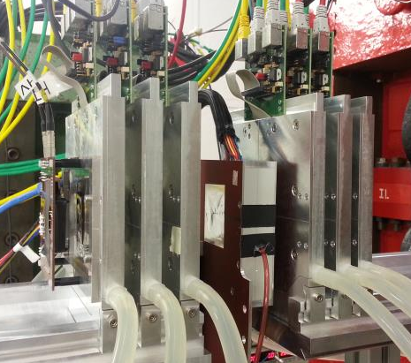
Testbeam Setup
6 position reference sensors (Mimosa 26)
1 time reference sensor (FE I4) as trigger plane
1 DEPFET DUT
Read by DHE (no DHC)
Triggered by TLU (no FTSW)

Slide 6
Measurement / Optimization
BEAST calibrations need to be ported to “lab” version of our framework.
Ongoing work by Botho, Harrison and Philipp.
“Detailed” mass production optimization
Optimize Bias voltages with sources (Cadmium, Strontium)
DCD Optimization including gain measurement.
After irradiation: Adaptive biasing - aim for the same source current.

Slide 7
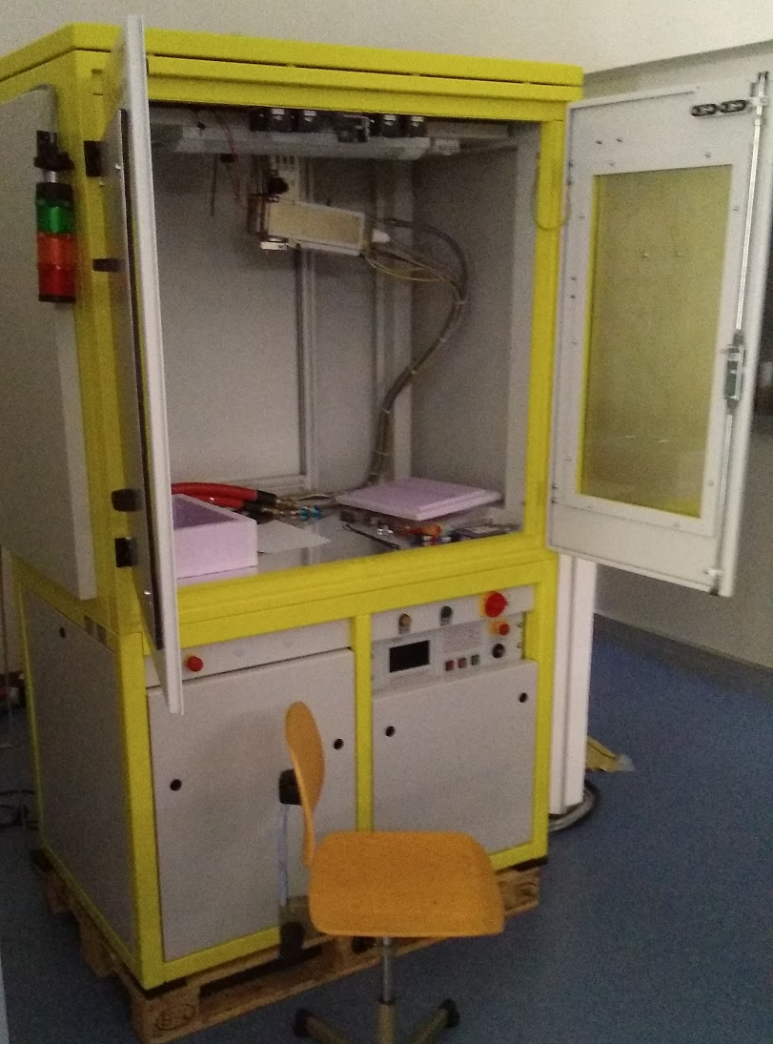
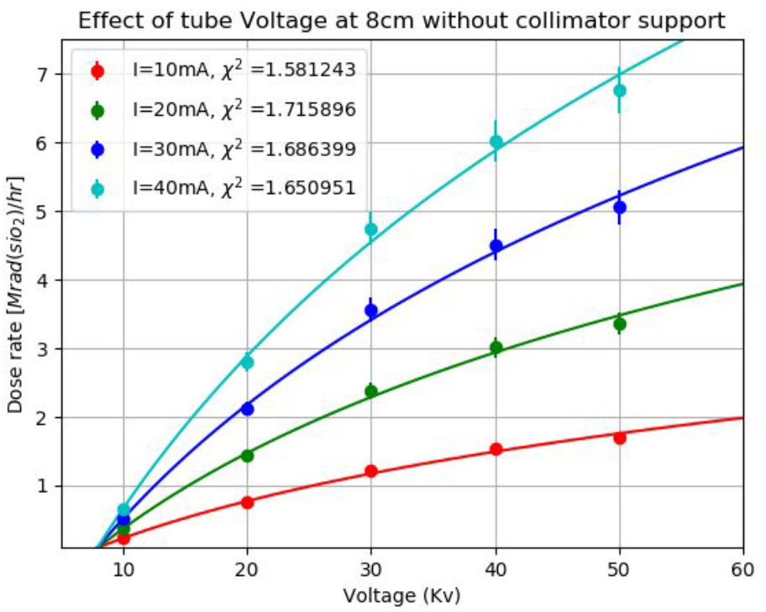
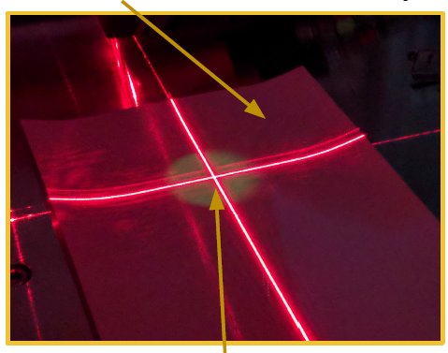
Irradiation Setup in Bonn
X-Ray machine Seifert Analytical X-Ray XRD Eigenmann GmbH
70 kGy/h at r=1.05 cm with 50 kV and 40 mA. Largest beam spot r=7.5 cm Characterization currently ongoing
Laser Alignment

Slide 8
Software Status: DAQ
DAQ: New PXD local DAQ version for DHE. First tests done (Thanks, Harrison!).
EUDAQ: Version 2 available at DESY. We plan to use version 1.X
DEPFET producer updated for EUDAQ 1.X.
New DEPFET producer for EUDAQ 2 almost ready.
FE-I4 Producer only available for EUDAQ 1.
EUDAQ & TBSW: New DEPFET data format needs to be implemented.
DHE Firmware tested with TLU?

Slide 9
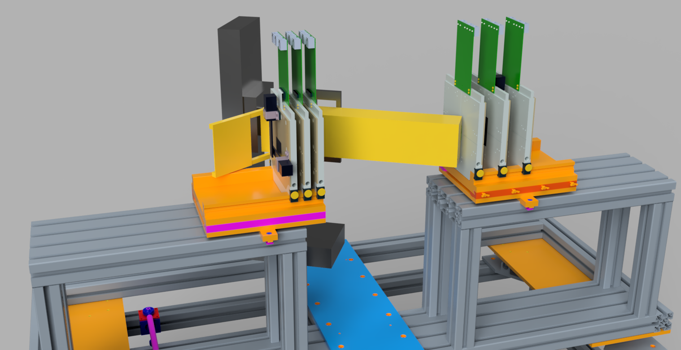
Status of the Mechanics
Small box with large windows needed. Width given by cooling block.
θ 0°-60° challenging but possible
η 0-40° possible due to box width
Checking for Collisions
Current box design

Slide 10
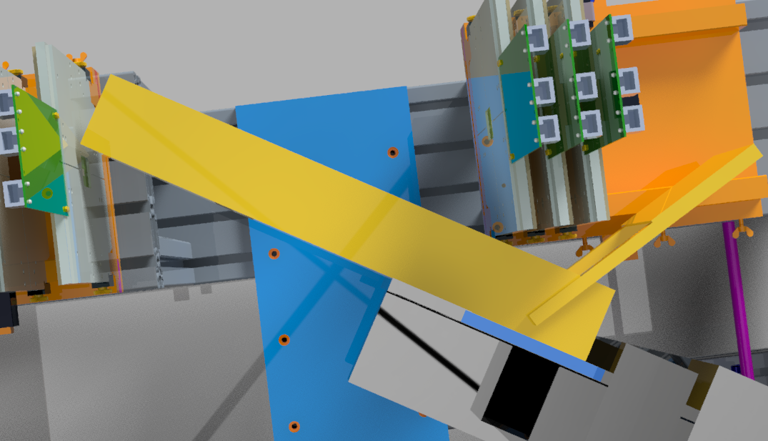
Status of the Mechanics II
Hinge for
patch pannel
Slanted, so the box
can be shorter
Connection to
motorstage

Slide 11
Conclusion and open questions
TB preparations ongoing.
Testbeam at DESY, Irradiation in Bonn.
We need to fix our plan: Which Module first? Which Irradiation steps? Preirradiate the OF? Could we manage three testbeams (e.g. TB Irrad TB Irrad TB) for the OF?
Additional Manpower? (FE-I4, EUDAQ2)

Slide 12
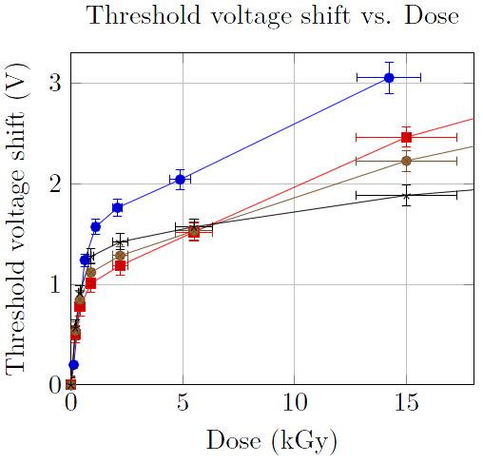
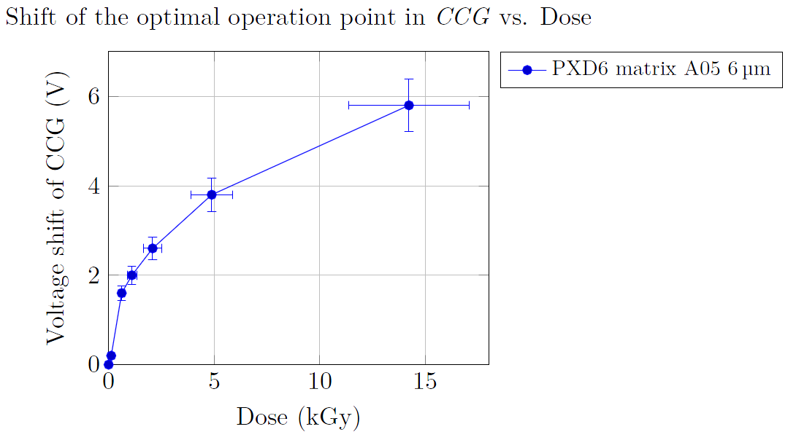
Radiation hardness
Irradiated with 10 MeV electrons
Irradiated with x-rays from 60 keV electrons on tungsten target

Slide 13
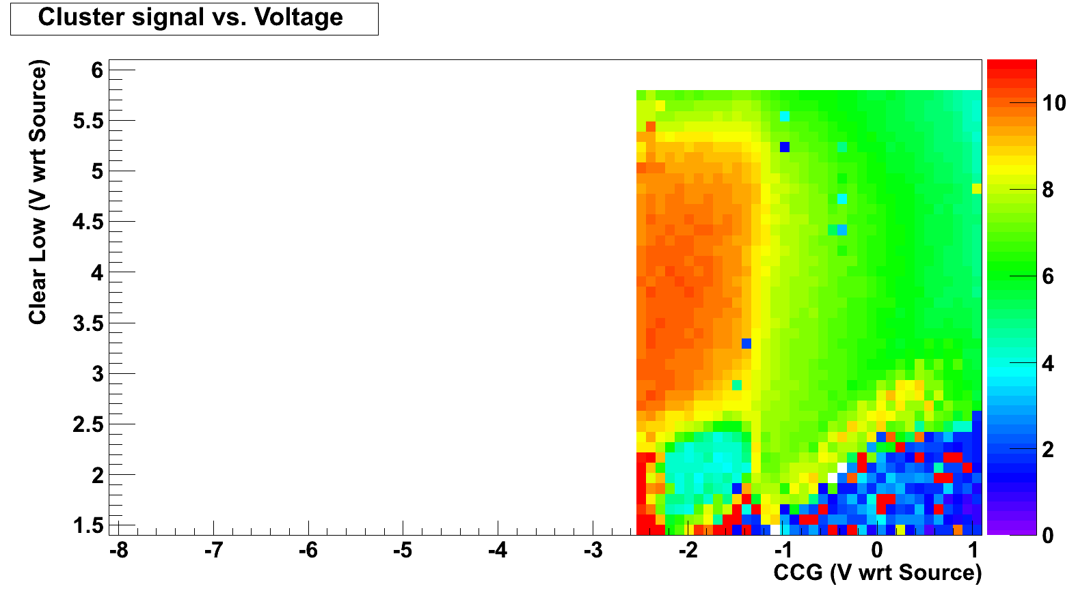
Irradiation – initial performance
Irradiation of matrix with 10 MeV electrons
Optimal operation point of matrix shifts with accumulated dose
Each point in this plot is a the MPV of a Landau fit to a ⁹⁰Sr source spectrum
Trapped oxide charge in Gate oxides

Slide 14
Irradiation – after 0.12 kGy
Noise is flat 0.5 LSB in whole parameter space for CCG and Clear Low
Different signal intensity because optimization was done with different Gate On

Slide 15
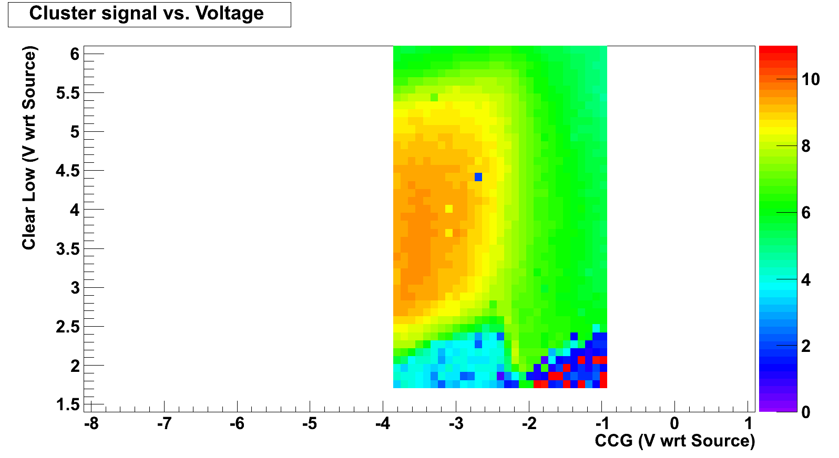
Irradiation – after 0.62 kGy

Slide 16
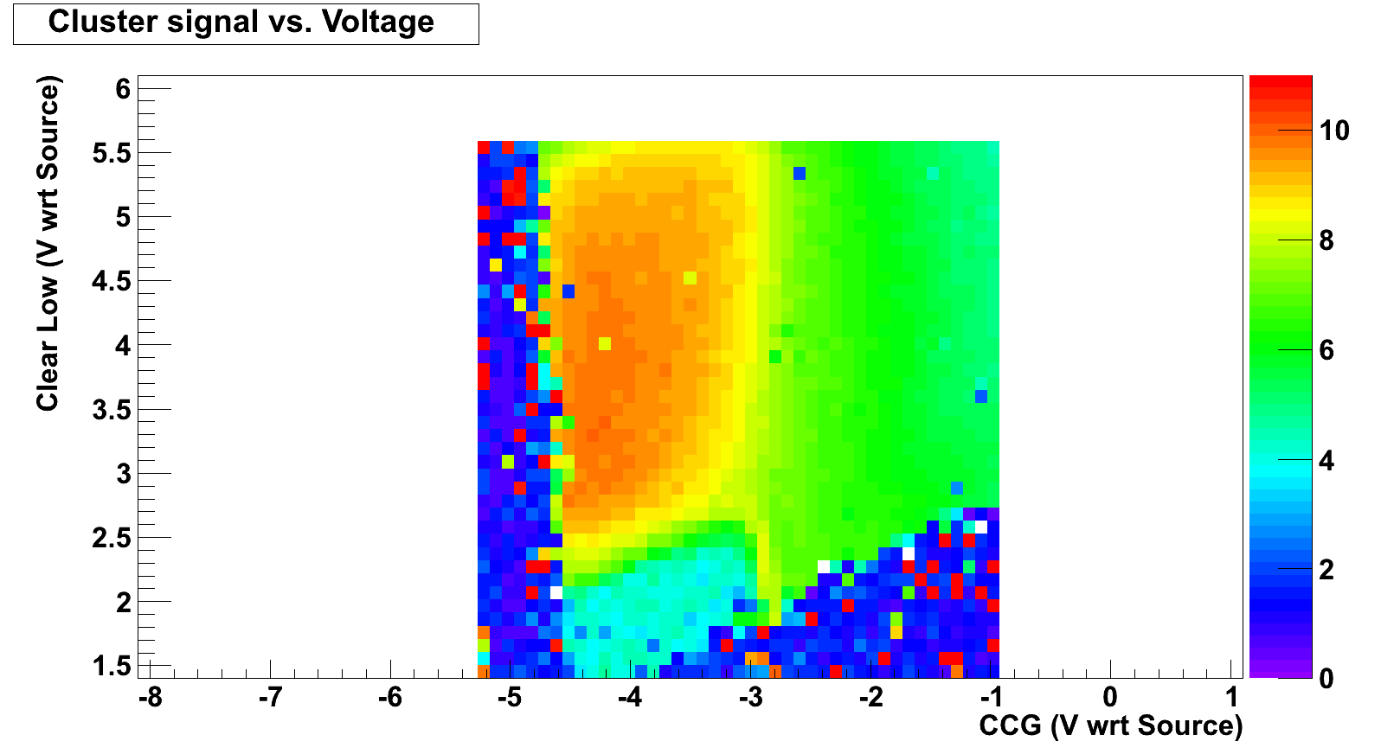
Irradiation – after 1.1 kGy

Slide 17
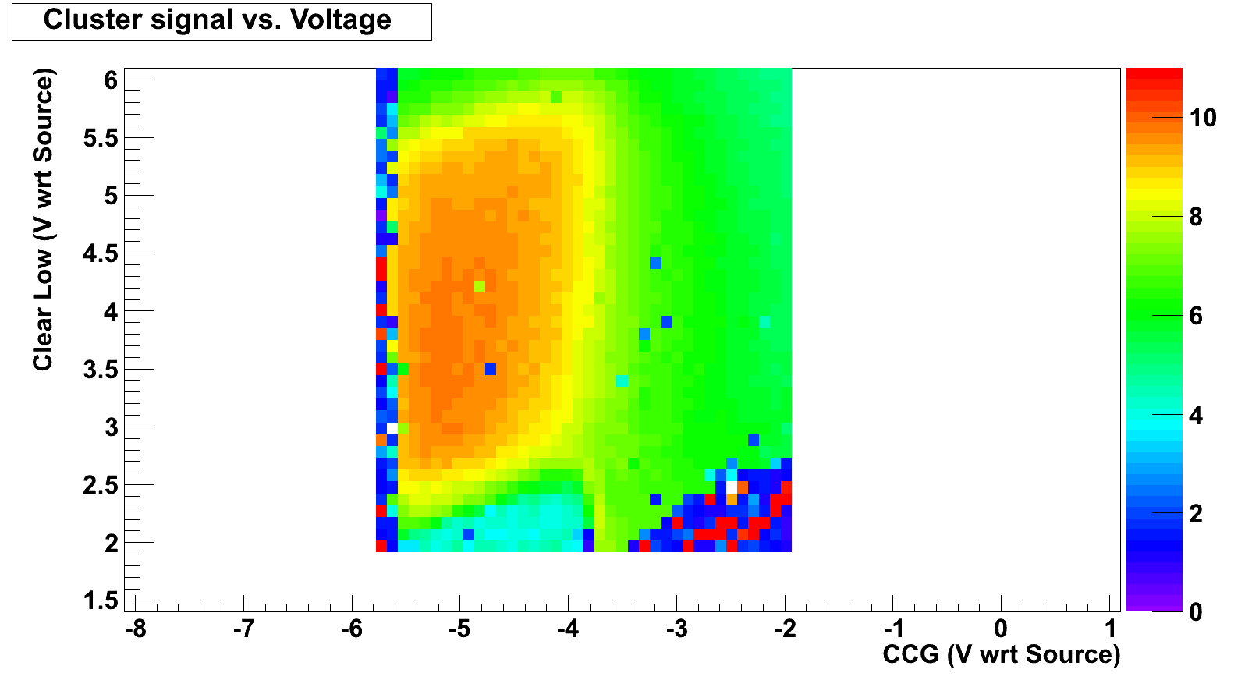
Irradiation – after 2.1 kGy

Slide 18
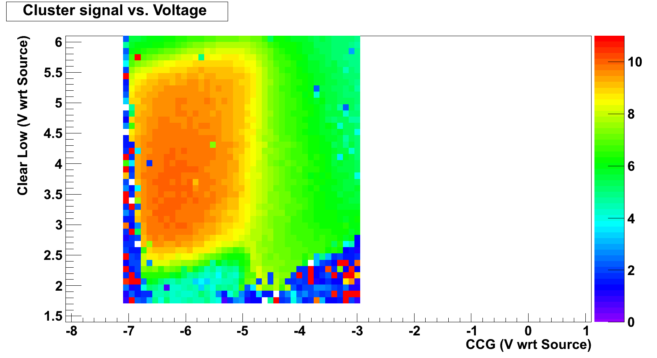
Irradiation – after 4.9 kGy

Slide 19
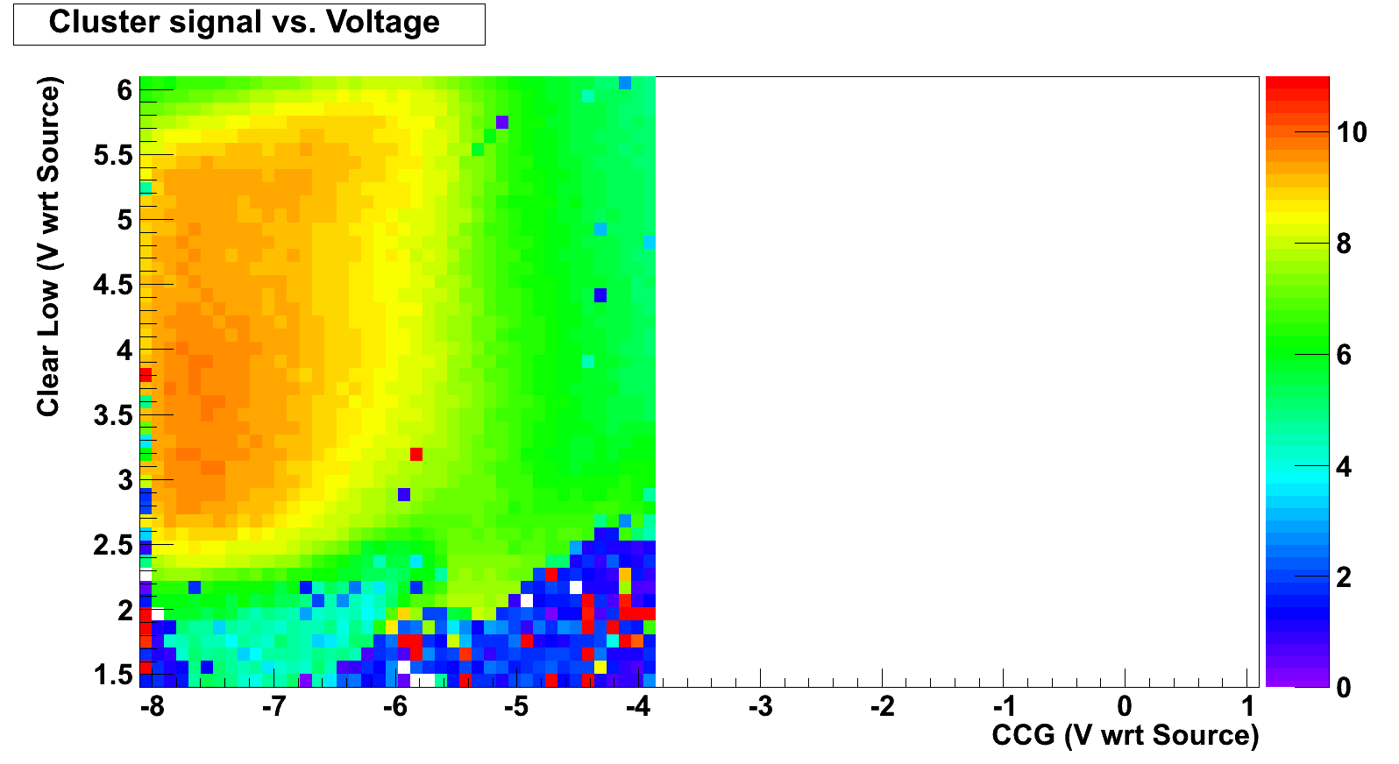
Irradiation – after 14.2 kGy
Adapting CCG for Clear Low 4 V

