Slide 1
•Florian Lütticke
PXD Calibration during Phase 3
Universität Bonn, Physikalisches Institut, Nussallee 12

Slide 2
Current calibration
Optimize DCD delay settings
„Optimize“ DHP link settings
Optimize DCD parameters
RefIn vs AmpLow, IPSource vs IPSource2
Measure DCD gain
Optimize Matrix bias voltages
HV – Drift, Cleargate – Clear Low. Gate On vs DCD SubIn setting.
Optimize Offsets
Mass Testing optimization takes about two days.

Slide 3
Calibration in Belle 2
Current Plan: 10 min every day for calibration
We need a way to speedup and split our calibration.

Slide 4
calibrations
Optimize DCD delay settings
„Optimize“ DHP link settings
Optimize DCD parameters
RefIn vs AmpLow, IPSource vs IPSource2
Measure DCD gain
Optimize Matrix bias voltages
HV – Drift, Cleargate – Clear Low.
Gate On vs DCD SubIn setting.
Optimize Offsets
Fast – might not be necessary
Slow – might not be necessary
Slow – necessary for performance
Fast – nice to have for performance
Slow – probably necessary for performance
Fast – so far done by hand
A little slow. Necessary
We need operational expertise with an irradiated module.

Slide 5
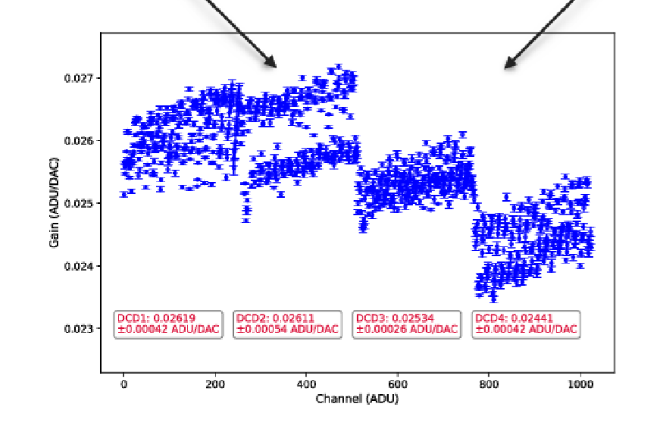
DCD Optimization
Two Methods: DEPFET and DHE current source.
DEPFET current source is faster
DHE allows absolute calibration.
Both too slow for a full measurement.
Suggestion:
Use DEPFET current source
Measure the default setting and a few other settings each day (3-5min)
After some weeks we have a complete scan
Use default setting as reference.
Every N days measure a few channels with the DHE Source

Slide 6
Matrix optimization
We expect a somewhat large operation window -> As long as we are inside we don‘t care.
We need a radioactive source -> Belle II
Suggestion:
Every few days perform (production!) runs with bias settings different from the defaults, which still should be in the optimal window.
If the new settings are better or worse, we should change the default accordingly.

Slide 7
Offsets and IPSUBIn
Full Offset calibration needs too long.
Solution:
Perform incremental calibration:
Calibration for neighboring IPDAC, IPSubIn DCD setting (e.g. 5x5 area, 7 minutes).
If better offsets are found -> update
Will also optimize IPSubIn

Slide 8
Gate On:
There is no script yet. Do we automatize it or shall it be Shifter duty?
Suggested Procedure
3 Gate On voltages.
Switch off ACMC
Make sure that the mean pedestal for all switcher regions is about the same by adjusting Gate On and DCD SubIn
Adjust Gate On so that a certain source current is reached..
If needed, readjust DCD SubIn

Slide 9
My suggestions
What shall be done during our daily 10 min?
(A) Most of the time:
Pedestals: 30 sec
Noise scan: 30 sec
ADC scans in the remaining time.
(B) Once per week or month
Incremental Offset calibration
Then do pedestals
Then do noise scan.
If needed:
Gate On or any other stuff
Taking pedestals is automated in calibration IOC. Nothing else.
We need to automate (A) and (B)
We need to put all calibrations into IOC.
-> No more access to server!

Slide 10
Comments?
Thanks for listening

