Slide 1
DCD and Switcher: availability and testing plans
Ivan Peric, Roberto Blanco

Slide 2
ASIC availability
DCD availability
800 x DCDB4.2
300 x DCD_EDET
200 x DCDC
200 x DCDC_EDET
All DCDs are diced (glued on a foil) but not tested
SWITCHER availability
4 wafers with each ~56 reticles x 2 chips

Slide 3
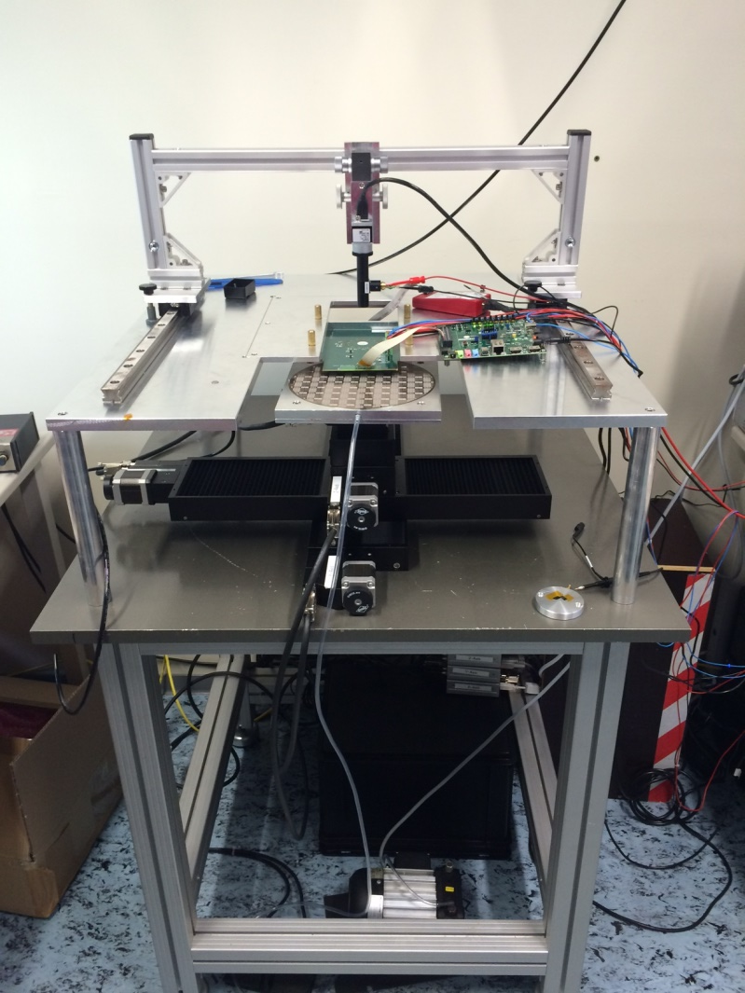
Wafer tests
Testing: KIT can do tests

Slide 4
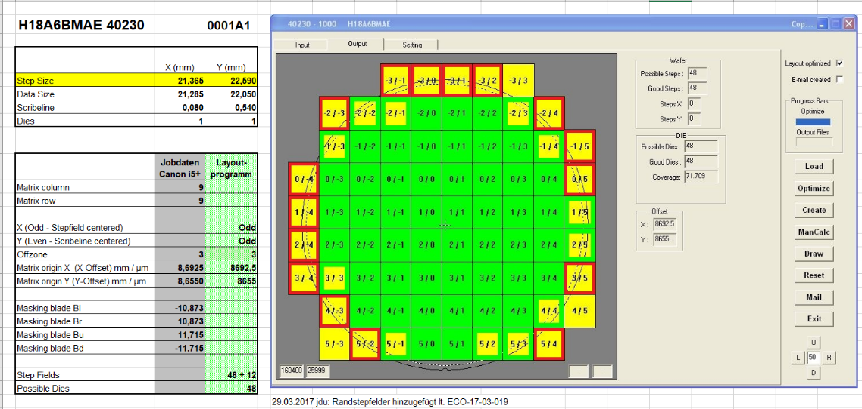
Modified SWITCHER design
Modified SWITCHER design - SWITCHERBa18
Technology: AMS aH18 instead of AMS/IBM H18
Changes: Al instead of Cu for metal layers
Submitted as a chip on HVCMOS detector run
4 extra wafers on standard substrate ordered: cost 17.48k€
4 wafers with each ~56 reticles x 2 chips
Wafers will be bumped at IZM – one wafer already sent to IZM

Slide 5
Modified SWITCHER design
DC current consumption of a regulator halved
  SUB DC current consumption: 2 x 360µA
Clamp circuit added between vdd and gnd and between VddRef and SUB
Changes in termination to allow functioning without JTAG
  DAC LSB hard coded to 1 to work without JTAG
  SerInN/P have hard coded 100Ω termination
  GStrN/P, CStrN/P, CkN/P have hard coded 600Ω termination
  Old SWITCHER design had programmable 50Ω termination
Only one chip edge
600k
1.5p

Slide 6
Modified SWITCHER design
SerInN/P have hard coded 100Ω termination
GStrN/P, CStrN/P, CkN/P have hard coded 600Ω termination
100
100
600
600
100
CkP
CkN
100
100
600
600
SInP
100
SInN

Slide 7
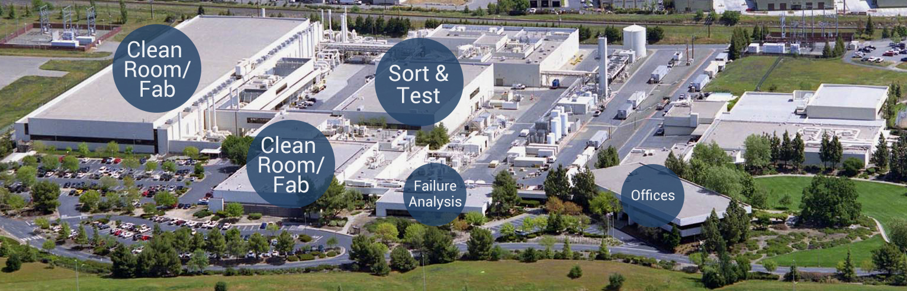
TSI
H18 process – foundries AMS, GF/IBM, TSI
If a new SWITCHER design is needed, it can only be submitted by TSI semiconductors
TSI have licensed the H18 process, same layout can be submitted
MPW and cheap engineering runs are available
We have tested the process within HVCMOS sensor project
It is difficult to find replacement for H18 technology, other 180nm HVCMOS processes (XFAB, ONSEMI, TSMC) use thicker gate oxides for HV transistors -> radiation tolerance may be worse

Slide 8
Summary
Bumping of about 450 SWITCHERa18 chips is starting at IZM
>800 DCDs available
Chips will be tested at KIT
Modified SWITCHER design SWITCHEa18
  Works without JTAG
  Should be more reliable
New foundry for SWITCHER – TSI
Design modifications for SWITCHED and DCD can be done

