Slide 1
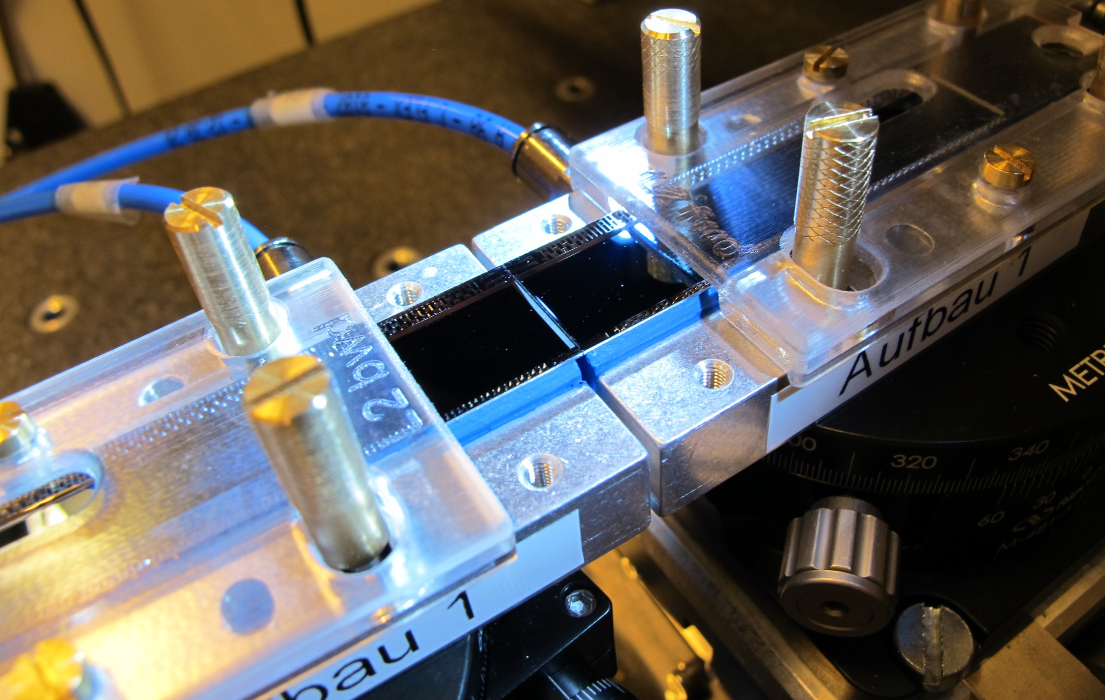
Ladder Assembly
Statistics
Issues
New gluing procedure (proposal)

Slide 2
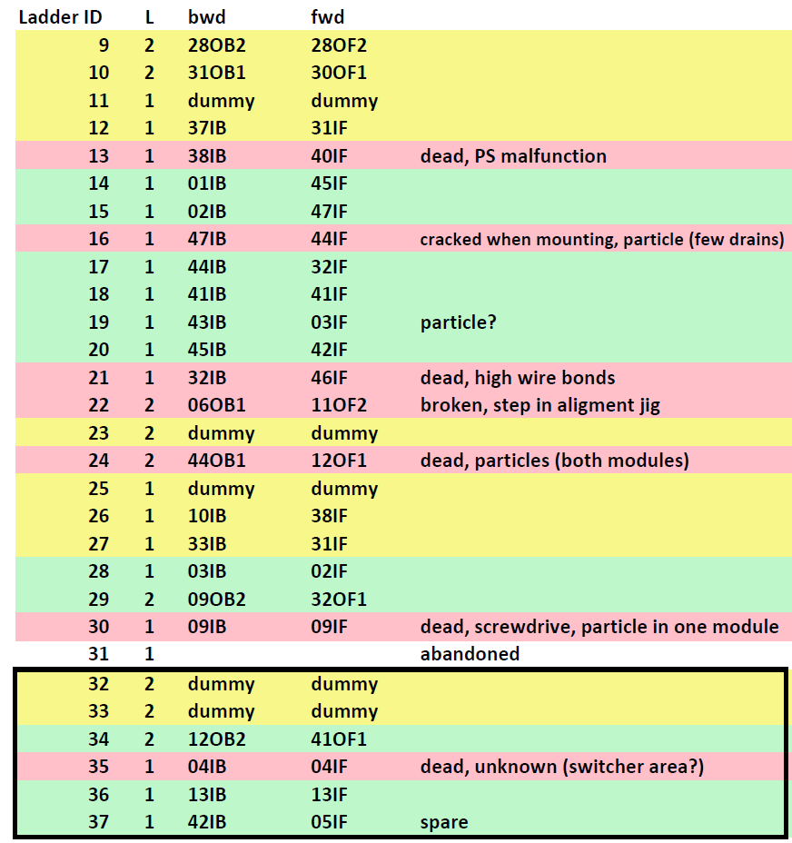
Statistics
18 ‘hot’ ladders glued
11 working ladders (10 in Phase III)
1: PS malfunction
1: jig misaligned
1: hit by screwdriver
1: particle
1: high wire bonds
1: cracked when mounting
1: unknown
Damage by particles
Some drain lines in 1 module
2 dead modules (in one ladder)
unknown (hidden by screwdriver acc).
~ 4 occasions
With nylon mesh

Slide 3
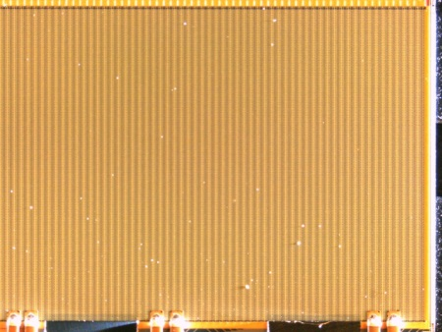
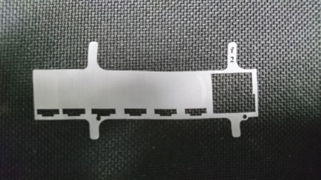
Problems
Particles pressed by into module surface (sensitive) leading to shorts:
- dead drain lines
- complete failure of the module
Measures:
- strict inspection and cleaning of modules and jigs
- nylon mesh
No such failures any more but:
- small statistics
- no absolute guarantee that all particles can be removed
- time consuming (45 min -> 4h)
Modify assembly procedure such that the module surface is not touched
Keep steps which are proven to work

Slide 4
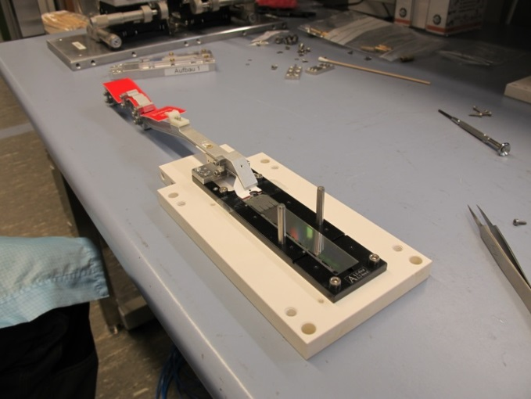
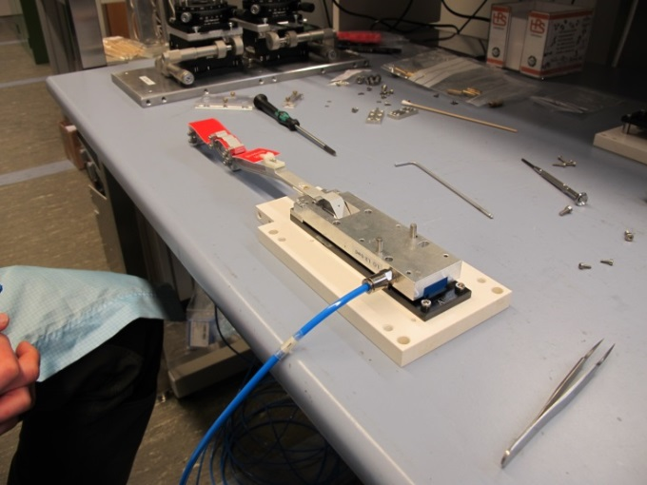
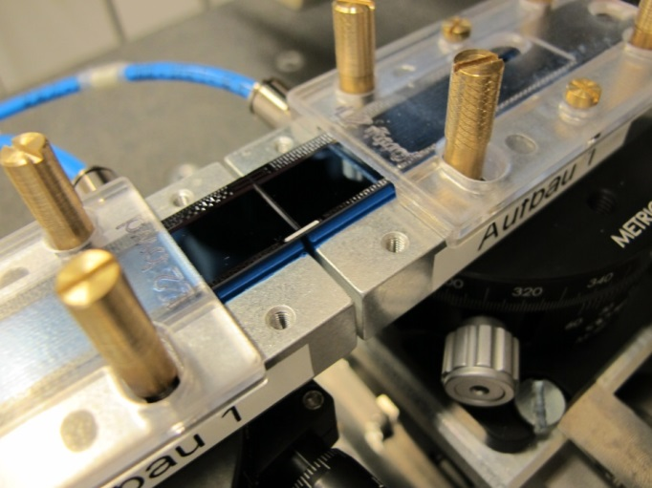
Old procedure
Module face up on jig
Transfer too put on top
Module fixed on transfer tool by vacuum
Flip and put on alignment stage
Groves on top
Glue and ceramic stiffeners are inserted by hand
Modules were glued face down, to get ceramic stiffeners into the grooves on the backside.
Can these stiffeners be inserted from below?

Slide 5
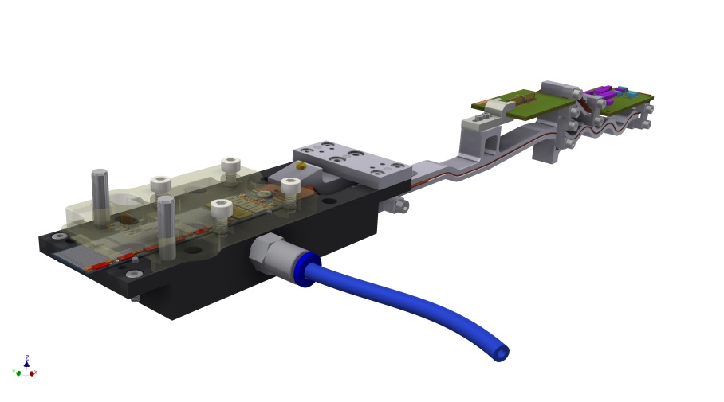
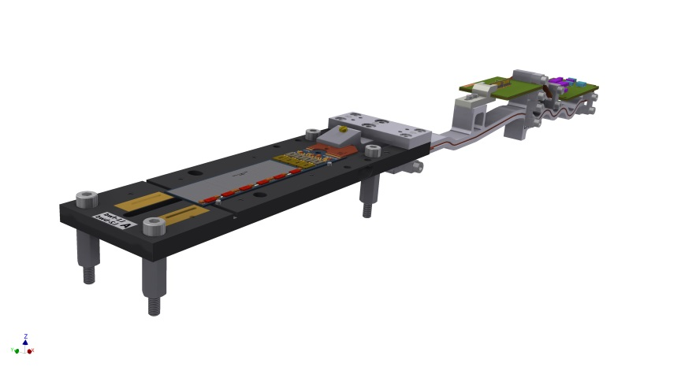
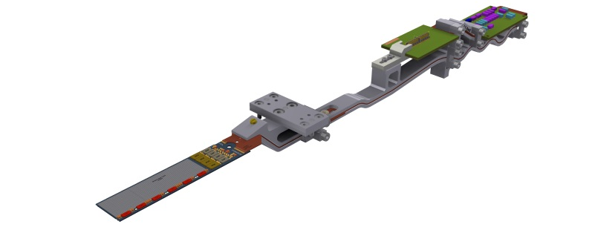
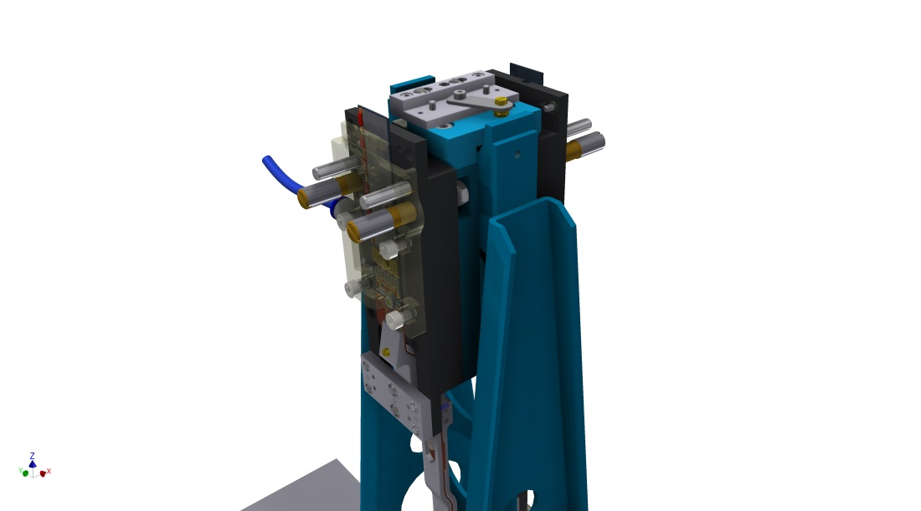
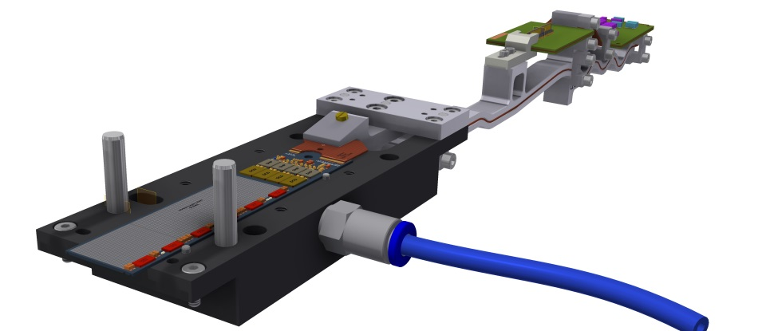
Proposal
Tscharlie Ackermann, Enrico Töpper:
1) Module on transport & test jig
3) Cover with protective cover & clamp
2) Take off and put on glue jig
Glue jig almost identical with test jig, just shorter
Held by vacuum (balcony and EOS)
Similar procedure as after kapton soldering
4) Dispense glue (modules & stiffeners)

Slide 6
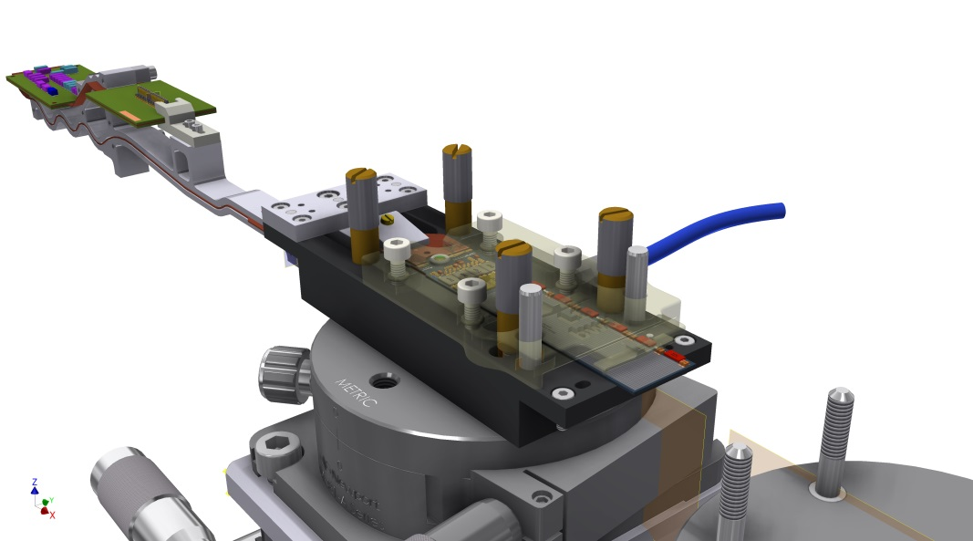
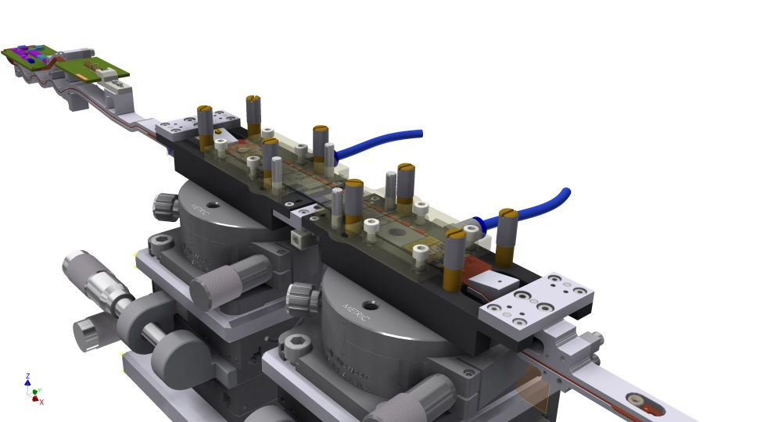
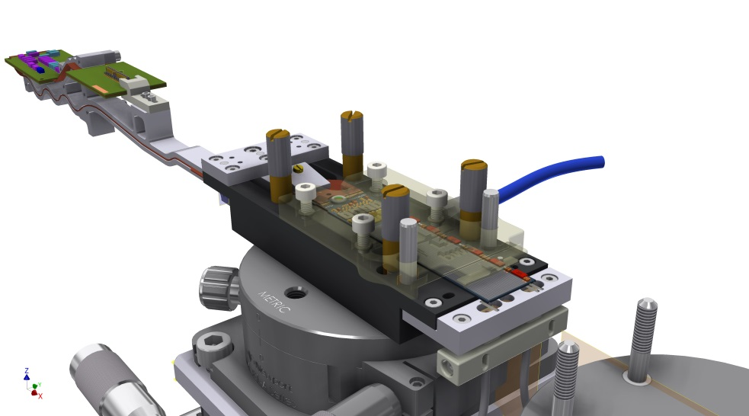
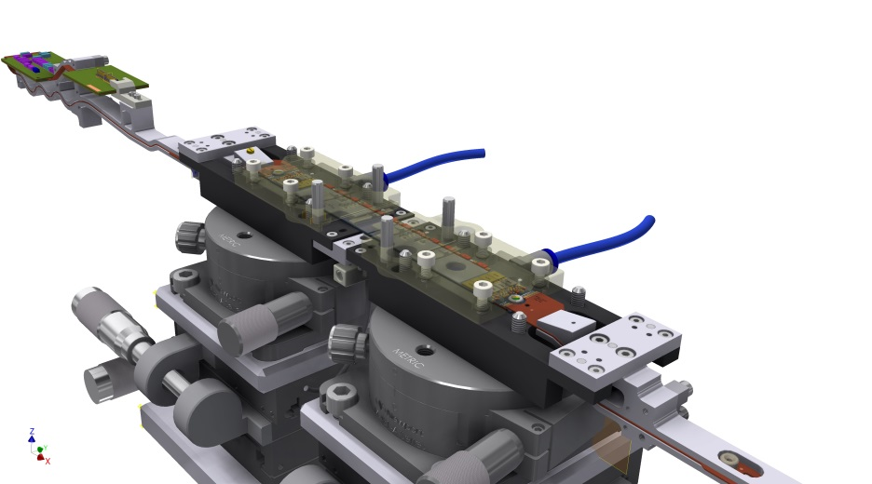
Proposal (cont.)
5) Place on alignment stage
7) Place 2nd module on stag
6) Add table with ceramic stiffeners
8) Align and join together

Slide 7
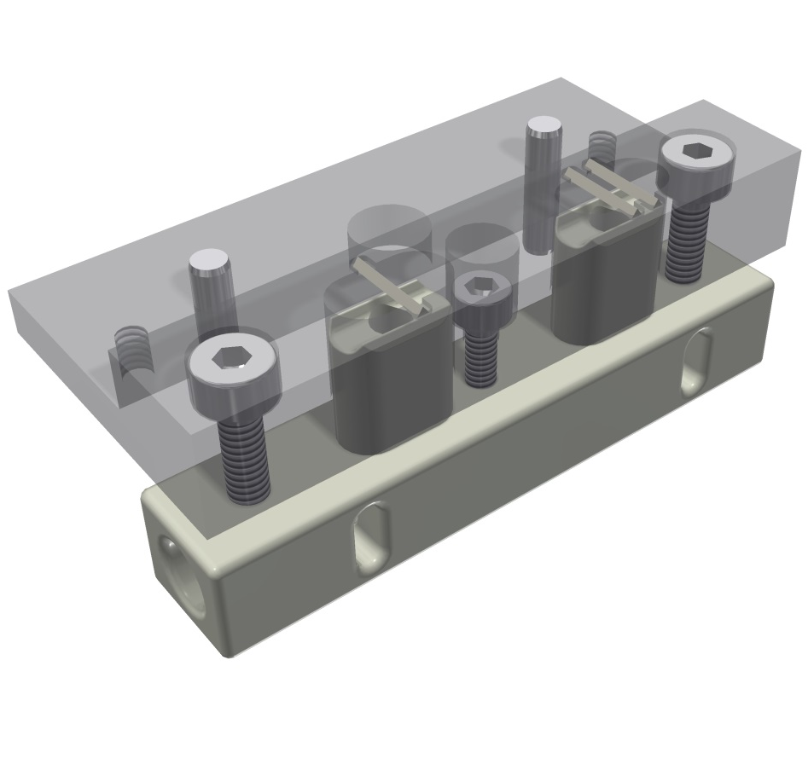
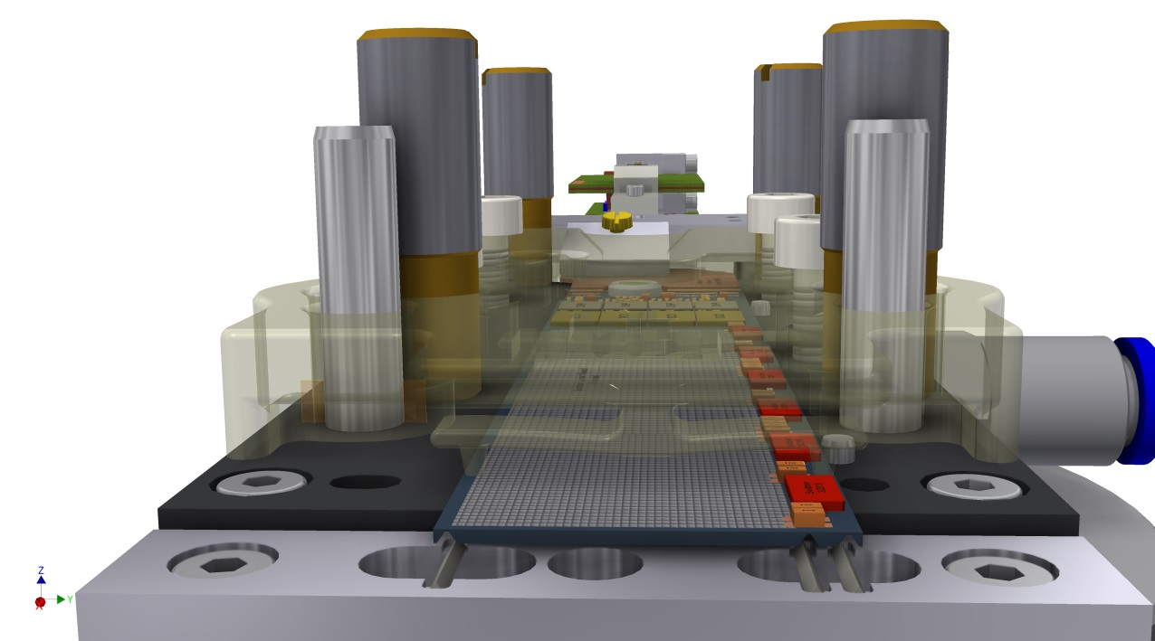
Proposal (cont.)
Ceramic stiffeners placed in slots in a table exactly under the grooves.
Pushed inside grooves by lifting guided lifters.
Stops to prevent over-travel.
Self alignment due to triangular geometry (to be checked).

Slide 8
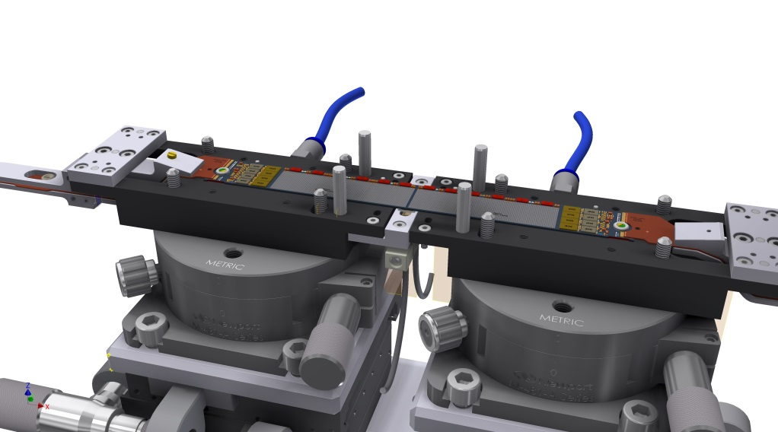
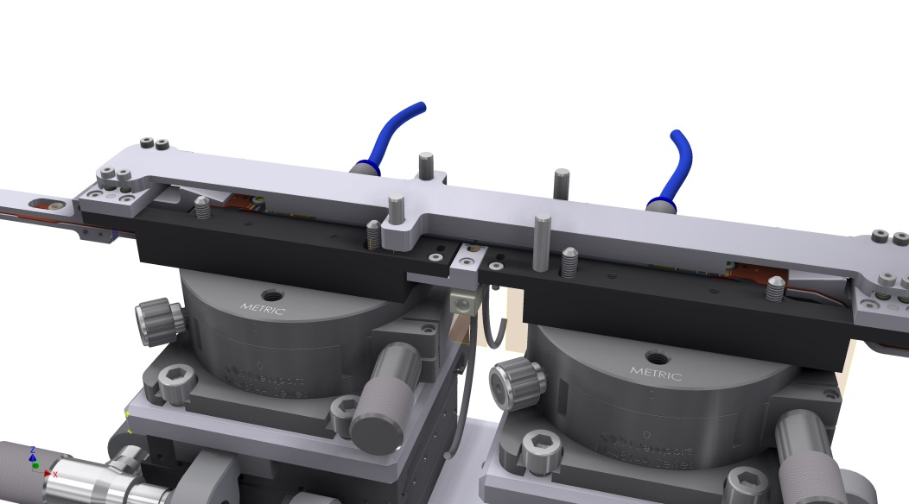
Proposal (cont.)
9) Place stiffeners, cure for 48h
11) Lift off and place on ladder jig
Same procedure as for ladder mounting
10) Add lift off jig
12) Remove lift off jig

Slide 9
Tests
Looks feasible
Procedure even simpler than old one
no turn-over (was critical)
automatic glue dispensing on stiffeners (better reproducibility)
less manual steps
However, everything has to be tested thoroughly so that the final procedure evolves
Test glue dispensing on ceramics
Does self alignment work?
Can the stiffener jam?
Need to stop over-travel, don’t apply too much force which can break module
First trials started
Glue dispensing on ceramic stiffeners
3D printed models of tray fro stiffeners
Prepare dummies (Material for 4 dummy ladders available but more is needed)

Slide 10
Location/manpower
Where and by whom?
Presently: ‘gray’ room at MPP (not really clean, class 10000 at best)
Operator: Enrico Töpper
Could continue like that (with some improvements of environment)
Availability of Enrico already agreed (>50%)
Alternative: Move to HLL (real cleanrooms)
Development and tests of procedure and stages at MPP
Transfer of tools (incl. glue dispenser) too HLL
(CMM to align modules cannot be transferred, HLL has to buy one)
Enrico does the assembly at HLL
However, Enrico is needed for ATLAS MDT too
(and other small jobs). Discussion needed, will not be easy.

Slide 11
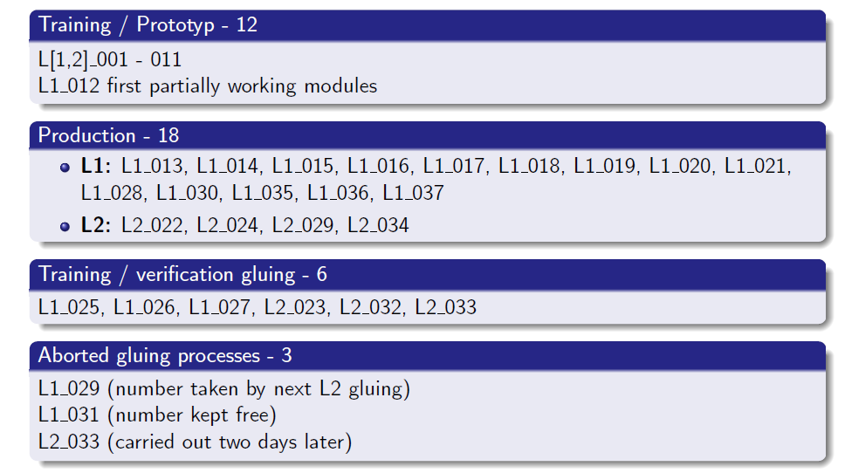
Overview
Philipp Leitl

Slide 12
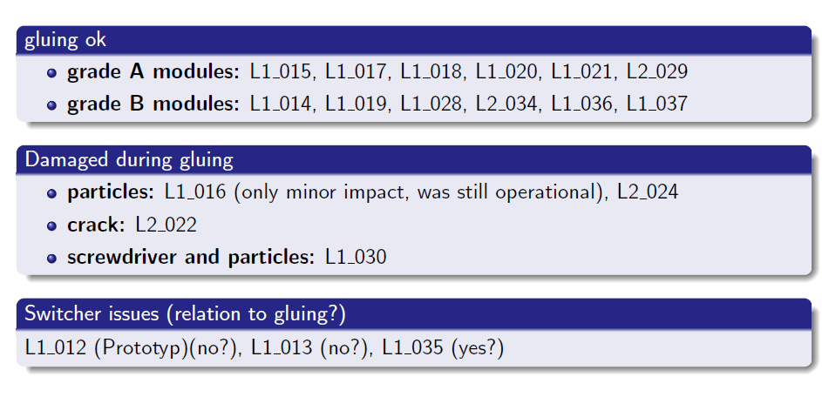
Overview
Philipp Leitl

Slide 13
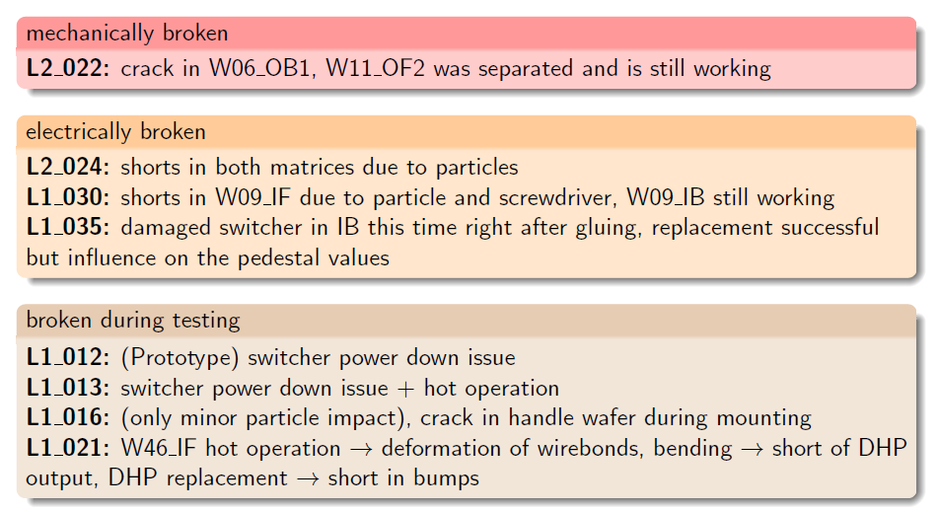
Overview
Philipp Leitl

Slide 14
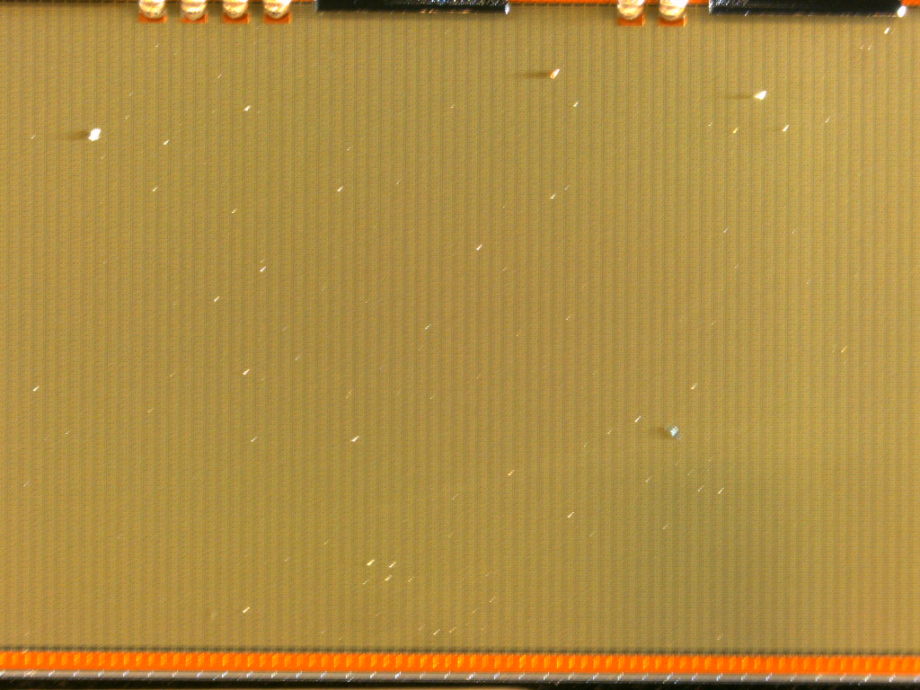
Module Inspection

Slide 15
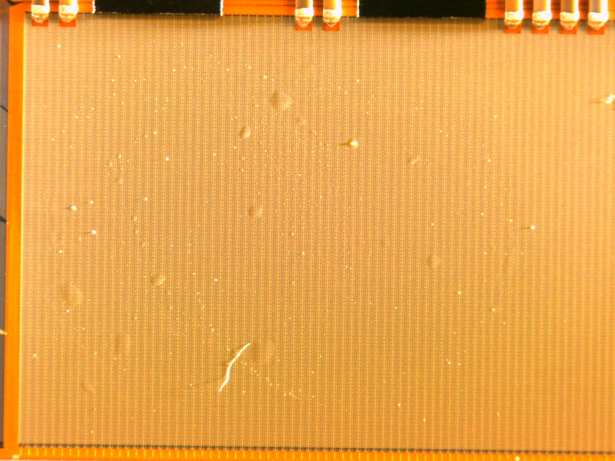
Inspection

