Slide 1
•Florian Lütticke
PXD Local DAQ Status
Universität Bonn, Physikalisches Institut, Nussallee 12

Slide 2
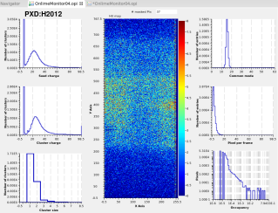
PXD local DAQ
HLT
x 8
DHE
Express Reco
DHE
ONSEN
EVB
DHE
Simplified
DHE
DHC
DHE
Subset of events
BonnDAQ
Standalone DAQ running without HLT for
PXD Calibration data
PXD DQM on full data (no ROI)
Proven useful in Phase 2

Slide 3
PXD local DAQ for Belle II
CMD Client(s)
Single instance with all data or multiple instances for independent calibrations
Keyboard Command Decoder
TCP Command Server
Control
BonnDAQ instance
Statistics/ Health
DHE/DHC Receiver Thread
Event building and sorting
Data Distribu-tion Server
Buffer 3
DHE/DHC Receiver Thread
File Writer Thread
DHE/DHC
DHE/DHC Receiver Thread
DHE/DHC
Buffer 1
Buffer 2
DHE/DHC
Buffer 1
Compression thread pool
Buffer 1
Compression thread pool
Compression thread pool
Data listener(s)
Data File
Error log file
Error log file
Error log file

Slide 4
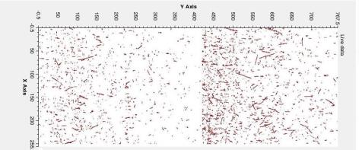
Software: EPICS Integration status
DQM display (python + CS-Studio)
Gets live data and calculates PXD DQM plots
Creates EPICs server and publishes results
Results are saved per run by ELOG server and are uploaded by Harrisons ELOG Server
Single threaded
TBD: Expand to one thread per DHC3
Hitmap
Live view
Cluster charge
Single pixel cluster charge
Seed charge
Occupancy (per pixel)
Cluster size
Common Mode
Pixel per Frame

Slide 5
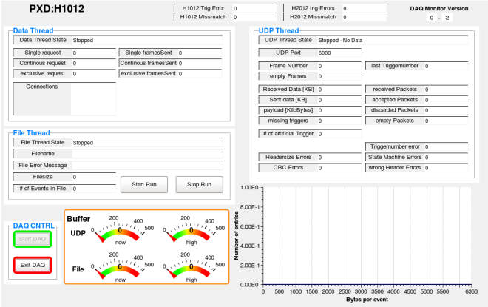
Software: EPICS Integration status
TBD: DAQ Health module (python + CS-Studio)
Shows status of threads, filename, file size, connected clients (for live data), buffer fill status, error counts etc.
Creates EPICs server, requests DAQ status and publishes EPICS variables.
OPI display available
Basic module ready, not feature completely
Some functionality now in Harrisons Utility IOC (Starting/Stopping DAQs)

Slide 6
Development status: Work packets
Port from pthread
Develop new File format
Basic
Efficient
Develop event building thread
Implement group event support in data distribution thread
Basic
Efficient
Performance Fixes:
Use preallocated buffers
Unwrapping UDP in Userspace
Less system calls for UDP
Prepare for Jumbo UDP frames
External dependencies
Port to new BLOSC version
Port to new JSON serializer version
Develop test bench (mostly done)

Slide 7
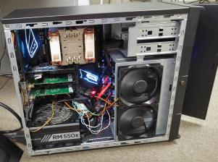
PXD local DAQ: Hardware
Phase 2
Main System: Lab PC
Backup System: Powerful Lab PC
12 Core, 32GB RAM
32TB Storage
1TB fast Storage
Installed in E-Hut
Currently used for DAQ Tests
Phase 3
Main: Server
24 Core, 128GB RAM
40 TB Storage
2TB fast Storage
Currently at HLL
Currently used for Commissioning
Backup System: As Phase 2

Slide 8
The Servers ran several services in Phase 2
PXD Local DAQ
ELOG Server
Reporting summaries for each run (Harrison)
Calibration Server
automatic calibration (Harrison)
Utility IOC
DHP temperature measurement (Harrison)
Online Monitor
Data format Monitor (TBD)
Online checking of data format errors not caught by PXD Local DAQ
DAQ Health Module (TBD)
Display DAQ Status and data format errors caught by PXD Local DAQ
What is the plan for Phase 3?

Slide 9
Resources for Calibrations
On Main System: 40 calibrations at once
1 Thread, 2.5GB RAM available per calibration
On Backup System: 10 Calibrations at once
1 Core, 2.5GB RAM available per calibration
Calibrations needing more memory need to be run at lower parallel count.
Please consider this numbers when creating calibration programs.

Slide 10
Data Storage
No live data storage on KEKCC due to slow connection.
“Unlimited“ backup storage on KEKCC
Data flow (current plan):
Store raw data on fast (SSD) Storage.
Store analysis results to local (HDD) storage, move raw files to local storage.
Backup data at KEKCC
Backup needs a password – but we need an automatic routine.
We need to create a default folder structure.
How to Access PXD local Data
Login to KEKCC with your credentials
The data is located in: /ghi/fs01/belle2/bdata/group/detector/PXD/
The folder is available on all KEKCC login nodes.

Slide 11
Data Estimates and Calibration Time for Phase 3
Needed! Current Plan: 10 min every day for calibration
Suggestion 1:
Pedestals: 30 sec
Noise scan: 30 sec
ADC scans: 3-5 min (Measure default setting and one setting to check for optimal values)
Gate On Voltage scan or other short measurement.
After a Month all surrounding settings will have been checked and a new optimal point can be chosen.
Suggestion 2:
For 5 IPDAC and 5 SubIn Settings, measure Offsets and select optimal setting. (7 Min)
Then do pedestals
Then do noise scan.

Slide 12
Conclusion
PXD local DAQ hardware ready and running at KEK. Tested with 5 kHz
Software still needs some work
How do we organize our data so that it is still useful in a few years?

Slide 13
(Old) data estimates
Pedestals:
Once per run, 3 runs/day, 200 days/year, 10 years: 6000 pedestals during lifetime
100 (1000?) Frames: 760MB (7.5GB) for pedestals
Total: 4 TB (40 TB)
Offsets
Once per Week, 40 weeks/year, 10 years: 400 Offset per lifetime
~32 (IPDAC) * 4(OFFSET) * ?4(SubIn) * 100 Frames: 100-400 GB for Offsets
Total: 40-160 TB
Delays
Once a month, 10 months/year, 10 years: 100 delays per lifetime
5 frames * 16 * 16 settings: 10 GB
Total: 1 TB
DCD transfer curves
Once per 2 months, 10 months/year, 10 years: 50 measurements
80 GB for all ADC channels (2MB channel, 2000 points/channel, 256 values/point), one setting. (2 * 25 settings?)
Total: 4 TB (200 TB?)
Time estimates:
Pedestals: 1 min DAQ + 1 min calc + 2 min upload. 4 min
Offset: 5 sec DAQ/setting * 32*4*4 settings. 40 min + calc
Delays: 4 sec DAQ/setting * 16 *16 settings: 18 min + calc
DCD transfer curves: DHE current source
10 min (All settings, one channel/DCD)
55 min (one setting, all channel)
42h (full scan)
Other Scans
SubIn/Gate voltage: Can be included in offset, would increase the time by 16 when using 4 voltage values and 4 SubIn values(then the scan is the perfect pedestal compressor scan) Else: Short SubIn VGate scan, then 10 min Offset scan. Much faster, perhaps less pedestal compression
Pedestal verification/noisy pixle scan: 1 min DAQ, 1 min calc

