Slide 1
LUXE accelerator update
F. Burkart

Slide 2
Option 1: Electron - Laser
Collimation
PDET
IP
Mirror
Laser
e⁺
Photon converter
Dipole
Dipole
CAL
γCAL
e⁺
γ
γ
e⁻
1bunch
Triplet
pulse
e⁻
Dump
Mirror
Dipole
17.5 GeV e⁻
EDET
E < 16 GeV
XTD5
Kicker & Septa
Dipole
XSDU1
Dump

Slide 3
Option 2: Photon - Laser
Collimation
PDET
PDET
IP
Mirror
e⁺
Dipole
Photon converter
e⁺
Laser
Dipole
CAL
γCAL
e⁺
γ
γ
e⁻
1bunch
Triplet
e⁻
Dump
pulse
e⁻
Dipole
Mirror
Dipole
17.5 GeV e⁻
EDET
E < 16 GeV
EDET
E < 16 GeV
XTD5
Kicker & Septa
Dipole
XSDU1
Dump

Slide 4
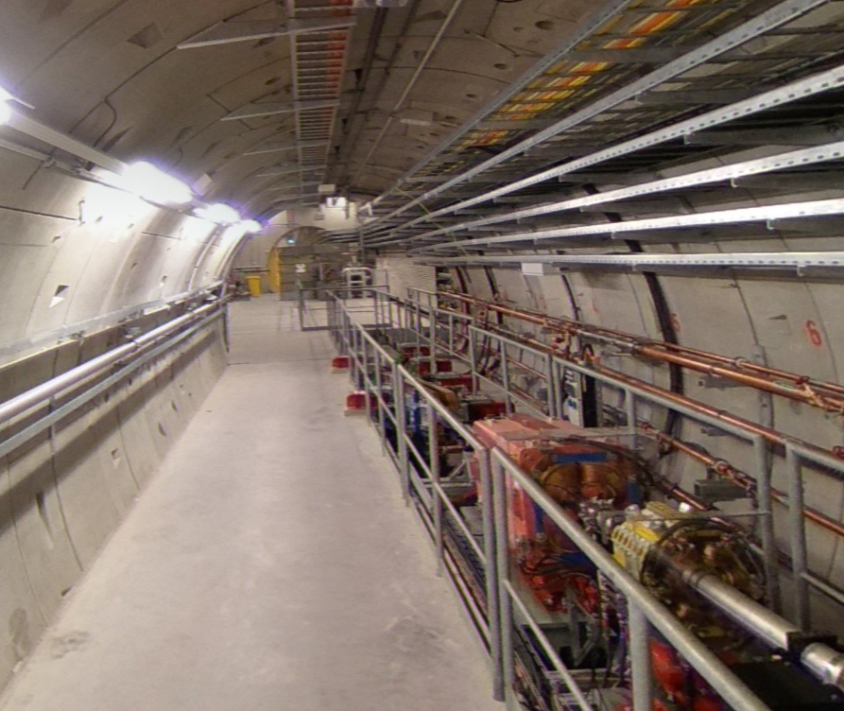

Slide 5
Next…
First contact with D3.
Integration studies.

