Slide 1
Tests on Chess 2 ASIC
Yubo Han_{IHEP} , Dionisio Doering, Pietro Caragiulo, Larry Ruckman, Camillo Tamma, Su Dong

Slide 2
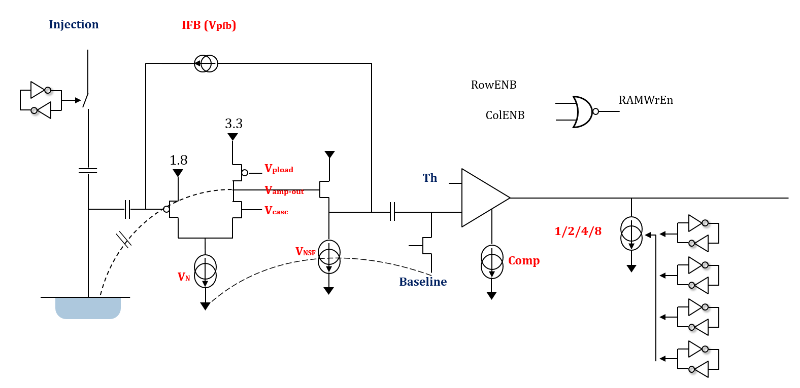
Pixel description

Slide 3
Outline
Review:
Ideal pulse: very fast raising/falling edge, narrow pulse
  Suggested by simulation
  Verified by tests using Red Laser with best setup
  Best signal from Red Laser:
    width ~ 5 micro sec
    Raising/falling ~ 2.5 micro sec
    Delay ~ 5 micro sec
Tests and observation （20Ohm/cm – Board #2）
  Impacts of laser trigger’s width
  Different trigger rate (same laser setup)
  The counts number of each individual pixels
    Roughly focused vs better focused

Slide 4
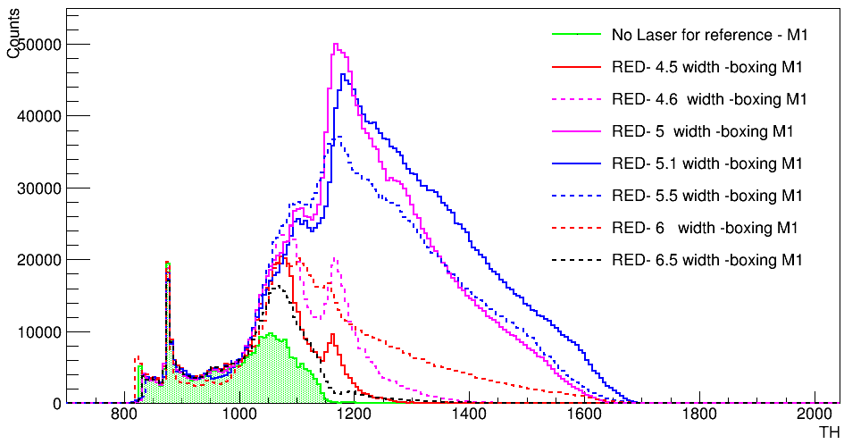
Trigger width of Laser
Tests with different trigger width:
(Confirm the observation )
Matrix 1
Delay fixed at 5 micro sec
BL = 0.75V
Keep laser position unchanged
The width of the trigger( laser) matters a lot to the results
Best width ~ 5 micro sec

Slide 5
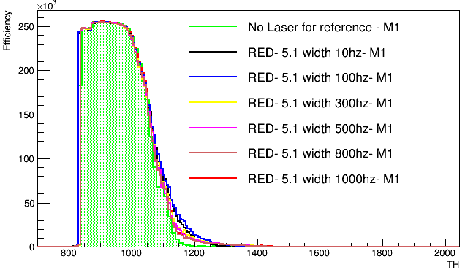
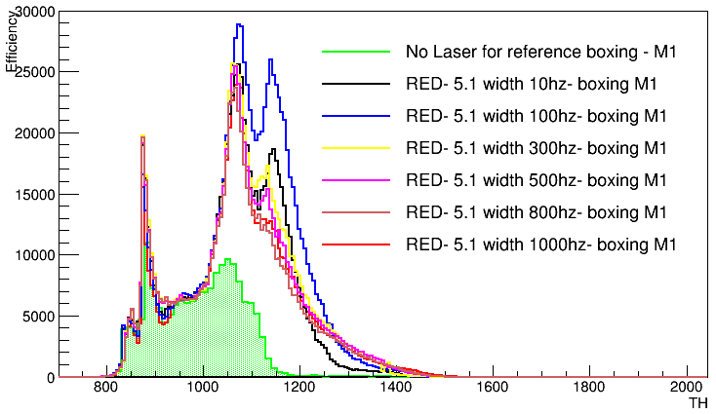
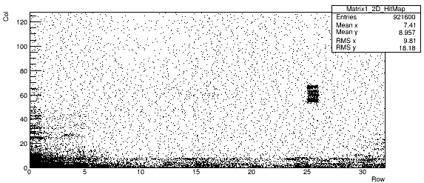
Different trigger rate
Not an Ideal signal after all (some recovery process or something else after signal)
-> change the time left to this process (by changing trigger rate)
Width and delay fixed at 5.1 and 5 micro sec.
Threshold scan with BL kept at 0.75V (930 [1V/1240])
Hitmap (summation of all the data)
Counts vs Threshold (edged pixel included or not)
Counts of 100 Hz higher than that of 10 Hz -> voltage goes up and then goes down?

Slide 6
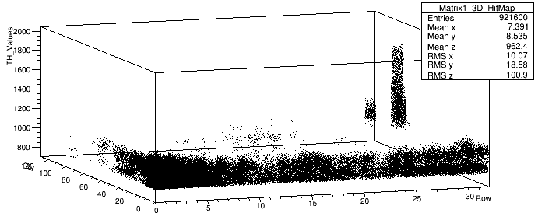
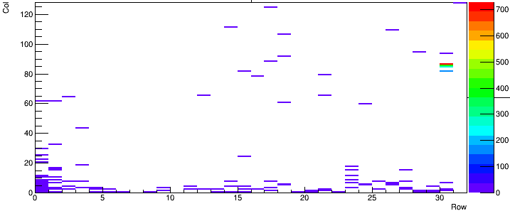
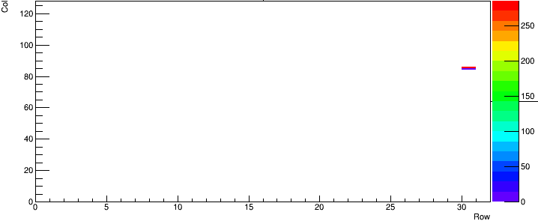
Counts of individual pixel
Constraints and biases:
Maximum 8 hits in one row
Each frame can only record one hit per strip
One frame could contain information of 32 hits of each matrix at most
Vibration of the platform/metal arm
Laser
High frequency noise can fired more than once
Unknown effects
Results will be confusing if more than 4 pixels fired in one trigger
Missing counts/ more counts(see backup slides)
Try to focus the laser (less than 4 pixels were targeted)
TH = 1408
TH = 1840

Slide 7
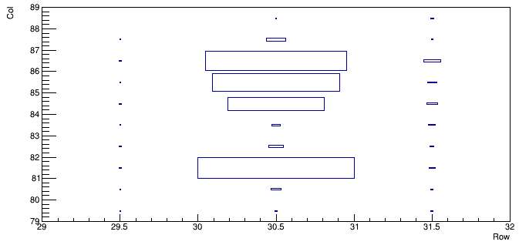
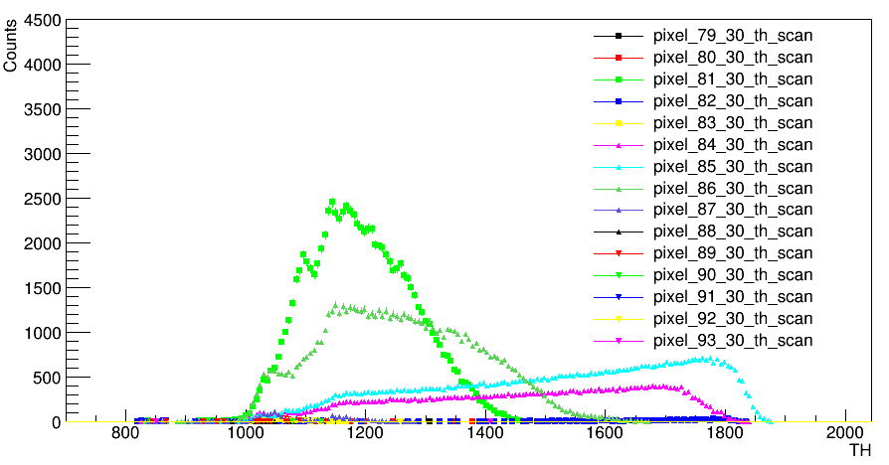
Counts of individual pixel
Try to focus the laser (less than 4 pixels were targeted)
Counts number of different pixels in row 30
Mainly contributed by 4 pixels
(81,30), (86,30), (85,30), (84,30)
Size of signal increased as laser better focused
Only (85,30),(84,30) response when Threshold larger than 1600(1.289V)
1000 Counts expected per Threshold
(81,30),(86,30) coupling with noise?
Address problem (receive hits from disabled pixels):
Only enable (81,30)
No hits from others pixels observed (same with different position of laser and different enabled pixel)
Only happens when multi pixel enables? Noise related?

Slide 8
Summary and Next
Identify optimal laser width setting
Pixel analog voltage excursions long after hits still to be understood
Real laser signal pixels showing sensible hit count ~ trigger count
Wrong hit address problem when multiple pixels enabled, but only for some pixels.
Next:
Optimize the pre-amp parameters

Slide 9
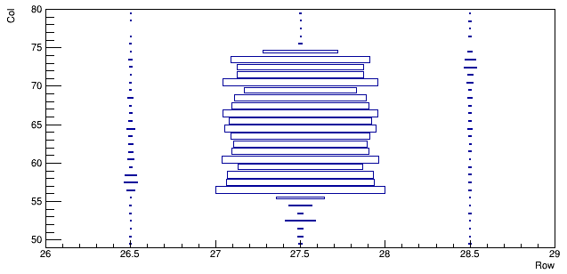
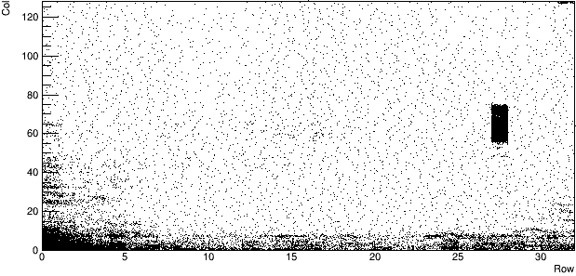
BACKUP Board #02 – counts of pixels – previous position
StreamRO_externalTrigger_Run7_20180830_160504_TH
5.5 micro sec width/ 5 micro sec delay
1000hz
BL =0.75V
Row : 26, 27, 28
Col: 50 ~80

Slide 10
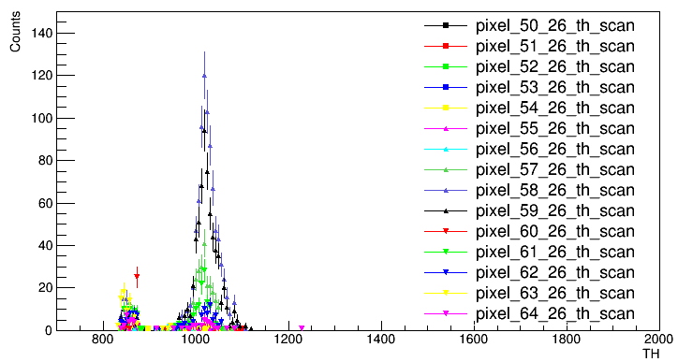
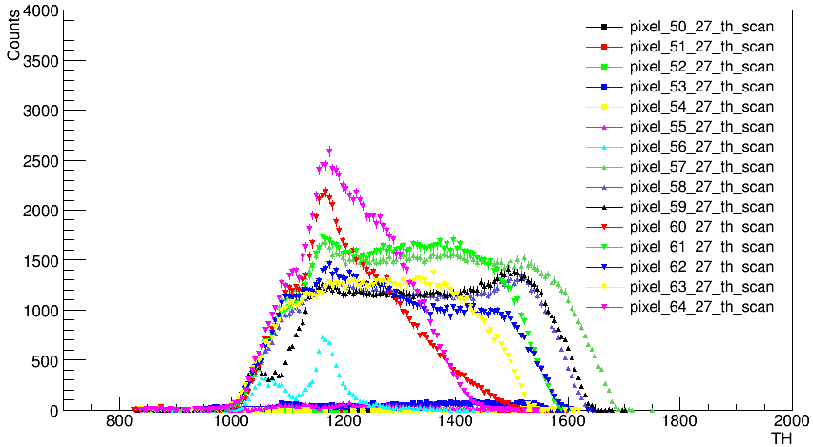
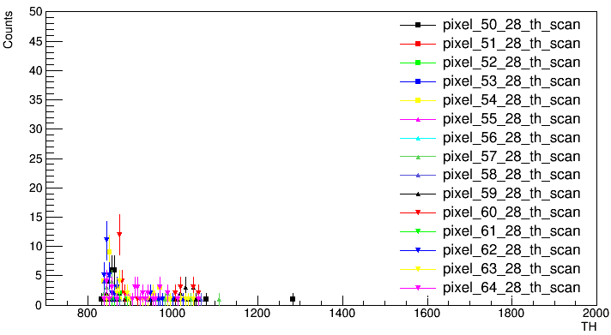
BACKUP Board #02 – counts of pixels – previous position

Slide 11
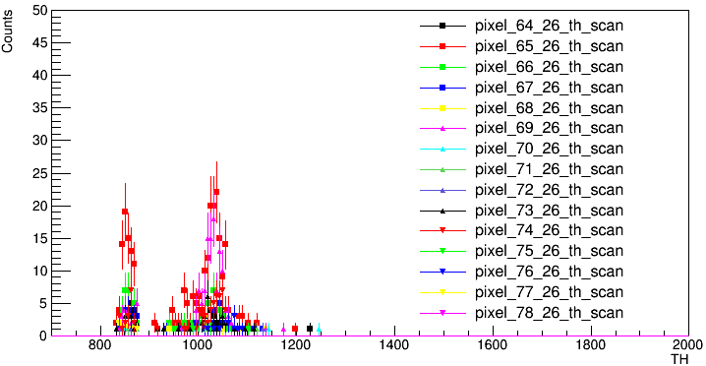
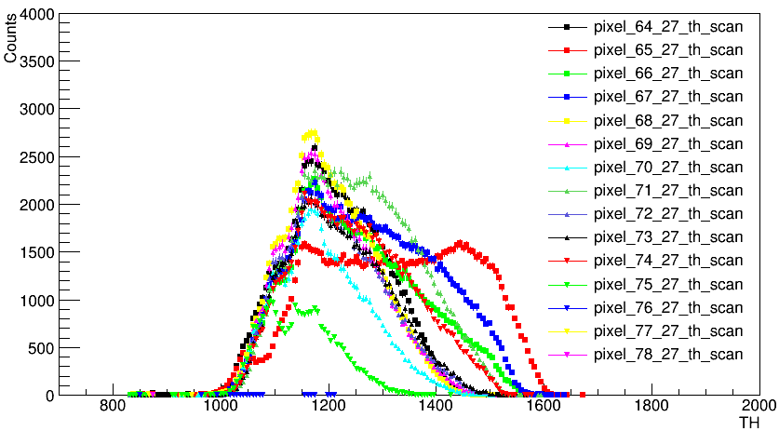
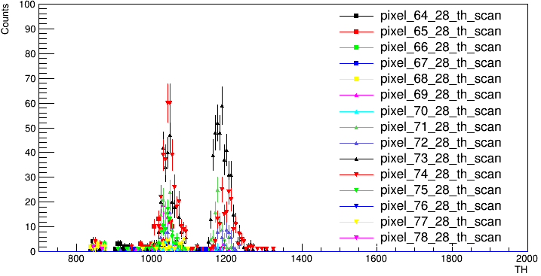
BACKUP Board #02 – counts of pixels – previous position

