Slide 1
Probing TeV-Scale Physics
with Heavy Flavors
Ulrich Uwer
Heidelberg University
Hamburg, November 2009
Disclaimer: Subject of this talk is B-Physics at LHC (b).

Slide 2
Flavor in the Standard Model
EWSB
Quarks
V_{pq}
p
Diagonalization of mass matrices:
6 Dirac masses, quark mixing in CC described by V_{CKM}
q
W
In SM Yukawa interaction only source of Flavor Violation
Masses and the mixing angles cannot be understood within SM
Notes:
Yukawa Interaction explicity breaks the

Slide 3
FCNC Processes in the SM
ΔF = 2
ΔF = 1
W
q
W
b
u, c, t
b
u, c, t
q
b
q
FCNC in SM suppressed:
Only in loop diagrams
CKM couplings small
GIM suppression (in B decays inactive)
Result of SM particle content and hierarchical Yukawa couplings
→ Suppression of FCNC processes not necessary present in generic extensions of SM.

Slide 4
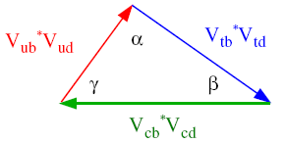
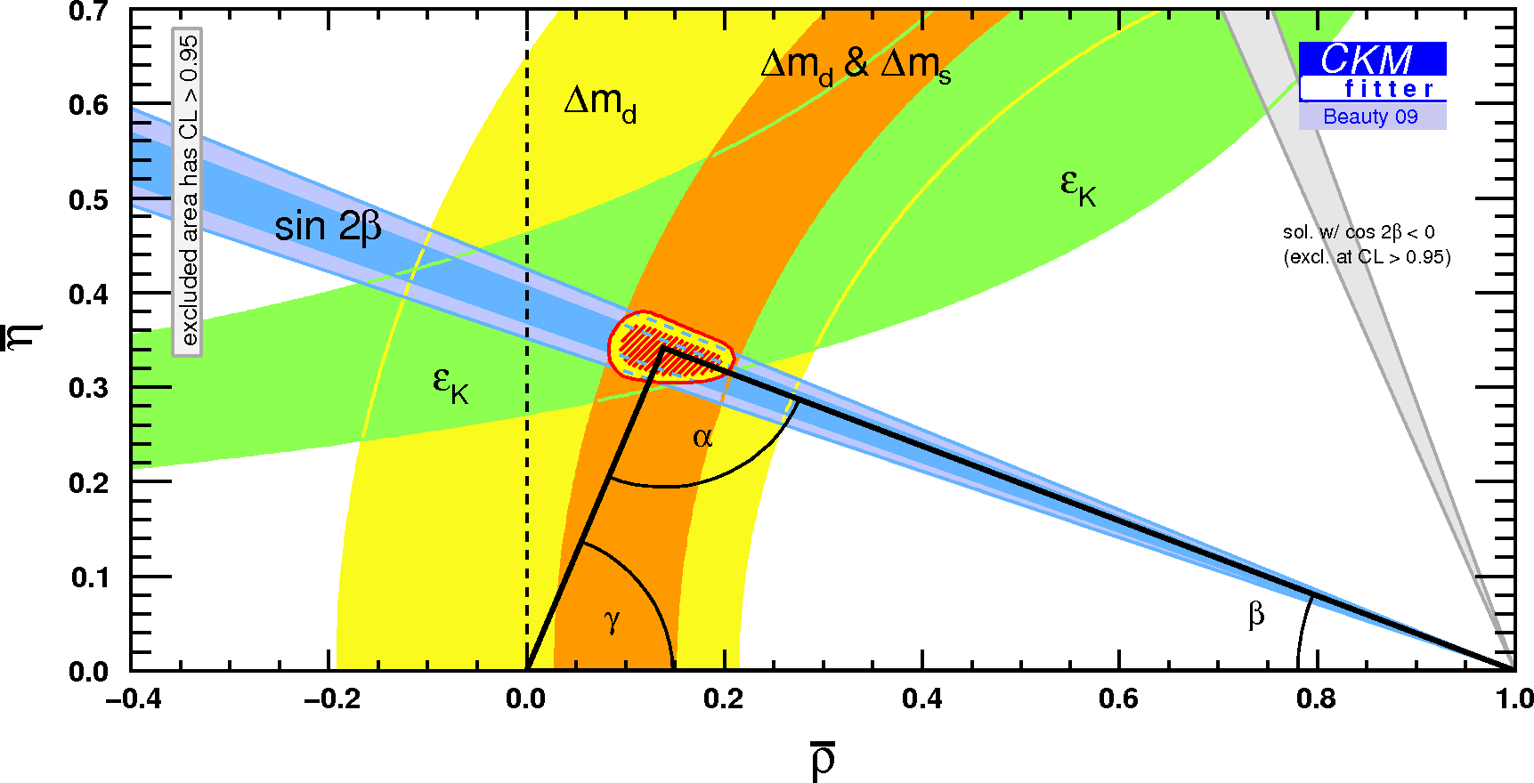
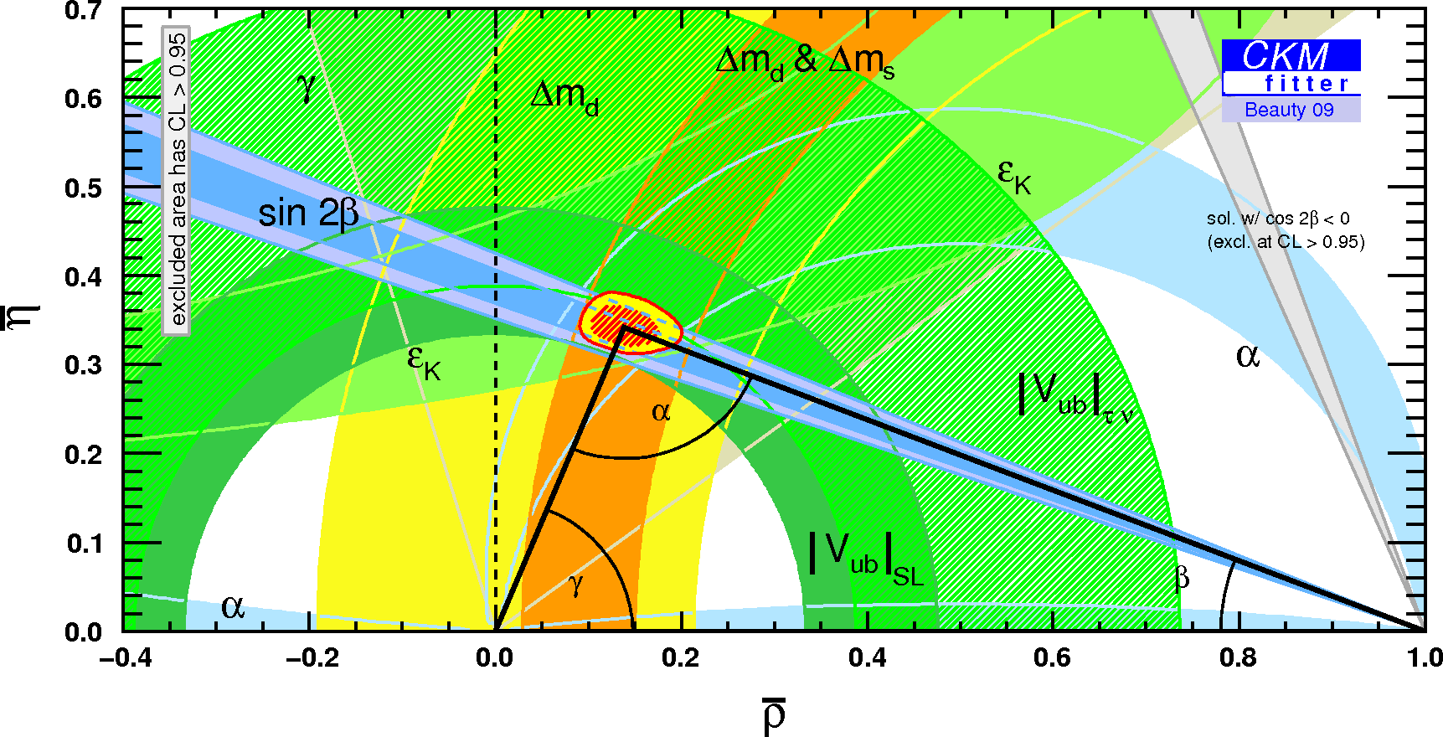
CKM paradigm works well
Constraints only from loops
Within uncertainties, Flavor Changing data well described by SM.
New Physics effects only appear corrections to leading SM terms.

Slide 5
Flavor Violation beyond the SM
New Physics*⁾ at Λ = O(Λ_{EW}) in low-energy effective theory
*⁾ electroweak
Effect on flavor changing amplitudes:
Y
b
u, c, t
s
b
X
s
“CKM” factors
Loop-factors
In most general case NP with generic flavor structure!
Notes:
series of higher dimensional operators in terms of Standard Model fields suppressed by powers of Λ. In case

Slide 6
Flavor Problem
No indication of large O(1) New Physics contribution to FCNC processes.
Puts severe constraints on New Physics.
Example: ΔF=2 mixing measurements
(V_{tb}*V_{td})²
1
Λ²
A(B_{d}↔B_{d}) ~
+ c_{NP}
16 π² m_{W}²
G. Isidori (2009)
~ 1
tree + generic flavor
Λ > 2×10⁴ TeV [K]
~ 1/(16 π²)
loop + generic flavor
c_{NP}
Λ > 2×10³ TeV [K]
~ (V_{tb}*V_{td})²
tree + MFV
Λ > 5 TeV [K&B]
Not too far from EW scale
~ (V_{tb}*V_{td})² / (16 π2)
loop+ MFV
Λ > 0.5 TeV [K&B]

Slide 7
Minimal Flavor Violation
Flavor Physics
New Physics at TeV-scale must have*⁾ non-generic flavor structure.
*⁾ modulo some conspiracy
Minimal flavor violation:
Standard Model Yukawa couplings are the only non-trivial flavor-breaking terms also beyond the Standard Model.
Minimal flavor violation realized “by construction” in MSSM SUSY models (CMSSM, NUHM) often used as reference point.
MFV should not be taken as granted!

Slide 8
Flavor Structure of New Physics
Limit discussion to B decays important at LHC
Test MFV Hypothesis - Flavor breaking terms beside SM Yukawas ?
Study flavor structure of new particles if found by ATLAS/CMS.
Expect sizeable deviation even in MVF models
B_{s} mixing phase φ_{s}
b → s γ penguins
Very rare FCNC proc.
A_{CP} (B_{s} → J/ψ φ)
B_{d,s} → μμ
B_{d} → K*γ
B_{d} → K* μμ

Slide 9
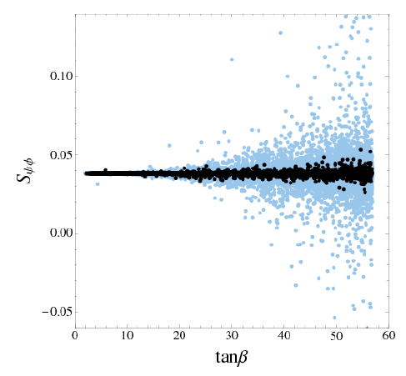
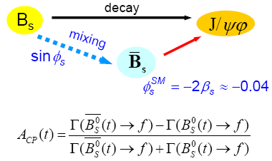
B_{s} Mixing Phase φ_{s}
φ_{s} from A_{CP}(B_{s}→J/ψφ)
Buras et al. (2009)
MFV MSSM Scenarios
- φ_{s}
Large (non-zero) CP asymmetry in B_{s} → J/ψφ rules out SM and MFV MSSM
Notes:
Plot: Blue points do not satisfy existing B physics constraints (b->sgamma). Black points satisfy these constraints. With MFV MSSM large
NP contributions are only expected for DeltaB=1 processes.
Hinweis: Es gibt inzwischen Verallgemeinerungen von MFV, die Flavor-diagonale CP-Phasen haben und damit Phasen arg(Bs) induzieren koennen. In den “Standard MFV” ist das aber nicht der Fall.

Slide 10
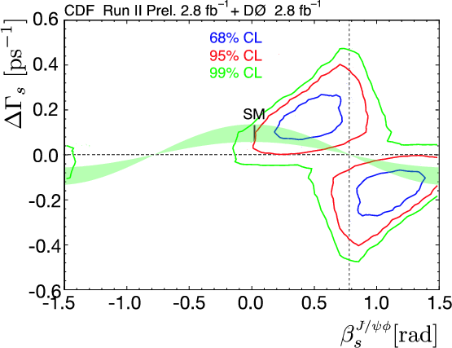
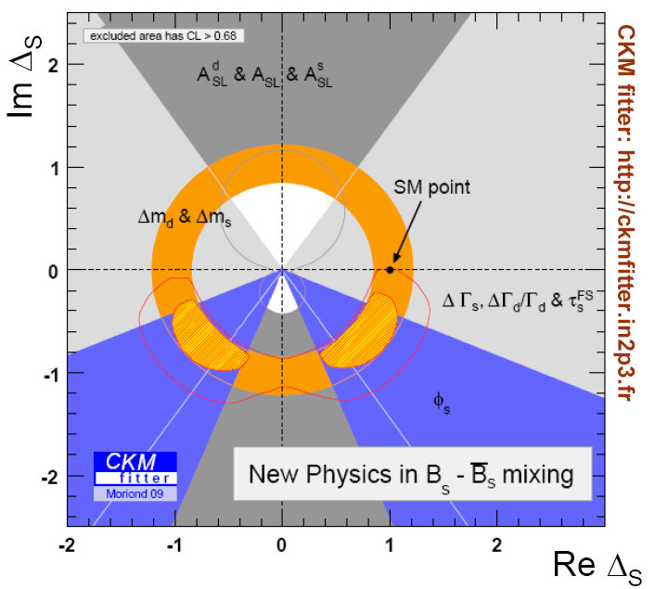
Experimental Status
EPS 2009
# B_{s} (CDF) ~ 3200 (2.8 fb⁻¹)
New Physics
W
A.Lenz, U.Nierste
There is room for NP in B_{s} mixing.

Slide 11
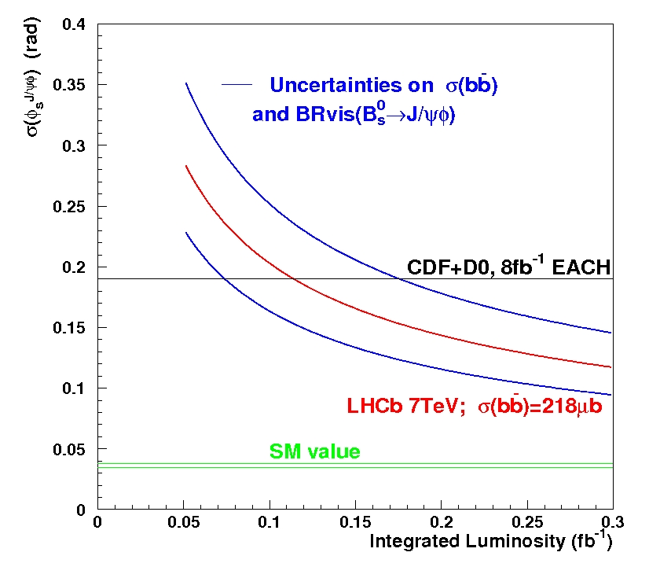
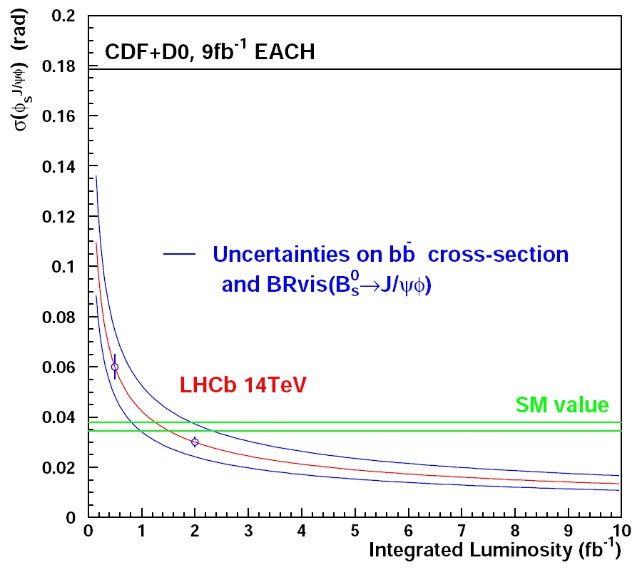
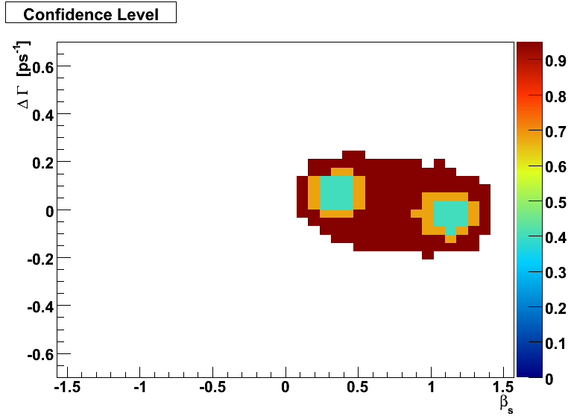
LHCb Prospects for φ_{s}
#Evts (2fb⁻¹) | B/S | ε_{tag}(%)
117k | 2.0 | 6.2
A. Bien, Heidelberg
Toy study with
φ_{s} = -0.8 [CDF]
3200 evts
~ 55 pb⁻¹
2010
No reliable point estimate?
Feldman-Cousin Contour: 40%, 68%, 95% CL

Slide 12
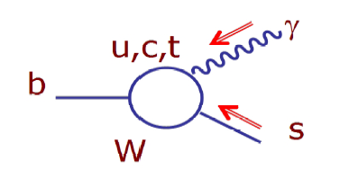
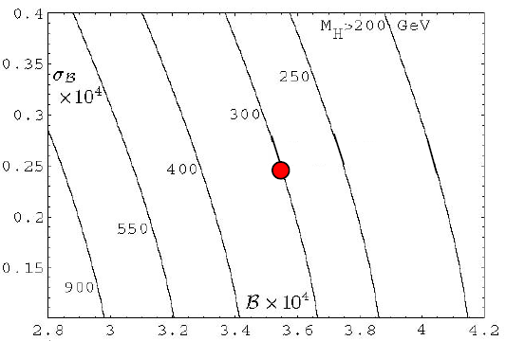
B → X_{s} γ
Challenge for any NP model
Probe photon polarization:
B_{s}→φγ events:
Constraints on Type II 2HDM
LHCb: 12k (2fb⁻¹)
From time dependent decay rates:
σ(Br)
LHCb: σ(ψ)≈0.11
= amount of wrong pol. photons
Test models w/ RH currents
Misiak et al. PRL (2007)
Br × 10⁻⁴

Slide 13
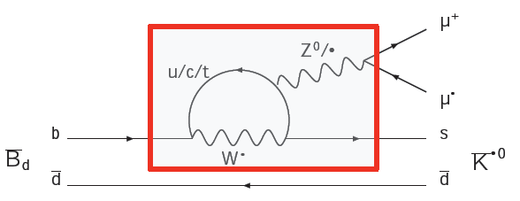
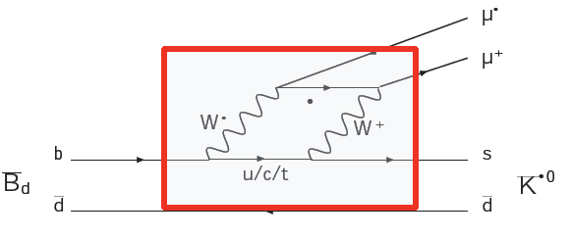
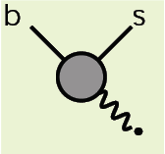
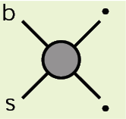
B⁰ → K*μμ
Standard Model
Effective Theory
Operator Product Expansion
Corresponding Wilson coefficients C_{i} describe short-range physics.
New Physics in Wilson coefficients C_{i} = C_{i}SM + C_{i}^{NP} or new operators.
Notes:
In the SM the decay K*->mm proceeds only via loop processes. It is common to write the effective Hamiltonian in a model independent way using operator product expansion. The Wilson coefficients describe the short range physics. All observables can be expressed in terms of these coefficients.

Slide 14
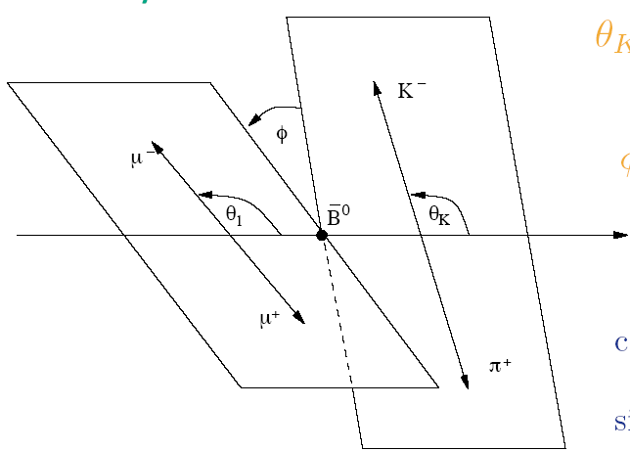
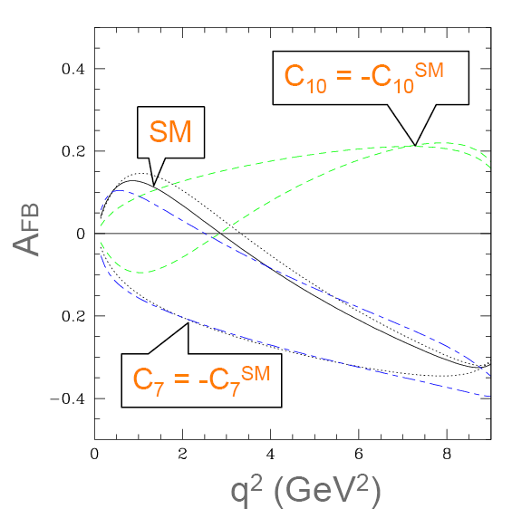
Sensitivity of Angular Observables
q²
SUSY
Observables: θ_{l}, θ_{K}, φ, m²_{μμ}
→ μμ forward-backward asymmetry:
A_{FB}(q²) ~ - Re { C₁₀* [ C₇^{eff} + β(q²) C₉^{eff} ] }
Angular observables offer a powerful test bench for any New Physics model

Slide 15
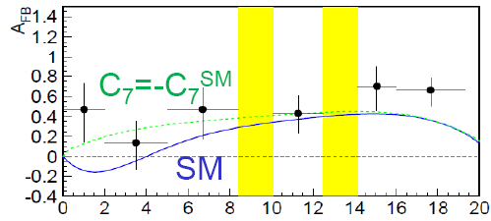
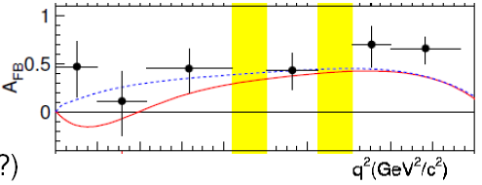
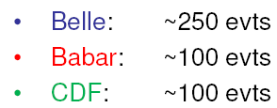
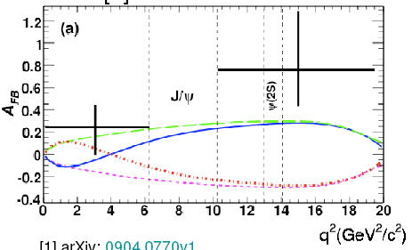
B⁰ → K*μμ - Experimental Status
BELLE arXiv:0904.07770
657 M BB
B⁰→ K*μμ events:
(4.4 fb⁻¹)
~450 evts
BABAR PR D79:031102
Poor agreement with SM. LHCb data will clarify.
384 M BB
LHCb expectation for 2 fb⁻¹
~7000 events w/ B/S~0.25
700 events for 200 pb⁻¹

Slide 16
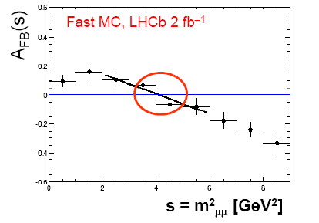
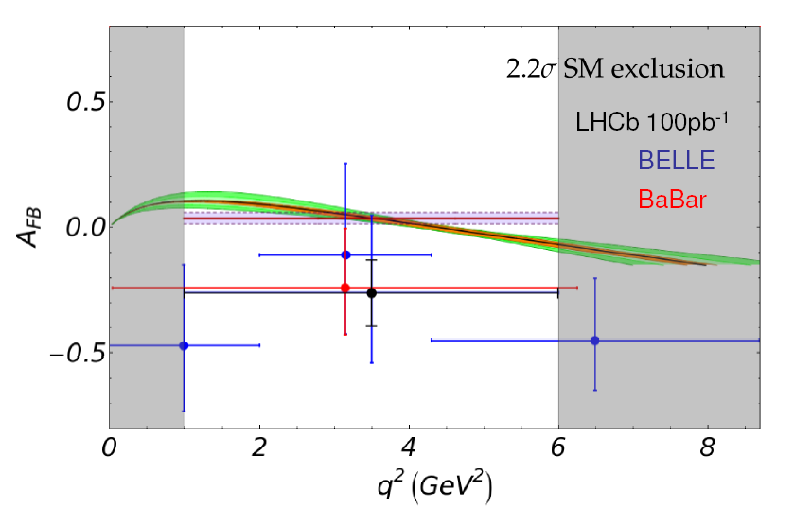
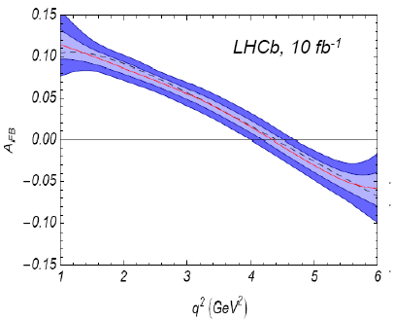
B⁰ → K*μμ - Prospects
2 fb⁻¹
Example:
LHCb sensitivity for early data (assume BELLE values for A_{FB})
100 pb⁻¹
1) Simple Counting
10 fb⁻¹
A_{FB}(s)
Preliminary
2) Full angular fit
s [GeV²]

Slide 17
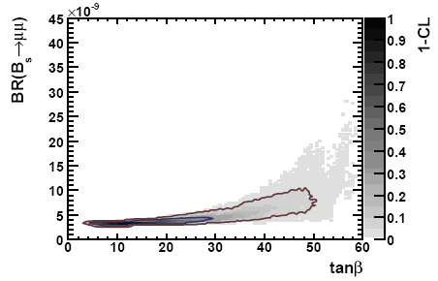
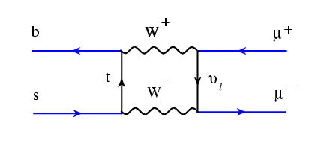
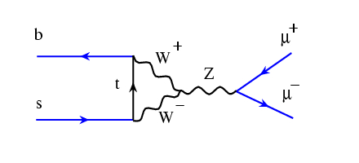
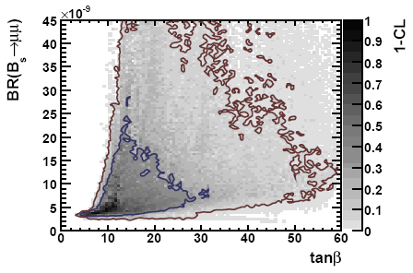
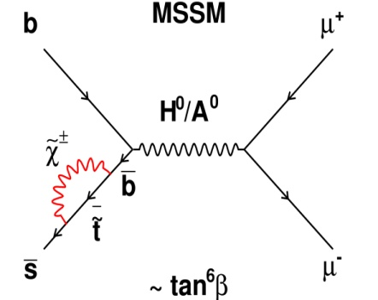
Very Rare Decays - B_{d,s}→μμ
Buchmüller et al., 2009
Constrained MSSM
SM: BR(B_{s} →μ⁺μ⁻)= (3.2±0.2)x10⁻⁹
BR(B_{d} →μ⁺μ⁻)= (1.0±0.1)x10⁻¹⁰
w/ non-universal Higgs mass (NUHM)
Large SUSY contributions possible
Notes:
Two MSSM models are analysed by fitting them to the electroweak precision data. Shown are the CL in tha tan\beta Br() plane.
While the CMSSM currently predicts BR close to the SM value, the model with non-universal Higgs Mass predicts a significant deviation of the BR. Shown are 68% and 95% CL contours.

Slide 18
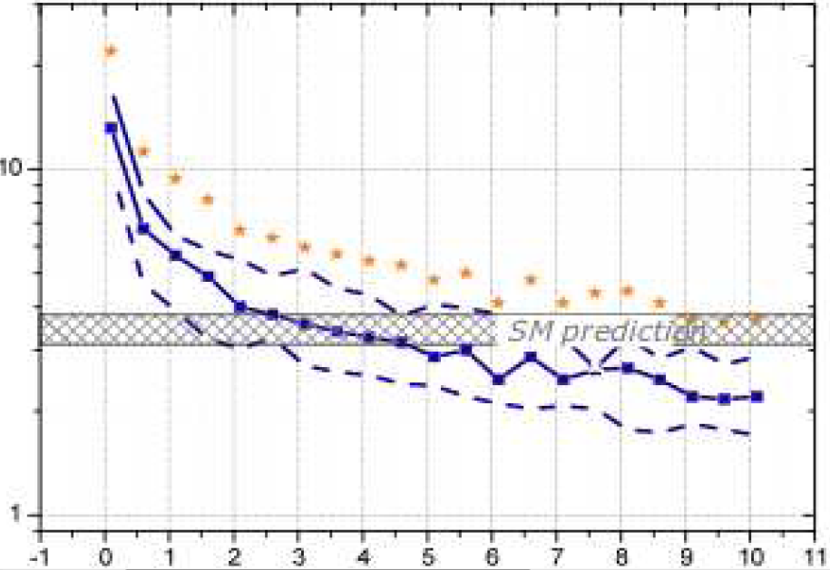
LHCb Prospects for B_{s}→μμ
Experimental status: CDF 2009
BR(B_{s} → μ⁺ μ⁻) < 4.3×10⁻⁸ 95% CL BR(B_{d} → μ⁺ μ⁻) < 7.6×10⁻⁹ 95% CL
For ~150 pb⁻¹ LHCb expects to reach the final Tevatron sensitivity.
Discovery
BR (x10^{–9})
5σ observation
SM prediction
SM
MFV
3σ evidence
Ratio is sensitive test for MFV
0
5
10

Slide 19
Conclusion & Outlook
We have learned a lot about and from heavy flavor physics:
TeV-scale physics must have a sophisticated flavor structure not to be excluded by existing data.
High-precision flavor physics provides the tools to further explore the flavor structure of New Physics at the Tera-scale:
Flavor structure of new particles found by direct searches.
LHCb has the possibility to perform several unique measurements: For some key observables early results (2010 data?) are possible.
Experimental flavor program will be complemented by the Kaon physics program and by a Super-B factory.

Slide 20
Backup

Slide 21
