Slide 1
Karabo Roadmap
Sandor Brockhauser, Control and Analysis Software
Schenefeld, Sept 21, 2018
IT & Data Management

Slide 2
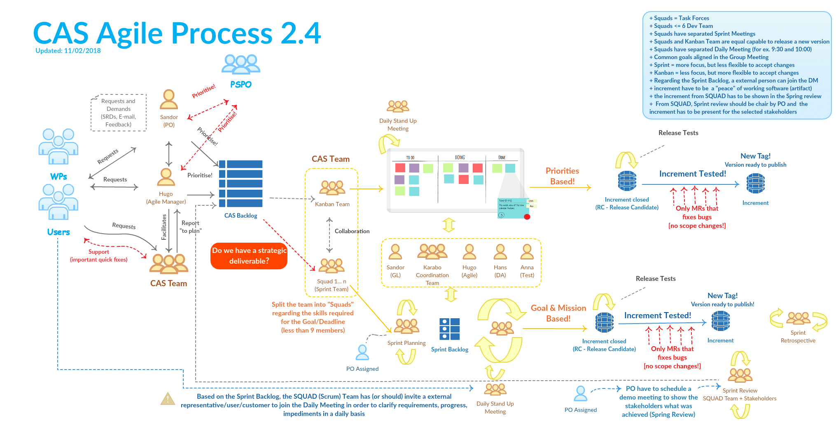

Slide 3
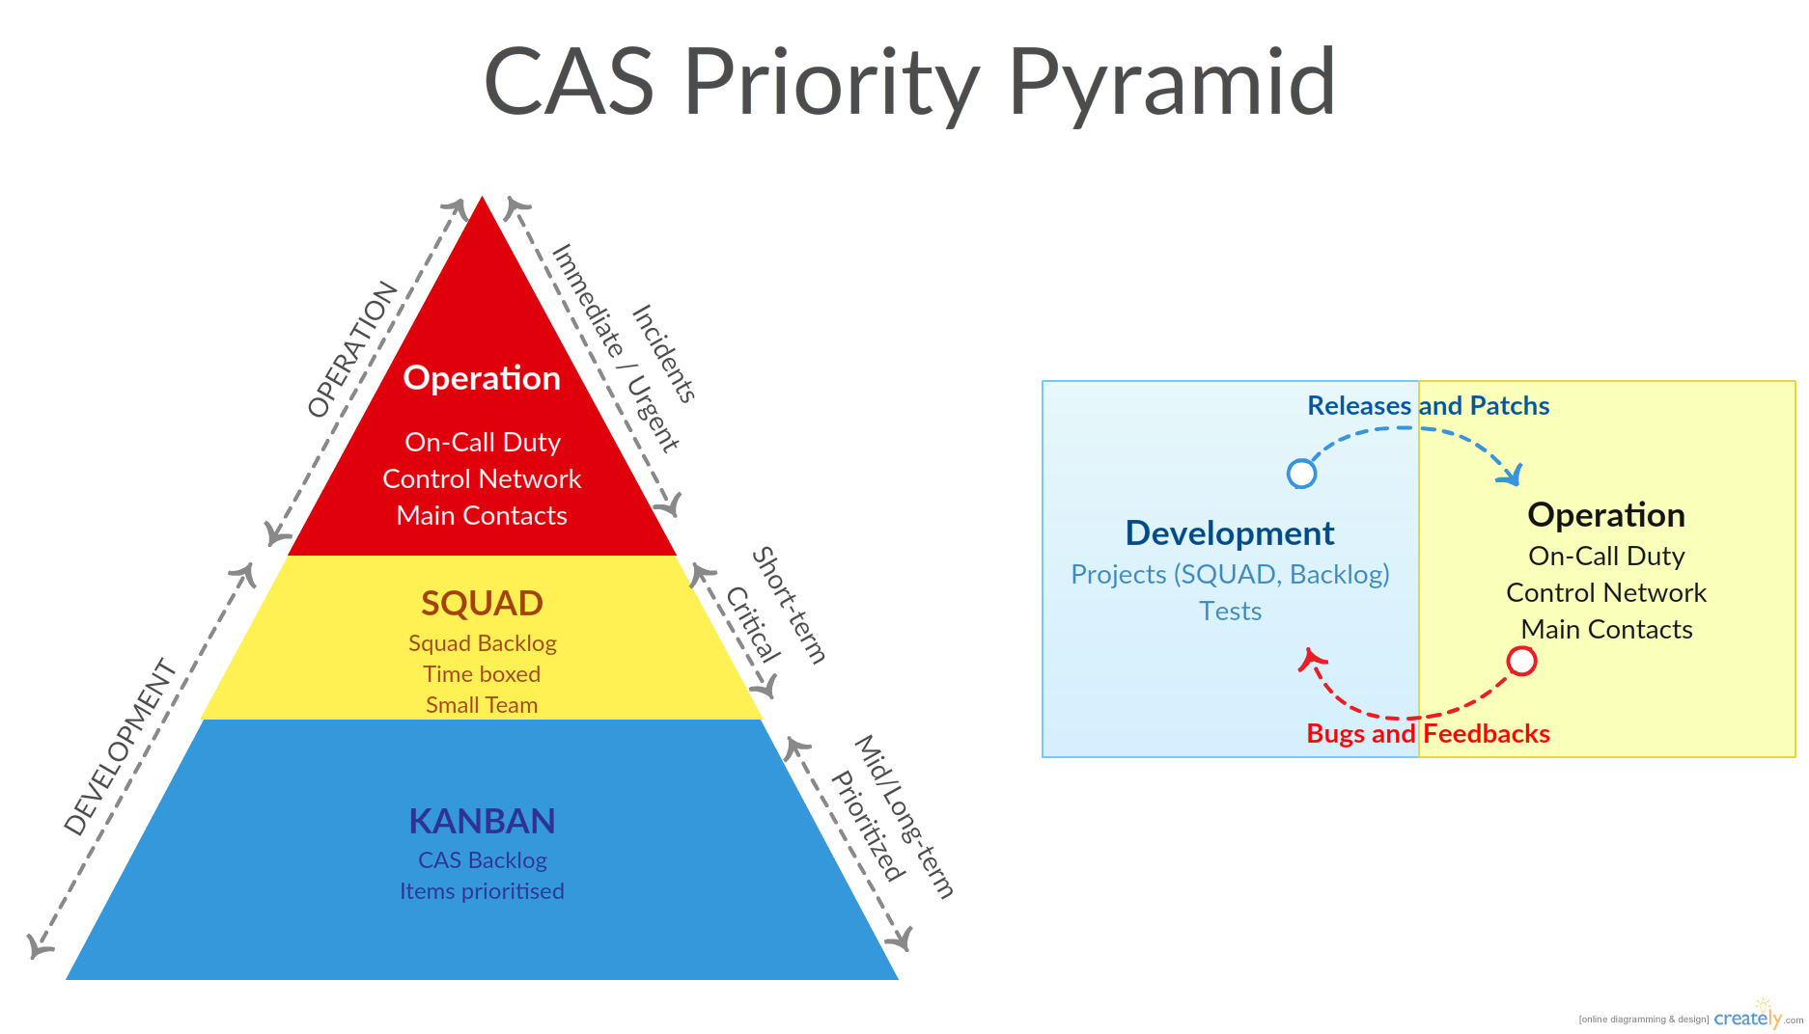
CAS Priority Pyramid (May 4, 2017)

Slide 4
Karabo Enhancement Topics (May 25, 2018)
Robustness & Reliability - quick fixes done, next step: broker layer upgrade; DAQ tests
Performance - quick fixes done, next step: GUI communication
Configuration - quick fixes prioritised, default params; system topology
Deployment, Installation - quick fixes prioritised, dependency cleanup; license
Operability, Usability - quick fixes prioritised, GUI; CLI/macro; system monitoring
Data Analysis - planned, Karabo Data tools; basic online tools; visualisation
Security - planned, property/device/server visibility; device communication
Maintainability - planned, hot-swap; Git restructuring; documentation; KEP process
Recoverability - planned, (sub)system reset; device log mining

Slide 5
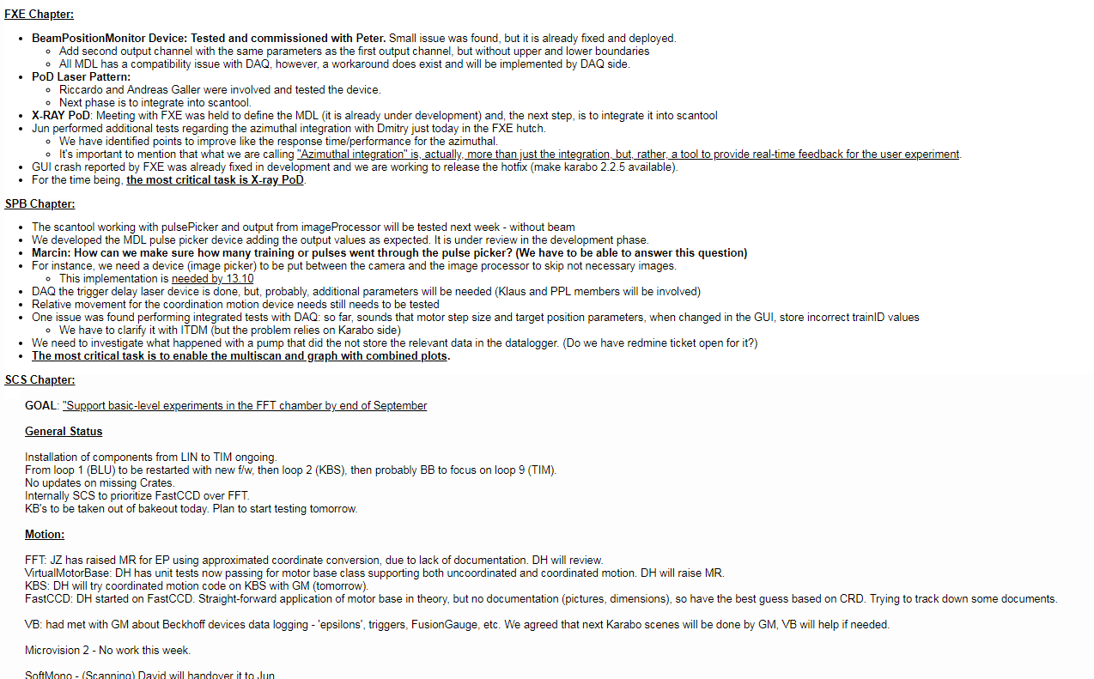
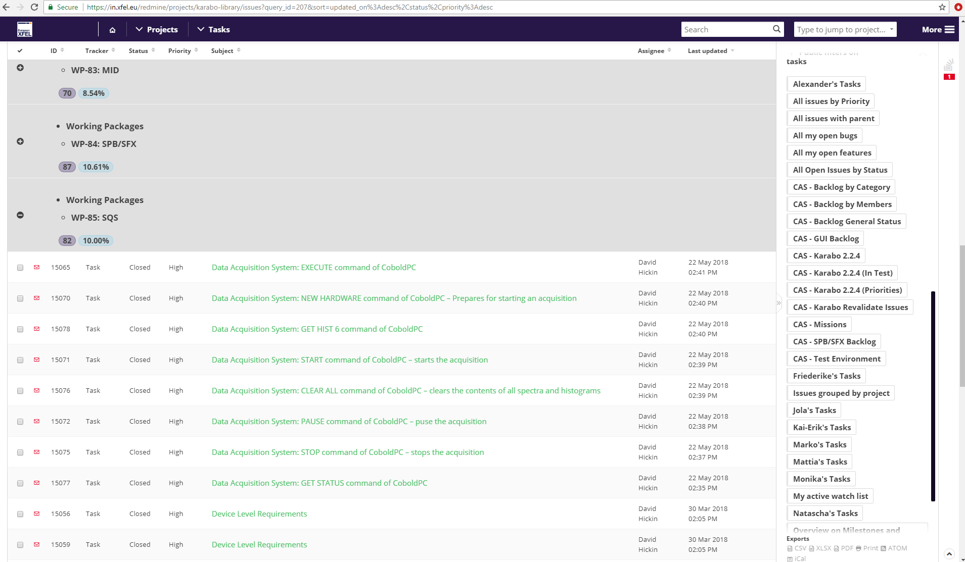
Karabo Priorities (Sept 6, 2018)
Urgent Requirements (Operation and Commissioning)
SPB complex scans for Pulse on Demand (PoD); camera refresh performance
FXE DA Analysis support for LPD/GreatEyes/Gotthard detector data; BPM feedback; pulse correlation in different data sources
SCS Middle Layer devices (MDL) for Differential Pumping System (DPS); MDL for Softmono; MDL for FFT
SQS Convenient interface for operating MPOD; DA support for Digitizer data
MID powder calibration; MDL for CRL
HED support Split & Delay Line; HiBEF integration
XPD BPM feedback (XGM, MCP); scene developments
XRO/VAC scene development; MDL for gaincurve; mono (MID,FXE); exit slits; image processor; configuration manager
LAS Pulse patter settings; camera refresh performance
DET Hera South support (Agipd/DSSC/MPOD); Jungfrau

Slide 6
Karabo Priorities (Sept 6, 2018)
Reliability
Karabo Bridge (support different versions; increase performance)
MDL API development (support direct hw connection and pipeline*) *DONE
new broker
Data Logger
General Logging System (mainly Operability)
regression tests as part of CI/CD
CAS TEST_LAB
Performance
new broker to support bigger topics
Device DB (to help system startup)
Robustness
new broker (failover)
asyncio => new python version
pipeline connection robustness (DAQ, DA, camera image transmission)

Slide 7
Karabo Priorities (Sept 6, 2018)
Operability
Online Analysis feedback
CLI API rework (including Tab complition)
support Device locking / macros
GUI scene parameters (to save)
cinema mode
online/hierarchical documentation
Datalogger servers (GUI/CLI/integration to DA tools)
User Macro API
Scantool (immediate analysis of scan data; any device to scan (not only floats); plotting; virtual motors)
Deployment
GPL (new broker)
CONDA
vvv requirement engineering for the deployed control system vvv

Slide 8
Karabo Priorities (Sept 6, 2018)
DataAnalysis
data completeness (device info; pulse info [e.g. pattern])
scientific data model
jupyter integration (e.g. remote DA)
external tools to pipelines
support multiple configurations
Configuration
Configuration Database
Maintainability
dependency system should be more flexible (helps Testing and Deployment)
Recoverability
GUI reliability must be ensured
GUI tools to guide to solve problems
broker is a single point of failure => new broker should support broker clustering
configuration support for recovery

Slide 9
Karabo Priorities (Sept 6, 2018)
Security
harmonising access modes in GUI/CLI
Log User Actions
maintain the separation of the control network
User Macro API shall be secured
graphana should be available to serve DA logger data to those allowed
secure Config DB service

Slide 10
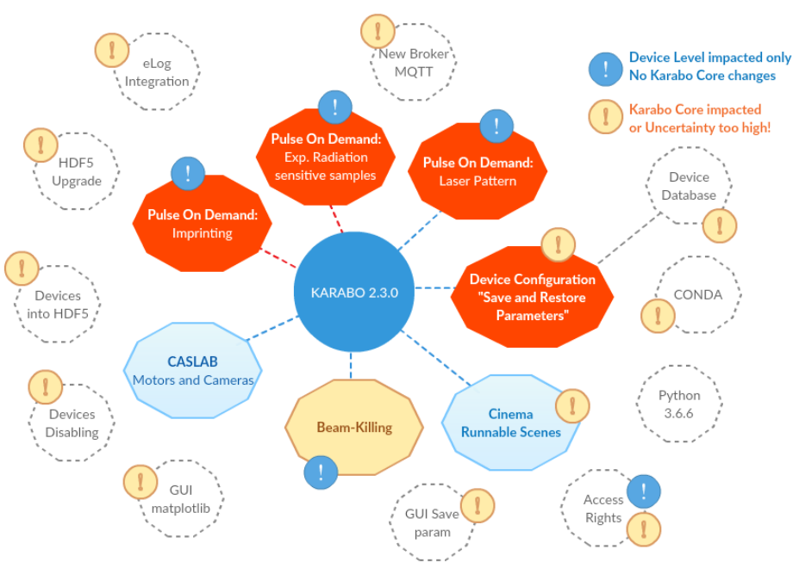
Karabo Roadmap

Slide 11
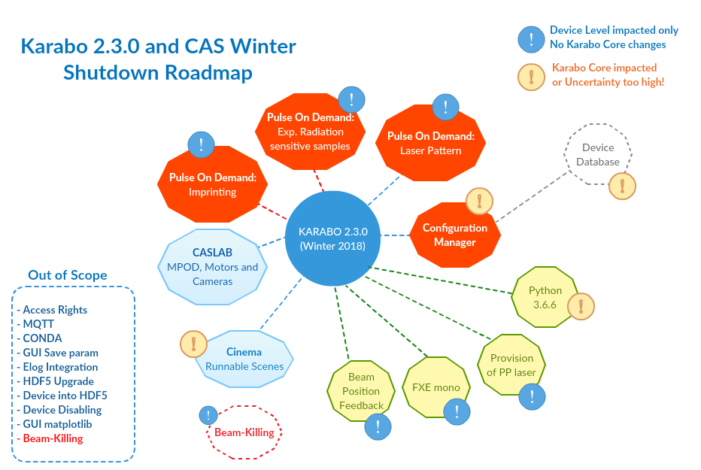
Karabo Roadmap

Slide 12
Karabo Roadmap
2.6.0 (Summer 2019)¶
GUI guiqwt refactor for Images and Vectors
Conda packaging in test/gui
Device Database (GO/NO_GO)
Global Documentation entry point
DataLoggers in InfluxDB (GO/NO_GO)
Background work (CAS internal milestones)
New Broker ready for test
User Authentication backend (unit-integration test GO/NO_GO for current implementation)
User Authentication token transfer gui client to gui server and in CLI.
3.0.0 (Winter 2019)¶
Very speculative:GUI guiqwt out of karabo.
Conda packaging in production
New Broker in production
Multi-Topic development enabled
Log mission enabled
Python >=3.7
c++ 14/17
Depending on new broker client library's license, licensing issue is solved by the new Broker

Slide 13
CAS for EuXFEL Experiments
Karabo
HelpDesk + On-call Availability

