Slide 1
Collimation
Counter
PDET
IP
Mirror
Photon converter
e⁺
Laser
e⁺
Dipole
CAL
γCAL
e⁺
γ
γ
e⁻
Triplet
e⁻
Dump
Mirror
pulse
e⁻
Dipole
Dipole
Counter
E < 16 GeV
EDET
E < 16 GeV
9 m
11 m
3 m
7 m
Preliminary estimates!
IP
Mirror
PDET
Laser
e⁺
Dipole
CAL
γCAL
γ
e⁺
γ
e⁻
Triplet
Mirror
pulse
e⁻
Dump
Dipole
EDET
E < 16 GeV
21 m
3 m
11 m

Slide 2
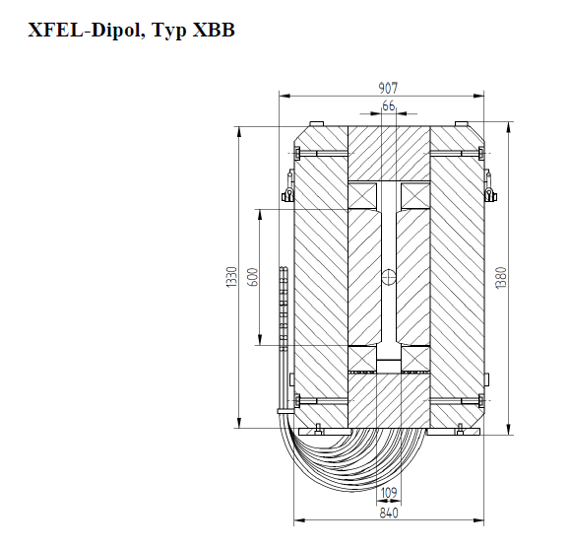
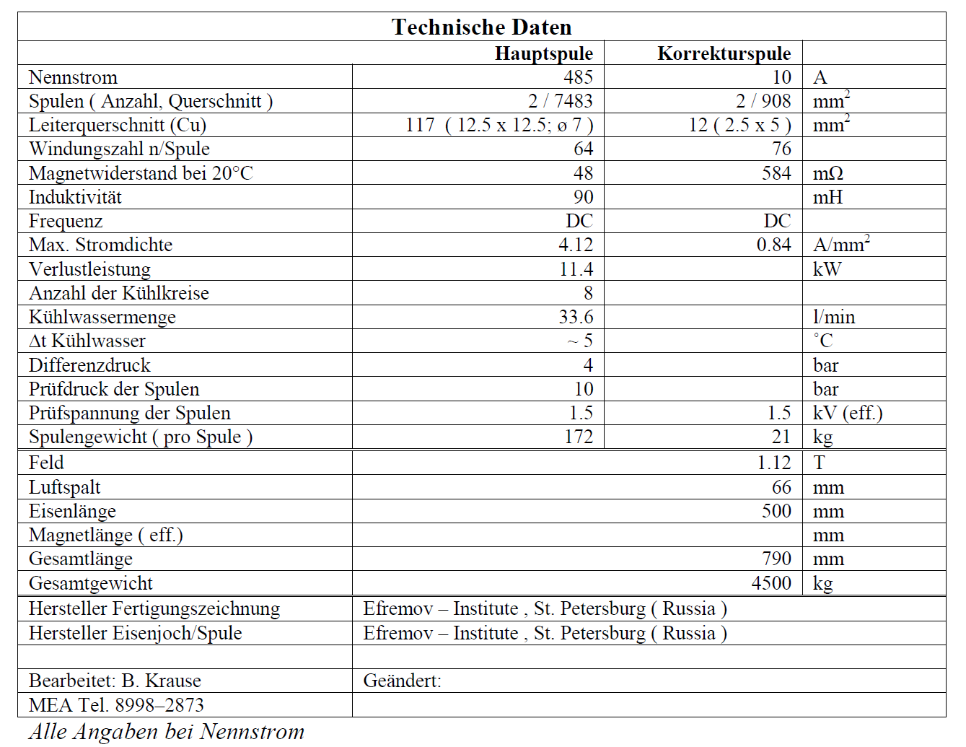

Slide 3
3 Dipoles:
Bdl: 1.68 Tm
1.5 m
4 m
10 m
Deflection (6 GeV) @ 4 m: 0.34 m
Deflection (16 GeV) @ 4 m: 0.13 m
Resolution Limit 2 GeV

