Slide 1
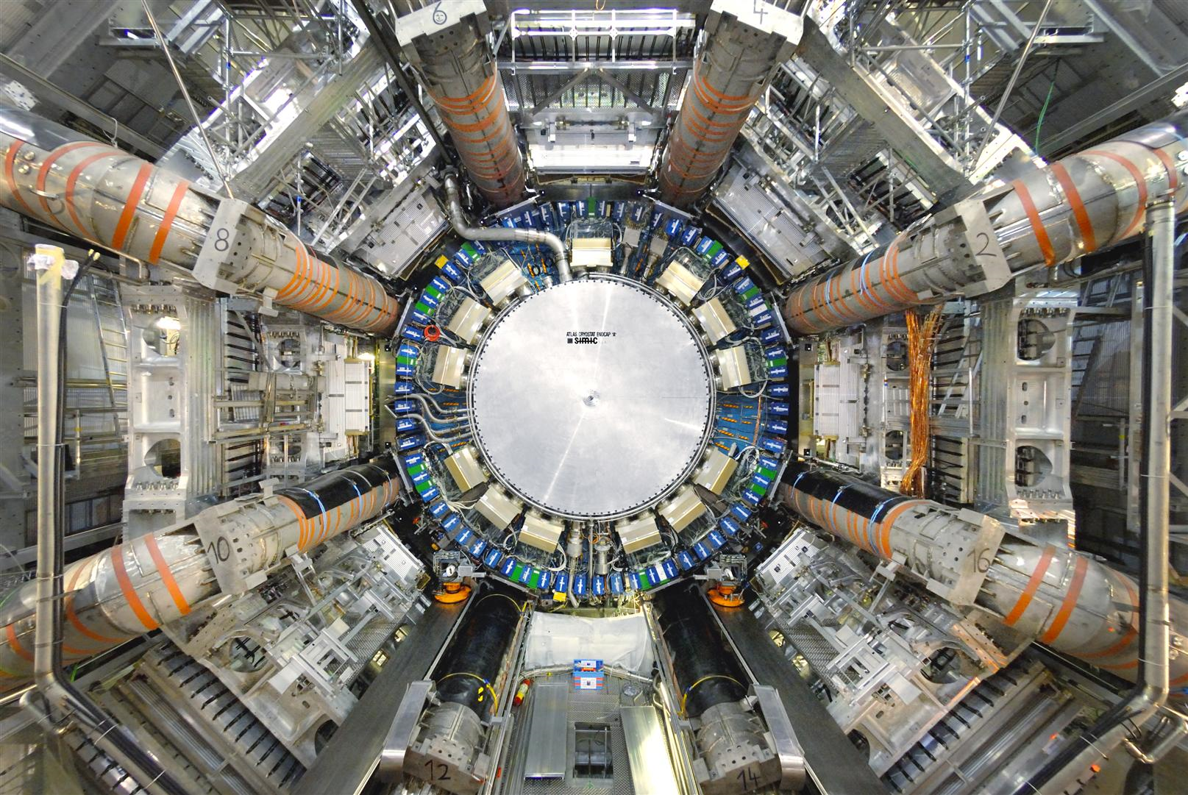
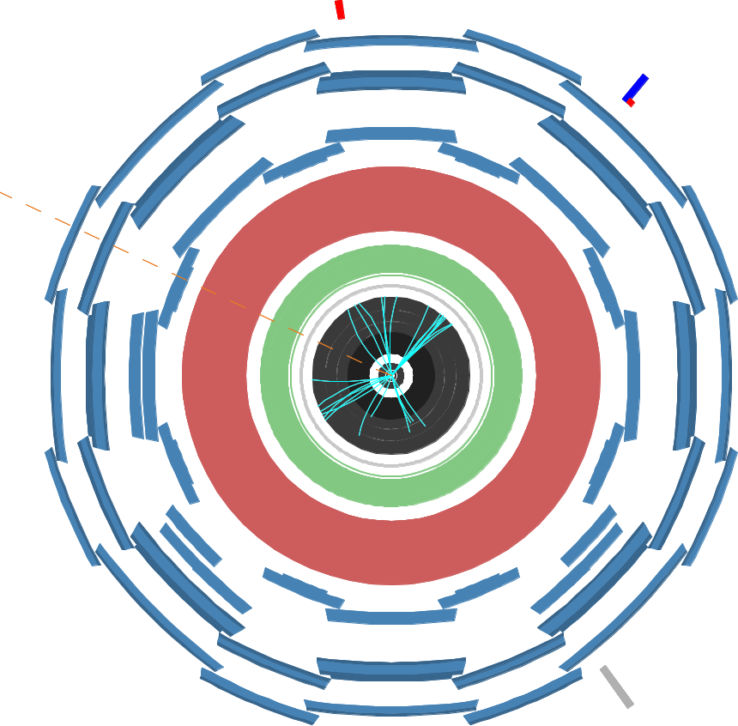
Prospects of the measurement of single top quark production with ATLAS
Dominic Hirschbühl
for the ATLAS Single Top Group
Single Top Workshop
DESY / Hamburg
14.09.2009

Slide 2
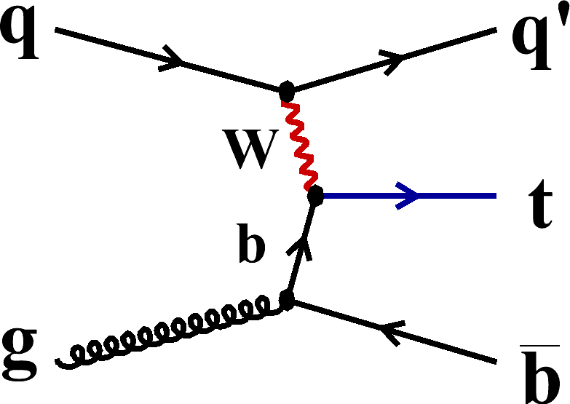
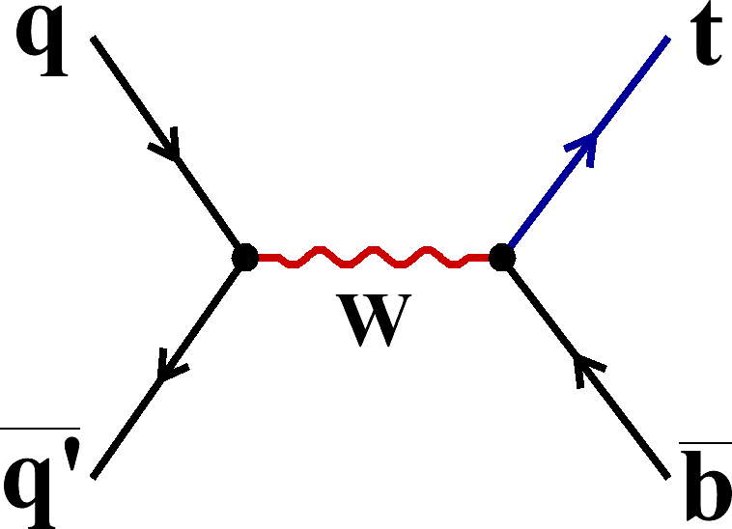
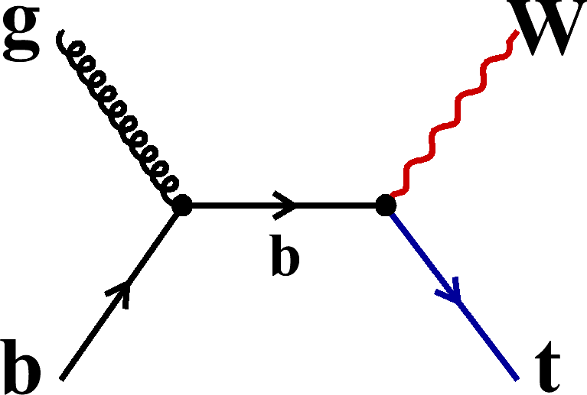
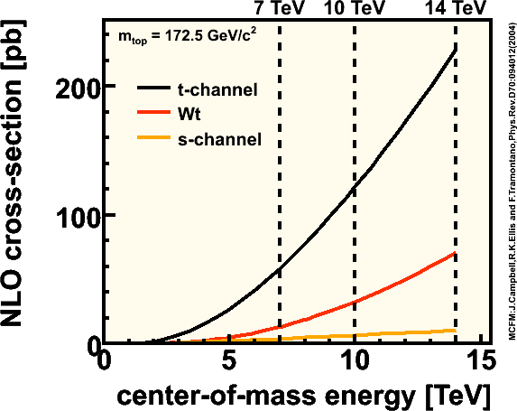
Production of single top quark events
t-channel
s-channel
Wt
@ 14 TeV (CSC efforts) 1 fb⁻¹
t-channel
s-channel
Wt (lepton+ jets & di-lepton)
@ 10 TeV (MC08)
t-channel

Slide 4
Signal and background modeling
All processes are normalized to theoretical cross sections
Process | Monte Carlo generator | Simulation | Cross section
Single top | AcerMC + Pythia | FullSim | t- & s-channel: Sullivan, Z., Phys. Rev. D70 (2004) 114012. Wt: Campbell, J. and Tramontano, F., Nucl. Phys. B726 (2005) 109–130.
tt | MC@NLO+Herwig | FullSim | R. Bonciani et al., Nucl., Phys. B529 (1998) 424–450.
W+jets | Alpgen+Pythia | ATLFAST | MCFM
Di-boson | Herwig | FullSim | Dobbs, M. A., Phys. Rev. D64 (2001) 034016.

Slide 5
Signatures
Common signature (one real top quark):
real W boson & one high-p_{T} central b-jet
t-channel
1 or 2 extra forward jet (2nd b-jet, if visible, is forward)
Leptonic decay of W :
1 high-p_{T} e or μ + missing transverse energy (MET)
s-channel
1 second central b-jet
Leptonic decay of W only : high-p_{T} e or μ + MET
Associated Wt production
1 second W boson
- lepton + jet channel (1 had W, 1 lep W) : BR = 34%
2 jets, 1 lepton, MET
- di-lepton channel (2 leptonic Ws) : BR = 6.4%
2 leptons, some MET, no extra jets
5

Slide 6
Analysis strategy
Common event selection
Cut-based Boosted Decision Trees
Optimized cuts
Likelihood
Optimized cuts
Boosted Decision Trees
Calculation of cross section : .
Evaluation of systematics using toy MC

Slide 7
Systematic uncertainties
Main systematic effects
Luminosity: 5% variation
Jet energy scale:
Shifting up/down the jet energy by ± 5%
b-tagging efficiency:
Varying the b-tag efficiency by ± 5%
Cross section: (factorization and renormalization scale, PDF, top quark mass)
tt: ± 12% , W+jets: 15%
ISR/FSR
PDF
Error set of CETQ6.1
Error source | N_{obs} | N_{bkg} | ε | L
Data statistics | ✓
MC Statistics |  | ✓ | ✓
Luminosity |  | ✓ |  | ✓
Backgrounds XS |  | ✓
B-tagging, JES… |  | ✓ | ✓
Errors from a same source are 100% correlated between MC samples and channels
Errors from different sources remains uncorrelated

Slide 8
Common event selection
Single electron or muon trigger (20 GeV threshold)
1 isolated electron or muon, p_{T} > 30 GeV/c², |η| < 2.5
no extra lepton with p_{T}>10 GeV/c², |η| < 2.5
MET > 20 GeV
1 b-tagged jet, p_{T} > 30 GeV/c², | η | < 2.5
b-tag eff ~60%, rejection ~ 100
at least 1 extra jet, p_{T} > 30 GeV/c², | η | < 5

Slide 9
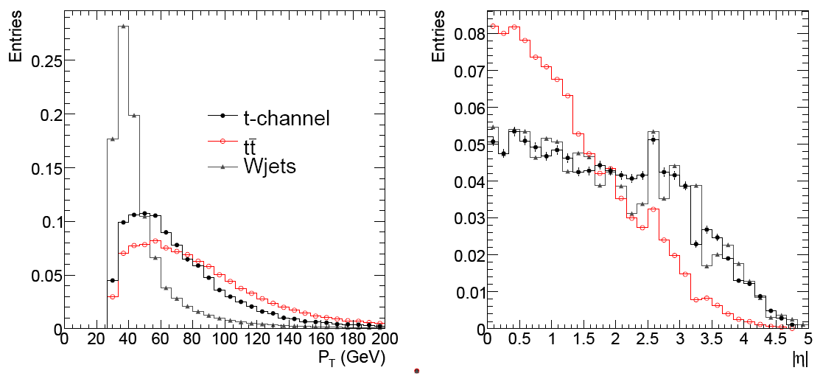
t-channel cut based analysis
Harder b-jet cut : p_{T} > 50 GeV/c² (against W+jets)
Forward light jet (cut based analysis only):
hardest untagged jet with |η| > 2.5 (against tt)
t-channel | 1460
s-channel Wt | 148
tt | 2816
W+jets | 942
Total Background | 3906
S/B | 0.37
S/√B | 23.4

Slide 10
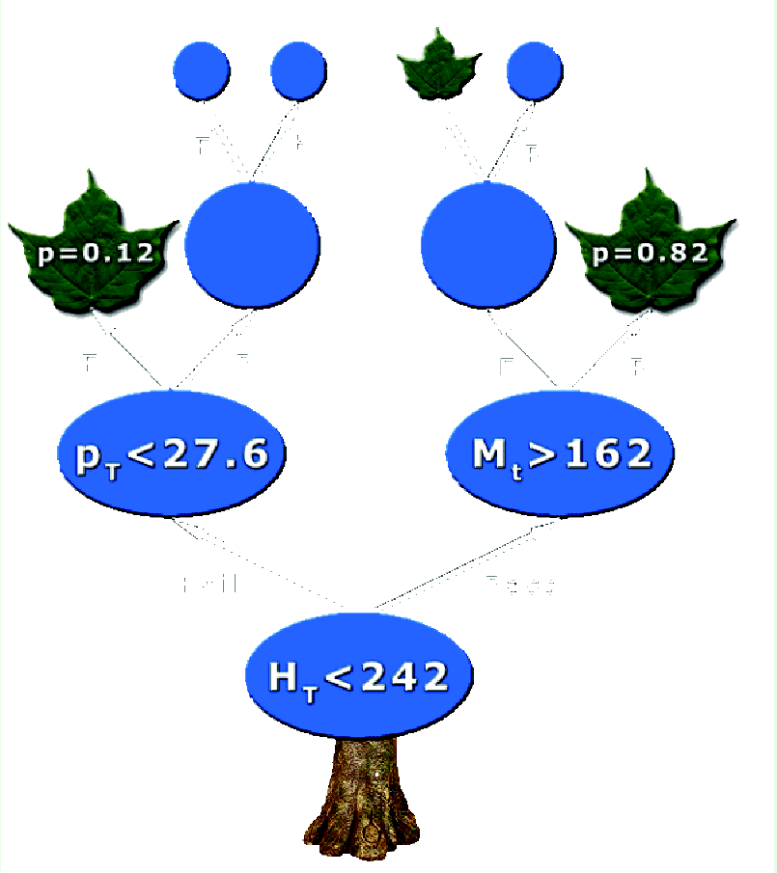
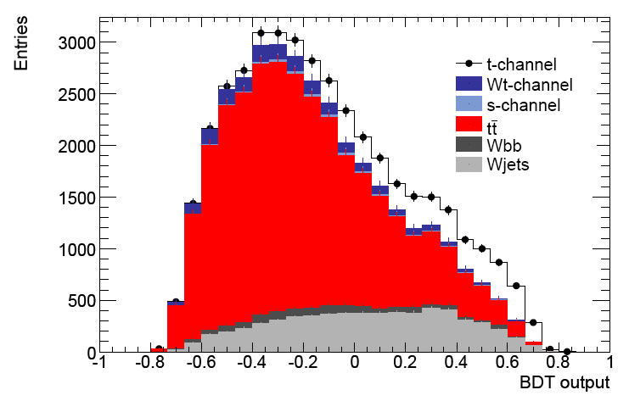
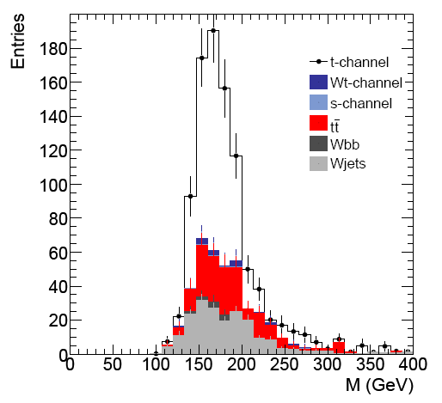
t-channel BDT analysis
Large number of input variables
Cuts produces branches
Terminal leaf calculate: purity = N_{S}/(N_{S} + N_{B})
Each data event is assigned the purity value of the leaf it falls into
Boosting: Create series of many trees by reweighting based on value of misclassification
Used 12 input variables
BDT > 0.6
S/B ~ 0.12
S/B ~ 1.3

Slide 11
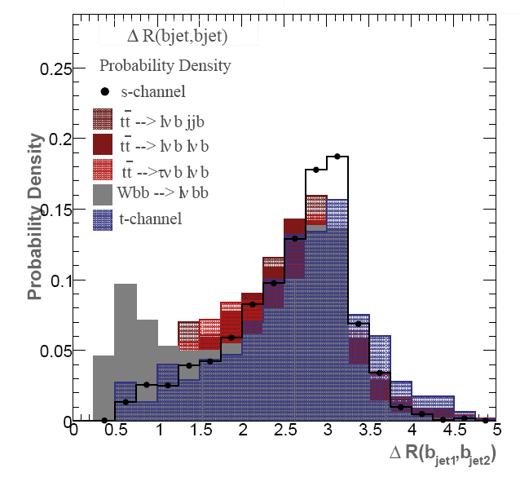
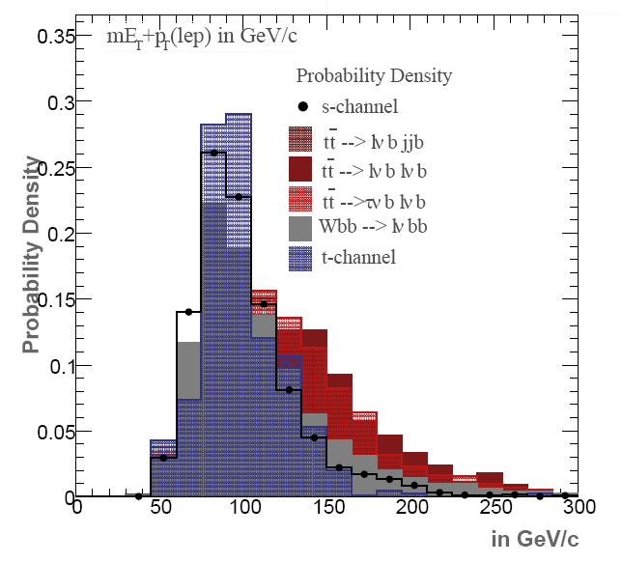
s-channel cut based analysis
Second b-tagged jet with p_{T} > 30 GeV/c²
Veto on extra jet with p_{T} > 15 GeV/c²
Topological cut (cut based analysis only)
0.5 < ΔR (b₁,b₂) < 4
80 < H_{T}(jets) < 220 GeV
60 GeV/c² < lepton p_{T} < 130 GeV/c²
s-channel | 24.8
t-channel Wt | 39.5
tt | 145.1
W+jets | 66.4
Total Background | 251
S/B | 0.1
S/√B | 1.6

Slide 12
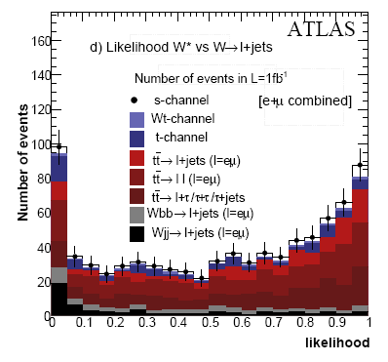
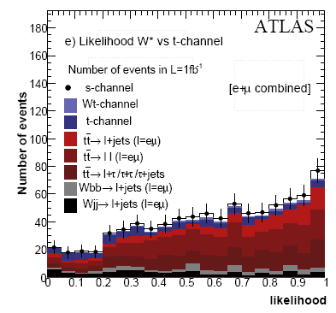
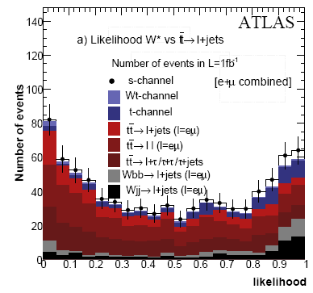
s-channel likelihood analysis
Likelihood ratio :
In total use 5 different Likelihood functions:
s-channel vs. tt (lep+jets), tt (dilepton), tt (lep+tau), W+jets and t-channel

Slide 13
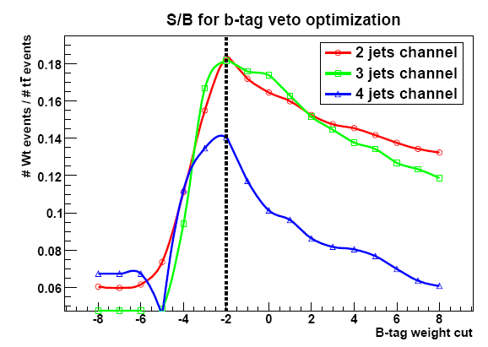
Wt lepton+jets cut based analysis
Harder b-jet cut : pT > 50 GeV
Veto extra b-jet,
using looser b-tag (eff~90%, rejection~2)
2 to 4 jets (incl b’s)
Hadronic W mass cut (cut based analysis only):
if at least 2 light jets : 50 GeV/c² < M_{jj}< 125 GeV/c²
Wt lepton+jets | 639
t-channel s-channel | 1418
tt | 3022
W+jets | 3384
Total Background | 7824
S/B | 0.08
S/√B | 7.2

Slide 14
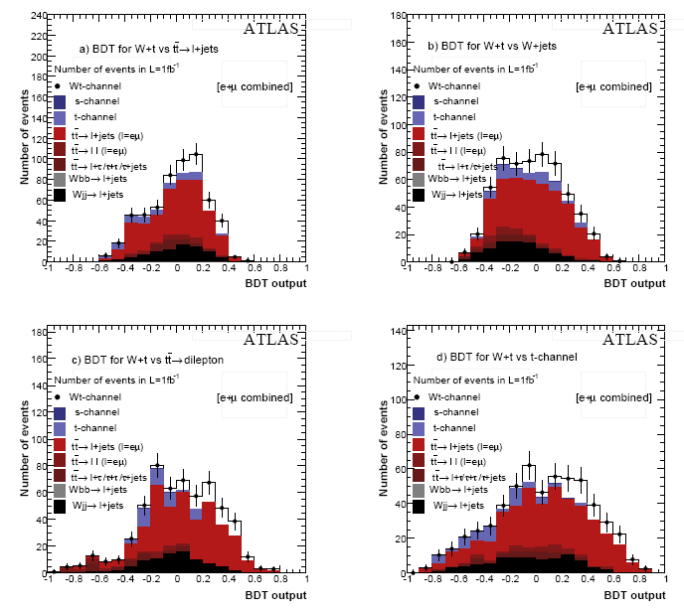
Wt lepton+jets BDT analysis
12 Boosted Decision Trees
Wt lepton+jets vs. tt->lj, tt->ll, W+jets, t-channel
for 2/3/4 jet multiplicities

Slide 15
Wt dilepton cut based analysis
Event selection based on lepton+jets selection:
Exact 2 good opposite sign leptons p_{T} > 30 GeV/c
p_{T} (jet1) > 30 GeV/c
p_{T} (jet2) > 20 GeV/c
MET > 20 GeV (eμ) , > 30 GeV (ee/μμ)
Z veto cut
 | eμ | ee | μμ
Wt dilepton | 121 | 38.2 | 61.0
tt | 321.8 | 104.3 | 181.6
Diboson | 67.7 | 17.5 | 47.1
Z+jets | 31.6 | 39.5 | 162.8
W+jets | 64.2 | < 50 | < 50
Other single top | < 2 | < 2 | < 2
Total Background | 421 | 161.3 | 391.5
S/B | 0.29 | 0.24 | 0.16
S/√B | 5.9 | 3.0 | 3.1
Backgrounds:
tt (dilepton & lep+jets)
Diboson
Z + jets
W+ jets
Other single top

Slide 16
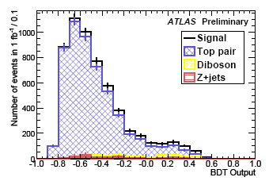
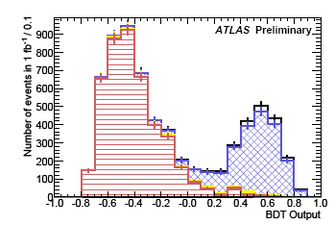
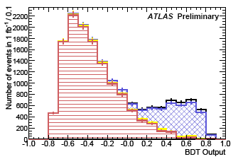
Wt dilepton BDT analysis
Relaxed cuts
MET > 20 GeV
No pT cut on 2nd jet, no Z veto
3 Boosted Decision Trees
Wt dilepton vs. tt (eμ) and Z (ee, μμ)
eμ
ee
μμ

Slide 17
Number of expected events 1fb⁻¹
¹³¹ | t-channel |  | s-channel | Wt l+j | Wt dilepton
 | cut-based | BDT | Likeli. | BDT | cut-based | BDT
Signal | 1460 | 542 | 15.4 | 85.5 | 220.2 | 131.7
Other single top | 148 |  | 3.5 | 13.3 | < 6 | negl.
tt | 2816 |  | 48.6 | 113.5 | 607.7 | 168.2
W+jets | 942 |  | 30.5 | 99.4 | 64.2 | negl.
Diboson | ------ | ----- | negl. | ----- | 132.3 | 72.6
Z+jets | ------ | ----- | ------ | ----- | 233.9 | 41.7
Total Background | 3906 | 417 | 82.7 | 226.3 | 1038.1 | 282.5
S/B | 0.37 | 1.3 | 0.2 | 0.4 | 0.2 | 0.5
S/√B | 23.4 | 26.5 | 1.7 | 5.7 | 6.8 | 7.8
No systematics included!!!

Slide 18
Systematic erros and sensitivity
Δσ/σ for 1 fb⁻¹ | t-channel |  | s-channel | Wt l+j | Wt dilepton
Source | cut-based | BDT | Likeli. | BDT | cut-based | BDT
Stat. error | 5.0% | 5.7% | 64% | 20.6% | 15% | 15%
MC stat. | 6.5% | 7.9% | 29% | 15.6% | 20% | 18%
Luminosity | 18.3% | 8.8% | 31% | 20% | 26% | 15%
b-tag efficiency | 18.1% | 6.6% | 44% | 16% | --------- | --------
Jet energy scale | 21.6% | 9.9% | 25% | 11% | 26% | 17%
Lepton ID trigger | 2.3% | 1.8% | 6% | 3.2%
Theory (xs, PDF, ISR/FSR …) | 28.1% | 13.5% | 74% | 35% | 22% | 8%
Total | 45% | 22% | 95% | 48% | 50% | 34%
For 1 fb⁻¹

Slide 19
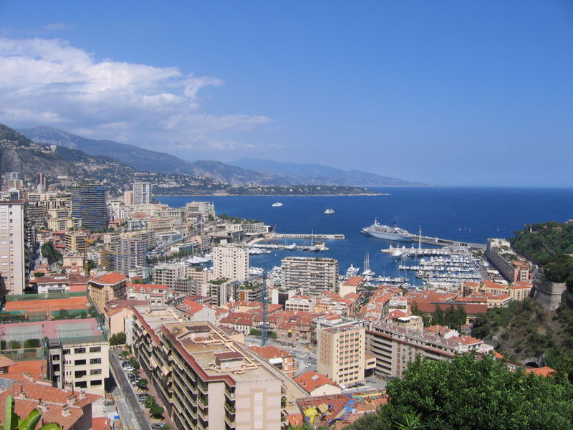
MC08
MC08
Work in progress

Slide 20
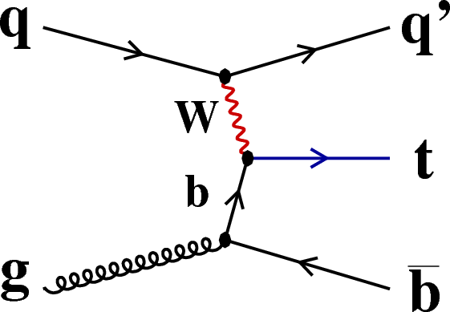
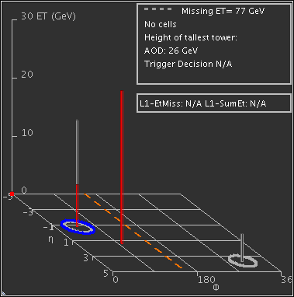
Object / Event selection
Trigger:
Threshold: 15 GeV/c
Lepton selection (electron / muon):
p_{T} > 20 GeV/c
|η|< 2.5
Isolation: ET within cone 0.2 < 6 GeV
Jets
p_{T} > 30 GeV/c²
|η| < 5
b-tagging
JetProbability ε_{b}= 45%, rej. = 93
Exactly one lepton
2 or 3 jets
E_{T,miss} > 20 GeV

Slide 21
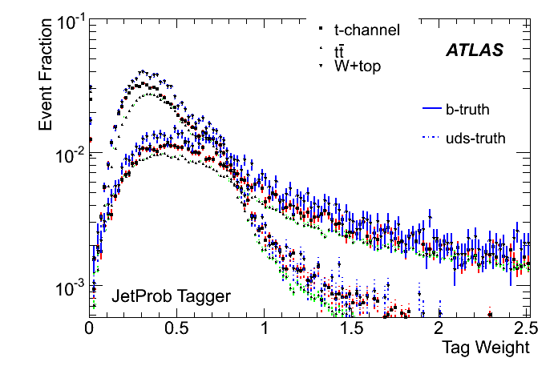
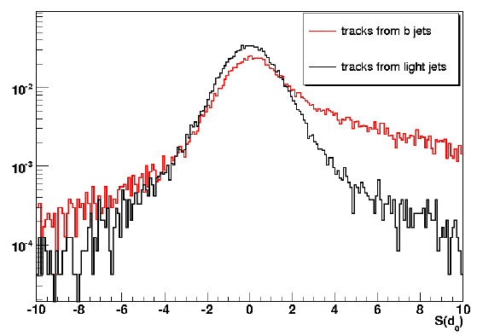
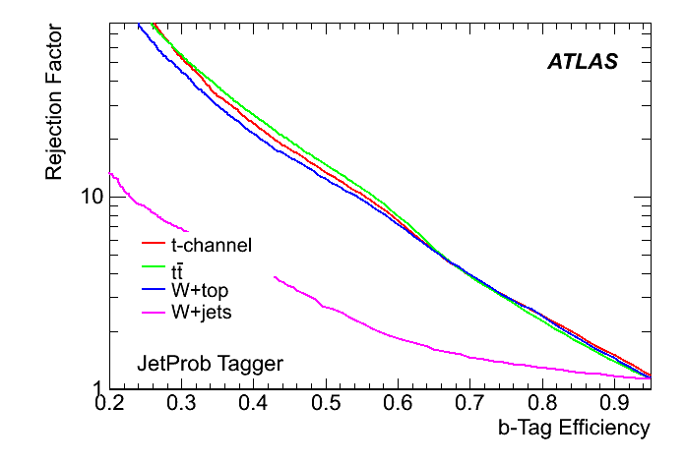
Jet probability tagger
Use b-tagger, which will be comissioned with early data and which is robust.
Calculating the probability of the tracks to belong to the primary vertex.
Using the decay length significance.

Slide 22
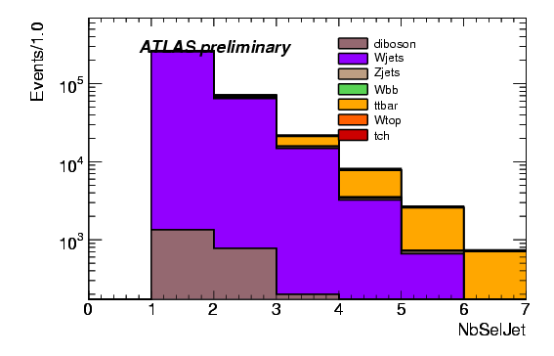
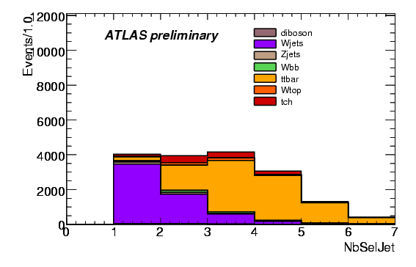
Summary of event selection / Strategy
Before b-tagging (pretag)
After b-tagging
Extraction of t-channel cross section using Likelihood method
Normalization of tt and W+jets background using neural networks

Slide 23
Summary of event selection / Strategy
Before b-tagging (pretag)
After b-tagging
Validation of
NN technique
Extraction of t-channel cross section using Likelihood method
Normalization of tt and W+jets background using neural networks

Slide 24
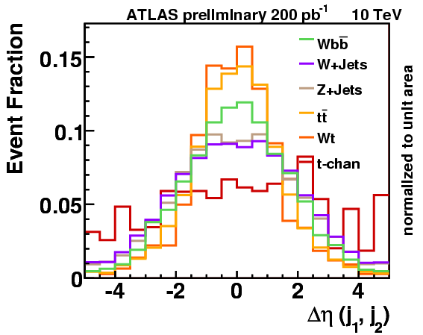
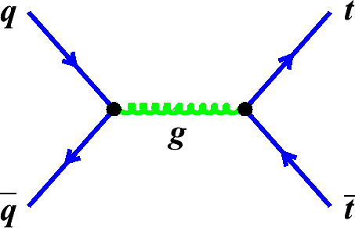
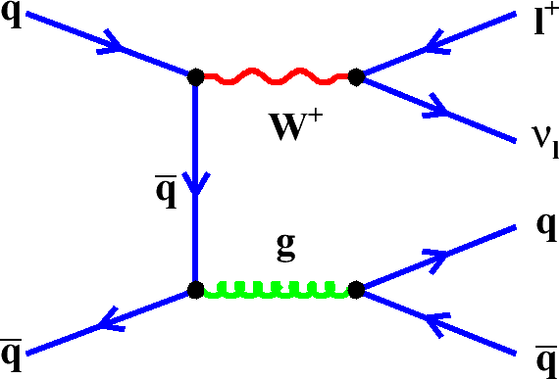
Background estimation → Shape Fit
Use shape fit to gain sensitivity for the background calibration.
Parts of distribution can have much better purity.
Which variable is the best one?
Combine several variables into one discriminate

Slide 25
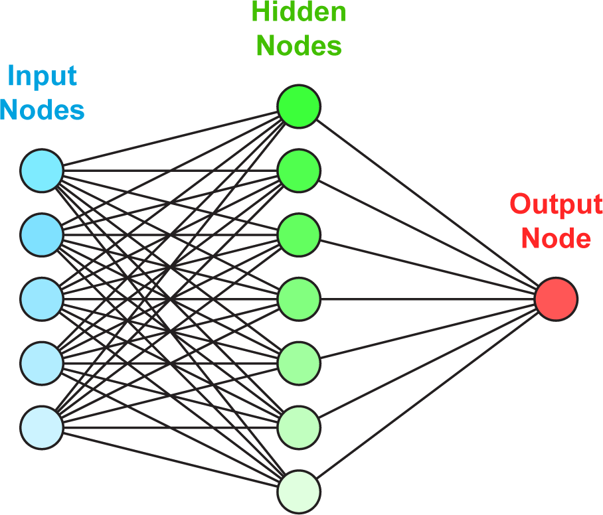
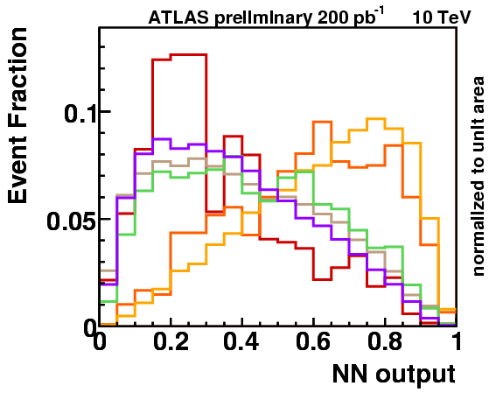
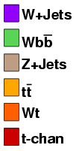
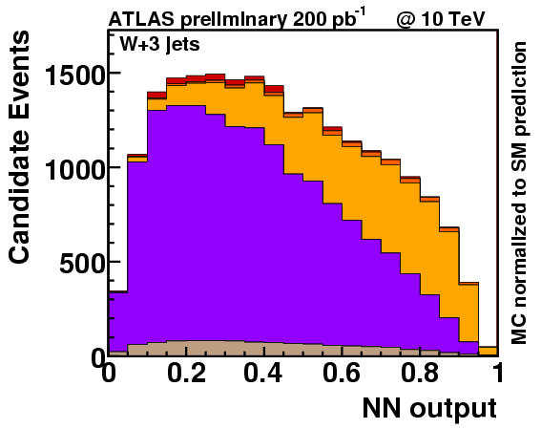
Determination of W+jets & tt background
Feed forward NN with variable preprocessing (NeuroBayes)
Trained with events with 3 jets, no b-tag information
Training was done only with W+jets and tt (50% / 50%)
15 hidden nodes
10 input variables

Slide 26
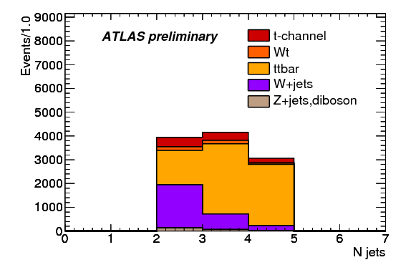
Cross section measurement
Two approaches
Cut-based:
p_{T} (b-jet) > 50 GeV/c
|η (light-jet)| > 2.5
Likelihood Analysis:
Discriminants for W + jets & tt
Few angular variables (to be insensitive to JES)
η (light jet)
ΔR(lepton, b-jet)
ΔR(b-jet, light-jet)
centrality
Use events with 2 jets and
at least one b-tagged jet

Slide 27
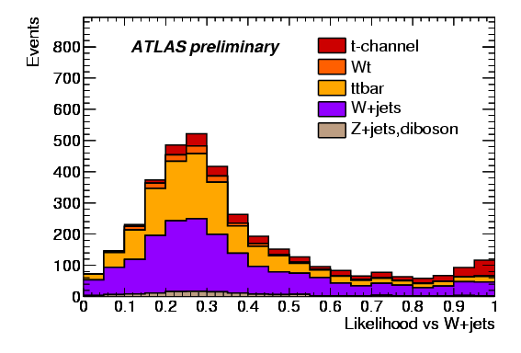
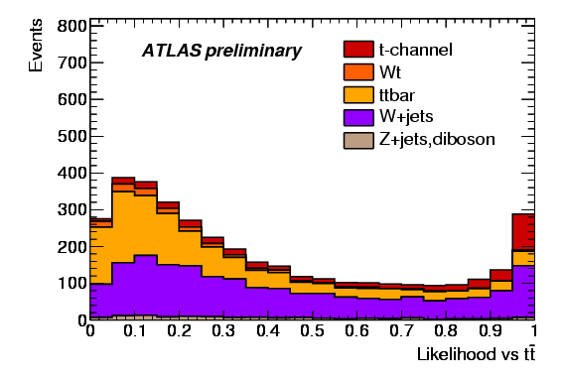
Likelihood method
Two likelihood functions has been constructed to separate W+Jets / tt from t-channel single top:

Slide 28
Systematic uncertainties
Analysis done in 4 channels (electron / muon & +/- charge)
Estimated using ensemble tests (same method as for CSC note)
Source of uncertainty | Δσ/σ (%) Cuts | Δσ/σ (%) Likelihood | Variation
MC Statistics
Jet Energy Scale |  |  | ± 5% on jet energy
b-tagging |  |  | ± 5% on b-tagging eff. ± 10% mistag rate
BG cross section |  |  | Input from NN fit
ISR/FSR |  |  | tt / single top specific samples
PDF |  |  | tt / t-channel
Lep. ID, trigger |  |  | ±1 variation
Luminosity |  |  | ±10%
Total

Slide 29
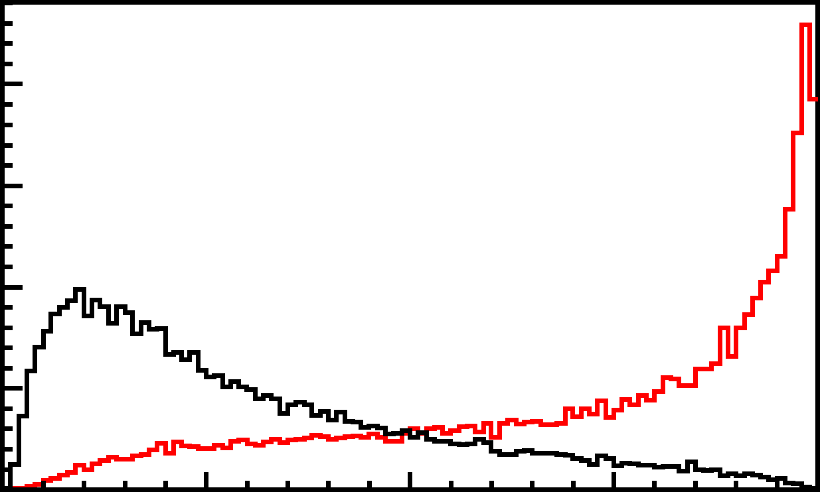
Validation of NN technique
For this exercise we use a NN trained with events with 2 jets and at least 1 btag
Validation of input variables
and correlations
Events with 2 jet 0 tag
Each lepton type separately
Choose well modeled ones
For this exercise we used 10 variables
Δη (j1,j₂)
p_{T} (light jet)
M(j₁,j₂)
E_{T,miss}
Polarization angle
Helicity angle
η (lep)
p_{T} (lνj₁)
Train network
Validation of NN output
Events with 2 jet 0 tag
Slice & Dice 2 jet 0 tag
Output itself

Slide 30
Summary / Conclusion
For the 14 TeV szenario:
Full suite of single top analysis.
Explored each channel and determine sensitivity for 1 fb⁻¹
It is obvious that MVA are necessary
Errors on the cross section measurements
20% (t-channel BDT) - 100% (s-channel)
Now moving to more data driven techniques.
Start is to determine W+jets and tt contribution from sideband
Exploring techniques to validate MVA with data

