Slide 1
Strong-field and attosecond science in nanoscale solids
Giulio Vampa
Stanford PULSE Institute

Slide 2
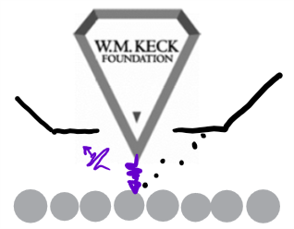
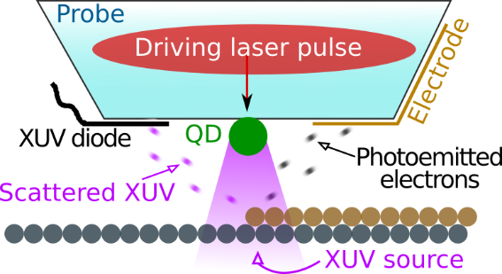
Watching chemical and material processes on the atomic scale in space and time
Giulio Vampa, Jelena Vuckovic, Shanhui Fan, Olav Solgaard, Phil Bucksbaum & David Reis (+ Tony Heinz)
Began Jan 2018
Development of an XUV microscope with:
Superresolution (goal: atomic res.)
Chemical / elemental specificity
Time-resolved (atto-femto)
Non-contact
Non-vacuum

Slide 3
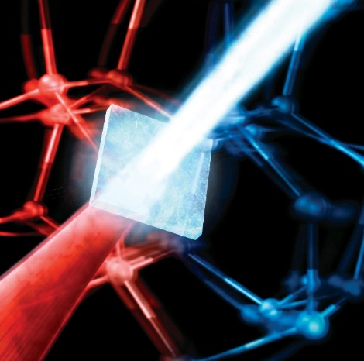
Watching chemical and material processes on the atomic scale in space and time
Fundamentals and applications of high-harmonic generation from silicon
Ghimire, Shambhu, et al. "Observation of high-order harmonic generation in a bulk crystal." Nature physics 7.2 (2011): 138.

Slide 4
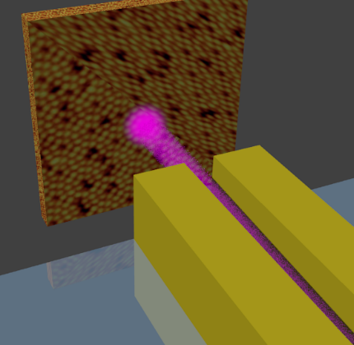
Watching chemical and material processes on the atomic scale in space and time
Obvious connection: use DLA for e-/x-ray microscopy, as long as beams can be kept small (nanoscale)

Slide 5
Watching chemical and material processes on the atomic scale in space and time
… using coherent VUV/XUV high-harmonic sources
10⁸ ph/sec
Driver: 2.4 um, 70 MHz MOPA
Ghimire et al, Nature Physics 7, 138 (2011)
G. Vampa et al., Optics Letters 44, 259 (2019)
Fundamentals and applications of high-harmonic generation from silicon
Ghimire, Shambhu, et al. "Observation of high-order harmonic generation in a bulk crystal." Nature physics 7.2 (2011): 138.

Slide 6
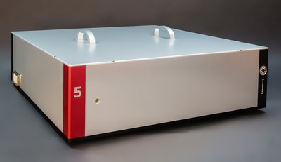
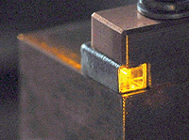
Watching chemical and material processes on the atomic scale in space and time
The lasers
Yb rod amplifier + OPCPA
Yb pump: Amplitude – 35 W, 230 fs, 350 kHz, 1030 nm
OPCPA: Class 5 Dual Quasar – 4 W, ~ 50 fs, CEP @ 1500 nm
2 W, ~ 100 fs, CEP @ 3200 nm
IPG Cr²⁺:ZnS MOPA
(80 MHz , 6W, 26 fs (3 cycles), 2.3 um, + 0.4 W of SH output!)
Now 27 W, 8 cycles. Future sub-2-cycles.
Generated ~ 11 eV harmonics from ZnO @ 80 MHz!

Slide 7
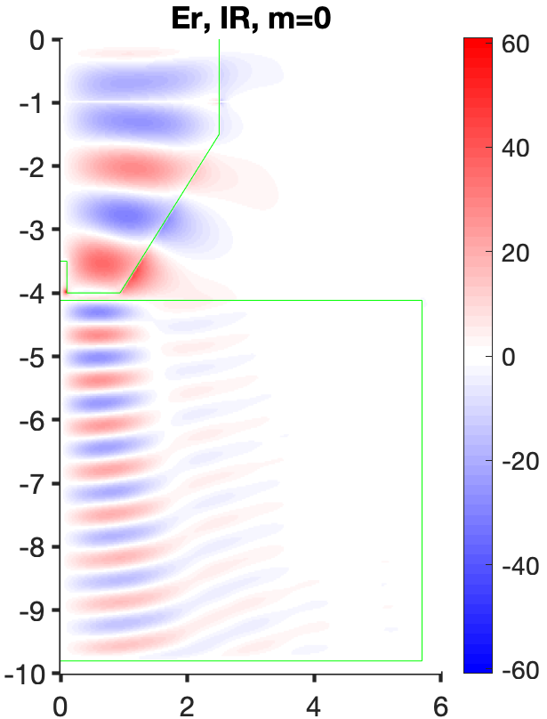
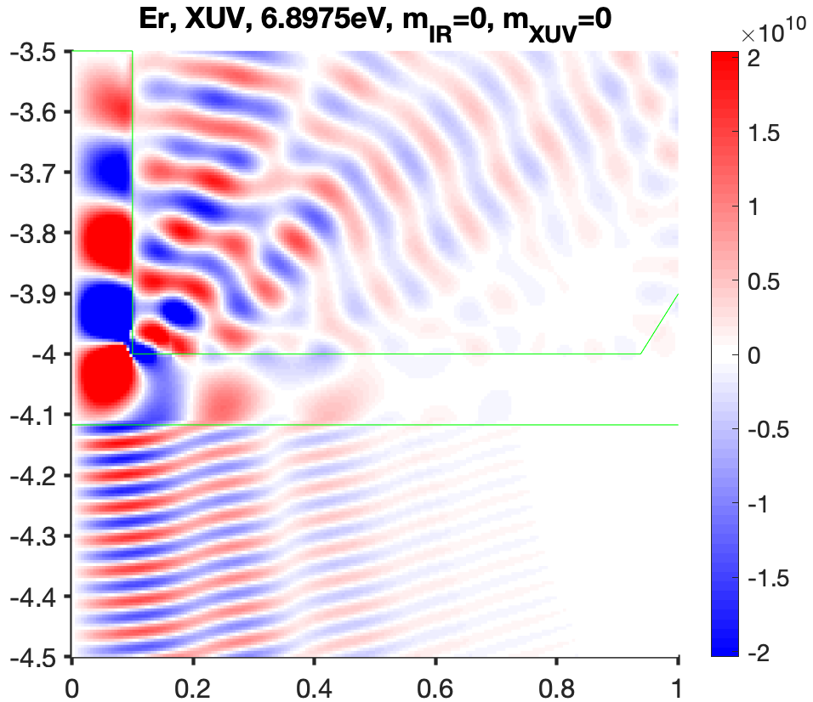
Nanoscale bright coherent VUV sources One proposition with dielectric tips/cones
S. Buddhiraju, S. Fan collaboration
Size limitation is ~ 1 wavelength of XUV

Slide 8
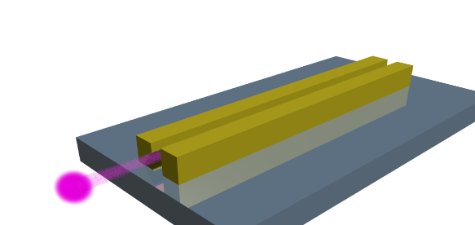
Nanoscale bright coherent VUV sources The goal
Phase matching absorption-limited VUV/XUV
Nanoscale VUV/XUV source
Size limitation is ~ 1 wavelength of XUV

Slide 9
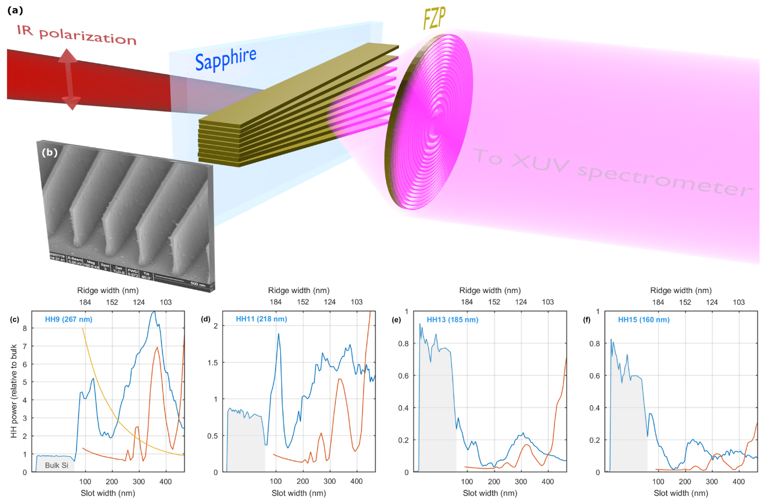
Nanoscale bright coherent VUV sources A first experiment

Slide 10
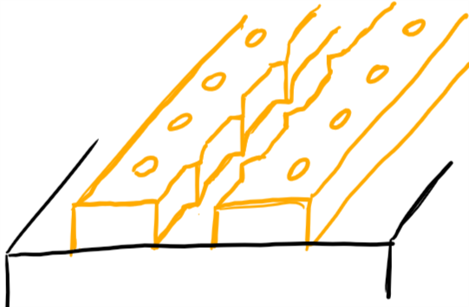
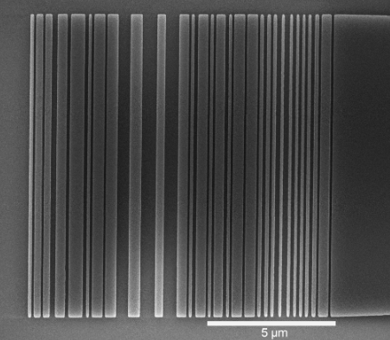
Nanoscale bright coherent VUV sources Future plan
Devise phase matching scheme for planar structures
Development of “attosecond nanophotonics” building blocks. Broadband nanophotonic couplers optimized for low GDD (w/ Fan & Vuckovic)
N. Sapra et al., ArXiv:1808.07630
Notes:
#3: ties to the general approach of merging strong-fields and light transients with nanophotonics (for example: on-chip sources and optical strong-field communication?)

Slide 11
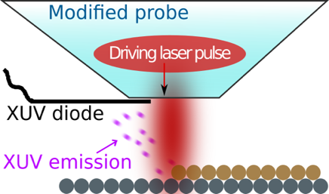
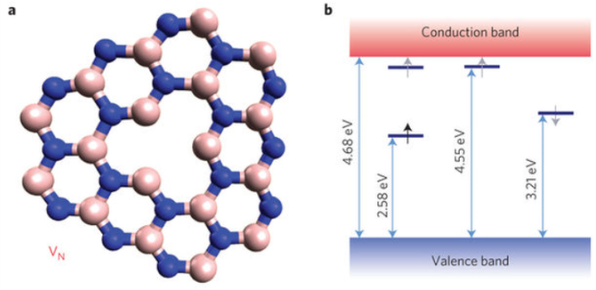
Going super-resolution
~ 10 nm
~ 1 nm
Tips (dielectric & metallic)
Isolated defects in a host lattice

Slide 12
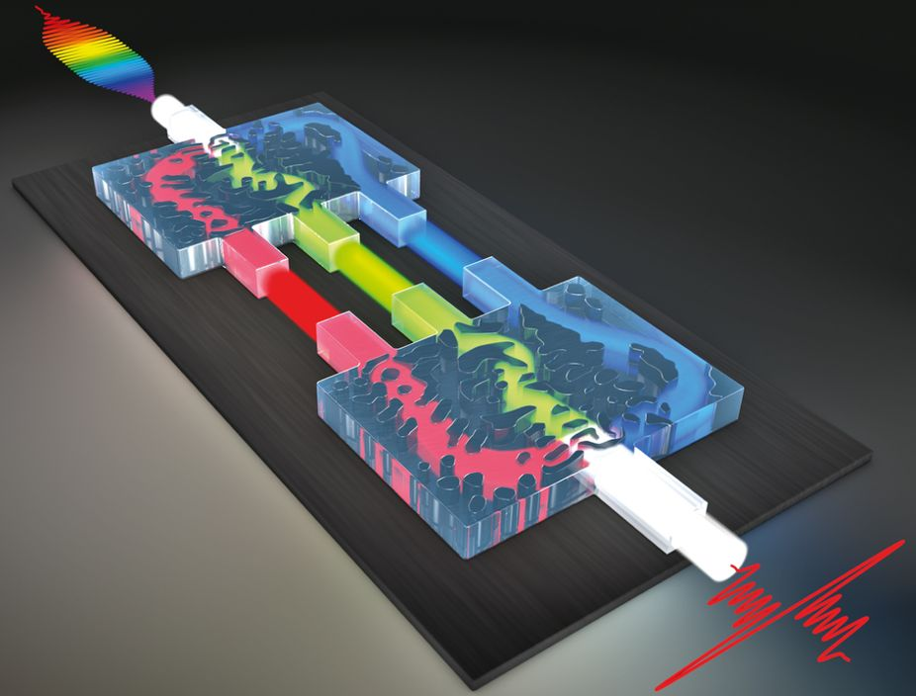
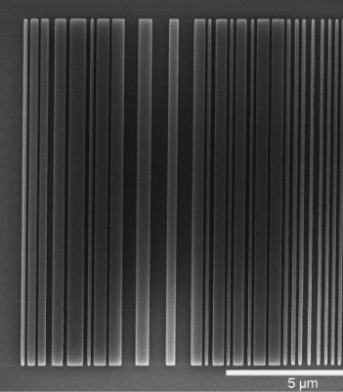
Joint opportunities
Coupling of short femtosecond laser pulses to planar nanophotonic devices
Bandwidth (1 octave!)/ Spatio-temporal distortions
Dispersion engineered waveguides
Tailored field distribution inside materials, not in vacuum
Nanopatterning skills
Nanotips as confined strong-field/XUV sources

