Slide 1
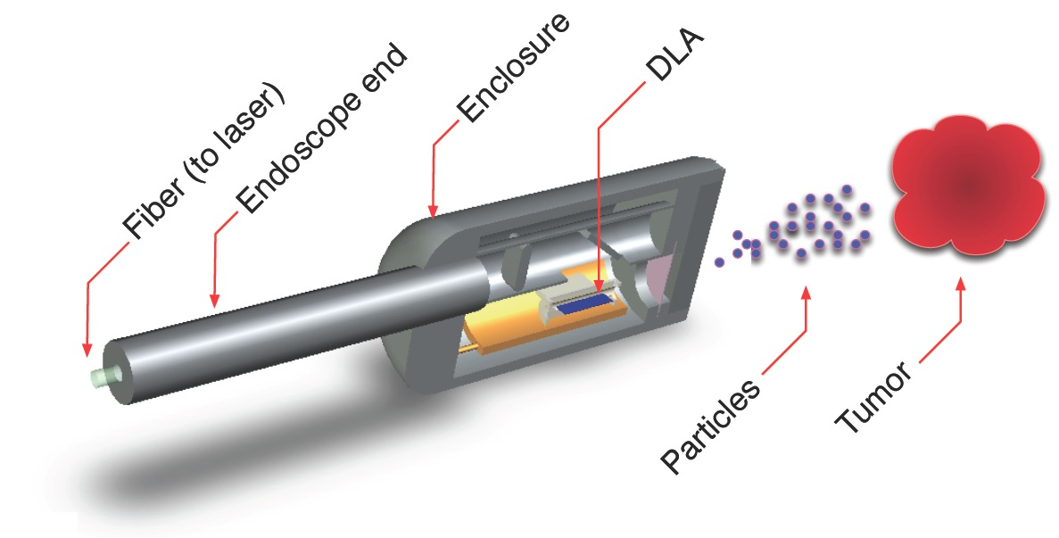

Applications for a Laser-Driven Accelerator on a Chip
R. J. England (SLAC, Stanford)
2nd Workshop on Applications of Dielectric Laser Accelerators
Stanford Univ., March 26, 2019

Slide 2
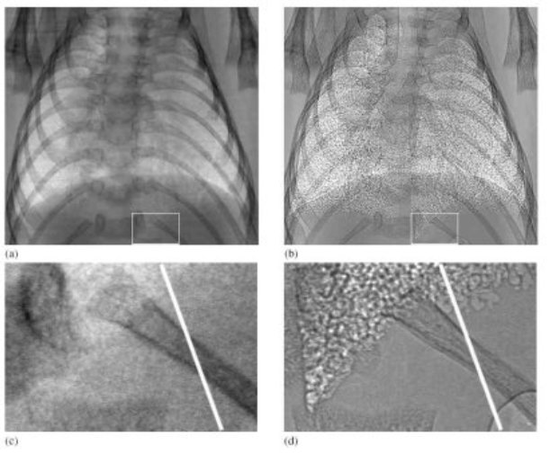
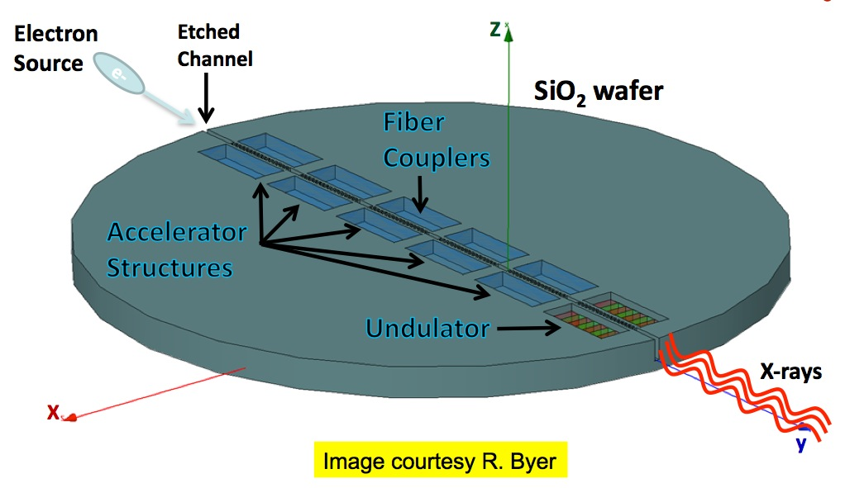
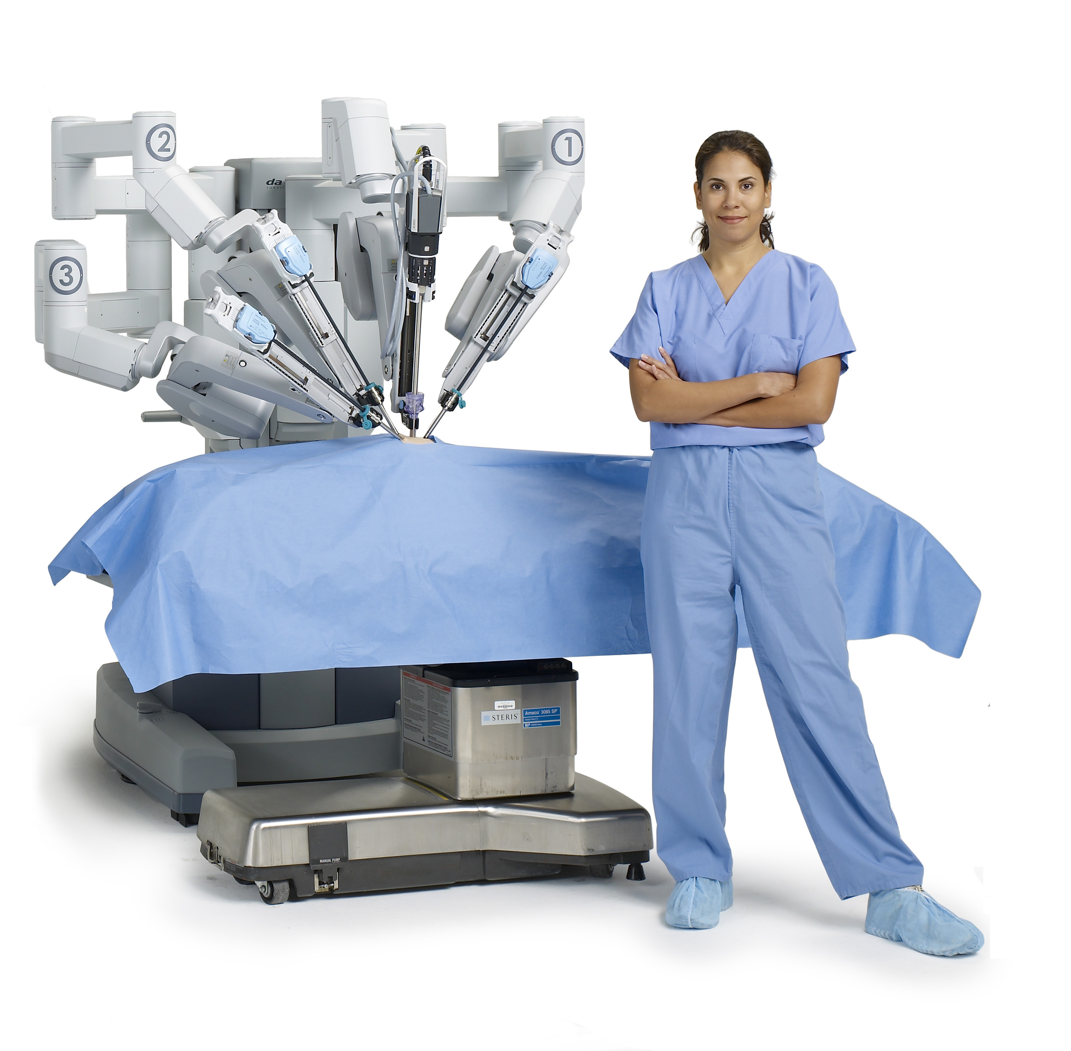
In what ways could smaller more affordable particle accelerators benefit us?
phase contrast imaging
university-scale x-ray laser
SPRING8, UNE
R. L. Byer, Stanford
Hamamatsu
Gil Travish, UCLA
CERN
industrial wafer inspection
portable cancer treatment
Notes:
So why would we want to do this? What are some ways in which small affordable particle accelerators could benefit us? Well to start with, particle accelerators are used in a wide variety of areas, from high energy physics, to light sources to medicine. Making them smaller and more affordable would expand access to this wide variety of instruments for both science and industry.
Figure 2. The effect of sample-to-detector propagation distance on images of a newborn rabbit pup. Images are recorded using beamline 20B2 at the SPring-8 Japanese synchrotron facility using an energy of 25 keV, an exposure time of 500 ms and a CCD x-ray camera having an effective pixel size of 12 μm. (a) Distance = 7 cm, (b) distance = 3 m, (c) enlarged area marked by rectangle in (a), and (d) enlarged area marked by rectangle in (b). (from R.A. Lewis, N. Yagi, M.J. Kitchen, M.J. Morgan, D. Paganin, K.K.W. Siu, K. Pavlov, I. Williams, K. Uesugi, M.J.Wallace, C.J. Hall, J. Whitley, S.B. Hooper (2005). Dynamic imaging of the lungs using X-ray phase contrast. Phys. Med. Biol. 50, 5031-5040. ) – University of New England

Slide 3
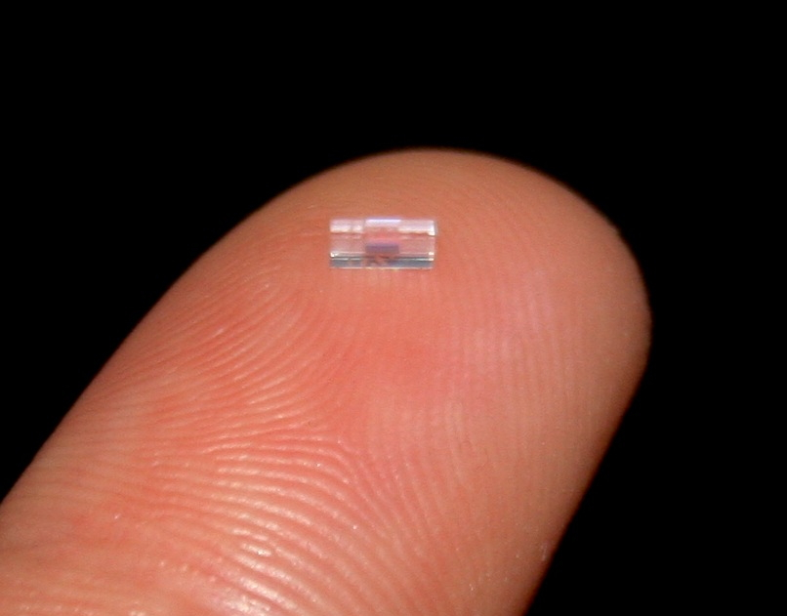
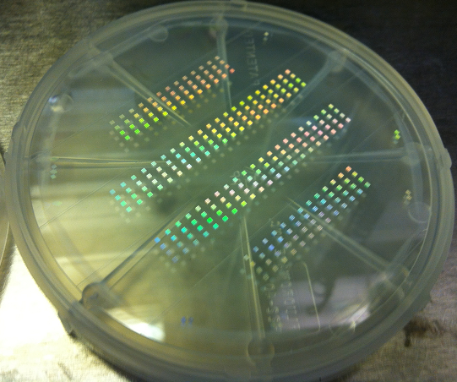
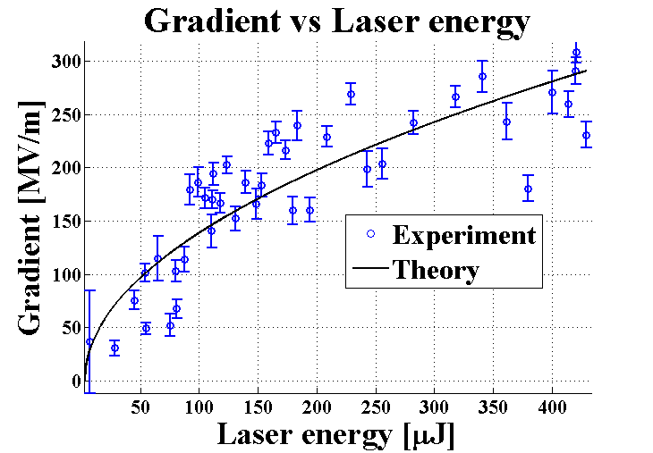
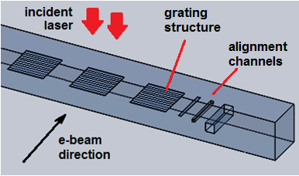
Dielectric Laser Acceleration (DLA) Concept
"Accelerator-on-a-chip"
laser-driven microstructures
• lasers: high rep rates, strong field gradients, commercial support
• dielectrics: higher breakdown threshold → higher gradients
(1-10 GV/m), leverage industrial fabrication processes
bonded silica phase reset accelerator prototypes fabricated at SLAC/Stanford
Goal: lower cost, more compact,
energy efficient, higher gradient
gradient
Wafer is
diced into
individual
samples
for e-beam
tests.
300 MV/m
Notes:
Dielectric Laser Acceleration or DLA is a term that we use to describe an advanced accelerator concept based upon particle acceleration powered by infrared lasers inside of devices made of dielectric materials. The basic operating principles are similar to conventional accelerators in many respects but scaled down in wavelength by 4 orders of magnitude. These devices would operate using low average power microjoule class lasers to generate high peak electric field intensities in the GV/m range. Dielectric materials have high damage thresholds which allow them to withstand GV/m fields at these optical wavelengths, and leverage the fabrication processes used to make microchips in the integrated circuit business. This has led to this approach being referred to in the media as an accelerator on a chip. The goal is to make future accelerators that are lower cost, compact, and higher gradient.
The wafer shown here contains several hundred accelerator structures, each of which appears as a small iridescent square. A single of these accelerator stages can be diced out and tested with an electron beam and an incident laser pulse. Recent results have demonstrated gradients as high as 300 MV/m with this approach and we anticipate that with further refinement of materials and structure design this can be extended by another order of magnitude.

Slide 4
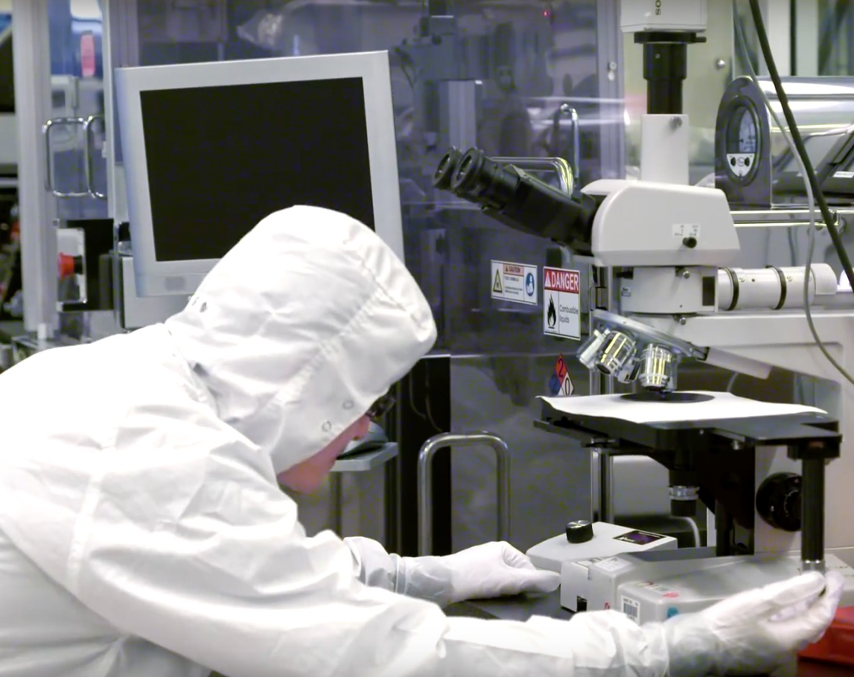
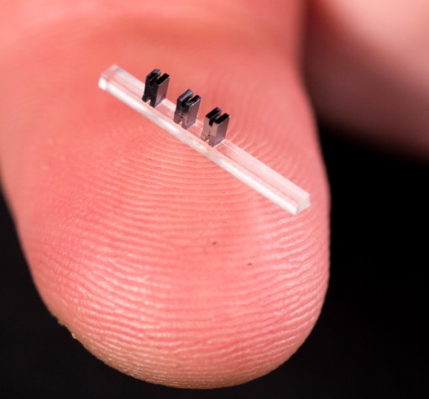
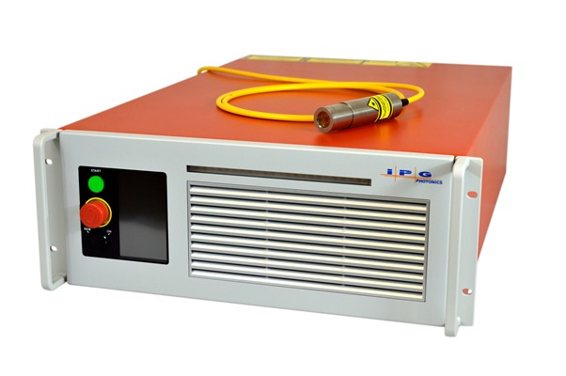
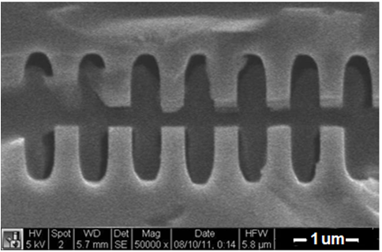
DLA leverages advances in two major industries: solid state lasers + semiconductor fabrication
Not high peak power lasers!
Fabricated using techniques of the integrated circuit industy.
Parameter | DLA Value
Wavelength | 2 µm
Pulse Duration | 100 fs
Pulse Energy | 1 µJ
Laser Power | 100 W
Rep Rate | 100 MHz
Laser Efficiency | 30%
Cost/laser | $150k
Stanford - H. Deng
DLA structures are made by students in the Nanofabrication Facilities at partner universities.
SEM images of DLA prototypes tested at NLCTA
Available now
“off the shelf”
Solid-state laser
fused silica
silicon
Notes:
Dielectric laser acceleration or DLA refers to the use of solid state lasers to drive GV/m accelerating gradients in dielecrric microstructures, allowing for unprecedented compactness. The structures are made of materials such as fused silica and silicon (as seen in these insets) and operate by supporting an electromagnetic accelerating mode inside of a narrow vacuum channel about one laser wavelength wide. A periodic variation in index of refraction is used to enforce a synhcronicity condition which allows the particles to be continuously accelerated. The lasers required are microJoule class research lasers that operate at high rep rates (so NOT high peak power lasers) and lasers with these specifications are now available off the shelf with small footprints and reasonable price tags. The dielectric structures are fabricated by students at partner universities, such as Stanford student Huiyang Deng shown here hard at work in the Stanford nanofab.

Slide 5


A 5-Year initiative in DLA has been funded by the Gordon and Betty Moore Foundation (2015 – 2020)
Executive Committee:
R. L. Byer (Stanford), P. Hommelhoff (FAU), R. J. England (SLAC), R. Assmann (DESY), R. Ischebeck (PSI)
Sub-Relativistic DLA experiments
Stanford: Harris, Solgaard
Erlangen: Hommelhoff
Structures
Stanford: Harris, Solgaard, Byer
Erlangen: Hommelhoff
Electron source
UCLA: Musumeci
Erlangen: Hommelhoff
Stanford: Harris, Solgaard
System integration
(Core DLA groups)
Stanford: Byer, Harris, Solgaard
Erlangen: Hommelhoff
Simulations
Tech-X: Cowan
U Darmstadt: Boine-Frankenheim
Light Coupling
Stanford: Fan, Vučković
Associated Scientific Collaborators
Yenchieh Huang (Tsinghua)
Evgenya Simakov (Los Alamos)
Zhirong Huang (SLAC)
Kazu Koyama (Tokyo U)
Relativistic DLA experiments
SLAC: England
DESY/UnivHH: Assmann, Kaertner, Hartl
PSI/EPFL: Ischebeck, Rivkin
Industrial affiliate Hamamatsu Corp. Japan (joined June 2017)
Program start: Dec. 2015
ACHIP Scientific Advisory Board:
Chan Joshi (UCLA), Tor Raubenheimer (SLAC) , Reinhard Brinkmann (DESY)

Slide 6
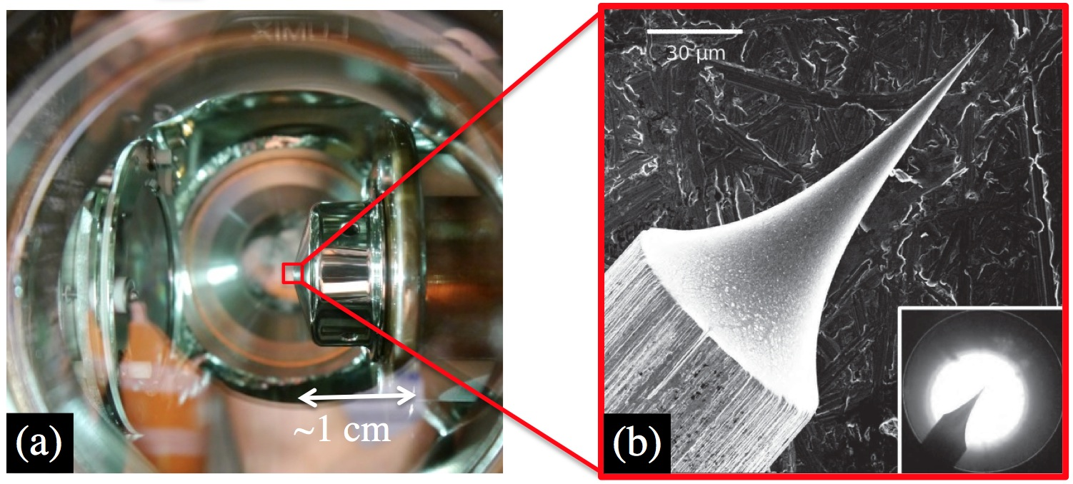
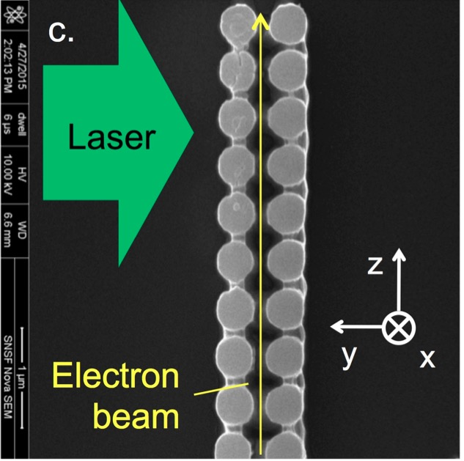
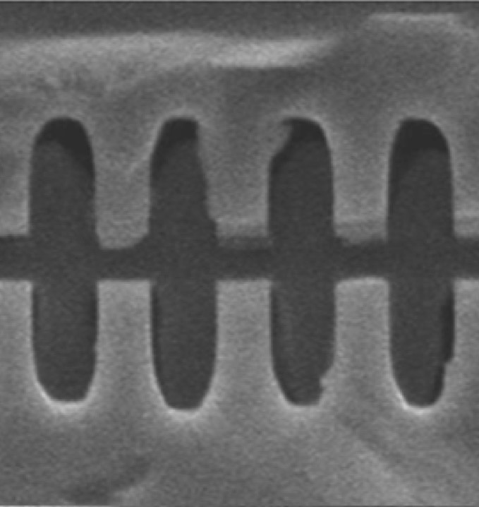
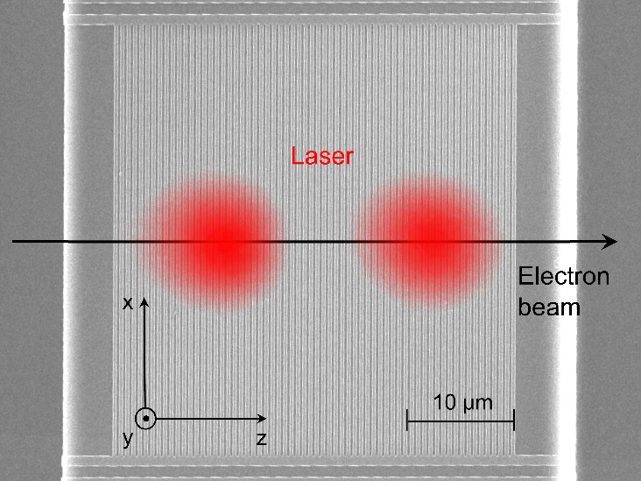
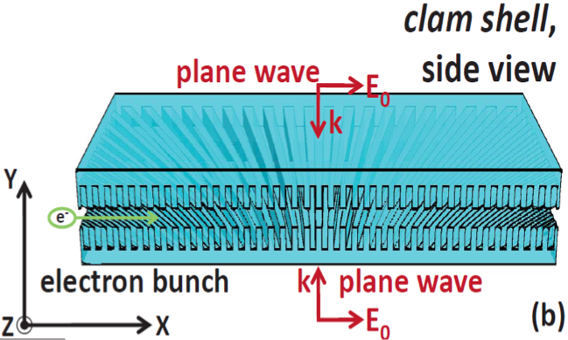
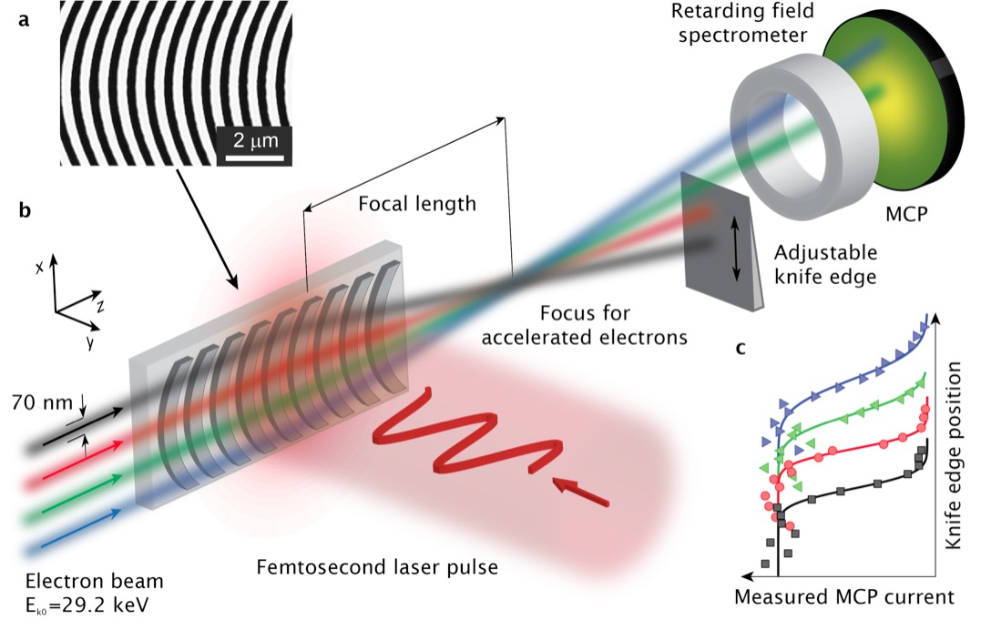
What has been done to date?
compact field emission e- sources
high gradient (0.3 → 0.85 GV/m)
10 um
laser
8 MeV electrons
30 keV
30 keV
Hoffrogge, et al. J. Appl. Phys. 115, 094506 (2014)
Leedle, et al. Opt. Lett. 40, 4344 (2015)
Cesar et al., Nat. Comm. Phys. (2018)
“staging” with 2 lasers
sub-relativistic focusing
beam position monitor
M. Kozák et al., arXiv:1512.04394v1
10 µm
Opt. Lett., 37 (5) 975-977 (2012)
Opt. Lett., 39 (16) 4747 (2014)

Slide 7
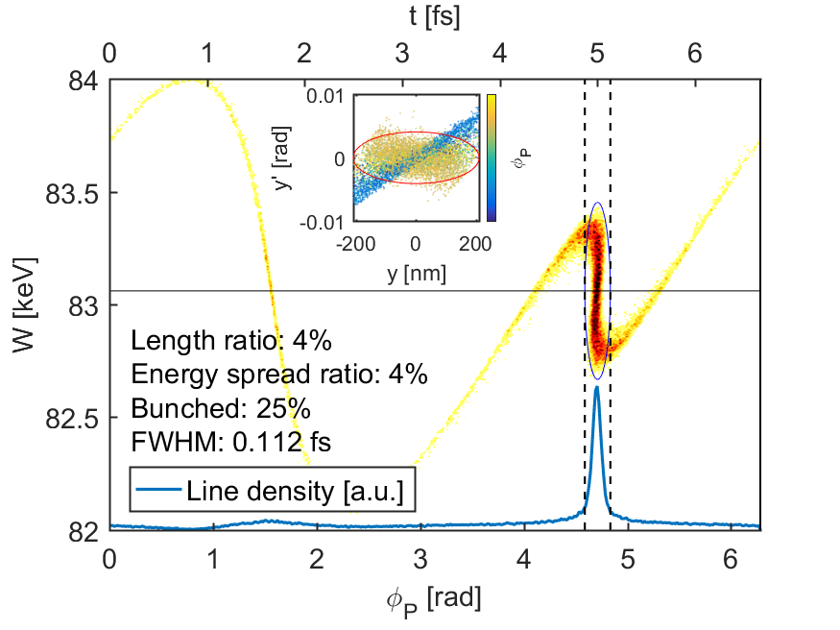
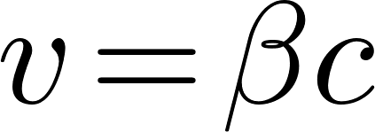
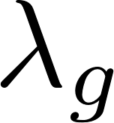

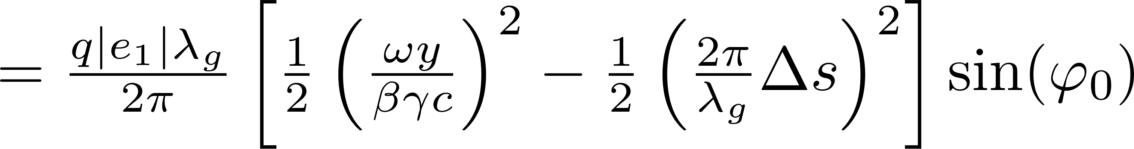
Alternating Phase Focusing DLA structures
Niedermayer, et al., PRL 121, 214801 (2018)
APF beam dynamics scheme works in theory
  Overcomes resonant acceleration defocusing problem
  Can also used for bunching in the attosecond range
  Makes DLA scalable!
Laser
y
Silicon
pillar
x
z
s
Silicon
pillar
Laser
N S
Quadrupole magnet for focusing in the invariant direction
DLA
U. Niedermayer, T. Egenolf (Darmstadt)

Slide 8
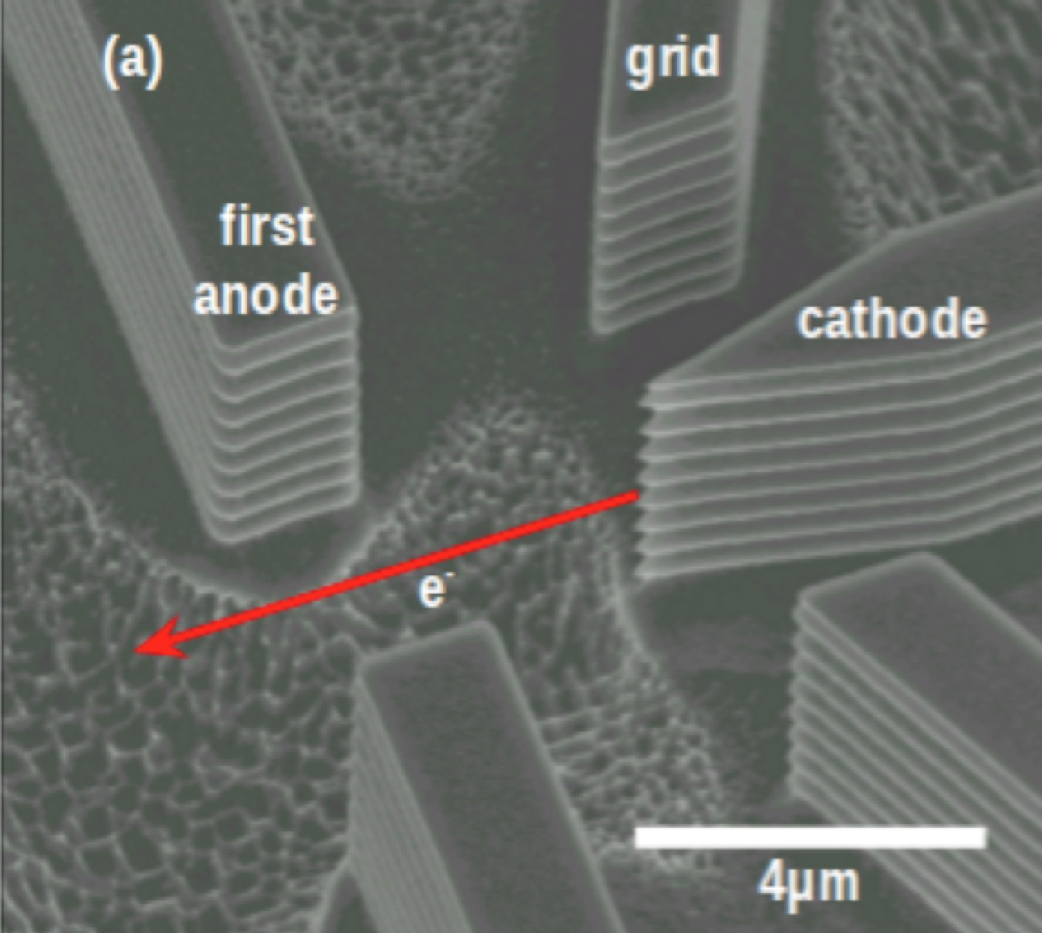
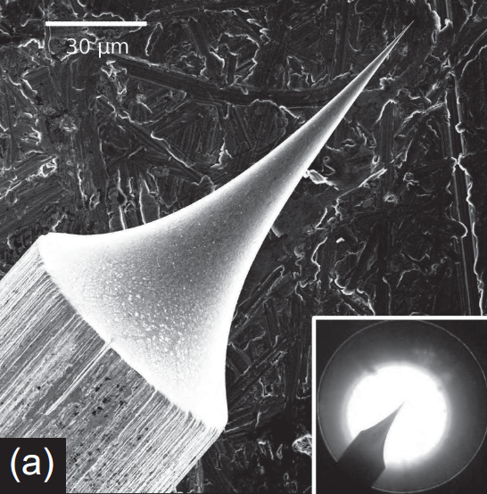
combined with ultra-small electron sources that are well matched to the structures…
A. Ceballos, Solgaard group, Stanford EE Dept., Ginzton Lab
J. Hoffrogge et. al, “A tip-based source of femtosecond electron pulses at 30keV”. arXiv:1303.2383 (2013).
Integrated Si photocathode fabrication with lithographically defined vertical tip array + several additional electrodes in a tetrode configuration (grounded anode not shown).
30 keV electron pulses triggered by a 10 femtosecond 800nm Ti:Sapphire laser with up to 2000 electrons per pulse.

Slide 9
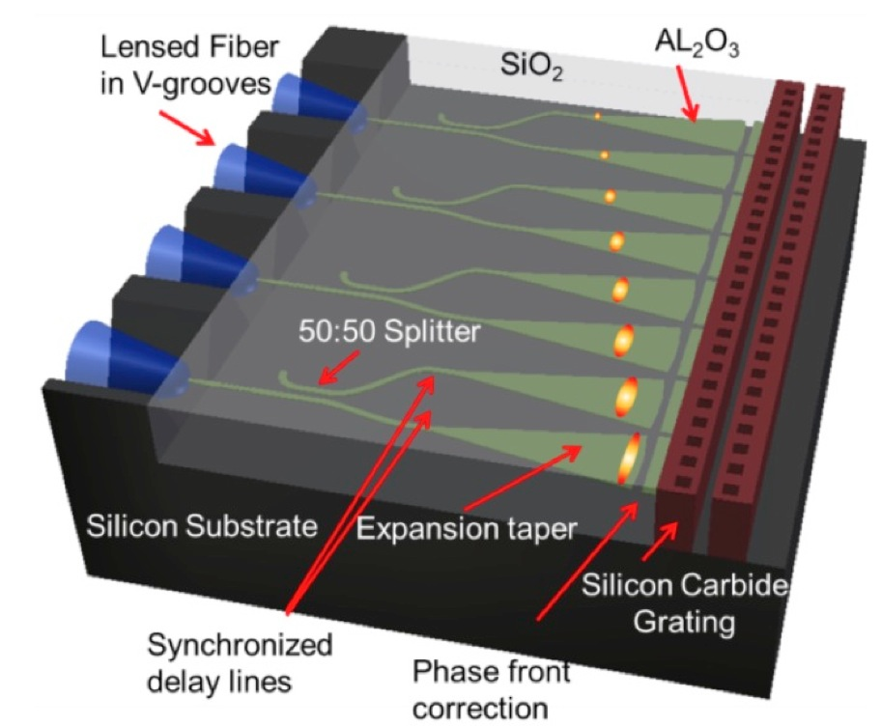
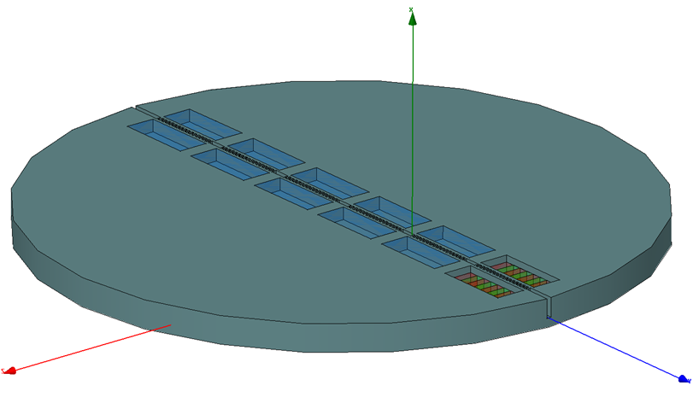
would pave the way for a MeV-scale device on a wafer.
Electron
Source
Etched
Channel
Z
30 keV
e-
Laser Couplers
SiO₂ wafer
40 MeV
X
e-
y

Slide 10
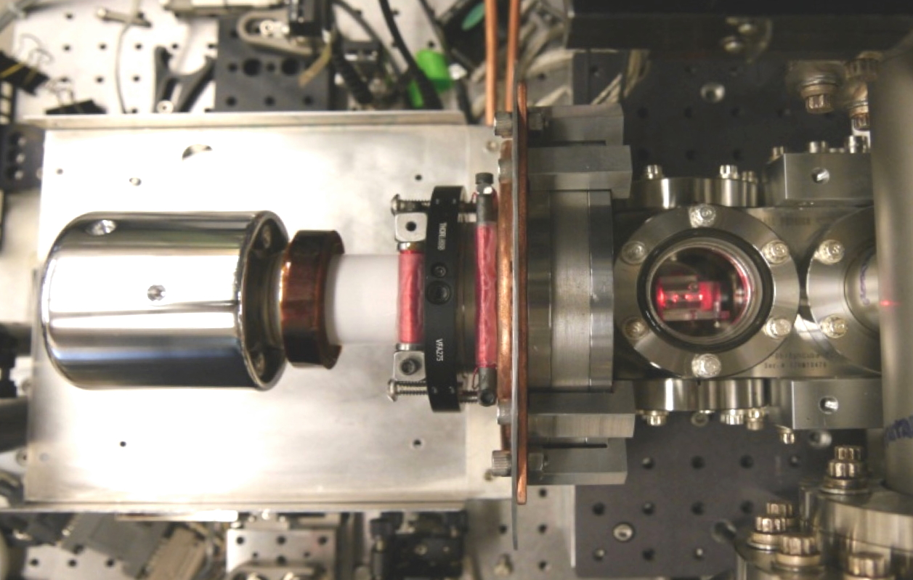
A compact prototype “shoebox” test system is now operating at Stanford University – goal of 1 MeV energy
Dual Drive Lasers
DLA
Electron Gun
w/HV Shield
e- axis
12’’
55 keV e- gun; nA beam current
Diamond tip emission source; Hexapod positioning stage
image courtesy K. Leedle, J. Harris lab (Stanford University)

Slide 11
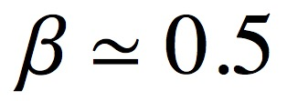
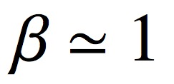
Concept for 1 MeV “Shoebox” Injector (1.5 Year)
A single bunching/acceleration/focusing stage driven by a tilted laser pulse.
Pulse Front Tilted Laser
tip emitter +
electrostatic
lens
...
50-100 keV
Acceleration
Focusing
Emitter
Buncher
DLA Linac with APF Focus + Velocity Taper
1.3 cm

Slide 12
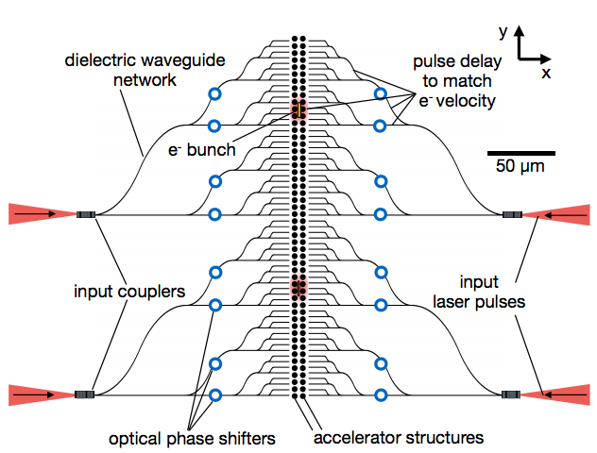
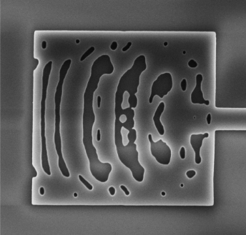
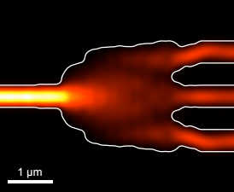
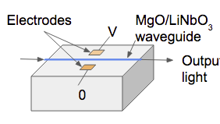


Multistage Waveguide Network Design for a Dielectric Laser accelerator
couplers
splitters
phase shifters
T. Hughes, et al. “On-Chip Laser Power Delivery System for Dielectric Laser Accelerators,”
Phys. Rev. Appl. 9, 054017 (2018)
• Design Study of Integrated Multi-Stage DLA Network
• Realistic Component Parameters
• Adjoint Variable (“Inverse Design”) Based Structure Optimizations

Slide 13
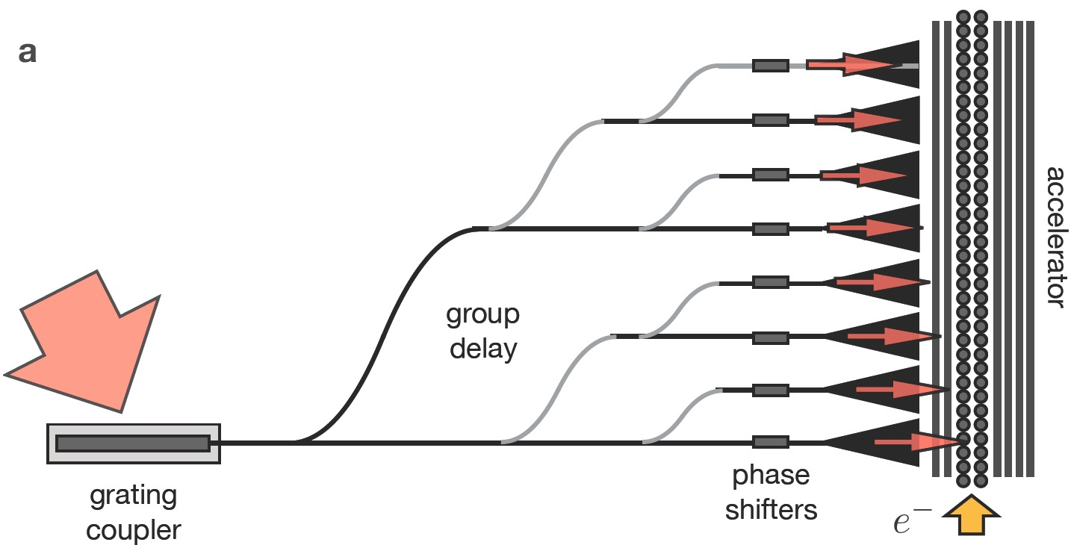
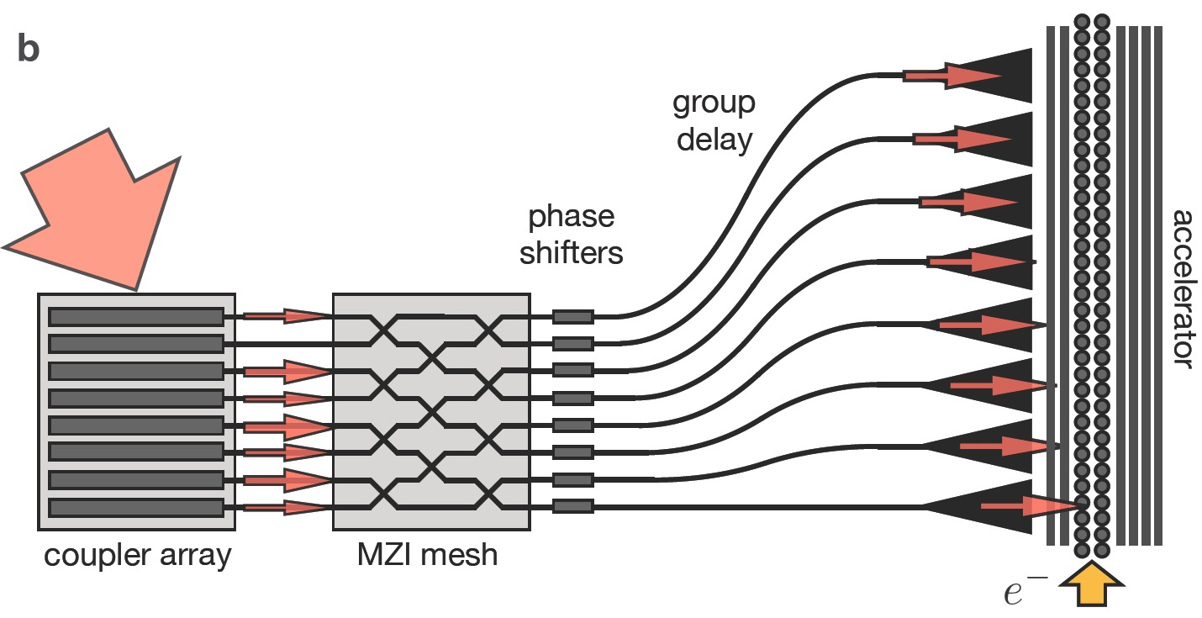
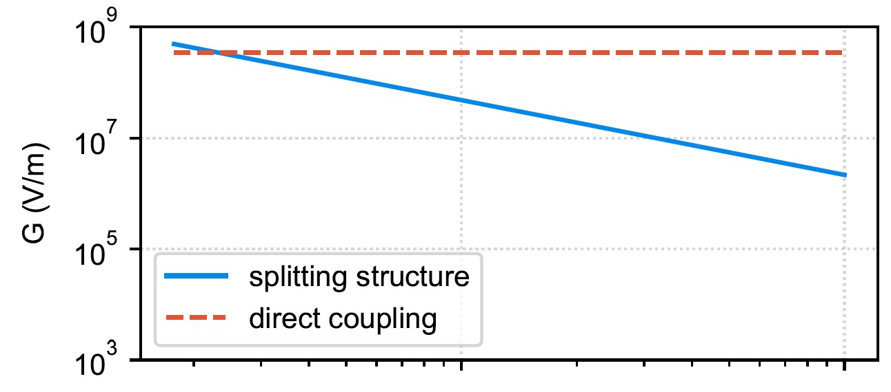
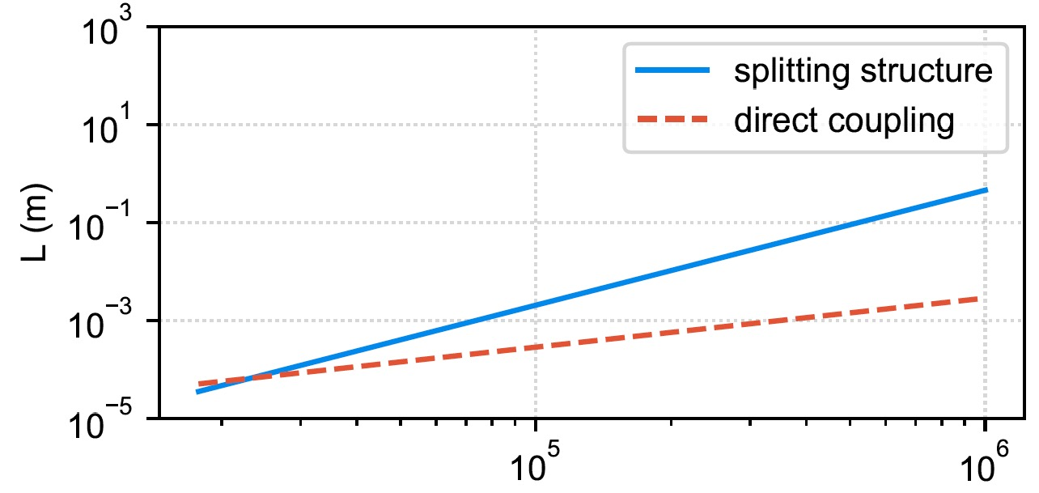
Direct Coupling to a Waveguide Network with MZI Control Removes Bottlneck at the Input Facet
splitting structure
direct coupling with MZI mesh
Hughes, et al. PRA 9, 054017 (2018)
Hughes, et al. submitted, PRA (2019)
Gradient (V/m)
Length per Laser (m)
Energy Gain (eV)
Energy Gain (eV)

Slide 14
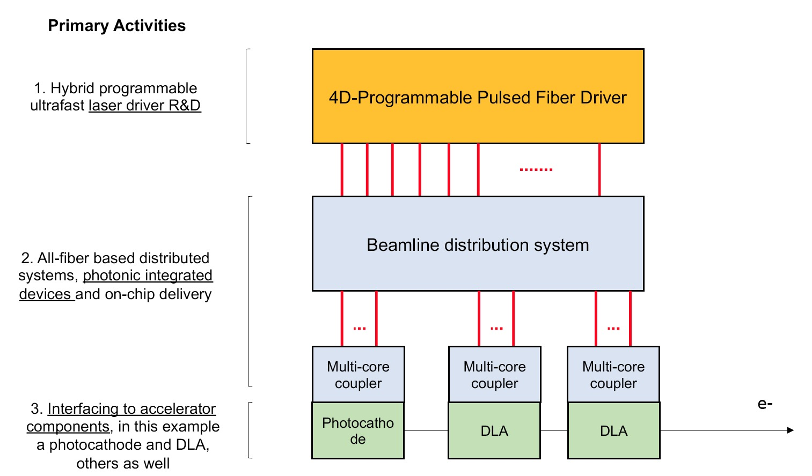
Phase Fiber Array Distribution System for a Multi-Stage Dielectric Laser Accelerator
Slide Courtesy S. Carbajo (SLAC) – Laser Group

Slide 15
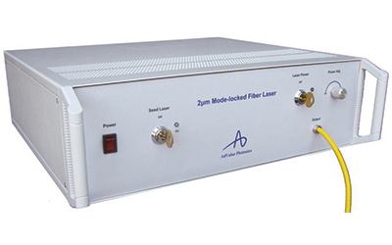
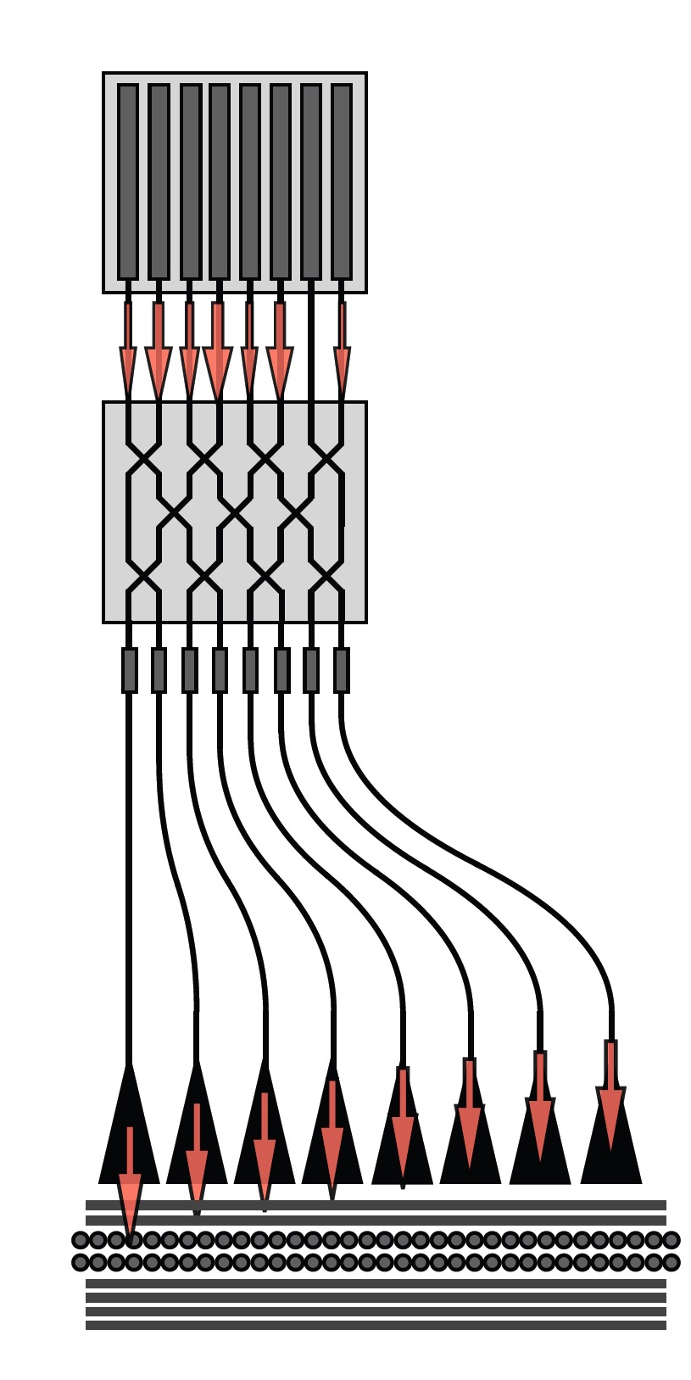
Concept for Injector + Multistage Accelerator (5 Year)
Thulium Fiber
Laser (2µm)
Master Clock
Master Oscillator
CEP phase locked network
…
Oscillator 0
Oscillator 1
Oscillator 2
Oscillator 3
Oscillator N
…
...
silicon
fused silica
50 keV 1 MeV 5-10 MeV
Injector/Buncher
MZI Controlled DLA Linac with APF Focus
15

Slide 16
Strawman Parameters (1.5 vs. 2-5 Year Time Scale)
 |  | Injector Only | Multi-Stage
Parameter | Units | 1.5 Years | 2-5 Years
Final Electron Kinetic Energy | MeV | 1 | 5
Unloaded Gradient | MeV/m | 73 | 357
Trapped MacroBunch Charge | e | 9 | 302
Bunch repetition rate | MHz | 0.1 | 50
Laser Pulse Duration | fsec | 250 | 250
Trapped Microbunch Charge | e | 0.05 | 1.7
Microbunch duration | attosec | 260 | 0.26
Microbunches per Train | # | 181 | 181
Design wavelength | micron | 2 | 2
Invariant Emittance | nm | 0.05 | 0.10
RMS Beam Size X | micron | 0.05 | 0.05
RMS Beam Size Y | micron | 1.00 | 1.00
Electron Capture Efficiency | # | 0.21 | 0.56
Electron Channel Width | nm | 420 | 420
Beam Power | µW | 0.2 | 3657
Total Laser Power | W | 0.4 | 2387
Laser Pulse Energy | µJ | 3.9 | 7.5
Number of Lasers | # | 1 | 7
Geographical Gradient | MeV/m | 73 | 204
Total Linac Length | mm | 13 | 24

Slide 17
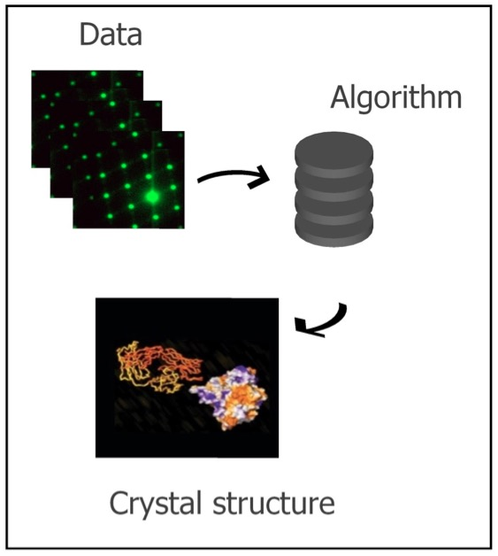
Applications Identified by the March 2018 DLA Applications 1-Day Workshop
potential areas of industry interest
Biomedicine industry
-- Radiation therapy
Semiconductor industry
-- low-power EUV for mask/wafer
inspection/calibration
potential areas of scientific interest
Nano- or micro-beam for radiobiology and radiation chemistry
Ultrafast electron diffraction, X-ray pulses at sub-fs time scales
Notes:
Dielectric Laser Acceleration or DLA is a term that we use to describe an advanced accelerator concept based upon particle acceleration powered by infrared lasers inside of devices made of dielectric materials. The basic operating principles are similar to conventional accelerators in many respects but scaled down in wavelength by 4 orders of magnitude. These devices would operate using low average power microjoule class lasers to generate high peak electric field intensities in the GV/m range. Dielectric materials have high damage thresholds which allow them to withstand GV/m fields at these optical wavelengths, and leverage the fabrication processes used to make microchips in the integrated circuit business. This has led to this approach being referred to in the media as an accelerator on a chip. The goal is to make future accelerators that are lower cost, compact, and higher gradient.
The wafer shown here contains several hundred accelerator structures, each of which appears as a small iridescent square. A single of these accelerator stages can be diced out and tested with an electron beam and an incident laser pulse. Recent results have demonstrated gradients as high as 300 MV/m with this approach and we anticipate that with further refinement of materials and structure design this can be extended by another order of magnitude.

Slide 18
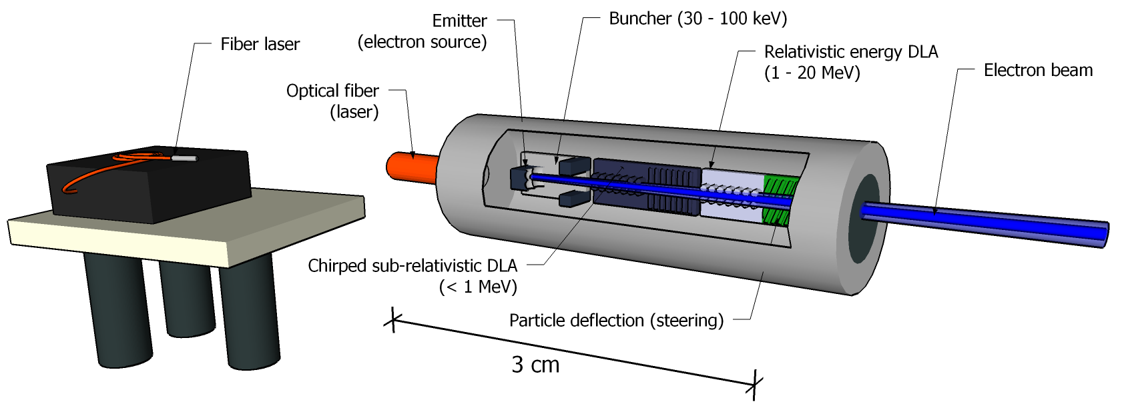
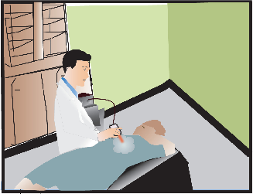
A Small Footprint Medical Accelerator Directly Maps to DLA’s Unique Features
Parameter | Desired Capability | Unique DLA Features
Electron energy | 10-20 MeV | Single-wafer design with 1 GV/m gradient
Useful dose | 1 Gray/sec | 2000 e- per bunch; 2 MHz rep rate
Treatment Volume | 5-10 cm³ | Directed (vs omnidirectional) beam and on-chip deflection to scan tumor area
Small footprint | ~ 1 cm x 10 cm | 2um wavelength optical scale device with 2 cm active linac length
Wall Plug Power | < 100 Watt | Modest 2.9% wall-plug to electron efficiency

Slide 19
What about the possibility of a DLA based light source?
Large facilities are often oversubscribed (e.g. the Linac Coherent Light Source at SLAC has ~ 5 times more proposals than it can accommodate)
Compact footprint and reduced cost would give university labs and smaller facilities greater access (e.g. an FEL in every university)
Sub-optical wavelength (attosecond) temporal bunch structure if translated into sub-fs radiation pulses would be useful for ultrafast science (molecular movies, atomic physics).
Compact, portable scanners for security (Nuclear Fluorescence), phase contrast imaging and medicine.

Slide 20
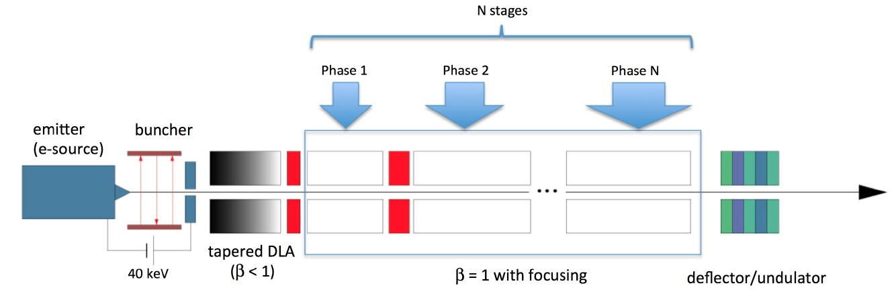
Components of a DLA Light Source
Overall goal: The demonstration of an integrated multi-stage particle “accelerator on a chip” will validate the potential to scale to energy levels of interest for “real-world” applications.
On-chip electron source
DLA structure development: (a) subrelativistic, (b) relativistic
Multi-staged acceleration
Coupling of laser to DLA
Laser-driven undulator

Slide 21
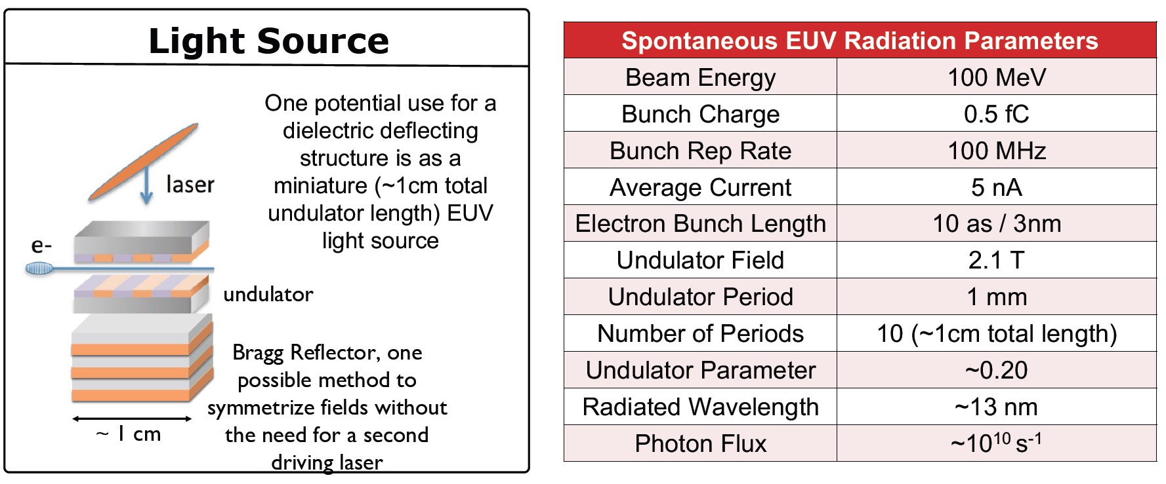
Concept for a compact laser-driven undulator for EUV production
An equal superposition of the TE and TM fundamental modes produces a pure deflection mode (i.e. no E_{z} component)!
A. Ody, R. J. England, Z. Huang, Advanced Accelerator Concepts Workshop 2018
see talk by A. Ody

Slide 22
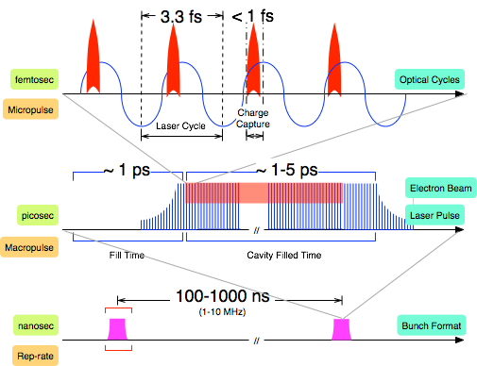
Optical structures naturally have sub-fs time scales and favor high repetition rate operation
DLA's attosecond bunch structure raises the possibility of making attosecond radiation pulses

Slide 23
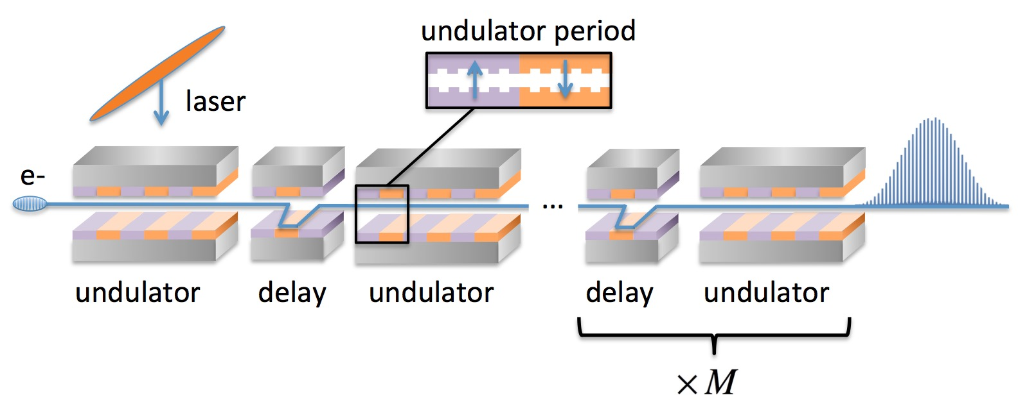
EUV Attosecond Frequency Comb
Modelocking scheme proposed could enable attosecond radiation pulses
(R. J. England, Z. Huang, FLS 2018)
Parameter | Unit | Value
Beam Energy | MeV | 40
Microbunch Charge | fC | 10
Undulator Period | µm | 250
Number of periods / Delay Modules | # | 10 / 100
EUV Photon Energy | eV | 50
Radiated Pulse Energy | nJ | 100

Slide 24
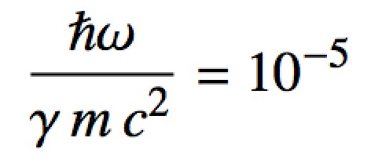
DLA X-ray FEL Strawman Parameter Table
Parameter | Units | Value
Ebeam Energy | GeV | 1.056
Microbunch Charge | fC | 0.5
Bunches per Train |  | 150
Rep Rate | MHz | 100
Normalized Emittance | nm | 0.87
Laser Wavelength | µm | 2
Laser Pulse Duration | ps | 1
Undulator Period | mm | 0.9
Equivalent Undulator B | T | 1.6
Undulator K |  | 0.14
Pierce Parameter |  | 2.29E-04
Undulator Length | m | 0.9
Photon Energy | keV | 11.5
Gain Length | m | 0.18
Photons per Bunch |  | 6.6E+04
Photon Flux | photons/sec | 9.9E+14
Brightness | SBU* | 1.05E+21
A DLA X-ray source would be in or near the Quantum FEL regime:
* 1 “SBU” = ph/s/mm²/mrad²/0.1%BW

Slide 25
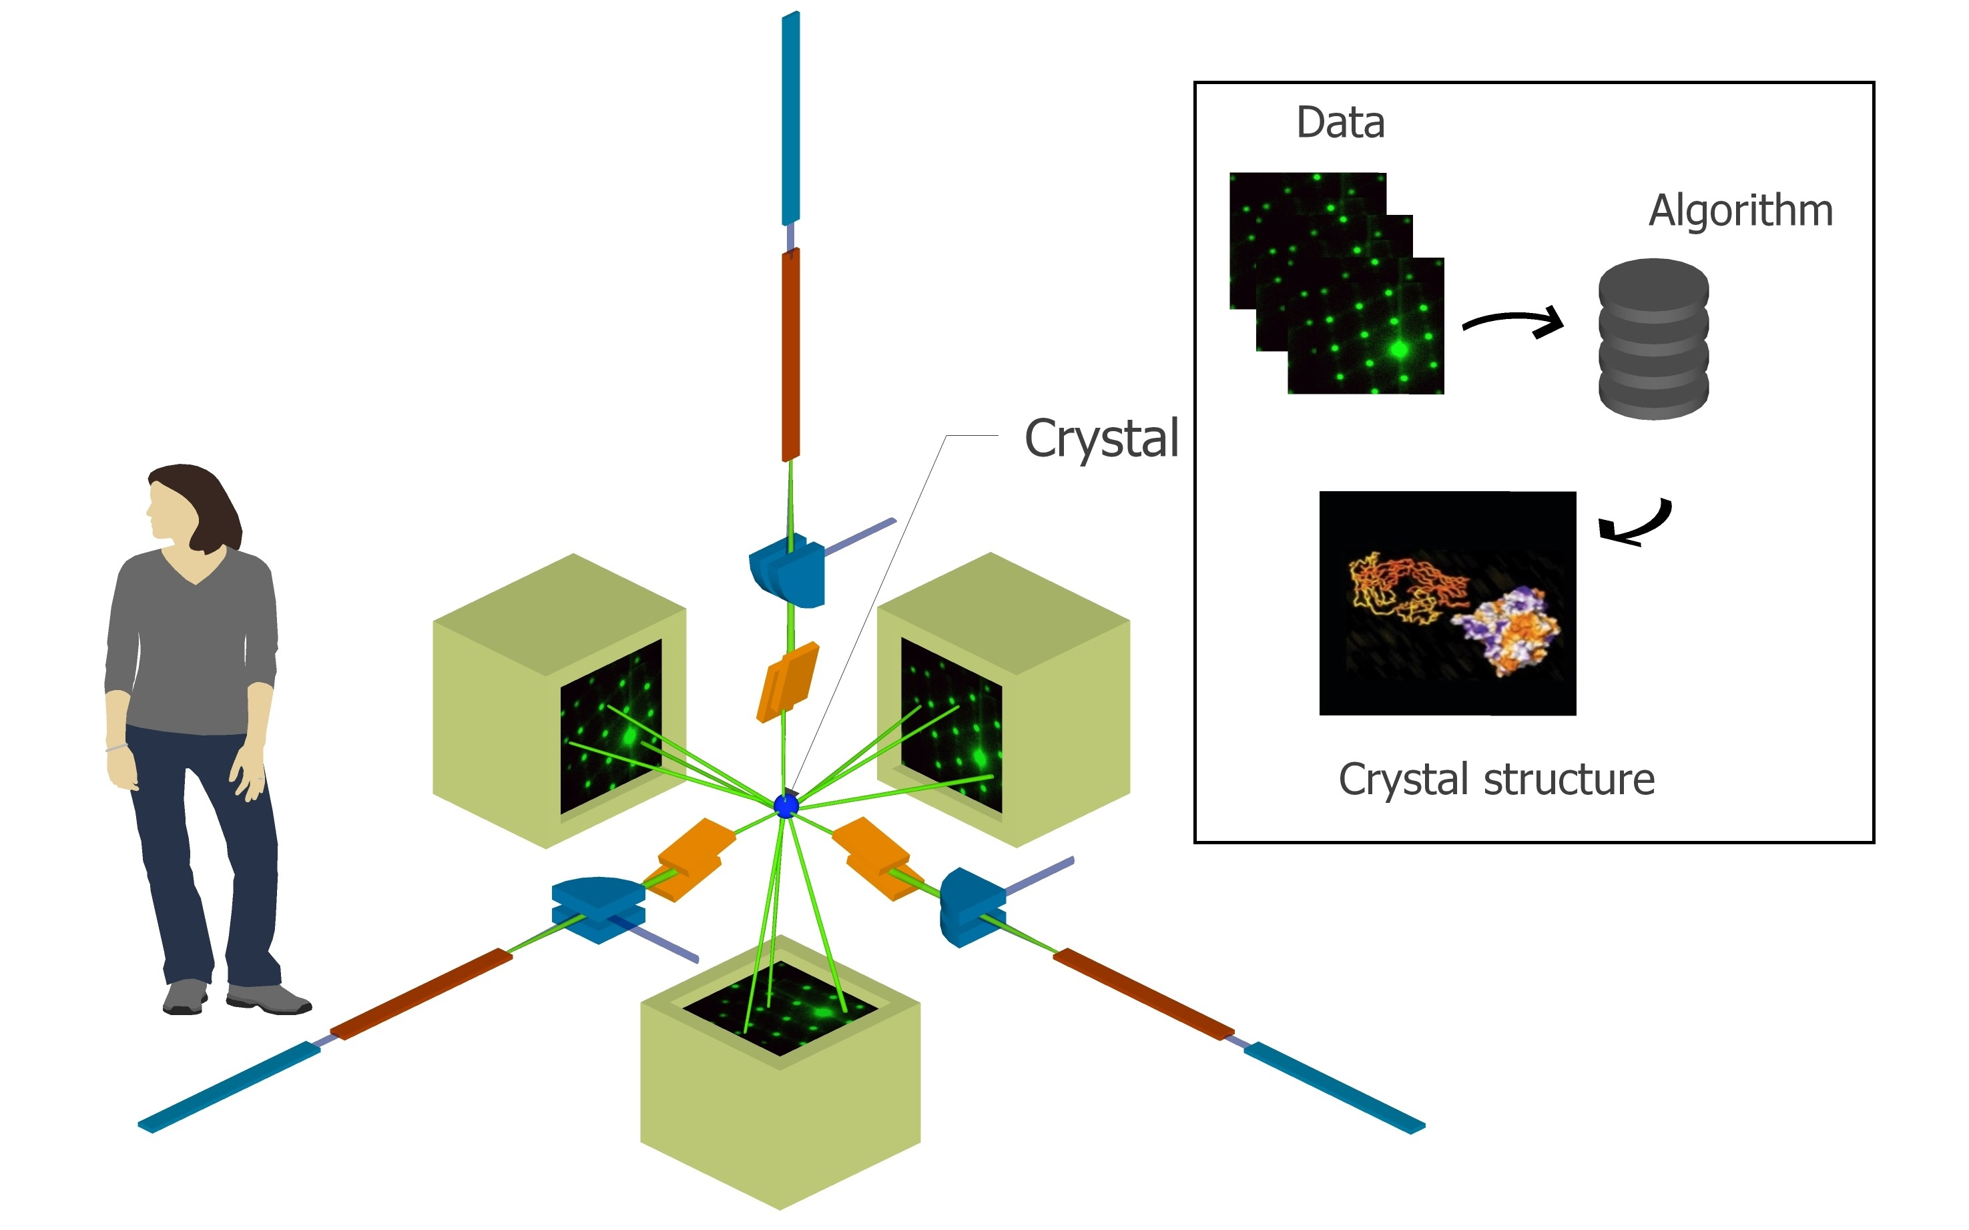
A miniaturized attosecond XFEL could enable revolutionary new science capabilities.
• Improved access for universities
• Ultrafast (attosec) pulses
molecular movies
atomic physics
• Inexpensive solid state devices
• Portable security scanners
Concept for multi-axis ultrafast tomography with DLA based XFELs (K. Wootton)

Slide 26

What are DLA’s Unique Capabilities?
“Create a matrixed list or table of all DLA related applications that have been proposed or discussed so far, both near and long-term, including industrial, scientific, and medical. Please evaluate each application in terms of area of interest (light source, HEP, industry, medicine, security, etc.), feasibility (is DLA a good match?), time scale (near-term vs. long-term), and degree to which it leverages DLA's unique capabilities.”
Features of a DLA Accelerator:
• Compactness: x10⁻² longitudinal, x10⁻⁴ transverse
• Efficiency: solid state lasers (> 30% wall-plug)
• Bunch Format: fC charge at MHz rep rates
• Attosecond Time Scale: intrinsic optical bunching
• Uniquely enabled by DLA?

Slide 27
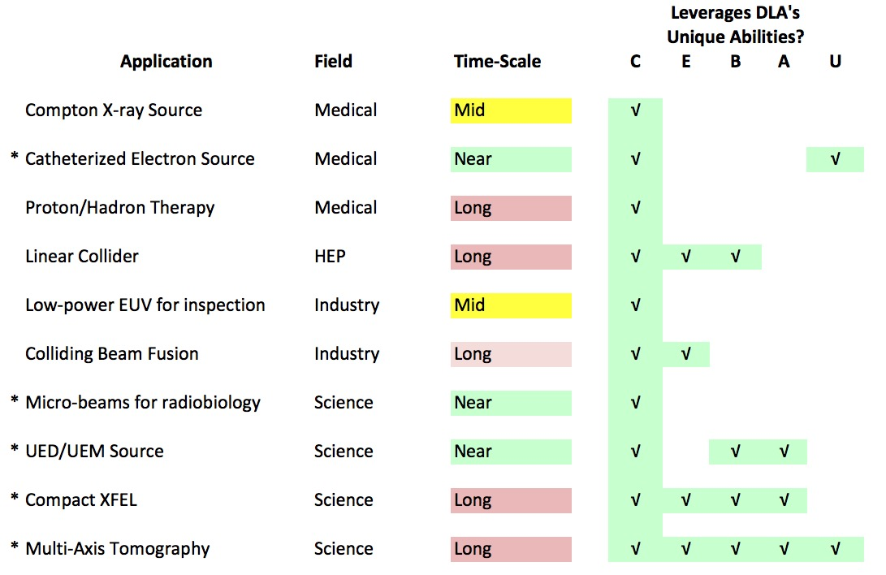
DLA Applications Matrix
*target for additional feasibility studies

Slide 28
Conclusions
Significant progress in DLA over the last few years:
Ongoing 5-year international collaboration funded by Moore Foundation
Gradients ~ 1 GV/m, energy gain > 0.3 MeV recently demonstrated
Components for an integrated on-chip system in development
Prototype “shoebox” demonstration system ready for testing
Key Strengths of DLA
short-bunch superradiance, diffraction-limited radiation (high brightness)
nm spatial and temporal resolution
energy efficient for applications (precise beam pointing)
reduced size and cost
Prospects for DLA-based Applications
medical radiation oncology (direct ebeam treatment)
industrial EUV sources for low-power wafer inspection
attosecond science, electron diffraction, microscopy
New ideas are welcome!

Slide 29
Acknowledgments
Stanford University
Prof. Bob Byer
Prof. James Harris
Prof. Olav Solgaard
Prof. Shanhui Fan
Prof. Jelena Vuckovik
K. Leedle
Andrew Ceballos*
Neil Sapra*
Huiyang Deng
Alex Ody
SLAC National Accelerator Laboratory
Joel England
Zhirong Huang
Tor Raubenheimer
UCLA
Pietro Musumeci
Jamie Rosenzweig
David Cesar
Purdue Univ.
Minghao Qi
Yunjo Lee
Tel-Aviv Univ.
Jacob Scheuer
Doron Bar-Lev
Avi Gover
Erlangen Univ., Germany
Peter Hommelhoff
Josh McNeur
Martin Kozak
Tech-X Corporation
Ben Cowan
Technion
Levi Schachter
Adi Hanuka
Paul Scherrer Inst.
Rasmus Ischebeck
DESY
Ralph Assmann
Frank Mayet
Willi Kuropka
Ingmar Hartl
Franz Kaertner
Livermore Natl. Lab
Paul Pax
Mike Messerly
TU Darmstadt
Oliver Boine-Frankenheim
Uwe Niedermayer
blue = students; * = current Bob Siemann fellows

Slide 30

Thank you!
Group photo, ACHIP collaboration meeting in Villigen, Switzerland, March 1-3, 2017.
contact: england@slac.stanford.edu
http://achip.stanford.edu
http://slac.stanford.edu/dla
Special thanks to K. Leedle, Z. Huang, Y-C. Huang, T. Hirano, U. Niedermayer for contributions of slides.

