Slide 1
The LUXE experiment
Laser Und XFEL.EU Experiment
Florian Burkart
For discussion
Hamburg, 18/10/2018

Slide 2
Location at the XFEL
End of UN2 Begining of Dump
3039 m – 3145 m
(660 m)
(137 m)
XTD7
XTD5
(204 m)
UN1
XS4
UN2
XTD8
XTD3
(263 m)
(365 m)
(480 m)
(595 m)
(546 m)
XS1
(301 m)
(221 m)

Slide 3
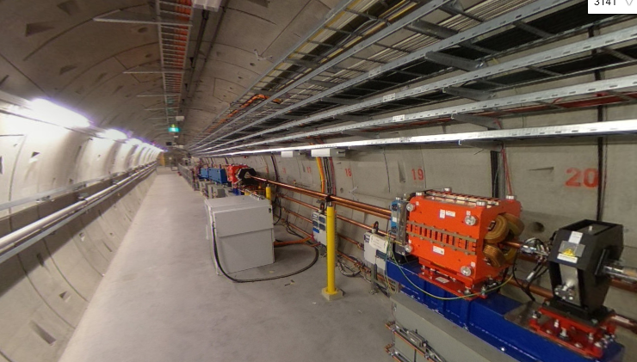

Slide 4
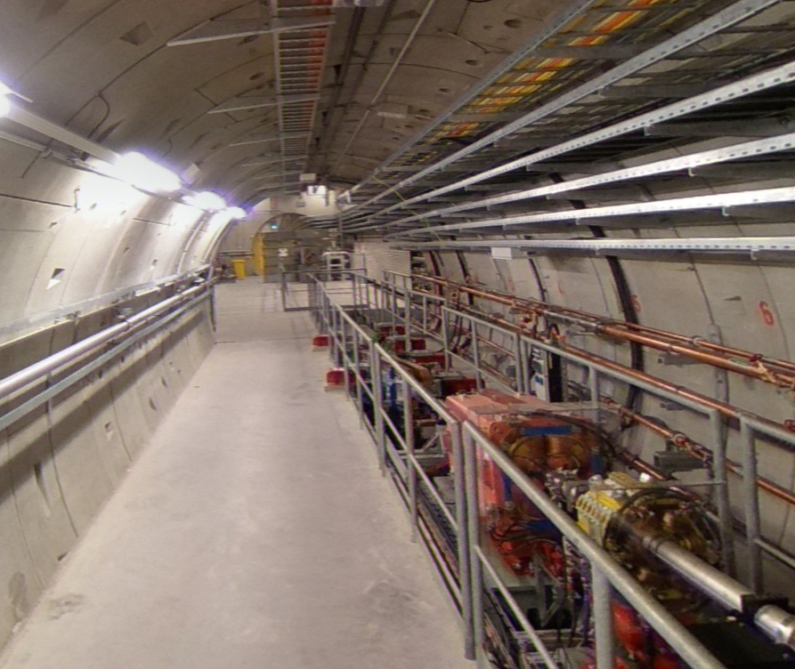

Slide 5
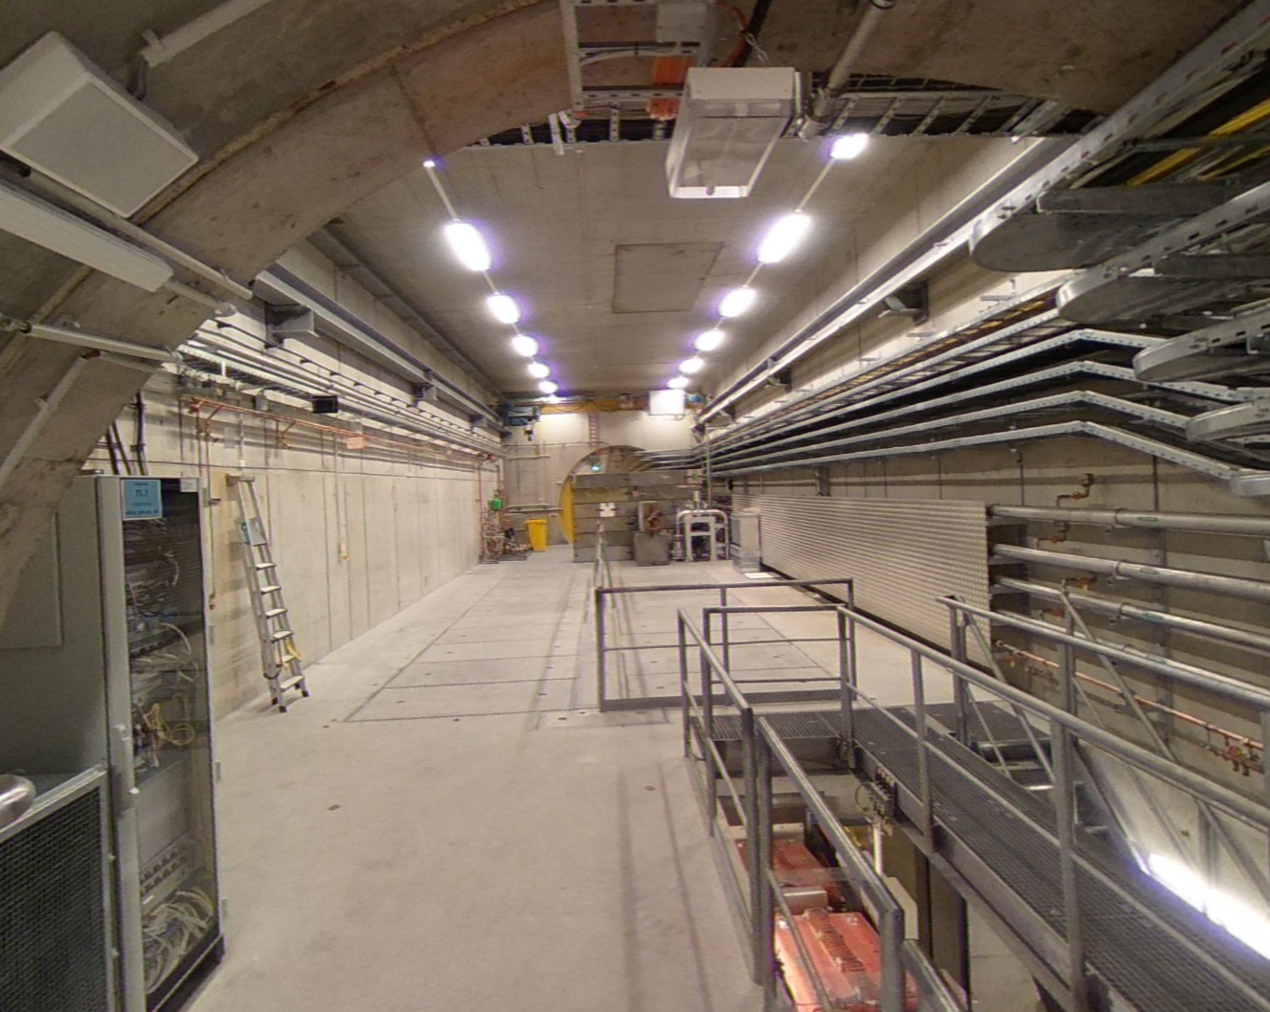
Proposal from XFEL: Could use area in the beam dump cavern.
In case of a severe beam dump failure (dump exchange), the full experimental setup has to be removed.

Slide 6
Experimental Scenarios and e⁻ Beam Parameters
Option 1: collide electron beam with laser pulse
Option 2: collide electron beam with foil → photon generation → collide photons with laser pulse
Electron beam parameters:
Electron energy: 17.5 GeV
Bunch intensity: 1 nC ( 6.25E9 e-)
Bunch length: 80 fs
Spotsize @ IP: σ = 5 μm
Repetition Rate: 1 – 10 Hz

Slide 7
General layout
Dipole
Dump cavern
XTD7
Triplet
1bunch
17.5 GeV e⁻
XTD5
Kicker & Septa
Dipole
XSDU1
Dump
Kick out one bunch and send it to the experimental area in the dump cavern.
Collide it with Laser/foil and send the rest to a single bunch beam dump
Kicker and Septa design can be copy-pasted.

Slide 8
Collimation
Counter
IP
PDET
Mirror
Dipole
Photon converter
e⁺
Laser
e⁺
CAL
γCAL
e⁺
γ
γ
e⁻
Triplet
e⁻
Dump
pulse
e⁻
Dipole
Mirror
Dipole
Counter
E < 16 GeV
EDET
E < 16 GeV
9 m
11 m
3 m
7 m
tbd
2 experimental options:
Collide bunch with foil and generate photons → collide photons with the laser. ( )
Collide electrons directly with the laser ( )
IP
Mirror
PDET
Laser
e⁺
Dipole
CAL
γCAL
γ
e⁺
γ
e⁻
Triplet
Mirror
pulse
e⁻
Dump
Dipole
EDET
E < 16 GeV
21 m
3 m
11 m

Slide 9
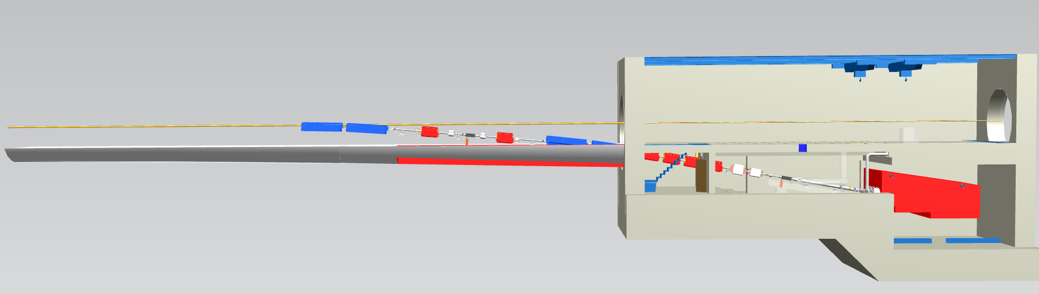
Schematic CAD Integration
Kicker/Septa
Bend
Triplet
IP
Dump
CAD designer highly appreciated.
Downstream of IP design to be studied.

Slide 10
Magnets - proposal

Slide 11
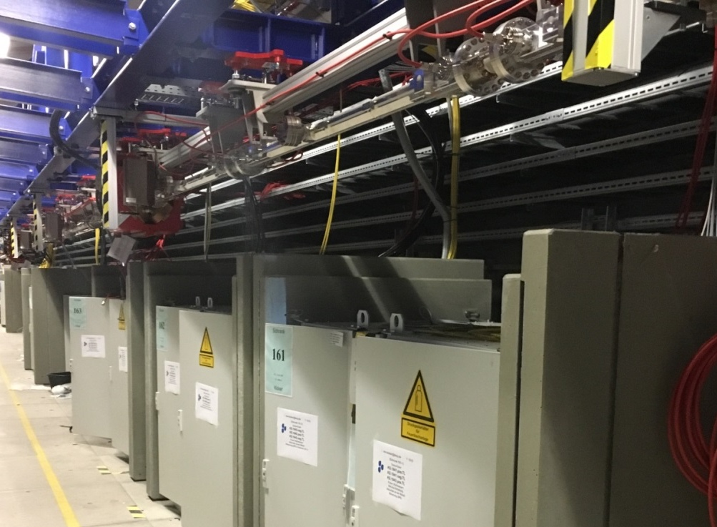
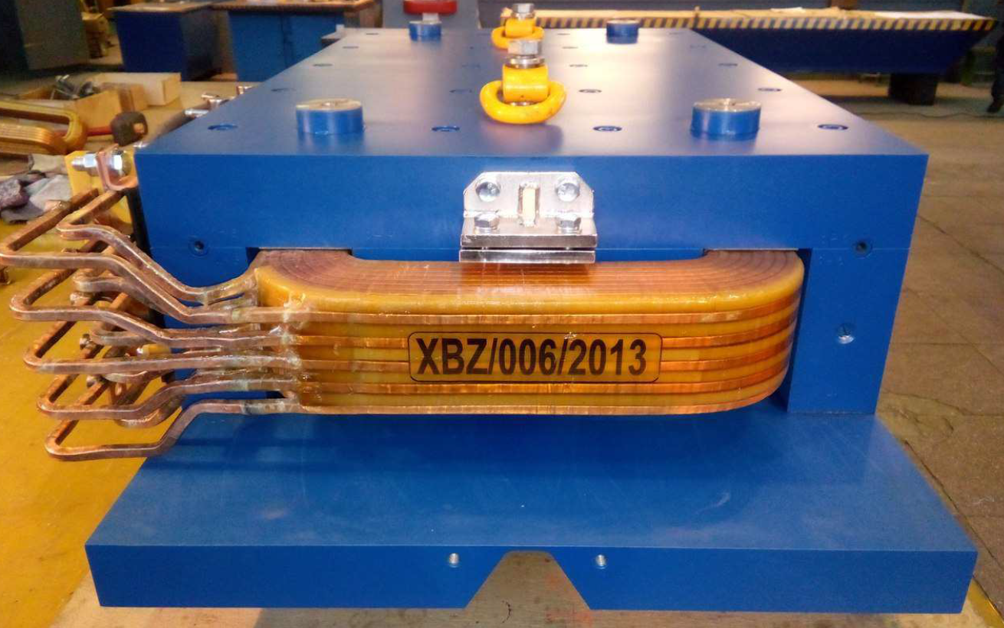
Kicker and Septa parameters
 | Kicker
Pulse Form | Burst
Pulse Width | 30 ns
Rise / Fall Time | 10 ns
Kick angle per element | 6.25 μrad
Number of elements | 10
Aperture | 30 mm
Active length | 2 m
Pulser Voltage | 5 kV
Pulse Current | 100 A
 | Septum
Type | Lambertson
Deflection angle | 35 mrad
Active length | 1 m
Number of elements | 4
Septum bar width (incl. beam pipe) | 5 mm (10 mm)
FOTOS

Slide 12
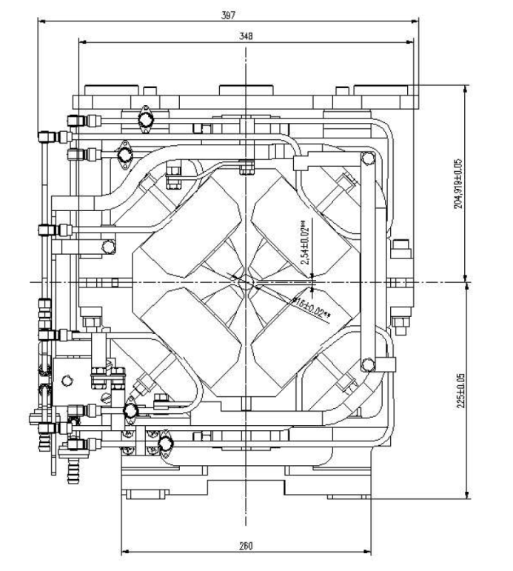
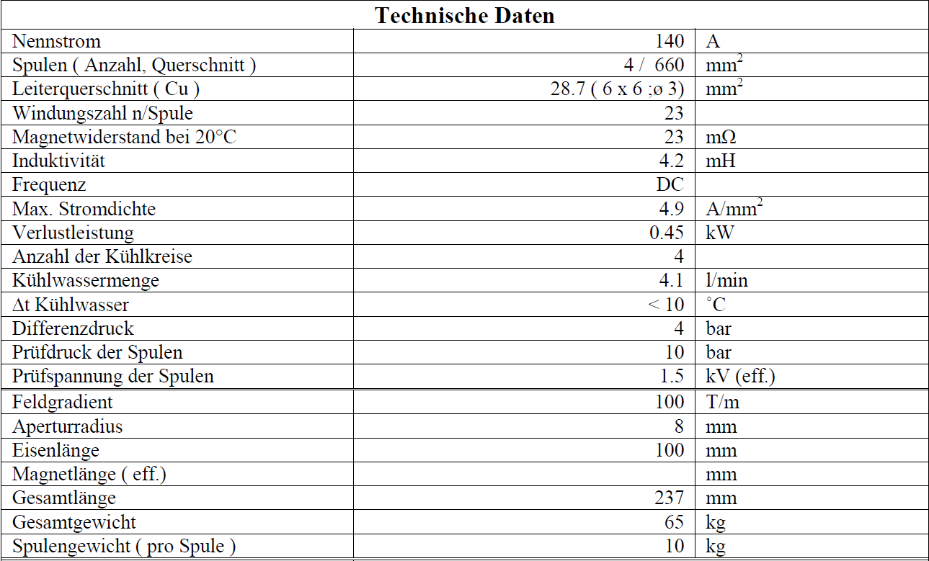
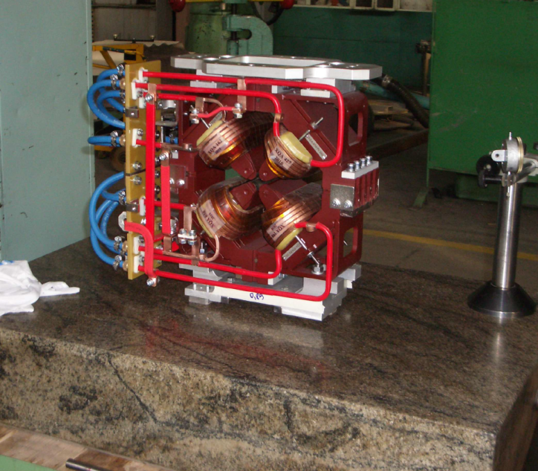
Triplet Magnet Parameters
Gradient: 100 T/m
Length: 10 cm
Aperture: 16 mm

Slide 13
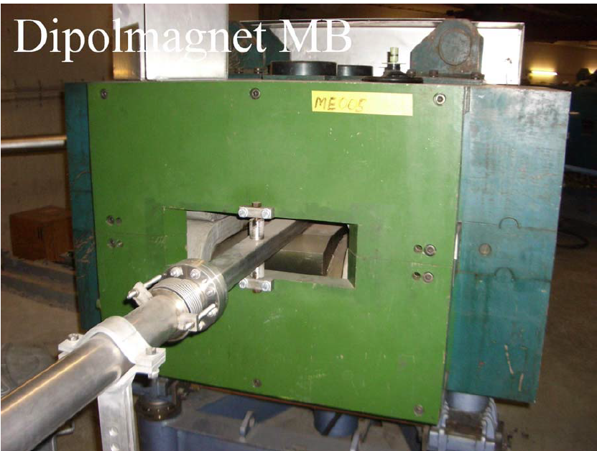
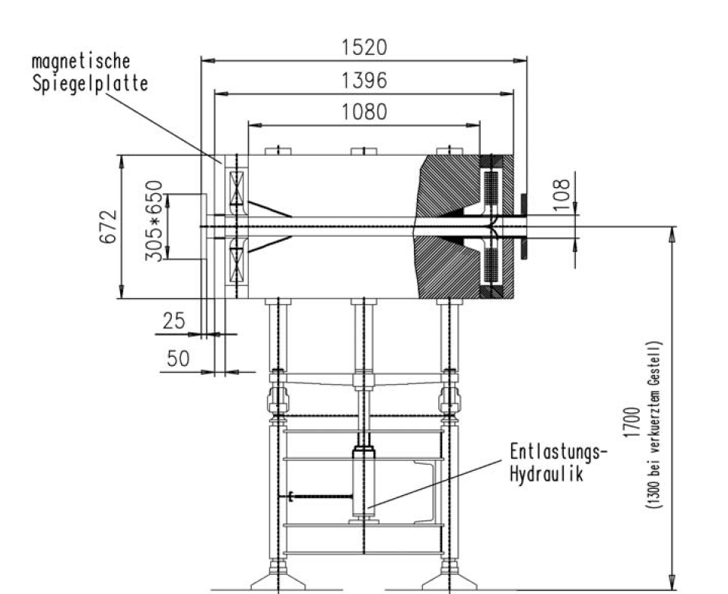
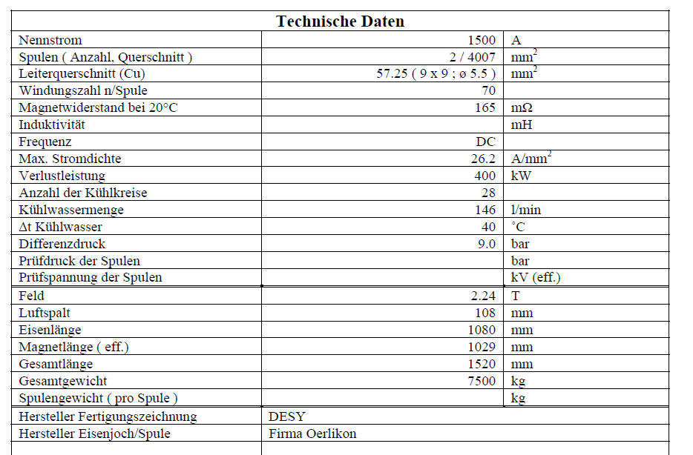
Spectrometer Dipole
Massive device:
1500 A, 240 V
Bdl: 2.31 Tm
Big aperture
7.5 t, 1 m long

Slide 14
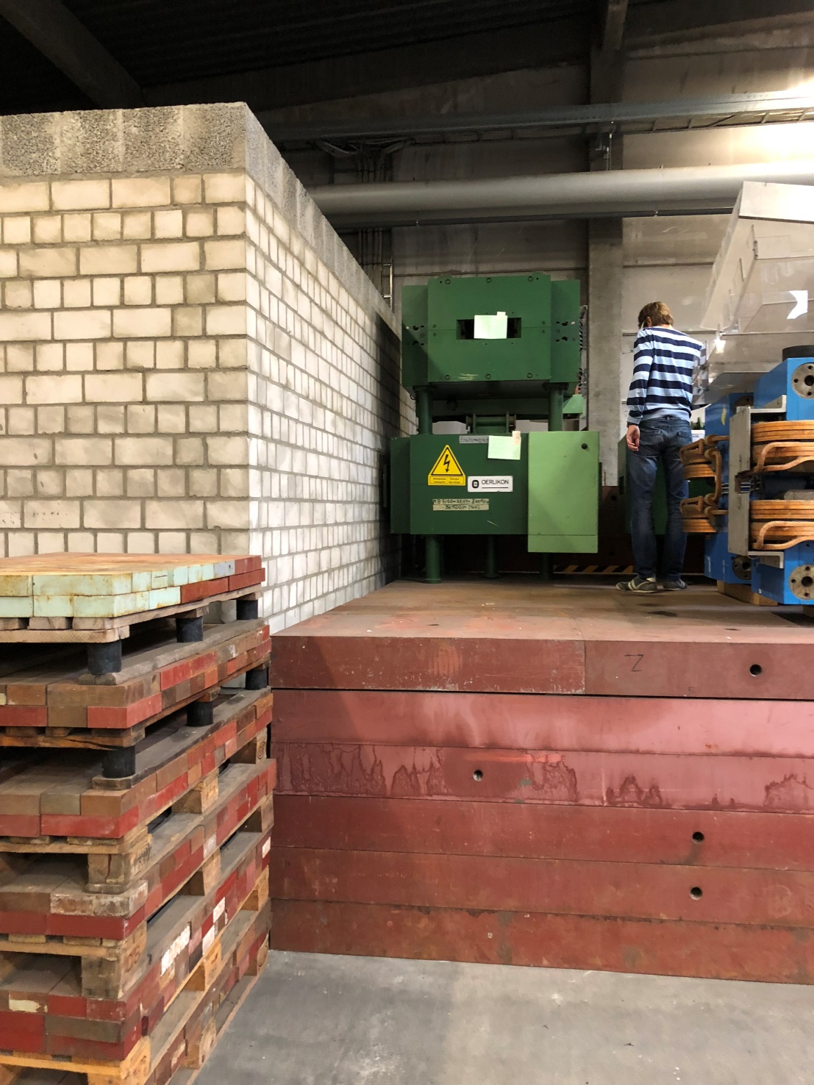
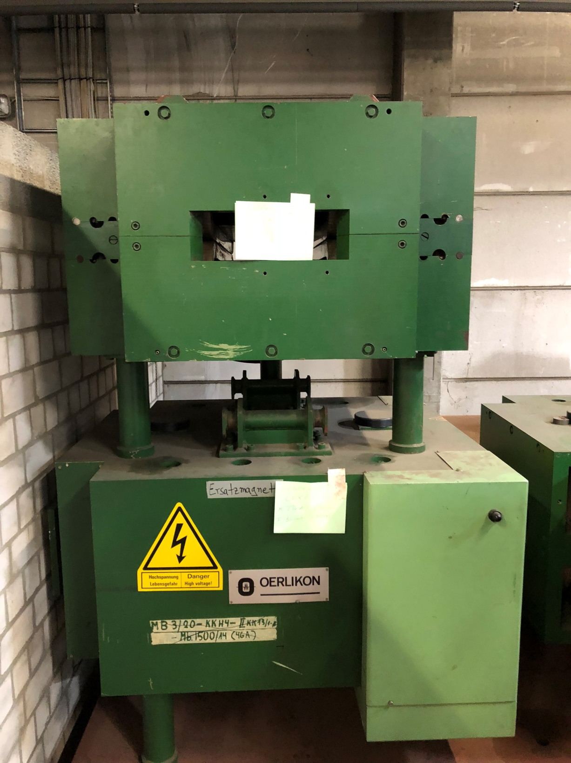
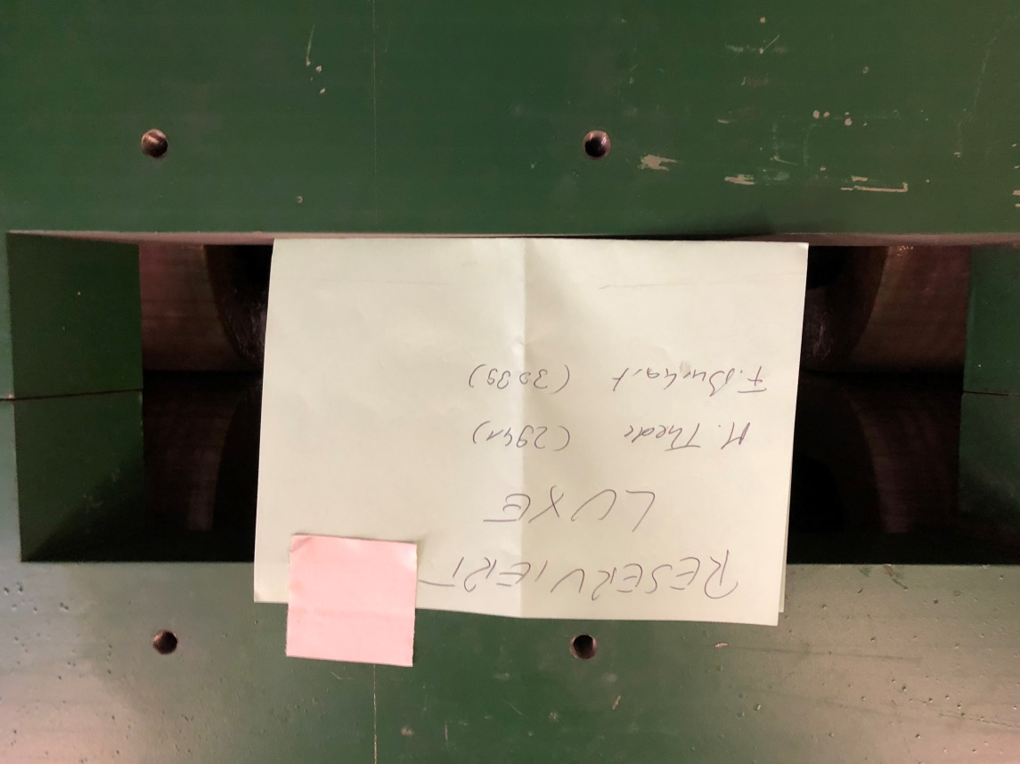

Slide 15
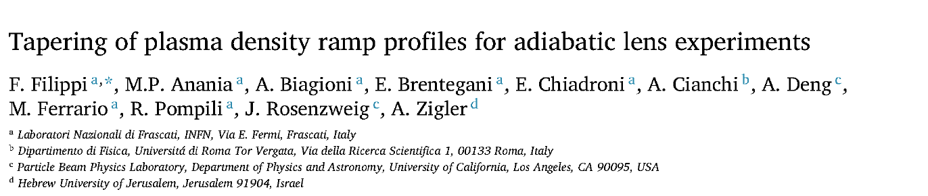
Next:
Iteration with D3 (head of D3, local SSB and Winni )
Infrastructure checks: Water, power, supports, etc.
Detector and IP design/integration
Study adiabatic plasma lens after the IP.
  Maybe PhD topic, to be discussed…

Slide 17
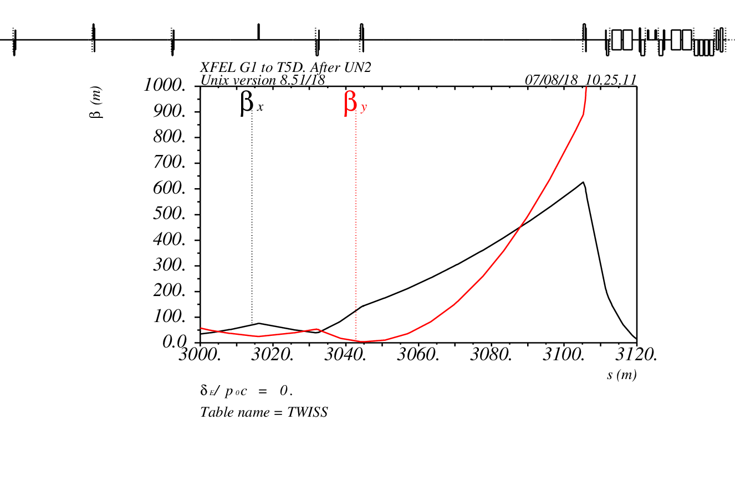
Optics in XTD5 with extraction to LUXE
Septa
Kicker

Slide 18
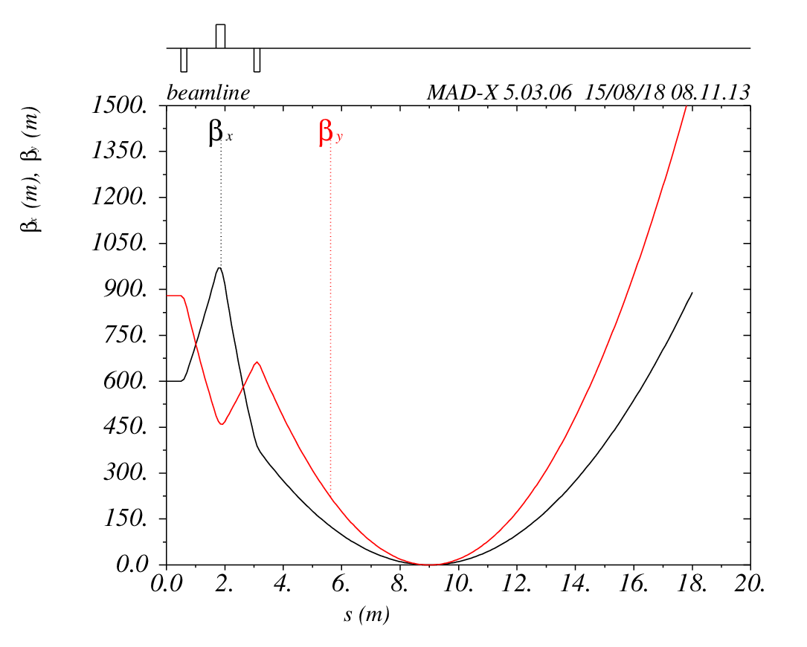
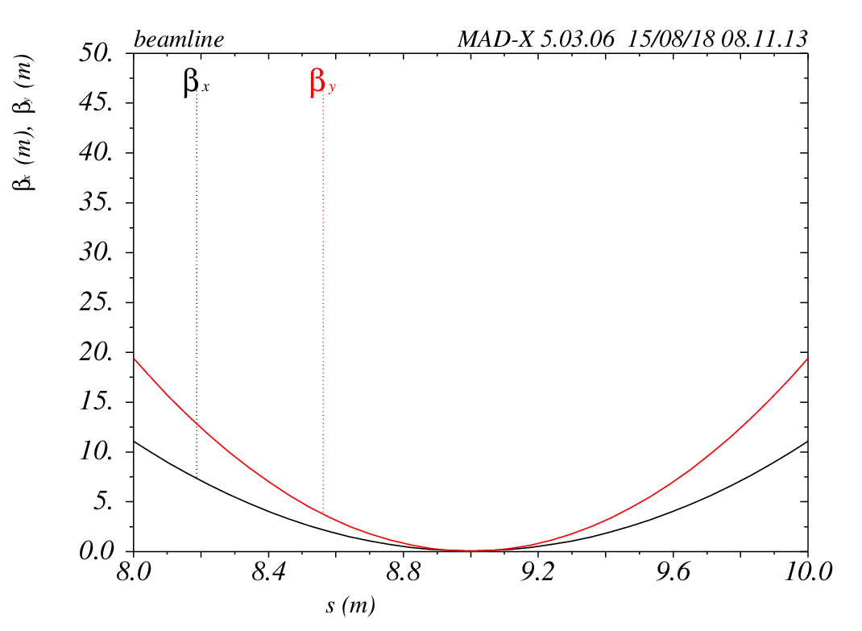
Final focus optics – downstream of Septum
Beam size at the IP: σ = 5.4 μm
Distance to first Quad: 9 m

Slide 19
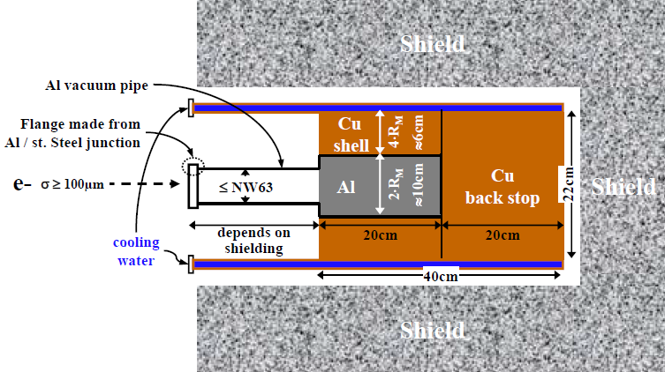
Single Bunch Beam Dump
First design considerations
~ 200 W power deposition
Al-Cu design, size and dimensions to be discussed.
In vacuum – Design of the beam window to be studied.
Shield dimensions to be discussed with radiation protection
Injector Beam Dump Design

