Slide 1
Magnets
XFEL Operator Training

Slide 2
Conventions: Dipoles (Incl. Correctors)
The XFEL has a right-handed coordinate system. z points downstream.
Where does this corrector deflect the electron beam?
UP
Which sign does its field/strength/kick have?
+

Slide 3
Conventions: Quadrupoles
Is this quadrupole focusing or defocusing in the horizontal plane?
DEFOCUSING
What is the sign of its gradient/strength/integrated strength?
–

Slide 4
Conventions
Dipoles and correctors with a positive field deflect electrons to the left (in positive x direction) or up (in positive y direction).
Quadrupoles with a positive generalized field are horizontally focusing for electron beams.
Usually, positive fields are driven by positive currents, but there are exceptions.

Slide 5
Controlling Magnets... From the Cockpit

Slide 6
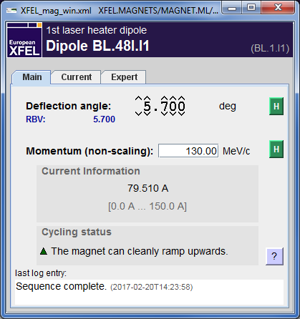
Controlling Magnets... From a Stand-Alone Panel

Slide 7
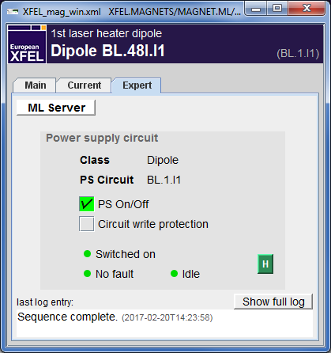
Controlling Magnets... From a Stand-Alone Panel

Slide 8
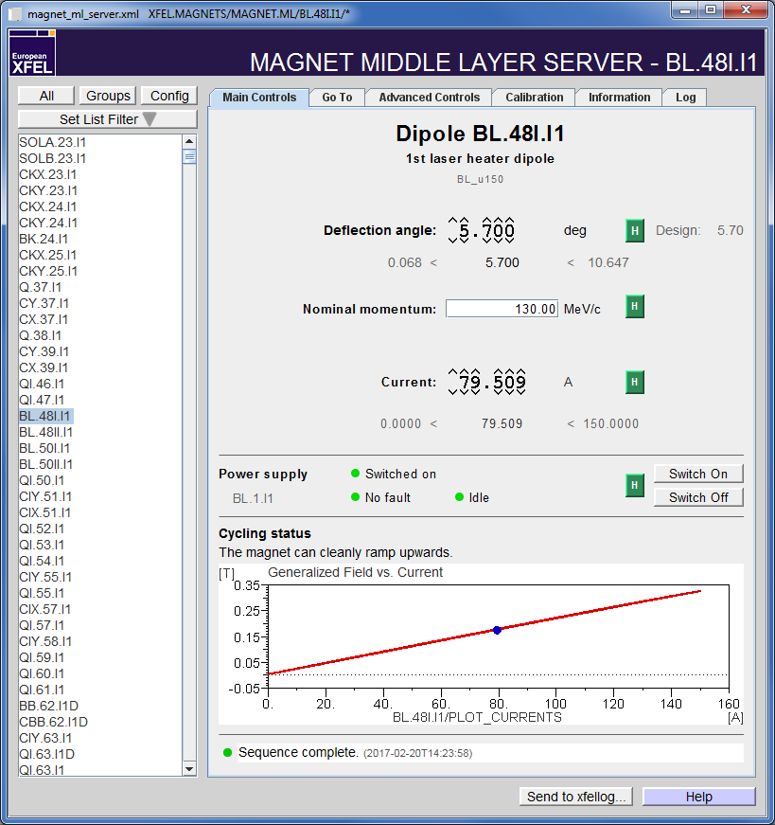
Controlling Magnets... From the ML Server Panel

Slide 9
Magnet Middle Layer Server
Magnet Name
<type>.<zpos>.<section>
SOL* – Solenoids
C* – Correctors
B* – Dipoles
Q* – Quadrupoles
S* – Sextupoles
O* – Octupoles
CB* – Correction/trim coils on dipoles (additional windings)
PS circuit names are similar: <type>.<ID>.<section>
Power Supply Circuit Name

Slide 10
Many Magnets Can Share The Same Circuit
There is one device for each magnet
... even if multiple magnets share the same power supply
Laser Heater Chicane
Magnet Names
BL.48II.I1
BL.50I.I1
BL.48I.I1
BL.50II.I1
BL.1.I1
BL.3.I1
BL.4.I1
Power Supply Names

Slide 11
Main Taskbar > Magnets

Slide 12
The Magnet Overview Panel

Slide 13
Current, Field, Strength, Gradient, Kick, Momentum, ...
... and other sophisticated words like “hysteresis” and “remanence”!

Slide 14
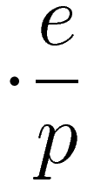
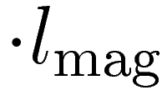
Magnet ML: Physical Parameters
calibration data
nominal momentum
effective magnetic length
current
(gen.) field
(gen.) strength
(gen.) kick
Dipole
Quadrupole
Sextupole
Octupole
[B] = T
[g] = T/m
T/m²
T/m³
[1/ρ] = 1/m
[k] = 1/m²
[m] = 1/m³
[r] = 1/m⁴
rad
rad/m
rad/m²
rad/m³

Slide 15
Magnet ML: Calibration & Hysteresis

Slide 16
Dealing with Hysteresis
Magnetic Field
“The magnet can cleanly ramp downwards.”
downward ramp
upward ramp
Current
klick down
“The magnet can cleanly ramp upwards.”

Slide 17
Dealing with Hysteresis
Magnetic Field
Uncycled magnets use an averaged calibration curve.
downward ramp
upward ramp
Current
“The magnet needs to be cycled.”

Slide 18
Cycling & Degaussing
Magnetic Field
Cycling
Force the magnet (back) onto its hysteresis curve. Ramp to maximum and minimum current a few times.
Current
Degaussing (Demagnetization)
Force the magnet out of its hysteresis curve so it has zero field at zero current. Ramp up and down with slowly decreasing currents.

Slide 19
Main Taskbar > Magnets

Slide 20
Magnet Energizer
The combobox on the right selects a group of magnets:
Sections or subsections: I1M, B1, T2, …
All magnets that need to be ON to transport the beam to a certain dump: MAG_I1D, MAG_T4D, …
All magnets through which the beam passes on the way to a certain dump: OP_I1D, OP_T4D, …

Slide 21
Magnet Energizer
This combobox selects what happens when „Set to beam energy“ or „Set to energy…“ is used:
Keep current (no scaling): Only the energy setting is changed, the magnet current stays the same. No impact on the beam, but the calculated kick is different.
Keep strenght (scaling): The magnet current is changed so that is has the same effect on a different beam. Use this when changing the beam energy.

Slide 22
Main Taskbar > Magnets

Slide 23
PS Monitor And Control (“PS MoCo”)
Low-level view on power supplies
Uses power supply circuit names
Has a search function for magnet names, circuit names, and MKK circuit numbers (menu Edit/Search...)
Use only for troubleshooting or if you‘re part of MKK!

Slide 24
Main Taskbar > Magnets

Slide 25
The “Good Old” PS Control
It handles only “DESY-type” magnets.
This means: It does not show all magnets.
IT DOES NOT SHOW ALL MAGNETS!
Please don’t use it – or only as a last resort for troubleshooting, if you know what you’re doing.

