Slide 1
2018 Radiation Dose Business on Undulators
Frederik Wolff-Fabris
Undulator Systems – XFEL

Slide 2
Content:
1. Dose evolution as function of time and actual status;
2. „Shielded“ Data;
3. A Bad Week;
4. Dose per charge rate;
5. Lifetime estimative.

Slide 3
Dose Time Evolution: SASE1
Overall improvement compared to 2017.

Slide 4
Since summer Shutdown: SASE1
Two weeks with singular events.
Week Sept.25th to Oct.1st with losses in the 5-m undulators (discussed later).

Slide 5
Dose Time Evolution: SASE2
Total doses smaller as compared to SASE1 and SASE3 commissioning.
Suffers from re-start of operations after shutdowns or maintenance.

Slide 6
Since summer Shutdown: SASE2
Total doses smaller as compared to SASE1 and SASE3 commissioning.
Suffers from re-start of operations after shutdown or maintenance.

Slide 7
Dose Time Evolution: SASE3
Overall improvement compared to 2017 (DU).
BBA generates doses.
5-m segments towards the end with
continuous dose increase (during lasing).

Slide 8
Since summer Shutdown: SASE3
Not operational for long time.

Slide 9
Total doses as of Oct.2018: SASE1
Cell#3 was re-measured in Dec.2017 with 230 Gy; currently has absorbed 270 Gy.

Slide 10
Total doses as of Oct.2018: SASE2
No reasons for any re-measurement.

Slide 11
Total doses as of Oct.2018: SASE3
DU has currently 4.8 kGy; last re-measurement with 4.4 kGy.
Cell#3 has 230 Gy, similar to SASE1-Cell#3 re-measurement in Dec.2017.

Slide 12
Shielded Bottom Radfets in SASE1
Cell#3 was shielded in July 2018 (4mm Pb).
Cell#31 was shieded in April 2018 (4mm Pb).
Dose in Cel#3 still increases, perhaps with lower rate as compared to the upper unshielded Radfet;
Dose in Cell#31 does not increase while upper unshielded Radfet does.
Behaviour suggests high energy radiation at Cell#3 and low energy radiation at Cell#31.
Gaf. Films with
2mm Pb:
Cell#3
Reference/not used
Cell#31

Slide 13
Top View
Cell#3 – SASE1 with 2mm Pb shield both on top and bottom of film (dashed area)
Cell#31 – SASE1 with 2mm Pb shield both on top and bottom of film (dashed area)

Slide 14
The Bad Week: SASE1 Sep.24th-Oct.1st

Slide 15
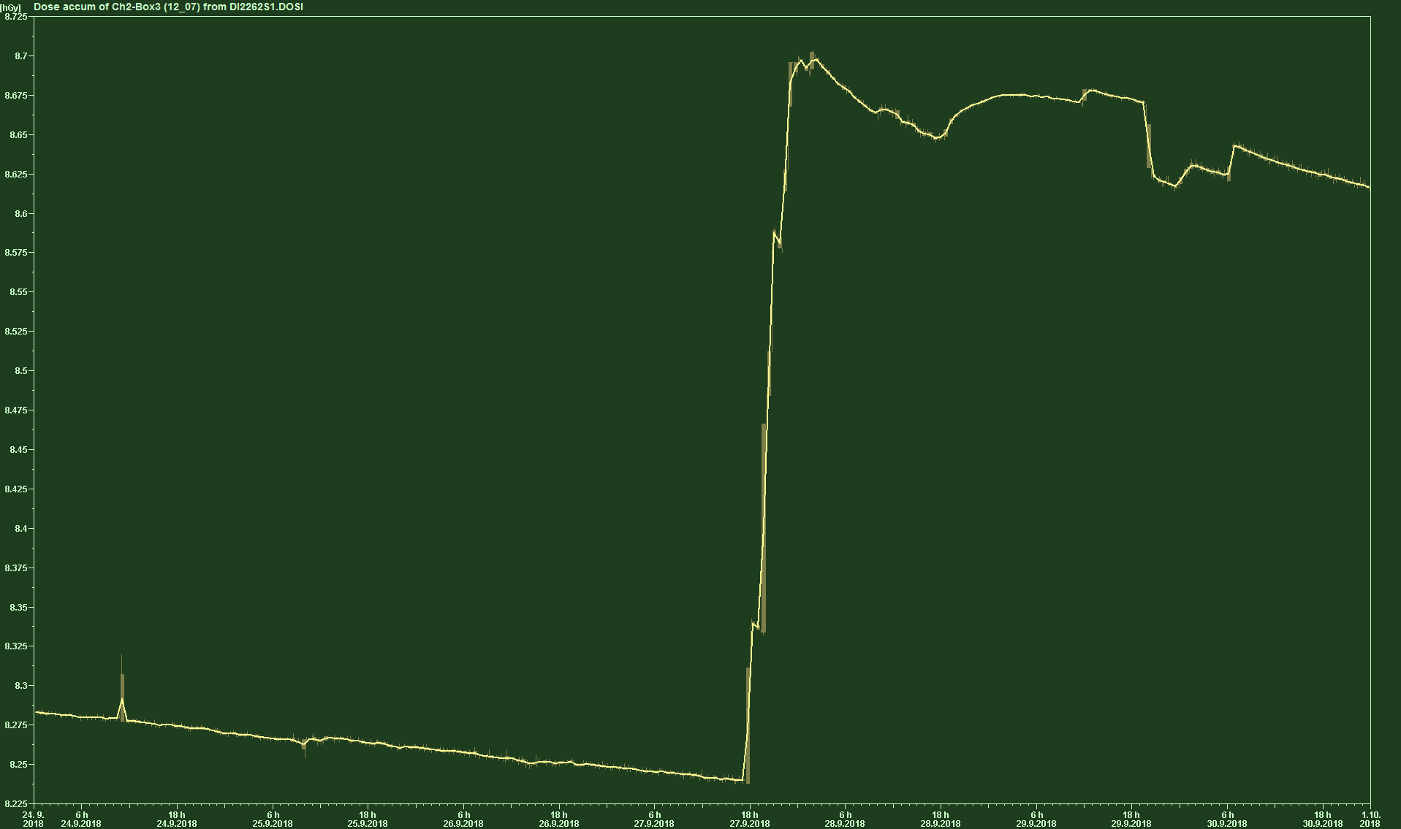
The Bad Week: SASE1 DU
Trying to find SASE? What the BLMs give?
On 27/09 starting 18:00
Dose ~ 45Gy

Slide 16
The Bad Week: SASE1 Cell#9
Trying to find SASE? What the BLMs give?
On 30/09 around 00:00
Dose ~ 25Gy

Slide 17
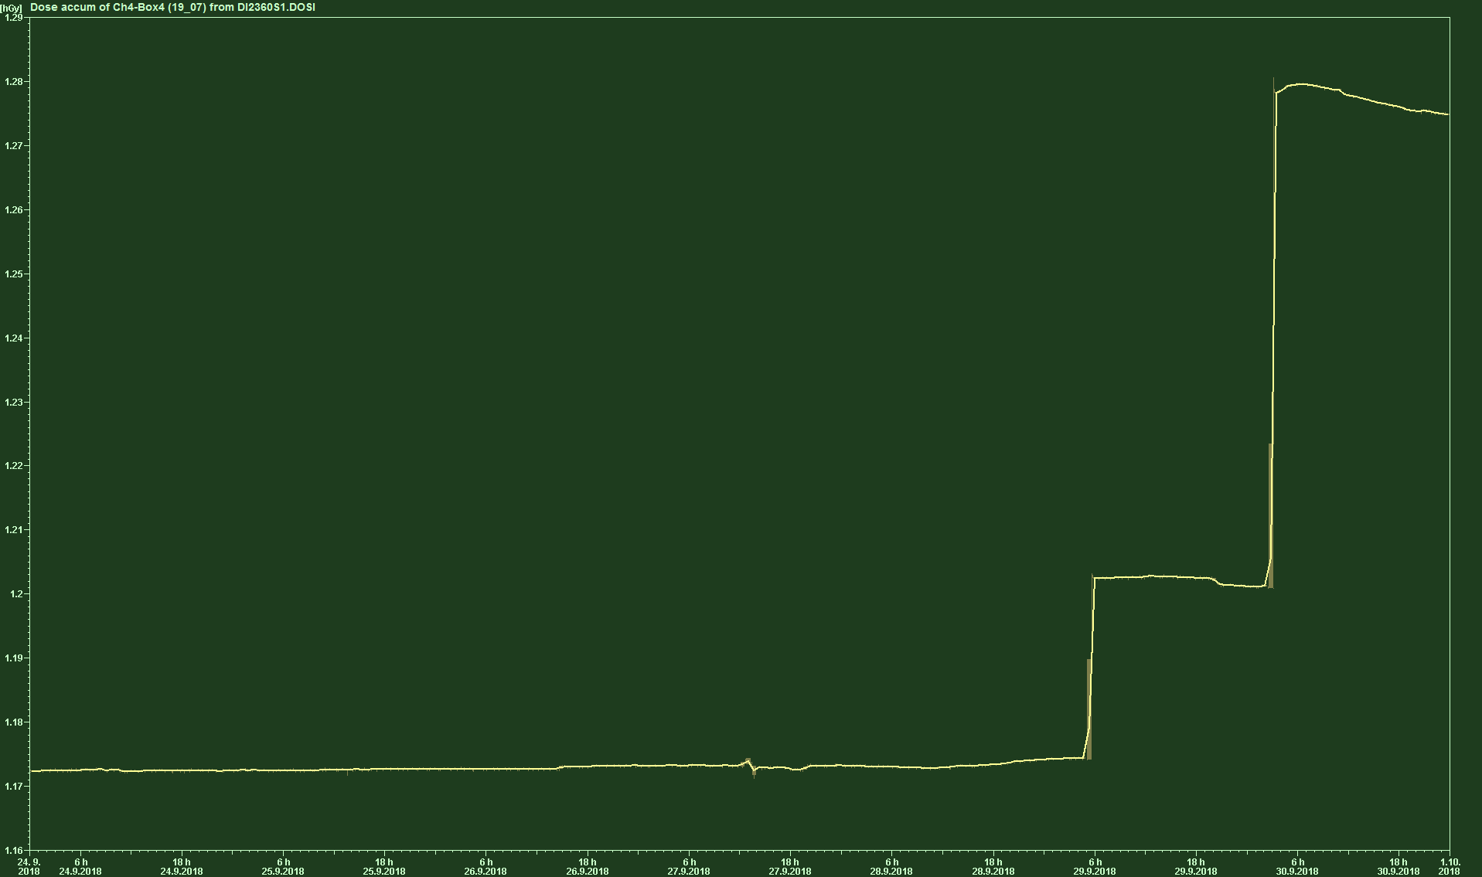
The Bad Week: SASE1 cell#22
Trying to find SASE? What the BLMs give?
On 30/09 around 06:00
Dose ~ 8 Gy
On 29/09 around 06:00
Dose ~ 3 Gy

Slide 18
DU
Times are not always correlated:
Locally losses
Cell#9
Cell#22

Slide 19
Dose per charge rate (SASE1)
- Total SASE1 Integrated Charge is shown below.
- Current Regular User operation up to 120 bunches per train (10Hz); 0.25nC
!!! LCLS: ~ 1C
between 2009-2014 !!!

Slide 20
TOTAL DOSE per TOTAL CHARGE as function of time

Slide 21
- Looking at SASE1 Integrated Charge (case of weekly increase):
Regular User operation up to 120 bunches per train (10Hz); 0.25nC

Slide 22
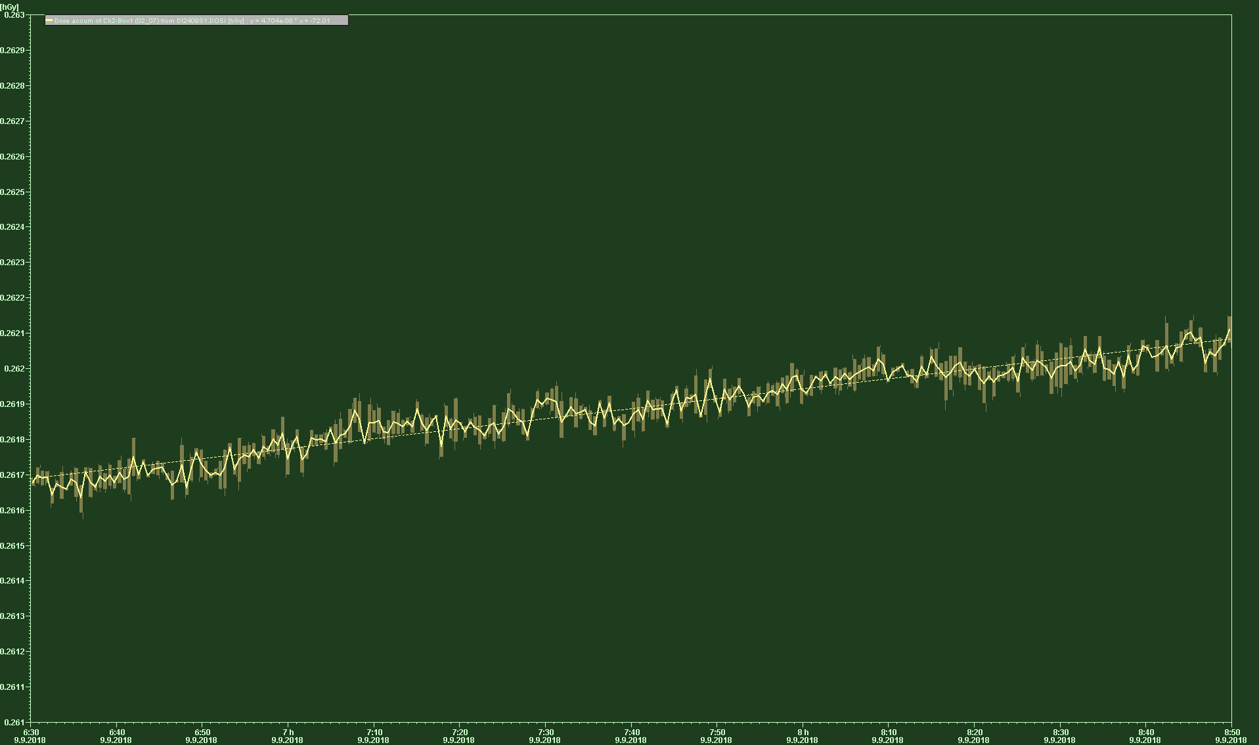
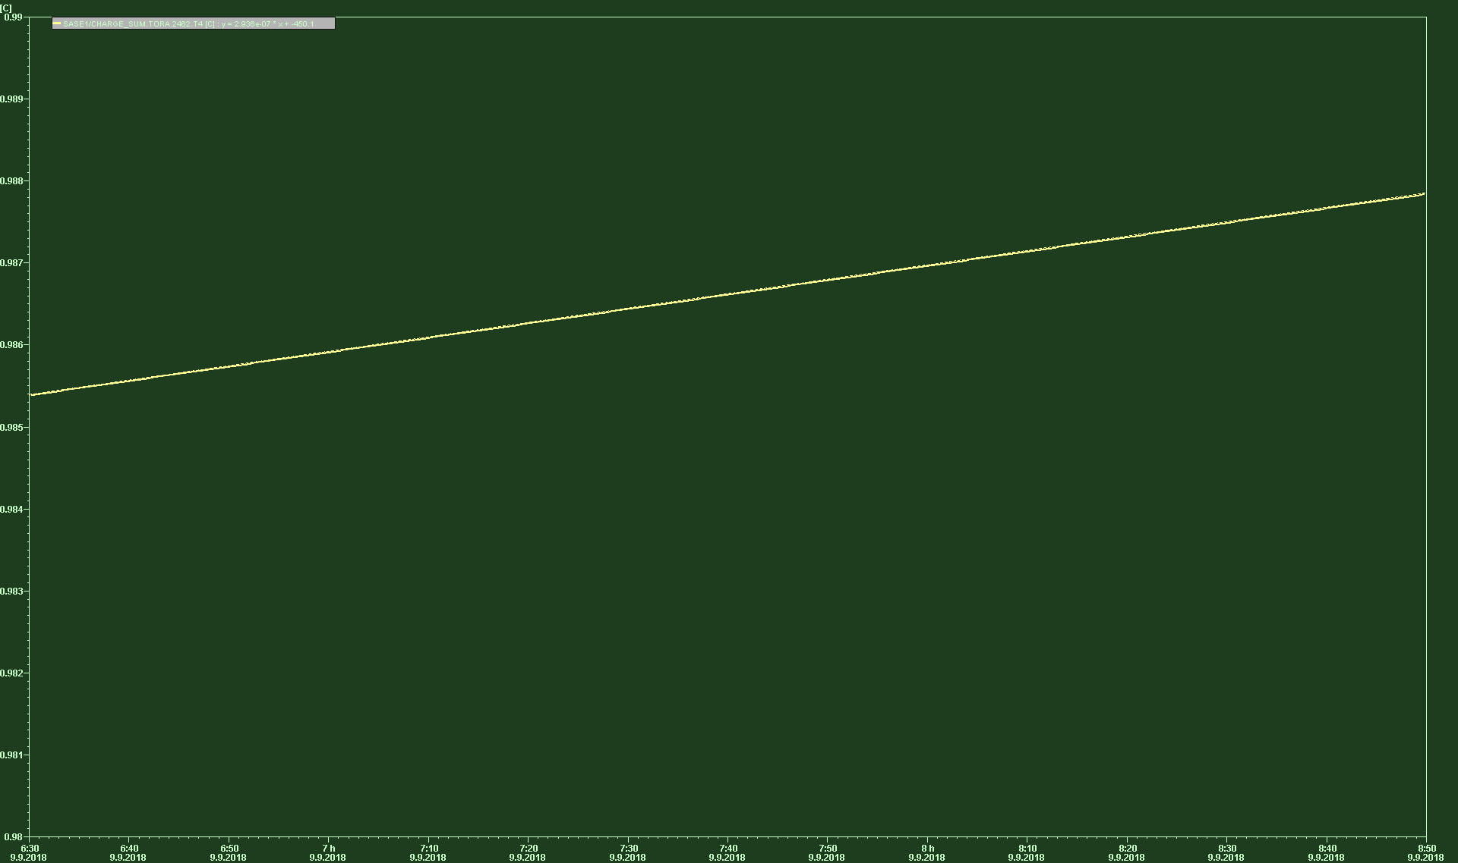
Dose
Cell27-SA1 (9.3 keV, 0.25nC):
- On 09.09.2018 between 6:30AM and 8:45AM
- full 120 bunches mode, cells#3 to #28 closed:
Dose rate: 4.704e-6 Gy/s
Charge rate: 2.936e-7 C/s
Charge

Slide 23
Dose per charge: 16.02 Gy/C
Seems to be a good number for us:
!!! LCLS !!!
Best ~ 3 Gy/C
Worst ~ 20 Gy/C
Ongoing: cross-calibration
Dose (Gy) Charge (C)
230 14.375
500 31.21
1000 62.42
Dose per charge: 16.02 Gy/C

Slide 24
$$\frac{{∆Dose}_{week i}}{{∆charge}_{week i}}$$
Calculating ; determine lower and upper limits to define a good or bad week

Slide 25
SASE1 Cloud

Slide 26
SASE1 Cloud

Slide 27
Dose (Gy) Charge (C)
230 14.375
500 31.21
1000 62.42
Dose per charge: 16.02 Gy/C
Dose (Gy) | Charge (C) | Mode | Time (weeks)
230 | 14.375 | 120 | 81
500 | 31.21 | 120 | 176
1000 | 62.42 | 120 | 352
230 | 14.375 | 500 | 19.4
500 | 31.21 | 500 | 42.2
1000 | 62.42 | 500 | 84.5
230 | 14.375 | 1200 | 8.1
500 | 31.21 | 1200 | 17.6
1000 | 62.42 | 1200 | 35.2
230 | 14.375 | 2700 | 3.6
500 | 31.21 | 2700 | 7.8
1000 | 62.42 | 2700 | 15.6
Cell27-SA1:
With Charge rate of 2.936e-7 C/s (or 0.17752 C/week):

Slide 28
- But we get about 2-4x less charge per week (not 0.17752 C/week):
Machine does not run continuously at 120 bunches mode

Slide 29
Cell#27, 9.3keV
Using recent User Operation weeks
Using 1nC
and not 0.25nC
Dose (Gy) | Charge (C) | Mode | Time (weeks) | Time (weeks) | Time (weeks)
230 | 14.375 | 120 | 81 | 162-324 | 40.5-81
500 | 31.21 | 120 | 176 | 352-704 | 88-176
1000 | 62.42 | 120 | 352 | 704-1408 | 176-352
230 | 14.375 | 500 | 19.4 | 38.8-77.6 | 9.7-19.4
500 | 31.21 | 500 | 42.2 | 84.4-168.8 | 21.1-42.2
1000 | 62.42 | 500 | 84.4 | 168.8-337.6 | 42.2-84.4
230 | 14.375 | 1200 | 8.1 | 16.2-32.4 | 4.05-8.1
500 | 31.21 | 1200 | 17.6 | 35.2-70.4 | 8.8-17.6
1000 | 62.42 | 1200 | 35.2 | 70.4-140.8 | 17.6-35.2
230 | 14.375 | 2700 | 3.6 | 7.2-14.4 | 1.8-3.6
500 | 31.21 | 2700 | 7.8 | 15.6-30.2 | 3.9-7.8
1000 | 62.42 | 2700 | 15.6 | 31.2-62.4 | 7.8-15.6

Slide 30
SUMMARY
No clear need for re-measurements during next Winter Shutdown;
Absorbed Doses
Got improvement in 2018;
Still suffering from BBA and few singular events;
Shielded Data: First results going towards the depiction of high-low energies.
Dose per Charge rate
Based on cell#27, 120bunches, 0.25nC, 9keV: about 16 Gy/C.
Is this approximation still valid at much higher bunch mode?
Can we minimize this number?
If no singular events happens, next re-measurement with today´s knowledge and data may occur in 1-2 years.

