Slide 1
Joint Operation & Readiness meeting
Report Operation / Photon Run Coordinator*
Report Dispatch
Instruments
FXE
SPB/SFX
SCS
SQS
MID
HED
Beam transport
Vacuum
X-ray optics
Photon diagnostics*
Optical lasers*
Detectors*
Electronics
AE*
EETF
CAS
ITDM
SRP
Technical services
AoB

Slide 2
Report from PRC
Machine/photon report:
Tuesday ZZ access to XTD6.
Vacuum group have connected the compressed air for MID shutter.
First FEL beam in MID-OPT hutch.
K-mono studies for SASE1 undulators.
HIREX diamond bender commissioning.
PES commissioning in parasitic in SASE3.
User program starting from Friday for SASE1 instruments.
SPB: Day shift with 1 pulse and 120 pulses @photon energy 9.3keV with 1MHz beam delivery of intensity ~1600uJ.
FXE: night shift, 1pulse @photon energy 9.3keV with 1.1MHz.
SCS and SQS commissioning the beamline optics system.

Slide 3
XPD
:Support of beam delivery in all 3 SASE areas
Relocation of WP74 Clean Tents from HERA-S to XHQ was done this week
New overview scenes for BKR wall
XGMs:
Online: XTD1, XTD2, XTD6, XTD9, XTD10, SCS
SCS XGM
commissioning is ongoing
MCH from AE works properly
Imagers
XTD6 commissioning: operation and scenes for imagers.
DAQ issue with rotated images, workaround exists, CAS found a solution and will deploy the fix (tag?) next week.
HIREX:
commissioned the *new* bent Diamond.
Measured the spectra with Si220 crystal, results in: https://in.xfel.eu/elog/SASE1+technical+commissioning/1648
MCP
XTD6 MCP is now baseline - commissioned with beam
Need to get it ready for gain measurements (cross-calibrations, DAQ, etc.)
Kmono
SA2: measurements done on friday 19.10.2018
SA1: measurements done on tuesday 23.10.2018
effect of Kmono data feedback into operation, see example from 17.10.2018:
When corrected K offsets are applied, FEL intensity increased by 100-150 uJ (about 10%)

Slide 4
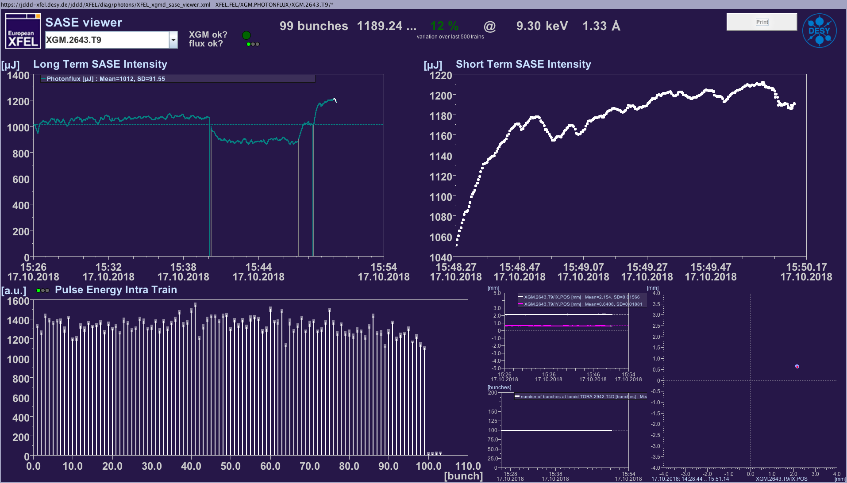
XPD
17.10.2018 15:50 XFEL | Froehlich, Decking, Freund | K offsets improve lasing
• vertical position scan of undulator #8 in SA1 shows a nice curve derived from the ring diameters:
https://ttfinfo.desy.de/XFELelog/show.jsp?dir=/2018/43/23.10_M&pos=2018-10-23T12:07:56
The segment was vertically misaligned by 300 - 350 µm.

Slide 5
Optical lasers
SASE 1: last run of user operation at FXE and SPB
SASE 3: installation and commissioning ongoing
SASE 2: installation and commissioning falling a bit behind.
regulated cooling water: 5. Nov.
interlock commissioning now foreseen to start in week starting on 5. Nov.
potential issue with inner hutch door: it closes poorly, may become worse. Info from TS is, that to fix it, the frame would have to be ripped out and renewed.

Slide 6
Detectors – DET
1st AGIPD SPB
19-22.10: User beamtime (p2108)
Configuration with 128 memory cells, 120 X-ray pulses per train
Collected raw data: 125 TB
Configuration for next User beamtime (p2100) prepared
Issues:
No major issues
LPD at FXE
No issues to report

Slide 7
Detectors – DET
2nd AGIPD MID
Vacuum leak rate was checked (4-5 x 10^-6 mbar/sec)
External VETO tests → problems with VETO signal for wing 1 to be investigated by DESY.
We plan to open the wing 1 to repair or replace the MFPGA board due to the external VETO issue and missing sense wire.
Preparation for moving the detector from HERA south to XHQ ongoing → start of installation and commissioning of the detector at MID instrument planned for cw45
Issues:
Configurations for PC data → two extra cells (Id=370) in the hdf5 to be understood. These cell Ids corresponds to non-existing cells, so can be easy removed in the analysis. The problem does not exist in the X-ray/dark data configurations.
DSSC
DSSC Integration at HERA South hall
PLC crate installation finalized. Vacuum and motion system PLC wired to the level needed now.
In-vacuum wiring of the motion system ongoing. Now all components are available.
Motion system being tested with manual control. PLC control test will follow.
Reworked lateral flanges arrived, will be installed next week.
Reworked quadrant mounting tool arrived, rails still missing, this prevents the testing

Slide 8
Detectors – DET
Power supply control in Karabo
Under test, some issues identified
First two quadrants ready at DESY
DSSC to be mounted and to some extent tested by the end of the year
Tight schedule needs careful planning → ongoing
FastCCD
DAQ infrastructure in place
Chiller needs modification for use with DI water; might delay detector commissioning
Installation of camera at beam line planned for the week of 6th November
Commissioning at beam line will start after installation

Slide 9
AE
SQS
Several loops updated to fix and upgrade features in the instrument.
Ongoing integration of servodrives AX5000.
SCS
CDIFFT_MOV Elmos commissioning.
Loop 4 – Sample environment nanomotion is ready to be back in the loop 4, only some mechanical problems were detected.
MID
Commissioning of Technosoft powered motor for mono table motion – ongoing.
Loop 1 preparation for mono PI stage test.
Loop 2 running – prepared for commissioning.
Loop 5 in preparation.
SPB / FXE
Gathering requirements and fixing dates for different works during shutdown.
CR Procedure
AE currently working with EETF in order to have an improved overview of the status of different change requests.
The normal workflow for change requests’ procedure will be distributed to the different groups so that they can have better understanding of it.

