Slide 1
Tests on Chess 2 ASIC
Yubo Han_{IHEP} , Dionisio Doering, Pietro Caragiulo, Larry Ruckman, Camillo Tamma, Su Dong

Slide 2
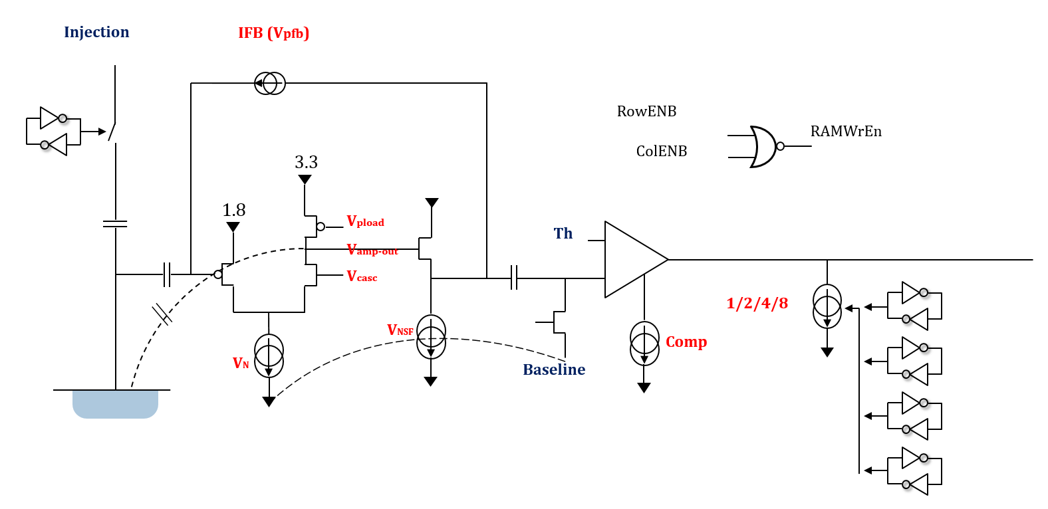
Pixel description

Slide 3
Outline
Review:
Move back to use Qinj
Different results with different polarity -> DC level changed by Qinj and important to the result
DC level : ~40mV
Tests to find the proper testing signal:
AC signal
DC signal with different pulse width -> a sharp peak
Confirm the “Working range” of BL/Threshold

Slide 4
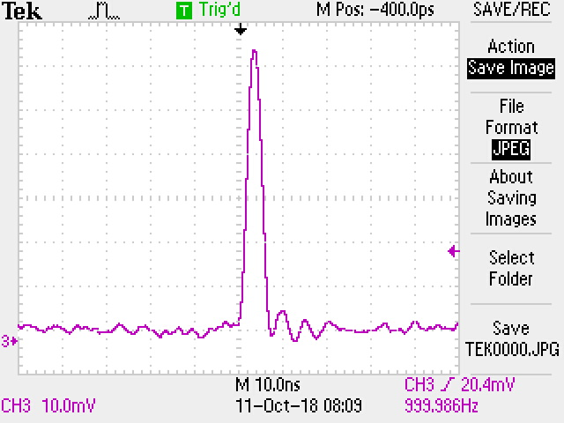
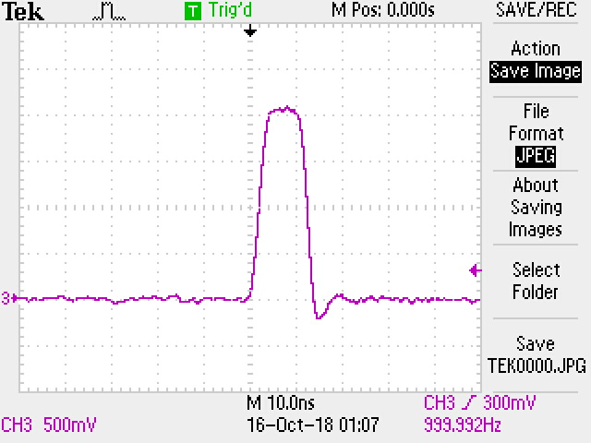
AC & DC signal with Register mode readout
AC signal
Adding a 1pf capacitance after the pulser
Pulse from the pulser : few micro sec width, amplitude ~4V
AC signal pulse shape
No signal observed
DC signal
Produce pulse with different width:
5ns 10ns 20ns 25ns 30ns 40ns 50ns 60ns 70ns 80ns 90ns 100ns 200ns 500ns 1000ns 3000ns
Amplitude: 2V (no signal with 1.5V)
Ramping edge: 5ns
Offset: 40mV
Start to see signal (width > 20ns)
A sharp peak at lower threshold

Slide 5
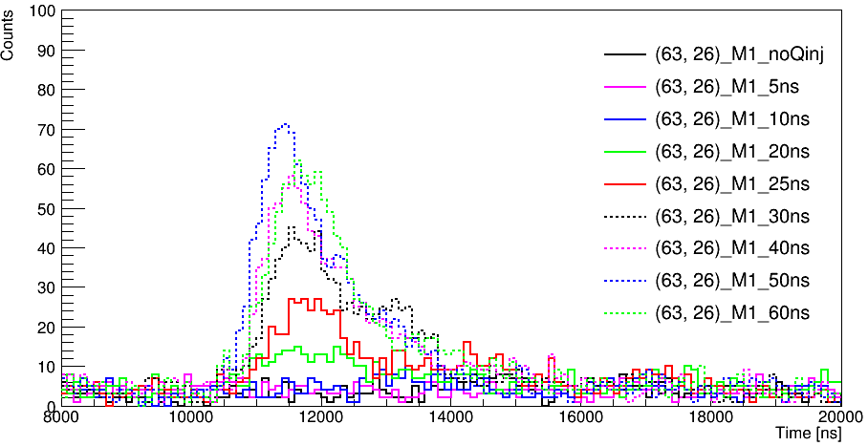
DC Qinj : Effect of pulse width variation
Counts vs Time
20Ohm/cm
BL=0.75V
One pixel enabled
(63,26)
Projection on Time
wide peak at width > 20ns
The peak reach its highest counts at width = 50ns
A sharp peak observed(similar results for Matrix 2)
Correct interval time
Big wide lump always at > 1.5micro sec after the negative edge.

Slide 6
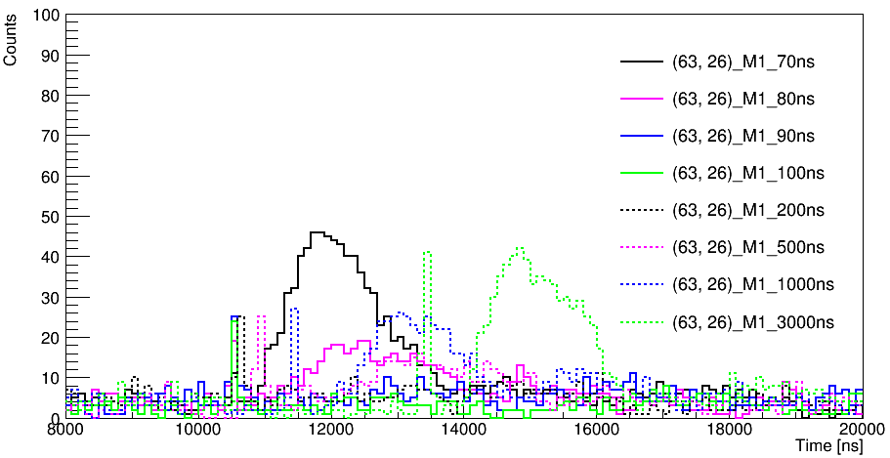
DC Qinj : Effect of pulse width variation
Counts vs Time
20Ohm/cm
BL=0.75V
One pixel enabled
(63,26)
Projection on Time
wide peak at width > 20ns
The peak reach its highest counts at width = 50ns
A sharp peak observed(similar results for Matrix 2)
Correct interval time
Big wide lump always at > 1.5micro sec after the negative edge.

Slide 7
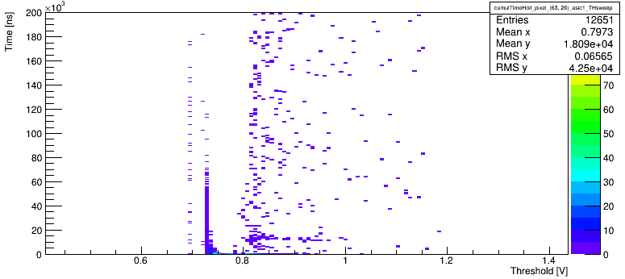
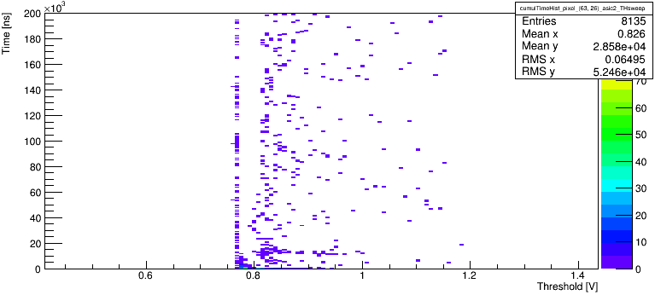
Threshold to see the sharp peak
Matrix 1
Threshold to see the sharp pulse
e.g. results of pulse with 80ns width
Matrix 2

Slide 8
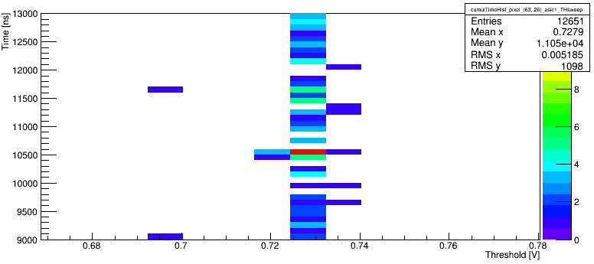
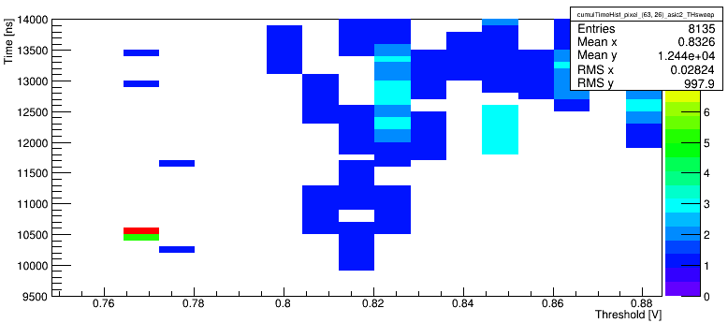
Threshold to see the sharp peak
Matrix 1
Threshold to see the sharp pulse
e.g. results of pulse with 80ns width
The sharp peak only happened once of the 8 hit(reading first 8 hits after within the 200micro sec time window) we got (for Matrix 2 the sharp peak always from the 1st hit)
~500ns later than the falling edge
Is the sharp pulse the real signal?
Matrix 2

Slide 9
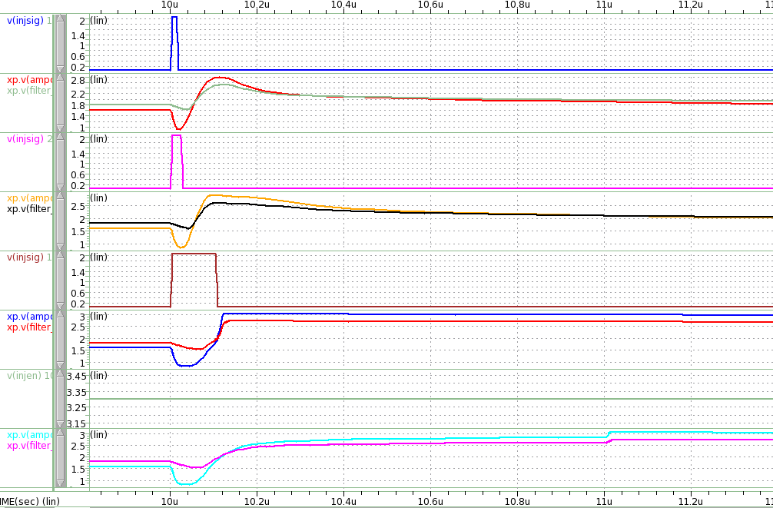
Simulation of different pulse width
Simulation using default configuration
Positive pulse
Amplitude : 2v
Different pulse width
10ns
20ns
100ns
100ns

Slide 10
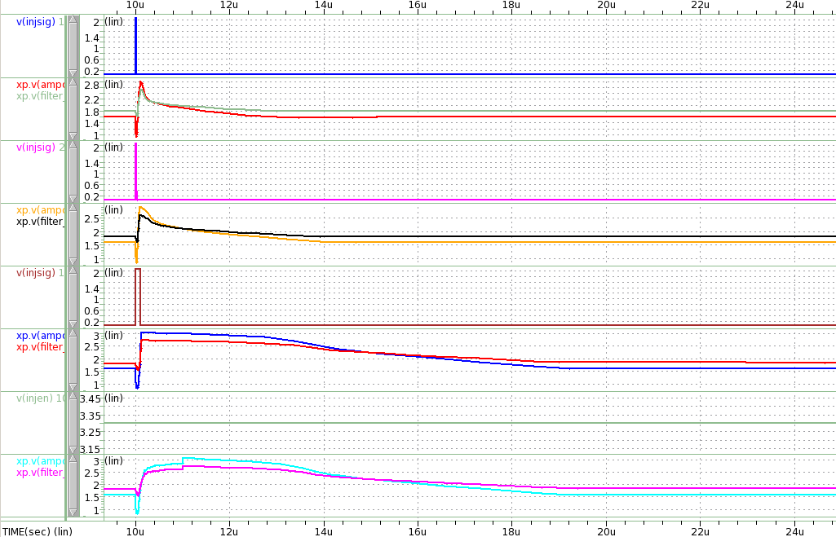
Simulation of different pulse width
Simulation using default configuration
Positive pulse
Amplitude : 2v
Different pulse width
10ns
20ns
100ns
100ns

Slide 11
Effect of BL variation
Confirm that the BL/Threshold working range still constant with the one we used to have(0.6-0.9v)
Constant pulse width of 50ns
10 micro sec delay
Different BL
BL=0.2V
BL=0.4V
BL=0.62V
BL=0.72V
BL=0.82V
BL=1.03V
BL=1.44V

Slide 12
Effect of BL variation
BL=1.2V
Confirm that the BL/Threshold working range still constant with the one we used to have(0.6-0.9v)
BL=1.65V
BL=1.86V
BL=2.06V
BL=2.27V
BL=2.475V

Slide 13
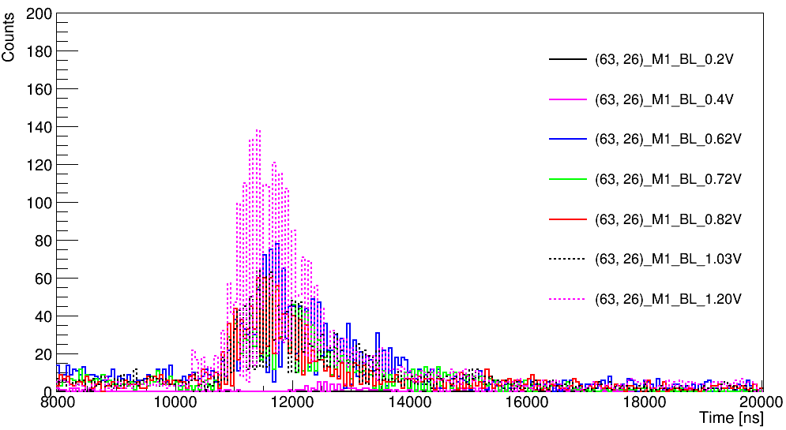
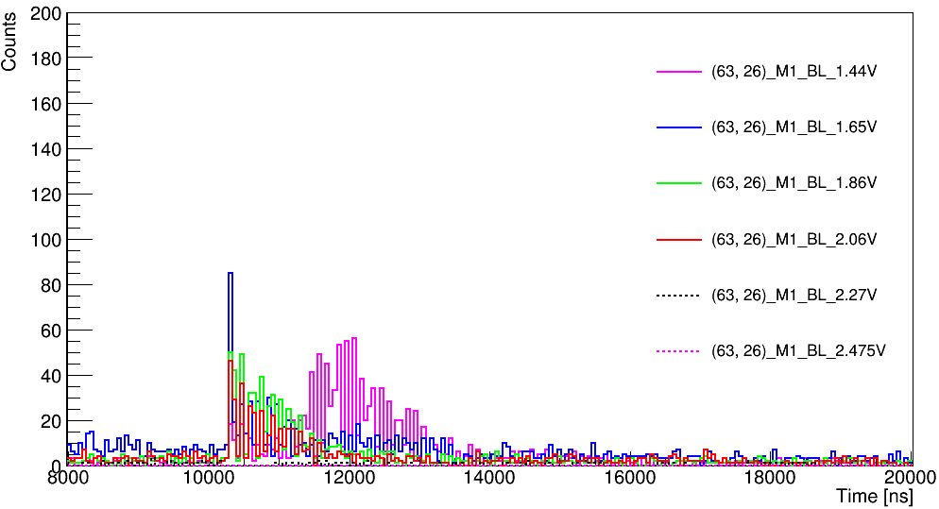
Effect of BL variation
Confirm that the BL/Threshold working range still constant with the one we used to have(0.6-0.9v)
Constant pulse width of 50ns
10 micro sec delay
Different BL
Confirm the working range similar for the 50ns signal
Start to see the sharp peak with higher BL (but with higher threshold )
But the noise of Higher BL is very huge
The sharp peak to be further understood

Slide 14
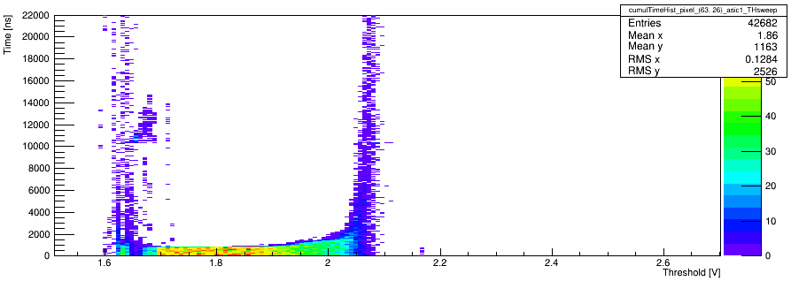
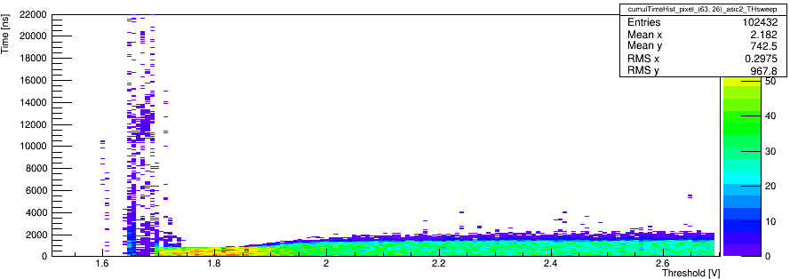
DC signal – Register reading
To confirm that the BL/Threshold working range still constant with the one we used to have(0.6-0.9v)
50ns
Different BL
Confirm the working range similar for the 50ns signal
Start to see the sharp peak with higher BL (but with higher threshold )
But the noise of Higher BL is very huge
The sharp peak to be further understood
Qinj with BL=1.65V
Matrix 1
Matrix 2

Slide 15
Summary and Next
Tests with different signal and BL
Signal with 50ns width looks better from the counts number( of the time of interest) of view->Still need to learn and understand the proper signal for this sensor
confirm the BL/Threshold working range
Sharp peak to be understood ->Is the sharp peak the signal in time the real signal we are looking for?

