Slide 1
Joint Operation & Readiness meeting
Report Operation / Photon Run Coordinator
Report Dispatch
Instruments
FXE
SPB/SFX
SCS
SQS
MID
HED
Beam transport
Vacuum
X-ray optics
Photon diagnostics
Optical lasers
Detectors
Electronics
AE
EETF
CAS
ITDM
SRP
Technical services
AoB

Slide 2
Report from PRC
Last Weekend
- Laser setup and machine delivery of 2699 bunches per train in the TLD.
- Transport of 200 bunches to T5D (SASE2) and 400 bunches to T4D (200 SASE1 and 200 SASE3).
Monday/Tuesday
- Accelerator studies, e.g. BBA in SASE2.
Wednesday
- Beam transport SASE1/SASE2/SASE3 with 11.5 GeV (to be used until the end of the run);
- SASE tuning: SASE1 with 9.3keV, 0.5mJ; SASE3 with 900eV, 0.5-1.2mJ; SASE2 no lasing;
- XTD9 open until 13:30 for FXE mono work.
Thursday
- SASE1: pointing stabilities study; SASE3: photon commissioning.
- Commissioning of FEEDBACK device with SPB-XGM as input (Harald/CAS/XRD).
- XRO, XRD commissioning.
- SQS test of pulse on demand tool.
- Some SASE2 lasing spot at 6.5keV at 13:00.
From Friday
- X-ray development; XRO, XRD, instruments developments.
- SASE3 (Sat-Mon): SCS day shift, SQS night
- Monday: 2x ZZ in XTD10 (Natalia/Raul) for gas exchange on the attenuator (SASE3 mono resolution).
Back

Slide 3
Report from dispatch
For the winter shutdown planning we got tasks list from:
MID
HED
SQS
AE
ITDM
EETF
VAC
XPD
CIE
TS
Undulators
SAVE
D3
MKK2 and some other DESY group.
These activities will be take into account to spot collisions.

Slide 4
Report from Dispatch - Planning tool
Back

Slide 5
HED
DN160 roughing line installed from outside pump to IC1 (EXP)
OPT hutch
vacuum connected from transport pipe up to PAM (1/3 of OPT hutch), and only one bellow missing to connect up to CRL (1/2 of opt hutch)
last missing component (IPM1) ready to be installed in hutch Friday or next week
OPT almost ready for TÜV rehearsal next week, TÜV planned for Nov 20 with MID EXP
OPT ready for first cable pulling (to start this Friday or next week).
Back

Slide 6
XPD
XGM
All 6 XGMs are online
Tested successfully SASE1 Position Feedback devices (with SPB-XGM or FXE-BIU-imager as input)
Bolometer/XGM cross-reference measurement at SASE3 / SCS this weekend
Imagers
Failures of Photonic Science cameras under investigation
All FEL and SR imagers: CAM shutter operation optimised (updated parameters)
Wavefront
Test with Hartmann-style Imagine Optics sensor scheduled for next week at SCS
Hard X-ray PES
First review meeting done, next on Nov.15. No major issues so far.
HIREX2
Designated tunnel position optimized → detailed pdetermination of cable lengths
PAM
Reinstallation in SPB-SFX hutch; piezo-motor issue solved
Discussions on MID-PAM
Back

Slide 7
Optical lasers
SASE 1:
PP-laser is now in service mode for the whole month of November.
it shall be in operation again for timing tool experiments starting in the first week of Dec.
SASE 3:
incremental progress in PP-laser installation and commissioning
SASE 2:
incremental progress (cabling: timing cables laid)
Back

Slide 8
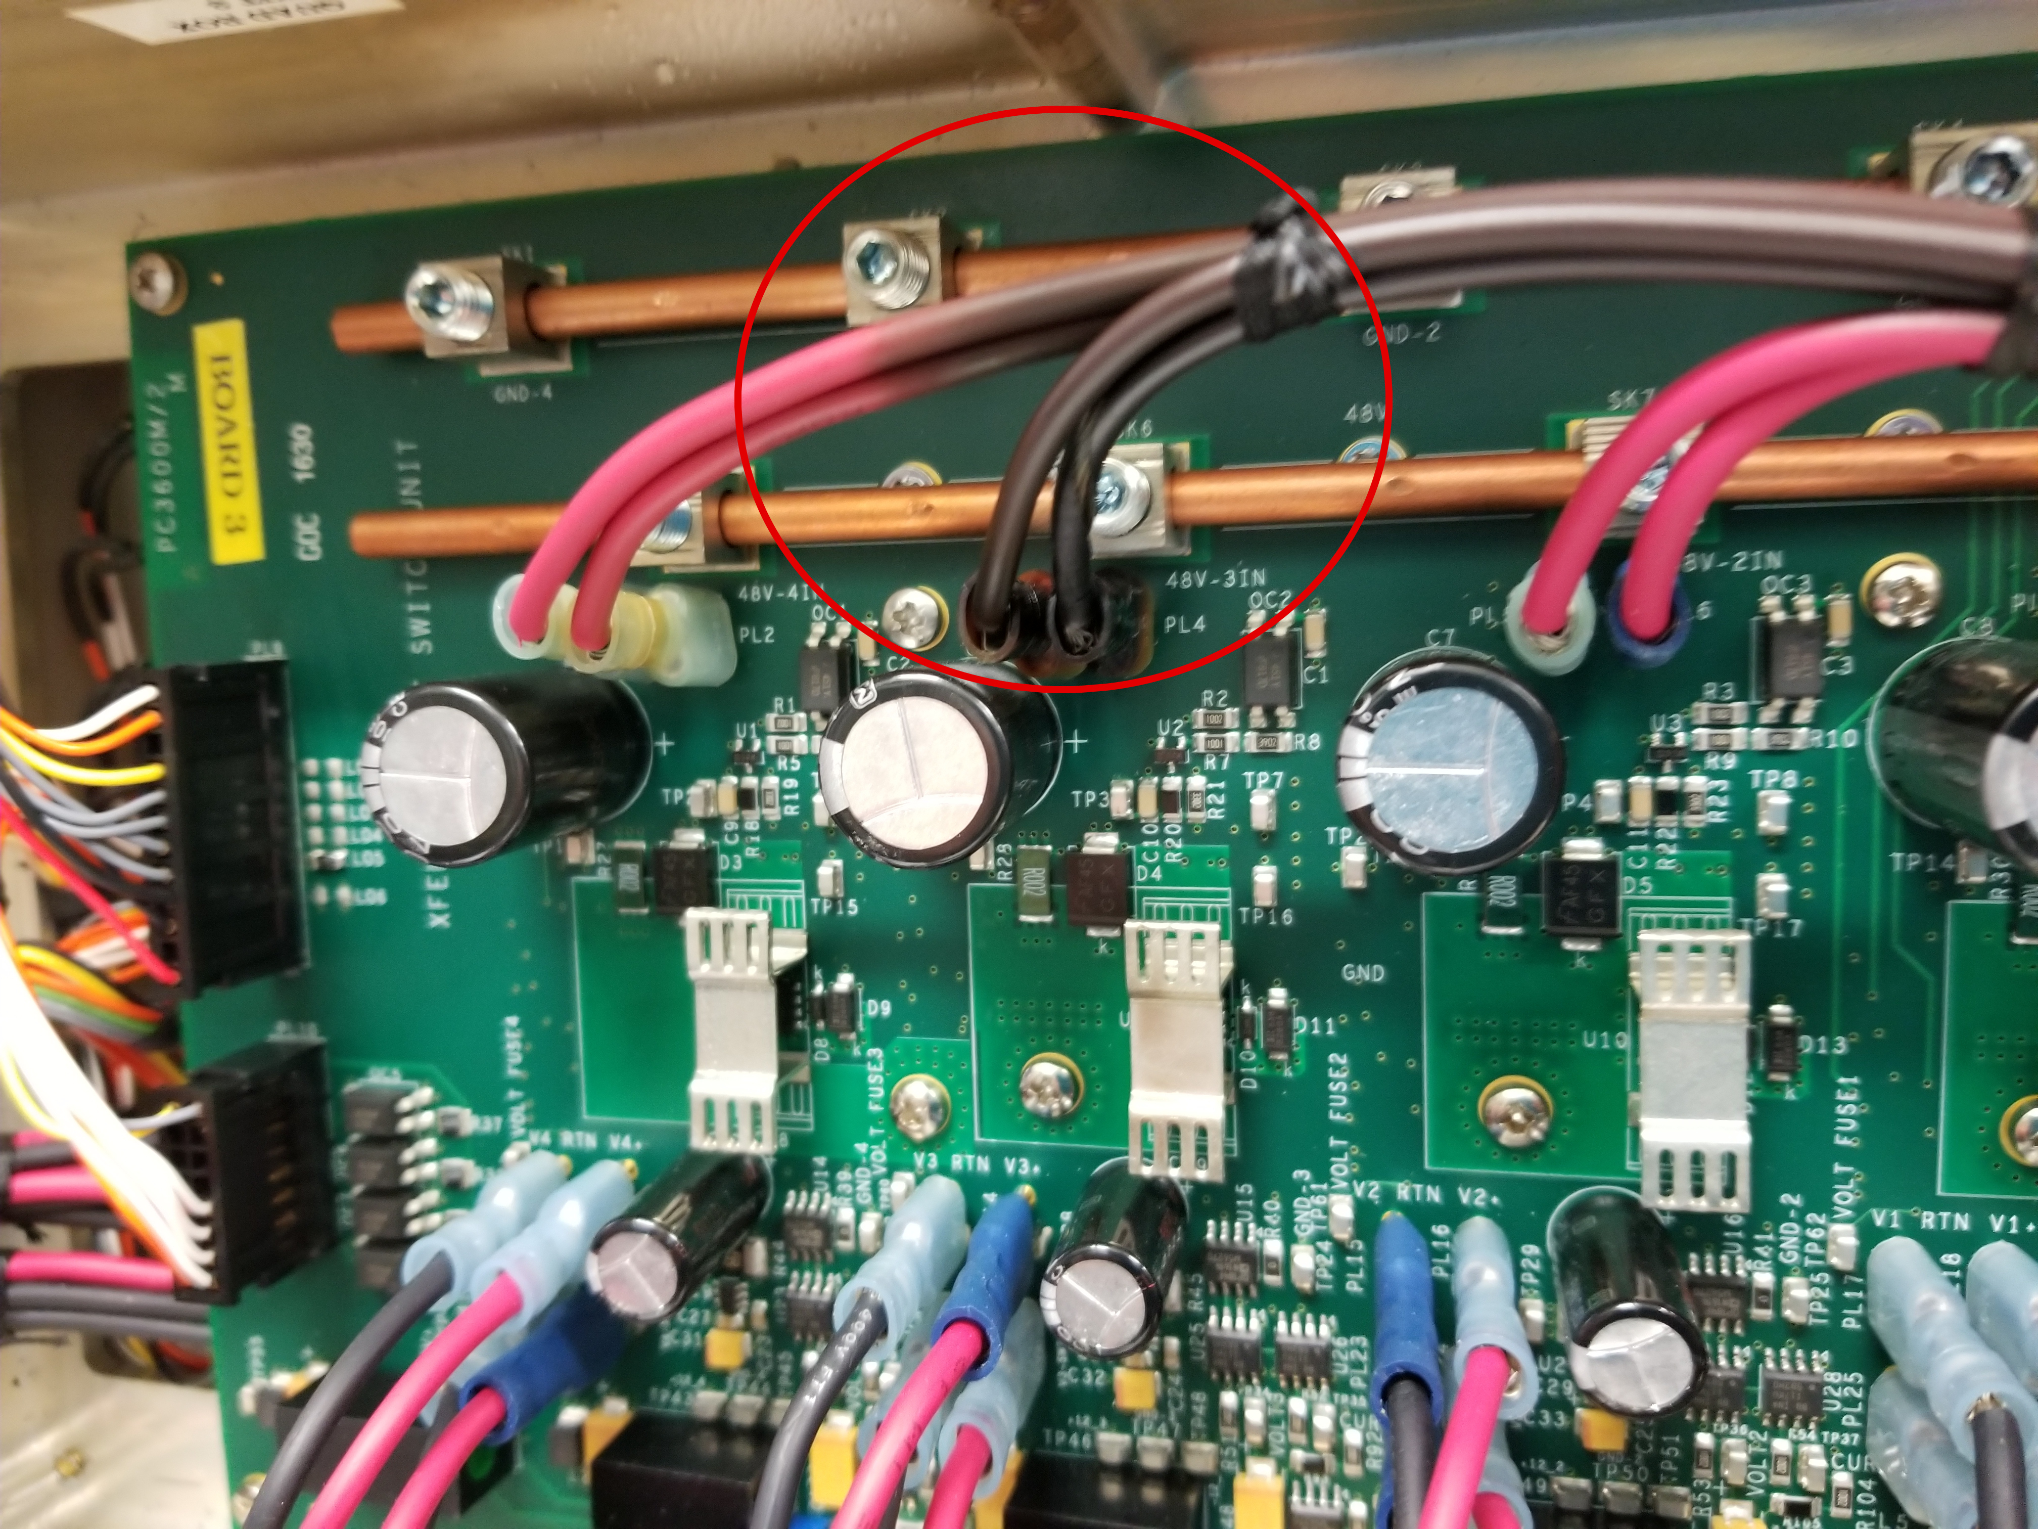
Detectors – DET
1st AGIPD SPB
The detector is moved to upstream position
Hole size was adjusted for the upstream position
The detector was tested after the movement, no problems were identified
Karabo was upgraded → system has to be tested after the upgrade
Loop 5 upgrade → small bug was introduce for chiller T_set value when interlock is triggered → should be solved today
Leak test was done by SPB, several leaks were identified and fixed → leak rate < 4 x 10^-5 mbar/sec
LPD at FXE
Defect cables noticed (overheated) in two of the power supply control units (PSCU). The LPD was working as usual without showing any sign of bad behavior.
Contacted Matthew Hart from RAL to discuss the issue. RAL will send replacement units.
The problem is under investigation and the detector shall stay off until the source of the problem is understood.

Slide 9
Detectors – DET
2nd AGIPD MID
Detector was transported from HERA South to MID hutch on Wednesday, 07.11
The detector was installed in the MID DCS support
Work on installation of vacuum components and the “cage” parts around the detector ongoing
Configuration of MPODs for AGIPD detector - work in progress
Issues:
Loop 11 (AGIPD part) will be delayed by ~ 1 week
DSSC
Integration in HERA South
Vacuum PLC cabled and partially tested (missing scroll pump and test with closed system)
In-vacuum wiring of the motion system finalized
Dummy quadrants installed in the vessel
Reworked quadrant mounting tool arrived, partially tested, some parts needed reworking, partially done in house, the rest will be done outside.
Power supply control in Karabo
Device is fully working and will be tested now. Control to be fully ready by end of November.
First three quadrants are ready at DESY, 4th in preparation

Slide 10
Detectors – DET
FastCCD
Camera and cooling head installed on beam-line
Chiller has been modified and connected; detector cooling to be tested soon
Interlock partially ready (can control chiller but not power supply)
Electronics installed, connected
DAQ/slow control tested as far as possible without turning camera on
Resumed work on documentation
Commissioning with beam scheduled to start on 21/11
JUNGFRAU
PSI circulated the final drafts for two offers:
Spare parts
The remaining 7 of 13 JF modules
Offers should arrive soon to XFEL
Meeting with SPB/SFX to coordinate the JF installation of next spring
To be repeated in two weeks time for updates
Back

Slide 11
AE - 1
PLCs
SQS:
loop 12 running but still work to do
loop 02 problem with one encoder was solved - problem with Harting connector on the crate
Next week planned updates for rest of MPS interlocks.
SCS:
loop 04 is still running without 3 crates, working on it.
loop 13 was updated, and now includes Nanos motors and crate BKF00206(SCS_CDILLC_VAC).
loop 07 - Elmo motors with breaks, motor and break are configured, but still not tested completely - this will happen today or tomorrow because they have higher priorities.
SPB:
Solved problem with encoders SAMPLE1_X/Y/Z in loop 07.
Loop 5 updates with interlock for Z_STEPPER and new pumps.
CR needed for Ebara pumps.

Slide 12
AE - 2
PLCs
MID
MONO in optics hutch Y-Motion - commissioning ongoing
AGIPD to be prepare next week.
Loop 1 – piezos to be added next week when cabling is finished.
SASE1
FXE-MONO – Assistance with commissioning and tuning.
DCSS
PLCs for Vacuum and Motion running, support will be given next week for quadrant motion.
AE-uTCA
Preparation of MicroTCA crates:
MID Experiment Room
HED Rack Room
SQS Experiment Room
Back

