Slide 1
LArTPC Charge-Light Matching and PID with Wire-Cell
Xin Qian
BNL
On behalf of the Wire-Cell team

Slide 2
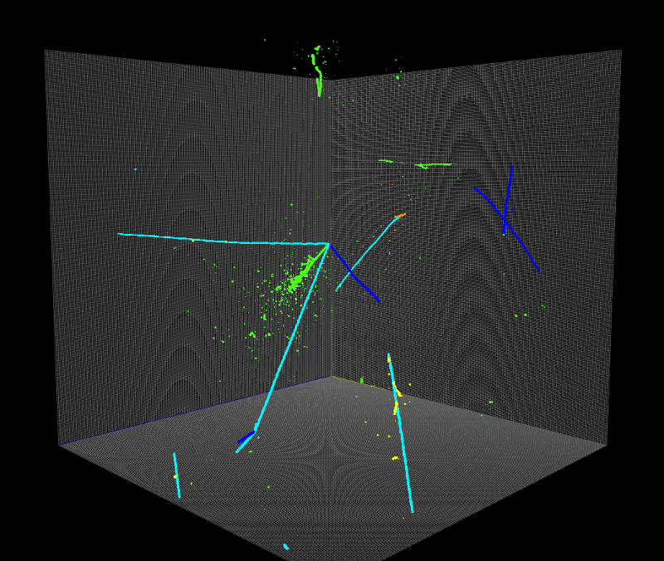
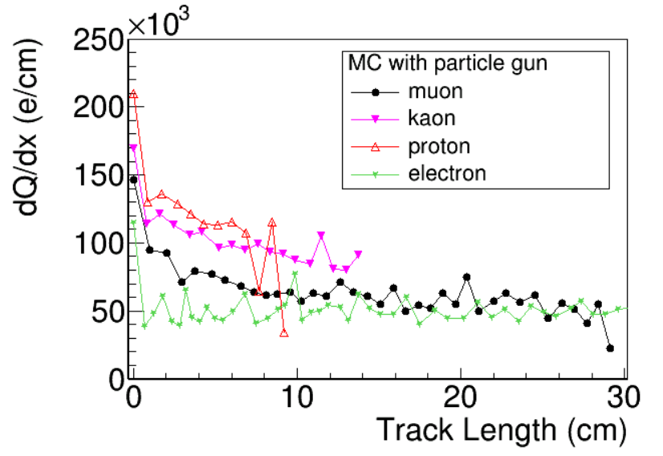
Introduction
Event reconstruction can be viewed as unfolding/fitting problem
Likelihood function cannot be (easily) written
E.g. general pattern recognition
When good data is available, machine learning techniques are expected to have clear advantages in solving this type of problem
Likelihood function can be (approximately) written
A computing problem to maximize likelihood
Provide essential insights/feedbacks with imperfect data
Example I: Charge-light matching in LArTPC
Example II: track trajectory and dQ/dx fitting in LArTPC
SLAC/DL
BNL/Wire-Cell

Slide 3
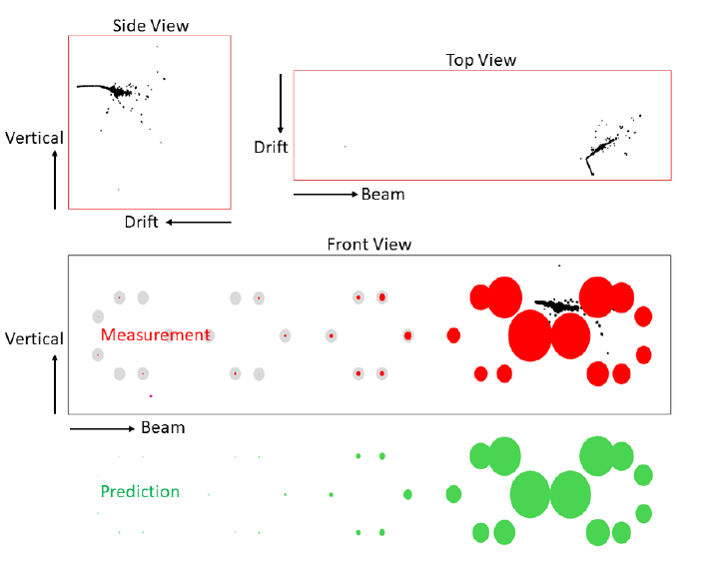
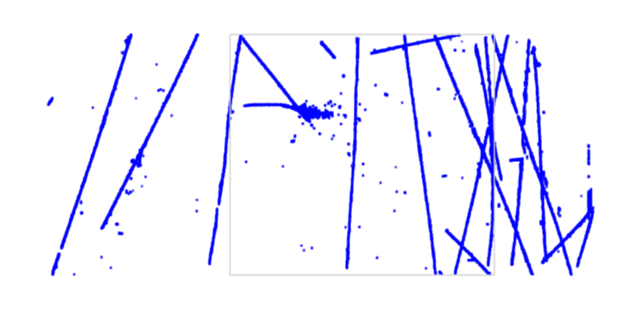
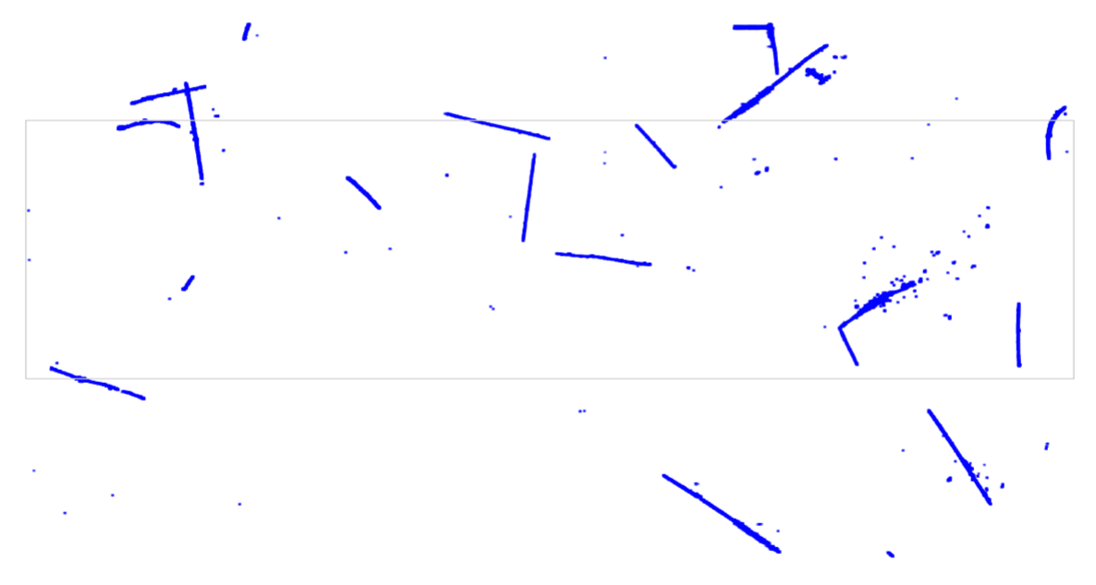
LArTPC Charge-Light Matching
Side view
Top view
Front view
After 3D Imaging
Procedure | Neutrino : Cosmic Muons
Trigger | 1 : 800
PMT filter (late light rejection) | 1 : 200
Many-to-many charge-light Marching | 1 : 7
After Charge-Light Matching

Slide 4
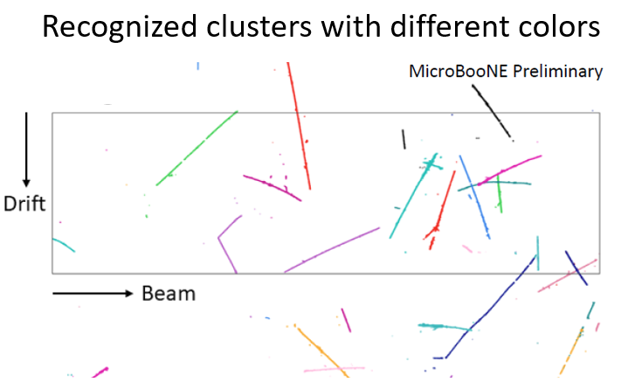
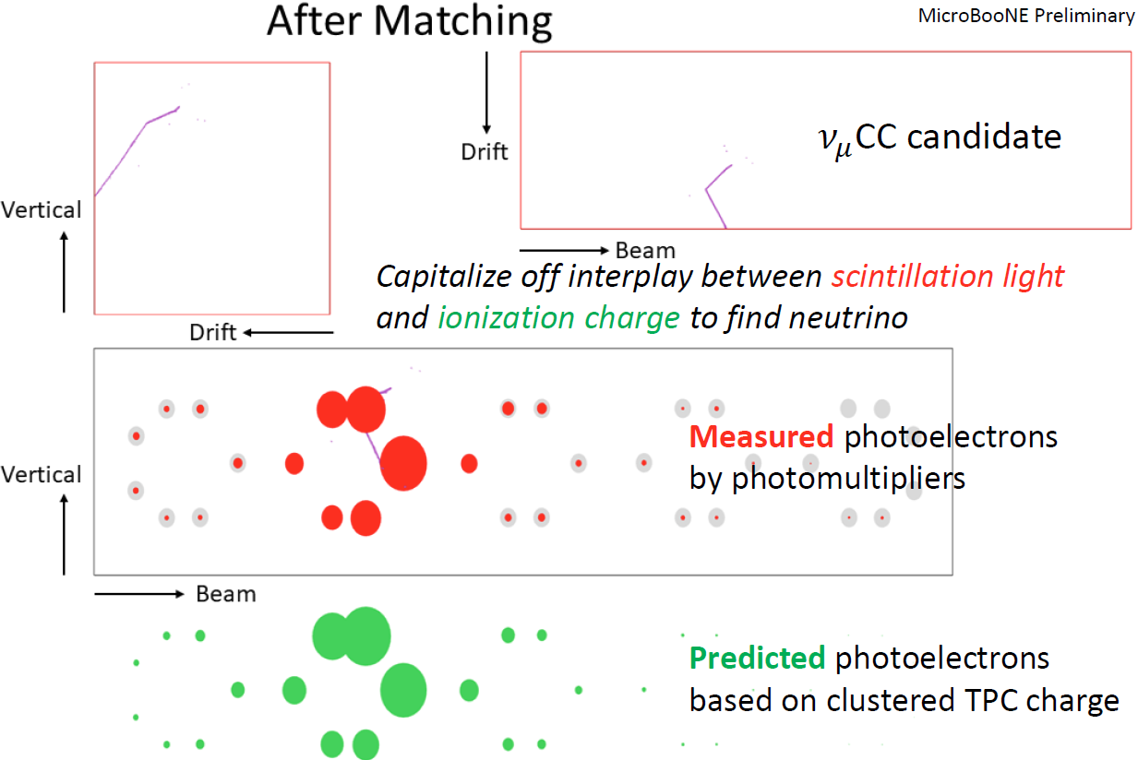
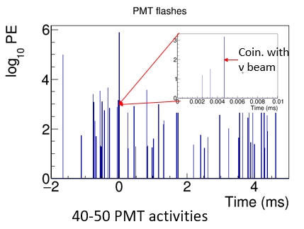
Matching Principle
4.8 ms drift window
Matching Hypotheses
Clustering
3D Image
Light Reconstruction
Hypotheses Selection
20-30 TPC activities
All possible hypotheses
One flash → many or zero TPC clusters within corresponding active volume (activities in inactive volume)
One cluster → at most one flash (inefficiency in the light system)
Light signal proportional to (reconstructed 3D) charge
Known light acceptance given position
Predicted vs. Measured light pattern with Compressed Sensing

Slide 5
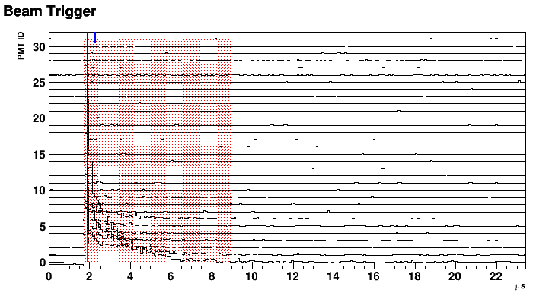
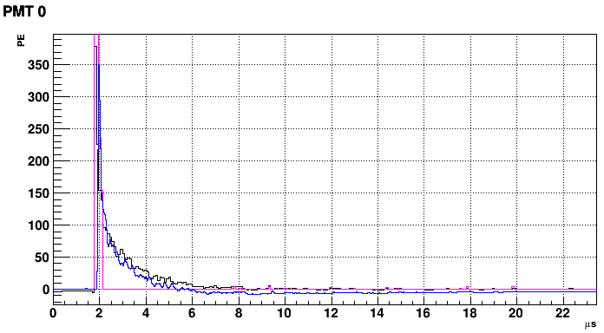
PMT Light Flash Reconstruction
Employ signal processing techniques (see H. Wei’s talk) for PMT waveform
Key is to handle the late light
70% of overall light being long component (~1.5 us) for M.I.P.
Integration window to fully encapsulate late light
Raw
Deconvolved
Late light unfolding

Slide 6
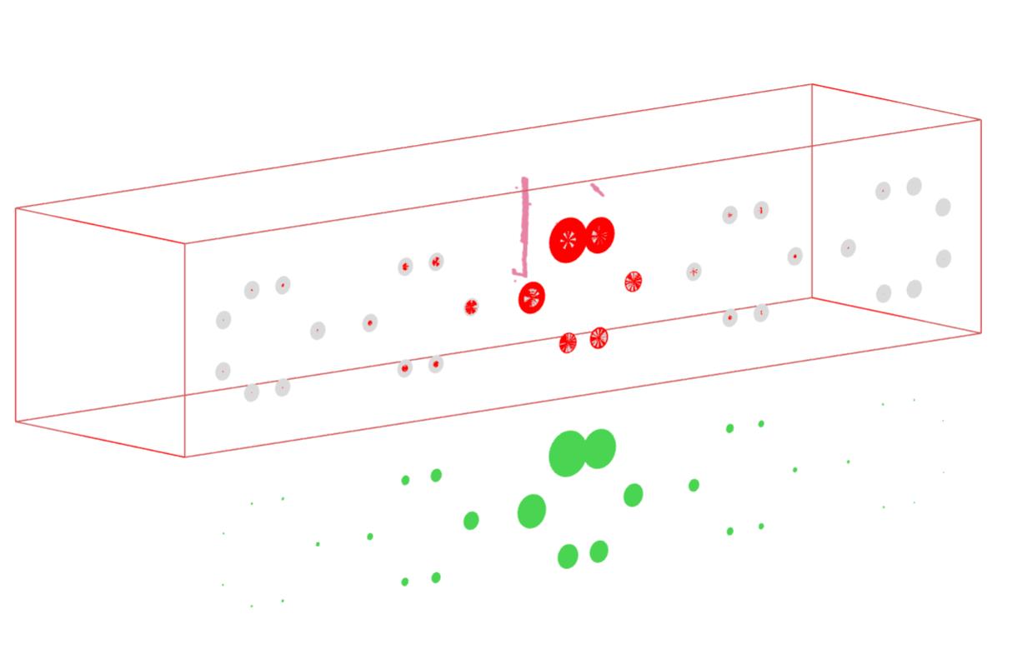
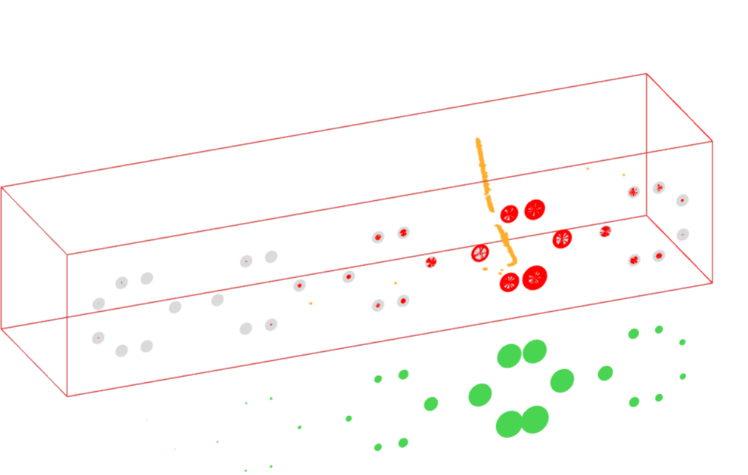
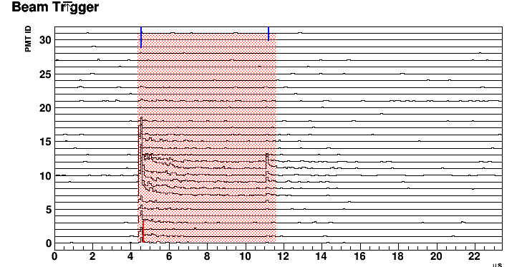
Light Signal for Michel Electron
Compressed Sensing technique was used to unfold the late light
Light signal of Michel electrons is sometimes visible

Slide 7
Interaction Clustering
LArTPC is a fully active detector
Design of cold electronics with anti-aliasing filter respects this feature
In principle, clustering based on connectivity and distance is straight forward
In practice, additional challenges
Dead channels
Noise filtering and signal processing
Real coincidence in ionization electron arrival time

Slide 8
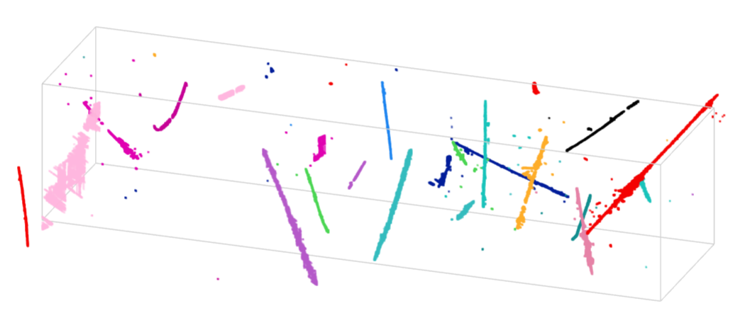
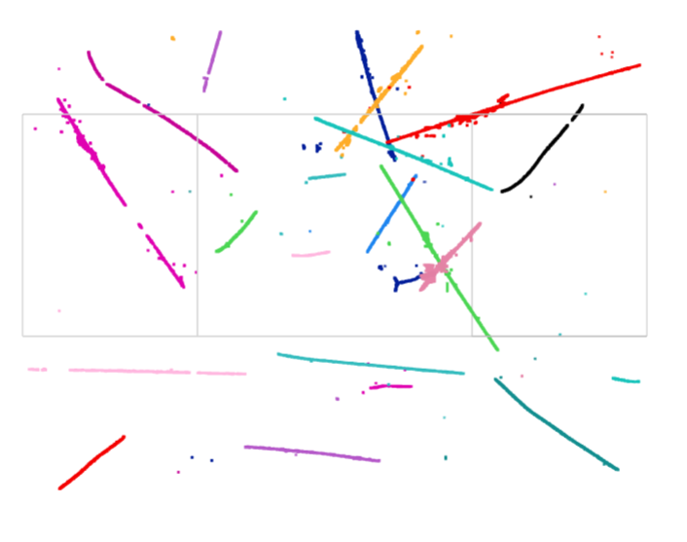
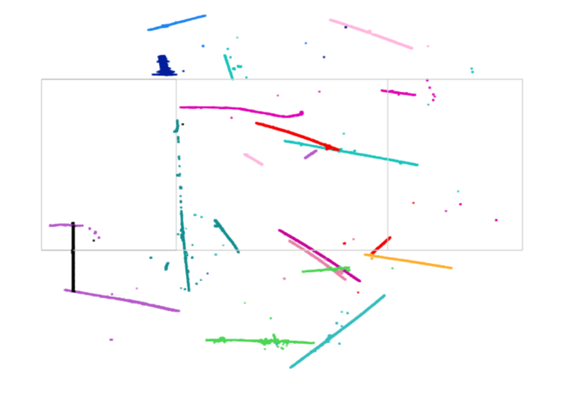
Challenges in Clustering (I)
Gap as a result of Noise Filtering
Gap as a result of Signal Processing
(Left) coherent noise subtraction may remove signal when the S/N is small
(Right) signal recovery for prolonged track in the induction wire plane is a difficult task
Drift Time
Drift Time
Projected Induction V view
Projected Induction U view

Slide 9
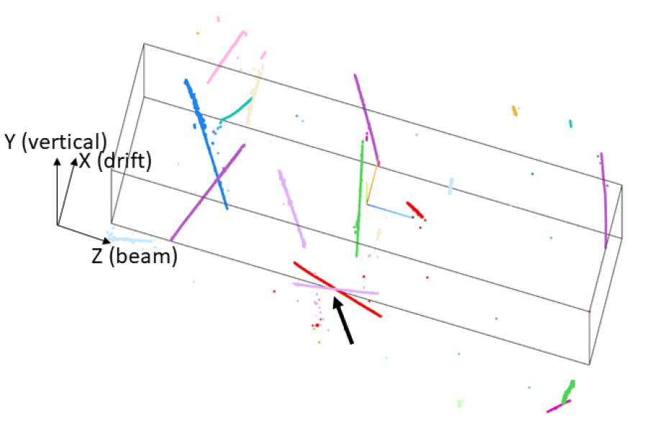
Challenges in Clustering (II)
Gaps as a result of non-functional channels
Random Coincidence in ionization electron arrival time
Before separation
Grey regions are with two non-active wire planes (2/3)
In average about 10% dead channels in MicroBooNE → 3% dead regions requiring 2/3 planes in image reconstruction
After separation

Slide 10
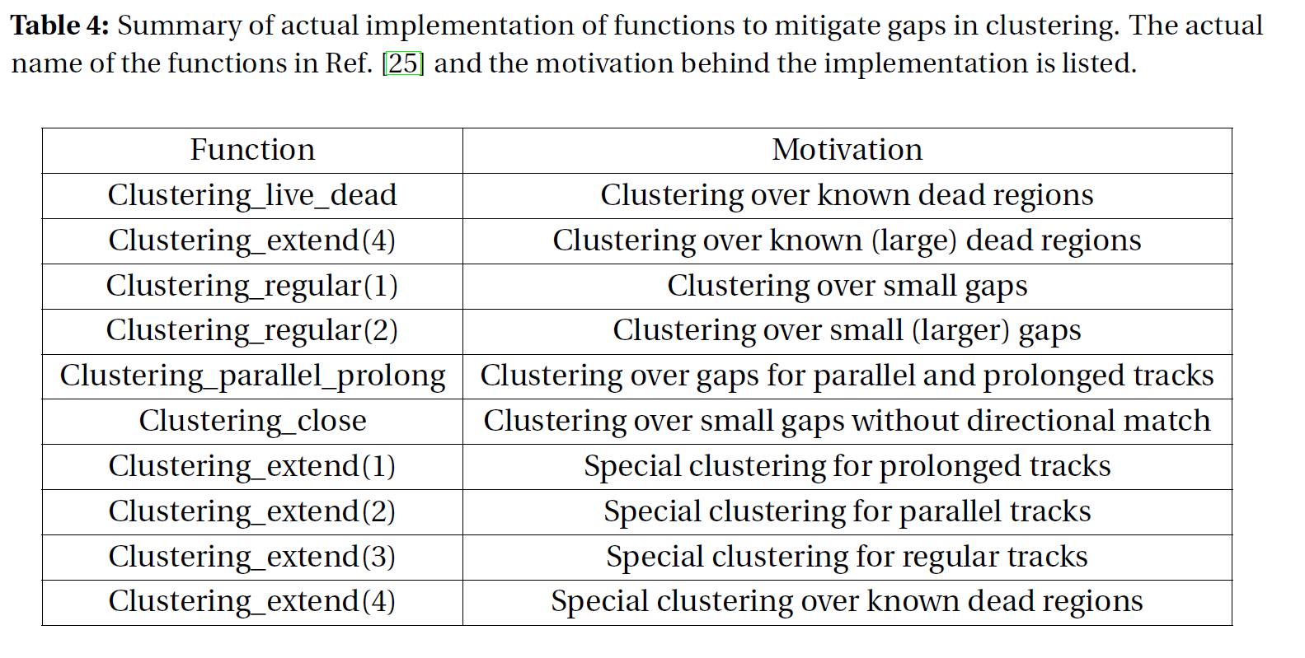
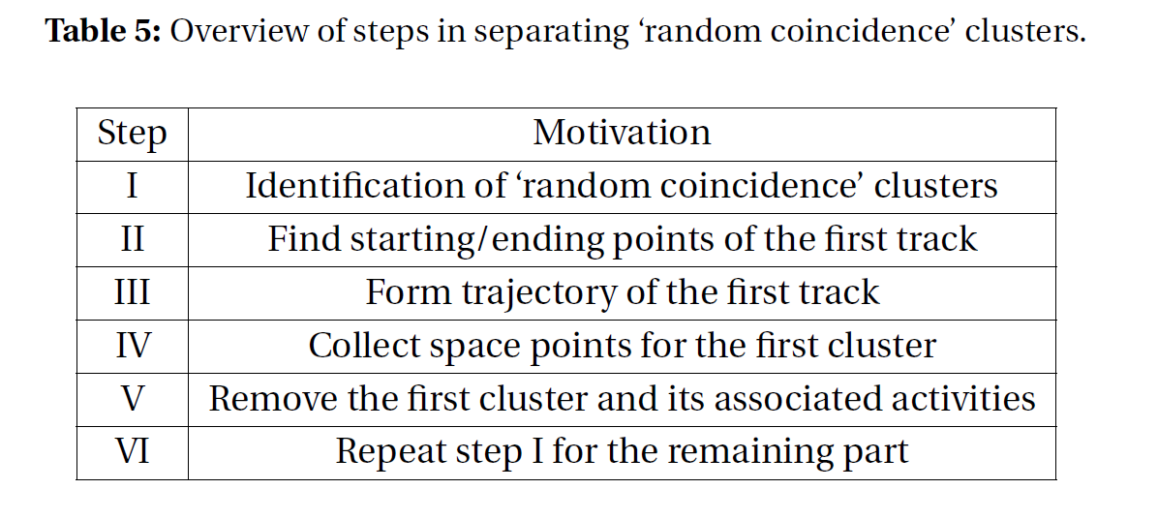
Example of Actual Algorithm for Clustering
Many advanced techniques, such as graph theory operations (Dijkstra’s shortest distance, connected components, minimal spanning tree), Kalman-filter, 3D and 2D k-d trees, are used to obtain a robust results in a quick and efficient way

Slide 11
Core Charge-Light Matching Algorithm
Overall test statistics to be minimized
Comparison of the measured and predicted light pattern
Each Charge Cluster can only be used once
Observed light flash may not correspond to any charge cluster
Aggressively pursue charge-light matching
Additional cuts to examine the “light mismatch” events
Compressed sensing to select the best pairs

Slide 12
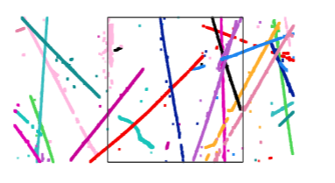
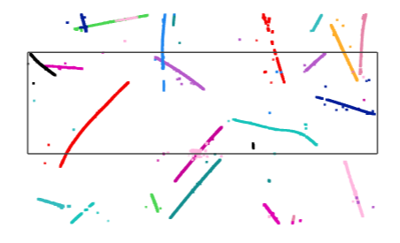
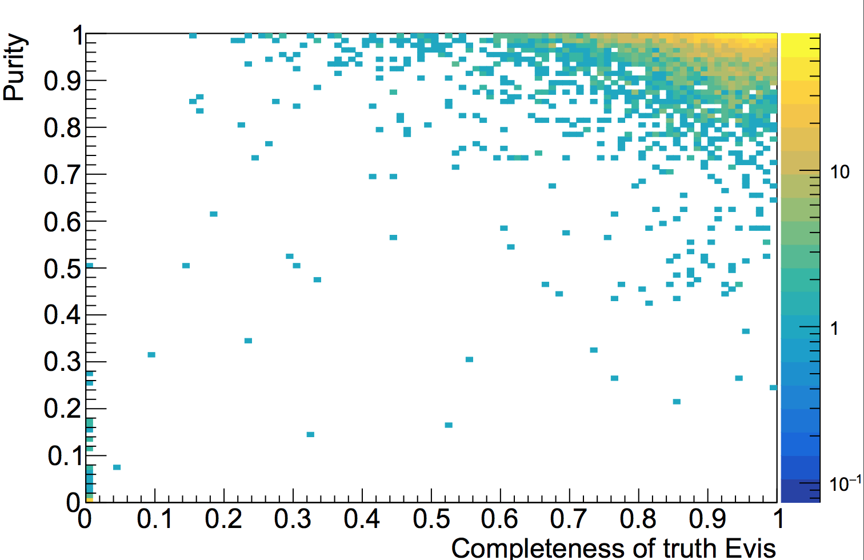
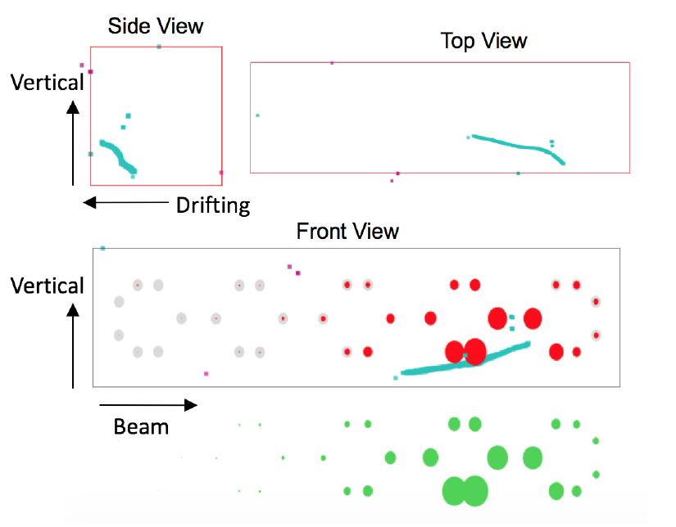
Performance
Side view
Top view
The Geant4-based simulation for neutrino interactions with above 90% accuracy in Charge-Light Matching
Front view
MicroBooNE Simulation
In Progress
$ν_{μ}$ CC interactions
in active volume
Completeness: overlap over true
Purity: overlap over reco [ghost, over-clustering, etc.]

Slide 13
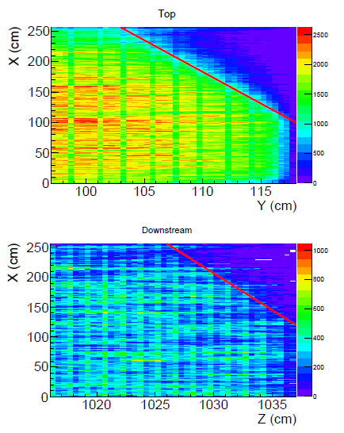
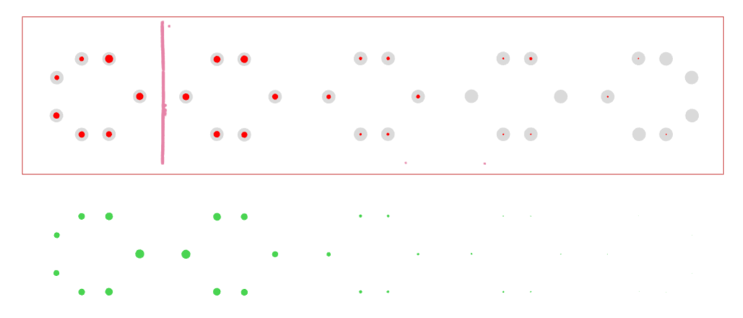
Application of Matching: Space Charge Boundary
Anode
E field (X)
Rejection of in-beam-time through-going muons (TGM) with correct active volume boundary
Cathode
Vertical Direction (Y)
Vertical Direction (Y)
Beam Direction (Z)
Vertical Direction (Y)
After correcting t₀ for all cosmic muons in one event
Drift direction (X)
Again, challenges on the dead and inefficient channels (NF and SP)
Neutrino : Cosmic ~ 1 : 1 after TGM rejection

Slide 14
Particle Identification in LArTPC: Track Trajectory and dQ/dx fitting

Slide 15
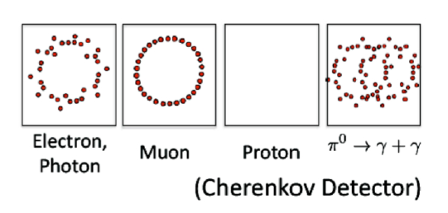
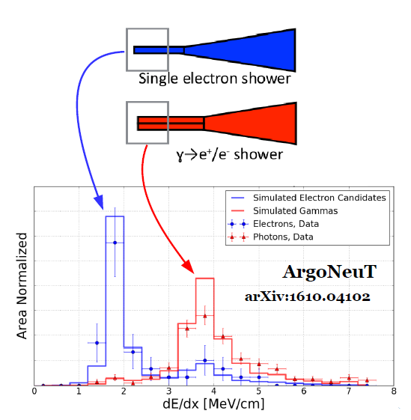
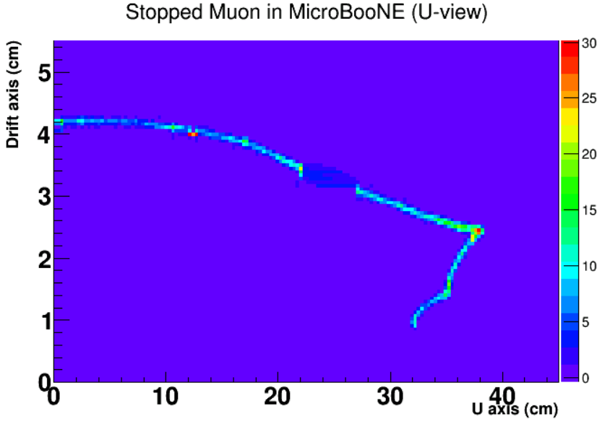
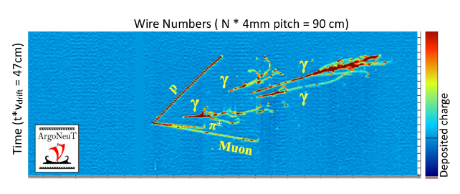
Unique Particle ID capability in LArTPC
Comparison of P_{MCS} and P_{Range} to separate low-energy e/µ for ν_{e} charge-current interaction
Gap Identification + dE/dx to separate e/γ for ν_{e} charge-current interaction
Stopped muon
Dead ch.
Michel e
Also, the identification of the Bragg peak can help to reject stopped Cosmic muons

Slide 16
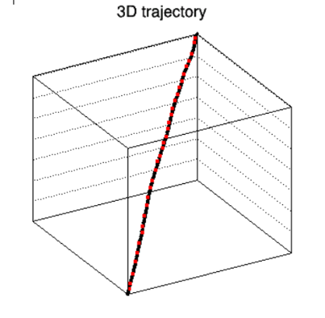
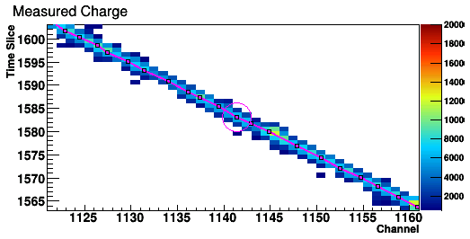
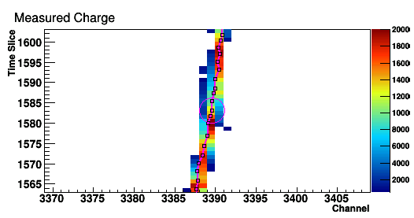
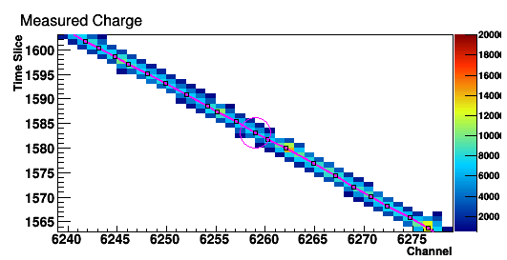
Principle of the Fit
Come up with a 3D track hypothesis (3D trajectory points and dQ/dx)
Predict the deconvolved signals on all projection views
Minimize the difference between the observation and prediction
U view
V view
W view
Inspired by the Projection Matching Algorithm (R. Sulej and D. Stefan)

Slide 17
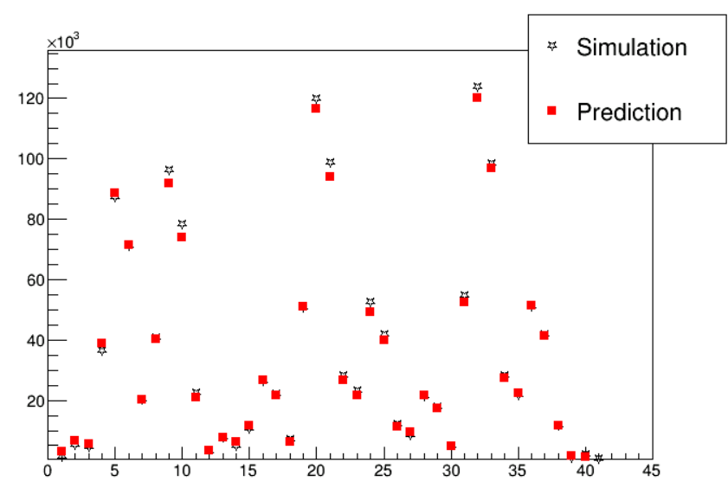
Simplified Prediction of the Deconvolved Signal
dQ/dx at generation
diffusion
Electron at anode plane
Convolve with field res.
Induced current on wires
Charge
At signal processing stage, we have two additional effects:
Software filters (time and wire dimension)
Usage of position-averaged overall response function
Simplified model
Convolve with elec res.
Pixel # in 2D Projections
Deconvolved signal
Signal Processing Chain
Digitized amplified current
Full process of signal formation and signal processing is complex (more details in H. Wei’s talk) → significant burden in computation
A simplified model was developed

Slide 18
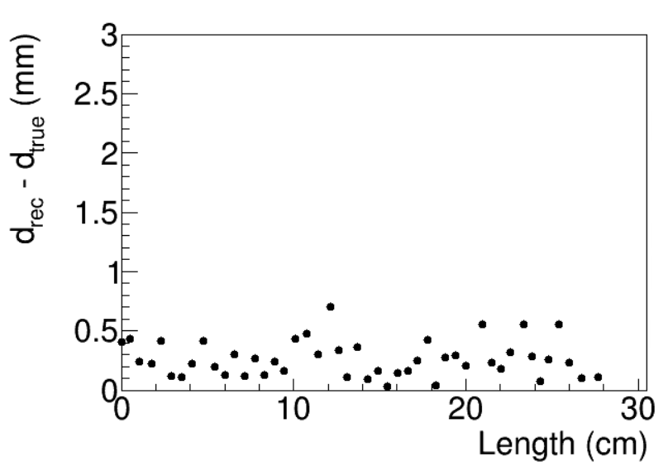
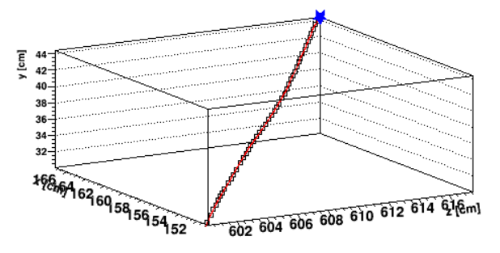
Trajectory Fitting
Choice of test statistics
Avoid nonlinear fit of Gaussian function → take advantage in linear algebra
Similar to an unbinned likelihood
Choice of regularization
Cases of two non-responsive wire planes
Unknowns
Measurements
Displacement to truth information
Notes:
https://www.phy.bnl.gov/twister/bee/set/692f6401-5e2d-45e1-94ba-b1f510db4b1b/event/1/

Slide 19
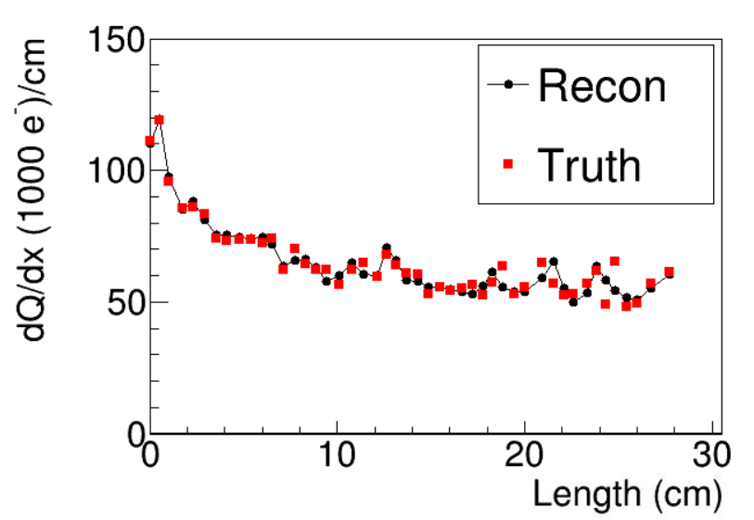
dQ/dx Fitting
Smearing coefficients are fixed with the determined trajectory
Linear Algebra can be used in the fit
Regularization(s) are necessary
Regularization on the smoothness
Additional regularization needed for the cases of compact projection view

Slide 20
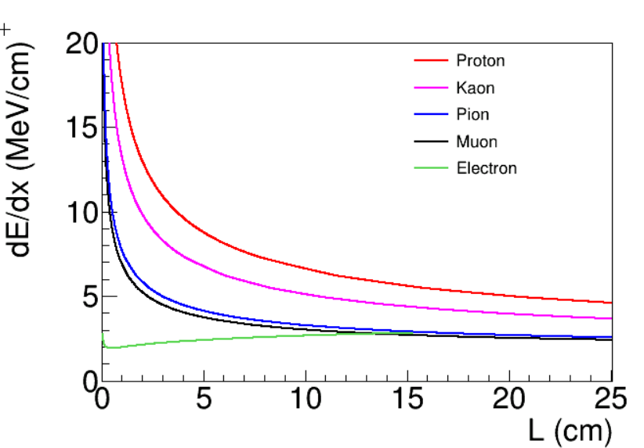
PID Performance on Monte Carlo

Slide 21
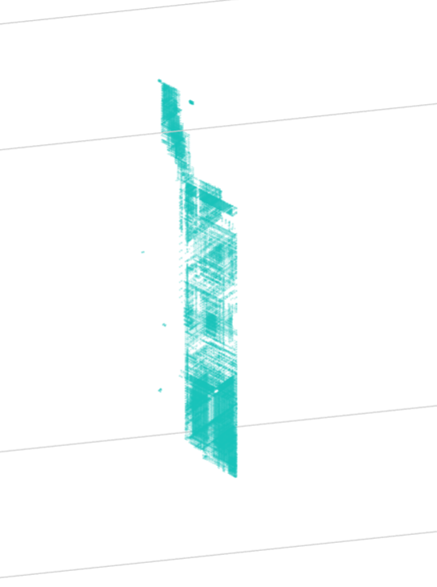
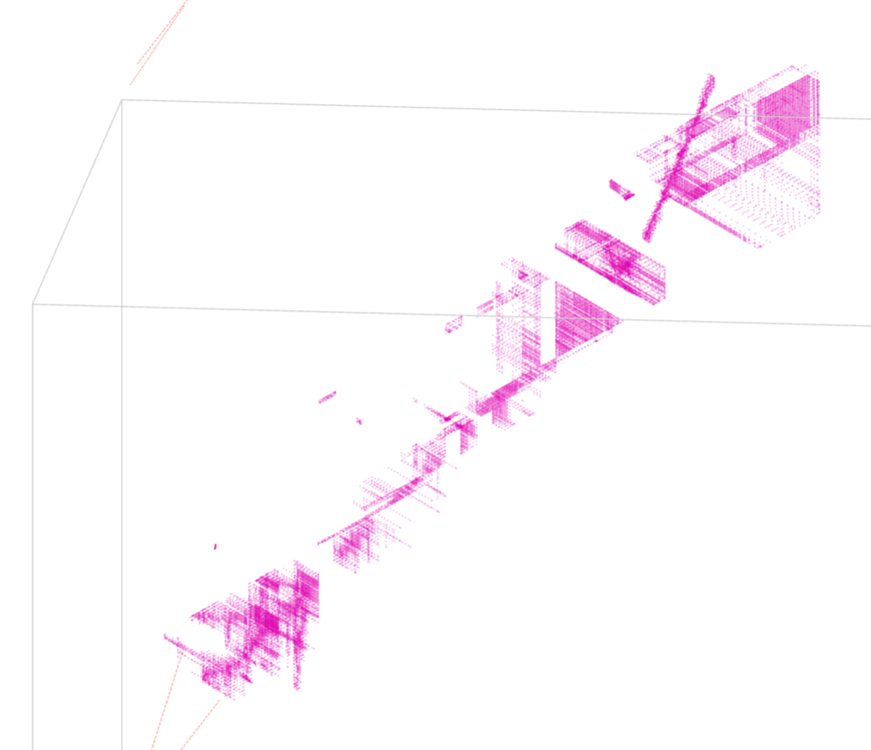
Issues in the Real Data
Imperfect detector response
Difficult topologies
Dead channels
Inefficient channels
Noise filtering → isochronous tracks
Signal processing → prolonged tracks
Isochronous tracks
Compact projection view (e.g. vertical cosmic muons)

Slide 22
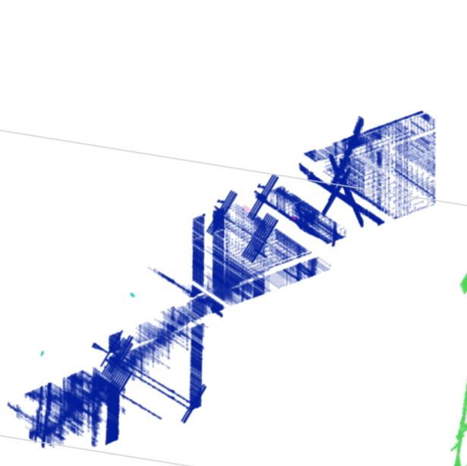
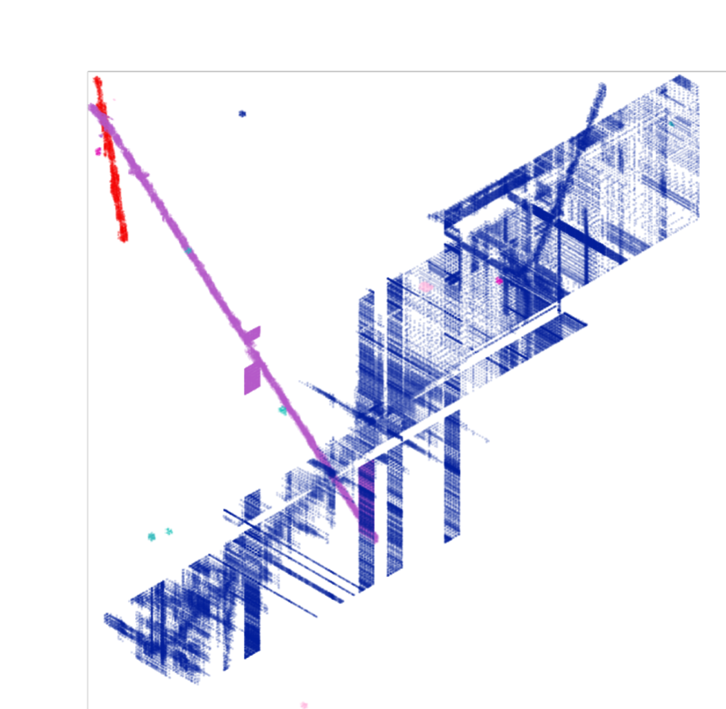
Graph Formation with Dead Channels
First round retiling with known dead channels
Second round retiling with inefficient channels
Original Image
3D view
3D view
Y-Z view
X-Z view
X-V view
X-V view
Link:
Link:
Link:

Slide 23
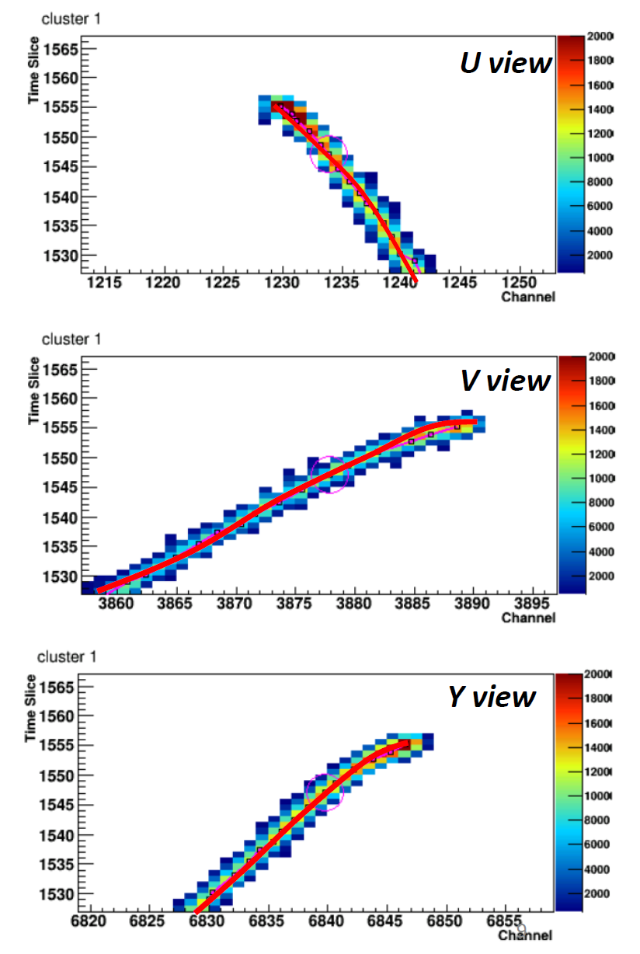
Seed in Trajectory Fitting
Seed is crucial to limit the number of DOF (degrees of freedom) and the define the region of interest for each charge-weighted center
(low-threshold) 3D points are ordered in a graph
Shortest path (between two points) in a graph gives the initial guess of the seed
Further refinement considering the high-charge points (Steiner-Tree, as gaps are expected)

Slide 24
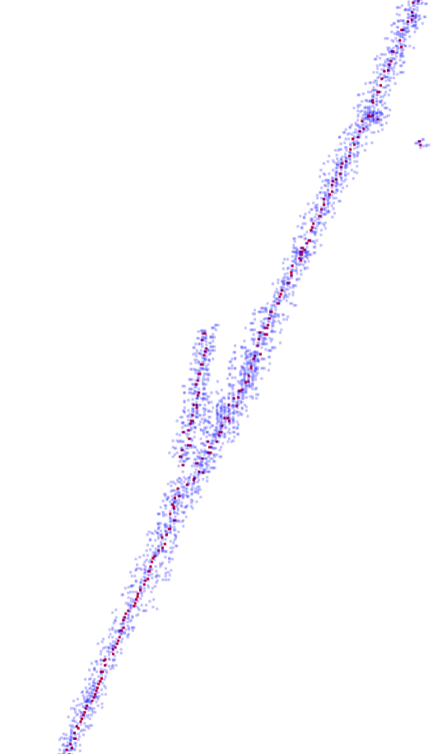
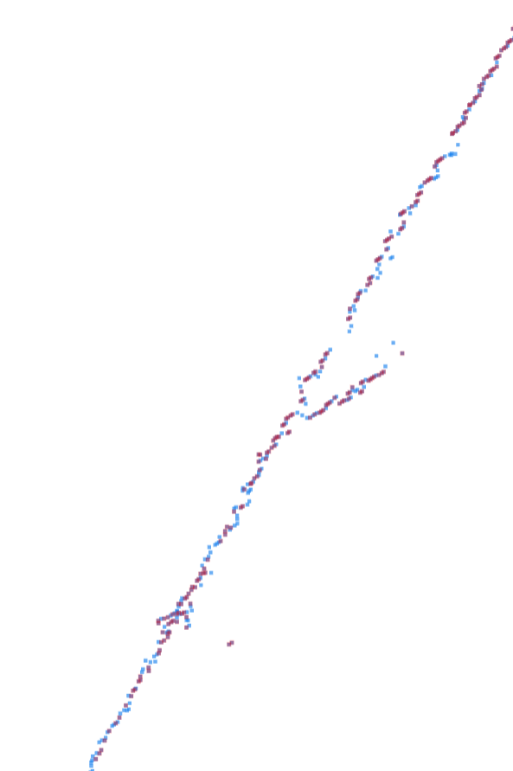
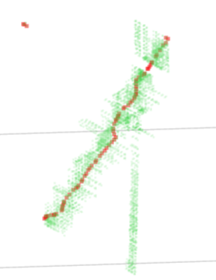
Examples of Seeds in Trajectory Fitting

Slide 25
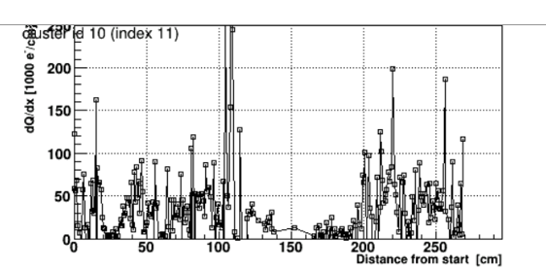
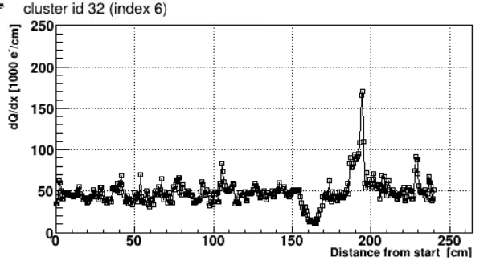
Example: Isochronous and Compact Track
Before Improvements
After Improvements
Compact in W view
U View
V View
Dead chs.
Dead chs.
In Progress

Slide 26
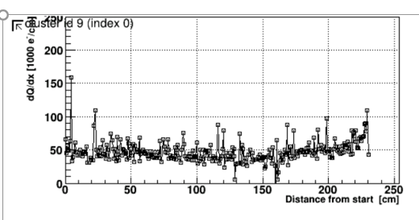
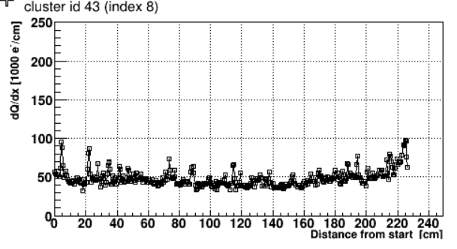
Example: Stopped Muon
Before Improvements
After Improvements
Bragg peak
U View
V View
Compact in W view
Dead chs.
U View
V View
W View
In Progress

Slide 27
Example: Proton Candidate
Before Improvements
After Improvements
V View
W view
U View
Dead chs.
In Progress

Slide 28
Example: Two vs. One MIP
Before Improvements
After Improvements
2 MIP
1 MIP
U View
V View
W view
Dead chs.
In Progress

Slide 29
Summary of Wire-Cell Reconstruction
LArTPC Signal Formation
Noise filtering and Signal Processing
3D Imaging
Improved TPC signal simulation (long-range and fine-grain)
deconvolving
Robust usage of induction wire planes
tiling
slicing
Trajectory and dQ/dx fitting for PID
JINST 12 P08003
JINST 13 P07006, P07007
2D projections→3D problem independent of event topology
solving
TPC/Light Matching
Precision PID?
fitting
Charge/Light matching
matching
clustering
3D pattern recognition
recognizing
Need to revisit
MicroBooNE neutrino selection paper under preparation
JINST 13, P05032
MicroBooNE imaging paper under preparation

