Slide 1

Event Classification using Neural Networks in DUNE
Saúl Alonso-Monsalve
CERN
(for the DUNE Collaboration)
Workshop on Reconstruction and Machine Learning in Neutrino Experiments
17/09/19

Slide 2
The DUNE Experiment
DUNE is a next-generation neutrino oscillation experiment.
Far Detectors (FD) are 800 miles from the neutrino beam source.
  Four modules, each with 10,000 ton of liquid argon.
High power muon neutrino beam produced at Fermilab.
  Can switch polarity to produce a muon antineutrino beam.
Look for the appearance of electron (anti)neutrinos at the FD.
  Measure CP-violation.
NB: I will only write neutrino from now on,
but the same is applicable for antineutrinos

Slide 3
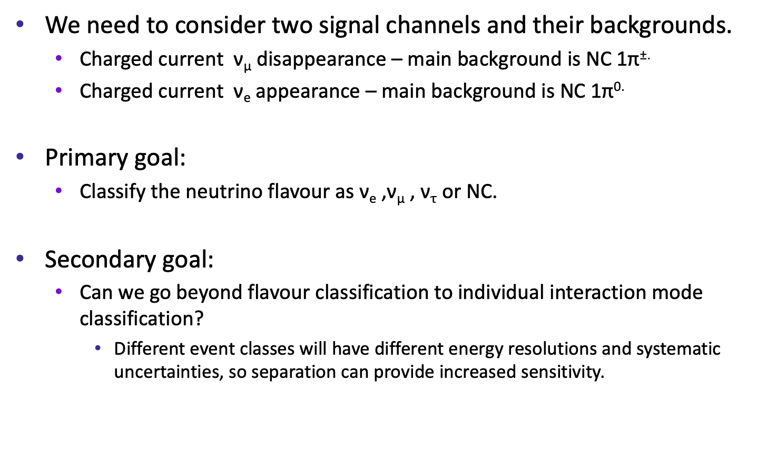
Ingredients for the CP-violation analysis
We need to consider two signal channels and their backgrounds.
  Charged current ν_{μ} disappearance – main background is NC 1π±.
  Charged current ν_{e} appearance – main background is NC 1π^{0.}
Primary goal:
  Classify the neutrino flavour as ν_{e} ,ν_{μ} , ν$τ$ or NC.
Secondary goal:
  Can we go beyond flavour classification to individual interaction mode classification?
    Different event classes will have different energy resolutions and systematic uncertainties, so separation can provide increased sensitivity.
( − )
( − )

Slide 4
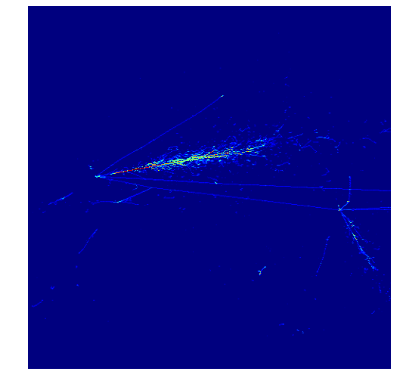
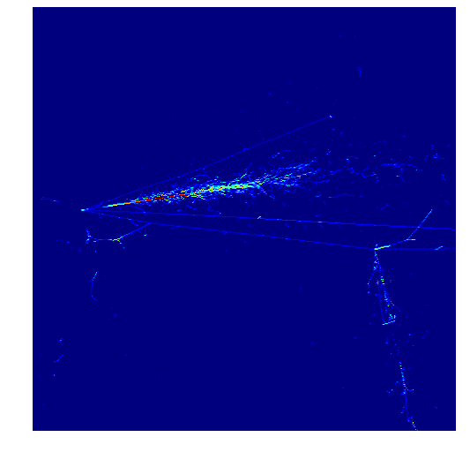
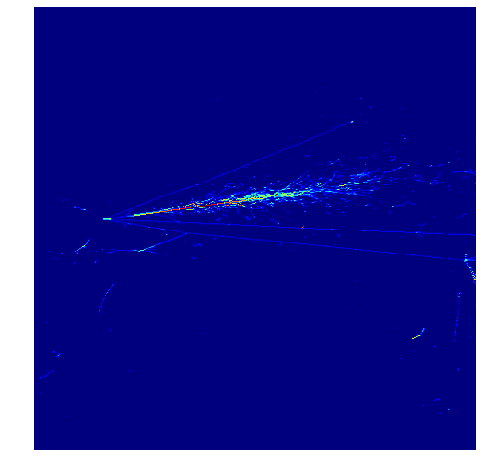
Far Detector Data
The Far Detectors contain three wire readout planes.
  This provides three “images” of each neutrino interaction.
Official simulated electron neutrino interaction (signal).
Time
Wire
Charge

Slide 5
Far Detector Data
The Far Detectors contain three wire readout planes.
  This provides three “images” of each neutrino interaction.
Official simulated electron neutrino interaction (signal).
Electron produces the highlighted shower, beginning at the vertex.
Electron
Electron
Electron
Time
Wire
Charge

Slide 6
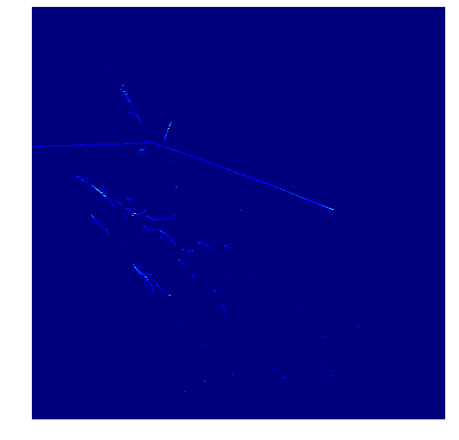
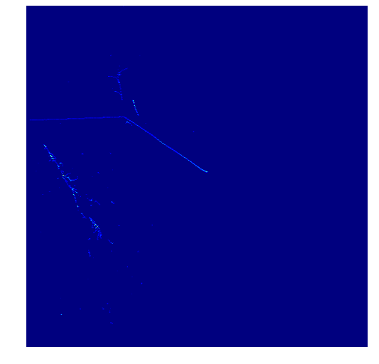
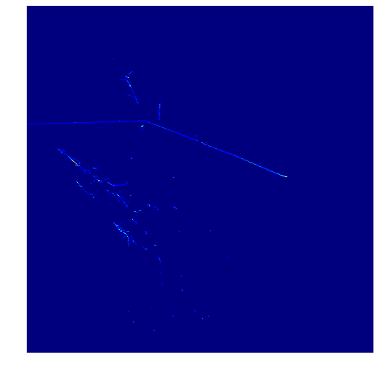
Far Detector Data
The Far Detectors contain three wire readout planes.
  This provides three “images” of each neutrino interaction.
Official simulated neutral current π⁰ interaction (background).
Time
Wire
Charge

Slide 7
Far Detector Data
The Far Detectors contain three wire readout planes.
  This provides three “images” of each neutrino interaction.
Official simulated neutral current π⁰ interaction (background).
π⁰ decay photon showers are displaced from vertex.
π⁰ decay photons
π⁰ decay photons
(overlapped)
π⁰ decay photons
Time
Wire
Charge

Slide 8
Image Recognition
Fine-grained detail of LArTPCs lends itself to image recognition.
The human eye is a remarkably good image recognition tool.
  Once you know what to look for, it is fairly easy to find distinguishing features of different types of interactions.
Realistically, the experiment will produce too much data for scanning the interactions by eye.
We need to be able to train a computer to do this task.
  Recent years have shown rapid development of automated image recognition. One of the most promising approaches is the Convolutional Neural Network (CNN).

Slide 9
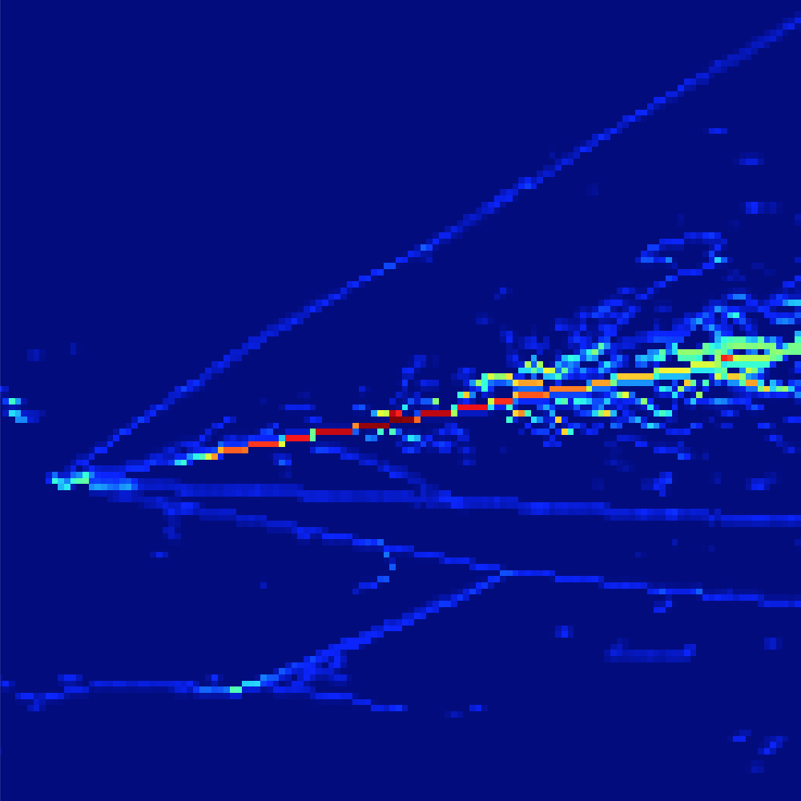
Convolutional Neural Networks
CNNs are used to classify images by applying filters to small patches of the image (using a convolution).
Scans over the image with a number of N x N pixel filters.
Each filter extracts some feature from the image.

Slide 10
Convolutional Neural Networks
CNNs are used to classify images by applying filters to small patches of the image (using a convolution).
Scans over the image with a number of N x N pixel filters.
Each filter extracts some feature from the image.
For example, filter 1 may find tracks.

Slide 11
Convolutional Neural Networks
CNNs are used to classify images by applying filters to small patches of the image (using a convolution).
Scans over the image with a number of N x N pixel filters.
Each filter extracts some feature from the image.
For example, filter 1 may find tracks.

Slide 12
Convolutional Neural Networks
CNNs are used to classify images by applying filters to small patches of the image (using a convolution).
Scans over the image with a number of N x N pixel filters.
Each filter extracts some feature from the image.
For example, filter 1 may look for tracks.
Filter 2 might look for showers.

Slide 13
Convolutional Neural Networks
The output from each filter then forms the basis of the next layer which can include further filters.
Different architectures can be considerably more complex than the above toy example.
Input image
Filters
Pooling
(Merge neighbouring pixels)
Filters
Pooling
Fully connected layers
Output

Slide 14
DUNE CVN introduction
The DUNE Convolutional Visual Network (CVN) is a CNN used for the neutrino identification task.
  The initial DUNE CVN was based on the NOvA implementation from 2016 (arXiv:1604.01444).
In the last year we have moved to a completely new architecture and framework.
  We now use a SE-ResNet^{[1,2]} based architecture.
  Helps preserve the fine-grained detail deeper into the network.
Residual Connection
Convolution
and
Pooling
Convolution
and
Pooling
Convolution
and
Pooling
[1] H. Kaiming et al., Deep residual learning for image recognition, CoRR, arXiv 1512.03385, 2015
[2] J. Hu et al., Squeeze-and-Excitation Networks, arXiv 1709.01507, 2017

Slide 15
Architecture Overview
Primary output:
Flavour identification
First few layers treat the three views separately
Each input image is 500 x 500 pixels in size

Slide 16
Architecture Overview
Neutrino / antineutrino
First few layers treat the three views separately
Secondary outputs:
Particle counting for exclusive final states
Each input image is 500 x 500 pixels in size

Slide 17
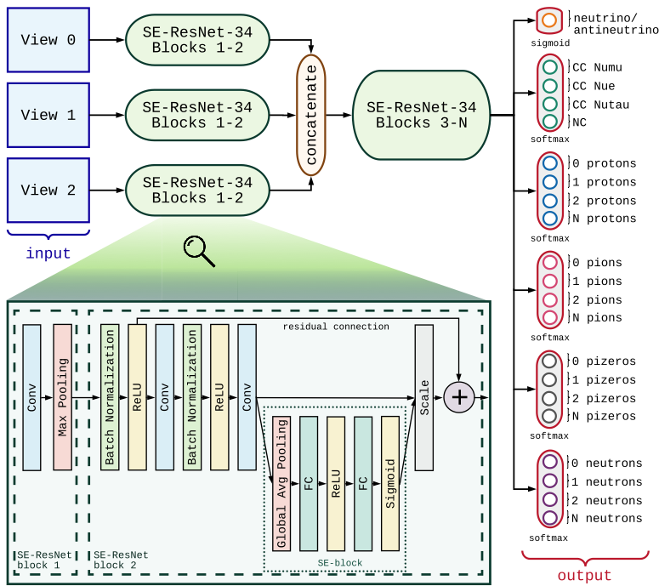
Architecture Overview
Neutrino / antineutrino
Primary output:
Flavour identification
Secondary outputs:
Particle counting for exclusive final states

Slide 18
Training and using the CNN
Use millions of images (~10M images) of simulated neutrino interactions with the true neutrino flavour known.
  Allows the CNN to learn the features of each type of neutrino interaction.
  The CNN filters are not predefined – it needs to learn which filters to use to extract the information required to classify events.
  Tested on a fully independent sample.
Once the CNN is trained it is applied to images with no truth information attached – eventually the experimental data.
The CNN gives probabilities for each event to be the following:
  Charged-current and neutral-current (all flavours).
  Outputs sum to one.
  Use these probabilities for the event selection.

Slide 19
Training and using the CNN
We have trained and tested the network on a very powerful machine (x8 NVIDIA Tesla V100 GPUs).
Loss and accuracy:

Slide 20
Visualisations of the feature extraction
_
Example: 12.2 GeV CC ν_{e} interaction.
Top box demonstrates the output from the first convolutional layer of the first branch of the network.
The bottom box shows the 512 feature maps produced by the network’s final convolutional layer.

Slide 21
Selecting Electron Neutrinos
Electron neutrino probability spectra from the DUNE CVN.
  Curves combine neutrinos and antineutrinos.

Slide 22
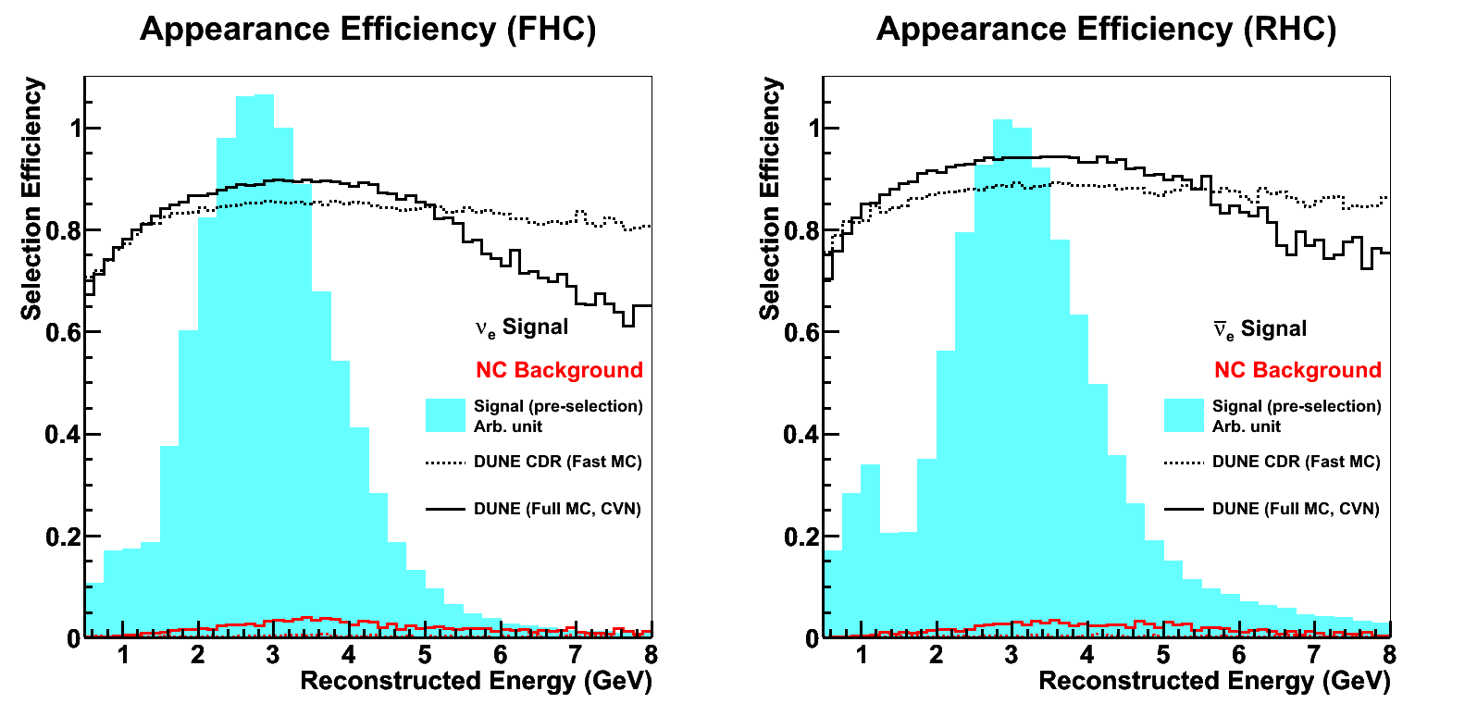
Electron Neutrino Efficiency
Select all events that are more than 85% likely to be electron neutrinos.
Over 90% selection efficiency in the flux peak.
Efficiency better for antineutrinos due to typically cleaner final state (neutron instead of proton).

Slide 23
Selecting Muon Neutrinos
Muon neutrino probability spectra from the new CVN.
  Curves combine neutrinos and antineutrinos.

Slide 24
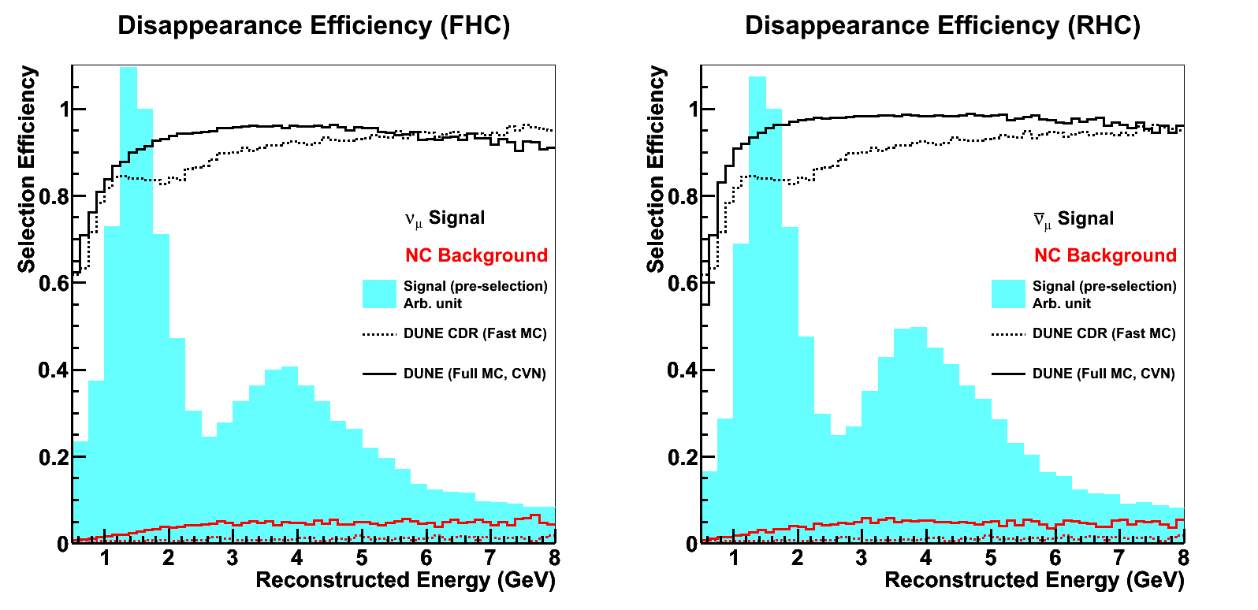
Muon Neutrino Efficiency
Select all events that are more than 50% likely to be muon neutrinos.
Over 90% selection efficiency in the flux peak.
Efficiency better for antineutrinos due to typically cleaner final state (neutron instead of proton).

Slide 25
CP-Violation Sensitivity – Dec 2018
Same selection criteria:
  ν_{e} selection: P(ν_{e}) > 85%.
  ν_{μ} selection: P(ν_{μ}) > 50%.
Exceeded the DUNE conceptual design report sensitivity.
  Very big milestone for DUNE!

Slide 26
Robustness
We will use ProtoDUNE-SP to test the CVN on real data.
  There are no neutrinos at ProtoDUNE-SP, but we can use single particle extracted from events to approximate simple neutrino interactions.
Select individual reconstructed objects and pass into the CVN.
  Cosmic muon tracks mimic CCQE ν_{μ} interactions.
  Beam electron showers mimic CCQE ν_{e} events.
  The CVN should return classifications of CC ν_{μ} and CC ν_{e} with no hadronic
  system, respectively.
We will also use fake data studies to ensure robustness against systematic effects, including those from alternative event generators.

Slide 27
Other Machine Learning Applications: DUNE photon simulation
Current DUNE photon simulation:
  Input parameters: x, y, z.
  Output: photon detector system as a 6x20 pixel image, where each pixel gives the visibility of one photon detector.
In the current simulation, the entire geometry is stored in memory.
  The current library is too big to store in memory.
  The idea is to have higher resolution and cover a larger volume, both of which will make it impossibly large.
The approach is to try the fast-simulation segment from our Model-Assisted GAN (arXiv:1812.00879) to speed things up.
Trained 3M images.

Slide 28
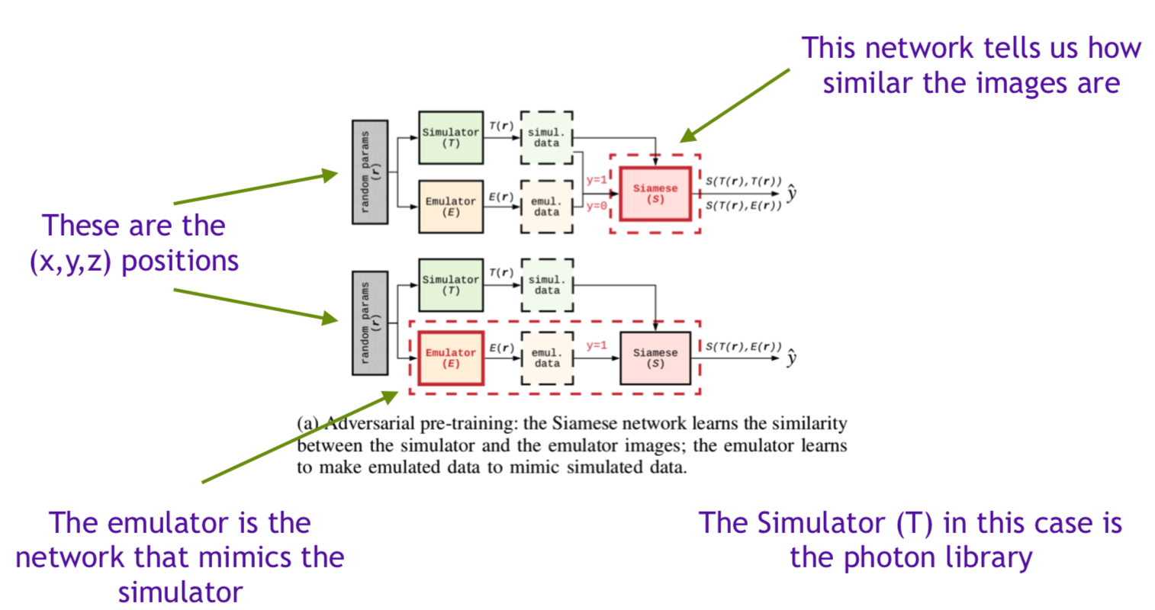
Other Machine Learning Applications: DUNE photon simulation
The procedure follows the pre-training stage of the MAGAN:

Slide 29
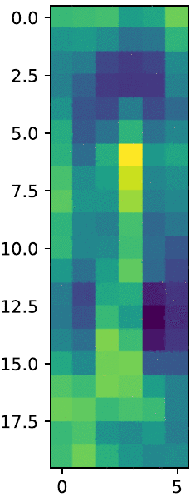
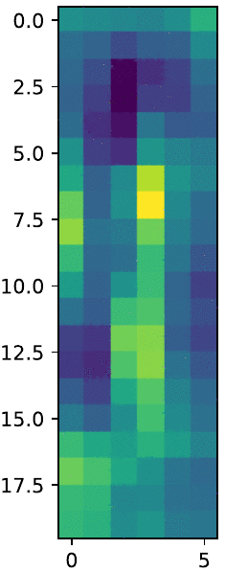
Other Machine Learning Applications: DUNE photon simulation
Example 1:
Example 2:
Training process
GAN output (8K iter.)
Simulated
Training process
GAN output (8K iter.)
Simulated
Time
Wire
Saúl Alonso-Monsalve

Slide 30
Other Machine Learning Applications: ProtoDUNE track vs shower identification
The approach is to use the GraphSAGE algorithm (arXiv:1706.02216) to label track vs shower hits in ProtoDUNE 3D images.
  Each image is internally stored as a graph.
    Graphs are much smaller than images (less size on disk).
    Neighbourhood (adjacency) can be used during the learning process.
  Model has a constant number of parameters.
    Training on graphs of different sizes.
    Inference on unseen graphs (graphs that were not seen during the training).
  Can be applied to any node of the graph.

Slide 31
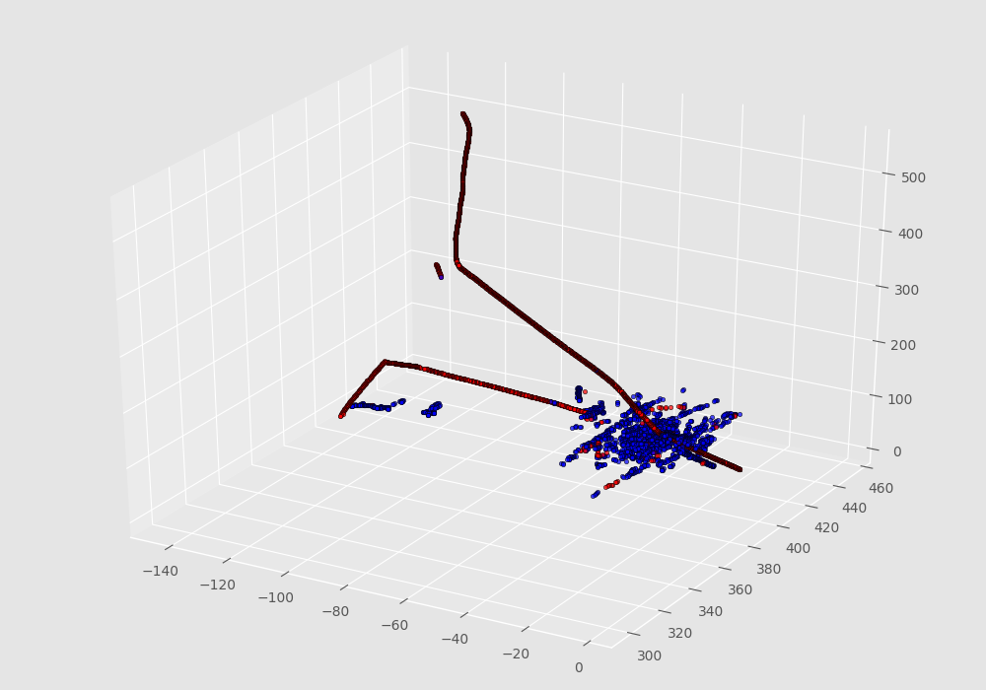
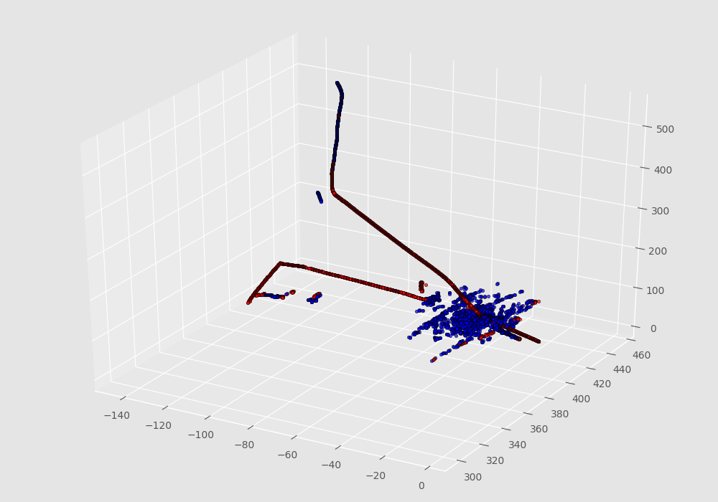
Other Machine Learning Applications: ProtoDUNE track vs shower identification
  Example:
  Red: track hits. Blue: shower hits.
true
predicted

Slide 32
Summary
The DUNE CVN provides powerful neutrino interaction flavour classification.
  Already working on demonstrating good performance of exclusive final-states in the coming months.
ProtoDUNE provides an excellent opportunity to test the CVN on data using single particles to mimic simple neutrino interactions.
Further improvements will provide diminishing returns on the experimental sensitivity.
  The focus now shifts to ensuring robustness and equal performance when applied to data and simulation.
Other Machine Learning work:
  Model-Assisted GAN for DUNE photon simulation.
  Graph neural network for ProtoDUNE track vs shower identification.
  See Jianming’s talk about energy regression and vertex reconstruction.

Slide 33
Backup Slides

Slide 34
Selecting Electron Neutrinos
Electron neutrino probability spectra from the DUNE CVN.
  Curves combine neutrinos and antineutrinos.
Neutrino beam
Antineutrino beam

Slide 35
Selecting Electron Neutrinos
Electron neutrino probability spectra from the DUNE CVN.
  Curves combine neutrinos and antineutrinos.
Neutrino beam
Antineutrino beam

Slide 36
Electron Neutrino Efficiency
Select all events that are more than 85% likely to be electron neutrinos.
Over 90% selection efficiency in the flux peak.
Efficiency better for antineutrinos due to typically cleaner final state (neutron instead of proton).

Slide 37
Selecting Muon Neutrinos
Muon neutrino probability spectra from the new CVN.
  Curves combine neutrinos and antineutrinos.
Neutrino beam
Antineutrino beam

Slide 38
Selecting Muon Neutrinos
Muon neutrino probability spectra from the new CVN.
  Curves combine neutrinos and antineutrinos.
Neutrino beam
Antineutrino beam

Slide 39
Muon Neutrino Efficiency
Select all events that are more than 50% likely to be muon neutrinos.
Over 90% selection efficiency in the flux peak.
Efficiency better for antineutrinos due to typically cleaner final state (neutron instead of proton).

