Slide 1
Laser diagnostics
Christian Rödel, Matt Zepf
Helmholtz-Institute Jena
LUXE meeting at DESY, 8.11.2018
Notes:
generelle Sprachwahl

Slide 2
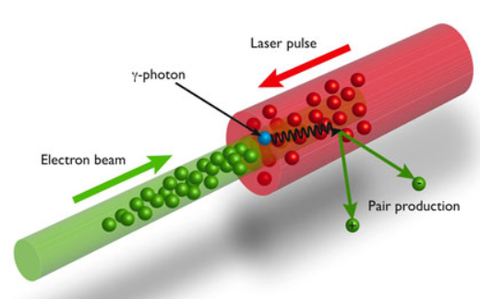

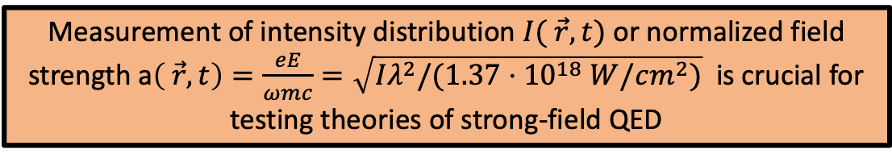
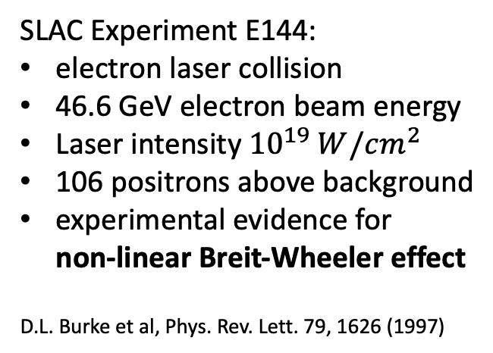
Motivation
SLAC Experiment E144:
electron laser collision
46.6 GeV electron beam energy
Laser intensity ${10}^{19} W/cm^{2}$
106 positrons above background
experimental evidence for
non-linear Breit-Wheeler effect
D.L. Burke et al, Phys. Rev. Lett. 79, 1626 (1997)
Measurement of intensity distribution $I( \vec{r},t)$ or normalized field strength a$\left( \vec{r},t\right)=\frac{eE}{ωmc}=\sqrt{Iλ^{2}/(1.37⋅{10}^{18} W/cm^{2})}$ is crucial for testing theories of strong-field QED
Notes:
pure photon photon colllider

Slide 3
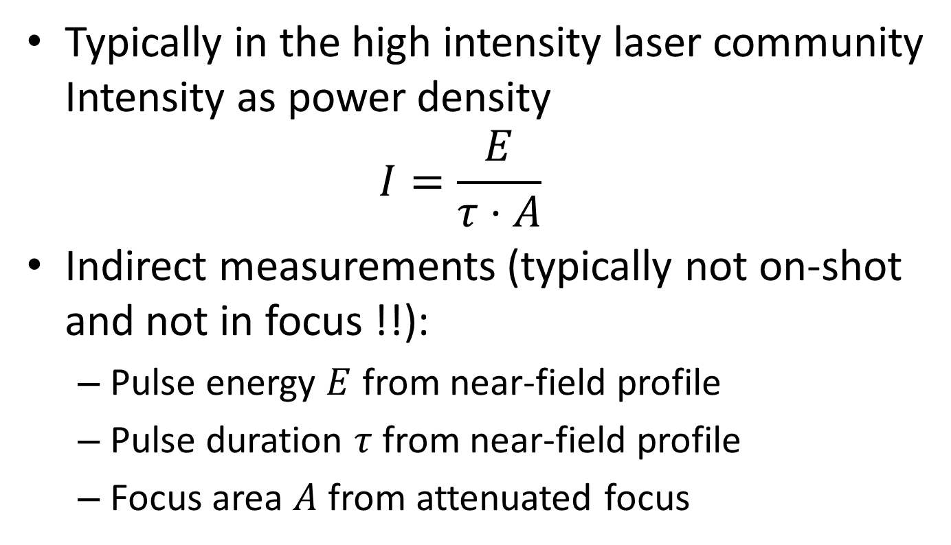
Intensity measurement
Typically in the high intensity laser community
Intensity as power density
$I=\frac{E}{τ⋅A}$
Indirect measurements (typically not on-shot and not in focus !!):
  Pulse energy $E$ from near-field profile
  Pulse duration $τ$from near-field profile
  Focus area $A$ from attenuated focus

Slide 4
Intensity measurement
Near-field measurements
Near field diag
Attenuated duplicated
Laser pulse
High intensity laser pulse
few J
30 fs
15 cm beam diameter
Turning mirror
leakage
Far field diag
Movable far field diagnostics
Off axis
parabolic mirror
F/#=2
Focal length = 30 cm
Electron beam
Gamma beam

Slide 5
Intensity measurements
1st step: on-shot near-field characterization
  Measurement of near-field profile (leakage of turning mirror) -> telescope and camera, get pulse energy and near-field distribution
  Measurement of pulse duration from nearfield (leakage, pick off mirror ?) -> “Spider”, “FROG”, “Wizzler”, etc.
  Measurement of wavefront, angular chirp and other spatiotemporal couplings of the light field (leakage ?) -> wavefront sensor (e.g. Phasics “SID4”), field correlator

Slide 6
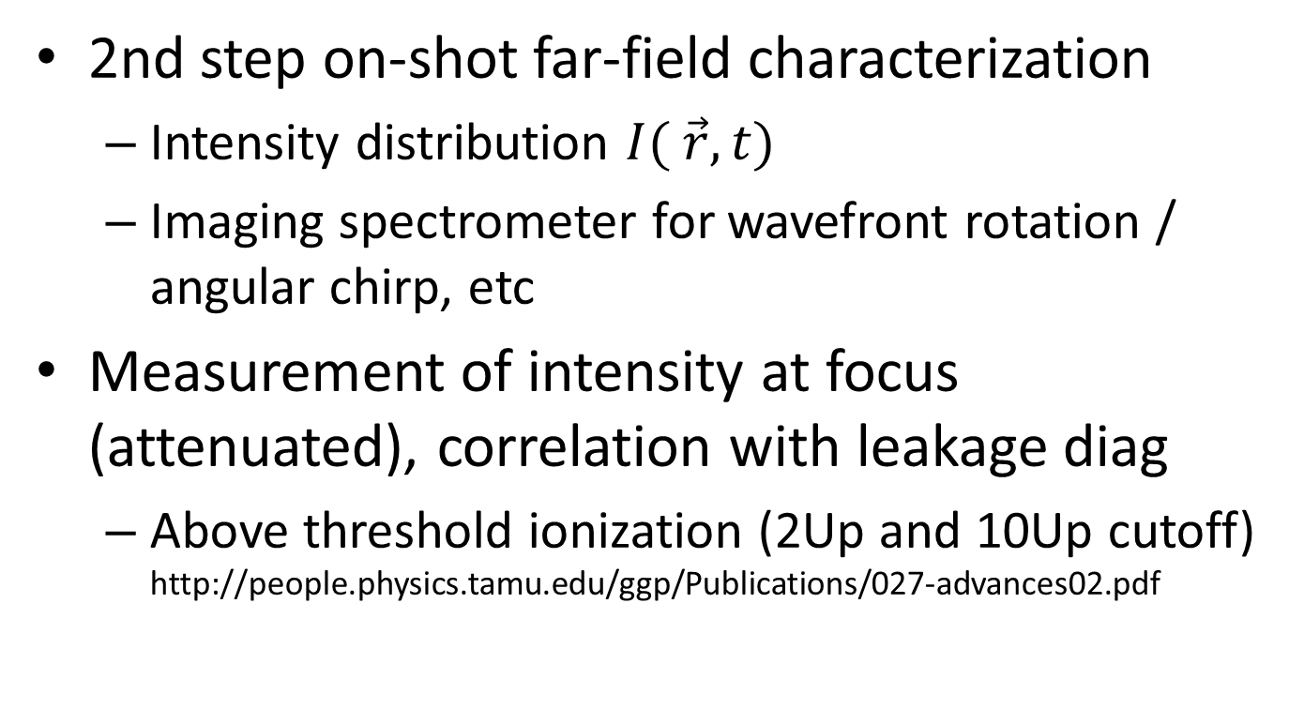
Intensity measurements
2nd step on-shot far-field characterization
  Intensity distribution $I( \vec{r},t)$
  Imaging spectrometer for wavefront rotation / angular chirp, etc
Measurement of intensity at focus (attenuated), correlation with leakage diag
  Above threshold ionization (2Up and 10Up cutoff)
  http://people.physics.tamu.edu/ggp/Publications/027-advances02.pdf
Photoelectrons
(log scale)
2Up
10Up

Slide 7
Experimental a₀ diag
Gamma ray profile gives a₀ (W. Yan et al, Nature Photonics 11, 2017)

Slide 8
Experimental a₀ diag
Transverse spreading of electrons in high-intensity laser fields
  Green, Harvey, Phys. Rev. Lett. 112, 164801 (2014)
  shoulder of electrons might provide a₀ and QED effects

Slide 9

Experimental a₀ diag
Measuring the gamma spectrum of Compton scattered photons
  Problem of building a good spectrometer in the gamma range (MeV), CsI stack ?
  Maybe calorimeter and low charge mode ?
$${ℏω}_{C}=\frac{4γ^{2}ℏω_{L}}{1+\frac{a_{0}^{2}}{2}}$$

Slide 10
Conclusion
Diagnosing high intensity laser pulses is not trivial and requires some dedicated work
Much experience in the Helmholtz Association
of diagnosing high intensity laser pulses:
Andi Mayer (DESY), Uli Schramm (HZDR), Malte Kaluza (HI Jena), Christian Rödel (HI Jena), Matt Zepf (HI Jena), Vincent Bagnoud (GSI Darmstadt), Toma Toncian (XFEL), ...
Kick-off meeting of experts from the high intensity laser community required -> beginning of next year

