Slide 1
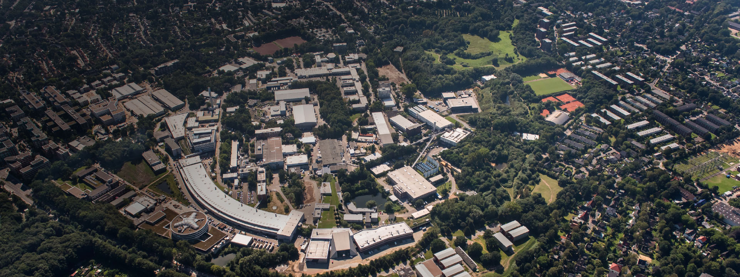
MKK High Availability
Final version
Jörg Eckoldt for the entire team
Travemünde, 22.02.2019

Slide 2
Topics
What did we did/do to increase the reliability
01 The good old days …
When did the investigation start?
Data from HERA
Conclusions drawn
02 Maintenance
How do we do it
Predictive Maintenance
03 Data collection/statistics
Bieler list
Electronic logbook
Statistics
04 Quality control
Test stand
05 Future plans
Education of shift personal
06 Was it worth the hassle?
Comparison of old and new

Slide 3
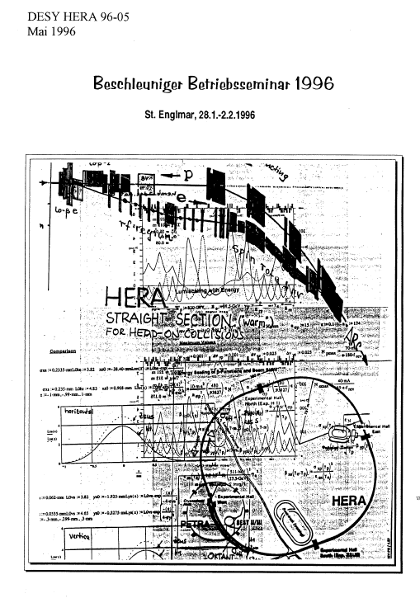
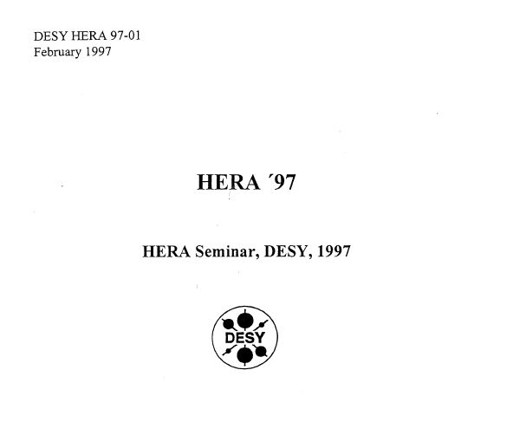
Reliability in 1995+1996
Betriebsseminar St. Englemar + ??

Slide 4
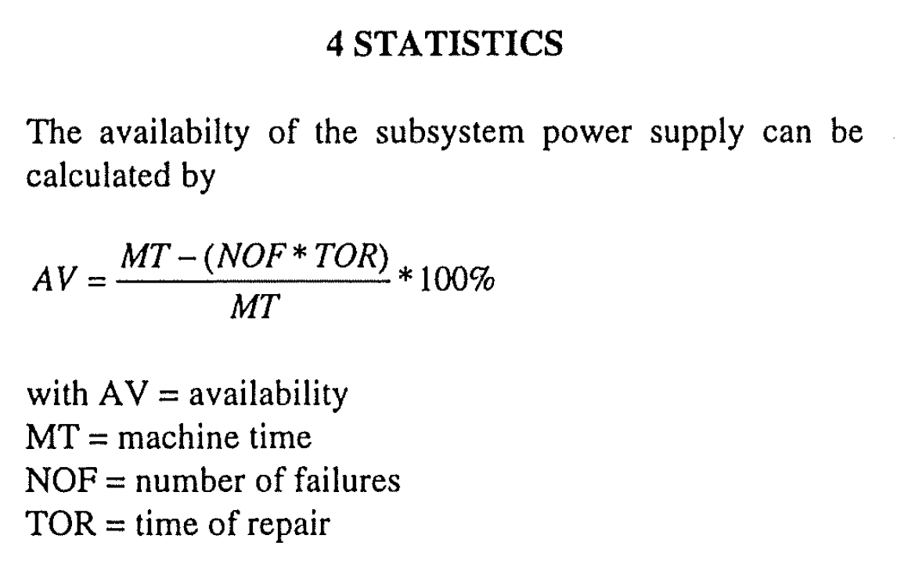
Reliability
Definition from the 90ths
+ magnet cycling

Slide 5
Reliability
Definition from the 90ths
Make all three as small as possible, but how
+ magnet cycling

Slide 6
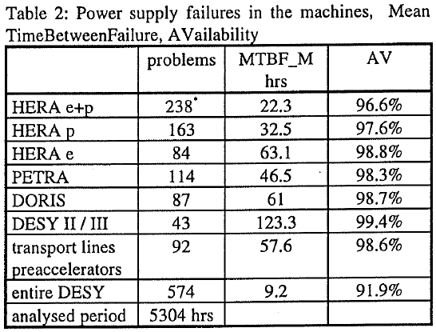
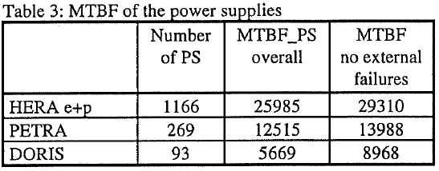
HERA Reliability
Data 1996
Different counting: every failure was counted when the shift was active.
Also commissioning and testing

Slide 7
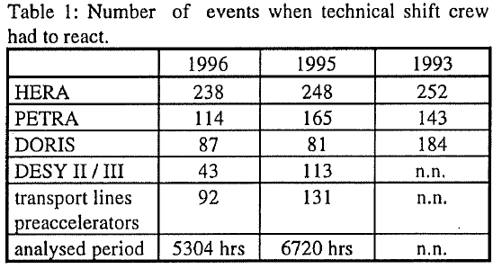
HERA Reliability
A certain number of components have a somewhat constant failure rate

Slide 8
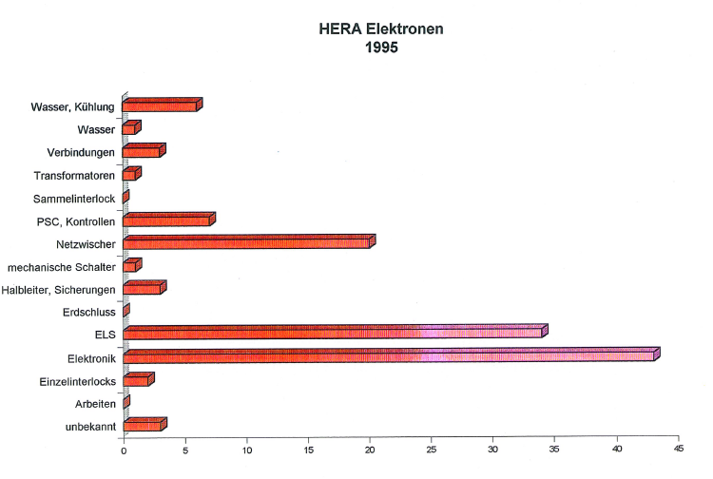
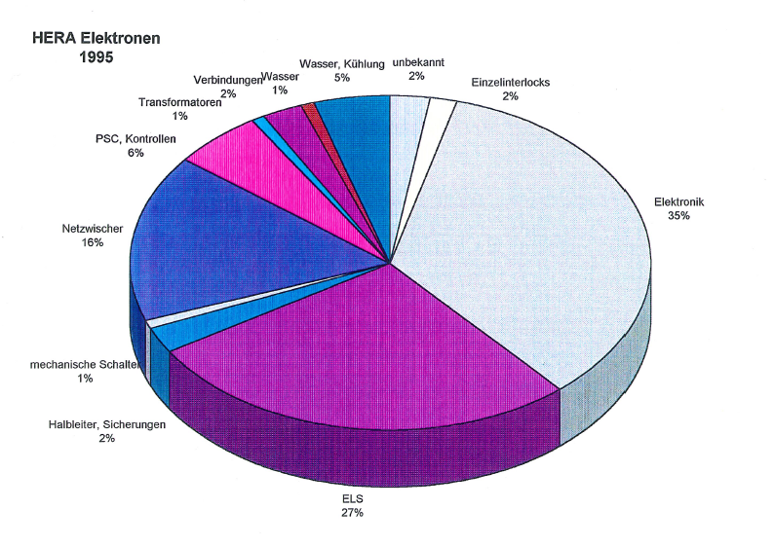
Statistics to find the best knob to turn
The ELS failure lead to a replacement of all semiconductor switches

Slide 9
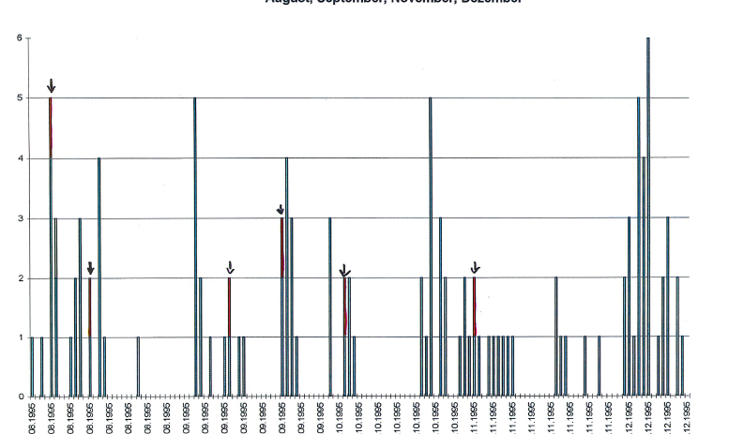
Failures over time
In Red mains undervoltage

Slide 10
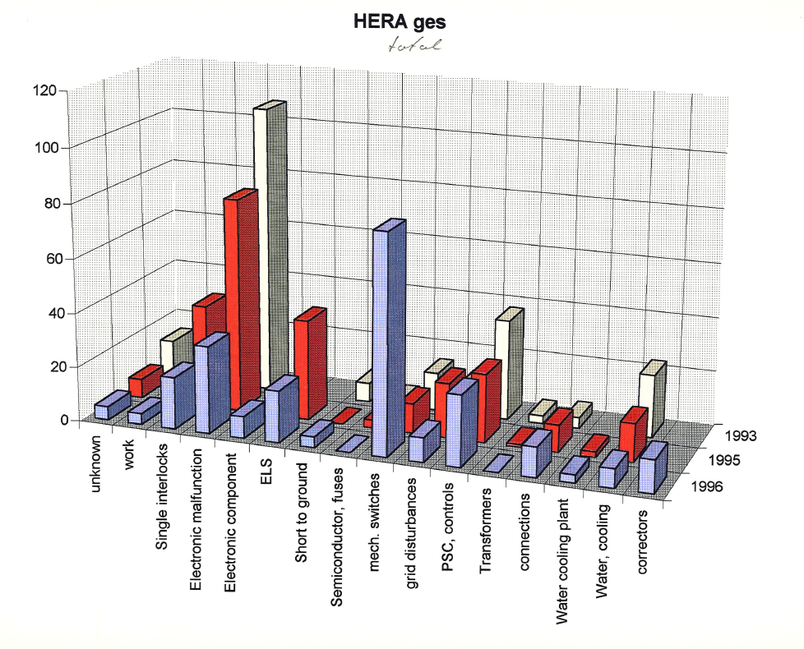
Failure development of PS in HERA
Electronic failures show the development of childhood desease

Slide 11
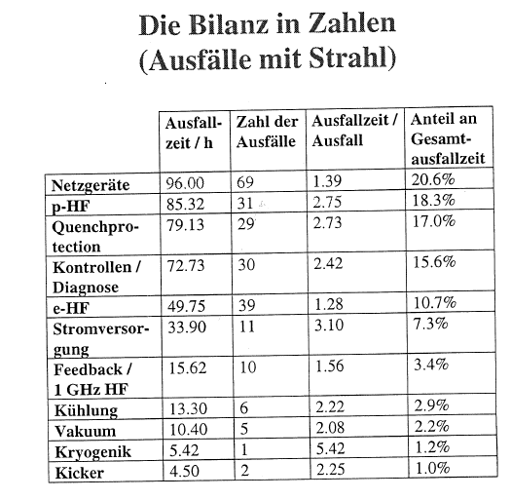
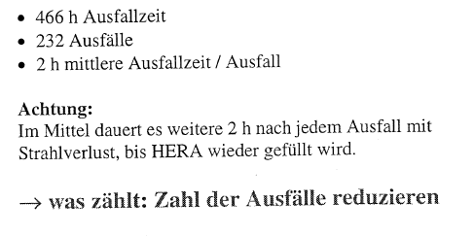
HERA-Reliability in 1996
Betriebsseminar HERA
HERA
Power supplies were already at that
time a well known reason for
failures

Slide 12
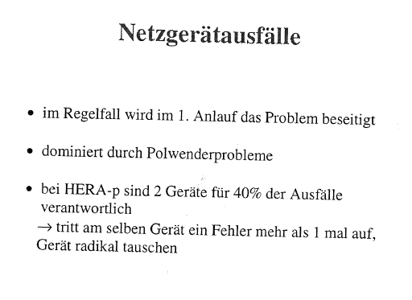
HERA-Reliability in 1996
Conclusion R. Bacher
HERA

Slide 13
Maintenance

Slide 14
Maintenance
No regular maintenance is done in the sense of oil-change in a car
The available time to do maintenance work at the supplies is getting shorter due to the demands of the user and machine
  During the maintenance day usually the time is just sufficient to replace broken components.

Slide 15
What to do instead?
Failure analysis
  Each failure is written into the electronic logbook and analyzed
  By this series failures can be detected
    One series failure was an auxiliary power supply that started to fail after 3 years of operation.
    All auxiliary power supplies (600) were replaced during this shutdown
    This took 8 weeks ( a work that cannot be done during the maintenance days)
    Shortly afterwards a new failure appeared by a bad contact
Remote access and scans of data with the digital regulation
  Eg. Ripple, temperatures
  Big advantage is that this can be done during the machine operation
  (when there will be the next for PETRA or first XFEL run)
  When a „strange“ supply is detected, it will be replaced during the maintenance day and examined in the test stand

Slide 16
Work during long shut-downs
Test Grounding switches,
Check of screw connections
Check of accuracy of current and voltage values
Calibration of DCCTs if necessary
Scans of control electronics
Emergency off-Test :
  Has to be done regularly
Check ofWater components
  Magnet valves
  Hoses, leaks

Slide 17
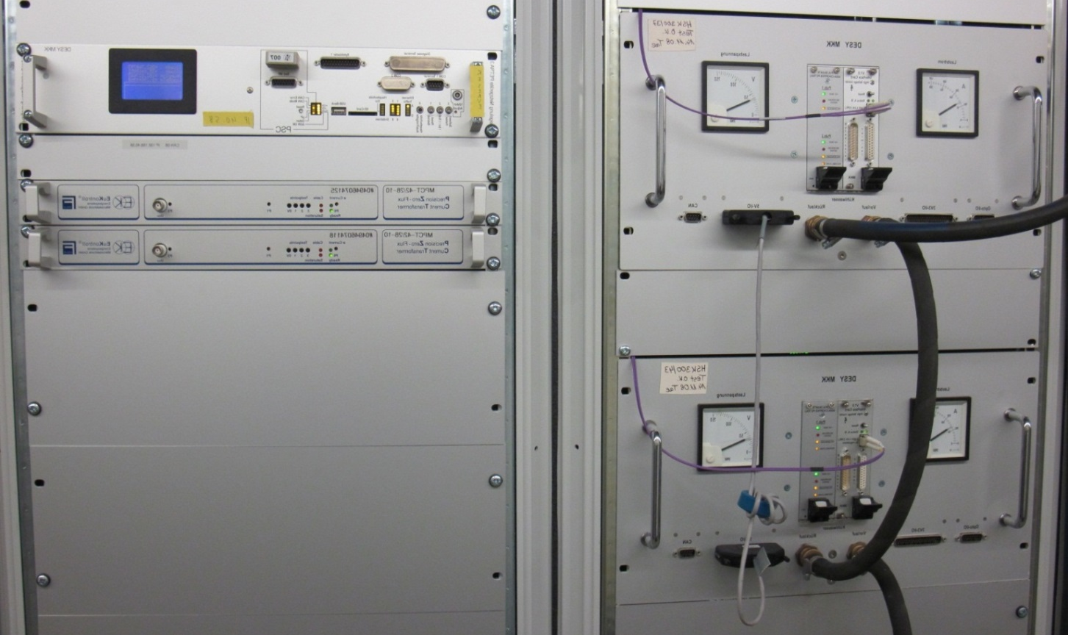
Assembly of power supply
Digital Regulation electronic
DCCT1
DCCT2
Power part with Interfacecard

Slide 18
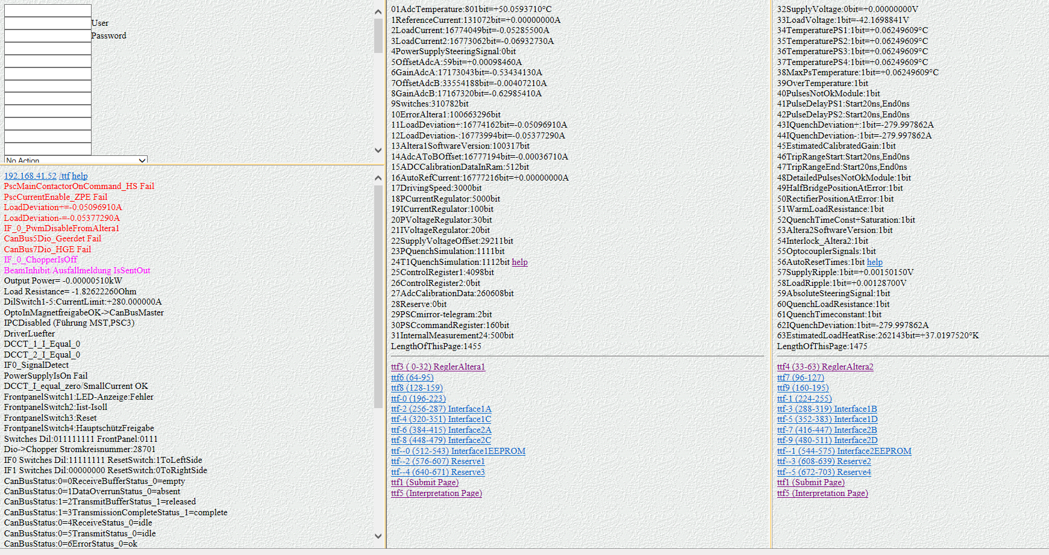
Homepage of a PS
About 500 signals can be read out

Slide 19
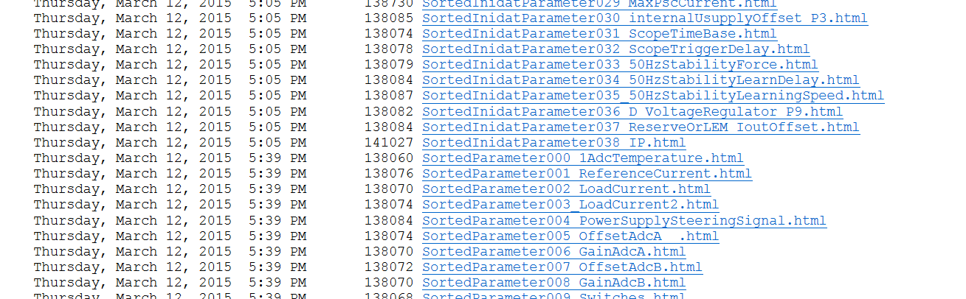
Scan Tool
Readout of data and values from the digital regulation
With the help of the Scan-Tool, it is possible to read values of the entire PETRA machine within 15 min.. This data can then be imported to into Excel-sheets and analysed

Slide 20
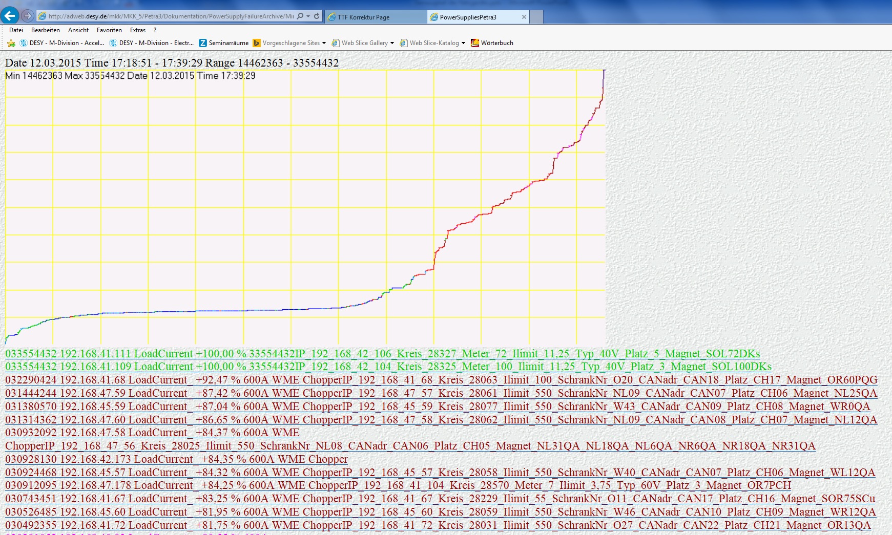
Scan Results
Deviation of load currents

Slide 21
Result of a scan
To-Do list for the workshops
[Request timed out] - 192.168.151.212
[Request timed out] - 192.168.151.240
192.168.41.65 schlechte Werte
192.168.41.127 schlechte Werte
---------------------------------------------------
Spannungsueberw12VRipple
http://192.168.53.168/ttf.htm
40V
87Spannungsueberwachung12V:49405bit=+12.0765094V
88Spannungsueberw12VRipple:1514bit=+0.37008060V
------------------------------------------------------
3V3
http://192.168.48.132/ttf.htm
200A
85Spannungsueberwachung3V3:40804bit=+3.11957186V
86Spannungsueberw3V3Ripple:206bit=+0.01574920V
119SpannungsueberwMax_3V3:40938bit=+3.12981651V
120SpannungsueberwMin_3V3:40535bit=+3.09900611V
http://192.168.45.53/ttf.htm
200A
85Spannungsueberwachung3V3:41448bit=+3.16880733V
119SpannungsueberwMax_3V3:41587bit=+3.17943425V
120SpannungsueberwMin_3V3:41150bit=+3.14602446V
---------------------------------------------------
Spannungsueberw12VRipple
http://192.168.43.68/ttf.htm
55A Kem
88Spannungsueberw12VRipple:1160bit=+0.28354920V
--------------------------------------------------
http://192.168.47.179/ttf.htm
600A
281Spannungsueberw1V2Ripple:2404bit
000002279 192.168.47.179 LoadCurrent__ +0,00_ % 600A WME ChopperIP192_168_47_179_Kreis_28823_Ilimit__Halle_Nord r._Magnet_NR 119QA_Optik_I_474_U_10,2_R_0
000001919 192.168.47.180 LoadCurrent__ +0,00_ % 600A WME ChopperIP192_168_47_180_Kreis_28824_Ilimit__Halle_Nord r._Magnet_NR 126QA_Optik_I_420_U_9,3_R_0
000001875 192.168.47.157 LoadCurrent__ -0,02_ % 200A ChopperIP192_168_47_157_Kreis_28815_Ilimit__Halle_Nord r._Magnet_NR 104PQK_Optik_I_160_U_20,1_R_0,1
000001809 192.168.41.56 LoadCurrent__ -0,02_ % 200A ChopperIP192_168_41_56_Kreis_28705_Ilimit__Halle_Ost_Magnet_OR 75PQK_Optik_I_123_U_14,1_R_0,1
000001787 192.168.42.179 LoadCurrent__ +0,00_ % 600A WME ChopperIP192_168_42_179_Kreis_28758_Ilimit__Halle_18_Magnet_OR 93PDE_Optik_I_402_U_26,7_R_0,1
000001766 192.168.42.175 LoadCurrent__ +0,00_ % 600A WME ChopperIP192_168_42_175_Kreis_28762_Ilimit__Halle_18_Magnet_OR 126QA_Optik_I_420_U_10,9_R_0
000001761 192.168.47.176 LoadCurrent__ +0,00_ % 600A WME ChopperIP192_168_47_176_Kreis_28819_Ilimit__Halle_Nord r._Magnet_NR 87PDD_Optik_I_275_U_18,2_R_0,1
---------------------------------------------------
http://192.168.47.179/ttf.htm
600A
283Spannungsueberw2V5Ripple:1621bit
000001621 192.168.47.179 LoadCurrent__ +0,00_ % 600A WME ChopperIP192_168_47_179_Kreis_28823_Ilimit__Halle_Nord r._Magnet_NR 119QA_Optik_I_474_U_10,2_R_0
000001388 192.168.41.55 LoadCurrent__ -0,02_ % 200A ChopperIP192_168_41_55_Kreis_28704_Ilimit__Halle_Ost_Magnet_OR 68PQK_Optik_I_142_U_15,9_R_0,1
000001302 192.168.41.56 LoadCurrent__ -0,02_ % 200A ChopperIP192_168_41_56_Kreis_28705_Ilimit__Halle_Ost_Magnet_OR 75PQK_Optik_I_123_U_14,1_R_0,1
000001277 192.168.45.72 LoadCurrent__ +0,00_ % 55A Kempower ChopperIP192_168_45_72_Kreis_28269_Ilimit__Halle_West_Magnet_WR 111S Cu_Optik_I_25_U_9,7_R_0,4
000001255 192.168.41.60 LoadCurrent__ -0,02_ % 200A ChopperIP192_168_41_60_Kreis_28709_Ilimit__Halle_Ost_Magnet_OR 85PQK_Optik_I_69_U_8,2_R_0,1
----------------------------------------------------

Slide 22
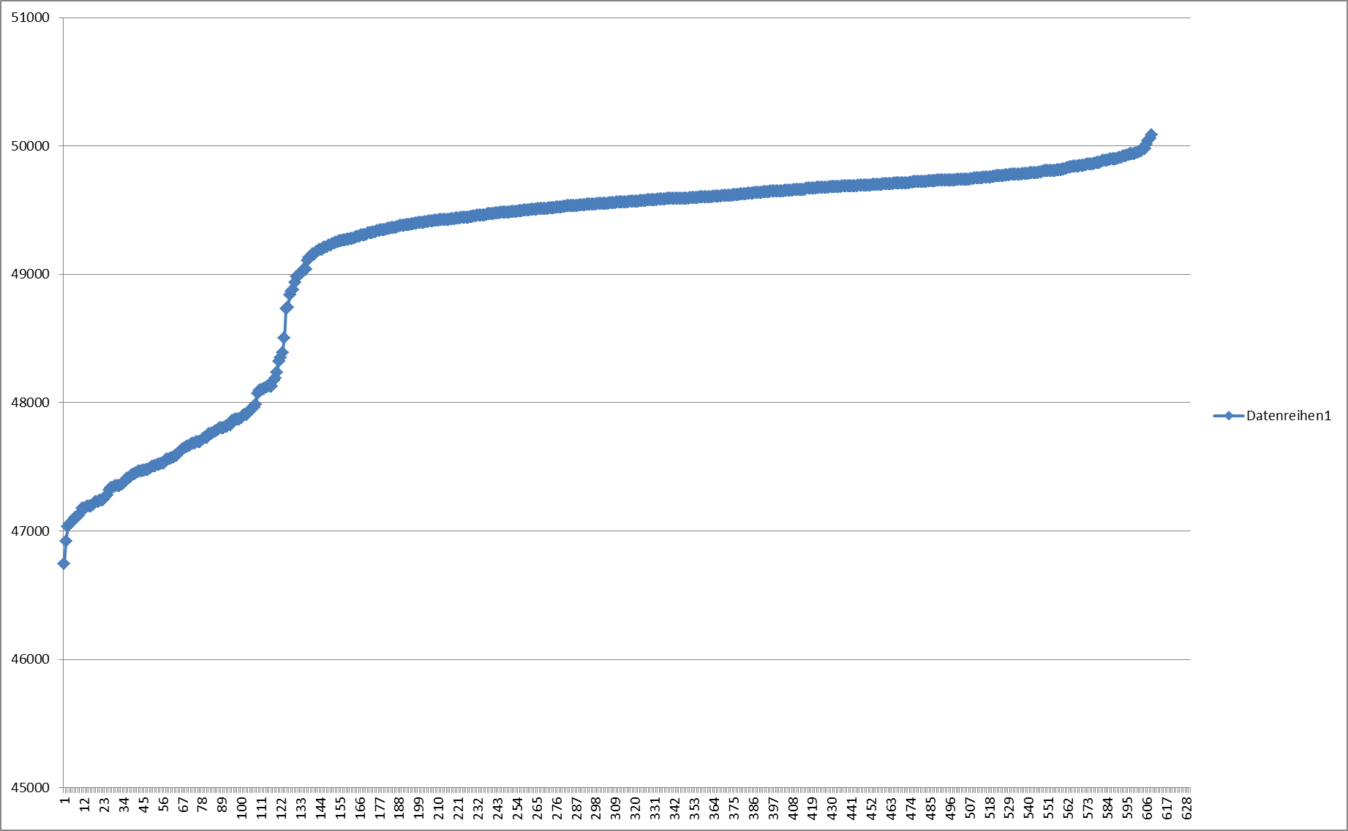
12 V auxiliary power supplies non conformity
Threshold of 12 V

Slide 23
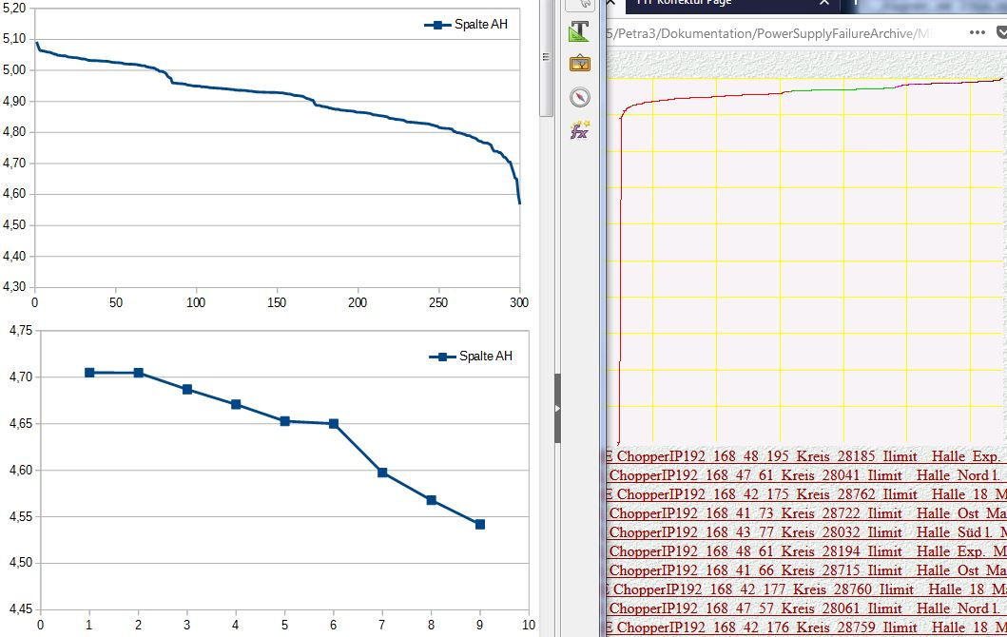
Scan of 5 V voltage inside the PS
10 PS müssen angesehen werden

Slide 24
Data Collection / Statistics

Slide 25
Bieler list
SYSTEM | SUM FAULTS | SUM TIME
ALL | 79 | 153:37:00
RF | 13 | 6:08:00
PS | 16 | 24:13:00
WK | 0 | 0:00:00
IL | 0 | 0:00:00
VAC | 3 | 3:04:00
INST | 2 | 34:29:00
SAFETY | 1 | 0:25:00
OP | 1 | 4:58:00
LINAC | 3 | 6:46:00
UNKNOWN | 5 | 2:33:00
SEKI | 0 | 0:00:00
POWER_GLITCH | 9 | 24:14:00
DESY | 2 | 5:15:00
FEEDBACK | 5 | 6:33:00
TIMING | 5 | 20:45:00
PIA | 1 | 2:01:00
LONG_INST | 0 | 0:00:00
INTL | 2 | 5:11:00
EXP | 10 | 6:36:00
SCHEDULED | 1 | 0:26:00
 | 79 | 153:11:00

Slide 26
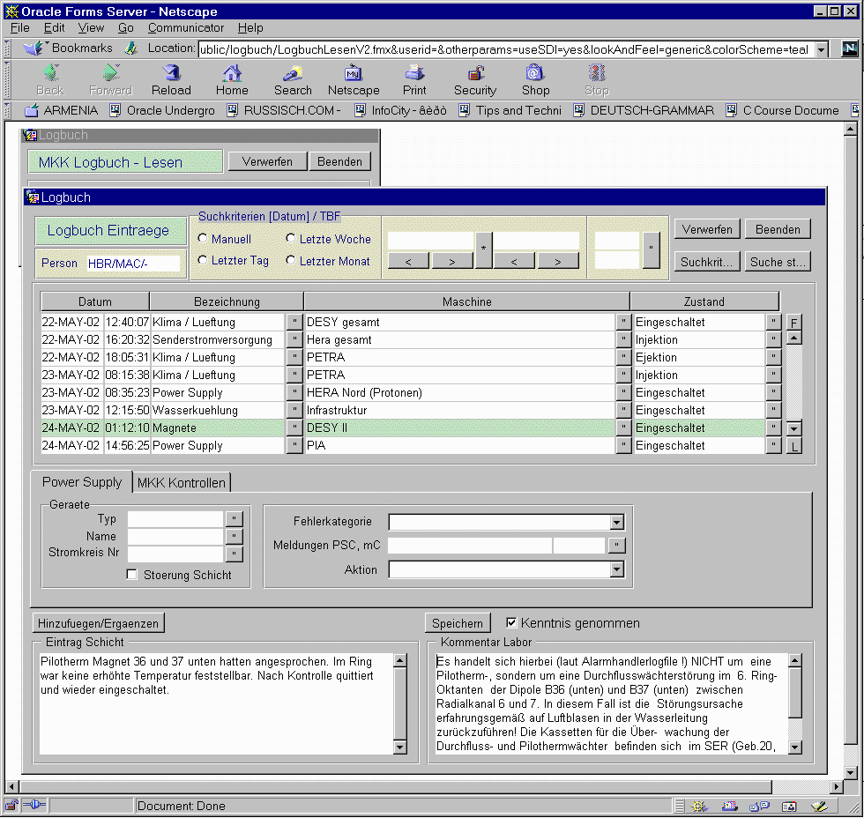
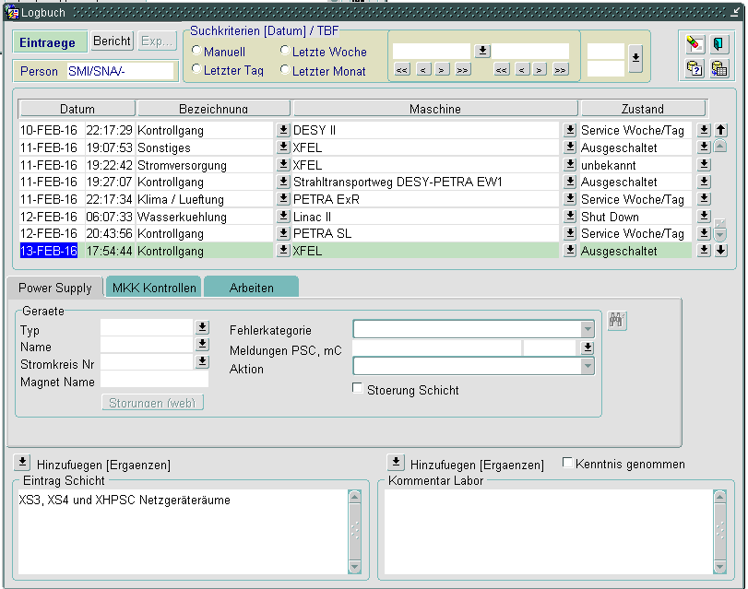
Elektronic Logbook
Developped by MKK

Slide 27
Failures during the year
2018
 | Anzahl
KW | PS Main | PS Corr
13 | 0 | 1 | 26.03.18 | PKVSX WR 140
14 | 0 | 0
15 | 1 | 1 | 14.04.2018/ beide | QA1 OL71, Umschalten auf Reserve geht nicht |  | PKVSX WR140 Spike
16 | 0 | 1 | 16.4.18 | 2 x PKVSX WR140 Spike
19 | 1 | 0 | 12.05.18 | Netzgeraeteausfall, NOR_57,59, 62 bei massage
24 | 0 | 1 | 12.06.18 | 2 Speicherkarten in 2 PS defekt |  | Abschaltung HST B
28 | 0 | 1 | 10.07.18 | PKVSX SR 140 auf NAH
29 | 1 | 0 | 16.07.18 | Umschalten auf das Reservegerät bei QA1_NOR_125
38 | 2 | 1 | 18.09./21.09.2018 | Ausfall PKH OR 101, Quench | Ausfall QA3 OL 80 | Ausfall PKH OR 101, Quench, dabei QA3 OL 80 repariert
42 | 1 | 0 | 20.10.2018 | QB3 NOR 105 ADC Fehler
47 | 1 | 0 | 21.11.2018 | QA5_OL_85
49 | 1 | 0 | 8.12. | Ausfall QA2 OL79, ein Leistungsteil defekt, erst falscher Chopper getauscht
50 | 2 | 0 | 15.12. beide | Q3_OR 80 mit Überstrom | 2 Ausfälle, Magnet-PS S1 mit Übertemperatur
 | 10 | 6

Slide 28
Failures in Petra
Normalized by failures / 1000 hrs

Slide 29
Failuretime in Petra
Normalized by failuretime / 1000 hrs

Slide 30
Statistics of Power supplies
Normalized by failures / 1000 hrs

Slide 31
Time to recover
(average 1:24:07)

Slide 32
Trips in calendar weeks in 2018

Slide 33
Water cooling
Normalized by failures / 1000 hrs

Slide 34
Power glitch
Normalized by failures / 1000 hrs

Slide 35
Air conditioning
No failure

Slide 36
Quality Control

Slide 37
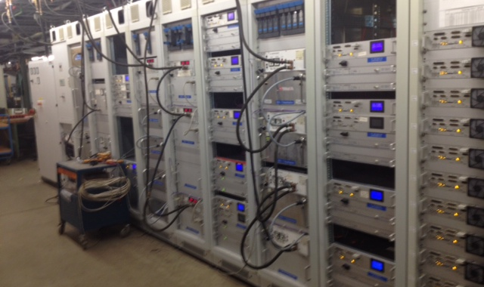
Teststand in hall II
Topology similar to PETRA III

Slide 38
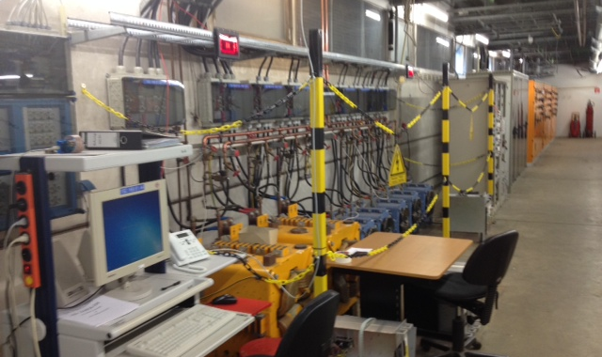
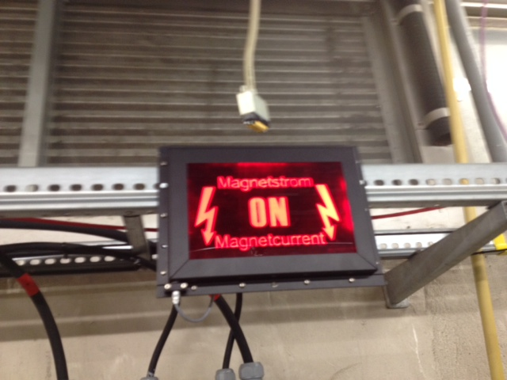
Teststand
Real Magnets as load + same control system

Slide 39
Quality control of software
Permit for Software roll out
  Each changes software has to go first onto the test stand to be checked
  After passing the tests, the first roll out is in one PETRA Hall, typically PE South east. After 4 weeks of failure free operation the permit is given to rollout into the machine.

Slide 40
Changes for the next runs

Slide 41
Time to recover has to decrease
Cycling procedure
The magnet cycling procedure is part of the recovery time. The procedure of cycling is investigated. A reduction of cycles is agreed.
Sequencer behavior has to be understood better

Slide 42
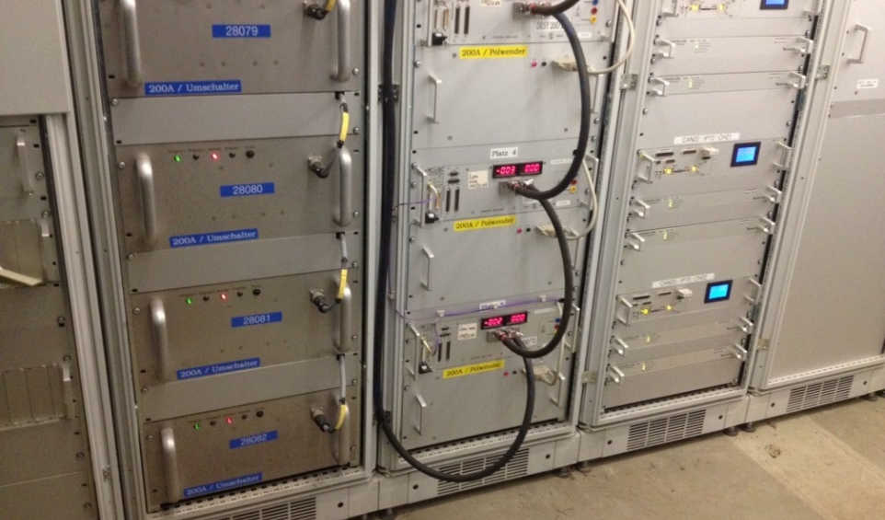
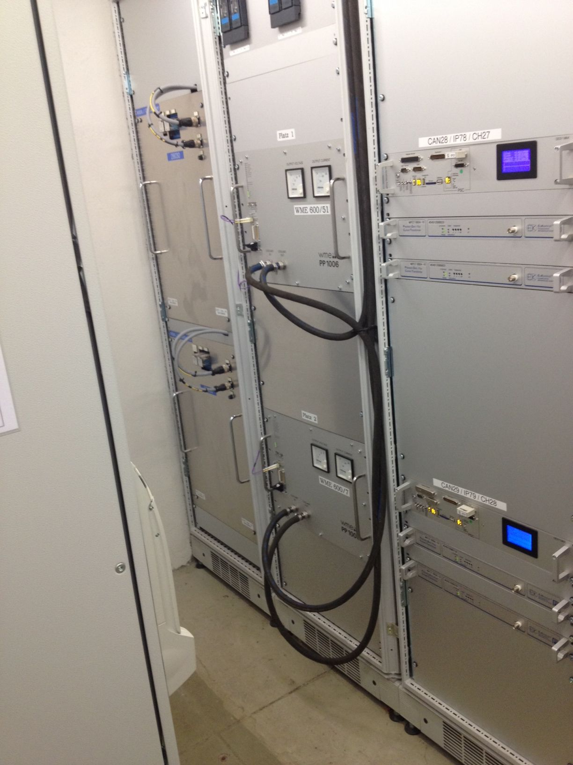
Redundancy-System from now on
Mechanical switches
For a group of power supplies a spare (redundancy) PS is introduced.
In case of a trip of a PS, the MKK crew gets informed
The broken supply shall be exchanged by the redundancy PS
After 30 min the machine should be in operation again

Slide 43
Training of the shift crew
Routines
Since the failures of the power supplies is low, a shift operator can be for years on shift without switching. The routine is missing. Therefore a training programm is established (started in Feb 2019)
Switching procedure of redundancy switches
Exchange of regulation electronic and corrector power supplies
Switching procedure of redundancy switches SCR-supplies (large units, not automized)

Slide 44
8D-Report
Methode zur Analyse von aufgetretenen Problemen mit der Zielsetzung der Schadensbegrenzung
1. Teambildung
2. Problem-beschreibung
3. Sofort-maßnahme
5. Geplante Abstellmaß-nahme
6. Eingeführte Abstellmaß-nahme
4. Fehlerursache
7. Fehler-wiederholung verhindern
8. Abschluss
Weltweit etablierte Methode
Dient der systematischen Analyse und Dokumentation von Problemen
Angewendet während der Beschaffungsphase des XFEL High Power RF Systems: Lieferant führt 8D-Report durch
Angewendet von MHF-p während der Betriebsphase des XFEL

Slide 45
Was it worth the hassle?
A comparison of values
Comparison of Availability
Failures during Lumrun |  | Userrun
 | HERA | PETRA III
 | 1996 | 2018
NumberFailures | 69 | 16
Downtime in Hrs | 96 | 24
operation hrs | 5304 | 4231
failures/1000 hrs | 13,01 | 3,78
Ratio of PS | 1,94
Failures/1000 hrs normalized | 6,71 | 3,78
Improvement | 1,7739023
Availability | 98,19% | 99,43%

Slide 46
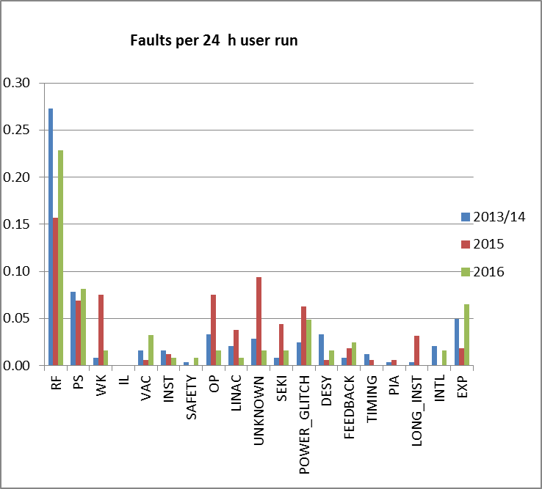
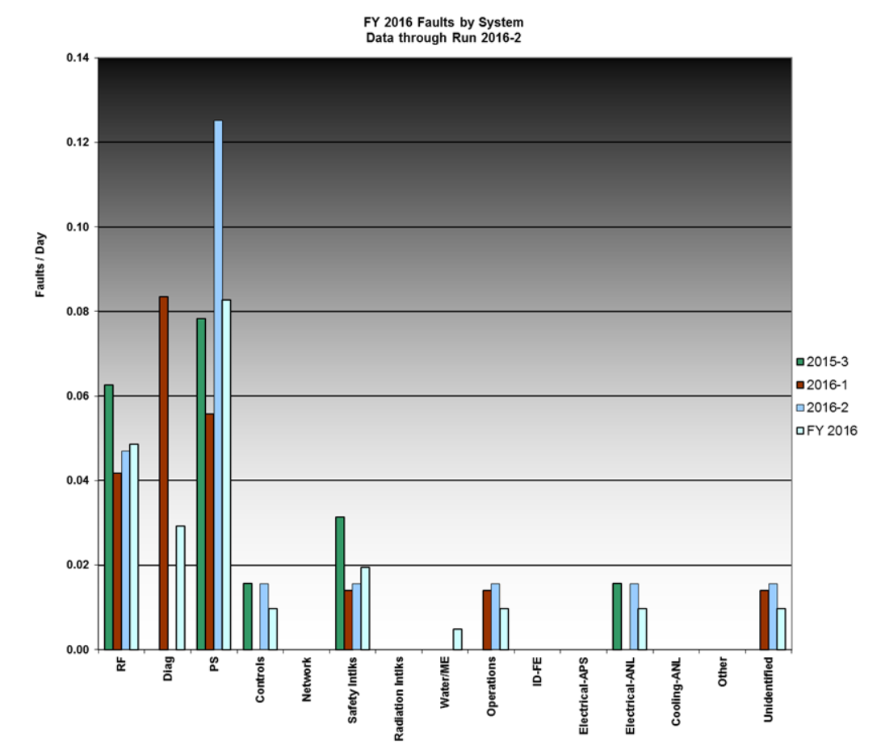
Faults per day: a comparison Folie Wanzenberg 2016
PETRA III
APS
0.14
RF
PS
0.06
http://www.aps.anl.gov/Accelerator_Systems_Division/Accelerator_Operations_Physics/statistics/
APS 0,06 Ausfälle/tag (13 in 5015 Std, 19,28 Std)
DESY 0,1 Ausfälle/tag (17 in 4000 Std, 12,17 Std)
DESY 0,068 Ausfälle/tag (11 in 4000 Std, 12,17 Std)

Slide 47
Even with the best statistic, not foreseeable failures occur and have to be handled

Slide 48
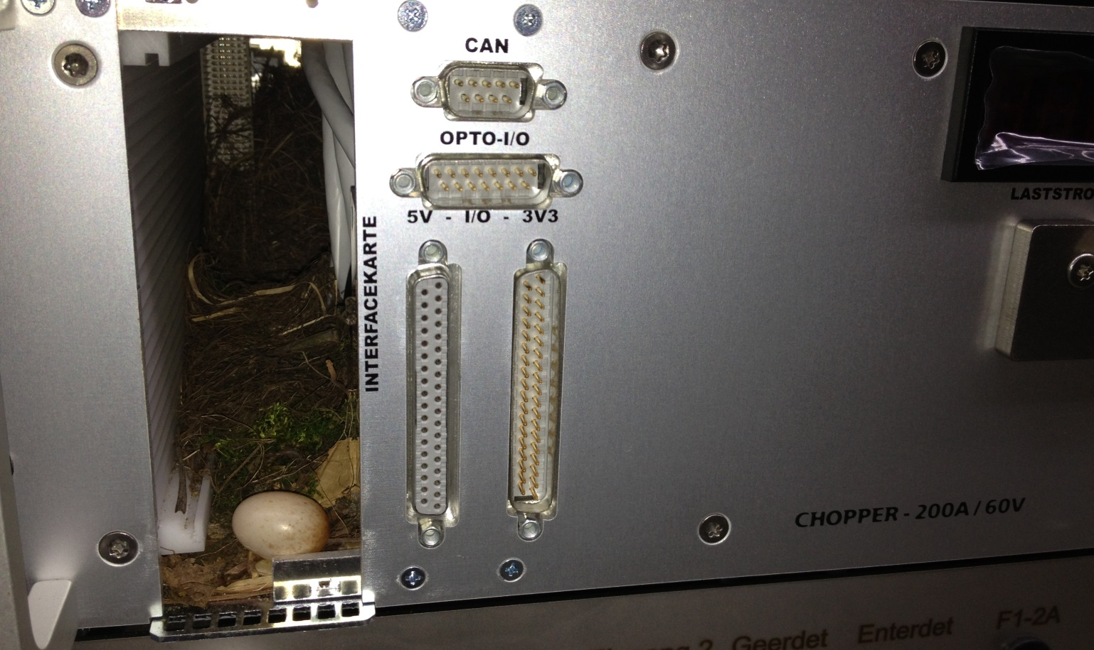
One cannot predict every failure!

Slide 49
Make the best out of it!!
We are working on sustainability
Thanks to the MKK team and especially the shift crew
for helping to get this high availability

Slide 50

If you liked this presentation and want to train yourself
  Meet the DESY Toastmaster
  Speech and leadership training
  effective feedback
  good results
  Every 1rst and 3rd Wednesday of the month
  Time from 17-19:00 o’clock
  Building 30 b, Room 459

