Slide 1
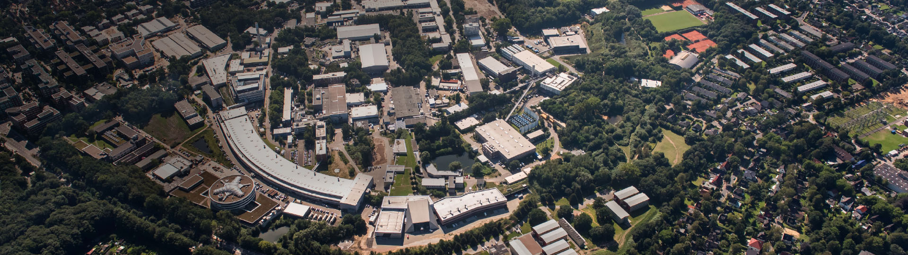
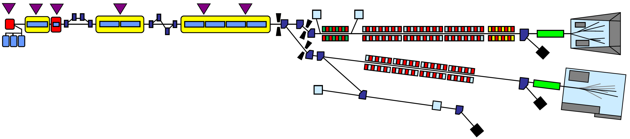
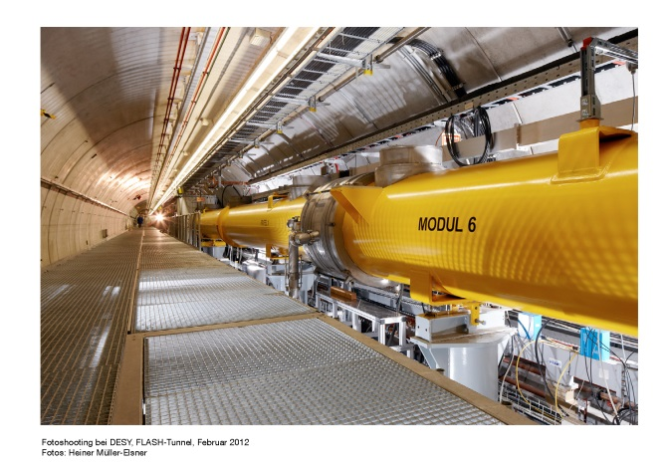
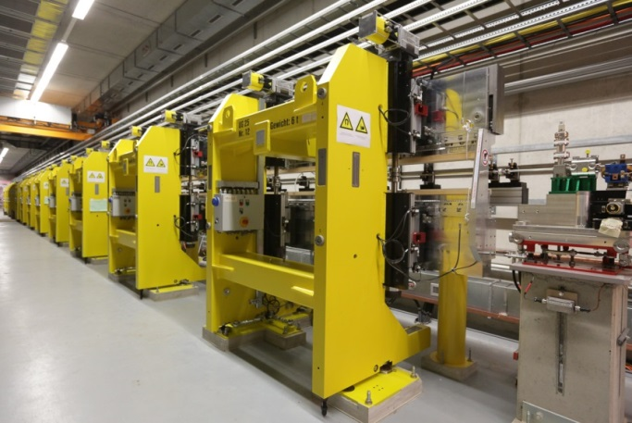
FLASH Refurbishment and FLASH 2020+
FLASH: the first soft X-ray FEL operating two undulator beamlines simultaneously
Siegfried Schreiber
DESY
Betriebsseminar Travemünde
21-Feb-2019

Slide 2
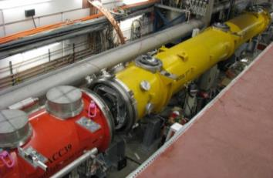
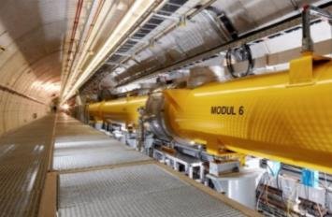
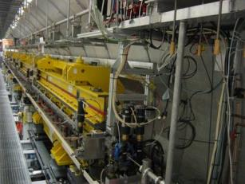
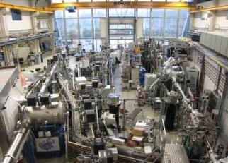
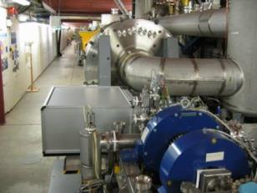
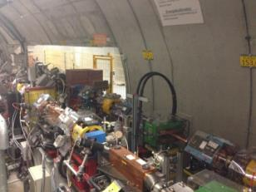

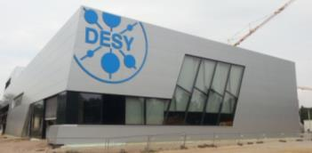
FLASH Layout 2019
3rd harmonic sc module 3.9 GHz
TESLA type superconducting accelerating modules 1.3 GHz
FLASH1 fixed gap undulators
FLASH1 Albert Einstein Hall
315 m
RF Stations
Accelerating Structures
sFLASH
Photon Diagnostics
Fixed Gap Undulators
FLASH1
THz
RF Gun
Bunch Compressors
FLASH2
Albert Einstein
Lasers
5 MeV
150 MeV
450 MeV
1250 MeV
Variable Gap
FLASHForward
Kai Siegbahn
FEL Experiments
Normal conducting 1.3 GHz RF gun
Ce₂Te cathode / 3 injector lasers
Extraction to FLASH2
FLASH2 Kai Siegbahn Hall
FLASH2 variable gap undulators

Slide 3


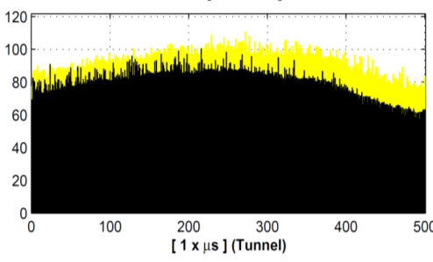
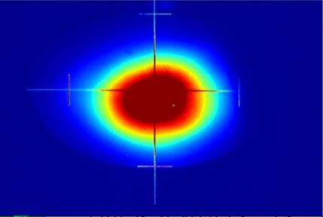
FLASH Parameters 2019
Stable parameter set delivered to users
FEL Radiation Parameter FL1 / FL2
Wavelength range (fundamental) 4.2 – 51 nm / 4 – 90 nm
Average single pulse energy 1 – 500 µJ / 1 – 1000 µJ
Pulse duration (FWHM) < 30 – 200 fs
Peak power (from av.) 1 – 5 GW
Pulses per second 10 – 5000
Spectral width (FWHM) 0.7 – 2 % / 0.5 – 2 %
Photons per pulse 10¹¹ – 10¹⁴
Average Brilliance 10¹⁷ – 10²¹ B*
Peak Brilliance 10²⁸ – 10³¹ B*
* photons/ s/ mrad²/ mm²/ 0.1%bw
Energy (µJ)
Bunch number
http://photon-science.desy.de/facilities/flash/publications/scientific_publications

Slide 4
Mid-term refurbishments
2017 – 2020+

Slide 5
Main Refurbishments
: indicates installation time
Projects
2017 2018 2019 2020
“Big” refurbishments
Two new modules → 1.35 GeV ………………………………………………………………………………………………..….
Next generation injector laser → improved beam quality ……………………………………..…………………………
Low charge diagnostics → for short pulses ……………………………………………………………………………………
Polarized photons for FLASH2 → for new type of experiments ………………………………………………………………
Other main refurbishments
Machine protection …………………………………
Coupler interlock electronics ……………………………………………………………………………….
Fast arrival time stabilization with warm RF cavity …………………….……………..
TDS FLASH2 to measure and monitor bunch and photon pulse duration ………………………………………….
THz undulator FLASH2 ……………………………………………………………………………………………………….
Waveguide upgrades ………………………………………………………………………………………..…………
Fast intra-train orbit feedback …………………………………………………………………….
Started
Started
BPMs finished
BAMs started
Scheme in discussion
Toroids/BLMs/Finished
Started
Installed
Started
Postponed
Design started
New project

Slide 6
Other refurbishments
 | Task | Status
E1 | Injector laser | on-going | *
E2 | Optical synchronization system | on-going | *
E3 | Afterburner FLASH2 | design in discussion | *
E4 | TDS FLASH2 | on-going | *
E5 | THz undulator FLASH2 | postponed
E6 | Bunch compressor FLASH2 | on-going | *
E7 | Magnet controls | started
E8 | Vacuum controls | starting
E9 | Screen stations FLASH1 | started
E10 | Upgrade LLRF | proposed
E11 | Upgrade RF master oscillator | proposed
E12 | Coupler interlocks | on-going | *
E13 | RF-gun (exchange) | prepared
E14 | ACC39 (exchange 1 cavity) | cavity 5 to be prepared
E15 | Personnel interlock system (waveguides) | started
E16 | Radiation shield Bogengang | started
E17 | Pumping stations 1 and 2 | proposed
E18 | Cooling towers | proposed
E19 | Cryogenics refurbishment | starting | *
E20 | Modulator 3.9 GHz | proposed
E21 | Fast orbit feedback | proposed
E22 | Controls (network switches) | started | *
E23 | Fast intra-train compression feedback | proposed
E24 | sFLASH (new EEHG chicane) | started
A long washing list
Concerning the priority:
All tasks are important to keep FLASH operating
None of the tasks are yet urgent, its mostly preemptive refurbishments
Tasks are worked on, when resources are available
For a few more important and cost intense tasks, measures have been taken to assure funding (*)

Slide 7
New Modules

Slide 8
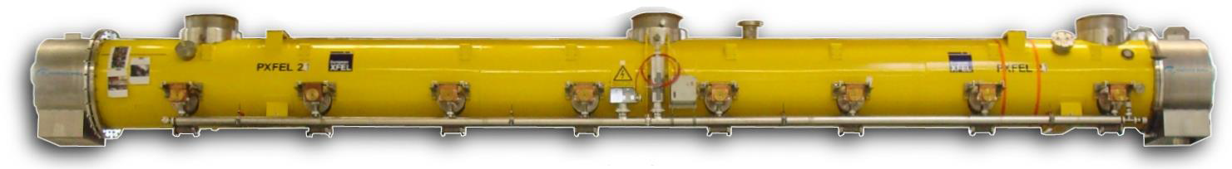
Refurbishment of old accelerator modules
Modules
Replace accelerator modules ACC2 and ACC3 with refurbished XFEL type modules (PXFEL2 and PXFEL3)
We have good cavities with high gradients: >100 MeV energy gain are expected
Cavities have already been assigned to the modules
M3*** Type II
M1* M7 Type I/II
M4/M5/M6/PXFEL1
Type III
ACC1
ACC2
ACC3
ACC4
ACC5
ACC6
ACC7
RF Gun
1250 MeV → 1350 MeV
He
Type I feedlines
Type I to III transition
150 MeV
450 MeV → 550 MeV
5 MeV
PXFEL 2/3 Type III

Slide 9
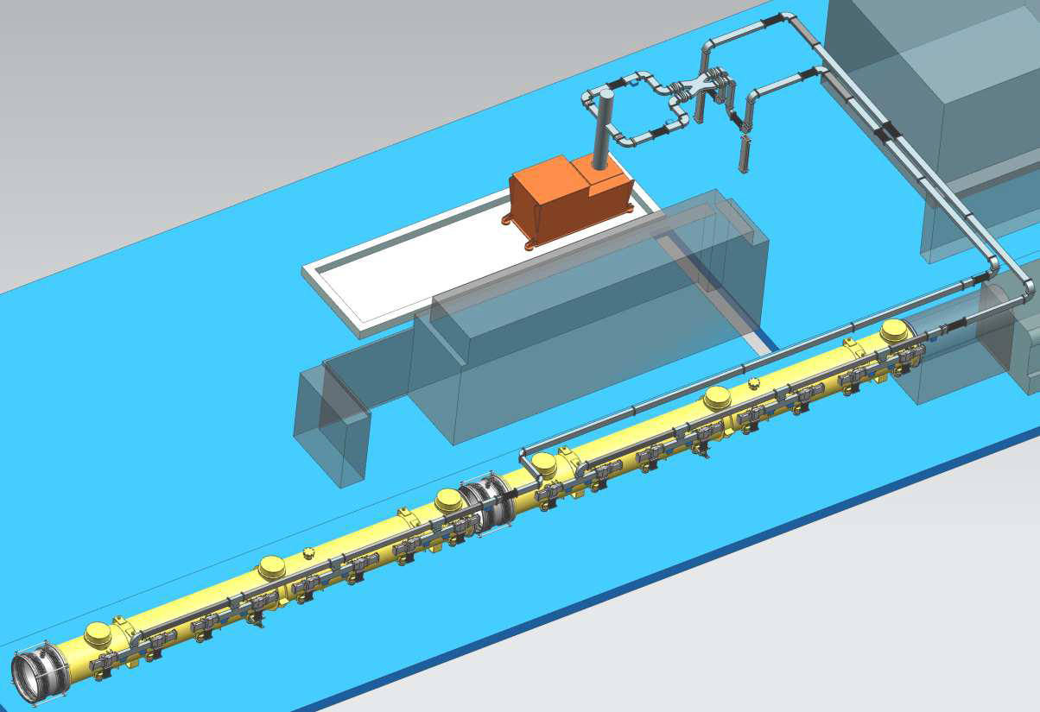
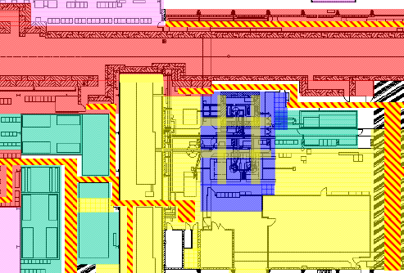
Refurbishment of old accelerator modules
RF and waveguides
Presently ACC2/3 is feed by RF-6 in the cryo-annex
A new station RF-1 will be installed in hall 3 close to the modules (10 MW klystron)
New waveguide distribution similar to PXFEL1/XFEL
Option: optimized waveguides at ACC4/5 to gain another 100 MeV
ACC4/5
ACC2/3
RF-1
RF-6

Slide 10
Injector Laser

Slide 11
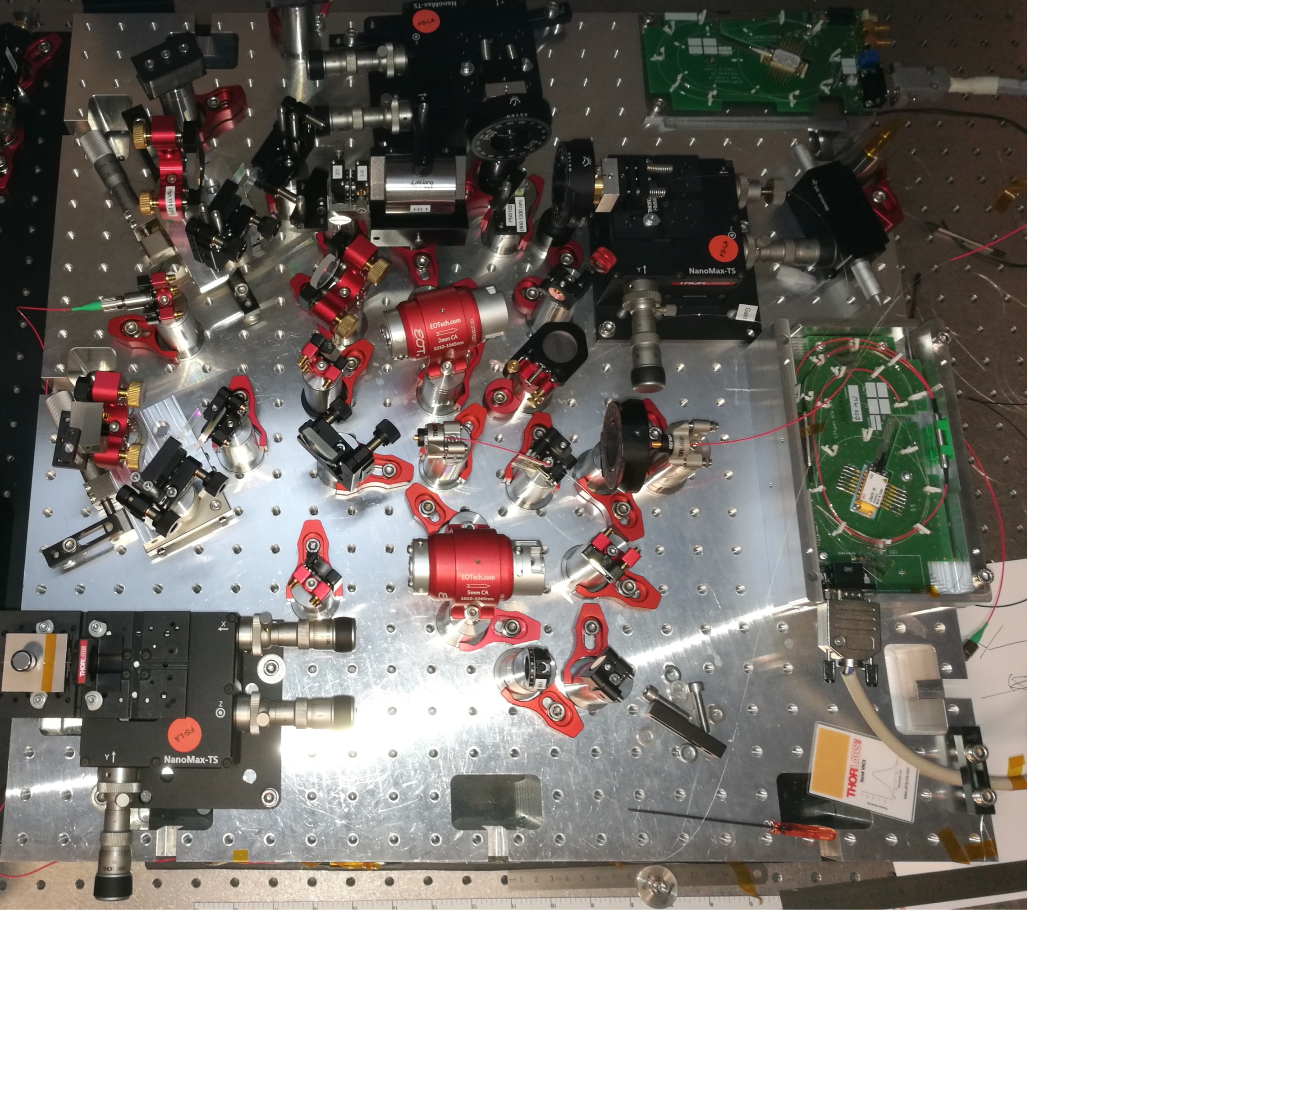
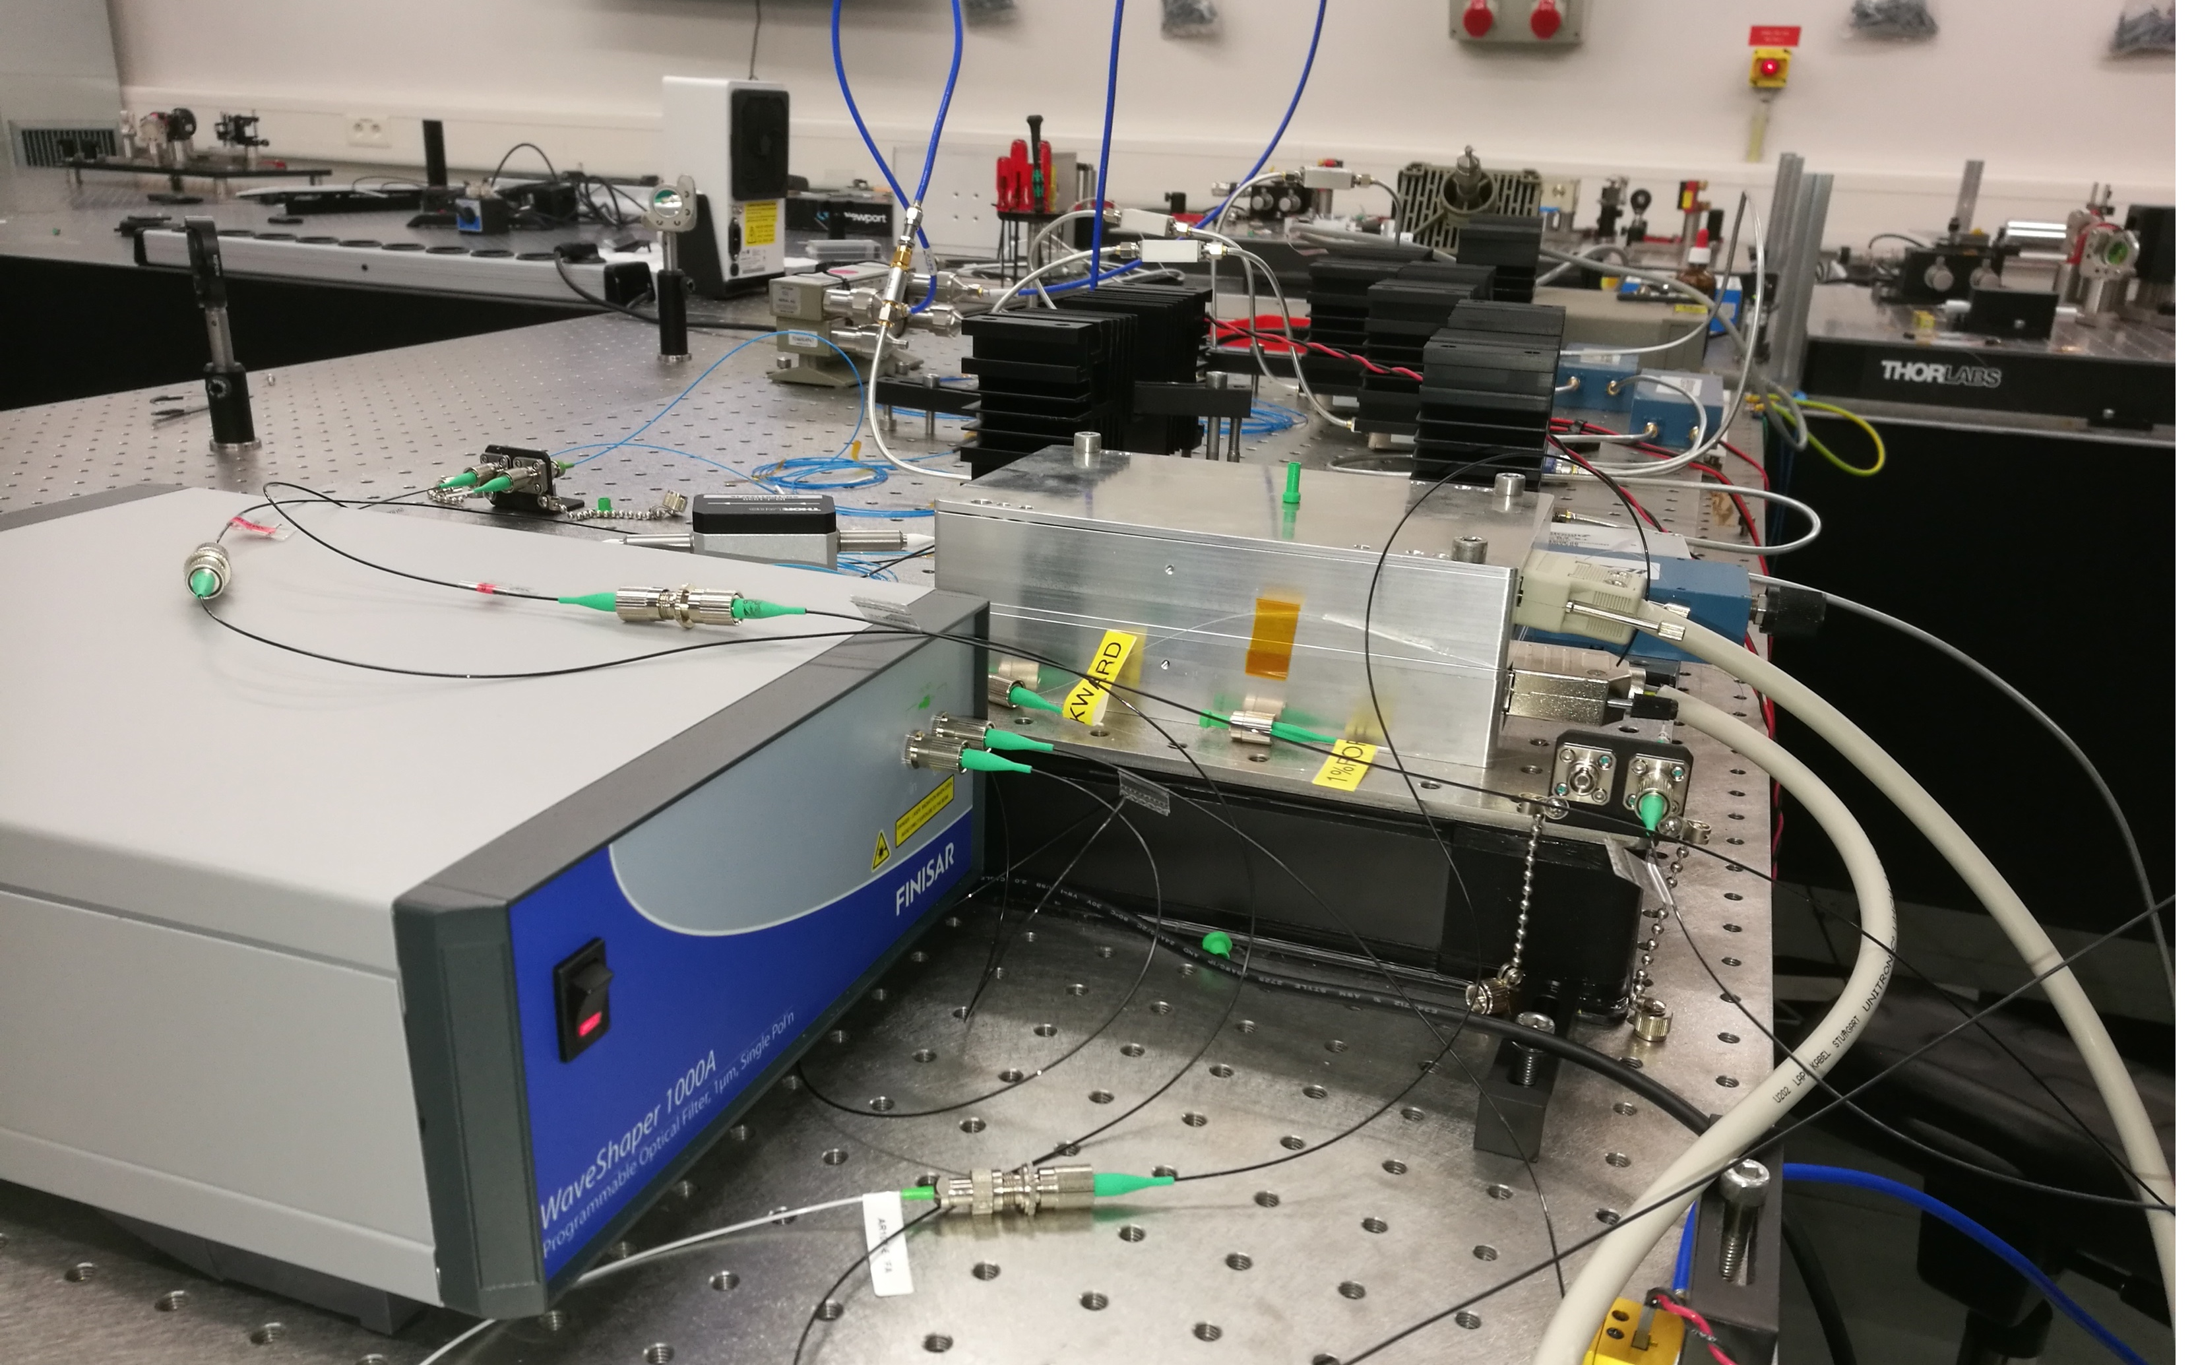
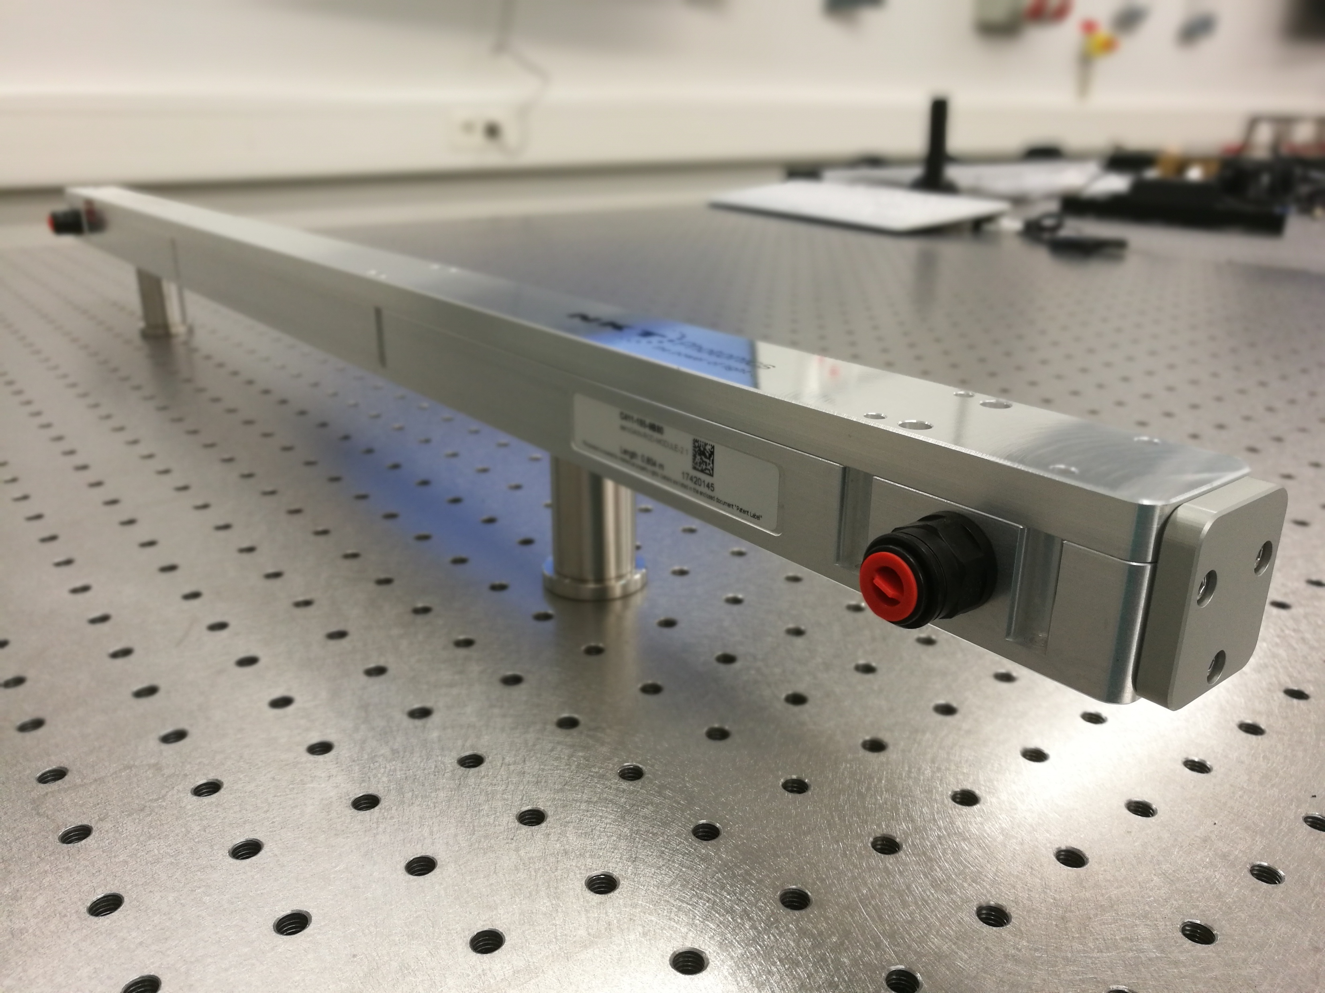
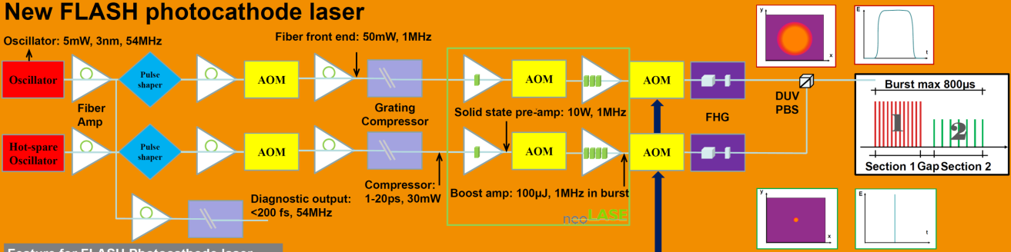
New Generation Photoinjector Laser Development
Project Goals
Simple and robust architecture
1 ms trains (10 Hz, 1 MHz)
Flexible pulse pattern within one train – for both, FL1 and FL2
  two different aperture sizes
  charges
  pulse durations
Very similar to now
  with modern laser technology
  flexibility in one system
  longitudinal pulse shaping
  option 4.5 MHz
Longitudinal pulse shaping development:
Tests with high resolution spectral pulse shaper
Oscillator development:
low phase noise nonlinear fiber loop mirror oscillator
Amplifier development:
High power fiber-rod amplifier module

Slide 12
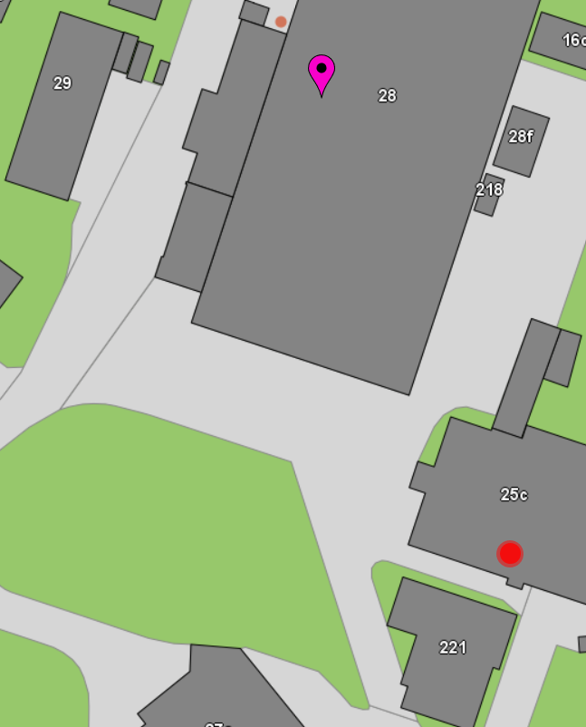
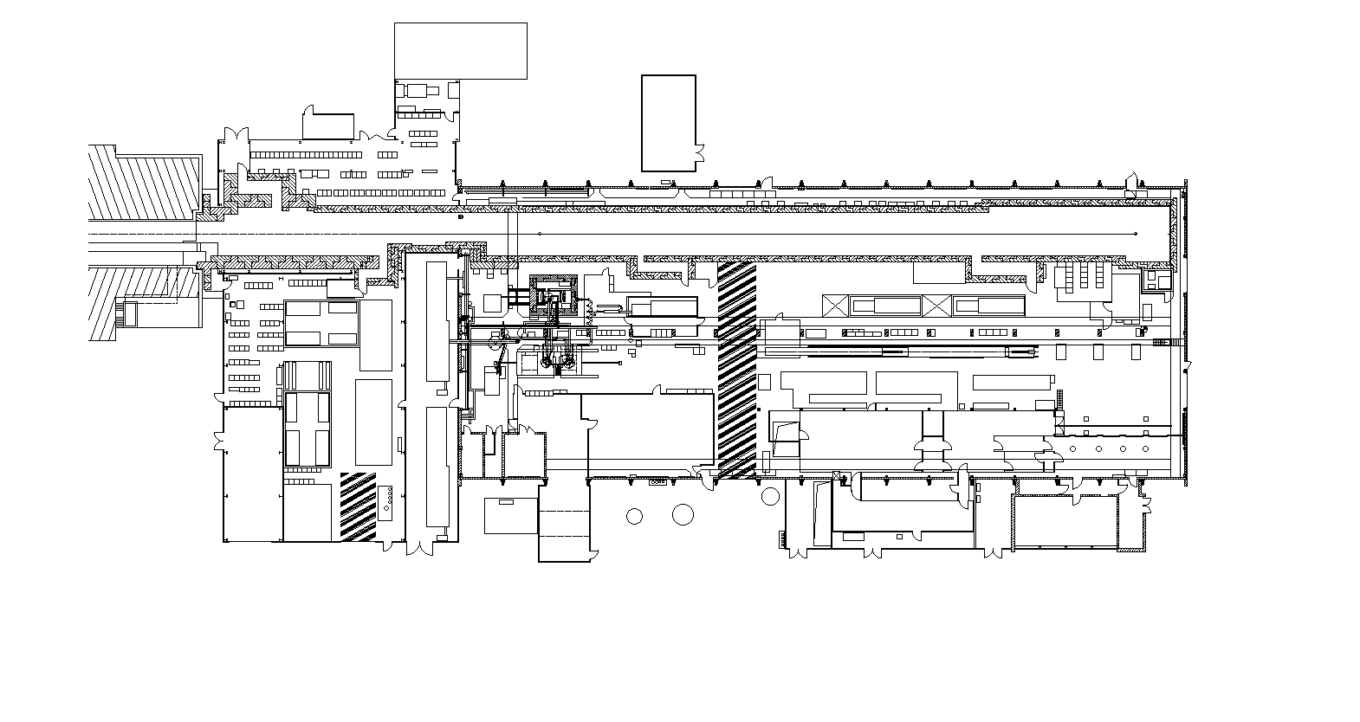
New injector laser rooms
To be installed close to the gun
The old laser rooms need to be replaced
However, to do this and to install and commission the new laser within a 6 month shutdown is too risky
Thus, we do not want to uninstall the present lasers before the new ones are ready to go
Size: about 100 qm
Laser heater: room replacing TOSYlab
Large enough to keep space for future laser developments
laser heater
New injector laser room
ACC3
ACC2
ACC1
Present laser room and synch hut

Slide 13
Diagnostics

Slide 14
Upgrade Beam Diagnostics
Better resolution especially for low charge operation
Upgrade charge measurement (toroids)
  New XFEL type toroids, data acquisition with MTCA (108 MHz ADCs)
  Improved resolution: smaller than 1 pC
  New TPS (toroid protection system, to prevent charge losses)
Upgrade electronics and hardware for machine protection system (MPS)
  Required to fully explore the multi beamline features
  New MTCA based standard, similar to XFEL
New electronics for most BPMs
  In order to get a much better resolution also for low charges
New hardware and electronics for BAMs
  To cope with short bunches with low charges
Profile monitors (OTR screens)
  BC2/3: we keep the vacuum chambers with OTR screens, new optics
  Other will be replaced by XFEL type screen stations – already realized in FLASH2 and one station in FLASH1
Upgrade finished
Upgrade finished
Upgrade finished
Upgrade started summer 2018
Upgrade postponed to 2020

Slide 15
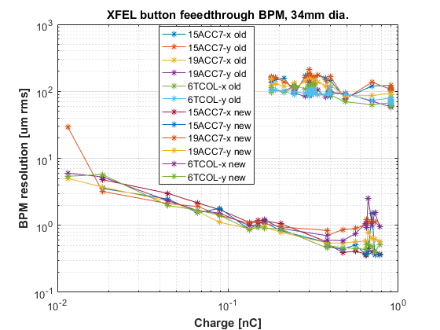
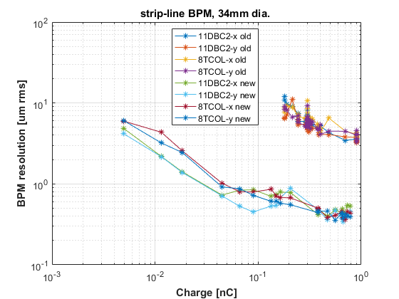
New BPM electronics
Goal: higher resolution also for low charge beams
Better resolution – mainly for low charges
old
10 µm
old
10 µm
new
new
10 pC
100 pC
10 pC
100 pC

Slide 16
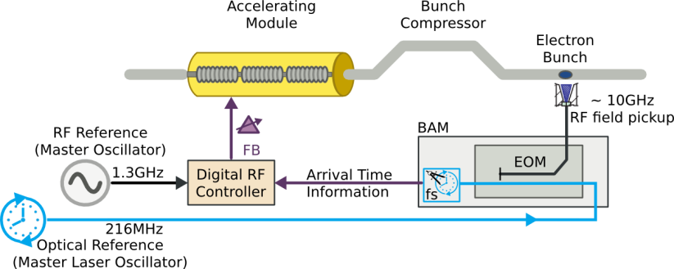
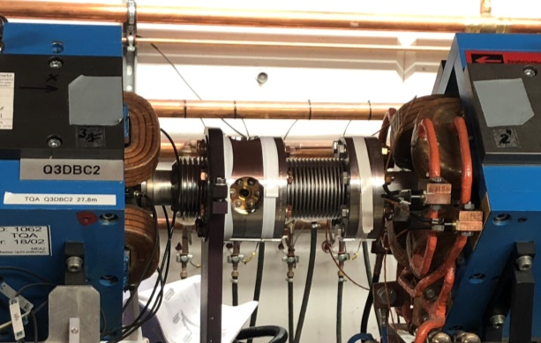
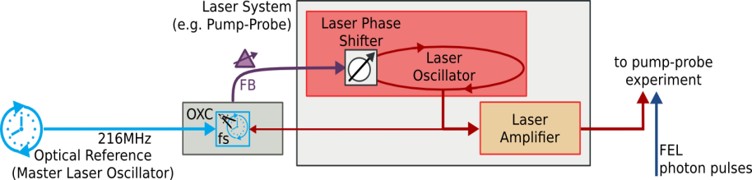
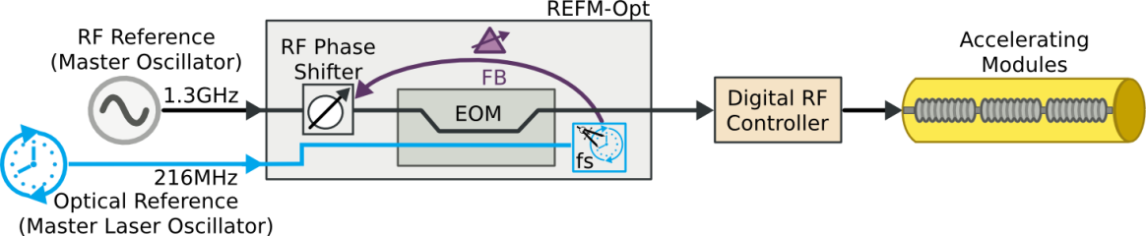
Upgrade BAM and Synchronization Systems
Beam Arrival Time Monitor
Measurement & Stabilization of the Electron Bunch Timing
New BAM pick-ups with an improved sensitivity especially for low bunch charges have been installed.
New electronics is being commissioned piece by piece
Priority to ensure slow and fast intra-train arrival time feedbacks for users
Expected resolution <10 fs rms
The new set-up will also allow separate arrival time feedbacks for both beamlines, FL1 and FL2
All-Optical Laser-to-Laser Synchronization
Phase Drift Compensation of the
RF-Reference used for Acceleration
UBC2
DBC2
DBC3
ACC7

Slide 17
Upgrade BAM and Synchronization Systems
SynchLab
The synchronisation lab has been completely refurbished
New links are being installed
The synchronisation signals are now distributed through new polarisation-maintaining optical fibres
Expected reduction of jitter of signal transmission from 3 fs to 0.5 fs
A few links mandatory for FLASH operation have already been installed and commissioned
The number of possible links will increase from 8 to 24.
Further optical links will be installed step by step.
The full new system is expected to be available in 2020.
 | Status 2017 | Upgrade plan 2018/2019
No. of Clients | 7 | 20
No. of spare links | 0 | 4
Laser-to-Laser (L2L) Synchronization | 2 | 6 (extension by further 4)
Bunch Arrival Time Monitors (BAM) | 3 | 7
Optical Reference Modules (REFM-Opt) | 0 | 3

Slide 18
Fast RF Feedback with BACCA

Slide 19
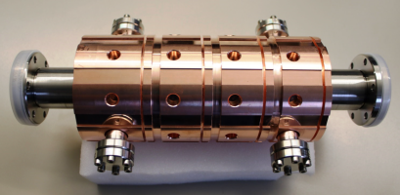
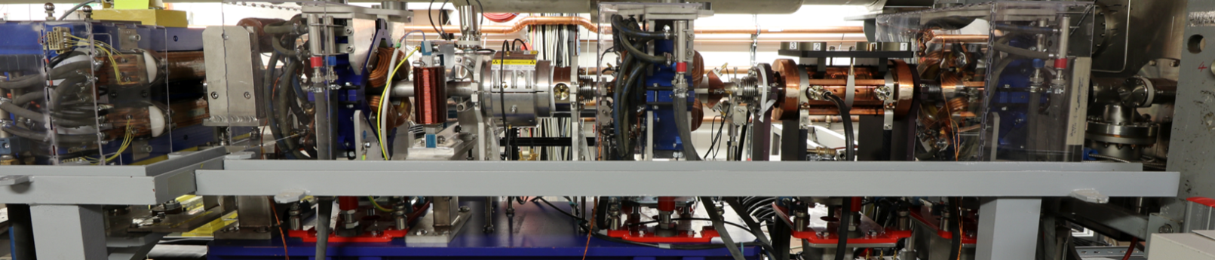
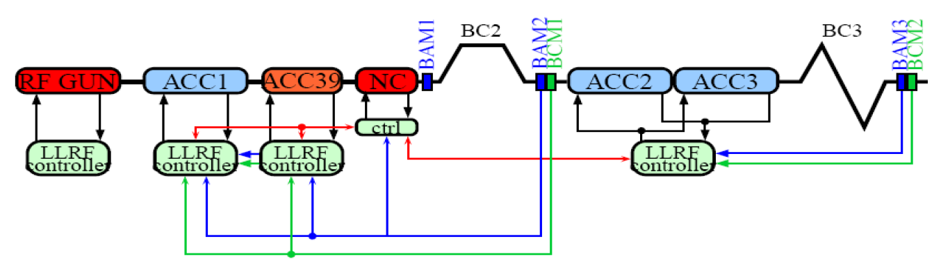
Fast RF Feedback Cavity
334 mm
BACCA
Correction of arrival time fluctuations which are too fast to be corrected by the narrow bandwidth (~ kHz) superconducting cavities
Goal is to push the arrival time stability well below 10 fs (~1 fs)
Fast corrector: large bandwidth normal conducting S-band cavity (~1 MHz, ~kW) controlled by a high-speed digital system (latency <1 µs)
Suppress the residual beam energy fluctuations towards dE/E~10⁻⁶
Arrival time measured in DBC2 with new high resolution low charge beam arrival time monitors
NRF cavity
BAM
* new electronics to process the NRF cavity
* new electronics to process the BAM signals

Slide 20
FLASH2

Slide 21
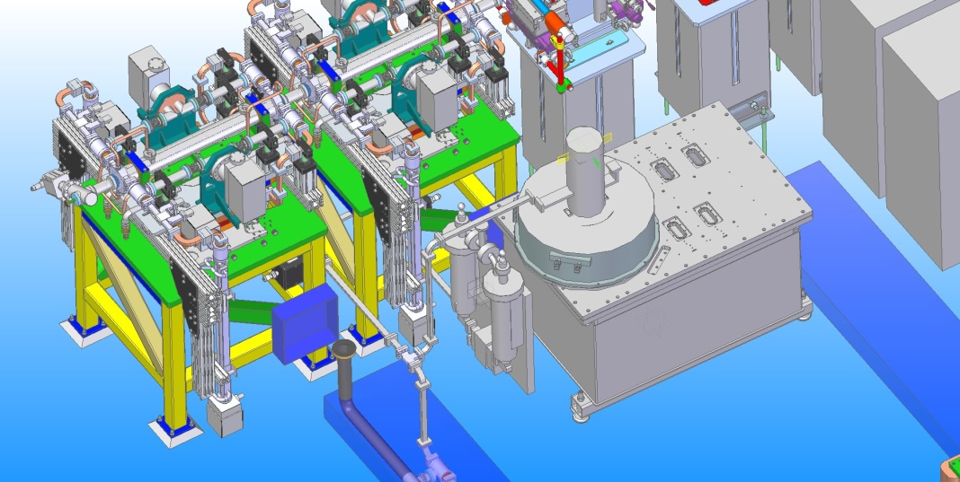
FLASH2
Installations 2019-2020
Bunch compressor downstream extraction
  Component design and construction on-going
  Installation planned summer 2019
  Better control of CSR due to less strong compression at lower energies
PolariX-TDS (X-band transversely deflecting structure) downstream undulators
  Installation planned in 2020
  To reduce cost, we share one RF-station with FLASHForward
TDS at FLASH2
BC
TDS
TDS

Slide 22
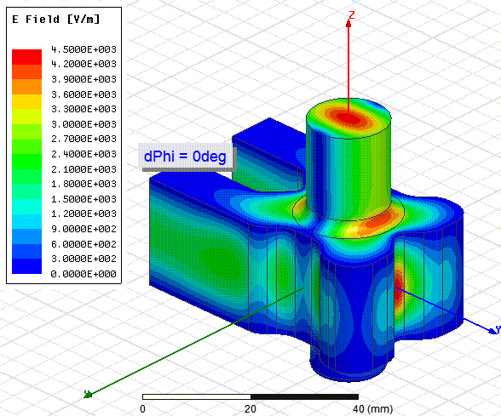
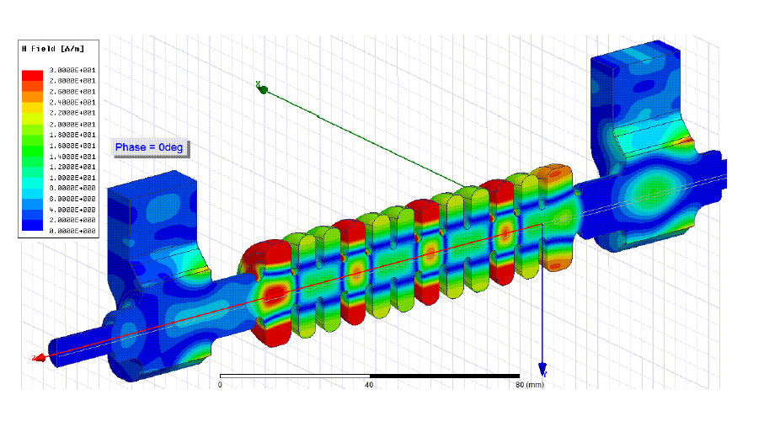
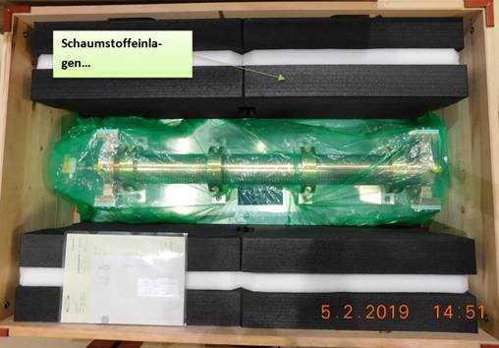
PolariX TDS
Collaboration contract signed
X-band Klystron and Modulator at DESY
Commissioning in Linac II (MIN)
Prototype cavity shipped PSI to CERN for RF tests (conditioning)
Prototype to be installed at FLASHForward in summer 2019
FLASH2 cavities in 2020
Polarizable X-band Transverse Deflection Structure
Development of a new X-band (12 GHz) deflector
In cooperation with CERN and PSI
New feature: variable polarization
DESY will use these cavities for SINBAD, FLASHForward and FLASH2
MIN group formed a new X-band RF technology section
TDS shipped from PSI to CERN February 2019
Courtesy of A. Grudiev, CERN

Slide 23
FLASH 2020+
Within the DESY 2030 strategy

Slide 24
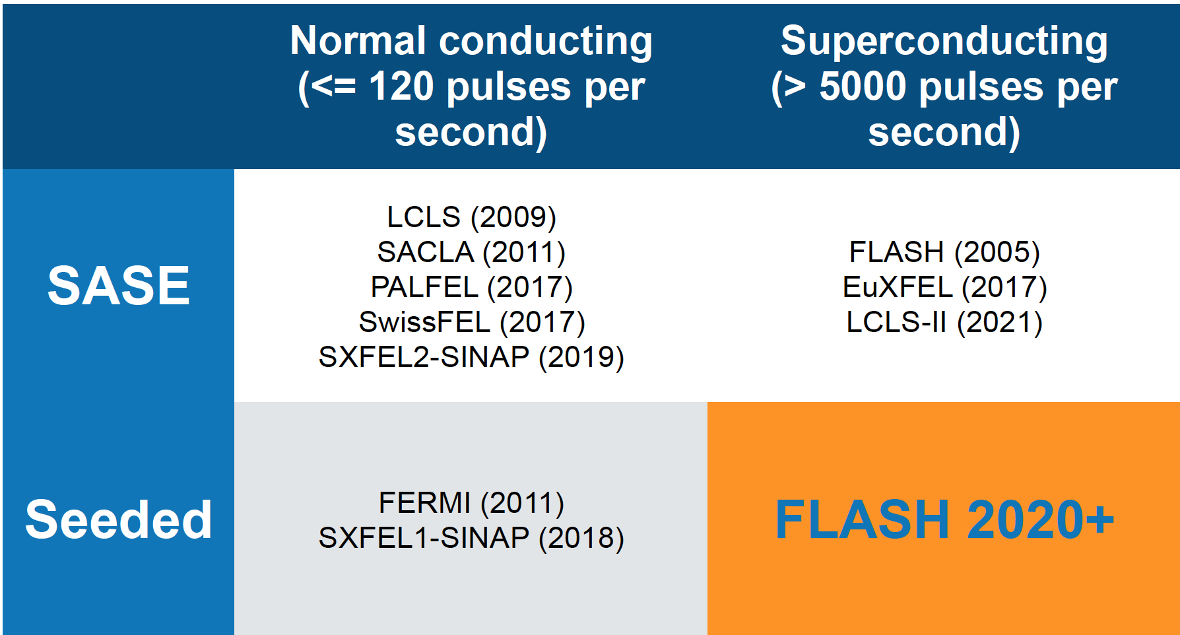
The XUV and Soft X-Ray FEL Landscape
SHINE (2023)
Wilfried Wurth Photon Science
FLASH – the only high repetition rate XUV and soft X-ray FEL

Slide 25
Unique FLASH Features
The first soft X-ray FEL operating two undulator beamlines simultaneously
High repetition rate ( = high average brillance)
Two almost fully independent FEL lines
Excellent timing synchronization
Mix of open ports and state-of-the-art dedicated endstations
Integrated THz source (phase stable with respect to FEL)
Advanced photon diagnostics

Slide 26
User Wishlist (Workshop Sept. 2017) vs. Upgrade Plans
“Dream Facility” | FLASH2020+ goals | FEL Line
fundamental up to O-K-edge | cover up to 6 decades of electromagnetic spectrum (mm to nm) with coherent radiation for multi-color experiments → novel undulator schemes | FLASH2
variable polarization | variable polarization | FLASH1 and 2
flexible pump-probe schemes (THz → XUV) | provide flexible laser- and FEL based schemes for multi-color pump-probe experiments | FLASH1 and 2
few fs- and sub-femtosecond Fourier-limited pulses | laser manipulate electron bunches in burst mode with up to 1 MHz rate → external seeding with high rep. rate | FLASH1
 | enable dynamic studies with attosecond precision | FLASH2
100kHz CW | Long-term goal (2030+) | FLASH@XFEL

Slide 27
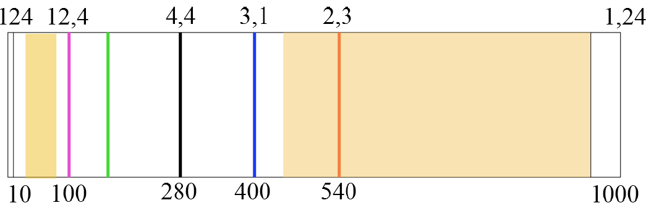
Expand Photon Energy Range → Element Specificity
XUV/Soft X-Ray Important Element Specific Resonances
FLASH
Wavelength [nm]
Water-window
3d-M-edges
Si-L-edge
S-L-edge
C-K-edge
N-K-edge
O-K-edge
3d-transition metals-L-edges
FLASH2020+
Photon energies [eV]
Catalysis, Biochemistry, Energy Science, Information Technology
Functional Materials (Magnetism, high_Tc, …), Life Science …..

Slide 28
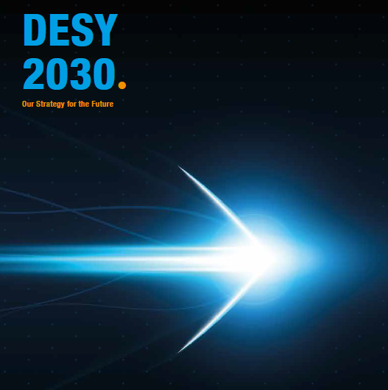
FLASH within the DESY 2030 strategy
Our Strategy for the Future
Page 40:
… The FLASH2020+ development program of the two FEL lines and the accelerator includes
the operation of two independent FEL lines (FLASH1 and FLASH2) with variable magnet structures (undulators) for trend-setting new lasing concepts and „seeding“ with a high repetition rate
the extension of the wavelength range in the fundamental to the oxygen K-edge, in order to reach the important elements for energy research and to cover the whole water window for biological questions (*)
flexible pump/probe schemes for time-resolved experiments (*)
variable polarization for the investigation of the light-induced switching of magnetic storage media; and
shortest pulses up to the attosecond range.
(*) Original document in German, I have corrected the English translation to fit with the scientific content expressed in German

Slide 29
FLASH 2020+
Preparation phase for FLASH2020+
  Six Task Forces (TF):
  TF1 accelerator, TF2 FEL beamline: seeded, TF3 FEL beamline: SASE and new schemes,
  TF4 Lasers, TF5 Experiments, TF6 Data
Conceptual Design Report (Spring 2019) followed by a Technical Design Report
Steps towards FLASH2020+
Upgrade linac
many refurbishment projects, increase beam energy, upgrade compression scheme
Installation of new undulators with variable gap for FLASH1
with a seeding option
Seeding with high repetition rate 100 kHz+
high repetition rate seed laser
New configuration of undulator structures at FLASH2 for novel lasing concepts

Slide 30
Task Forces

Slide 31
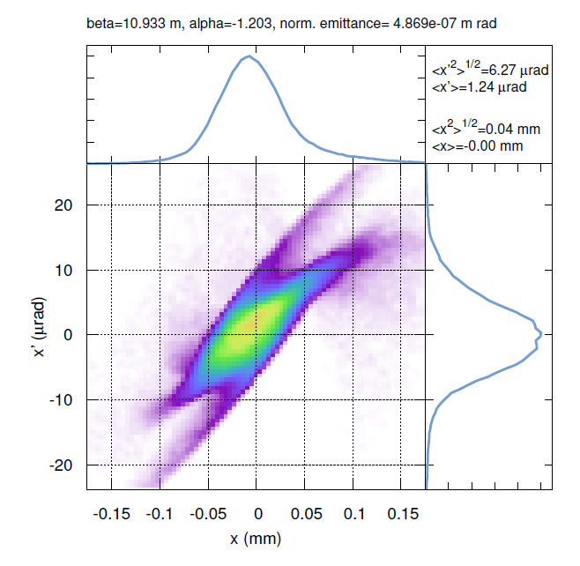
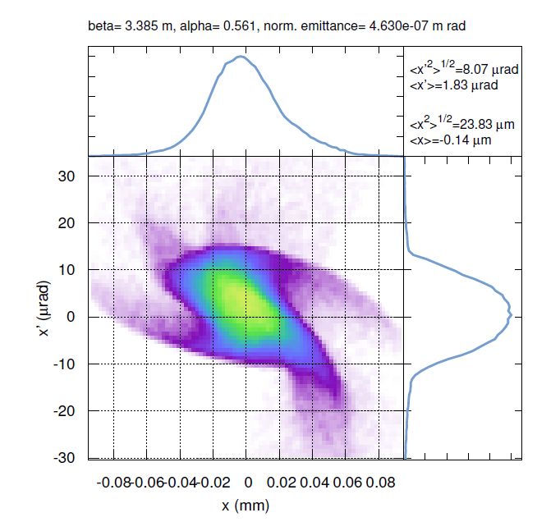
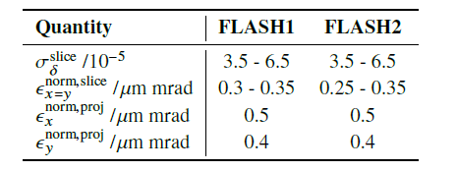
Task Force Accelerator
Current status
Increase beam energy to 1.35 GeV | ☑
Run linac at fixed working points (usually max and intermediate, exceptionally low energy) | ☑
Include laser heater upstream of bunch compressor 2 (required for seeding) | ☑
Modified bunch compression scheme - add two new bunch compressors (FL1 and FL2) at final energy to improve beam quality and to gain more flexibility in tuning of both lines | ☑
Examples of tracking simulations with improved compression (with CSR, cavity wakes, and space charge, 100 pC)
→ much better performance expected
FLASH1
FLASH2

Slide 32
FLASH: Laser heater 1st bunch compressor
Required for a future seeding beamline
Present
Move bunch compressor by ~ 1.5 m to make place for the laser heater
Keep matching section with four screens, all quads with own power supply
Accelerator modules are not moved
Modified
Heater laser
Short Undulator
Modified matching section
Laser heater chicane

Slide 33
FLASH: Modification of bunch compressor BC3
Allow matching in BC3
Present
Change S-chicane to a C-chicane and include matching section (2 additional quads)
Modified

Slide 34
New C-chicane bunch compressors
In FLASH1 and FLASH2 beamlines
FLASH1: we replace the dogleg with a C-chicane bunch compressor
  This move the beamline towards the tunnel center by 40 cm
  This gives the opportunity to renew the launching into the photon beamlines and to decouple the THz beamline from the photon beamline
FLASH2: add a C-chicane downstream extraction

Slide 35
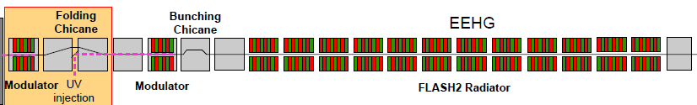
Task Force FLASH1 undulator beamline
Variable Gap Undulators and Seeding
New layout within existing FLASH1 footprint
Bunch Compressor / Matching Section / Modulator 1 / EEHG Chicane / Modulator 2/ HGHG Chicane / Radiator / Afterburner / TDS / Dogleg / THz undulator
Radiator (proposal)
1.15 m APPLE III, 8 mm gap, 50 mm period, Magnetic length: 16.8 m (16 sections, filling < 66%).
Sequence: Undulator/chicane/Undulator/Quad/chicane/BPM/Undulator/chicane/Undulator/Quad/chicane/Screen
Target specs
 | SASE | Seeding (10Hz) | Seeding (100kHz+)
Polarization | Linear/Variable | Variable | Variable
Wavelength | 4 – 90 nm | HGHG: 20 (10?) – 90 nm | HGHG: 20 (10?) – 90 nm
 |  | EEHG: 4 – 20 nm | EEHG: 4 – 20 nm

Slide 36
Task Force FLASH2 Line
Novel Lasing Concepts
BC
Uas
Kicker
TDS or dechirper
U1
U2
U2 (U3?)
Ulsca
THz(OAB)
3 m
0.5 m
1 m
2 m
20 m
2 m
25 m
2.5 m
1 m
4 m
compact
chicanes
(R56 ~ 100 µm)
compact
chicanes
(R56 ~ 100 µm)
U1: period 3.5 cm, K_{rms} = 2.55
U2: period 2.7 cm, K_{rms} = 1.45
Total length of elements about 60 m + ~20 m for quads, steerers, BPMs (already included in U1, U2)
Harmonic lasing (5th in U1 and 3rd in U2): 1.2 – 2 nm
Frequency doubling (chicane or reverse taper): 1.2 – 2 nm
HLSS: 2 – 6 nm
SASE: 2.3 – 18 nm
Two colors: 4.5 – 18 nm (U1) and 2.3 nm – 6 nm (U2)
Main FEL modes
(for fixed energy 1.35 GeV):

Slide 37
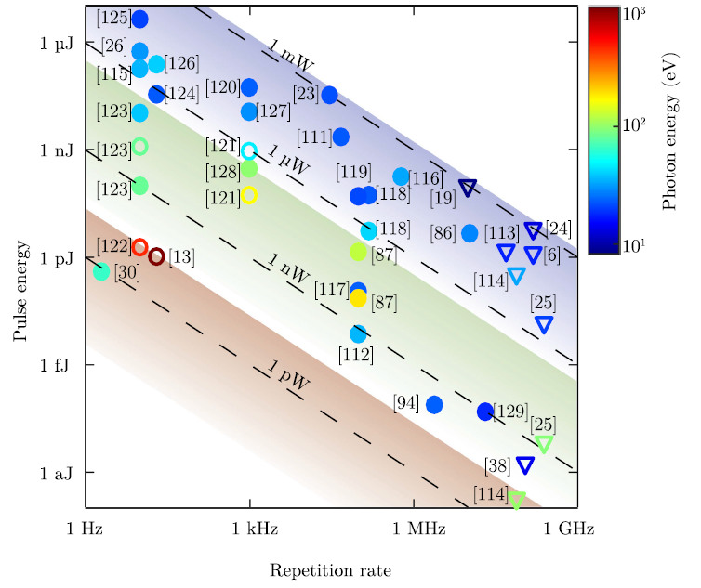
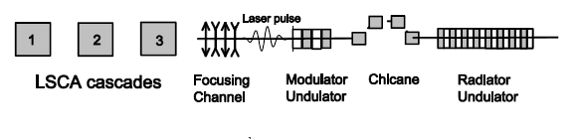
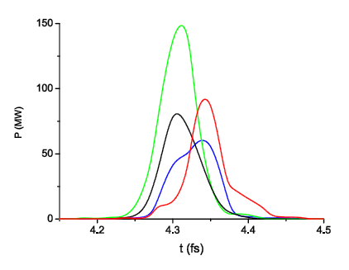
Attosecond Science at FLASH
Scaling of XUV HHG laser sources
Novel lasing schemes
„attoFLASH“
Wavelength 5 nm
pulse length 50-70 asec (FWHM)
pulse energy 5 nJ
contrast above 98%
C.M. Heyl et al., J. Phys. B: At. Mol. Opt. Phys. 50 (2017) 013001
M. Dohlus et al., PRSTAB 14 (2011) 090702
Exploit novel ideas based on laser-electron beam manipulation

Slide 38
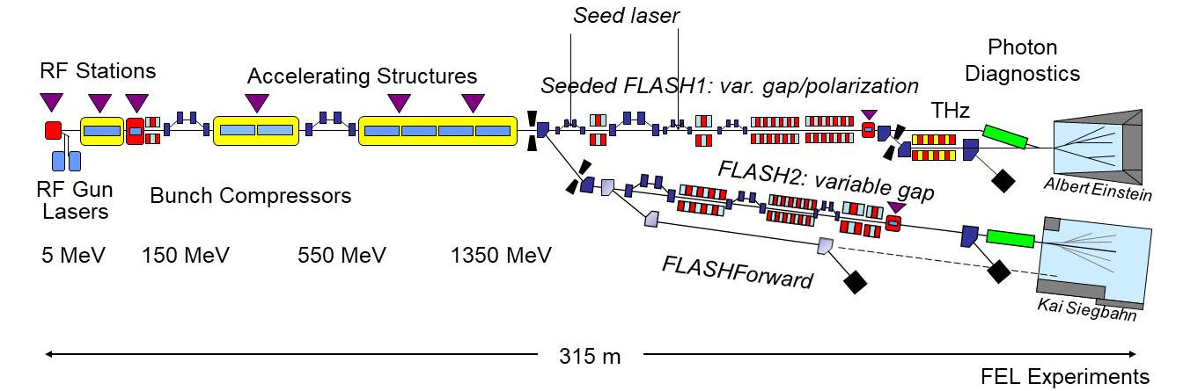
Proposed layout FLASH2020+

Slide 39
FLASH2020+ Expected Parameters
0.75 and 1.35 GeV assumed as energy points
 | FLASH1 (Seeded) | FLASH1 (SASE) | FLASH2
Wavelength range | 4 – 60 | 3.2 – 60 | 1.3 – 84 | nm
Pulse energy | <100** | <1000 | <1000 | μJ
Pulse duration (FWHM) | 30 | 5 - 200 | 0.1 – 200 | fs
Spectral width | Fourier limited | 0.5 - 2 |  | %
Pulses per second* | 10 – 5000 | 10 – 5000 | 10 – 5000
**Simulations not finished: value is estimation
*Shared between FLASH1 and FLASH2

Slide 40
The future XUV and Soft X-Ray FEL Landscape
SHINE (2023)
FLASH 2020+
FLASH – the only seeded high repetition rate XUV and soft X-ray FEL

Slide 41
Summary

Slide 42
Summary
Upgrades/refurbishments
Low charge electron beam diagnostics → finished
BAMs and synchronization system → started summer 2018
BACCA: Arrival time stabilization with a warm RF cavity → in commissioning
Many other upgrades/refurbishments are on-going or even finished:
timing, MPS, coupler interlocks, cryo, magnet server, screens, VME crates, servers, personnel interlock …
Refurbishment of two old accelerator modules → 2020/21
Next generation photocathode laser → 2020/21
TDS at FLASH2 → 2019/20

Slide 43
Summary
FLASH2020+ development program
Includes: operation of two independent FEL lines (FLASH1 and FLASH2)
  with variable magnet structures (undulators) for trend-setting new lasing concepts
  seeding with a high repetition rate
  extension of the wavelength range to the oxygen K-edge (540 eV/2.3 nm)
  flexible pump-probe schemes for time-resolved experiments
  variable polarization
  shortest pulses up to the attosecond range

