Slide 1
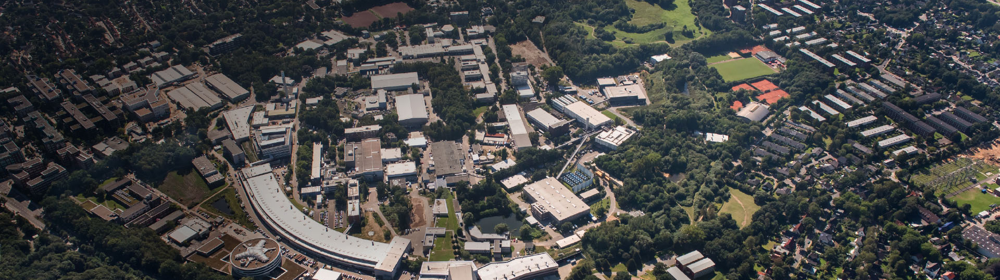
PETRA III Operation
2018
Michael Bieler
Travemünde, Febr. 21, 2019

Slide 2
Agenda
01 Operation 2018
02 Availability
03 Conclusion

Slide 3
Operation 2018

Slide 4
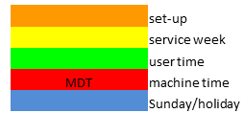
Operation 2018
Schedule
External users from March 26 to July 17
and from Sept. 3 to Dec. 20

Slide 5
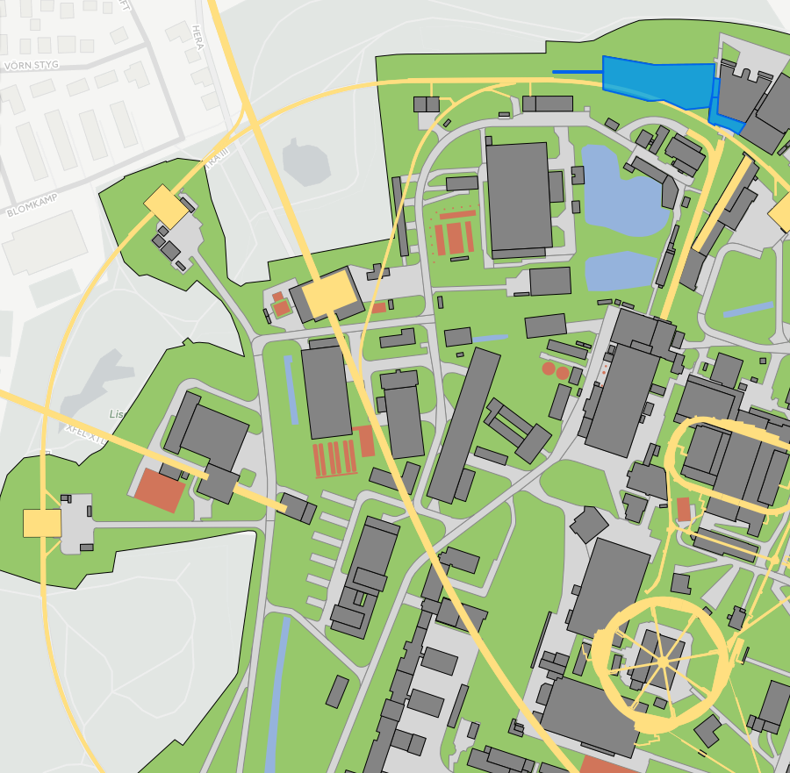
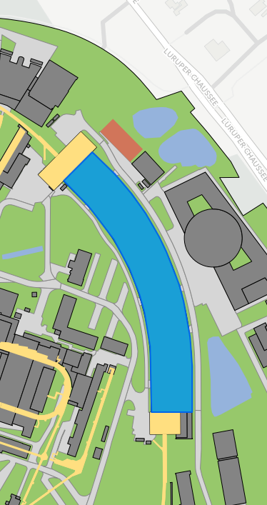
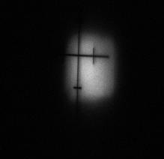
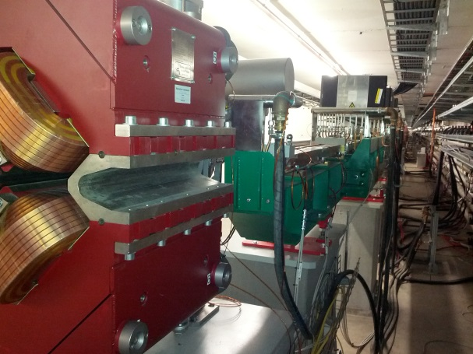
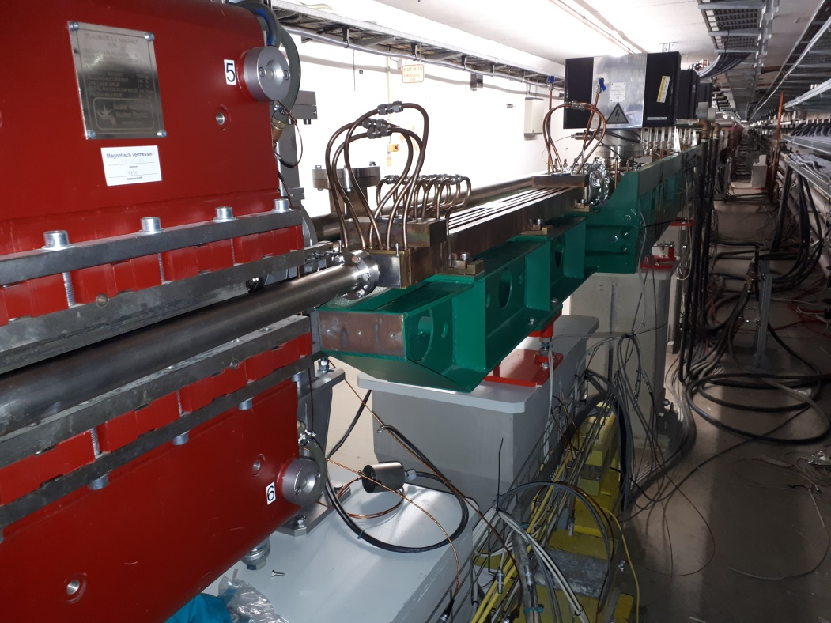
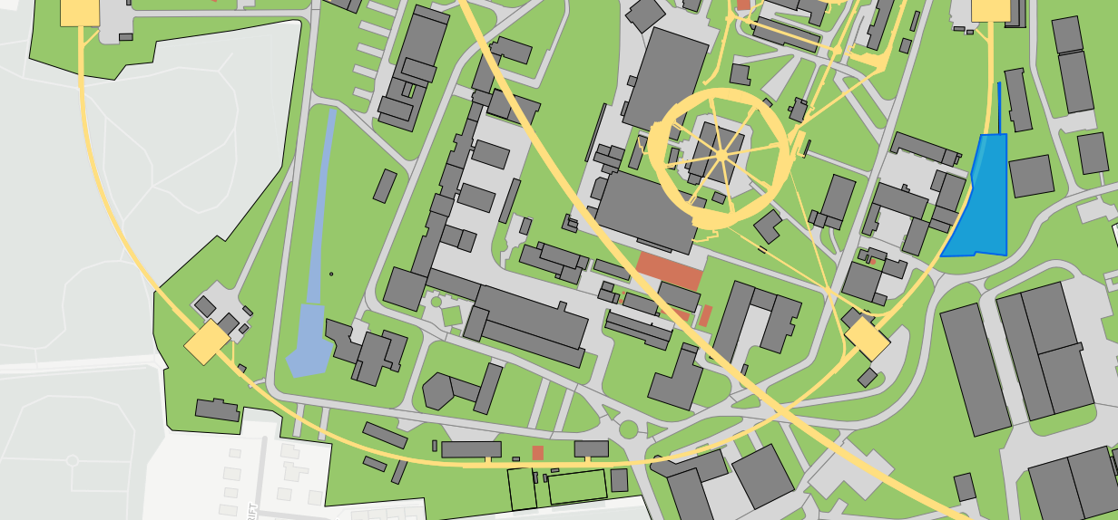
Operation 2018
Summer Shutdown 2018
15.8.2018
Straight section north, damping wigglers:
Hole in the wall for P61
Exchange of last absorber in damping wiggler section
Installation of front end for P61 in the tunnel, including a power absorber
First light in the front end of P61

Slide 6
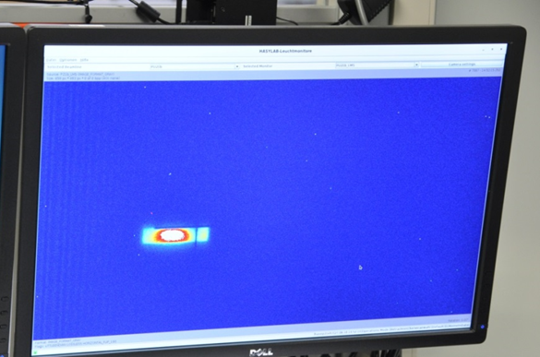
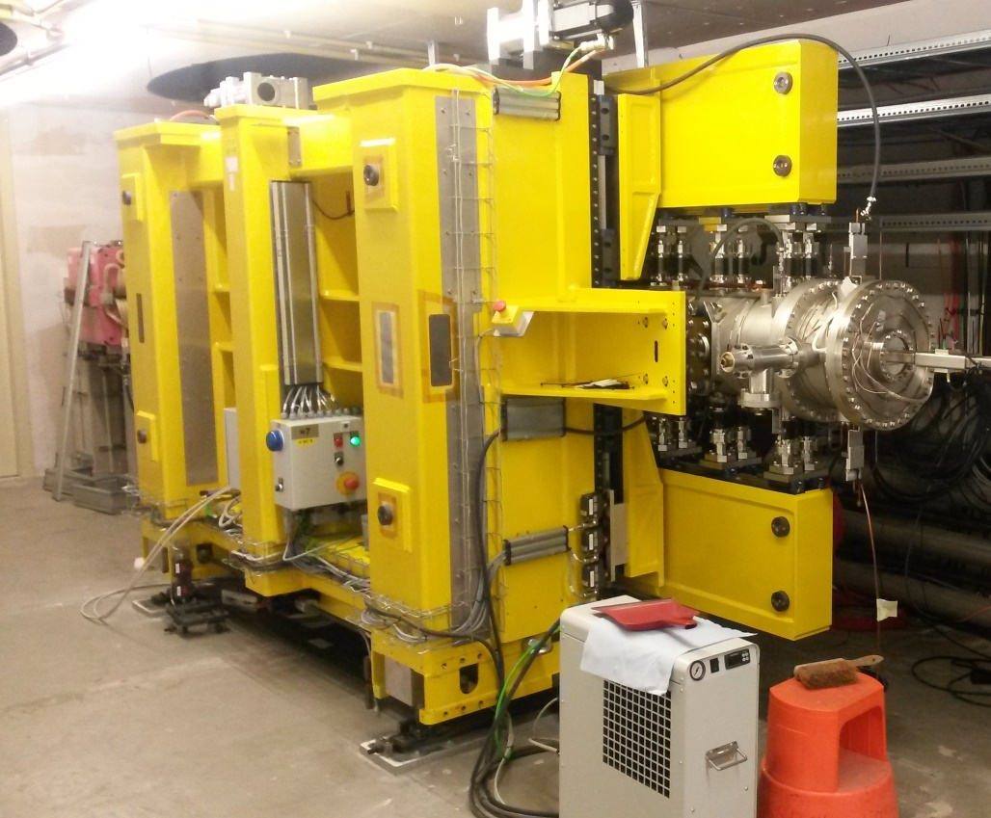
Operation 2018
Summer Shutdown 2018
Straight section East:
Removal of the temporary In-Vacuum-Undulator PU21b
Installation and bake out of the final In-Vacuum-Undulator PU21b
27.08.2018:
First monochromatic light from the IVU, PU21b
5.9.2018:
First proof of principle diffraction pattern from the IVU, PU21b
PU21b, IVU

Slide 7
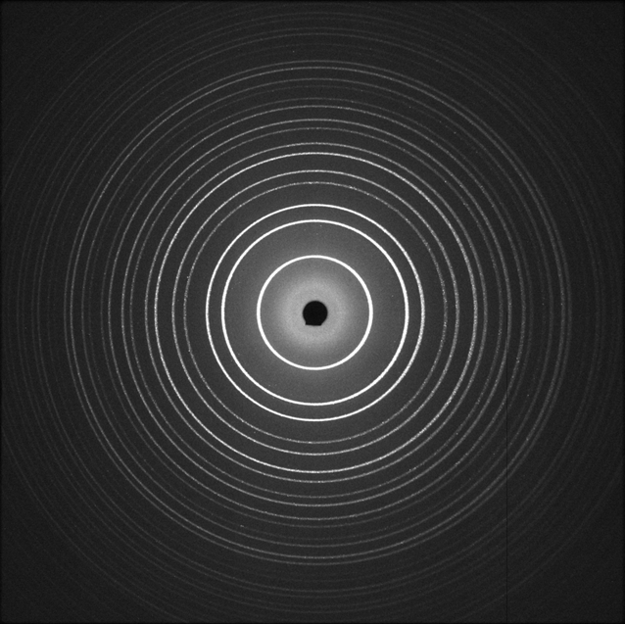
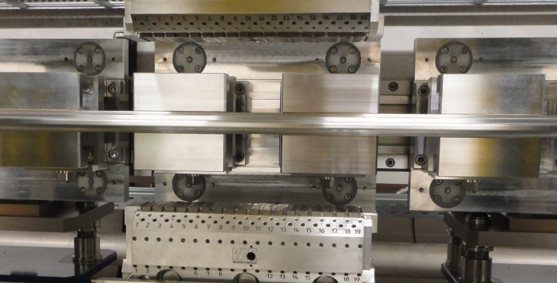
Operation 2018
PU21a
17.9.2018:
First proof of principle diffraction pattern from the ‘baby undulator’ PU21a
PU21b, IVU

Slide 8
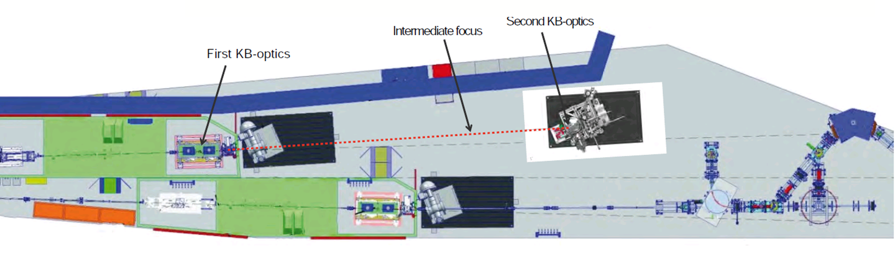
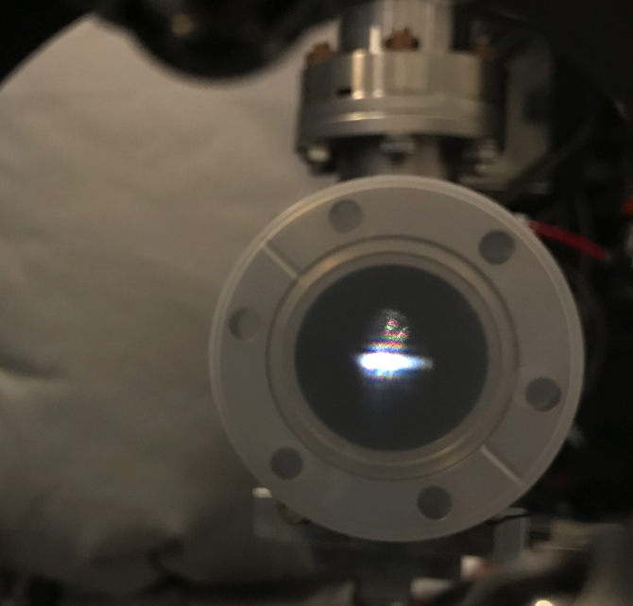
Operation 2018
PU04
Sept. 10 2018: First light at the end of the new branch of P04
PU21b, IVU

Slide 9
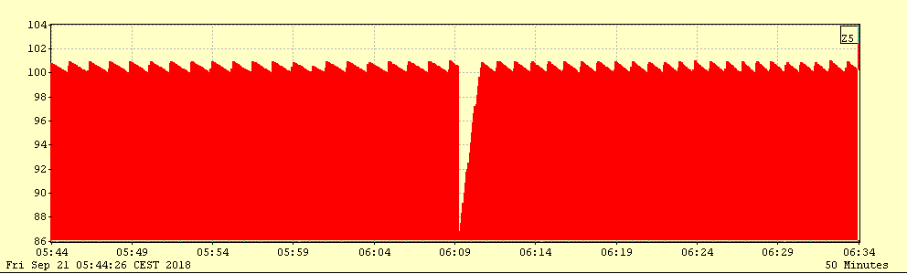
Operation 2018
Timing Mode
Timing Mode:
40 Bunch operation with 100 mA beam current became unstable. Spontaneous beam losses of 10-15 mA happened ~ daily.
Cure:
40 bunch mode with 90 mA beam current, no instabilities.
Experiments prefer stable operation.
PU21b, IVU

Slide 10
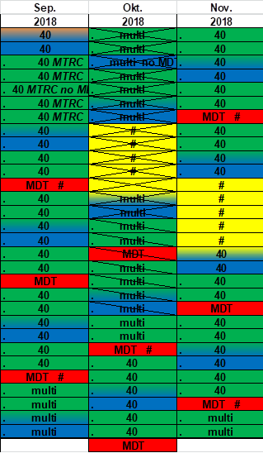
Operation 2018
PU22
The very first beam time at beamline P22 was very successful.
Therefore P22 requested a change in schedule:
Another 10 days of timing mode.
As a compromise a ‘mild’ timing mode with 80 bunches was delivered in October.
Again very successful experiments at P22.
At the same time P07 requested a low beta optics. This was established, for the first time with PU21 in the straight section east. Less degrees of freedom for tuning the optics, low beam life time, high emittance.
This optics needs more attention.
80 bunches,
low beta
PU21b, IVU

Slide 11
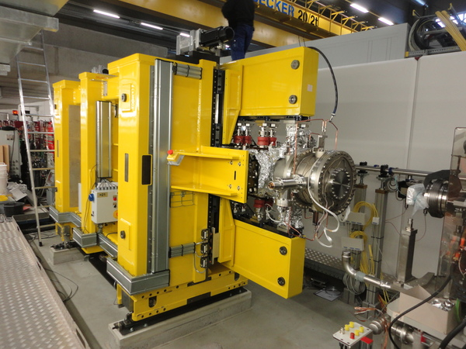
Operation 2018
Winter Shutdown 2018/2019
In the arc West Right:
Installation of 10 NEG coated dipole chambers, NO bake out (Test for PETRA IV)
Max von Laue Hall:
Removal of the temporary 2 m undulator PU7 (after 8 years)
Installation and bake out of the final In-Vacuum-Undulator PU7 (former temporary PU21b)
PU21b, IVU

Slide 12
Operation 2018
Plans für 2019
External users from March 11 to July 14
and from Aug. 5 to Dec. 19
PU21b, IVU

Slide 13
Operation 2018
Statistics
User Run 2018
Scheduled time: 4231 h
55 % Timing Mode (40/80 Bunches)
Availability 96,4 %
5 bunch patterns:
Timing Mode
  40 bunches, 192 ns
  80 bunches, 96 ns
Continous Mode
  240 bunches, 32 ns
  480 bunches, 16 ns
  960 bunches, 8 ns
80
PU21b, IVU

Slide 14
Availability

Slide 15
Availability
96.4 %
2017:
98 %
Studies,
Testruns
weekly average
goal
yearly average
PU21b, IVU

Slide 16
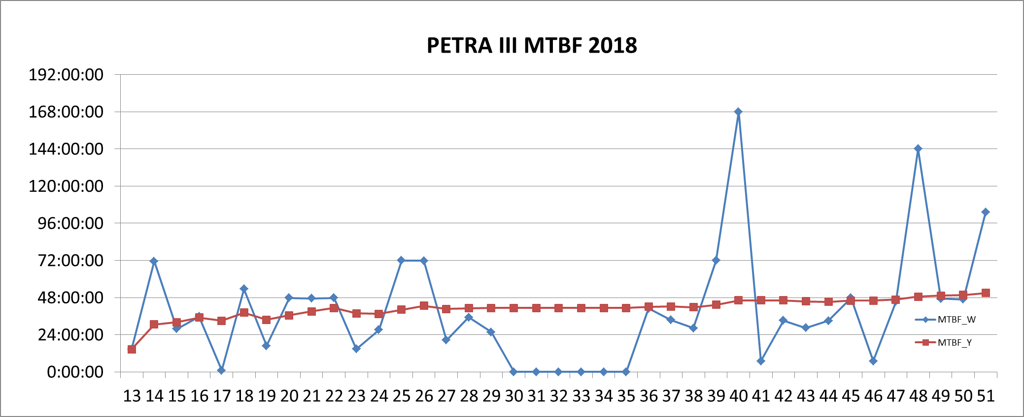
Availability
MTBF
Definition:
Mean Time between Failures =
delivered beam time
number of faults
50:00 h
2017:
42:37 h
Studies,
Testruns
PU21b, IVU

Slide 17
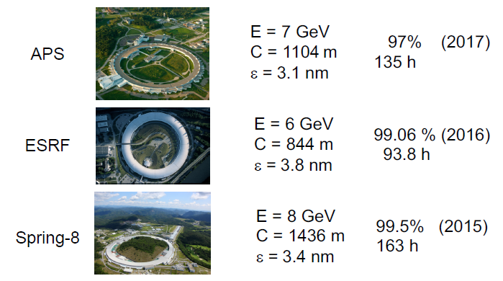

Availability
Comparison
6 GeV
2304 m
1.4 nm
PETRA III
96.4 % (2019)
50 h
PU21b, IVU

Slide 18
Availability
Faults statistics
PU21b, IVU

Slide 19
Availability
Faults statistics
Failure time:
Dominated by 3 disasters (red bars).
Together they represent
64 h failure time
42 % of the total failure time
1.5 % availability
PU21b, IVU

Slide 20
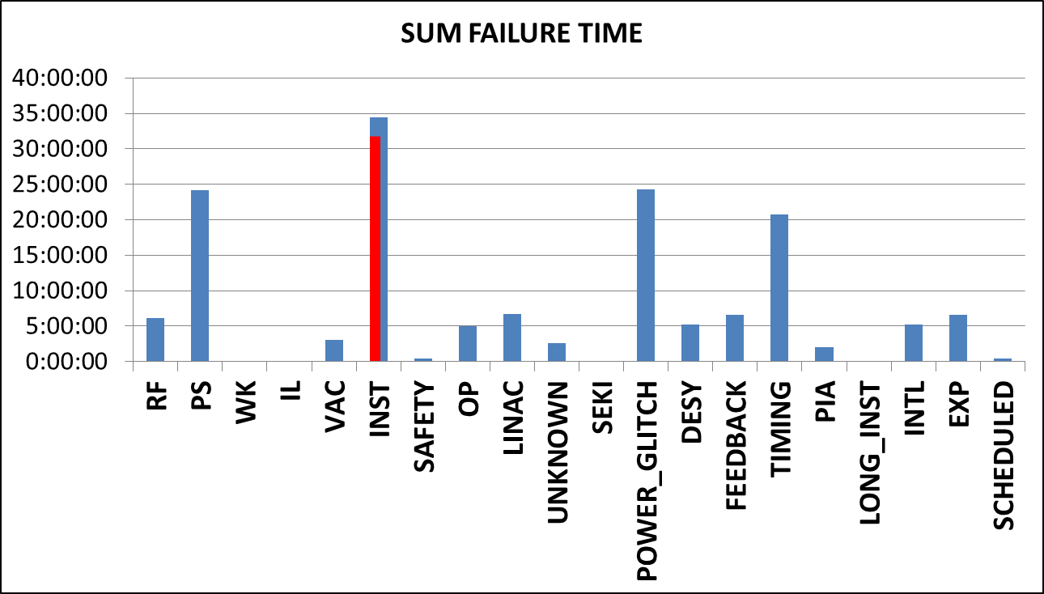
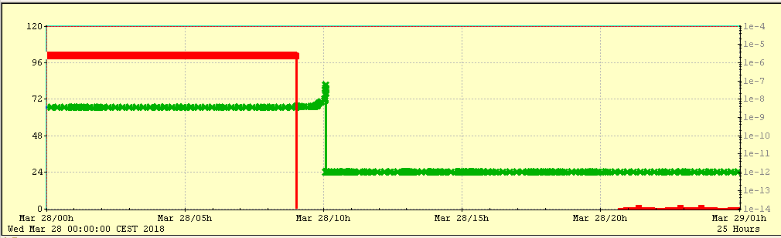
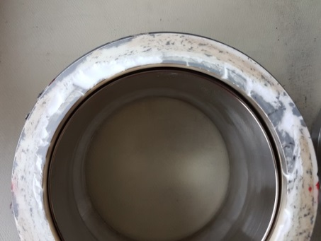
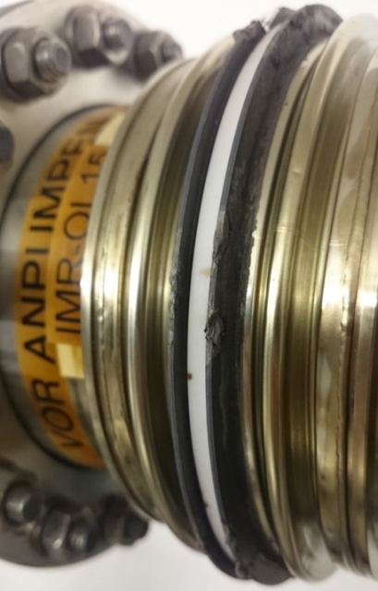
Availability
Faults statistics
Instrumentation, 28.3.2018:
Vacuum leak at a beam current monitor. 30 minutes after a beam dump the pressure went up. 200 m storage ring and 4 frontends vented.
Monitor build in 2008, no longer used, temperature no longer monitored.
Thorough investigation:
Vendor consulted
Broken surface inspected in material science lab
Temper colors normal
RF field calculations: 46 W deposited (currently used design: 16 W)
No reason found.
31 h lost.
Lesson learned:
Remove all unnecessary components to reduce risks.
PU21b, IVU

Slide 21
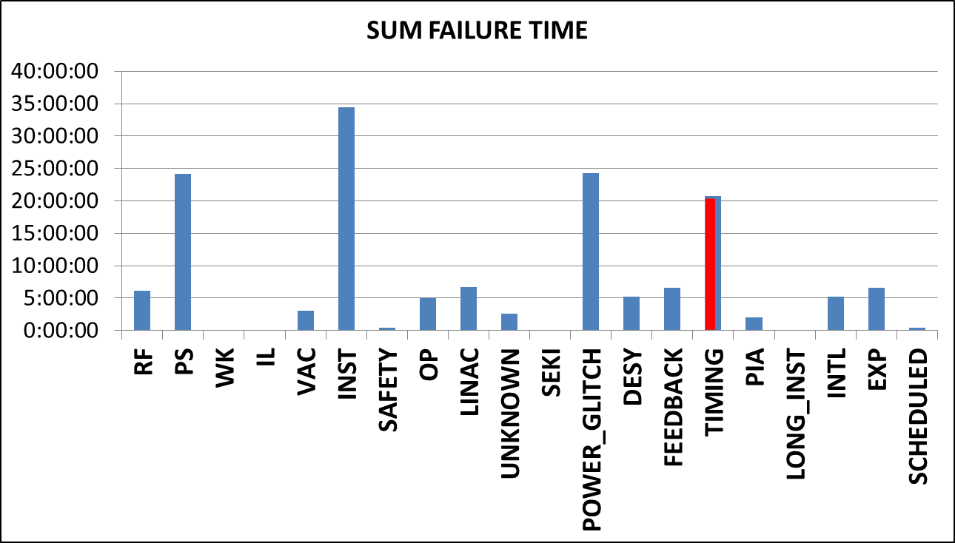
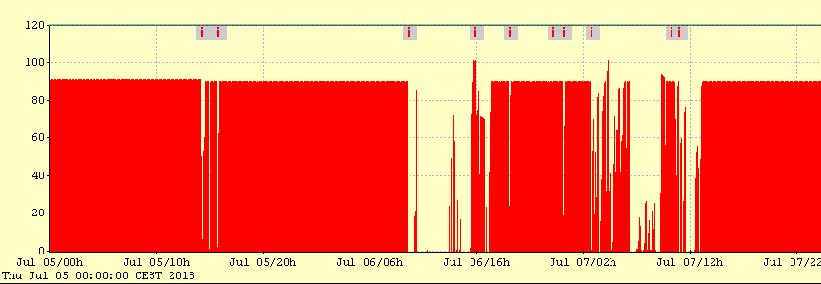
Availability
Faults statistics
Timing, 5.7.-7.7.2018:
Timing jumps lead to longitudinal instabilities and beam losses.
Reason unknown, components exchanged ‘randomly’. Very few experts working day and night.
Finally found: A faulty 500 MHz synthesizer in the timing system did phase jumps in the µs range.
20:45 h lost.
Timing jumps
Lessons learned:
Timing had
not enough diagnostics (added here)
not enough experts.
PU21b, IVU

Slide 22
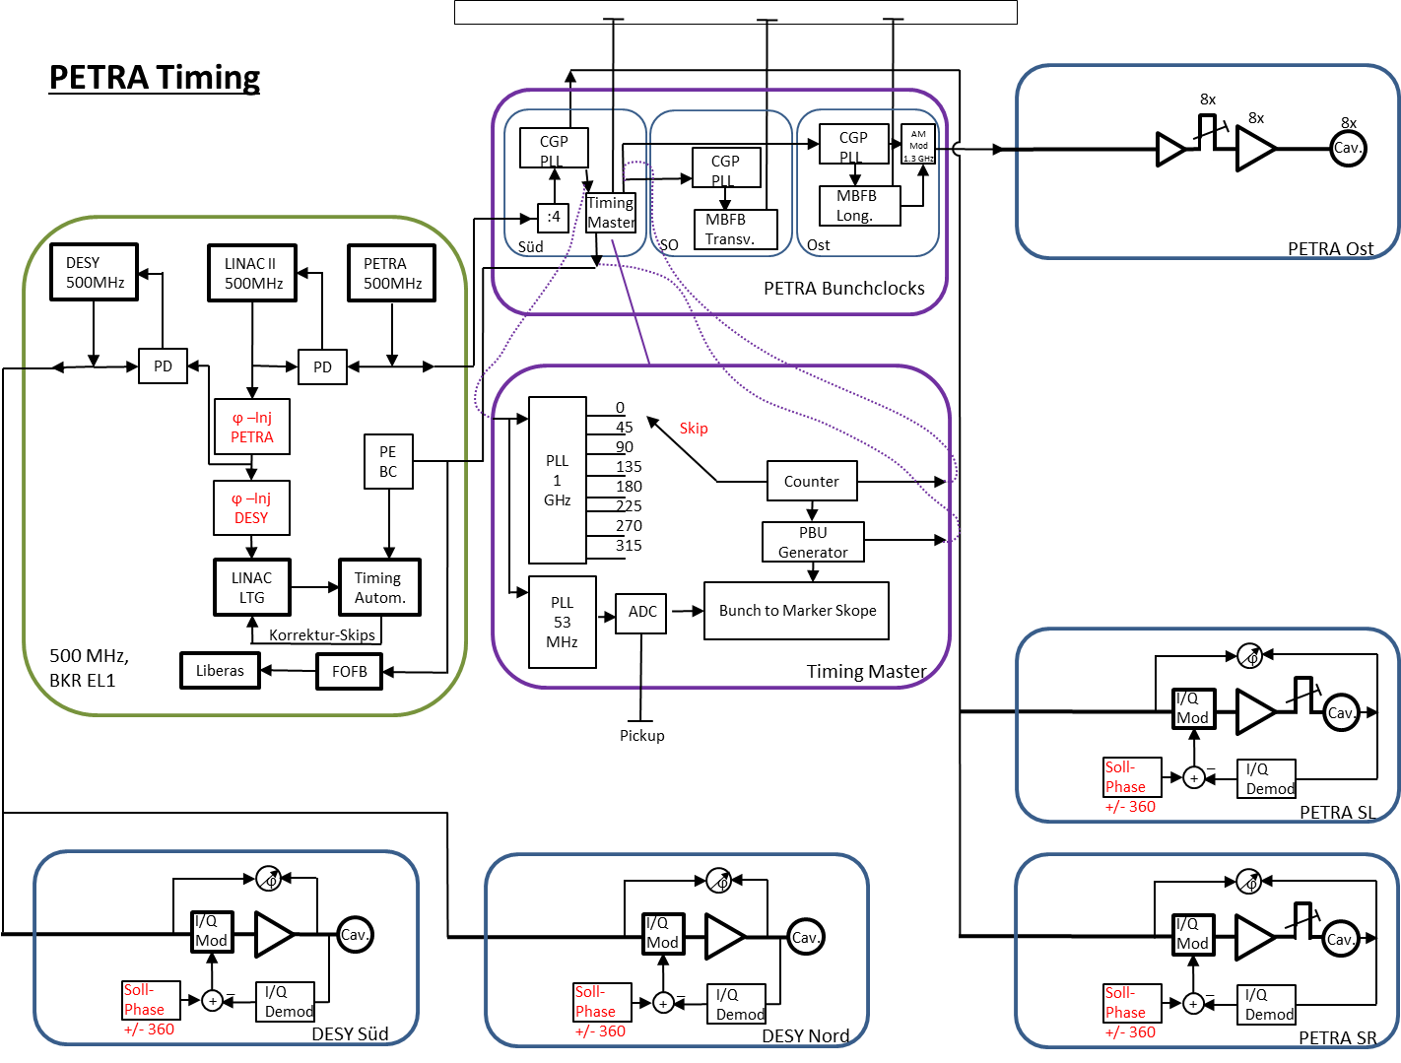
Availability
phase jumps in the µs range.
Faults statistics
20:45 h lost.
PU21b, IVU

Slide 23
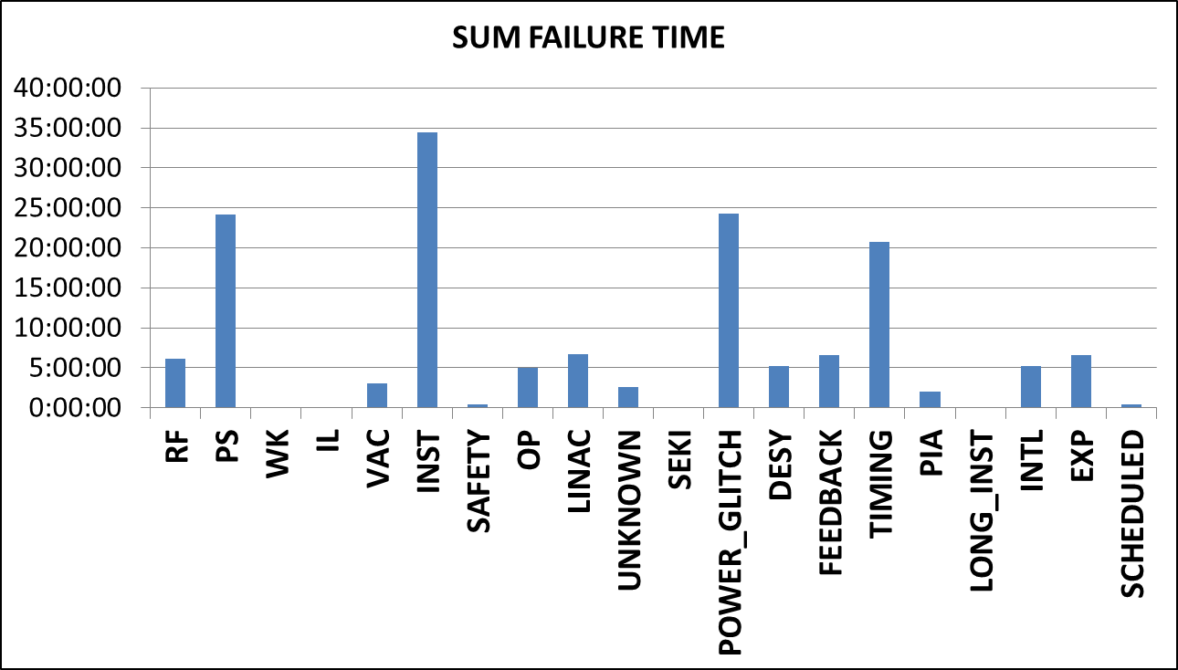
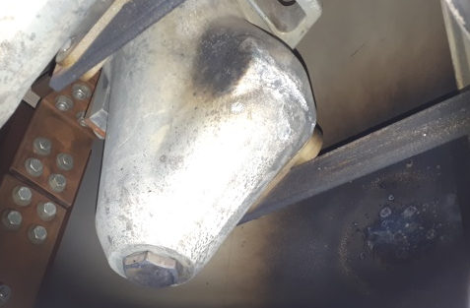
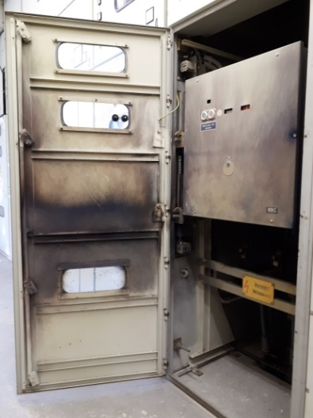
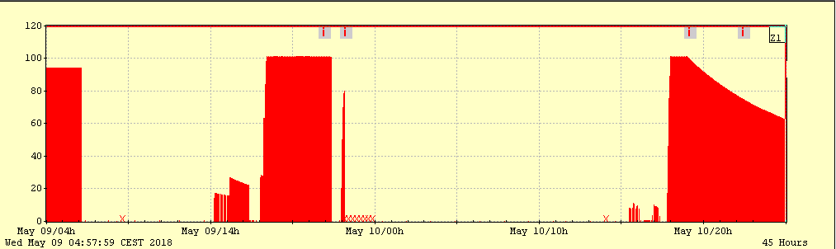
Availability
Faults statistics
Power Glitch, 9.5.2018, 11 PM:
Flash in a 10 kV switch on site.
DESY lost 2 of 3 power feeds.
PETRA III and FLASH affected. Buildings are dark, many broken components.
10 kV back after 2 hours.
On call services on site all night (after a full working day).
10.5.2018 is Ascension Day, national holiday, no fresh personal available. Several volunteers come in.
PETRA III user operation is supposed to start 10.5. 7 AM.
No beam before 10.5. 7 PM.
The 10 kV switch was investigated by
DESY personal
experts from the local power provider
The switch had been serviced regularly.
No reason for the fault found. The switch is back in operation.
12 h lost.
Service Day
Test Run
User Run
Lesson learned:
A power outage on the night before a public holiday is hard to cover.
PU21b, IVU
Power
Outage

Slide 24
Availability
Faults statistics
Failure time (w/o the 3 major events):
Magnet power supplies: Long time to repair.
Power glitch: Mainly from outside DESY.
The rest is equally distributed
PU21b, IVU

Slide 25
Availability
Faults statistics
Number of faults:
RF: High, but improved. No venting, no tests.
Magnet power supplies: High number of components.
Power glitch: Mainly from outside DESY.
Experiments:
  Users opening doors,
  Front End electronics,
  Undulator faults
PU21b, IVU

Slide 26
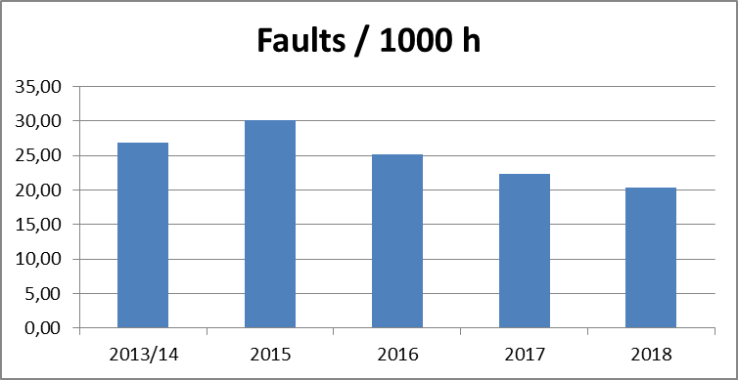
Availability
Faults statistics
Number of faults per 1000 h:
Mainly consistent with previous years.
PU21b, IVU

Slide 27
Conclusion

Slide 28
Conclusion
Availability 2018 was lower than in previous years.
3 major events dominated the statistics.
The number of faults per 1000 h is slightly improving over the years.
The MTBF is slightly improving over the years.
Both availability and MTBF are not yet in line with other facilities.
PU21b, IVU

Slide 29
Thank you

Slide 30
Michael Bieler
-MBB-
bieler@desy.de
Tel. (9)3805

