Slide 1
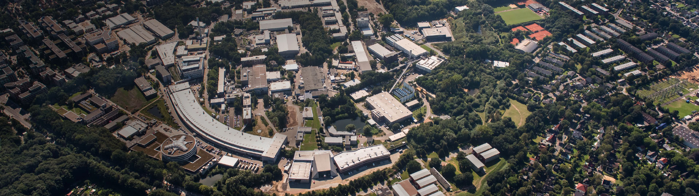
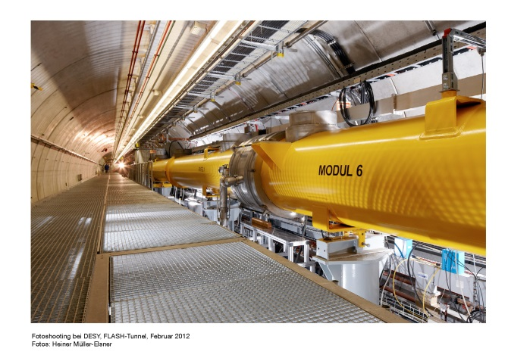
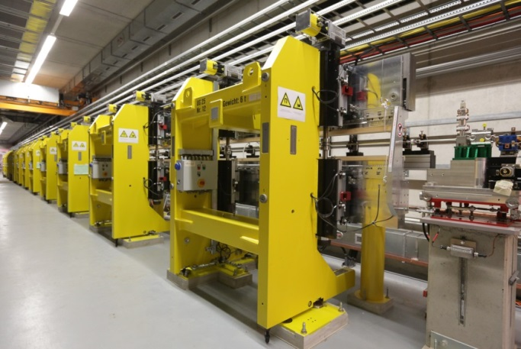
Operation and SASE tuning statistics
FLASH: The first soft X-ray FEL operating two undulator beamlines simultaneously
Juliane Rönsch-Schulenburg &
Katja Honkavaara
Beschleunigerbetriebsseminar
Travemünde
Februar-21, 2019

Slide 2
FLASH Operation
Statistics 2018

Slide 3
FLASH1 Operation 2018
FLASH1: 7103 operating hours
7103 operation hours
of which 4189 h FEL user operation
scheduled maintenance 59 h
scheduled shutdowns 1445 h
exchange RF-gun RF-window 100 h
cryo maintenance 53 h
Accelerator R&D
11% 804 h
Studies and
user preparation
30% 2110 h
FEL user operation
59% 4189 h
SASE delivery
81.8% 3427 h
Tuning + Set-up
14.7% 617 h
Down 3.5% 145 h

Slide 4
FLASH2 Operation 2018
FLASH2: 6831 operating hours
6831 operation hours (stand-by 1014 h)
of which 2269 h FEL user operation
scheduled maintenance 60 h
scheduled shutdowns 1717 h
exchange RF-gun RF-window 100 h
cryo maintenance 52 h
Accelerator R&D
19% 1323 h
Studies and
user preparation
48% 3239 h
FEL user operation
33% 2269 h
SASE delivery
80.3% 1821 h
2030 h User Experiments
239 h Methods and Instr. Dev.
Tuning + Set-up
14.9% 339 h
Down
2.5% 57 h
Stand-by
2.3% 52 h

Slide 5
FLASH Downtime
Statistics 2018

Slide 6
Downtime 2018
G
FLASH1: Total down 3.7%
FLASH2: Total down 3.4%
D
Downtime (%)
K
F
C
L
B
H
J
E
RF-gun window exchange
A
4%
I
Shutdown
Shutdown
Week
1
5
10
15
20
25
30
35
40
45
50
A: RF-6 (interlock card)
B: Magnet controls
C: LLRF (ACC23), Magnet PS / Magnet controls
D: Major power cut
E: Power glitch (1 s)
F: Cryogenics, Vacuum (SSK), RF-gun IR-detector
G: RF-gun window
H: Photon beamline
I: Cryogenics
J: LLRF (ACC23), RF-2, operating, photon beamline
K: Photon beamline
L: Photon beamline

Slide 7
Downtime 2018 (zoom)
D
F
G
K
FLASH1: Total down 3.7%
FLASH2: Total down 3.4%
C
B
H
L
E
J
A
Downtime (%)
4%
I
2%
1%
Shutdown
Shutdown
Week
1
5
10
15
20
25
30
35
40
45
50
A: RF-6 (interlock card)
B: Magnet controls
C: LLRF (ACC23), Magnet PS / Magnet controls
D: Major power cut
E: Power glitch (1 s)
F: Cryogenics, Vacuum (SSK), RF-gun IR-detector
G: RF-gun window
H: Photon beamline
I: Cryogenics
J: LLRF (ACC23), RF-2, operating, photon beamline
K: Photon beamline
L: Photon beamline

Slide 8
Downtime Reasons 2018
P11: January – June 2018
FLASH Linac : 3533 operating hours
P12: July – December 2018
FLASH Linac: 3570 operating hours
FLASH Linac down
Only FLASH1 down
Power Cuts +
Power Glitches
Photon Beamlines
Only FLASH2 down
Magnet PS +
Magnet Controls
RF-Gun
Downtime (hours)
RF-Stations
Operating
LLRF
Controls
Vacuum components
Injector Lasers
Cryogenics
Air conditioning
Kickers
Others
Water
Timing
P11 P12
P11 P12
P11 P12
P11 P12
P11 P12
P11 P12
P11 P12
P11 P12
P11 P12
P11 P12
P11 P12
P11 P12
P11 P12
P11 P12
P11 P12
P11 P12
Notes:
This year 2 power cuts -> ~10h already

Slide 9
FLASH Tuning

Slide 10
FLASH1 Operation 2018
FLASH1: 7103 operating hours
7103 operation hours
of which 4189 h FEL user operation
scheduled maintenance 59 h
scheduled shutdowns 1445 h
exchange RF-gun RF-window 100 h
cryo maintenance 53 h
Accelerator R&D
11% 804 h
Studies and
user preparation
30% 2110 h
FEL user operation
59% 4189 h
SASE delivery
81.8% 3427 h
Tuning + Set-up
14.7% 617 h
Down 3.5% 145 h

Slide 11
FLASH1 operation statistics in the user runs of the last years

Slide 12
FLASH1 operation statistics in the user runs of the last years
Notes:
Stability becomes more and more an issue

Slide 13
FLASH1 + FLASH2 User Operation
A:
FL1: 30 nm, 1 bunch, 220 pC
FL2: 50 nm, 60 - 80 b 200 kHz, 90 pC, L3
18.3. – 26.3. 2018
FL1: Delivery: 85%, Tuning + Set-up: 11%, Down: 4%
FL2: Delivery: 84%, Tuning + Set-up + Stand-by: 15 %, Down: 1 %
B:
FL1: 13.4 nm, 1 bunch, 280 pC, THz
FL2: 21.3 – 21.7 nm, 1-100 b 40/200/250 kHz, 60 - 80 pC, L3
SASE Delivery
Set-up+Tuning
Stand-by
Down (Machine failures)
Sun
Mon
Tue
Wed
Thu
Fri
Sat
Sun
Mon
07h00
Night shift
23h00
Time (h)
Afternoon shift
15h00
Morning Shift
7h00
A
A
B
B
A
A
B
B
B
Notes:
This means a typical run without changing the users lasting 2 days:
Setup: ~ 7h (mainly in the beginning)
Down: ~ 1.5 h
SASE delivery; ~ 39.5h

Slide 14
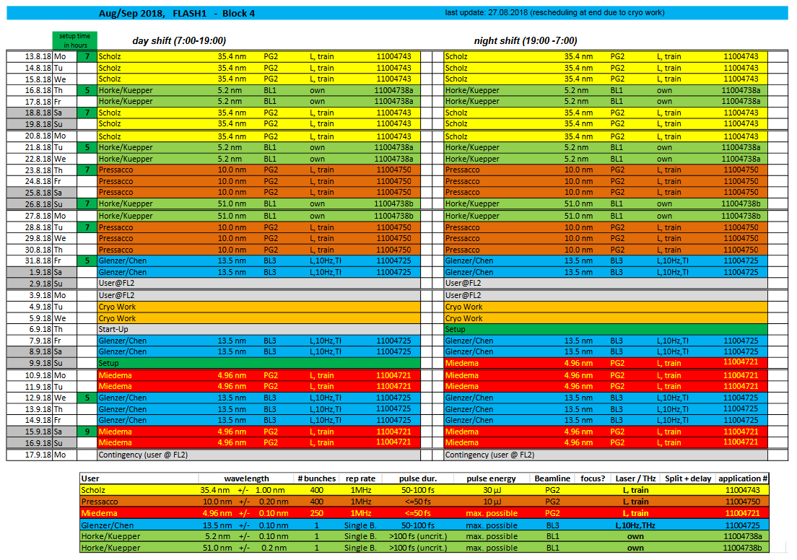
Typical FLASH1 User Operation

Slide 15
Setup-Prozedur

Slide 16
FLASH setup
Shift docu
Setup preparation (open FLASH2 undulators, remove RF-slopes & RF-steps, switch off feedbacks, switch off FLASH2 undulator optics)
Gun-phase scan and on-crest phase scan of modules
Check virtuell cathode (not need for every setup)
Set bunch pattern for FLASH 1 & 2
Sequencer (load machine file)
Setup LLRF (or check)
Restore charge & compression
Restore transmission / orbit
Reduce losses
Measure and correct Dispersion
SASE tuning
Check wavelength
scaling (if needed)
Special SASE tuning (short pulses, pointing, long bunch trains, high charge (mainly used for THz), High Pulse Energy …)

Slide 17
FLASH setup
Special SASE tuning:
  Long pulse trains maximum length
  Short pulses (tuning time and time for LOLA measurement required)
  High or Low energy (>1.1 GeV or <0.45 GeV, LLRF adjustment needed)
  High Pulse Energy
  Bandwidth narrow & large (chirps)
  high charge (>0.5 nC) / THz
  Large difference between FLASH1 and 2
  Strict pointing requirements
  Chirps on the beam
  Double bunches
  Third & fifth harmonics

Slide 18
standard setup
task | min. time (min) | typ. time (min) | max. time (min)
Shift documentation | 10 | 15 | 20
Preparation setup | 1 | 2 | 5
Gun-phase scan | 12 | 20 | 45
Phase scan of modules | 10 | 15 | 40
Set bunch pattern | 1 | 2 | 5
Sequencer (load machine file) | 15 | 20 | 30
Setup (or check) LLRF (<1.1 GeV) | 5 | 10 | 30
Restore charge & compression | 5 | 10 | 15
Restore transmission / orbit | 0 | 15 | 40
Reduce losses | 0 | 30 | 60
Dispersion | 0 (not done) | 10 | 15
SASE tuning | 30 | 90 | 150
Check wavelength | 11 | 15 | 20
 | 1:40 | 4:14 | 8:15

Slide 19
Standard + special setup
task | min. time (min) | typ. time (min) | max. time (min)
Shift documentation | 10 | 15 | 20
Setup preparation | 1 | 2 | 5
Gun-phase scan | 12 | 20 | 45
Phase scan of modules | 10 | 15 | 40
Set bunch pattern | 1 | 2 | 5
Sequencer (load machine file) | 15 | 20 | 30
Setup (or check) LLRF | 5 | 10 | 30
Restore charge & compression | 5 | 10 | 15
Restore transmission / orbit | 0 | 15 | 40
Reduce losses | 0 | 30 | 60
Dispersion | 0 | 10 | 15
SASE tuning | 30 | 90 | 150
Check wavelength | 11 | 15 | 20
Time for simple setup | 1:40 | 4:14 | 8:15
task | min. time (min) | typ. time (min) | max. time (min)
scaling
Sequencer | 10 | 15 | 25
Setup (or check) LLRF | 5 | 10 | 20
Restore transmission / orbit | 0 | 5 | 15
Reduce losses | 0 | 15 | 30
Dispersion | 0 | 5 | 10
SASE tuning | 30 | 60 | 90
Check wavelength | 11 | 15 | 20
Time scaling once | 0:56 | 2:05 | 3:30
LOLA setup / measurement | 20 | 30 | 45
SASE tuning special requirements | 30 | 90 | 210
Setup + scaling once + special tuning | 3:26 | 8:19 | 16:00

Slide 20
What can we optimize ?
task | min. time (min) | typ. time (min) | max. time (min)
Shift documentation | 10 | 15 | 25
Setup preparation | 1 | 2 | 5
Gun-phase scan | 12 | 20 | 45
Phase scan of modules | 10 | 15 | 40
Set bunch pattern | 1 | 2 | 5
Sequencer | 15 | 20 | 30
Setup (or check) LLRF | 5 | 10 | 30
Restore charge & compression | 5 | 10 | 15
Restore transmission / orbit | 0 | 15 | 40
Reduce losses | 0 | 30 | 60
Dispersion | 0 | 10 | 15
SASE tuning | 30 | 90 | 150
Check wavelength | 11 | 15 | 20
Time for simple setup | 1:34 | 4:14 | 7:55
task | min. time (min) | typ. time (min) | max. time (min)
scaling
Sequencer | 10 | 15 | 20
Setup (or check) LLRF | 5 | 10 | 20
Restore transmission / orbit | 0 | 5 | 15
Reduce losses | 0 | 15 | 30
Dispersion | 0 | 5 | 10
SASE tuning | 30 | 60 | 90
Check wavelength | 11 | 15 | 20
Time scaling once | 0:56 | 2:05 | 3:25
LOLA setup / measurement | 20 | 30 | 45
SASE tuning special requirements | 30 | 90 | 210
Setup + scaling once + special tuning | 3:20 | 8:19 | 15:35

Slide 21
FLASH setup - conclusion
  What can we optimize at the current situation?
  Setup times for user operation can only be improved significantly with current FLASH layout by optimizing the scheduling, means reducing the numbers of setups, unfortunately this is limited by constraints on experimental side, like in manpower, experiment setup time & sample exchange time, …
  For the success of the experiment the present scheduling seems the best compromise
  From the variable gap undulators in FLASH1 we would gain:
  we have only two or three fixed beam energies and thus a new setup is not required so often
  we don’t need to scale files, because wavelength changes are realized by opening and closing the undulators

