Slide 1
European XFEL Status
Winni Decking, DESY
Beschleuniger-Betriebs-Seminar 2019
21 February 2019

Slide 2
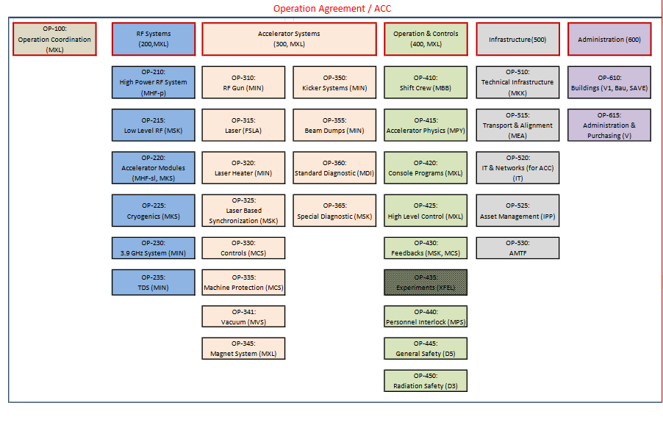
The Team
Basically the complete M-Division (about 230 FTE)
Photon systems & experiment scientists from European XFEL GmbH
Coordination team (MXL): Riko Wichmann (Planning & Budget), Matthias Scholz (Operations Coordination), Dirk Noelle (Technical Coordinator), Winni Decking (Overall Coordination & User Liaison)
Operation packages (and their leads) interface to sub-systems and technical groups

Slide 3
Operation
Weekly (accelerator) operation is supported by a team of 10 run-coordinators (always two on 24/7 on-call duty), BKR-crew, 24/7 sub-system on-call duties
Similar set-up at European XFEL GmbH (photon run coordinators, on-call services, all still being developed)
Operation coordination with European XFEL through ‘Operation Board’ (weekly meetings on Fr 08:30-09:30)
Regular Meetings:
  Mo 10-11 Technical Coordination Meeting (24/200)
  Fr 09:30-10:30 Run Coordination Meeting (Schenefeld, video-link)
  Fr 10:30-11:30 Experiment Meeting (Schenefeld, video-link)

Slide 4
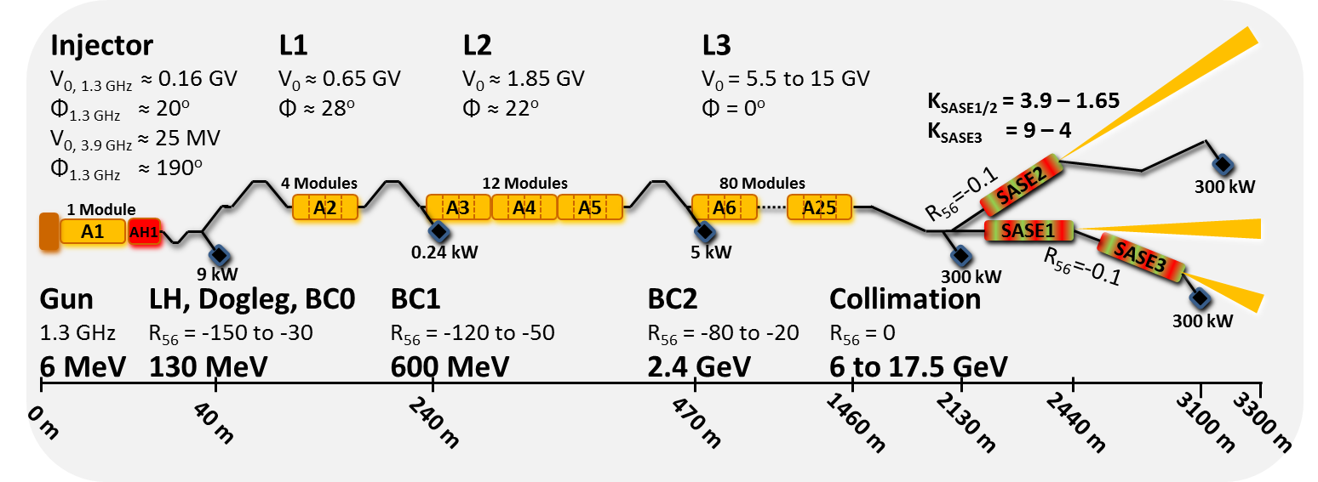
Accelerator Overview

Slide 5
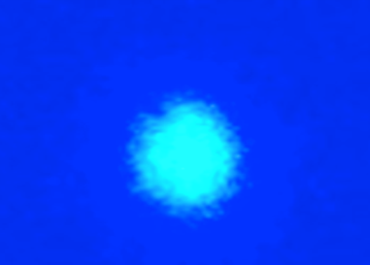
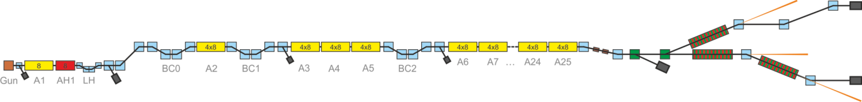
Commissioning timeline 2017
First lasing SASE1
@ 9 Å
May 2-3, 2017
April 27, 2017
Jan 13, 2017
Feb 2, 2017: 600 MeV
Feb 22, 2017: 2.5 GeV
Feb 25, 2017: 2.5 GeV
April 8, 2017: 12 GeV
Oct 23, 2017: 14.9 GeV
Jan 15, 2017: 130 MeV
Jan 19, 2017: 600 MeV

Slide 6
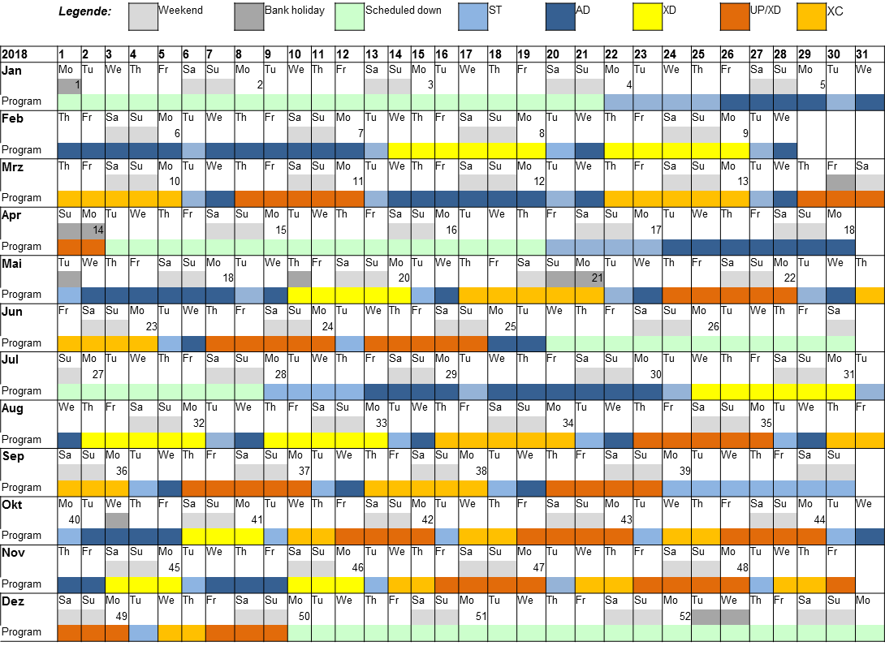
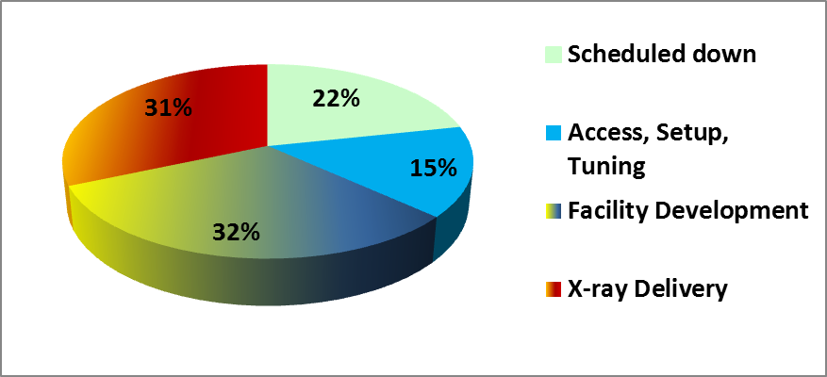
Schedule 2018
About 6800 hours of operation

Slide 7
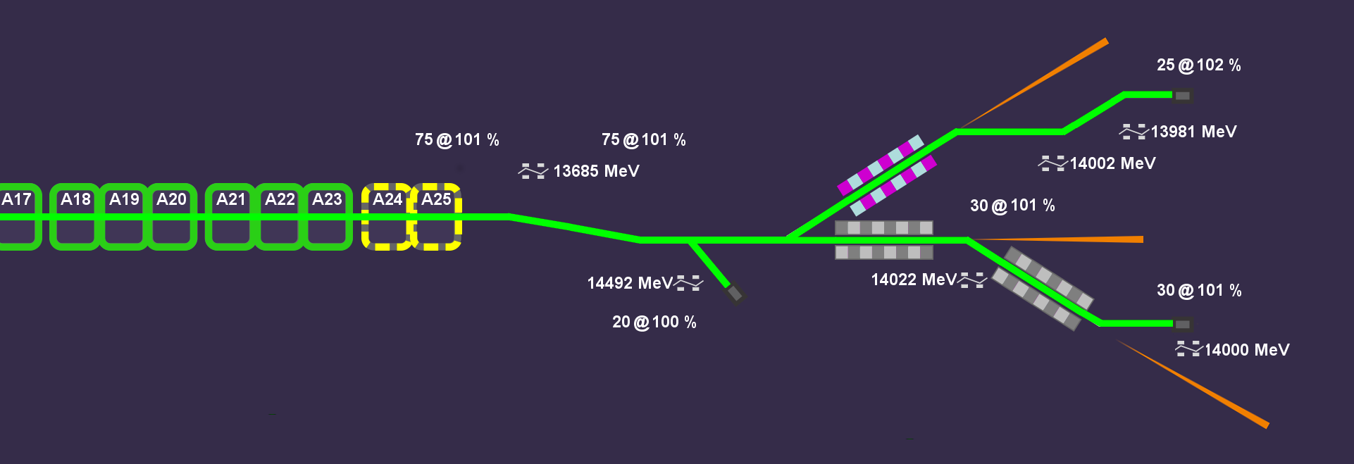

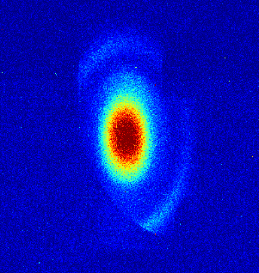
Achievements 2018
Flexible Beam Distribution
First lasing SASE2
@ 1.8 Å
March 13, 2018
First lasing SASE1
@ 9 Å
May - October, 2018
May 1, 2018
May 2-3, 2017
April 27, 2017
Jan 13, 2017
Feb 2, 2017: 600 MeV
Feb 22, 2017: 2.5 GeV
First lasing SASE3
@ 1.3 nm
Feb 25, 2017: 2.5 GeV
April 8, 2017: 12 GeV
Oct 23, 2017: 14.9 GeV
Jan 15, 2017: 130 MeV
Jan 19, 2017: 600 MeV
July 12, 2018: 17.6 GeV
Nov 2, 2018: 2699 bunches/RF pulse
February 8, 2018

Slide 8
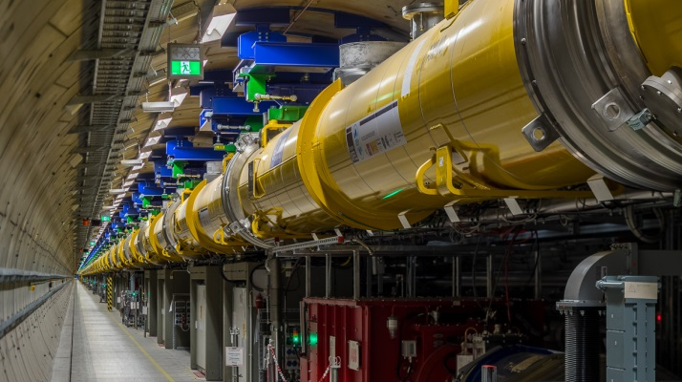
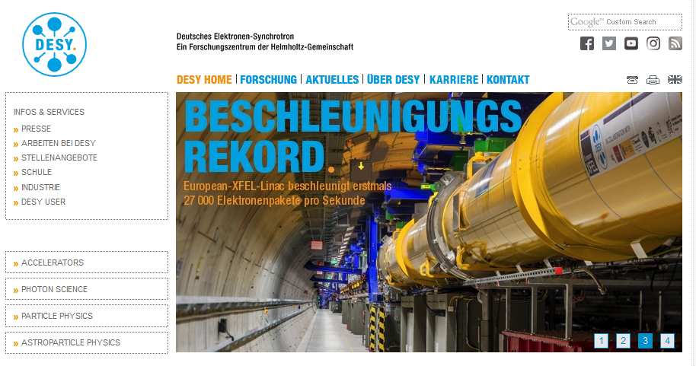
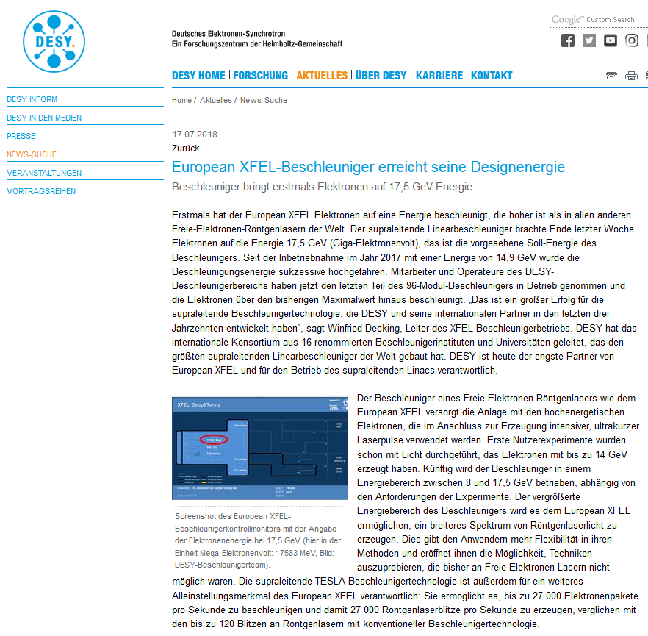
Superconducting linear accelerator demonstrates design performance

Slide 9
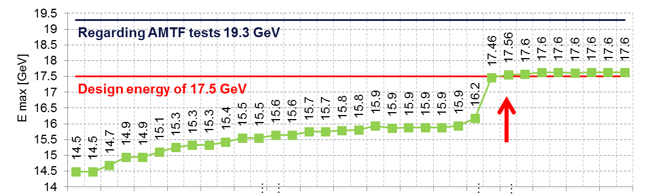
Linac Status: Design Energy reached
June 2017 Sept 2018
Continuous improvement of RF-station* performance in parallel to standard operation
Design energy of 17.5 GeV demonstrated
At this energy no RF station in reserve (only 25 of 26 stations are installed)
* “Linac” consists of 96 cryo-modules with 8 superconducting cavities each
“RF Station”: Modulator, Pulse Transformer, Klystron feeding 4 cryo-modules

Slide 10
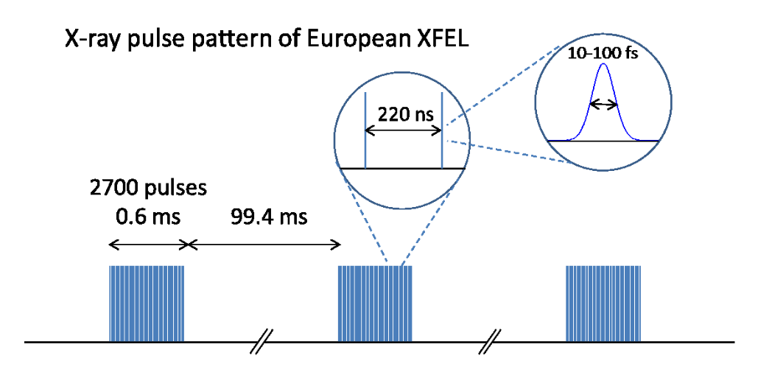
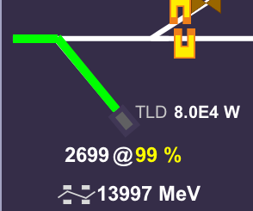
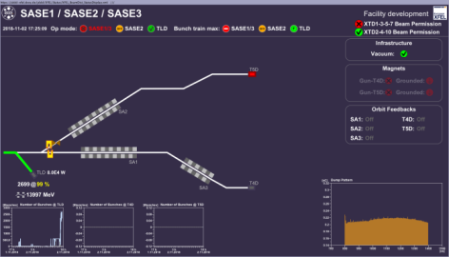
Linac Status: Full Bunch Train Accelerated
650 µs long RF pulse in gun and accelerating modules
LLRF takes into account electron beam induced fields
Energy jitter over bunch train < 5e-4
No losses, 80 kW beam power safely distributed to beam dump
e⁻ bunch = photon pulse
RF-pulse (or pulse)
= Burst
Typical bunch repetition frequencies [MHz] | bunch spacing [ns] | max # of bunches in 600 μs train
4.514 | 222 | 2700
1.128 | 886 | 670
0.1003 | 10000 | 60
- | - | 1

Slide 11
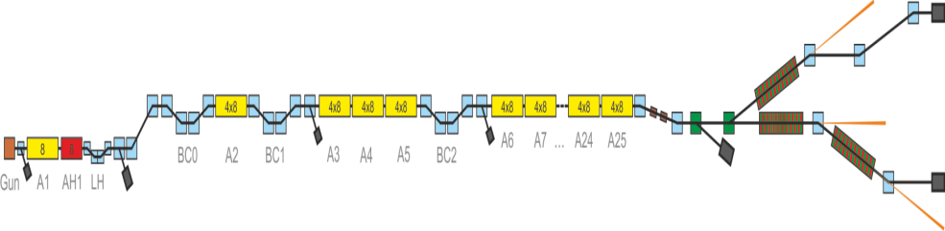
Linac Status: Operation with longitudinal and transverse Feedbacks
8 slow (rf-pulse to rf-pulse) longitudinal FB loops in operation
  Energy stability < 2e-4 RMS
  Arrival time jitter 25 fs RMS
  Arrival time drift 30 fs RMS
7 slow (0.1 Hz) and one fast (bunch to bunch) transverse FB loop in operation
Pointing stability at undulator (source point)
  ≈ 0.1 σ bunch to bunch
  ≈ 0.1 σ rf-pulse to rf-pulse (> 20 bunches)
  ≈ 0.1 σ drift
All numbers expected to improve during advanced development of systems

Slide 12
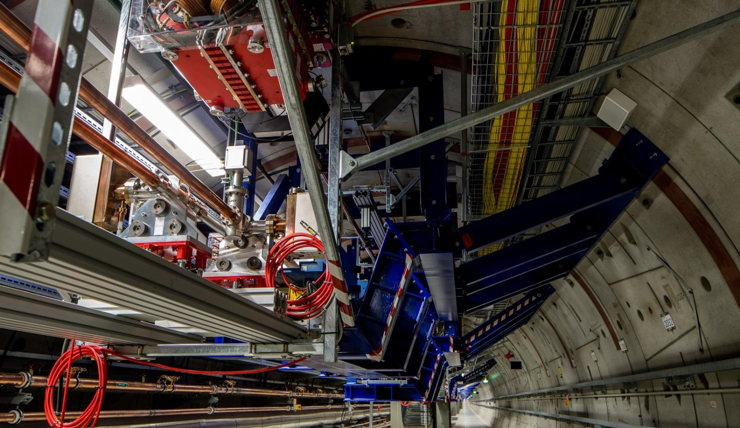
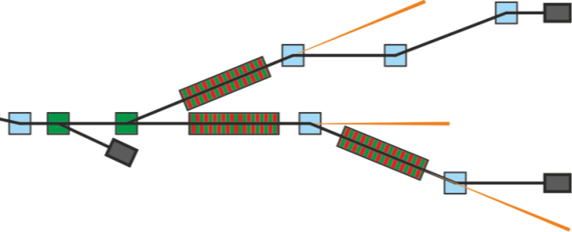
Flexible Electron Beam Distribution System commissioned
Dump beamline
XS1
Both kicker and septum sections
Northern branch: SASE1 and SASE3
Southern branch: SASE2
Collimation section

Slide 13
Parallel operation of beamlines - Flexible Electron Beam Distribution System commissioned and further developed
75 bunches per pulse
25
So-called user-defined timing patterns available since January 2018
User controlled bunch numbers available since summer 2018
Possibility to switch bunch pattern with 10 Hz since January 2019
System is extremely flexible
750 bunches per second accelerated in the linac
SASE2
Main linac
SASE1
SASE1
20
30

Slide 14
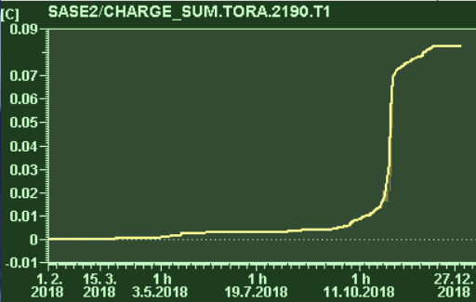

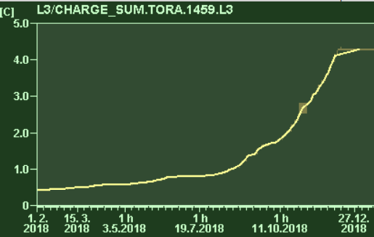
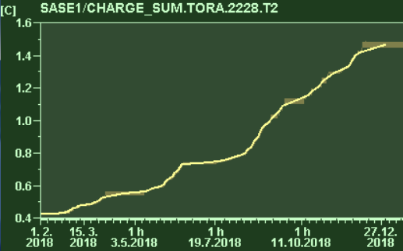
Integrated Charge 2018
Through SASE2: 0.08 C
Total charge after linac: 3.6 C
Through SASE1/SASE3: 1.1 C

Slide 15
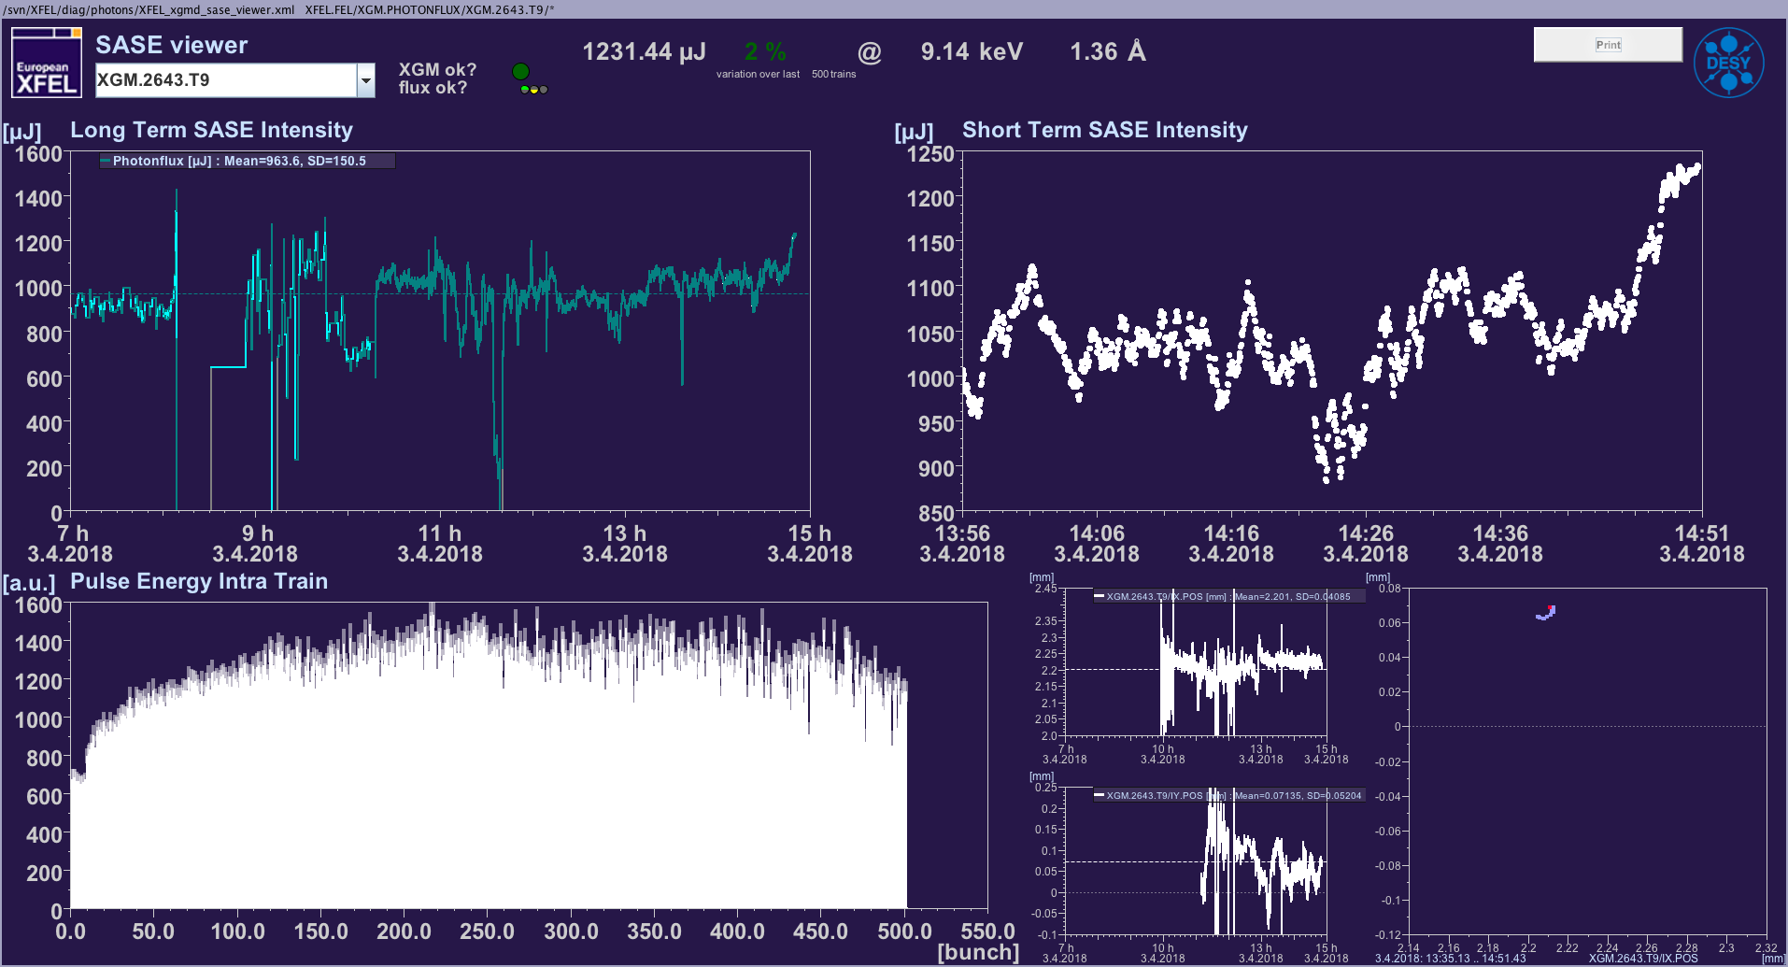
Operation at SASE1
About 4000h of photon delivery for user operation, experiment commissioning and studies
Set-up further improved, maximum pulse energy > 2 mJ
5.8-19 keV operation demonstrated by gap tuning
Up to 120 bunches / RF-pulse during user operation, restricted by safety concerns
Up to 500 bunches / RF-pulse and up to 10 W X-ray beam during test operations

Slide 16
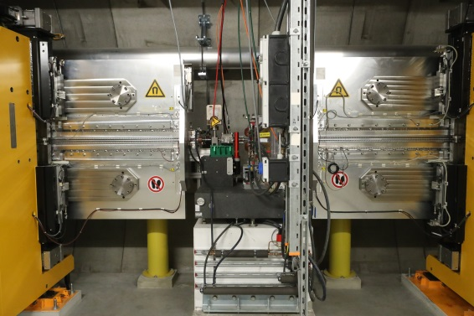
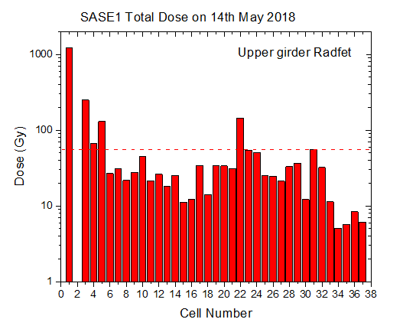
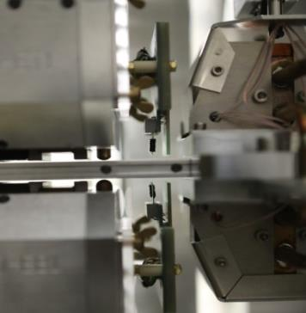
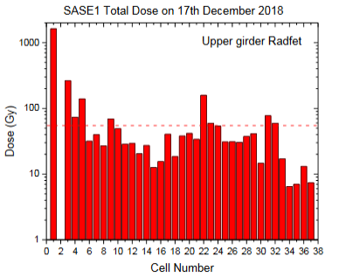
SASE1: Undulator Radiation Dose
2017: Dose measured with RadFet sensors too high after commissioning, some field changes in first periods of first undulator observed
Improved diagnostics
Improved operations
Dose rate in undulator reduced to tolerable level
Differentiate between particle loss (bad) and synchrotron radiation (okay)
0.9 C
2 Radfets and 2 TLDs at each undulator

Slide 17
Operation of SASE3
Lasing on Feb 8th at fist at 900 eV
Set-up easy, up to 10 mJ reached
Operation stopped for about 6 weeks due to safety concerns
Flexible wavelength tuning by undulator gap-change over complete tuning range
First user experiments by end of 2018
SASE1
SASE3

Slide 18
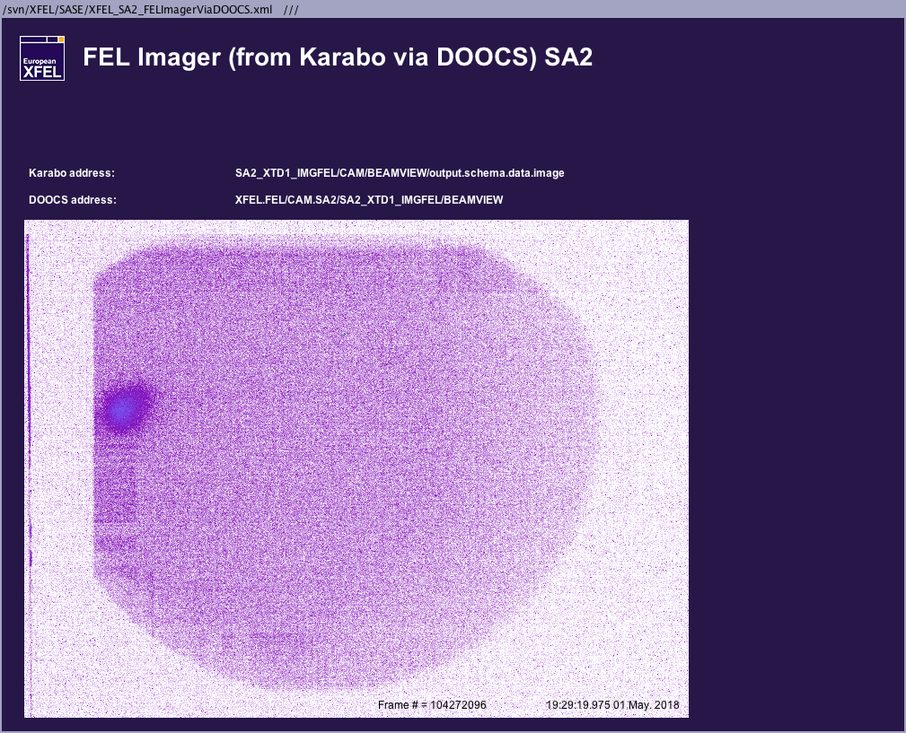
Operation of SASE2
First lasing May 1st 2018
Alignment issue of undulator beamline discovered with electron beam based techniques
Pointing of SASE radiation misaligned to photon beamline
Extensive survey and re-alignment during summer 2018 and winter-shutdown 2018-2019
Beam-line and experiment commissioning towards end of 2019
First lasing
October
Winter shut-down
Re-alignment of photon beamline
1944 px = 21.6 mm
May – Sept:
Additional survey
Beam based alignment measurement
Undulator alignment based on BBA
3 mm
2592 px = 28.8 mm

Slide 19
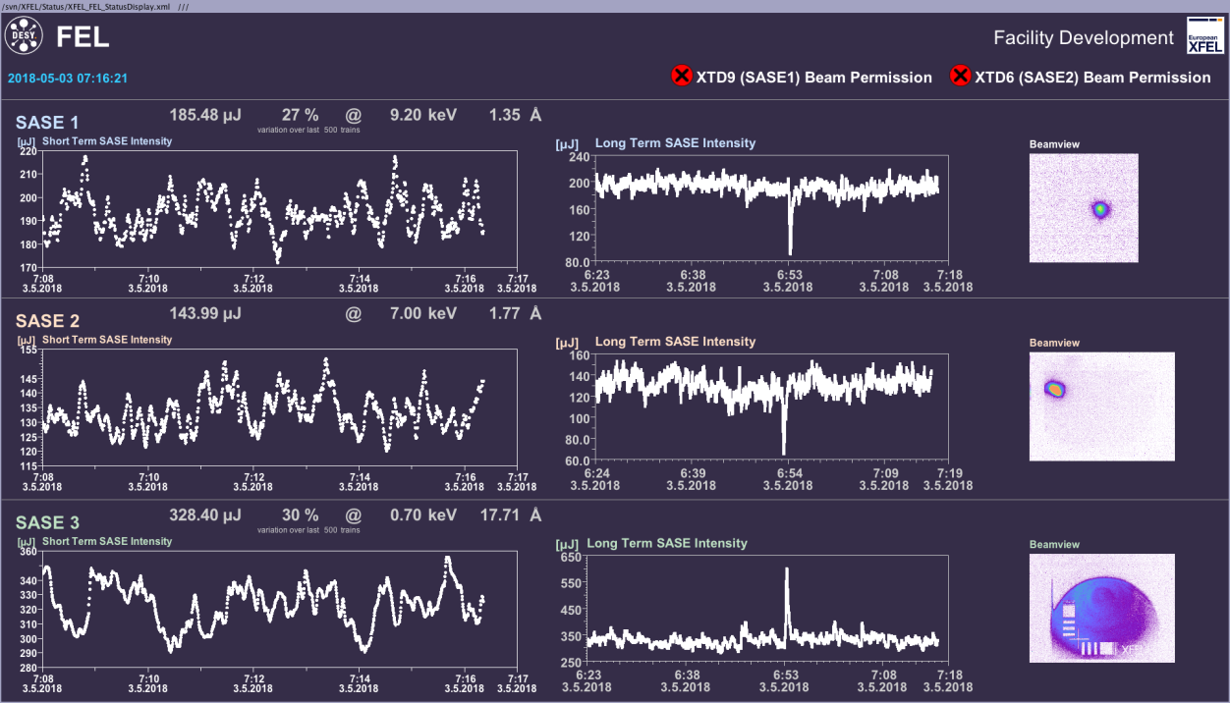
All Three FELS lasing in parallel
(only 1 day after 1st lasing in SASE2)

Slide 20
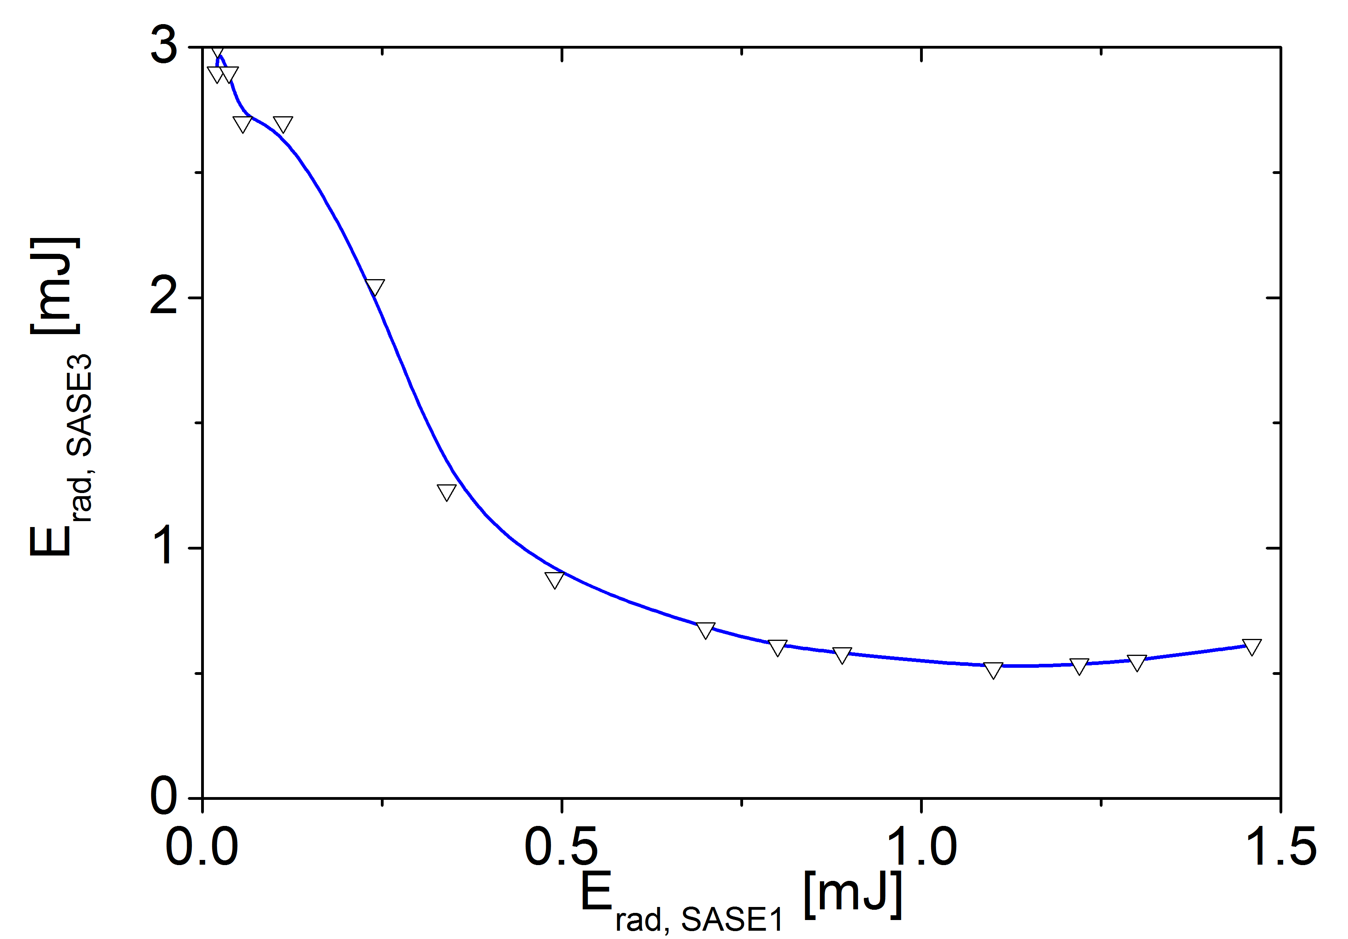
Operation of SASE1 and SASE3
Parallel operation SASE1/3 challenging:
  “Fresh bunch mode” has been implemented on the fly
  Recovers pulse energy of SASE3 bunches
  But FEL and/or spontaneous radiation from suppressed bunches still reaches the photon beamline
  Suppression at experiment bigger than at XGM
  Suppression cannot be guaranteed
  More experience to be gained
  Flexible e-beam distribution allows for other solutions
  Needs good communication between experiments
SASE1
SASE3
Correlation between SASE1 and SASE3 photon pulse energy.

Slide 21
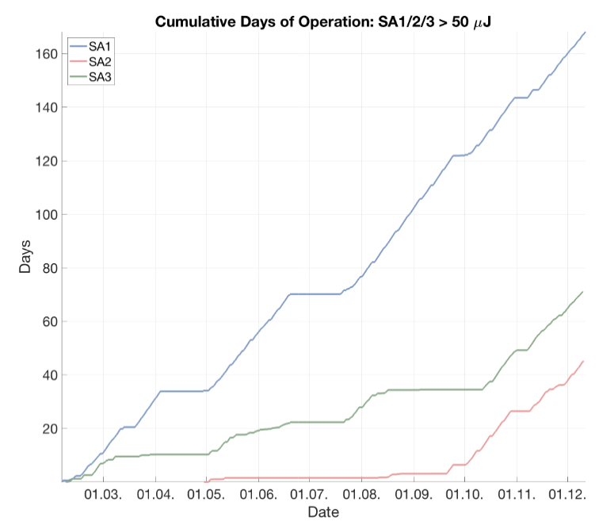
SASE Delivery in 2018
SASE1: 168 days
SASE3: 71 days
SASE2: 45 days
Total: 284 days

Slide 22
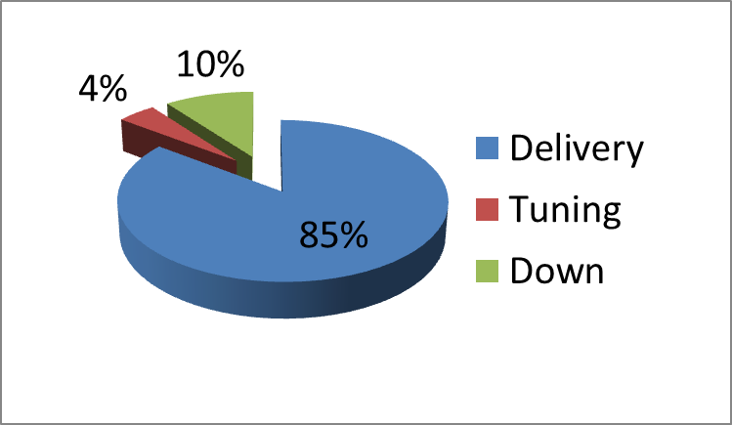
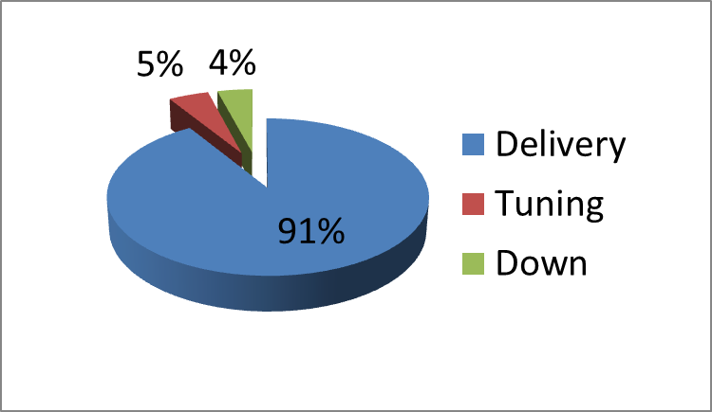
Availability during user runs 2018 (total about 62 days)
Recording of SASE level
Recording of SASE level
Four dominating single events removed
Dominated by 4 single events:
  Three cold compressor failures
  Power supply issue
About 2 RF trips/day
Frequent beam interruptions due to EPS/MPS actions

Slide 23
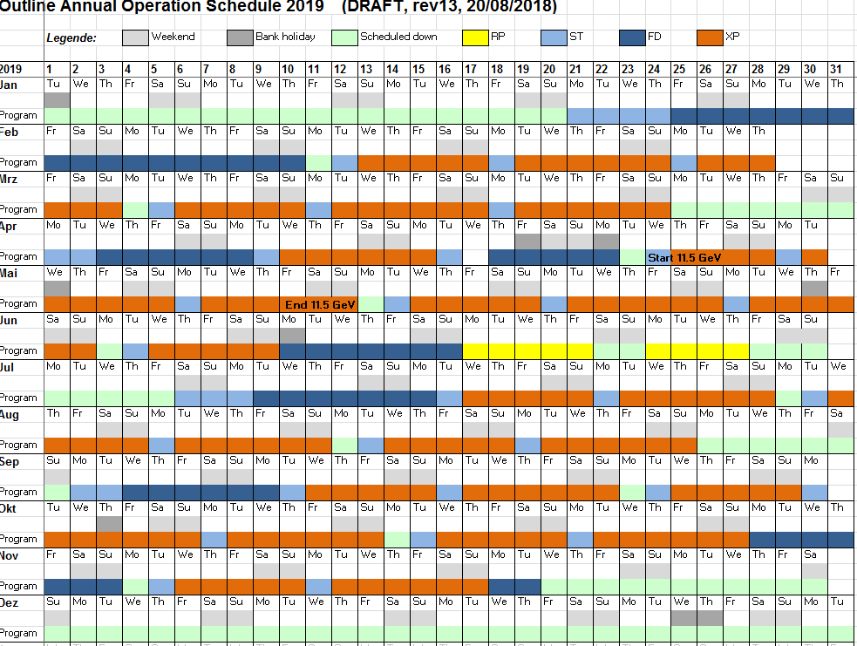
Operation in 2019

Slide 24
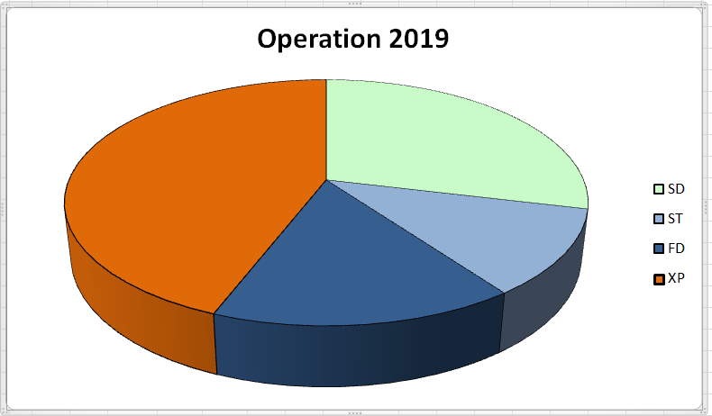
Operation in 2019
Scheduled Down: 105 d
  Of this 40 d scheduled maintenance
Operation: 6240 h
  Setup and tuning: 984 h
  Facility Development: 1392 h
  X-Ray Delivery: 3864 h
29 %
Scheduled Down
44 %
X-ray Delivery
11 %
Setup/Tuning
16 %
Facility Development

Slide 25
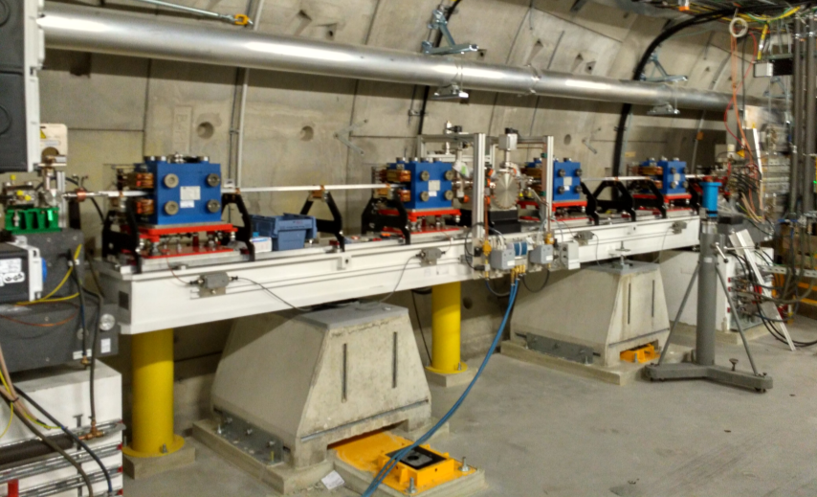
Plans for 2019: Facility Development
Establish (safety) concept for high average power operation in photon beamlines
Further improve set-up procedures (machine-learning, …)
Further increase flexibility
  User selection of # of bunches
  User selection of wavelength
  Low charge / short pulse operation
  Variation of beam parameters over bunch train
Enhance capabilities
  Commissioning of SASE2 self-seeding
  Advanced lasing concepts (HHL, 2-colour, …)

Slide 26
Plans for 2019: User operation
600 bunches / rf pulse at 1.1 MHz distributed into all 3 FELs
Improve operation & stability by integration of as many photon signals as available
Establish additional operating points at 11.5 GeV and 16.5 GeV and operate with users
Test short pulse length (100 pC electron bunch) operation with users
Test 4.5 MHz operation with users

Slide 27
Plans for 2019/20/21: Hardware activities
Replacement of screens in BC1/BC2 (and eventually I1 again) when available (19)
Installation of tune-up dumps before SASE1-3 (19)
Installation of dedicated kicker before SASE3 (19)
Installation of dark-current collimator after south-branch septum (19/20)
Installation of self-seeding chicanes in SASE1 (19/20)
Installation of delay chicane in SASE3 (19/20)
Installation of polarization after burner after SASE3 (infrastructure work 19/20, beamline 20/21)
SASE4/5
  Concept development till 2020
  Secure funding, technical design 2021/2022
  Fabrication, installation 2022-2024

Slide 28
Accelerator Development beyond 2019
R&D to improve operational stability and efficiency
  Long. Diagnostics
  Automatization
R&D to enable CW operation of the European XFEL in the future
  Electron source development
  Cavity and module enhancements
  Rf system development
  Controls, beam distribution
R&D to extend the parameters and performance range
  Seeding to enhance spectral brightness
  De-chirper to increase bandwidth or to shorten pulses
  Novel concepts, SASE4/5

Slide 29
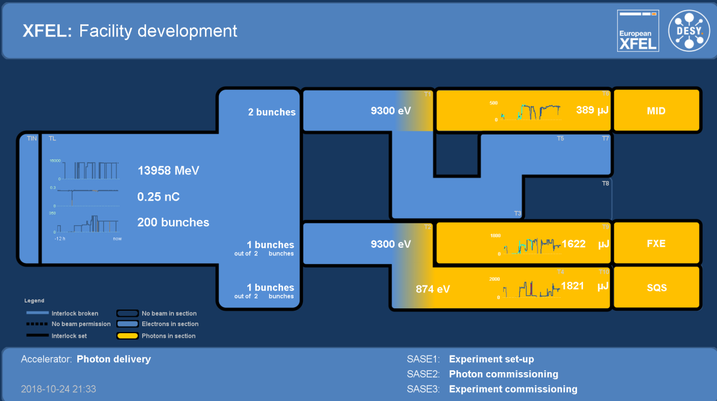
Thanks to all colleagues from DESY and European XFEL
http://tesla.desy.de/status_PNGs/XFEL_StatusPublic.png

Slide 30
(Accelerator) Parameter Space (as of today)
Quantity | Unit | Project Goal | Achieved | Routine
electron energy | GeV | 8 – 17.5 | 6 – 17.5 | 14
bunch repetition within pulse | MHz | Up to 4.5 | Up to 4.5 | 1.1
bunch charge | pC | 20 – 1000 | 100 – 500 | 250
electron bunch length after compression (FWHM) | fs | 2 – 180 | 20 – 90 | 50
max. beam power | kW | 500 kW | 80 kW | 6 kW
undulators in operation (lasing) |  | SASE1-3 | SASE1-3 | SASE1-3
photon pulses / s / undulator |  | 27000 | 5000 | <1200
photon energy | keV | 0.25-25 | 0.4-1.2; 5.8-19.3 | 0.6-1.2; 9.3 - 14
photon pulse intensity (SASE1) @ 14 GeV, 250 pC, 9.3 keV | mJ |  | 2.0 | 1.2
photon pulse intensity (SASE3) @ 14 GeV, 250 pC, 600 – 900 eV | mJ |  | 10 | 2
photon pulse intensity SASE2 (@ 14 GeV, 250 pC, 9 keV | mJ |  | 0.9 | 0.6

