Slide 1
Preparation for ZZ and recovery after access
Thomas Wamsat
February 5, 2019

Slide 2
Topics
Magnet current during ZZ
ZZ Injector
Restart Injector after ZZ
ZZ XTL
Restart XTL after ZZ
ZZ XTD-1-3-4-7-
Restart XTD-1-3-5-7 after ZZ
ZZ XTD-2-4-10-
Restart XTD-2-4-10- after ZZ
ZZ and Restart XTD6 and XTD9
Useful hint

Slide 3
Magnet current during ZZ
Before ZZ with magnets under current, MXL or RCs make a safety audit to ensure that there is no work near the beam pipe
Point out to the colleagues who enter the tunnel that the magnet current is on
Also the shift leaders should point that out while the ZZ team enters the ZZ door
Under this conditions ZZ with magnets under current and without attendance of MKK colleagues is permitted
Injector and XTL all magnet connections are covered
XTD1-3-5-7 and XTD2-4-10 not every magnet connection is covered sufficiently
In XTD1-3-5-7 and XTD2-4-10 using a bike with magnets under current is prohibited

Slide 4
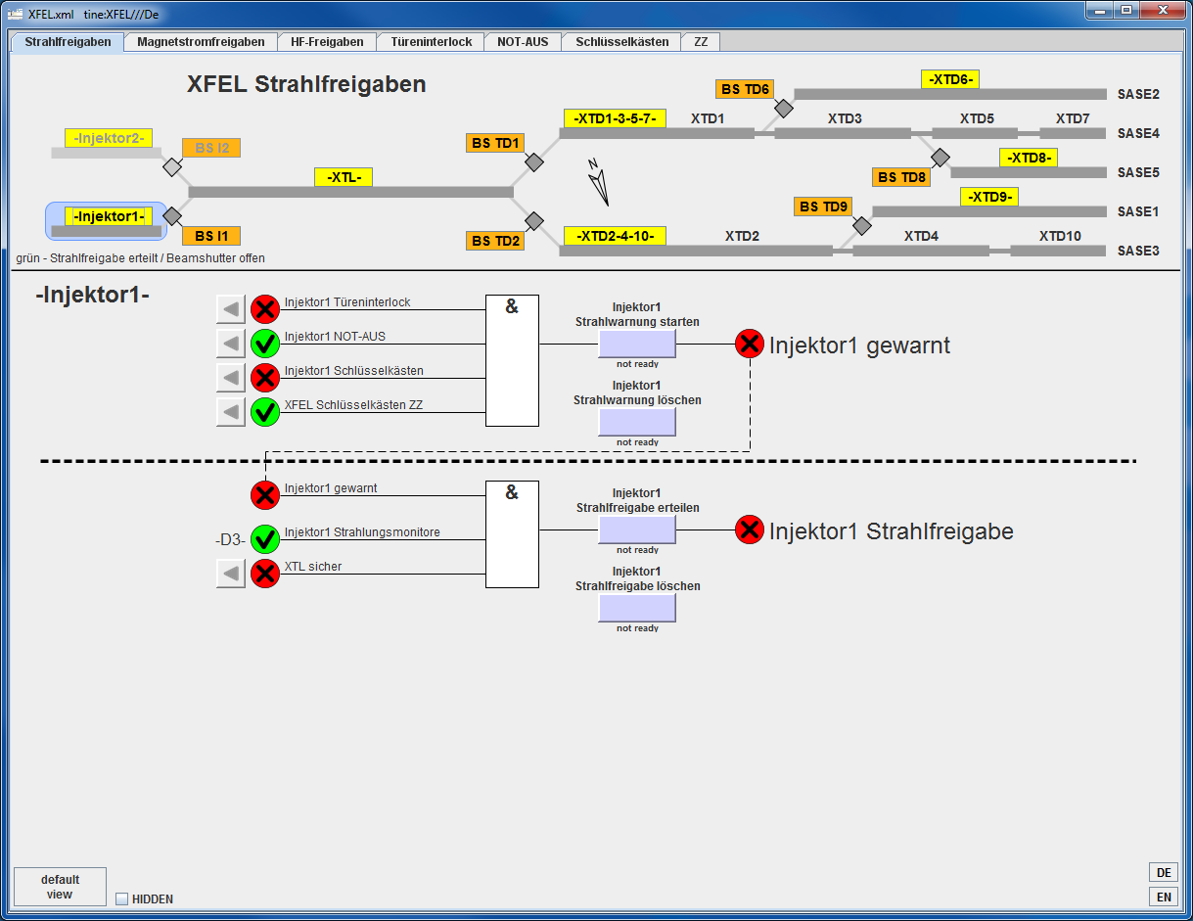
ZZ areas
Injector
XTL
XTD1-3-5-7 (SASE2 branch)
XTD2-4-10 (SASE1 branch)
XTD6 (SASE2 Photon tunnel)
XTD9 (SASE1 photon tunnel)
XTD8 (empty tunnel)

Slide 5
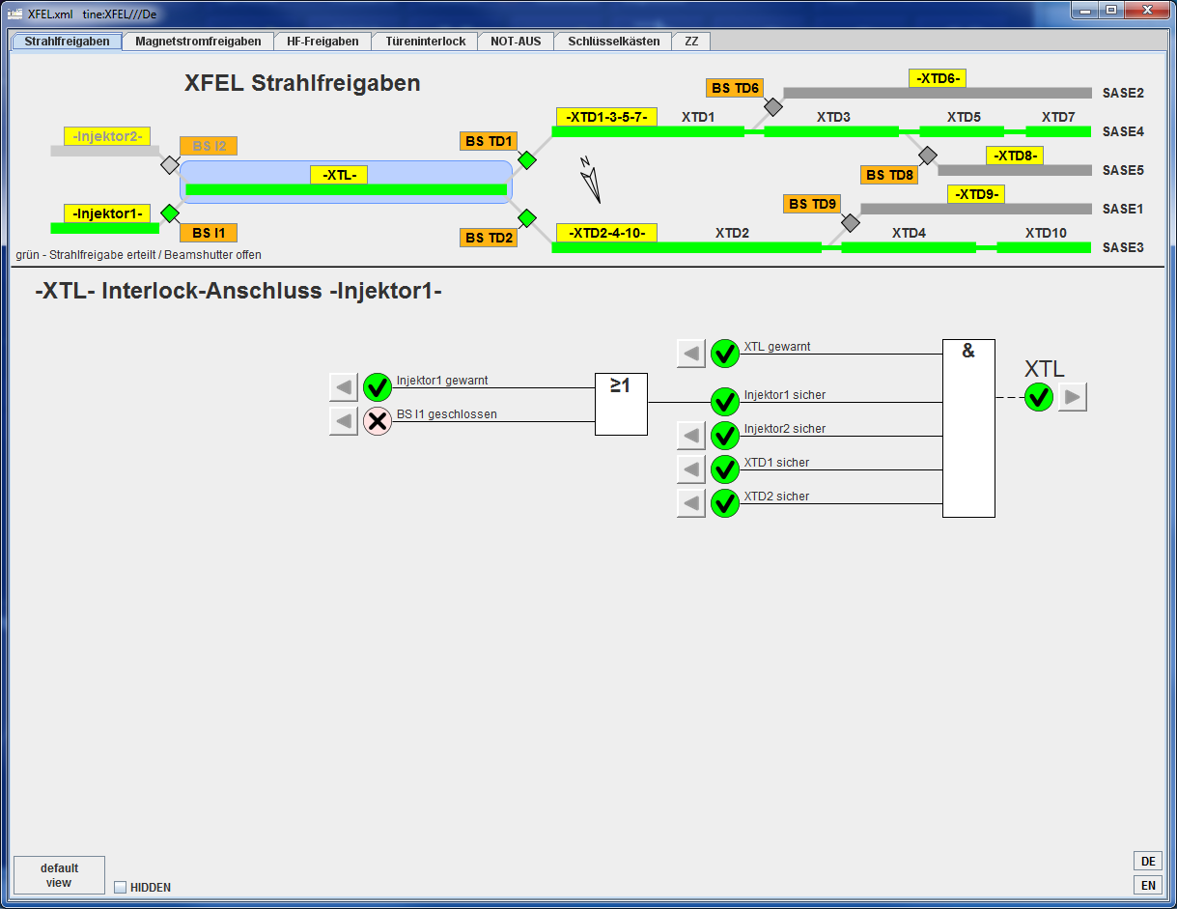
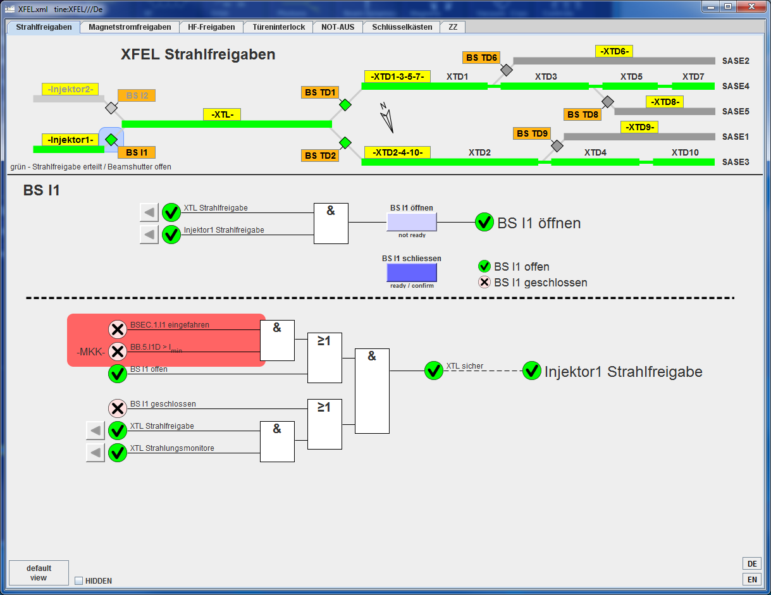
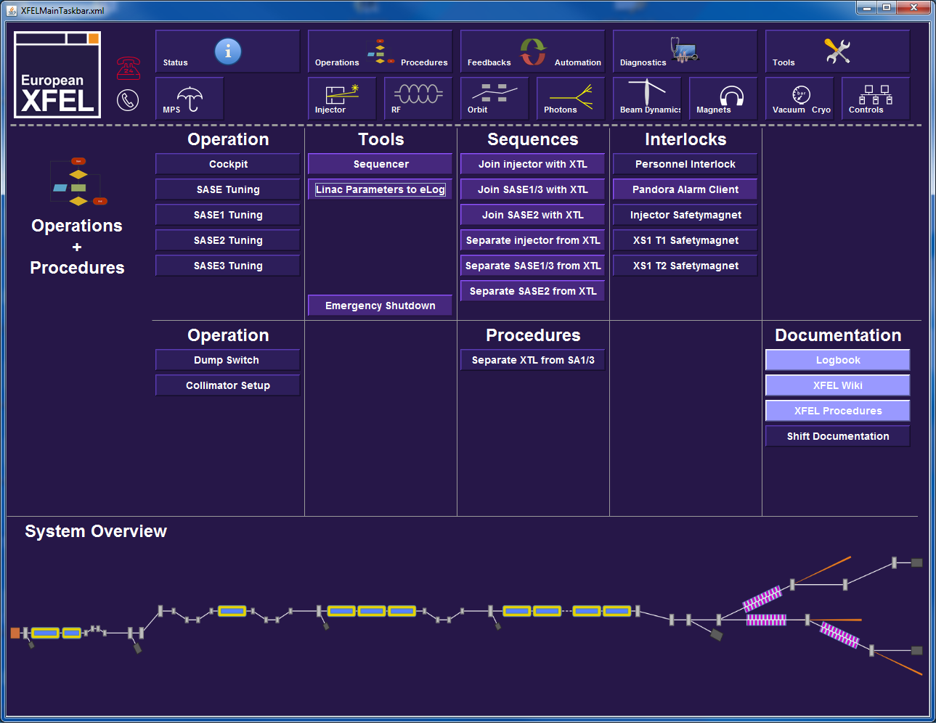
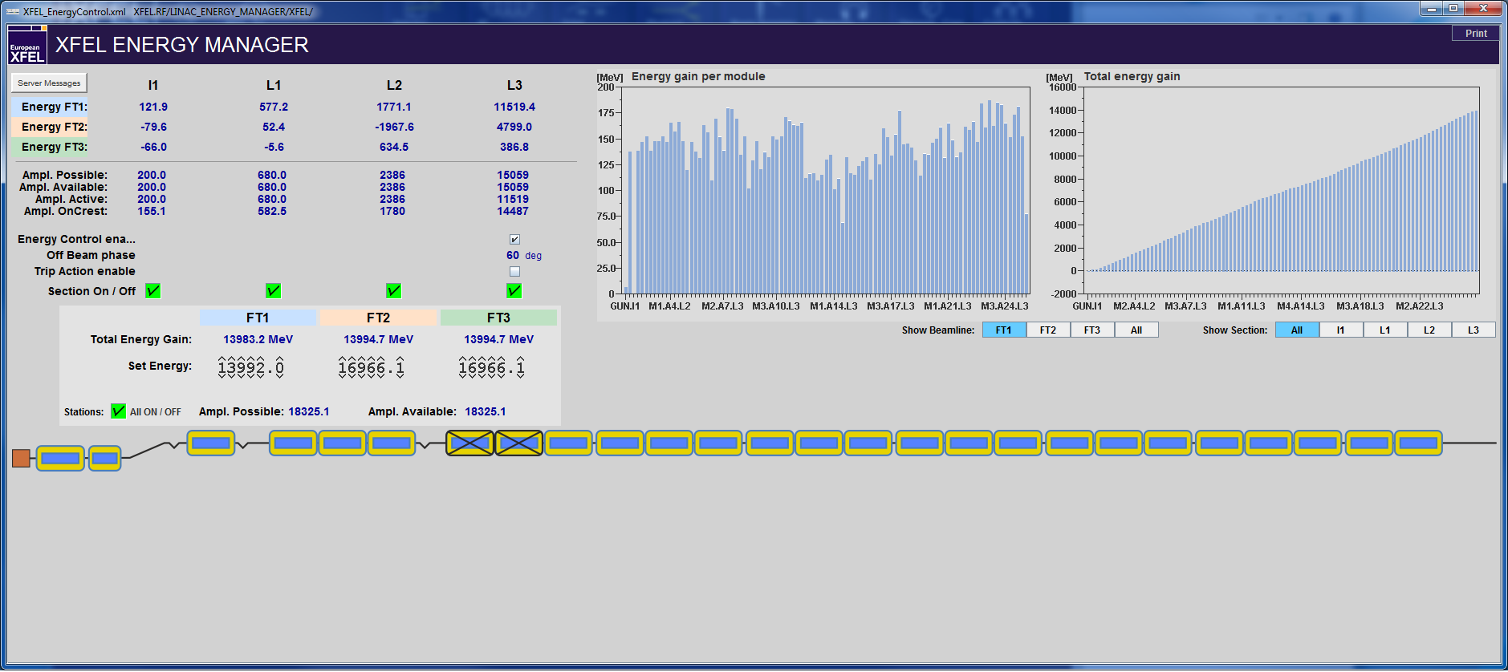
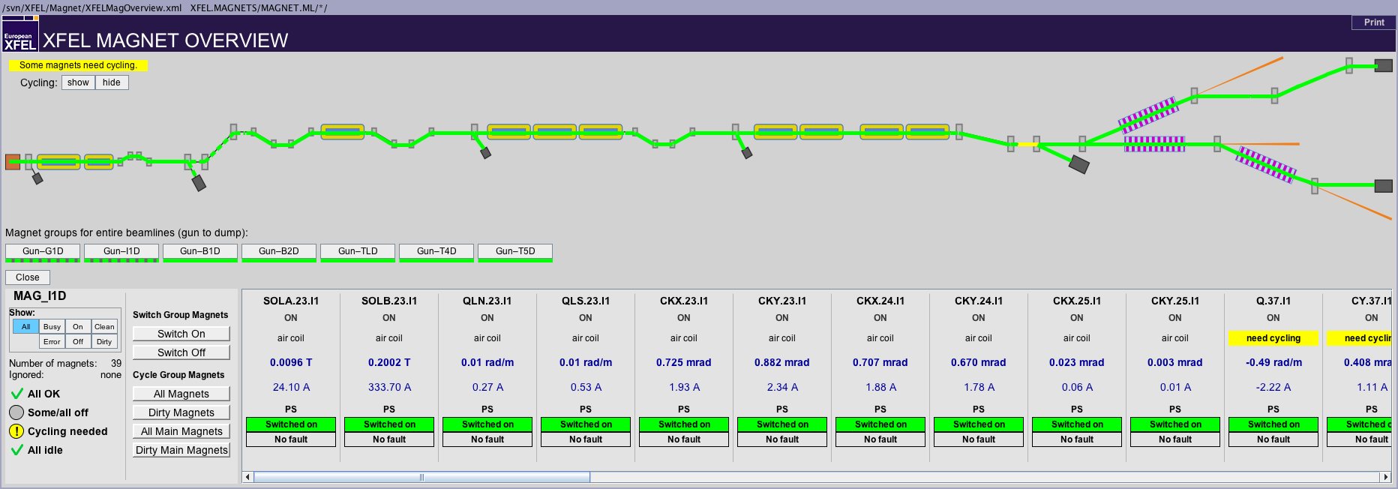
ZZ Injector
Save a file (sequencer)
Use sequence “Separate Injector from XTL” (required to close BS TD1)
Switch of RF
GUN
A1 and AH1 (with energy manager)
Injector TDS (uncheck RF on/off)
In case of work near beam pipe, switch off and ground magnets
Use ‘Magnet overview’ panel to switch off magnets and ask MKK for grounding (also Dump dipole will be switched off, no effect on XTL beam permission

Slide 6
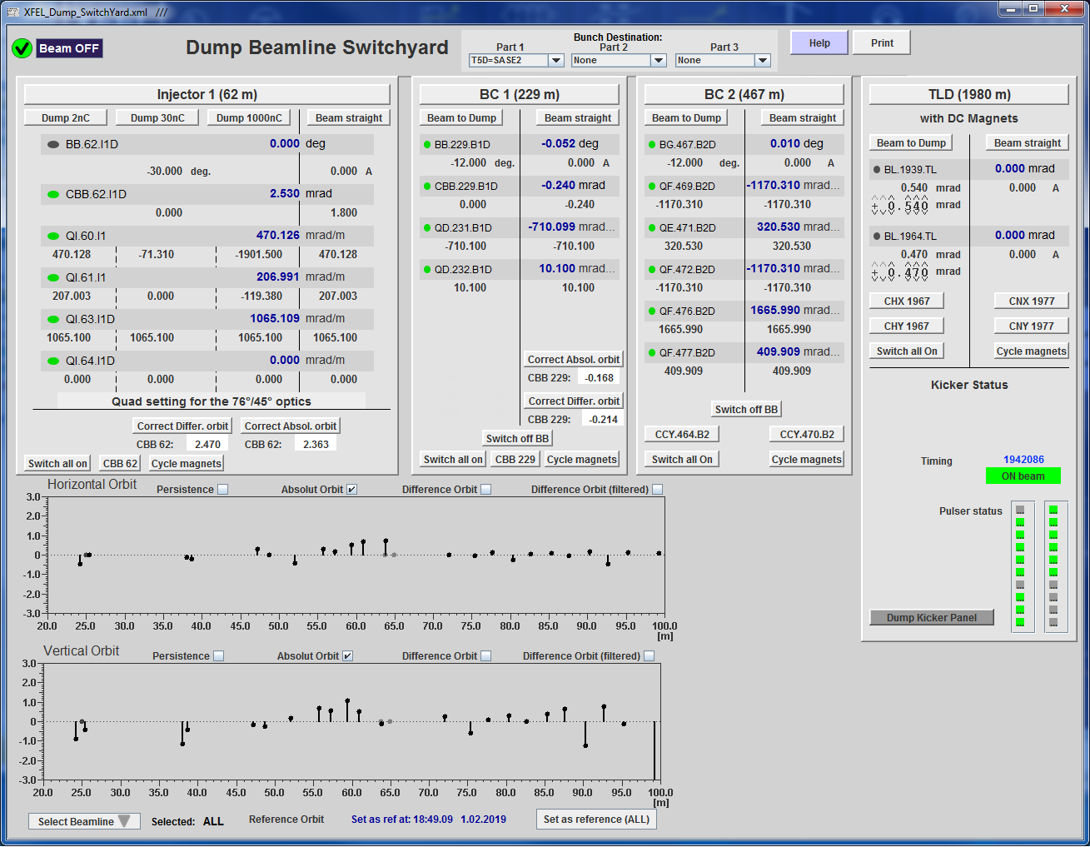
Restart Injector after ZZ
Ask MKK to unground magnets
Switch on magnets and load file values
Switch on BB.62.I1D (use “Dump Switch” panel
Switch on RF
GUN (see training “GUN operation”)
A1 and AH1 with energy manager
Injector TDS
Use sequence “Join Injector with XTL”

Slide 7
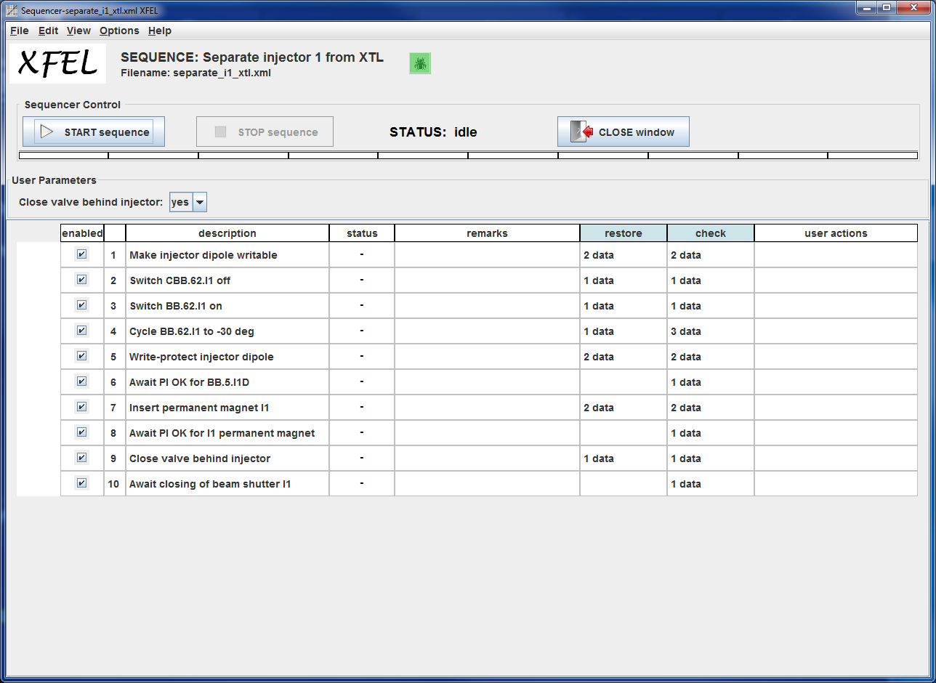
ZZ XTL
Save a file
Set golden orbit in orbit FBs
Use sequence “Separate Injector from XTL” to keep Injector running
Shut down RF by using “Linac Energy Manager”
Shut down TDS B2 (press STBY)
In case of work near beam pipe, switch off and ground magnets
Use ‘Magnet overview’ panel to switch off magnets by clicking on each section and press Switch off
Ask MKK for grounding

Slide 8
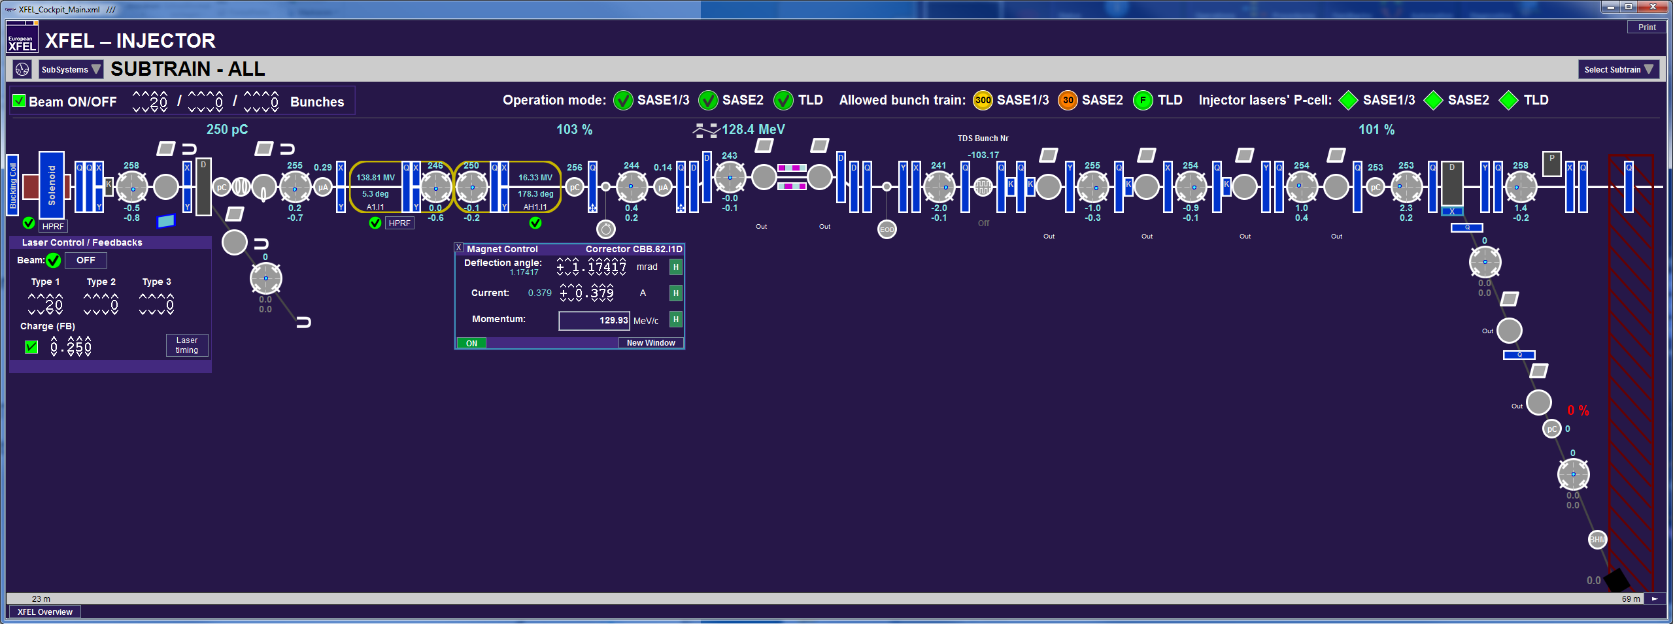
Restart XTL after ZZ
Unground magnets
Switch on magnets and load file
Cycle all main magnets
Ask Shift leader for beam permission
Restart RF using the ‘Linac Energy Manager’
See training “LLRF”
Use sequence “Join Injector with XTL”
Use corrector CBB.62.I1D to correct orbit and re-establish transmission
Switch on orbit FBs to re-establish transmission

Slide 9
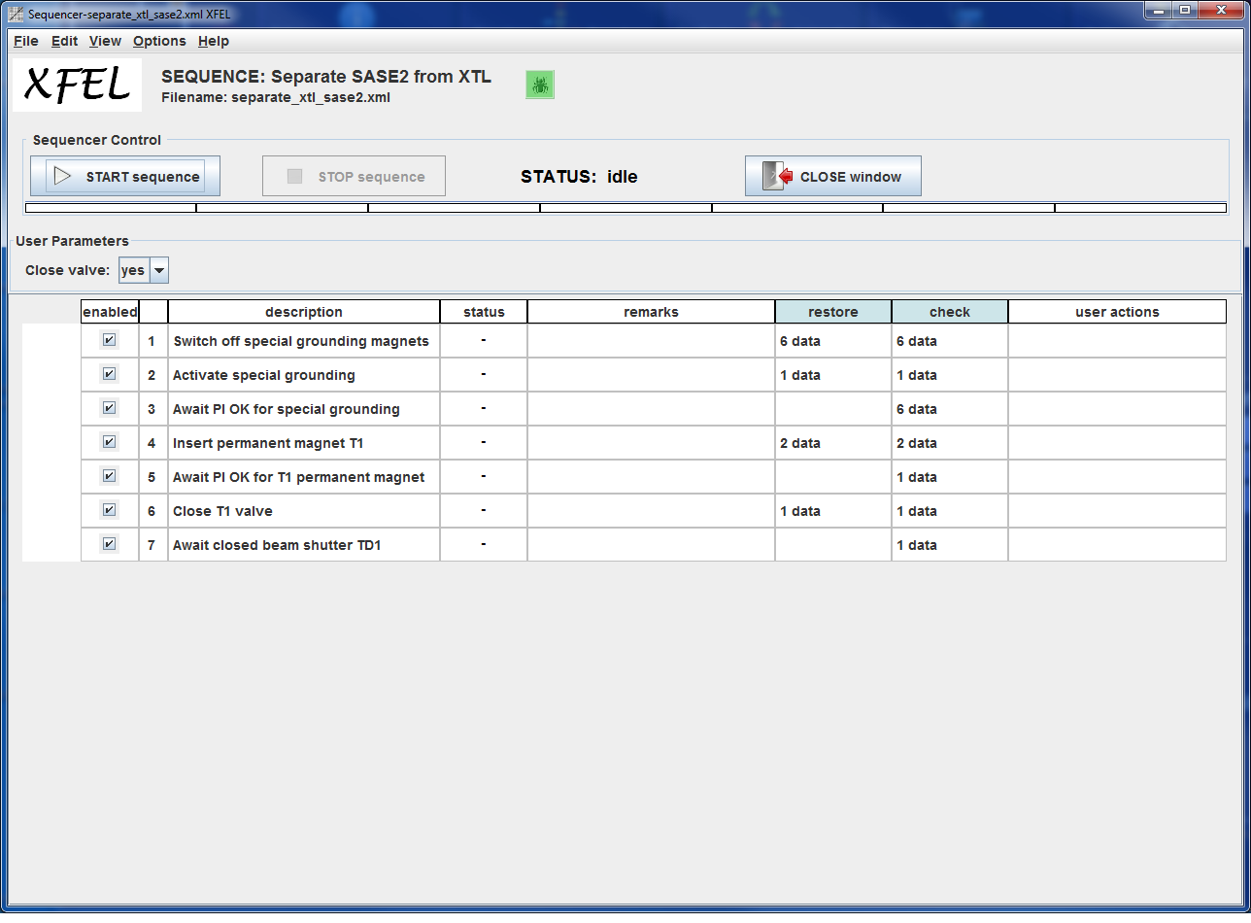
ZZ XTD1-3-5-7 (South branch SASE2)
Save a file
Set golden orbit in orbit FBs
Use sequence “Separate SASE2 from XTL”
In case of work near beam pipe, switch off and ground magnets
Use ‘Magnet overview’ panel to switch off magnets by clicking on each section and press Switch off
Ask MKK for grounding

Slide 10
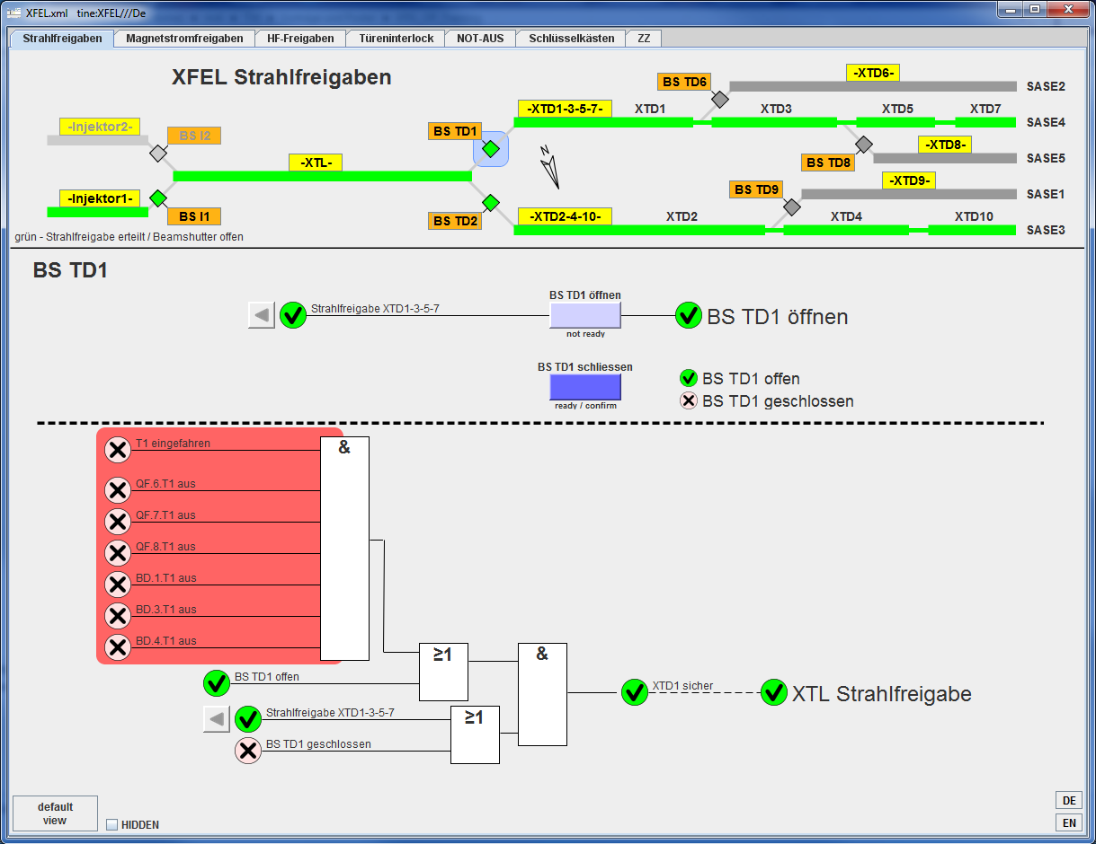
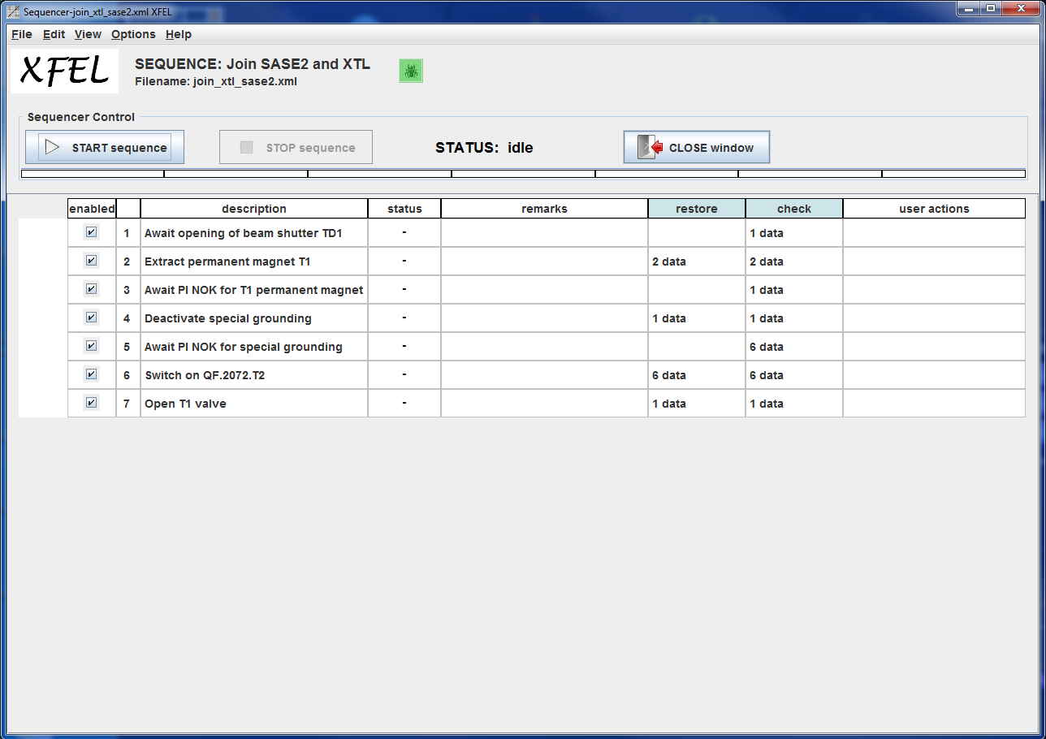
Restart XTD1-3-5-7 after ZZ
Use sequence “Join SASE2 with XTL”
Cycle special grounded magnets
In case magnets were grounded, unground, switch on and reload file and cycle main magnets
Switch on orbit FB to re-establish transmission

Slide 11
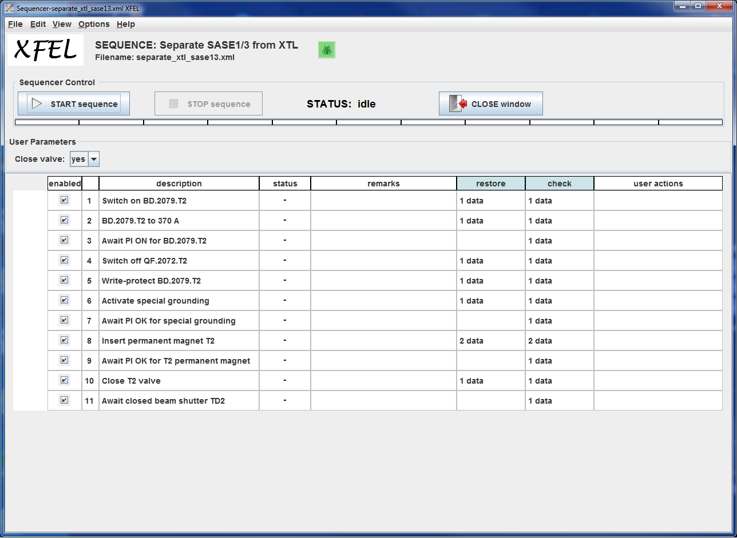
ZZ XTD2-4-10 (North branch SASE1/3)
Save a file
Set golden orbit in orbit FBs
Use sequence “Separate SASE1/3 from XTL”
In case of work near beam pipe, switch off and ground magnets
Use ‘Magnet overview’ panel to switch off magnets by clicking on each section and press Switch off
Ask MKK for grounding

Slide 12
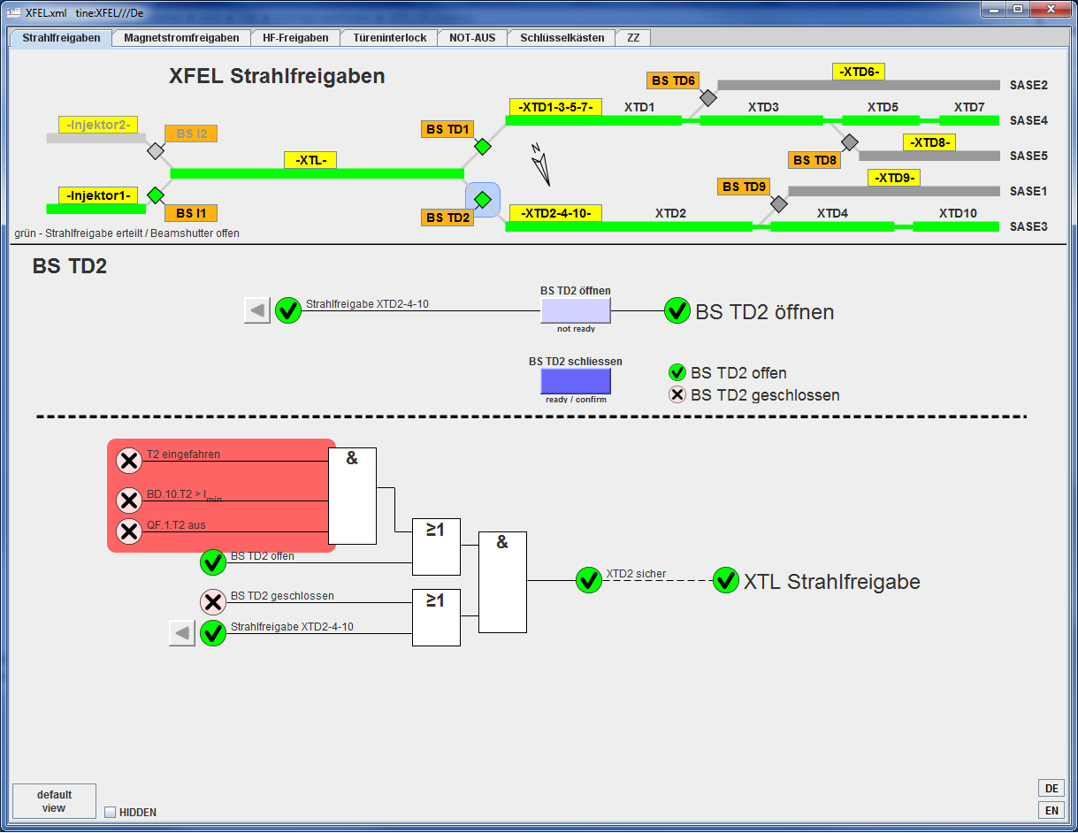
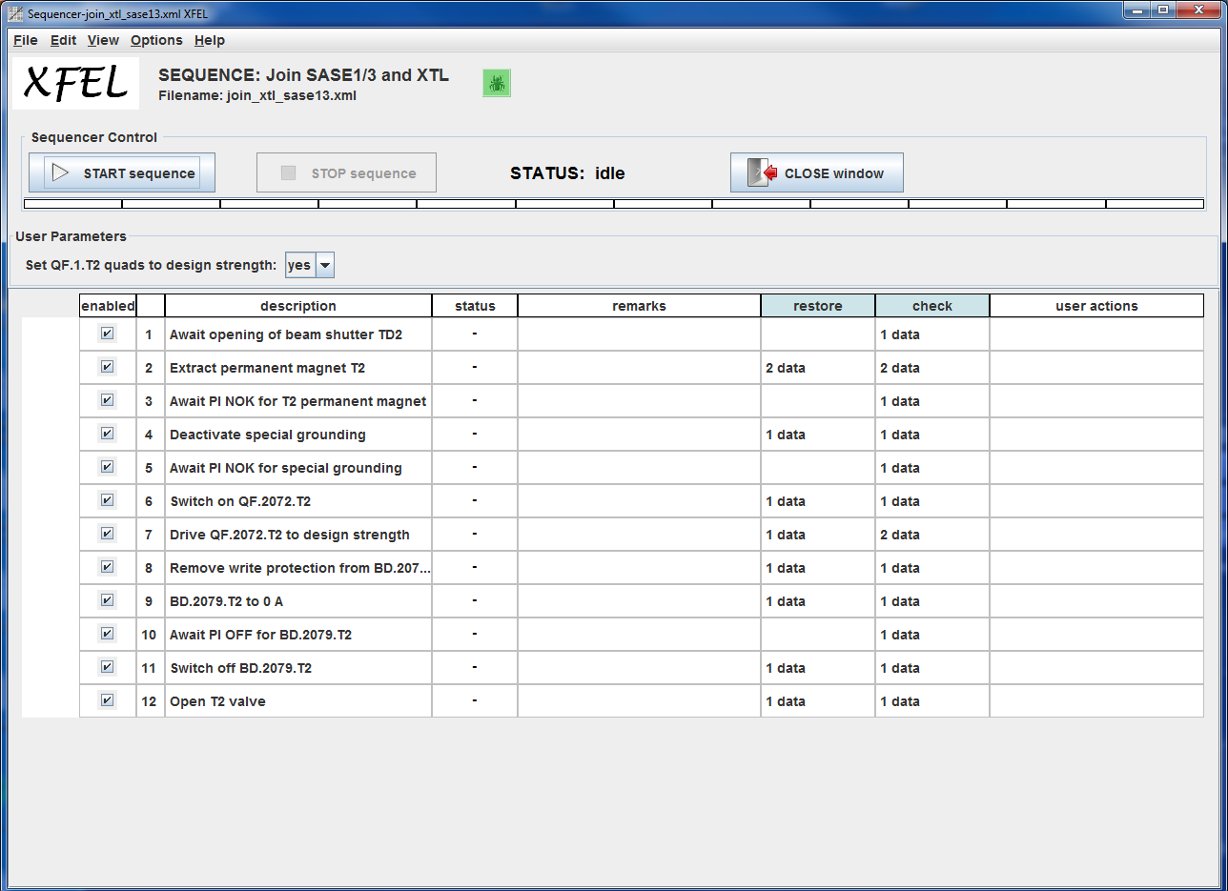
Restart XTD2-4-10 after ZZ
Use sequence “Join SASE1/3 with XTL”
Cycle special grounded magnets
In case magnets were grounded, unground, switch on and reload file and cycle main magnets
Switch on orbit FB to re-establish transmission

Slide 13
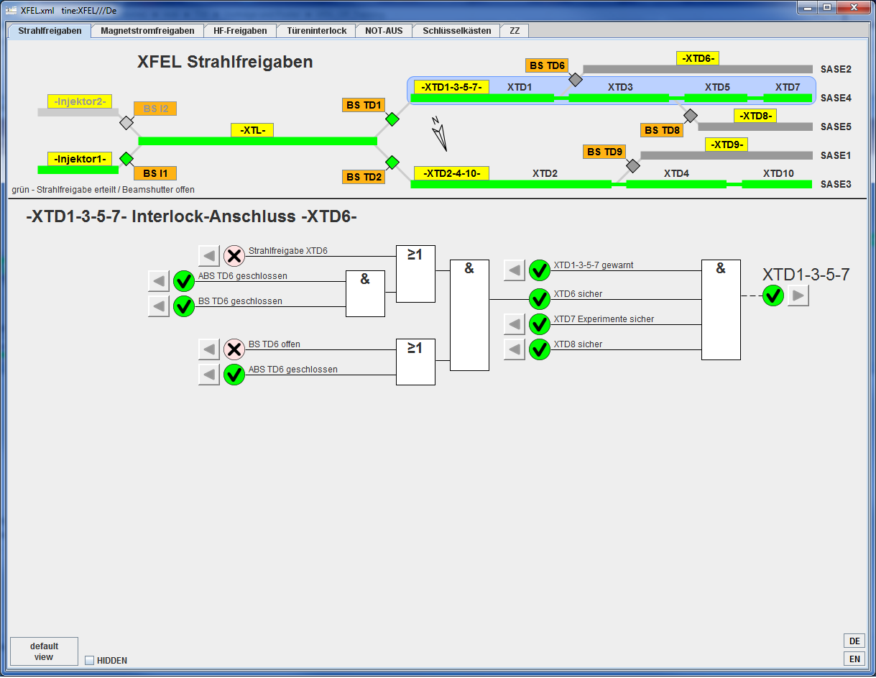
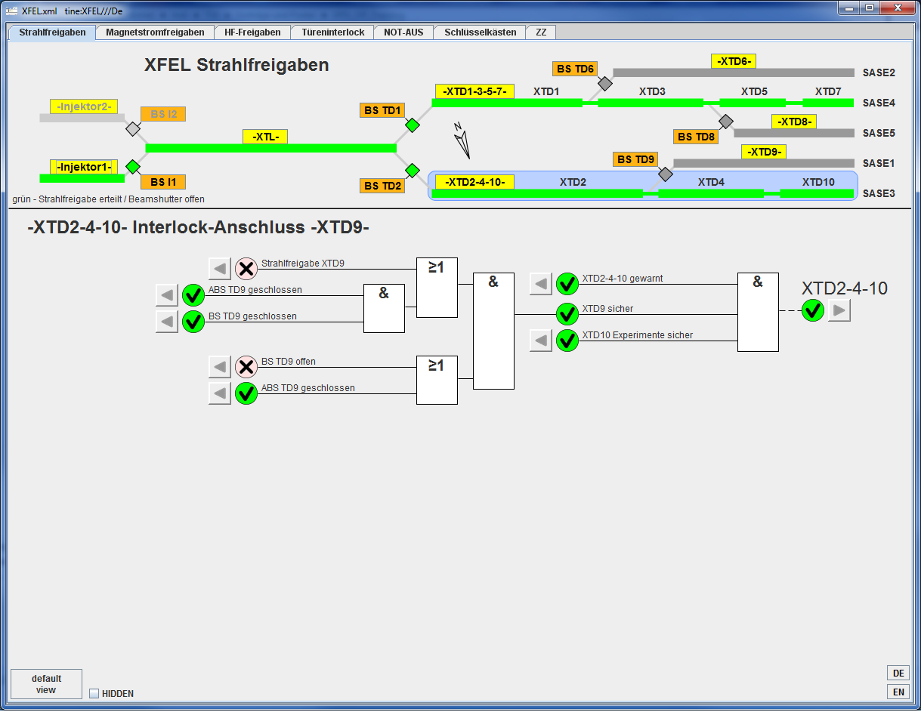
ZZ XTD6 and XTD9
No magnets in this areas
For ZZ in XTD6 close BS TD6
For ZZ in XTD9 close BS TD9

Slide 14
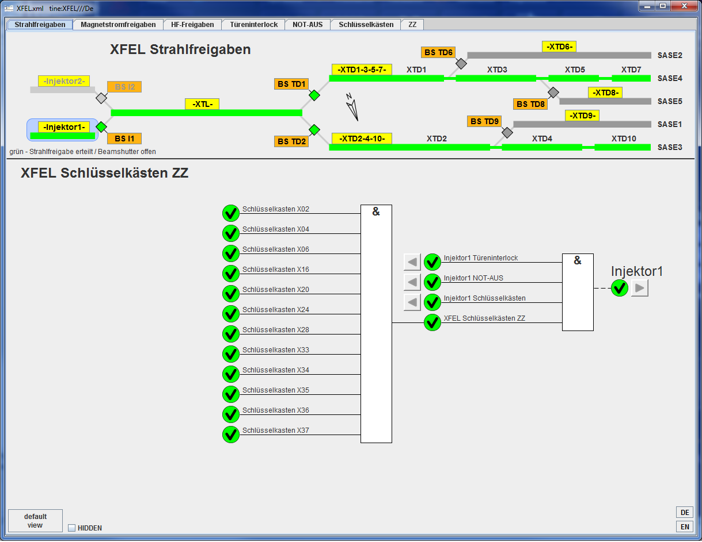
Useful hint
Beam warning, as requirement for beam permission, for any interlock section can only be given, when all interlock keys are locked
Thank you!
Questions?

