Slide 1

Plasma wakefields as an electron beam cathode
Alexander Knetsch
Research Group for Plasma Wakefield Accelerators FLA-PWA
Deutsches Elektronen Synchrotron, DESY
FH Fellow meeting, 01.02.2019

Slide 2





About Me
Who is Alexander Knetsch ? Where is he coming from ?
Rule of thumb: I shoot particle beams and lasers at plasmas
Bachelor and Master degree in Physics at TU Darmstadt
  Semester abroad in São Paulo in brazil
  Specialization in Plasma physics
  Master thesis: Measuring energy loss of carbon ion beams in dense carbon plasmas
PhD as a travelling scientist
  University of Hamburg, Group of Bernhard Hidding
  PWFA experiments at SLAC
  Plasma lens experiments in Jena
  LWFA experiment preparations at INFN Frascati
Now: Fellow at DESY

Slide 3

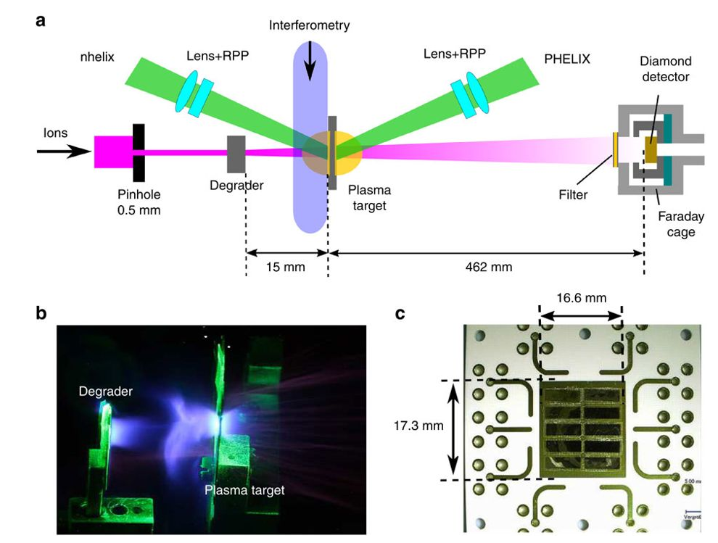
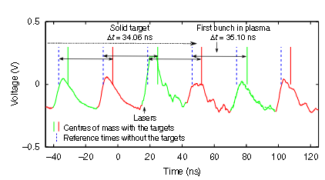
Master Thesis
Shooting Carbon ions at Carbon plasma
Ions at maximum stopping power.
Measure energy loss with time of flight.
Harsh Plasma environment with detector close by.
a: Experimental sketch.
b: Foto of interaction
c: TOF detector with diamond as a semiconductor
TOF signal of diamond detector

Slide 4
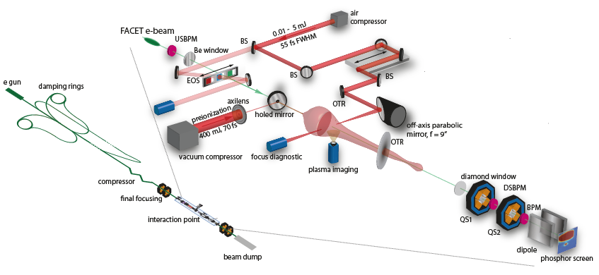
PhD Thesis at university of Hamburg
Shooting electron beams at a plasma and then shooting a laser pulse at it

Slide 5
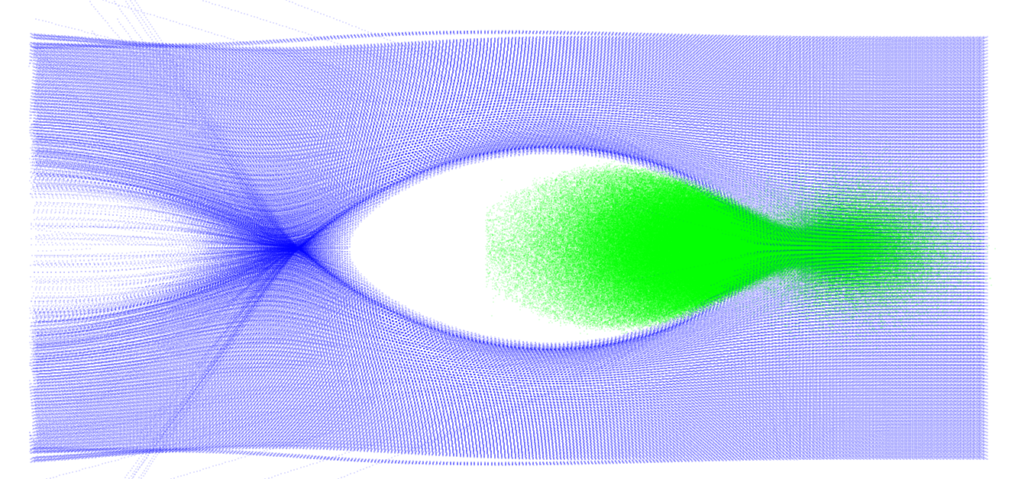
What is a Plasma wakefield accelerator ?
Plasma electrons
Drive bunch electrons
ca. 1 m
1 mm
+
+
+
+
+
+
+
+
+
+
v ~ c
+
+
+
+
+
+
+
+
+
+
+
+
+
+
~ 100 µm
Accelerating fields: 10 GV/m

Slide 6
What is a Plasma wakefield accelerator ?
Plasma electrons
Drive bunch electrons
ca. 1 m
1 mm
+
+
+
+
+
+
+
+
+
+
v ~ c
+
+
+
+
+
+
+
+
+
+
+
+
+
+
~ 100 µm
Accelerating fields: 10 GV/m

Slide 7
What is a Plasma wakefield accelerator ?
Plasma electrons
Drive bunch electrons
Witness bunch electrons
ca. 1 m
1 mm
+
+
+
+
+
+
+
+
+
+
v ~ c
+
+
+
+
+
+
+
+
+
+
+
+
+
+
~ 100 µm
Accelerating fields: 10 GV/m

Slide 8
How do we manage to inject electrons ?
Re-direct them out of the plasma wake sheath
By releasing additional electrons inside the plasma wake

Slide 9
Density Downramp Injection: The Concept.
High Density Plasma
Low Density Plasma
Drive bunch electrons
+
+
+
+
+
+
+
+
+
+
v ~ c
+
+
+
+
+
+
+
+
+
+
+
+
+
+
~ 100 µm

Slide 10
Density Downramp Injection: The Concept.
High Density Plasma
Low Density Plasma
Drive bunch electrons
Plasma wavelength decreases with plasma density.
Rapid change in phase velocity on density ramp.
Sheath electrons end up in accelerating phase.
β_{e} > β_{φ} ◊ Injection.
+
+
+
+
+
+
+
+
+
+
v ~ c
+
+
+
+
+
+
+
+
+
+
+
+
+
+
> 100 µm

Slide 11
Density Downramp Injection: The Concept.
High Density Plasma
Low Density Plasma
Drive bunch electrons
Witness bunch electrons
+
+
+
+
+
+
+
+
+
+
v ~ c
+
+
+
+
+
+
+
+
+
+
+
+
+
+
> 100 µm

Slide 12
Trojan Horse Injection
Co-propagating laser pulse
Plasma electrons
Drive bunch electrons
Witness bunch electrons
ca. 1 m
1 mm
+
+
+
+
+
+
+
+
+
+
v ~ c
+
+
+
+
+
+
+
+
+
+
+
+
+
+
~ 100 µm
Accelerating fields: 10 GV/m

Slide 13
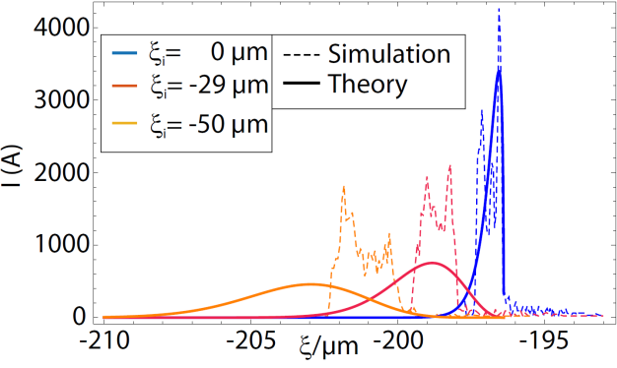
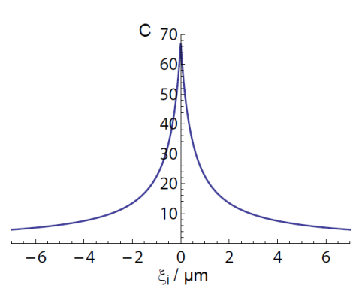
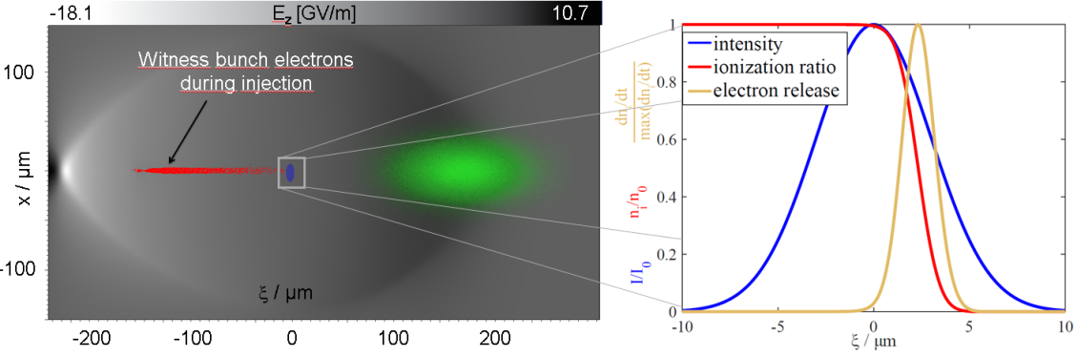
Theoretical results
Electron-bunch compression in Trojan Horse injection
Laser ionization front gives a very small phase spread at the injection.
Witness bunch gets longitudinally compressed initially while being
Very small electron bunches (few µm)
Very short electron bunches (below 10 fs FWHM)
Low emittance (e-2 µm)

Slide 14
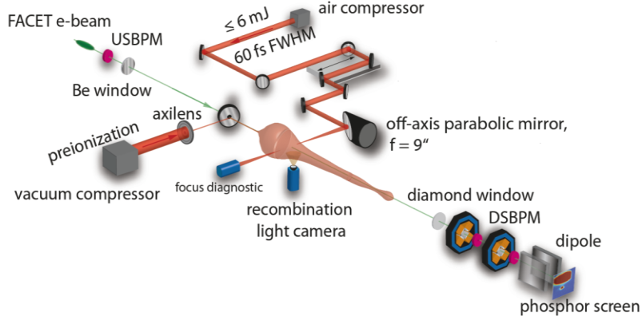
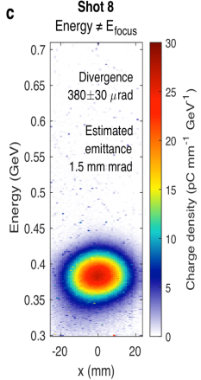
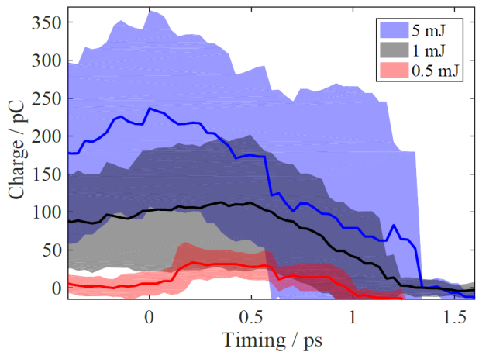
Experimental campaign at
We developed the experimental setup and methods and adapted it for the FACET facility.
We successfully demonstrated the laser-triggered Density Downramp Injection.
We found evidence of the transition between Density Downramp-Injection and Trojan-Horse injection.

Slide 15
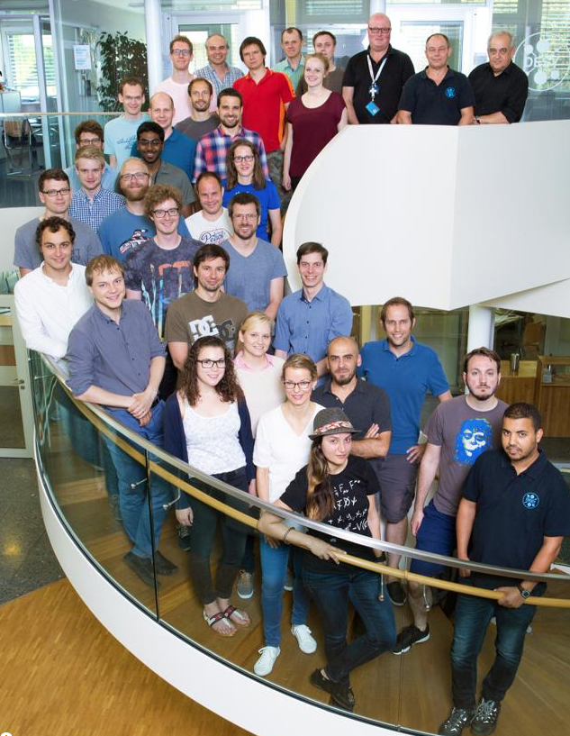
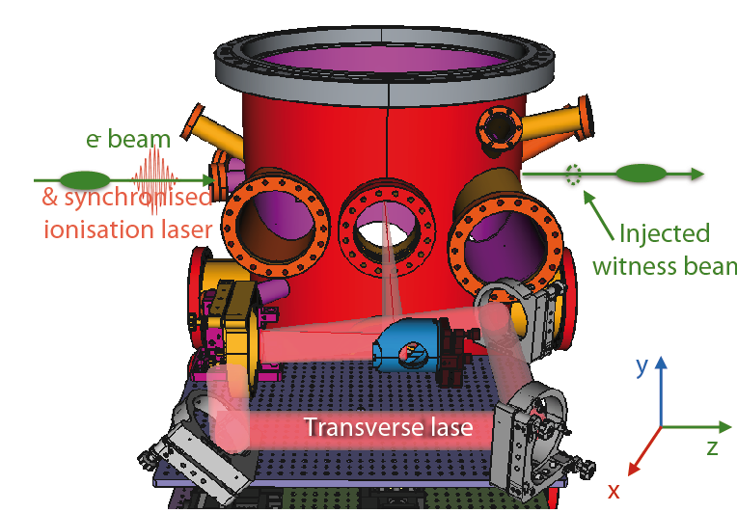
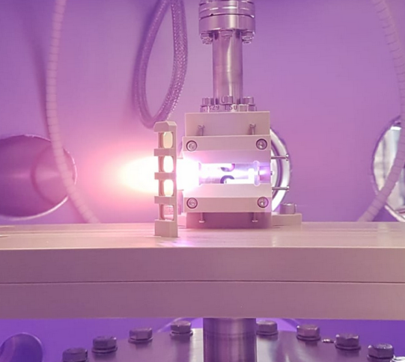
Current work
DESY fellowship to investigate internal injection methods at FLASHForward

Slide 16
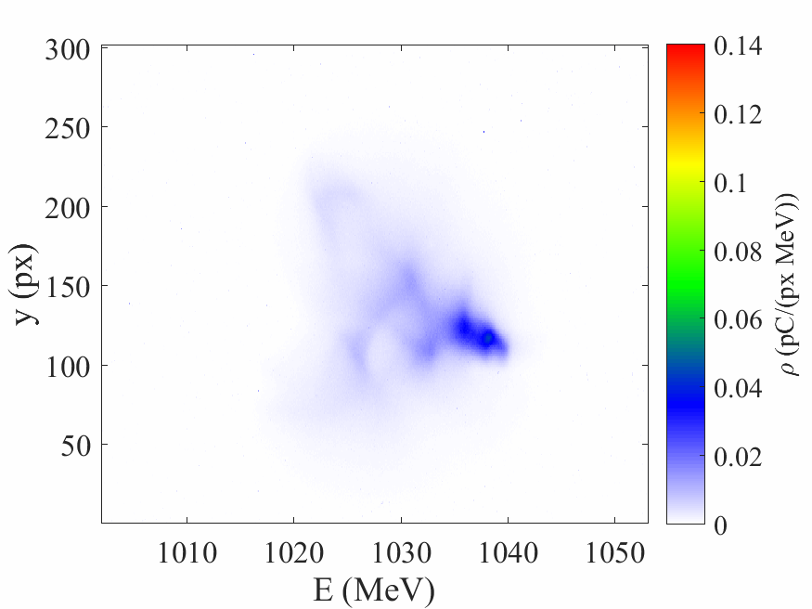
My Favourite Plot
Electron spectrometer measurement after interaction with laser-ionized plasma
Longest dataset: 1089 consecutive shots with interaction in every shot.

Slide 17
My Favourite Plot
Electron spectrometer measurement after interaction with laser-ionized plasma
Thank you, for your attention !

