Slide 1
KIT Plans for PoF-IV
Marc Weber

Slide 2
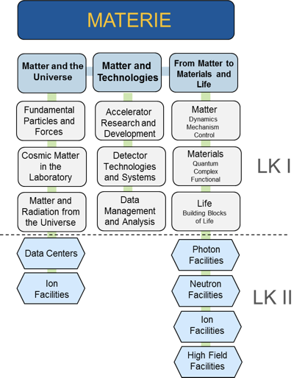
Participation of KIT in Matter
KIT participation

Slide 3
KIT ARD activities in PoF-IV
is likely to participate in ST2, ST3 and ST4

Slide 4
KIT DTS activities in PoF-IV
is likely to participate in every subtopic

Slide 5
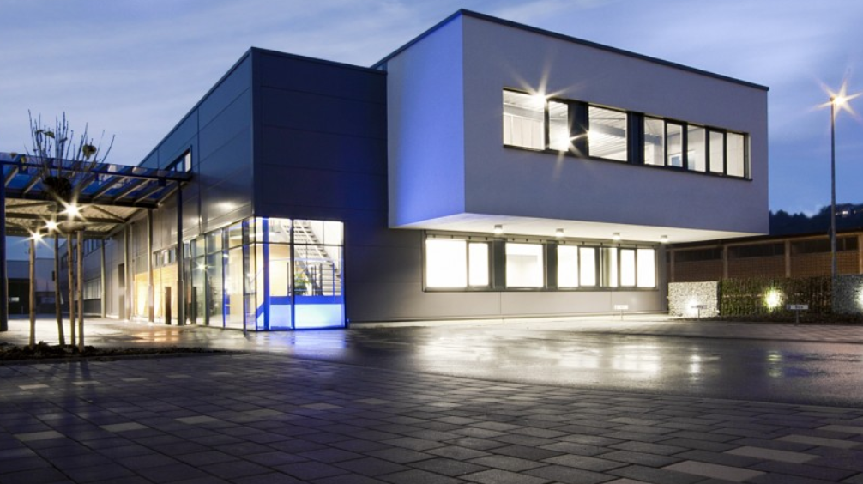
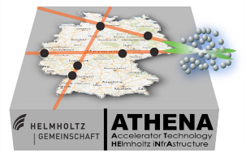
Infrastructure and environment
Hochauflösende Supraleitende Sensoren (HSS) and Karlsruhe Centre of Optics & Photonics (KCOP)
Interconnects and Packaging Lab
KIT-Centrum Elementarteilchen- und Astroteilchenphysik (KCETA)
KARA, cSTART, Athena, Flute
FLUTE

Slide 6
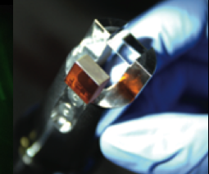
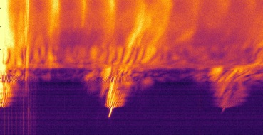
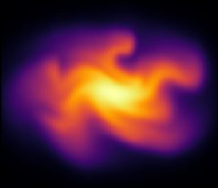
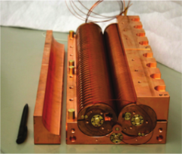
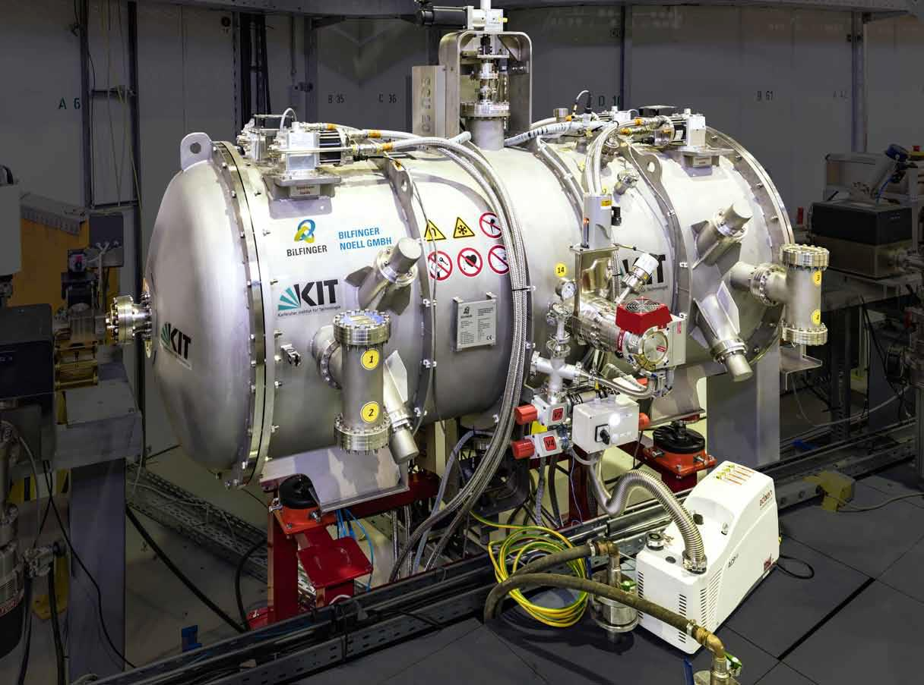
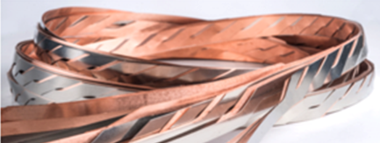
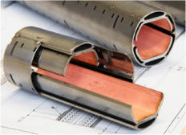
Competences ARD
Beam dynamics and diagnostics
for short electron and photon pulses into fs range
for high repetition rates up to 500 MHz
Machine learning for accelerators
Simulation eg. CSR & impedance effects (Inovesa)
High power RF into the 100 GHz range
Pulse power technology
Superconducting magnets and undulators
High-temperature superconducting materials
Cryo- and vacuum technology

Slide 7
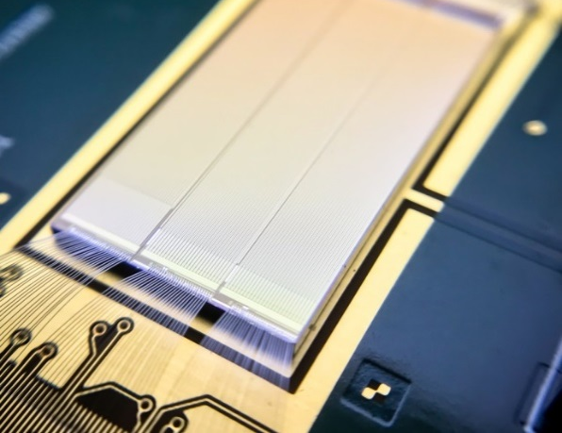
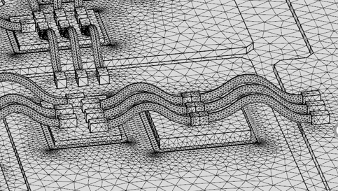
Competences DTS
HV CMOS sensors
Radiation-hard sensors
Cryo-sensors and readout
ASIC design
Interconnects and packaging
Silicon photonics
Data acquisition systems
Heterogeneous computing (eg. FPGA/GPU)
Detector systems in application

Slide 8
Anticipated FTE distribution in PoF-IV
84 FTE (scientists, engineers, technicians, no third-party)

Slide 9
Timeline for PoF-IV Evaluation

