Slide 1
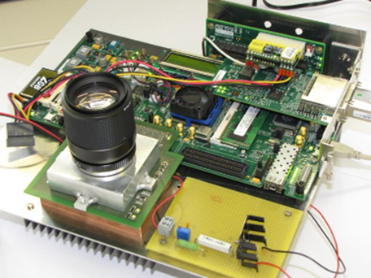
HZG Status of Planning for PoF IV
MT /DMA
Data Management and Analysis for in situ Materials Science Studies (2 FTEs):
Development of new software concepts: Segmentation of tomography data based on artificial intelligence (2019), multidimensional data analysis (2020)
Development of fast camera systems with high spatial and intensity resolution (cooperation with KIT)
Training of “Data Scientists” in the frame of the Helmholtz Graduate School DASHH
MT/DMA and Key Technologies/Information:
Joint Lab “Integrated Model und Data driven Material Characterization” (MDMC)

