Slide 1
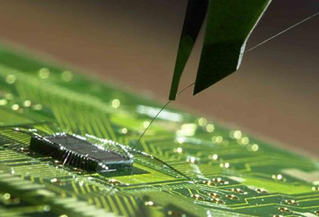
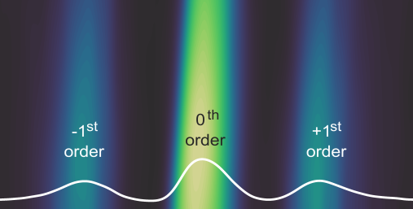
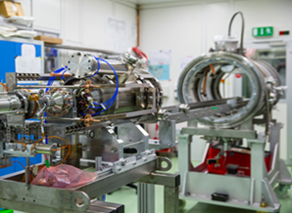



Matter and
Technologies
Cross-cutting Activities
Friederike Januschek (DESY)

Slide 2
Innovationspool Materie
Cross-Cutting activities
Activities that cannot be associated to a single program (or research field), but which are encompassed by a common strategy and coordinated work program.
In the program proposal, only such cross-cutting activities can/should be mentioned that are somehow formalised (e.g. by a cooperation agreement).
More generally, we should also cover/mention here cross-topic, cross-program, cross-research area activities.
As a new tool in PoF IV the Matter Forum has been planned to foster innovative cross-program activities. For 2019/2020 this has been already partially established and moneywise doubled in the Innovationpool, for which the first projects have been selected in October.

Slide 3
Innovatioool Materie
Cross-Cutting activities As in the FPZs
Cross-cutting activities mentioned in the FPZs are (preliminary)
Material research (Information, Energy, …)
Digitalisation (Information, Incubator, …)
Structural biology (Health, Information)
Radiation Research (Health, Energy)
In these fields cross-cutting activities by Matter are expected by the BMBF.

Slide 4

Innovationspool Materie
Cross-Cutting activities and MT
MT is designed as a program with strong connections within its topics and to the other Matter programs MML and MU.
MT is an enabler of the science in MU and MML.
Examples for cross-cutting activities in its broader sense are KAPTURE/KALYPSO, MicroTCA.4 and in general accelerator and detector development for MML and MU.

Slide 5

Innovationspool Materie
DMA and its Cross-cutting activities
Similarly to ARD and DTS the subjects of research in DMA are by its nature relevant to MU and MML and an enabler of the research there.
Activities which previously took place in MU/MML and ARD/DTS will be bundled and expanded within DMA, thus there are obvious cross-program implications.
DMA has a strong thematic connection to the more fundamental/less applied research in the research field Information (currently Key Technologies) as well as the Helmholtz Incubator and other initiatives.
There will be a first DMA-Information workshop for scientific exchange and development of first ideas regarding scientific cooperation within projects in January.

Slide 6
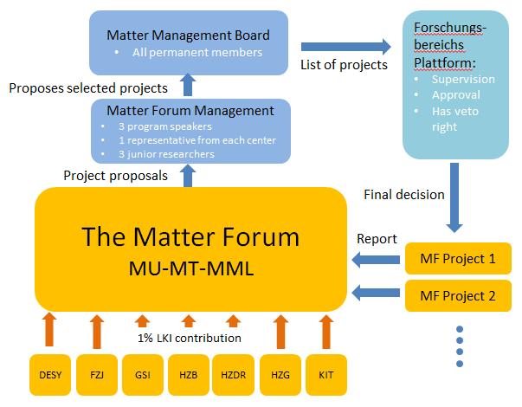
Innovationspool Materie
Innovationpool
Innovationpool (BMBF): 1% of LK I “Matter Forum” doubled by BMBF, i.e. 4M€ per year. BMBF asked for project proposals on a relatively short timescale.
Proposals were prioritized first within programs, then for Matter and finally decided on by the Forschungsbereichsplattform, i.e. together with BMBF.
Will be continued for 2020 and likely also within PoF IV.

Slide 7
Procedure within MT
Six MT proposals were submitted for review.
Procedure agreed within the program MT to prioritize the projects based on:
Scientific quality
Innovation potential
Strategic position
Degree of cross-center/ cross-program/ cross-research area
A ranking was decided on by the MT management board and all projects were presented to the Forschungsbereichsplattform which decided to fund the top two projects.

Slide 8
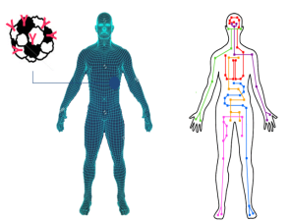
Pilot study for Imaging with compact plasma-based accelerators
Coordinating institute: DESY, Jens Osterhoff
DESY, HZDR, KIT, UniHH, HMGU (research area health)
A compact Roentgen source driven by a plasma based accelerator will be used to track
the position of Gold nano-clusters for medical imaging in mouse phantoms
Ultimate goal: application of technique to e.g. track drugs in the human body (Pharmakokinetik)
and to visialize tumors early
Compact system, eventually suited for clinical use
High rate system possible with today’s technologies
Gold nano-clusters are a promising technology for imaging in medicine
Know-how from accelerator (DESY, HZDR), detectors (KIT) and medicine (HMGU) come together to
demonstrate the principle of the system.
Cross-center
Cross-topic
Cross-research field

Slide 9
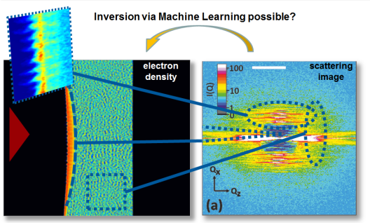


Amalea – Accelerating Machine Learning for Physics
Coordinating institute: DESY, Frank Gaede
DESY, HZDR, KIT, HZB
Build up a consortium of physicists from
Photon Science, particle physics, accelerator physics
to explore systematically novel machine-learning algorithms:
Fast, efficient feature extraction from complex data at high rate
(e.g. XFEL detectors, LHC detector, XFEL accelerator, BESSY accelerator)
Data reduction in a nearly-online fashion, highly flexible
Development of a tool kit for scientists in matter to easily use ML tools
Build-up of an IT infrastructure at DESY and HZDR to provide powerful, flexible, fast turn-around
computing platforms for algorithm development
Connect to recent incubator projects (in particular HAICU)
Cross-center
Cross-topic
Helmholtz Alliance Physics at the Terascale
Cross-program

Slide 10
DER Vorschlag von materie
The selected Proposals
PlasmedX
Medical Imaging meets Plasma
ADCMAPP
Analysis and Data Center for AP
HBC
Brilliant Sources for Neutrons
PhoDaMaS
Ultrafast real-time data analysis
SX-FragS
Serial Crystallography for Fragmentscreening
Big Data
Algorithms
AMALEA:
“Machine learning” for Matter
LASER
LUXE
Pushing the limits of QED
Photons
Materials
Pushing limits
Compact
Applications

Slide 11
SUmmary
Multiple cross-topic activities (see feedback from parallel sessions).
In general cross-cutting activities expected from us in Material Research, Digitalisation, Structural Biology, Radiation Research
Cross-program activities going on and will be further strengthened through DMA.
Workshop between DMA and Information in January to identify areas of common interest and develop ideas for cross-research field projects.
Innovationpool/Matter forum call has received excellent proposals and could fund two proposals, which are cross-topic, cross-program (and cross-research field)
Cross-cutting activities as defined by the proposal template need to be somehow formalised and have in some way budget/FTE associated with them

