Slide 1
Joint Operation & Readiness meeting
Report Operation / Photon Run Coordinator
Report Dispatch/PSPO
Instruments
FXE
SPB/SFX
SCS
SQS
MID
HED
Beam transport
Vacuum
X-ray optics
Photon diagnostics
Optical lasers
Detectors
Electronics
AE
EETF
CAS
ITDM
SRP ➔ Separate slides
Technical services
AoB

Slide 2
Dispatch meeting report / PSPO
installation of electronics and cabling for new equipment will only happen in the shutdowns!
Support from the users group is really precious due to the operation activities
Planning of the Electronics and cabling activities for 2019 is extremely important
Proper allocation of resources (EET, AE)
Cost control (Tendering of cables production and/or installation on time)
There is the need of input form the Experiment Groups:
When CRDs are realistically expected to land in the “INBOX” (Electronics and cabling planning and production takes several months! )
When are the components supposed to be commissioned (realistically)
Priority list
Iteration with PSPO/AE/EET/ITDM for the consolidation of a time plan is needed.
Right now, the information available is not sufficient for a proper planning
Back

Slide 3
HED
OPT hutch:
got beam permission
2 out of 4 sections under vacuum, ion pumps running.
last component installed, only vacuum pipes and bellows missing
YAG screen mounted, will be installed in next days
safety shutter modifications finished, re-assembly planned for Monday Dec 3
Planning for beam in OPT hutch on Wed, Dec 5 (SRP test)
EXP hutch:
successful commissioning of large roughing pump (found 1 leak in transfer vacuum line)
rails for IA2 delivered, ready to install
Back

Slide 4
XPD
XGM
XTD6 XGM is still set to offline, all other XGMs are online
“Fresh bunch” meeting: New servers by DESY colleagues, first tests at XTD1 XGM in SASE2
If possible (not urgent):
Tests on XTD10 XGM with beam (but we have to set it offline)
ZZ to XTD10 XGM before shutdown
PES
Draft of TDR for Hard X-ray PES
SA3 22.11.18: PES data taking concurrent with SA3 mono at 870eV (calibration vs. undulator settings at various photon energies, mapping function ToF→energy)
Others
PAM commissioning at SPB/SFX
HIREX in parasitic operation with FXE
Requests to CAS:
Status screen with input from all beamlines, across 4 topics
Bunch pattern table in karabo
Back

Slide 5
Detectors – DET
1st AGIPD SPB
Issue with MC_LIVE signal (again) is observed → DESY informed, debugging requires access to electronics in wing 2, to be scheduled with SPB during the winter shutdown
Commissioning beam:
There was no time to perform timing scan for AGIPD → other task took longer than expected (beam stability)
LPD at FXE
Debugging the software of the middle layer device after the update( with Astrid and Tian).
Further investigating the problem of the super-module Q4M3.
Feedback report from RAL about the main cause of the overheating failures occurred in the switch boxes.
The main cause was due to the poor contact between the wires and the associated crimps resulting in a drop of 5.8 W at the wire/crimp interface which heated up the cable insulation above its specific operating temperature.

Slide 6
Detectors – DET
2nd AGIPD MID
Cooling “in-vacuum”
after leak was detected at ~+5° C (on cooling blocks), the new connectors were installed on the pipes and connected to the distributor
Julabo PLC control → several issues were discovered concerning the wiring of the chiller to PLC, AE fixed the problems and chiller can be controlled via Beckhoff PLC
Detector was cooled down to -24° C
Work on isolation of the cooling circuit is ongoing → to be finished today
Valve was installed on the scroll pump to avoid accidental venting of the system in case of power cut
Online raw preview is operational
First tests of automatic power procedure were done → the same performance as at SPB, it can be used to power LV electronics (“up to FPGAs)
Next step
power FEMs (ASIC and HV)
Issues:
Installation and commissioning of the cooling system (in-vacuum) was very challenging and took much more time than expected
DSSC
Motion system testing progressed well, coordinated motion of two stages possible. Definition of not-so-small holes in the windmill configuration possible, cross problematic.

Slide 7
Detectors – DET
Vessel closed and tested for leaks. Leak found on the lateral flange, under investigation. No obvious problem observed at visual inspection.
Vacuum system PLC tested, some few not-understood issues (scroll pump and pressure gauges) do not preclude the operation of the system.
Work on external interlock definition (in addition to SIB) ongoing.
Work on chiller and related control started.
FastCCD
Cooling
Installed 3 new temperature sensors on the system to find the bad thermal contract and run a new cooling test
Two welded connections on the long aluminum pipe that cools the detector head are probably responsible for the largest temperature gradient (ΔT =150 K)
Copper bridge designed to overcome the issue to be tested Thursday night
DAQ
Mechanical tolerances make it impossible to reliably install the electronics boards we have.
New electronic boards with pigtails requested from LBNL, held at customs for a day, they should arrive soon
Malformed data crash the FastCCD DAQ device, investigation in progress

Slide 8
Detectors – DET
After a long debugging session with LBNL we concluded that the most probable cause of the issue is the connection with the data fiber optics transceivers
LBNL will send new transceivers and pigtail connectors next week
Commissioning to resume this weekend after removing electronics boards from their housings
Back

Slide 9
AE
SQS:
Steinmeyer stages running. Soft limits define so that the motors will not drive up to the limit switches.
SQS loop 9 is running
Following week commissioning of different motors in SQS 12.
SCS:
Loop 04 – needs to be updated, waiting for SCS to allow the intervention of the loop. Inside it the Huber Chiller should be configured.
Smaract stages running – still to clarify if one spare card is damaged.
Supporting, working and developing with Sample Environment framework for Nano motion stages.
MID:
Reported issue in MID MONO, which was solved when the default parameters were restored. Still investigating this issue.
Loop 11 – running after fixing electrical problems in Julabo Chiller.
Loop 7 – Firmware prepared, finishing cables connection. Running by end of this week.
DSSC
Supporting commissioning of Vacuum and Motion.
AE-Framework development
New framework release done 1.31.4. Will include new SD as SD_LED or SD_LEAKVALVE.
Back

Slide 10
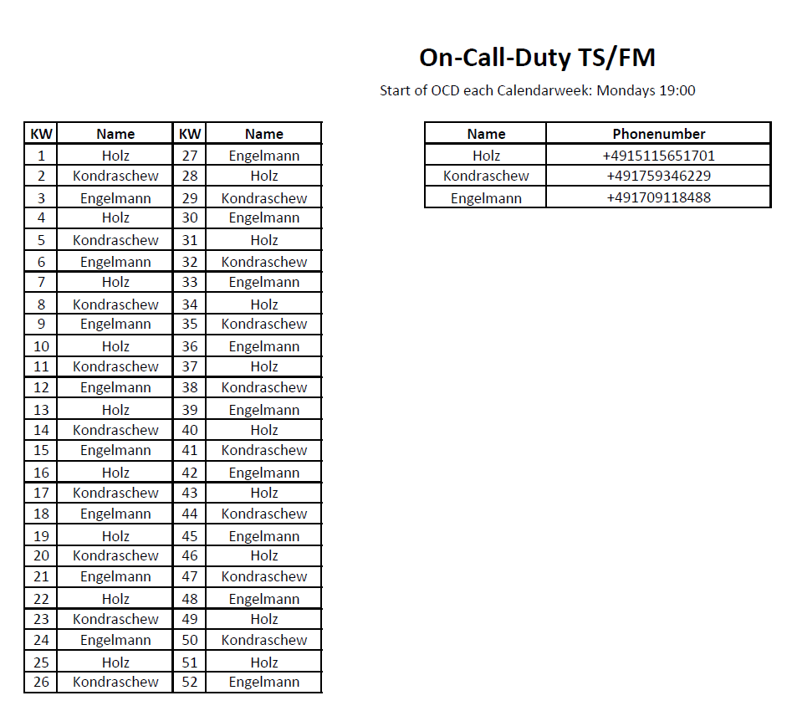
TS
Back

