Slide 1
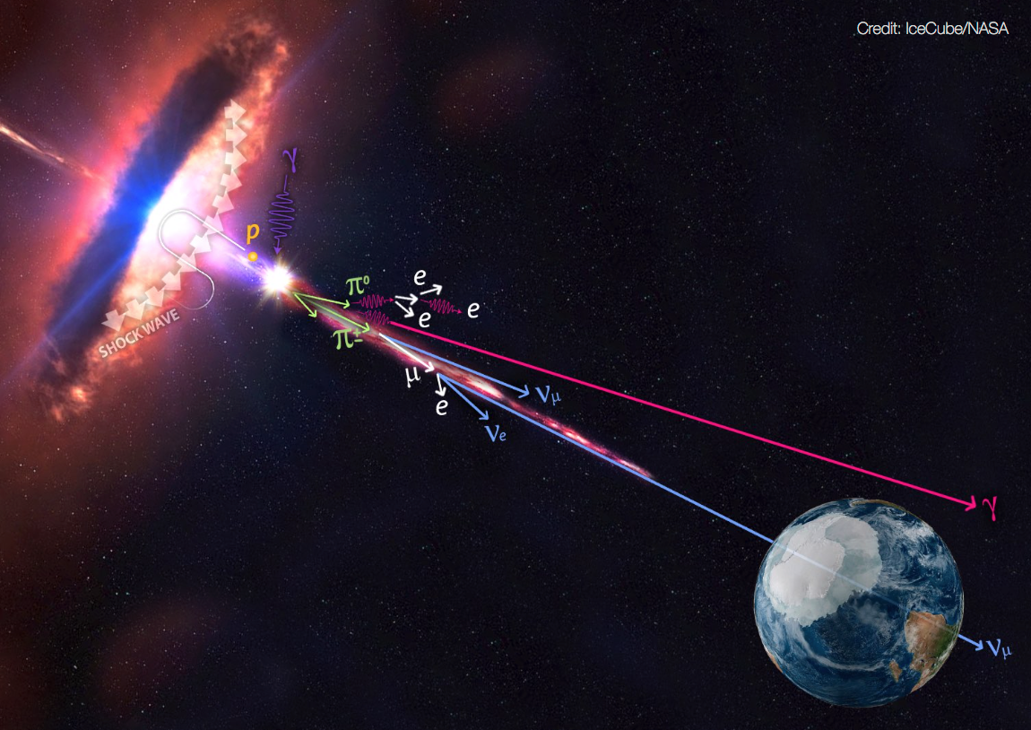
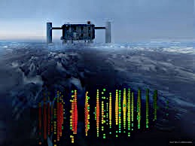


High-energy neutrinos from AGN?
(The TXS 0506+056 / IC170922A case)
Sara Buson
Würzburg Universität
Univ. of Maryland, Baltimore County
Anita Reimer
University of Innsbruck, Austria
Markus Böttcher
North-West University
Potchefstroom, South Africa
On behalf of the Fermi-LAT coll.
PAHEN 2019, Berlin, 25–27 Sept 2019

Slide 2
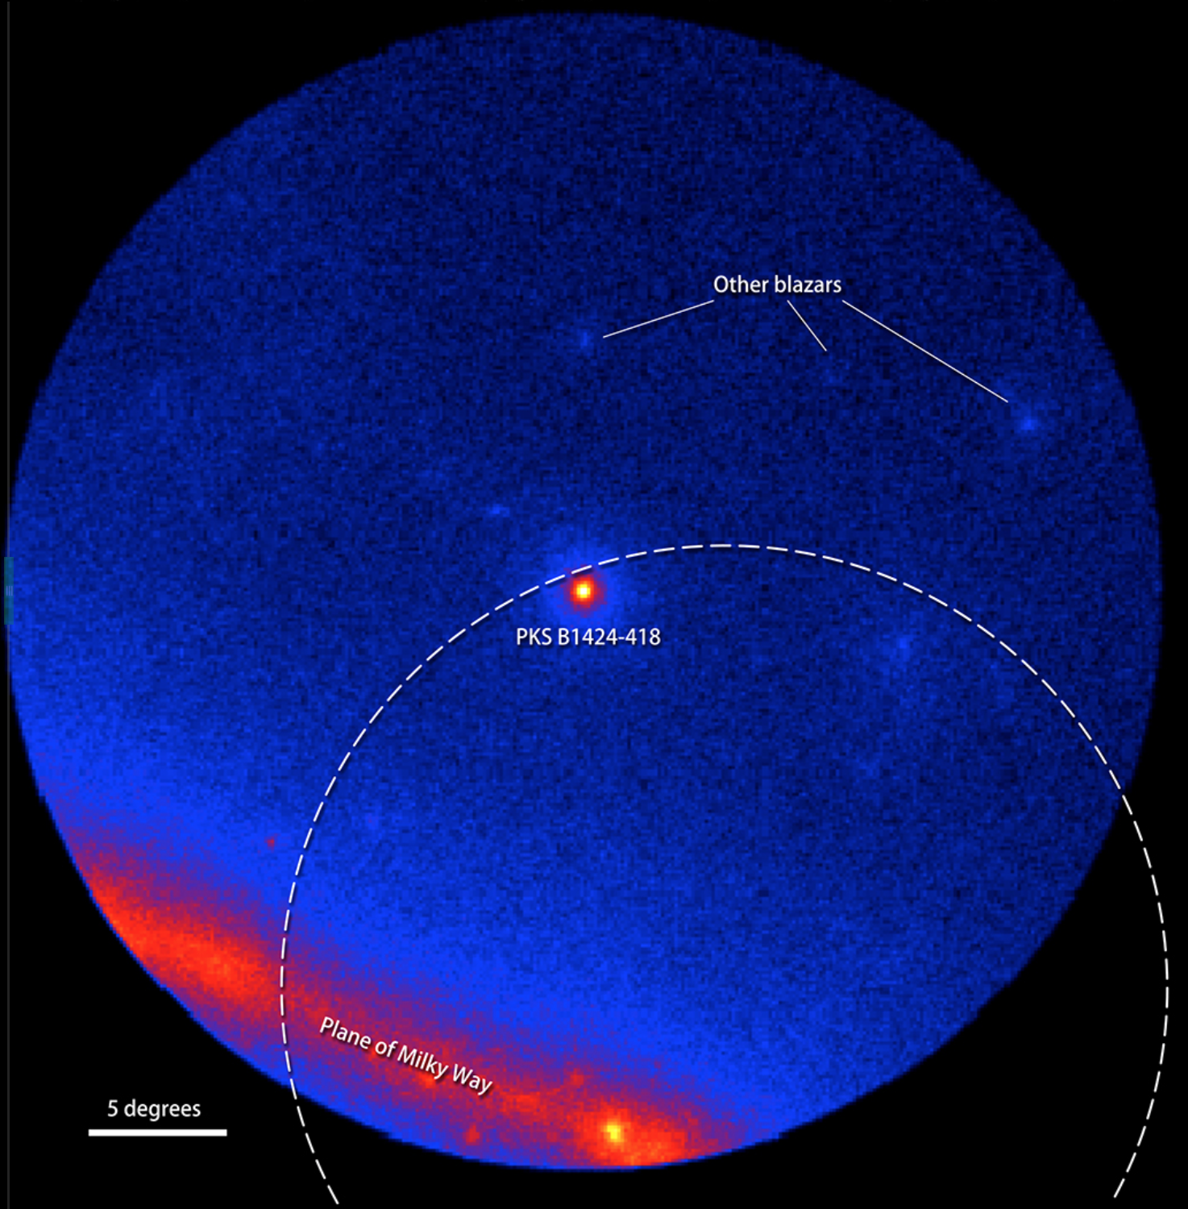
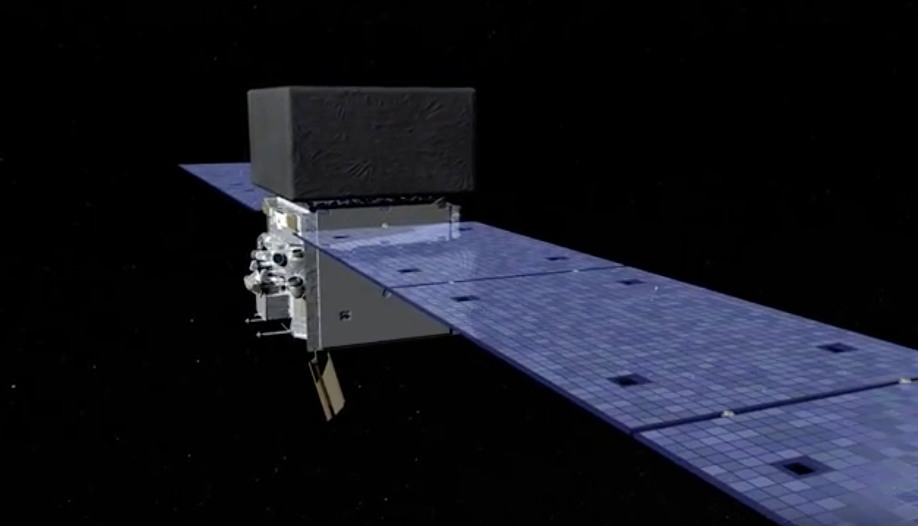
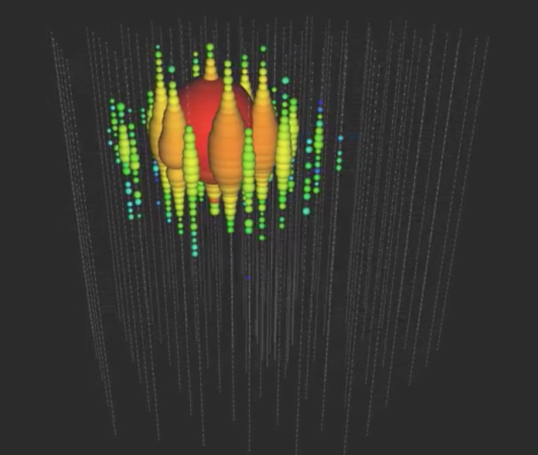
High-energy neutrinos in coincidence with Fermi Blazars
- a selection -
PKS 1424-418
  (FSRQ)
  association significance: ~2σ
A Suggestive Hint
  111 known γ-ray point sources:
  53 unidentified
  23 Galactic
  35 extragalactic
Kadler+ 2016 Nature Physics 12, 807
(see also Gao+ ApJ, 2017)
Big Bird – 2 PeV
December 4, 2012
ECAP Seminar

Slide 3
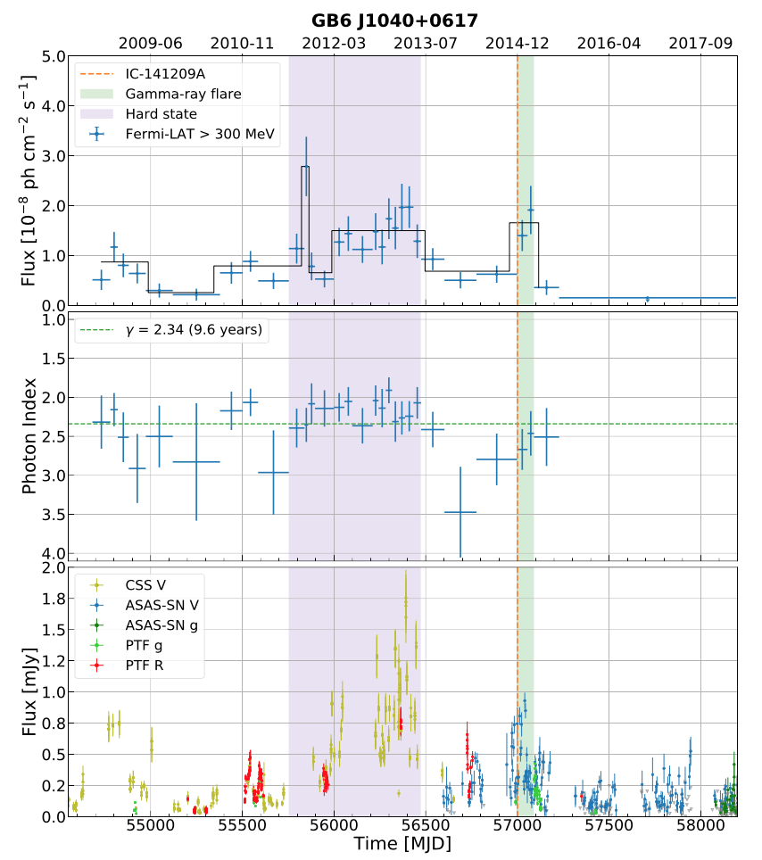
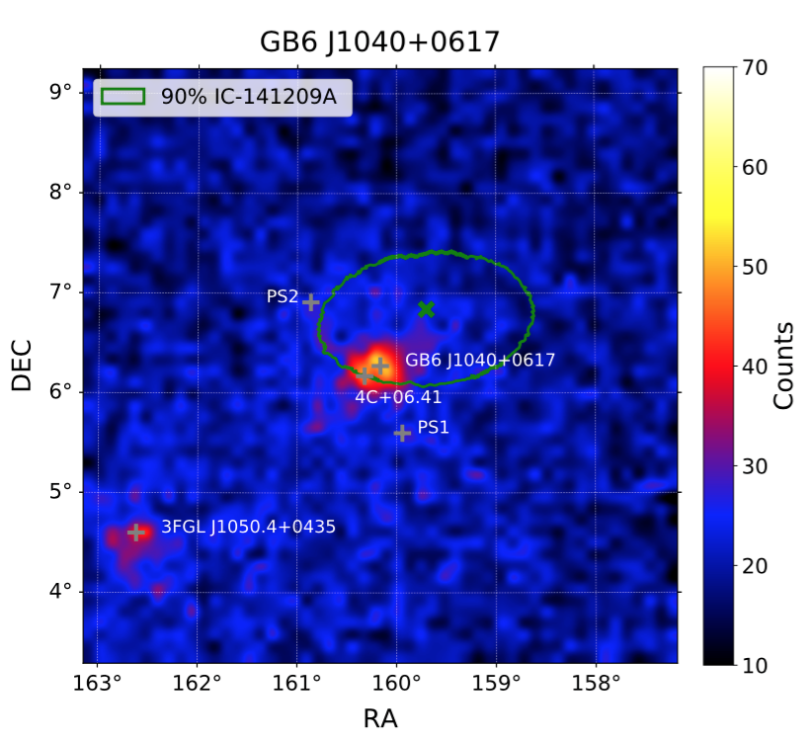
High-energy neutrinos in coincidence with Fermi Blazars
Association of
GB6 J1040+0617 with the neutrino is consistent with background expectations
Modest enhanced state observed at the neutrino detection
Garrappa+ 2019
- a selection -

Slide 4
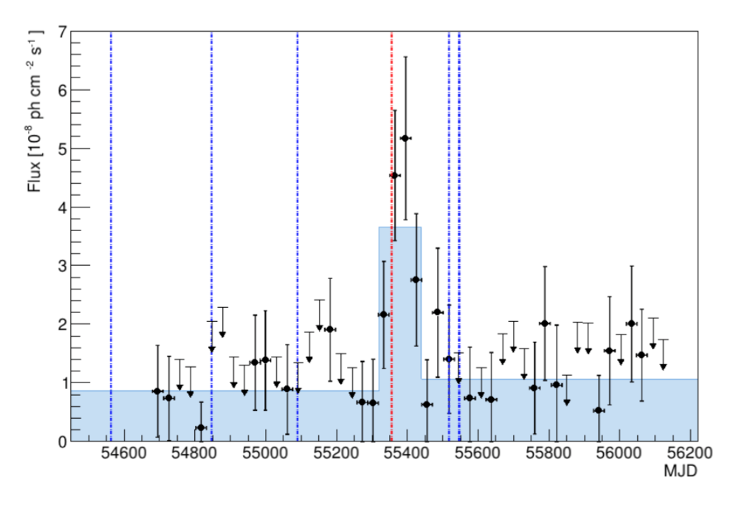
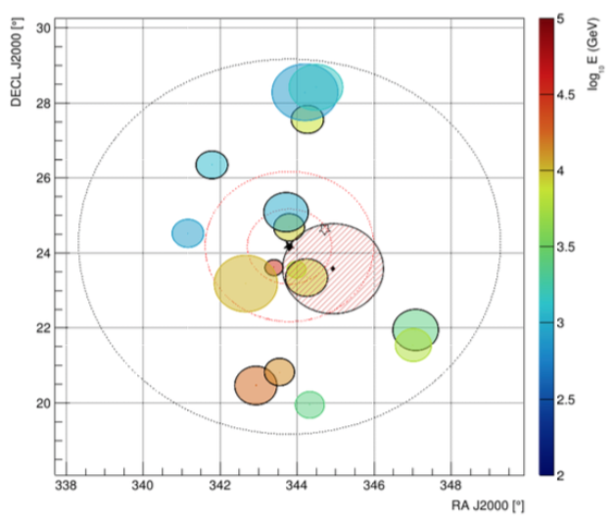
High-energy neutrinos in coincidence with Fermi Blazars
MG3 J225517+2409
ANTARES coll., ICRC 2019
- a selection -

Slide 5
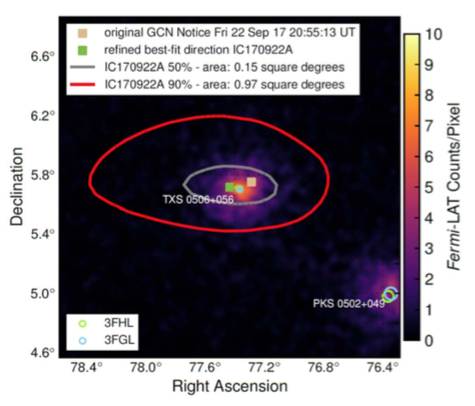
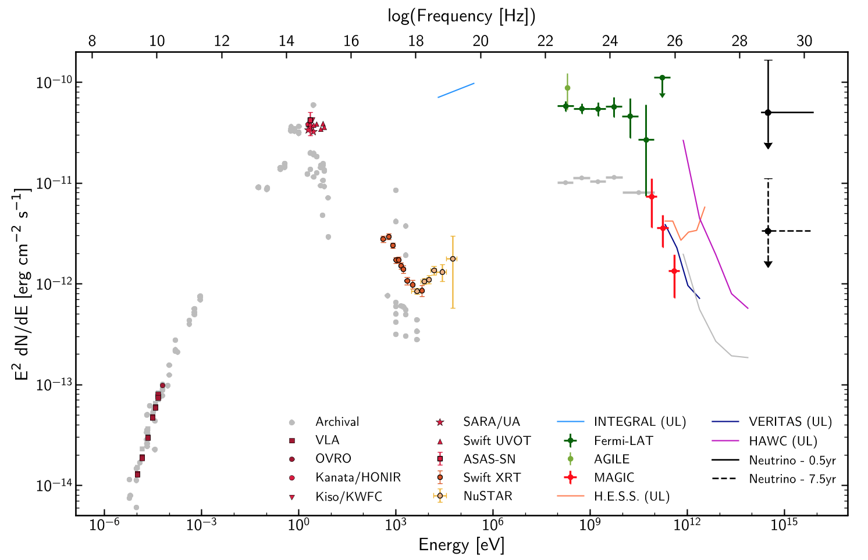
TXS 0506+056 / IC170922A
(~ 3 σ probability of association)
Masquerading BL Lac (!) Padovani et al 2019
IceCube, Fermi, MAGIC+ Science 361, 146 2018
z = 0.3365
(Ajello et al 2014; Paiano et al 2018)

Slide 6
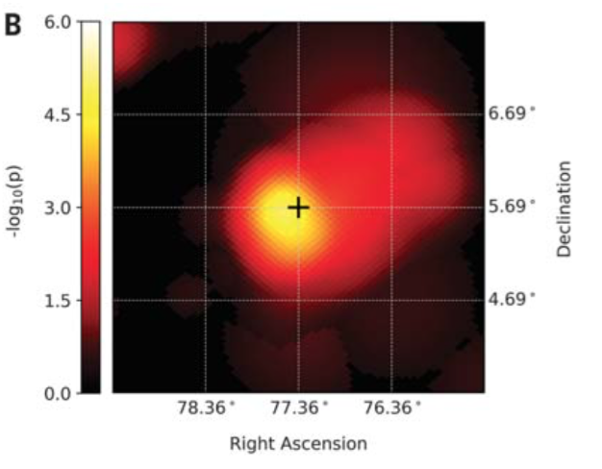
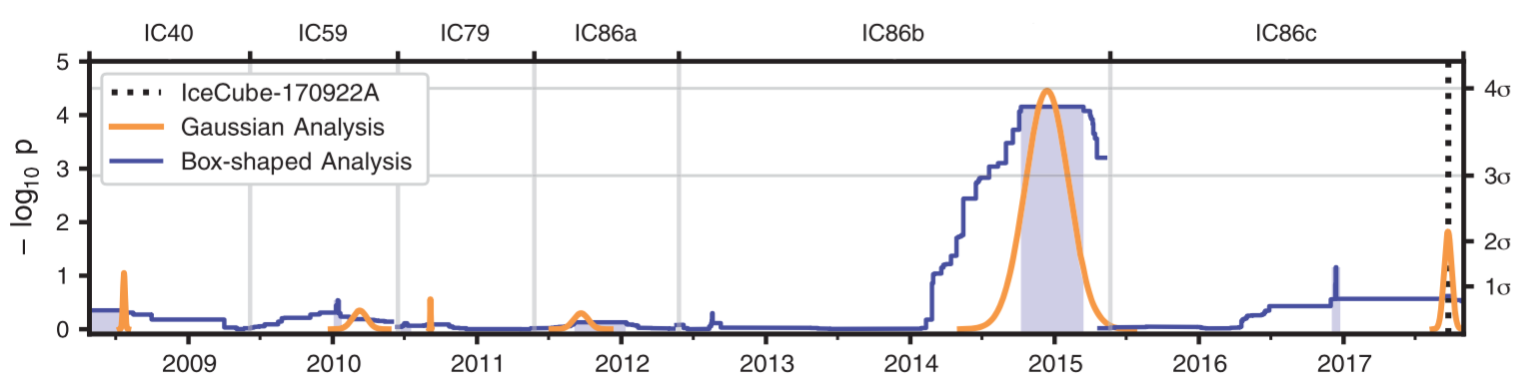
“Neutrino flare” 2014/2015
IceCube archival search found 3.5sigma excess positionally consistent with the same blazar
IC coll. 2018

Slide 7
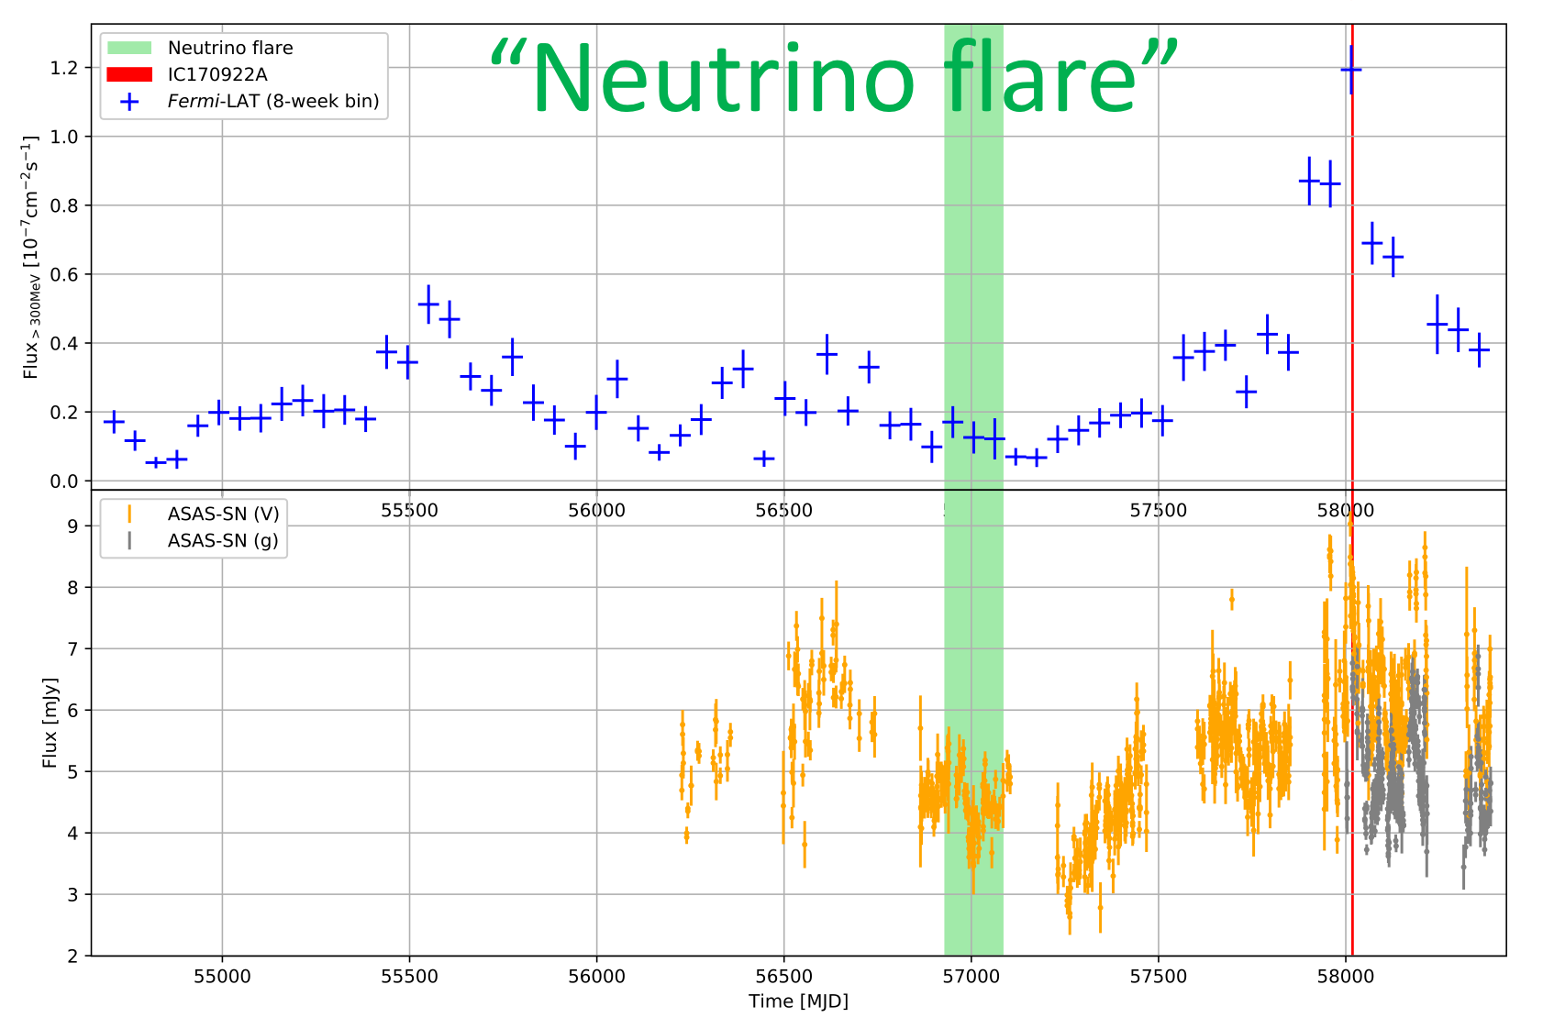
TXS 0506+056 Light Curve
During “2015/16 neutrino flare”
No evidence of enhanced state
Potential hint for spectral hardening (Padovani+ 2018; Garrappa+ 2019)
Gamma rays
Optical
Reimer+ 2019

Slide 8
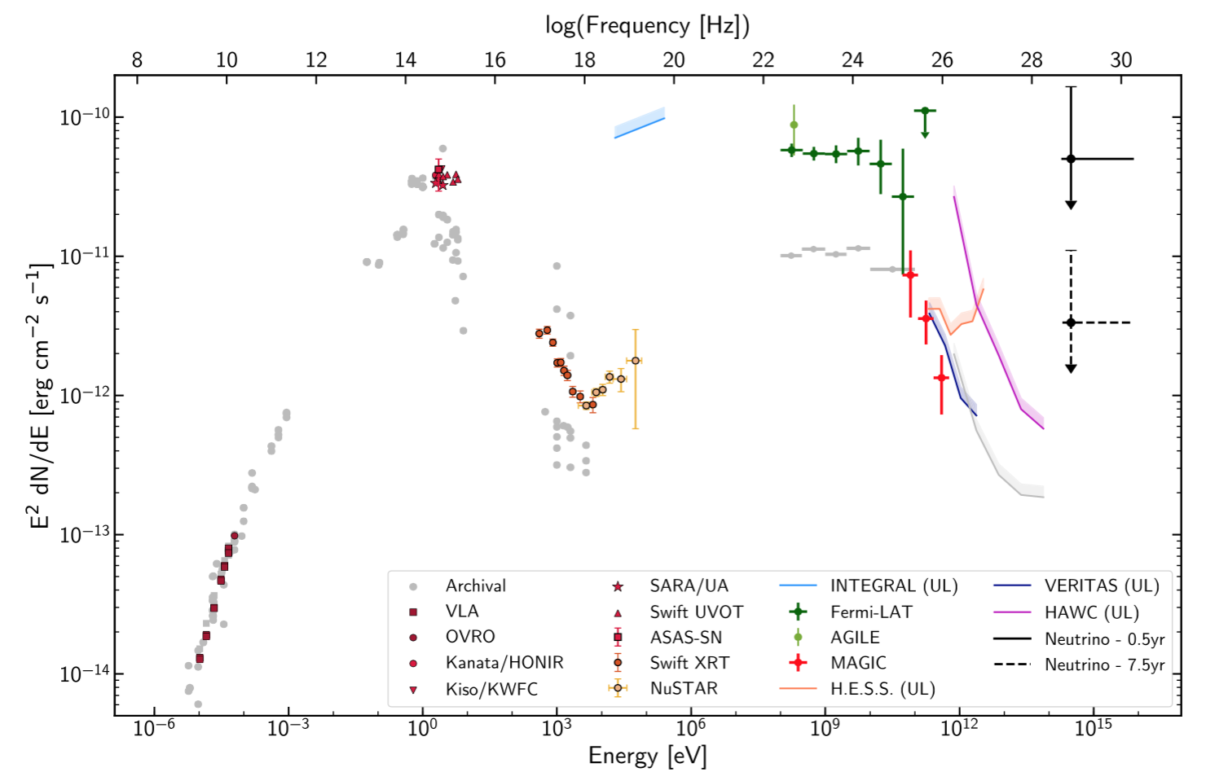
MWL SED – TXS 0506+056
2014-15 ν flare
IC 170922A
limits

Slide 9
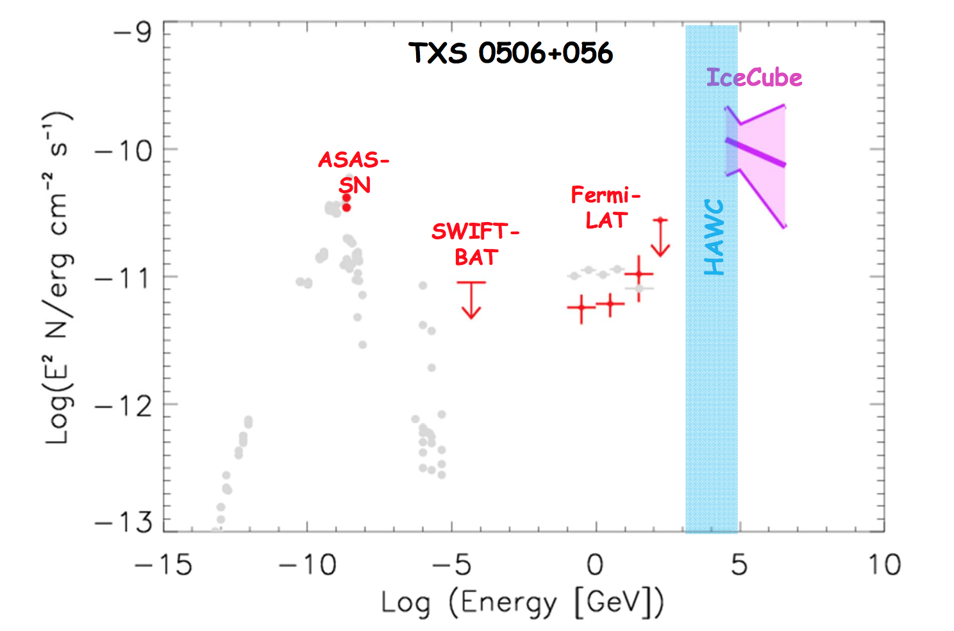
Quasi-Simultaneous Multi-Messenger SED
(TXS 0506+056 “neutrino flare”)
Reimer, Böttcher, Buson, ApJ 2019
(arXiv:1812:05654)
Photo-Hadronically Produced Neutrinos from TXS 0506+056?

Slide 10

General Scenario
pγ → p π⁰
n π⁺
$$δ= \frac{1}{Γ (1 − β cosθ)}$$
θ
Earth
Γ
E_{obs} = δ E’
M87

Slide 11
Photo-Pion Production / Energetics
pγ interactions are strongly dominated by single-pion production through the ∆⁺ resonance at an energy of E_{∆+} =1232MeV
At Δ⁺ resonance energy, the γ and p energies obey the relation:
s = E’_{p} E’_{t} (1 – β_{p}’ μ) ~ E’_{p} E’_{t} ~ E_{Δ+}² = (1232 MeV)²
and E’_{ν} ~ 0.05 E’_{p}
To produce IceCube neutrinos (~ 100 TeV → E_{ν} = 10¹⁴ E₁₄ eV):
(i.e., E’_{ν} = 10 E₁₄ δ₁⁻¹ TeV)
Need protons with E’_{p} ~ 200 E₁₄ δ₁⁻¹ TeV (< UHECRs energy)
and target photons with E’_{t} ~ 1.6 E₁₄⁻¹ δ₁ keV (X-ray band)

Slide 12
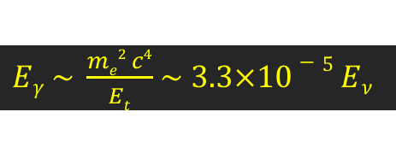
The pγ Efficiency Problem
Same target photon field for photo-pion production can also absorb any co-spatially produced γ-rays via γγ absorption.
The pγ cross section is several orders of magnitude smaller than the γγ absorption cross section.
Efficient pγ neutrino (and γ-ray) production requires that the optical depth for relativistic protons to interact with the target photon field, τ_{pγ} ∼ 1,
--> optical depth of the emission region to ∼ GeV photons is τ_{γγ} ∼ 310 τ_{pγ} >> 1
Photons with E_{γ} ~ GeV – TeV are heavily absorbed
EM cascade emission at lower energies
$Eγ \sim \frac{me2 c4}{Et}$ $\sim 3.3×10−5 Eν$

Slide 13
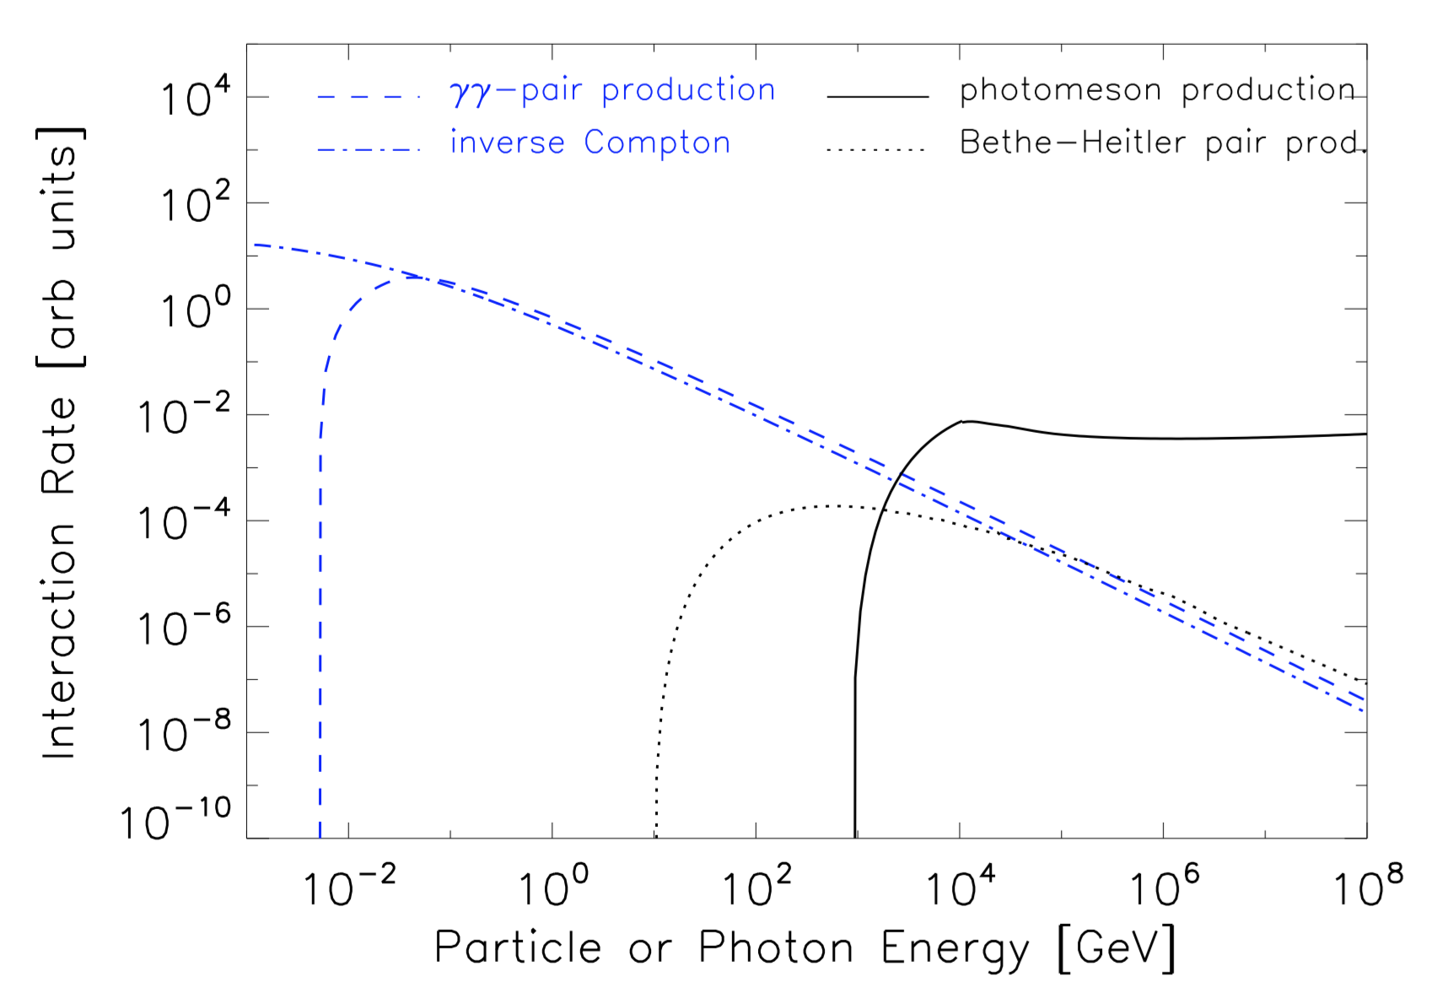
Mean interaction rates
In hadronic jet models:
both electron & proton population
=> Both leptonic and hadronic processes must be fully considered
synchrotron radiation
inverse Compton scattering of charged particles
photon-photon and Bethe-Heitler pair production
photomeson production
inelastic nucleon-nucleon interactions, neutron decay.
Credit: A. Reimer

Slide 14
Photo-Hadronically Produced Neutrinos from TXS 0506+056?
Find minimum target photon fields + proton spectra to produce IceCube neutrino flux from TXS 0506+056 “neutrino flare”
  minimal assumptions on the origin of the target photon field for particle-photon interactions
Target photons: n_{ph}(ε) ~ ε^{−α}, ε_{min} = 10 keV, ε_{max} = 60 keV, α = 1
Proton spectrum: n_{p} (E) ~ E^{-αp}, E_{max} = 30 PeV, α_{p} = 2.0

Slide 15
Spectra of Secondary Particles
Target photon field => γγ absorption optical depth τ_{γγ}
Simulate pair cascades initiated by secondary γ-rays and electrons/positrons
MC codes including Photo-Meson + Bethe-Heitler pair production (SOPHIA – Mücke et al. 2000)
Pair cascades with Matrix Multiplication Method (Protheroe & Johnson 1996)
Steady-state, linear cascades

Slide 16
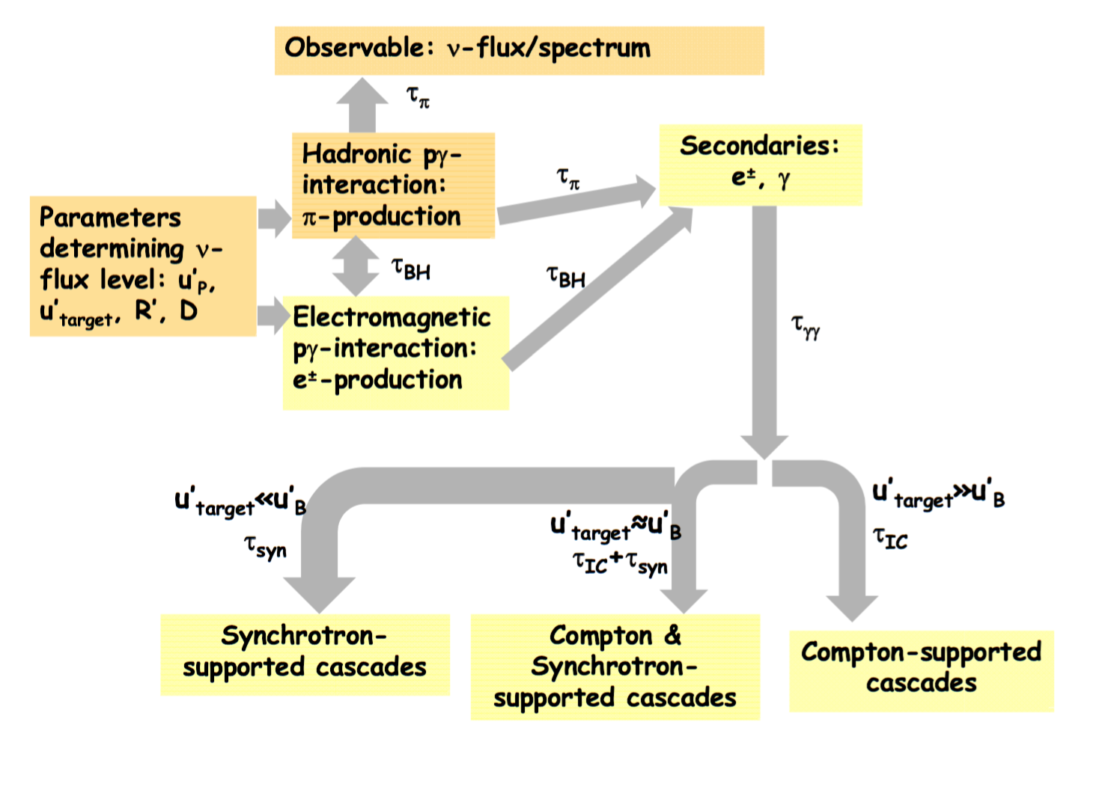
Cascade Drivers
Simulate pair cascades initiated
by secondary γ-rays and electrons/positrons
typically cascade down to lower energies and initiate cascades
Credit: A. Reimer
Energy density of the target photon field
Energy density of the protons
Size of the emitting region
Doppler factor
Changes in the doppler factor shift in energy the distribution; and one needs to change a bit the target photon field. Good thing is that for any choice of doppler factor, one can always find a combination of parameters that works

Slide 17
Synchrotron-supported Cascades
In tension with X-ray data for most cases
𝜏_{𝛄𝛄} << 1 ruled out by LAT data
𝜏_{𝛄𝛄} >> 10: significant internal absorption in >GeV/VHE energy range
u’_{B} >> u’_{target}
log₁₀(τ_{γγ}^{max})
Ruled out by MWL spectra
(over-predicting either Fermi-LAT or X-ray / radio fluxes)
(neglecting proton-synchrotron)

Slide 18
Synchrotron-supported Cascades
In tension with X-ray data for most cases
𝜏_{𝛄𝛄} << 1 ruled out by LAT data
𝜏_{𝛄𝛄} >> 10: significant internal absorption in > GeV/VHE energy range
u’_{B} >> u’_{target}
Expected proton-synchrotron over-predicts X-ray flux!
(with proton-synchrotron)

Slide 19
Compton-Supported Cascades
𝜏_{𝛄𝛄} << 1 : minimal photon flux produced along with the gamma-flux co-spatially
𝜏_{𝛄𝛄} >> 10: significant internal absorption in > GeV/VHE energy range
Bulk of LAT-flux can not be produced co-spatially with neutrino-flux
Feasible scenario
u’_{target} >> u’_{B}
Proton-synchrotron
In principle, allowed by MWL spectra:
Significantly below observed fluxes
Reimer, Bottcher, Buson, accepted by ApJ
--> No neutrino / γ-ray correlation expected!

Slide 20
Photo-pion prod.: Origin of the Target Field
To produce IceCube neutrinos (~ 100 TeV → E_{ν} = 10¹⁴ E₁₄ eV):
Need protons with E’_{p} ~ 200 E₁₄ δ₁⁻¹ TeV
and target photons with E’_{t} ~ 1.6 E₁₄⁻¹ δ₁ keV
=> Not UHECRs!
=> X-rays!
(At least) two possible scenarios:
Target photons co-moving with the emission region
E_{t}^{obs} ~ 16 E₁₄⁻¹ δ₁²/(1+z) keV
Observed as hard X-rays
Target photons stationary in the AGN frame
E_{t}^{obs} ~ 160 E₁₄⁻¹/(1+z) eV
Observed as UV / soft X-rays

Slide 21
TXS 0506+056 SED
2014-15 ν flare
F_{X} ~ 10⁻¹² erg/(cm² s)
(IceCube et al. 2018)

Slide 22

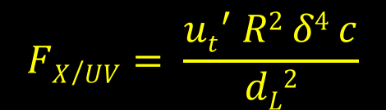
Photo-pion production – Origin of Target Photons
Place constrains on target photon luminosity and
required proton power using:
Observed neutrino luminosity (L’_{ν} ~ 1.7×10⁴² δ₁⁻⁴ erg/s for 2014 – 15 neutrino flare)
Limit on observed UV / X-ray flux (F_{x} ~ 10⁻¹² erg cm⁻² s⁻¹ for TXS 0506+056)
$$γp,pγ ≈−c<σpγf> \frac{ut′}{me c2 } γp$$
L_{kin,p}
$$FX/UV= \frac{{ut}^{′} R2 δ4 c}{dL2}$$
.
≈ 10⁻²⁸ cm²

Slide 23
Photo-pion production – Origin of Target Photons
Co-moving target photon field
X-ray flux limit => u’_{t} < 9×10⁻⁴ R₁₆⁻² δ₁⁻⁴ erg cm⁻³
Synchrotron-supported cascades (already ruled out)
L_{p,kin} ~ 1.6×10⁵⁴ R₁₆ Γ₁² erg/s
Unrealistically large kinetic power;
requires very low B-field (B < 1 G) to suppress proton synchrotron below X-ray flux limit
----> Ruled out

Slide 24
Photo-pion production – Origin of Target Photons
Stationary target photon field
From UV / X-ray flux: u’_{t} < 100 Γ₁² R_{t,17}⁻² erg cm⁻³
Compton dominated cascades for B << 100 G
L_{p,kin} ~ 1.5×10⁴⁹ δ₁⁻⁴ R_{t,17}² R₁₆⁻¹ erg/s
Below Eddington limit for M_{BH} > 10⁹ M₀ => plausible.
Can suppress p-sy below UV/X-ray limit for B ~ 10 G.
Plausible!
---- > Stationary UV / soft X-ray target photon field external to the jet is plausible!

Slide 25
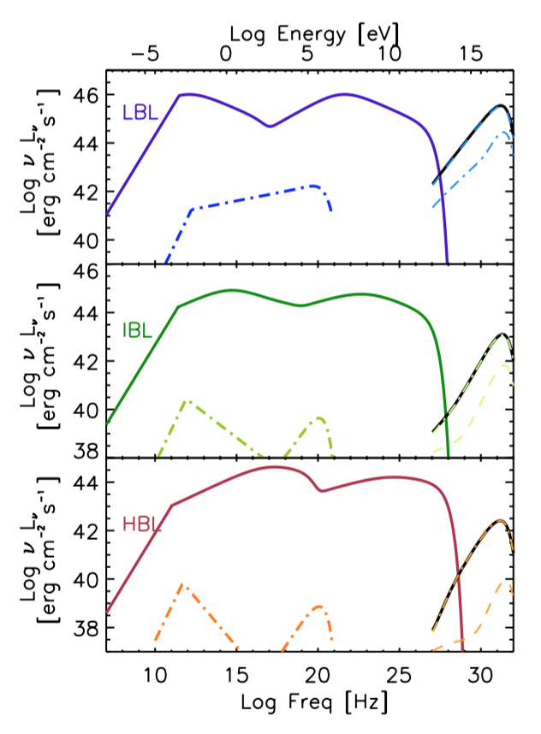
pγ Production, Origin of Target Photons
Stationary UV / soft X-ray target photon field external to the jet is plausible
Possible sources of external UV / soft X-ray target photons, e.g.,:
BLR (Padovani+ 2019 MNRAS, 484, 104)
Slow-moving sheath (Tavecchio & Ghisellini 2005)
Accretion flow (ADAF, Righi+ 2019 MNRAS, 483, 127)
(see also Rodrigues+ 2019)

Slide 26
Summary
Multi-messenger + time-domain a promising path to reveal the origin of neutrinos (and potentially cosmic rays)
Blazar / neutrinos coincidence challenging to reconcile : great push for theoretical modellings and still lot to learn!
  Multi-Messenger observations are crucial to provide insights to constrain the blazar physics
Future observatories will improve sensitivity and statistics, looking forward to IceCube-Gen2, KM3NeT, AMEGO, ASTROGAM, CTA +…
THANKS

Slide 27
Back UP

Slide 28
Photo-pion Models for TXS 0506+056
(Gao et al., 2018, Nature Astron.)
(Keivani et al.:, 2018, ApJ, 864, 84)
Models producing neutrinos and gamma-rays require leptonic-dominated gamma-ray production!

Slide 29
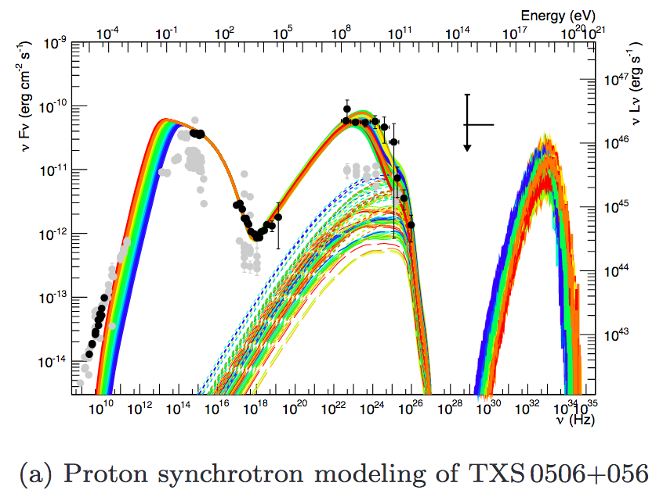
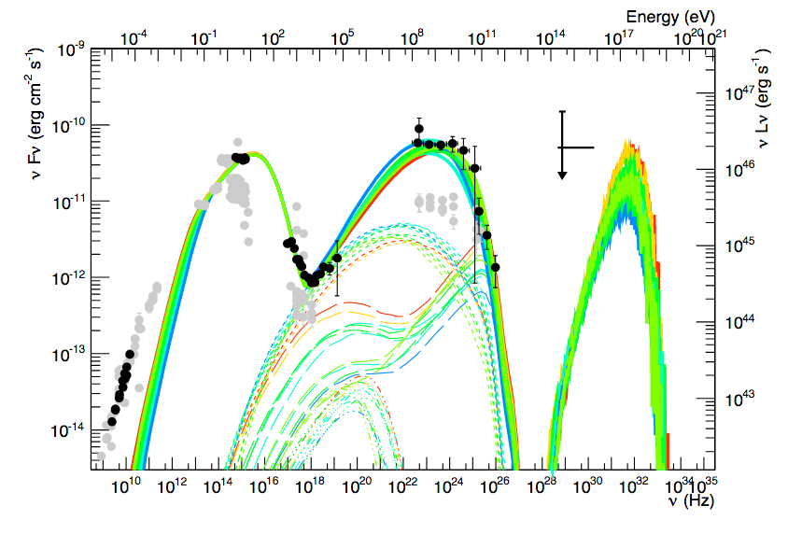
Multi-Messenger SED
(Cerruti+ 2019 MNRAS 483 12)
Models producing neutrinos and gamma-rays through the same proton population, predict too high neutrino energies!

Slide 30
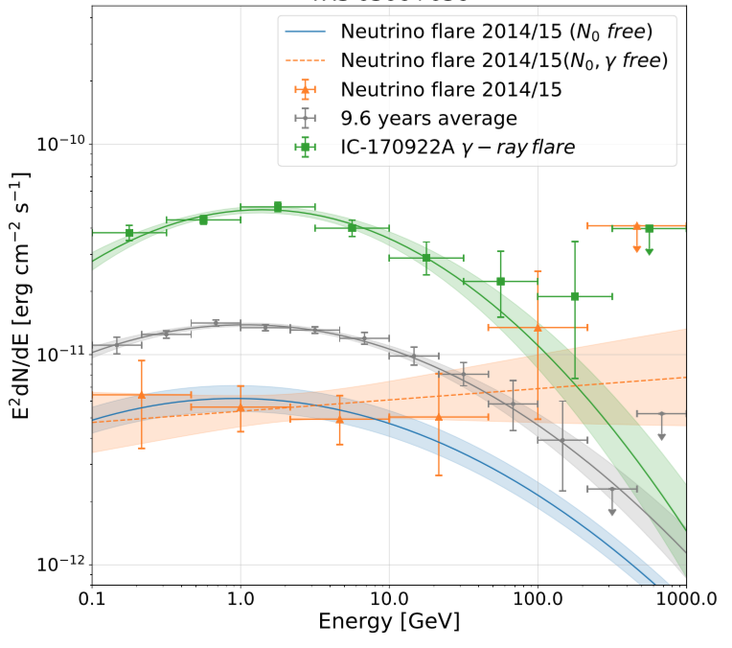
γ-ray SED for 2014/15 period
Compatible with quiescence (Garrappa, Buson, Franckowiak, ASAS-SN, IceCube coll. 2019)
(see also Padovani+2018)

Slide 31
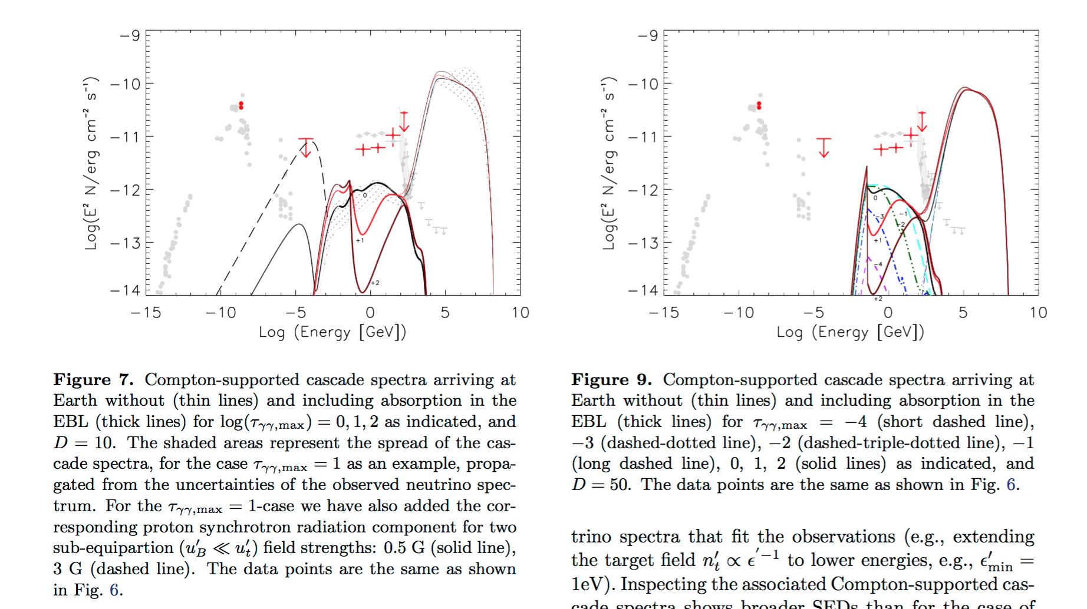
Varying the doppler factor

